Slide 1
VISN 23 CHRONIC DISEASE COLLABORATIVE
AN APPROACH TO POPULATION CARE MANAGEMENT
DARYL S. DICKSON MD
PRIMARY CARE SITE MANAGER
RAPID CITY VA CLINIC
VA BLACK HILLS HEALTH CARE SYSTEM CBOC
07/09/07
Notes:
VISN 23 CHRONIC DISEASE COLLABORATIVE
AN APPROACH TO POPULATION CARE MANAGEMENT
DARYL S. DICKSON MD
PRIMARY CARE SITE MANAGER
RAPID CITY VA CLINIC
VA BLACK HILLS HEALTH CARE SYSTEM CBOC
07/09/07

Slide 2
VISN 23 NETWORK LEADERSHIP
ROBERT A. PETZEL MD—NETWORK DIRECTOR
BARRY GRAHAM MD—NETWORK CMO
JANET P. MURPHY MBA—NETWORK PRIMARY AND SPECIALTY MEDICINE SERVICE LINE CEO—COLLABORATIVE DIRECTOR
TERRY WAHLS MD—PRIMARY AND SPECIALTY MEDICINE NETWORK MEDICAL DIRECTOR
Notes:
VISN 23 NETWORK LEADERSHIP
ROBERT A. PETZEL MD—NETWORK DIRECTOR
BARRY GRAHAM MD—NETWORK CMO
JANET P. MURPHY MBA—NETWORK PRIMARY AND SPECIALTY MEDICINE SERVICE LINE CEO—COLLABORATIVE DIRECTOR
TERRY WAHLS MD—PRIMARY AND SPECIALTY MEDICINE NETWORK MEDICAL DIRECTOR

Slide 3
CHRONIC DISEASE COLLABORATIVE
18 MONTH DURATION—STARTED IN APRIL 2006
4 FACE-TO-FACE LEARNING SESSIONS—MOST RECENT SESSION (L.S.#3) MAY 2007
3 ACTION PERIODS BETWEEN LEARNING SESSIONS
Notes:
CHRONIC DISEASE COLLABORATIVE
18 MONTH DURATION—STARTED IN APRIL 2006
4 FACE-TO-FACE LEARNING SESSIONS—MOST RECENT SESSION (L.S.#3) MAY 2007
3 ACTION PERIODS BETWEEN LEARNING SESSIONS

Slide 4
FOCUS OF COLLABORATIVE
Diabetes Mellitus
COPD
CHF—SUBJECT MATTER EXPERT DR. I. ANAND—MINNEAPOLIS VA CARDIOLOGY
Notes:
FOCUS OF COLLABORATIVE
Diabetes Mellitus
COPD
CHF—SUBJECT MATTER EXPERT DR. I. ANAND—MINNEAPOLIS VA CARDIOLOGY

Slide 5
CHRONIC CARE MODEL
Based on Wagner’s Chronic Care Model
Incorporates VA care, Community care, and encourages patients to take a more active role in their daily disease management.
Notes:
CHRONIC CARE MODEL
Based on Wagner’s Chronic Care Model
Incorporates VA care, Community care, and encourages patients to take a more active role in their daily disease management.

Slide 6
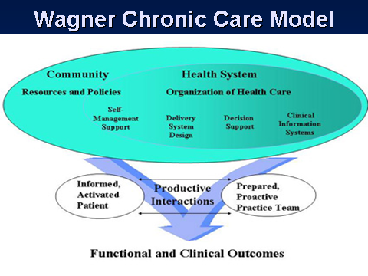
Notes:
Wagner Chronic Care Model

Slide 7
OVERALL CHF GOAL OF COLLABORATIVE
IDENTIFY PATIENTS WHO QUALIFY FOR THE COLLABORATIVE
ASSURE CORRECT DIAGNOSIS BASED UPON SET CRITERIA
CHF CRITERIA BASED UPON NYHA CHF CRITERIA AND ACC STAGING WITH EJECTION FRACTION CONFIRMATION
Notes:
OVERALL CHF GOAL OF COLLABORATIVE
IDENTIFY PATIENTS WHO QUALIFY FOR THE COLLABORATIVE
ASSURE CORRECT DIAGNOSIS BASED UPON SET CRITERIA
CHF CRITERIA BASED UPON NYHA CHF CRITERIA AND ACC STAGING WITH EJECTION FRACTION CONFIRMATION

Slide 8
OVERALL CHF GOAL OF COLLABORATIVE
DECREASE HOSPITAL ADMISSIONS FOR CONGESTIVE HEART FAILURE
DECREASE EMERGENCY ROOM AND URGENT CARE VISITS OF PATIENTS FOR CONGESTIVE HEART FAILURE SYMPTOMS
IMPROVE QUALITY OF LIFE FOR PATIENTS WITH CONGESTIVE HEART FAILURE
Notes:
OVERALL CHF GOAL OF COLLABORATIVE
DECREASE HOSPITAL ADMISSIONS FOR CONGESTIVE HEART FAILURE
DECREASE EMERGENCY ROOM AND URGENT CARE VISITS OF PATIENTS FOR CONGESTIVE HEART FAILURE SYMPTOMS
IMPROVE QUALITY OF LIFE FOR PATIENTS WITH CONGESTIVE HEART FAILURE

Slide 9
TOOLS PROVIDED
1.CHRONIC DISEASE MANAGEMENT PATIENT REGISTRIES
CREATED BY DSS FOR TRACKING PURPOSES—PATIENT IDENTIFICATION
EACH CHRONIC DISEASE HAS ITS OWN REGISTRY
CHF REGISTRY BASED UPON PROBLEM LIST AND DISCHARGE DIAGNOSIS
REGISTRIES ARE FACILITY (DIVISION SPECIFIC) AND CAN BE BROKEN DOWN TO PRIMARY CARE PROVIDER
Notes:
TOOLS PROVIDED
1.CHRONIC DISEASE MANAGEMENT PATIENT REGISTRIES
CREATED BY DSS FOR TRACKING PURPOSES—PATIENT IDENTIFICATION
EACH CHRONIC DISEASE HAS ITS OWN REGISTRY
CHF REGISTRY BASED UPON PROBLEM LIST AND DISCHARGE DIAGNOSIS
REGISTRIES ARE FACILITY (DIVISION SPECIFIC) AND CAN BE BROKEN DOWN TO PRIMARY CARE PROVIDER

Slide 10
TOOLS PROVIDED
2. CHRONIC DISEASE CASE MANAGERS
EACH FACILITY PROVIDED FTEE THROUGH NETWORK RESOURCES
CASE MANAGERS ARE MAINLY RNs BUT SOMETIMES DISEASE SPECIFIC INDIVIDUALS (RT) FOR COPD AND OR CDE FOR DIABETES
HOW TO USE CASE MANAGERS WAS DETERMINED BY FACILITIES
CASE MANAGERS BECAME PRIMARY CARE CCHT(CHRONIC CARE HOME TELEHEALTH) “EXPERTS”
Notes:
TOOLS PROVIDED
2. CHRONIC DISEASE CASE MANAGERS
EACH FACILITY PROVIDED FTEE THROUGH NETWORK RESOURCES
CASE MANAGERS ARE MAINLY RNs BUT SOMETIMES DISEASE SPECIFIC INDIVIDUALS (RT) FOR COPD AND OR CDE FOR DIABETES
HOW TO USE CASE MANAGERS WAS DETERMINED BY FACILITIES
CASE MANAGERS BECAME PRIMARY CARE CCHT(CHRONIC CARE HOME TELEHEALTH) “EXPERTS”

Slide 11
TOOLS PROVIDED
3. CDM HEALTH FACTOR TEMPLATES
TEMPLATED PROGRESS NOTE TO HELP OPTIMIZE CHRONIC DISEASE CARE BY PROVIDERS FOR EACH COLLABORATIVE DISEASE STATE
HELPS TO TRACK IMPROVEMENT OF PATIENT CARE WITH ESTABISHED STANDARDS OF CARE AS RECOMMENDED BY ACC AND AHA
ACTS AS A REMINDERS TO PROVIDERS OF HOW TO OPTIMIZE CARE FOR PATIENTS WITH CHF AND OTHER DISEASE STATES
Notes:
TOOLS PROVIDED
3. CDM HEALTH FACTOR TEMPLATES
TEMPLATED PROGRESS NOTE TO HELP OPTIMIZE CHRONIC DISEASE CARE BY PROVIDERS FOR EACH COLLABORATIVE DISEASE STATE
HELPS TO TRACK IMPROVEMENT OF PATIENT CARE WITH ESTABISHED STANDARDS OF CARE AS RECOMMENDED BY ACC AND AHA
ACTS AS A REMINDERS TO PROVIDERS OF HOW TO OPTIMIZE CARE FOR PATIENTS WITH CHF AND OTHER DISEASE STATES

Slide 12
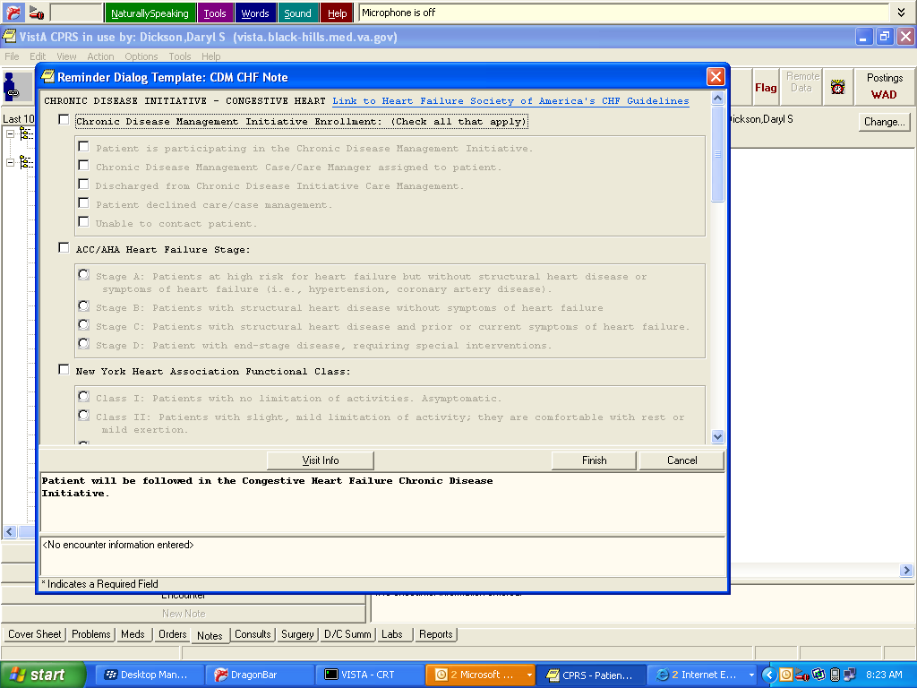
CDM HEALTH FACTOR TEMPLATES

Slide 13
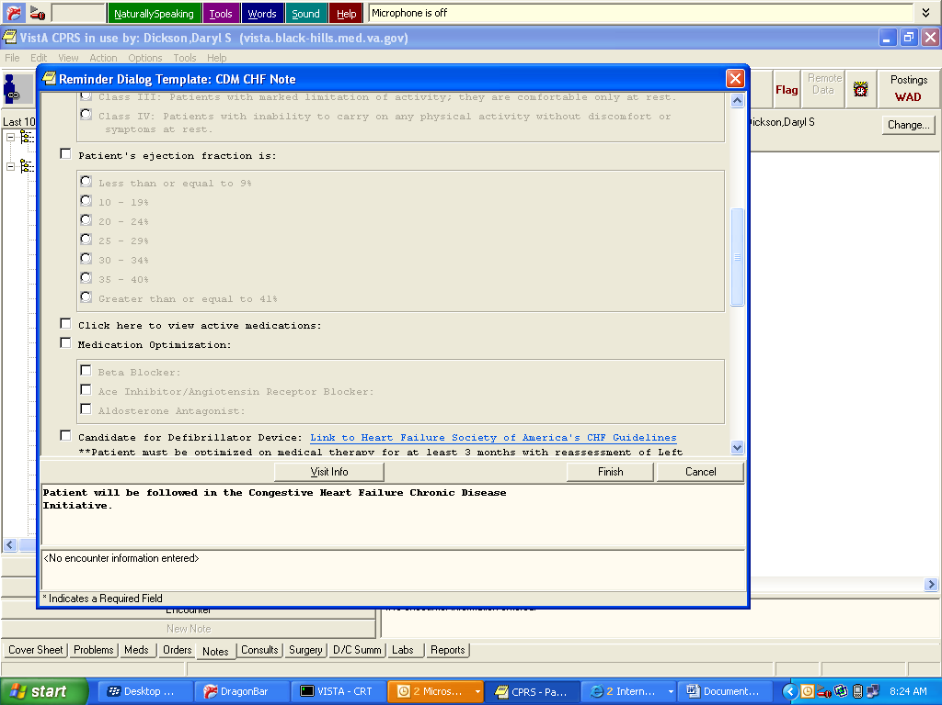

Slide 14
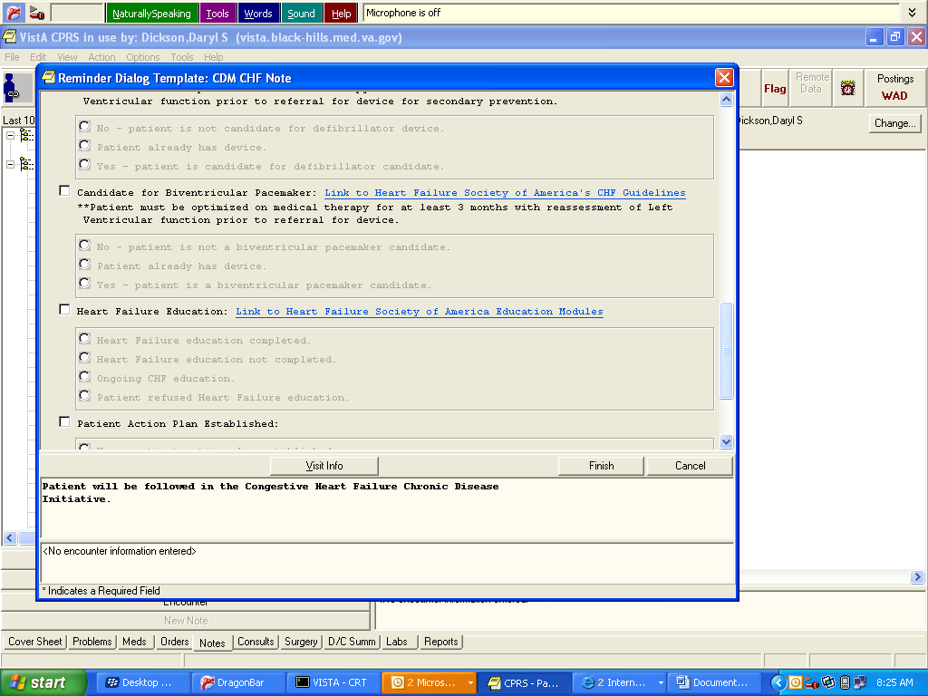

Slide 15
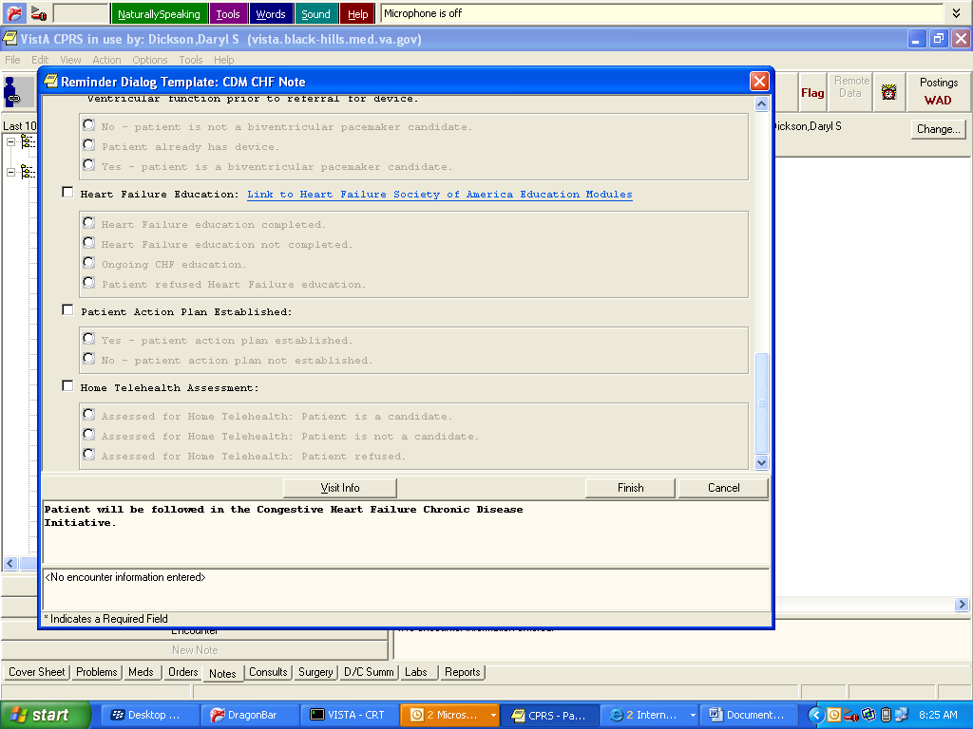

Slide 16
LESSIONS LEARNED
GREATEST AMOUNT OF IMPROVEMENT IN PATIENT CARE OCCURS WHEN STAFF CAN FOCUS ON IMPROVEMENT GOALS (CASE MANAGERS ARE INVOLVED IN PATIENTS’ CARE)
PROVIDERS ARE REMINDED REGULARLY OF COLLABORATIVE EFFORTS (STAFF MEETINGS)
STAFF REMAIN “ENGAGED” IN COLLABORATIVE EFFORTS (STAFF MEETING DISCUSSIONS)
PATIENTS TAKE AN ACTIVE ROLL IN THEIR HEALTH CARE/DISEASE MANAGEMENT
Notes:
LESSIONS LEARNED
GREATEST AMOUNT OF IMPROVEMENT IN PATIENT CARE OCCURS WHEN STAFF CAN FOCUS ON IMPROVEMENT GOALS (CASE MANAGERS ARE INVOLVED IN PATIENTS’ CARE)
PROVIDERS ARE REMINDED REGULARLY OF COLLABORATIVE EFFORTS (STAFF MEETINGS)
STAFF REMAIN “ENGAGED” IN COLLABORATIVE EFFORTS (STAFF MEETING DISCUSSIONS)
PATIENTS TAKE AN ACTIVE ROLL IN THEIR HEALTH CARE/DISEASE MANAGEMENT

Slide 17
QUESTIONS?
THANK YOU!
Notes:
QUESTIONS?
THANK YOU!

