Slide 1
MERIT Pump/Probe Data Analysis
Outline
The pump/probe program
Particle detector response correction
Pump/probe analysis results
NFMCC Collaboration Meeting ,
LBNL, January 26, 2009
Ilias Efthymiopoulos - CERN

Slide 2
The pump/probe program

Slide 3
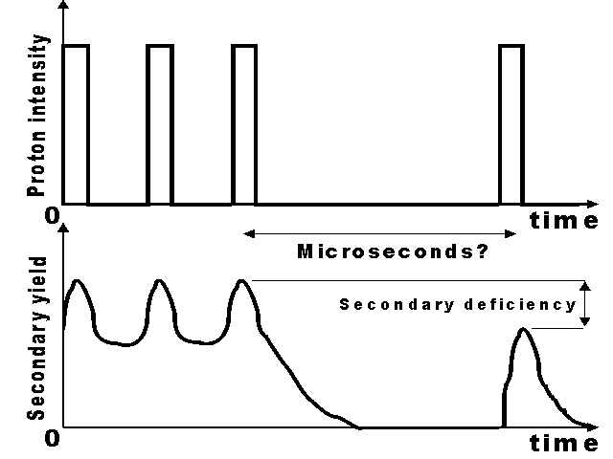
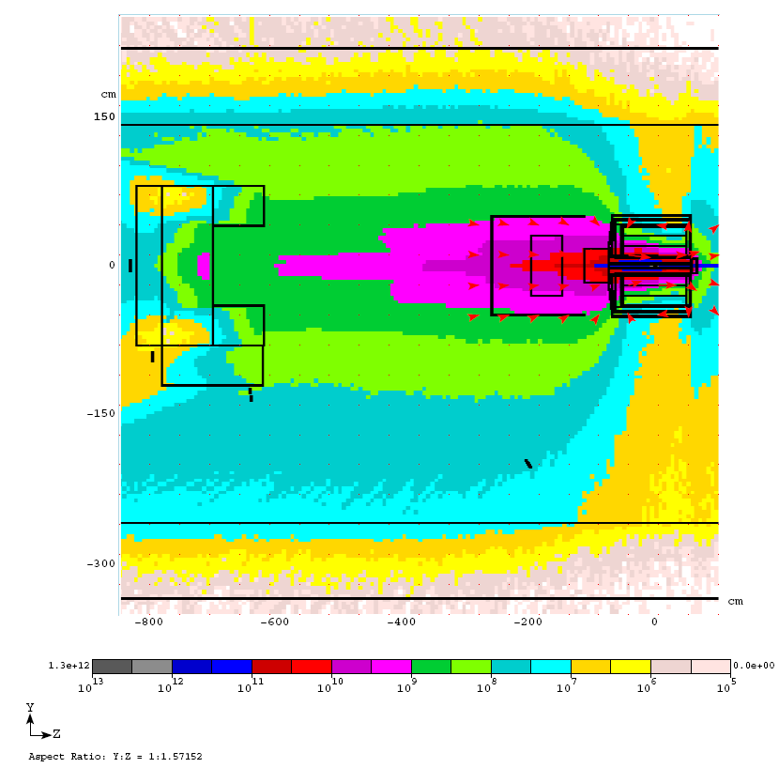
The pump/probe program
Use of the CERN PS flexibility to change the time structure of the extracted beam
PS normally set for h=16 (i.e. up to 16 bunches in the machine)
1st extraction : some bunches ➔ pump
2nd extraction : remaining bunches ➔ probe
same or following turns : Δt up to 700us
Detectors installed around the experimental setup to measure the secondary particle flux
A pump/probe signal deficiency in the detectors could be interpreted as a sign of target density variation → cavitation
Expected accuracy: ~5%
particle detectors

Slide 4
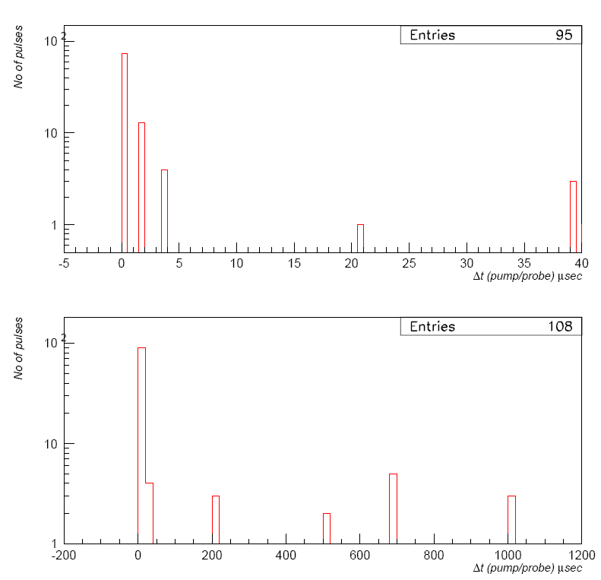
The pump/probe program – run summary
In total 108 beam pulses in pump/probe configuration
Including setting up shots
Only 6 shots at 24 GeV/c – the rest at 14 GeV/c beam
Unfortunately not valid BCT information for all pulses
Need more work to extract and analyze all signals

Slide 5
Particle detector response correction

Slide 6
Detector response analysis
Concentrate on the diamond detector signal
pCVD diamonds: ~1cm² sensitive area; only charged particle detection
Bunch signal : integral of response over a fixed time window (131ns)
Corrections:
Beam intensity fluctuations : BCT current transformer
Detector response vs flux : apply average correction from ALL runs (i.e. not only pump/probe)

Slide 7
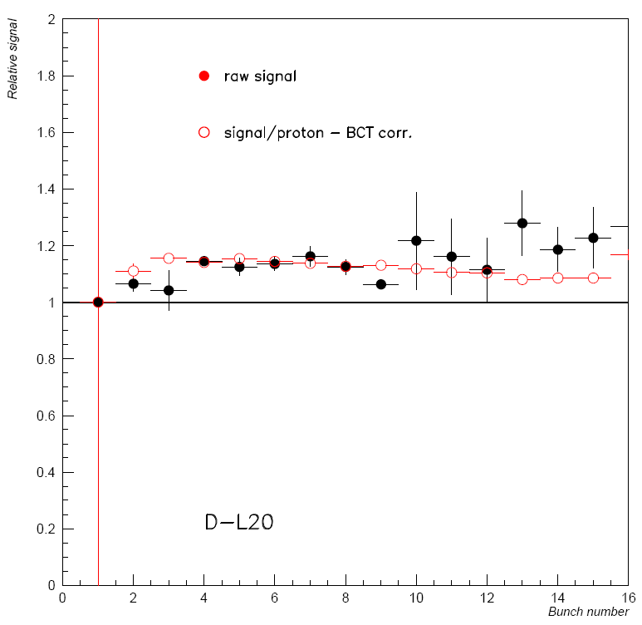
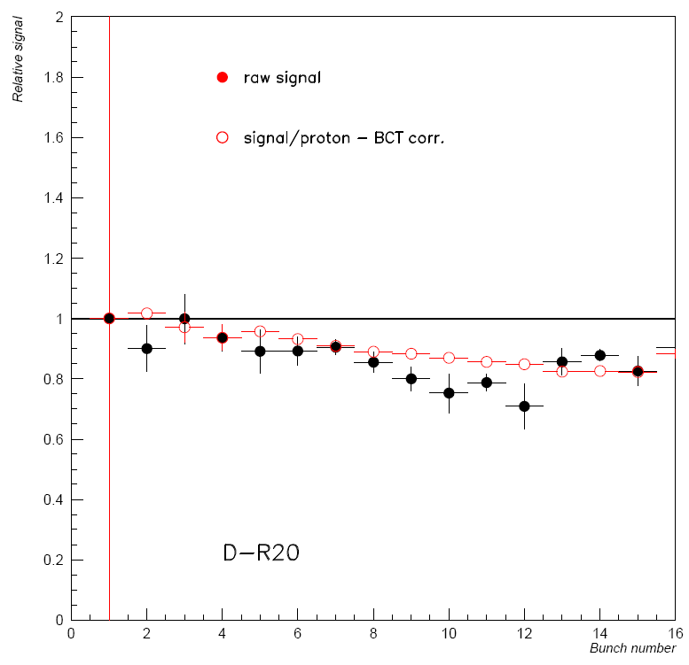
Diamond response vs bunch number
Data from ALL good runs with Δt(bunch)=131ns
BCT correction improves the uniformity of response – as it should!
Overall dependence to ~10% level → extract correction factors to remove the effect

Slide 8
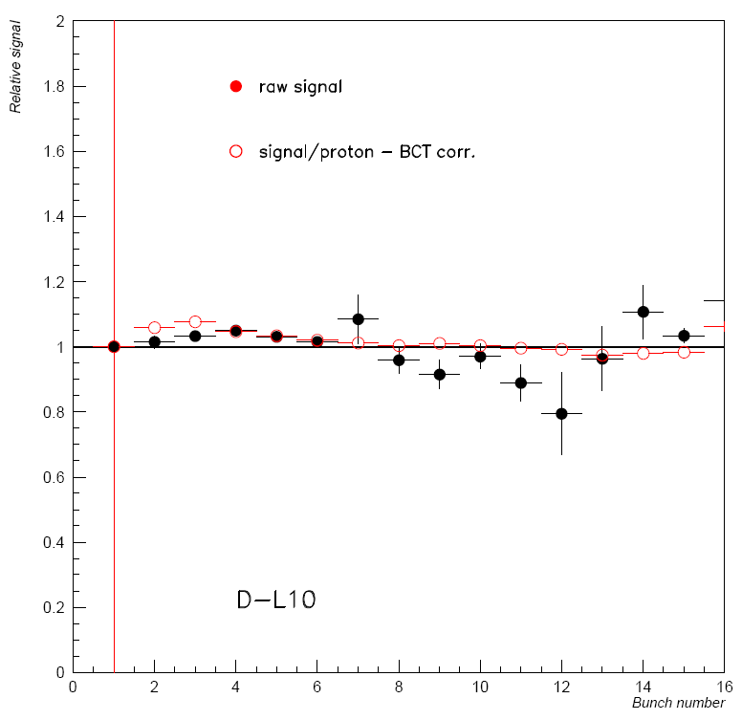
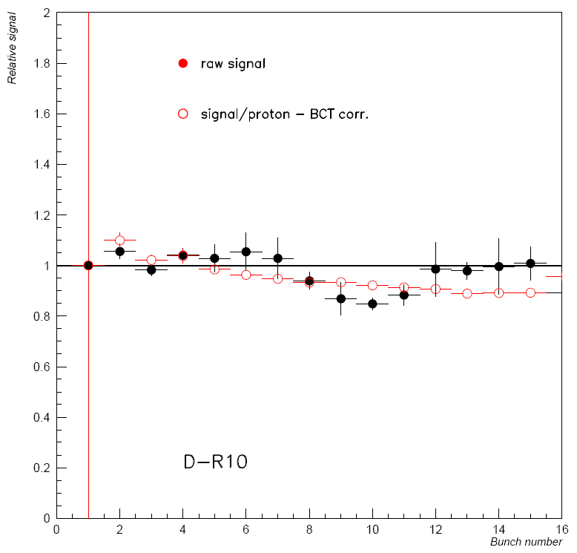
Diamond response vs bunch number
Data from ALL good runs with Δt(bunch)=131ns
Smaller dependence – most likely due to higher signal amplitude

Slide 9
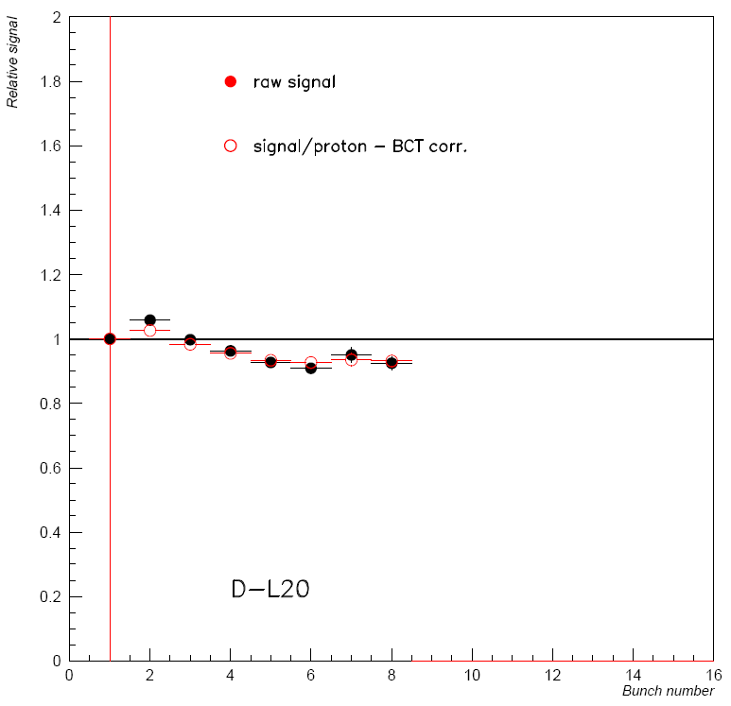
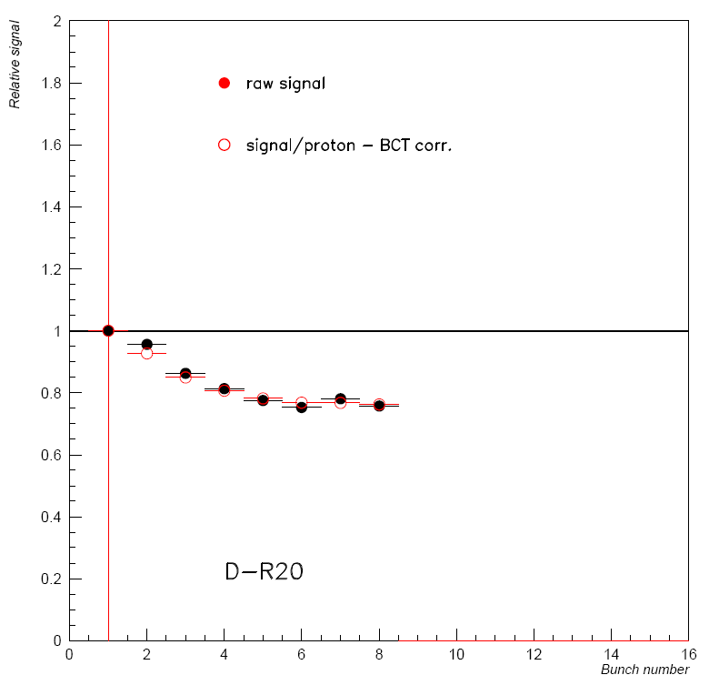
Diamond response vs bunch number
Data from ALL good runs with Δt(bunch)=262ns
Different effect with increased inter-bunch spacing
Signal amplitude is higher → drain capacitance effect gets visible

Slide 10
Pump – probe analysis results
Preliminary

Slide 11
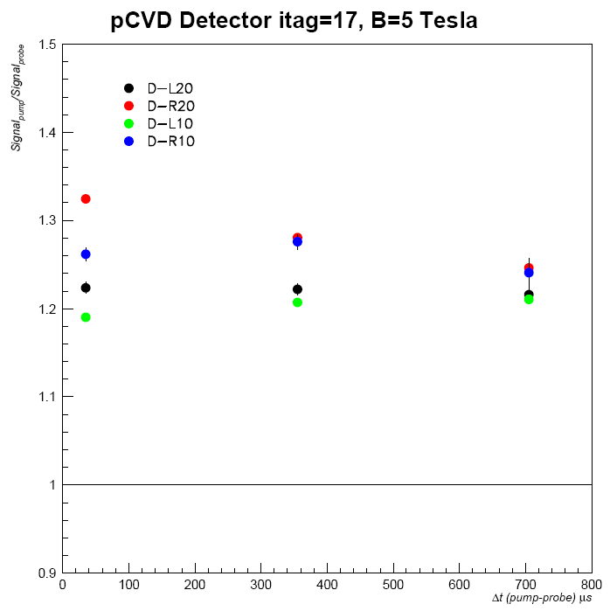
Pump – probe analysis result
Data from pump-probe runs – various Δt(bunch)
The plotted ratio is:
where A, B are the correction coefficients evaluated as before for each bunch
No significant variation with Dt(pump/probe) observed
If cavitation is formed in the target, then the ratio should increase with the pump-probe time distance (lower denominator)
Need to better understand why the ratios turn higher than 1.0
Systematic in the analysis
Wrong response of BCT transformer
Preliminary

Slide 12
Pump – probe analysis
Summary - next steps
Status of the analysis putting together the BCT and particle detector data is presented.
Average corrections to the particle detector signals has been developed.
Preliminary results indicate no large difference in the response in pump/probe signals
Next steps: continue working on the analysis, refine the applied corrections and combine the real data with MC simulation results

