Slide 1
RHIC Polarimetry
A.Bazilevsky
For the RHIC Polarimetry Group
RHIC&AGS User’s Meeting
May 29, 2008

Slide 2
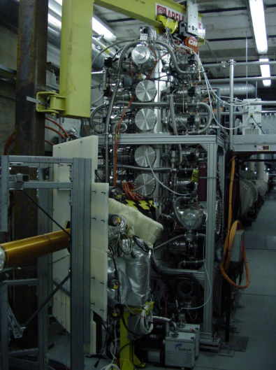
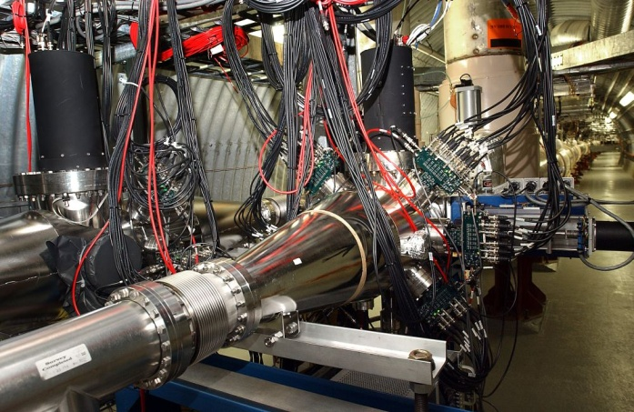
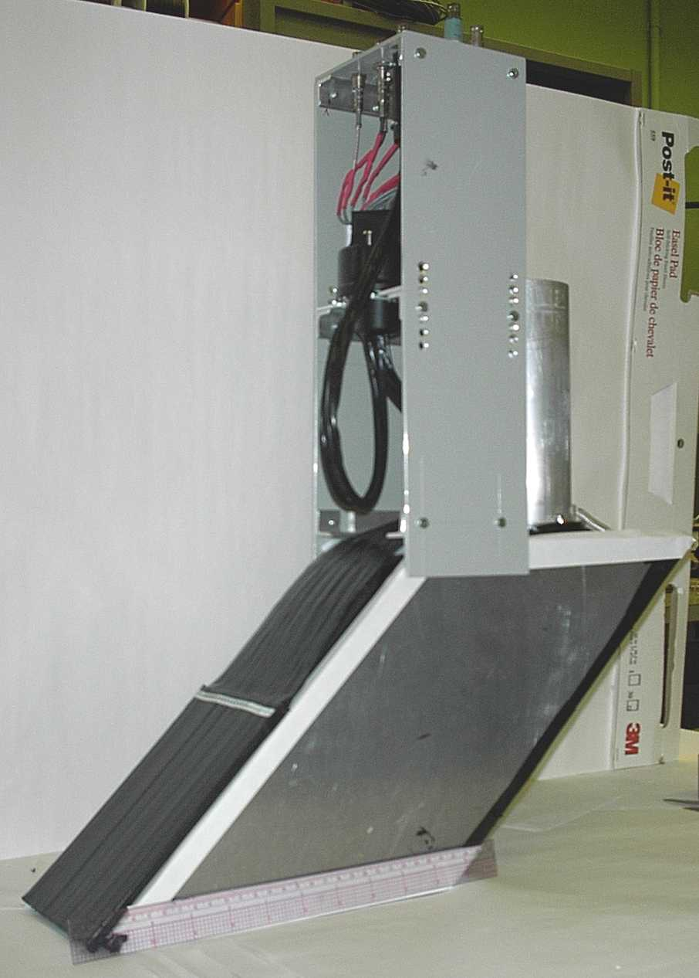
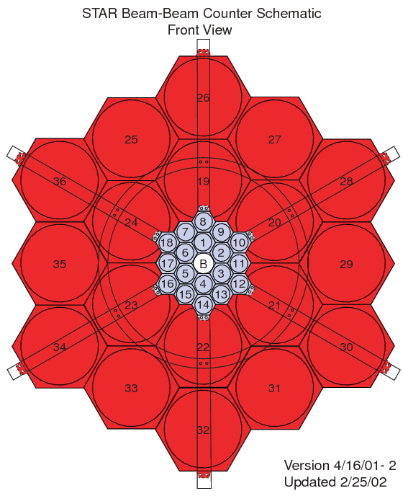
RHIC Polarimetry
Absolute Polarimeter (H jet)
RHIC pC Polarimeters
Siberian Snakes
BRAHMS & PP2PP (p)
RHIC
PHENIX (p)
STAR (p)
Siberian Snakes
Spin Rotators
Solenoid Snake
LINAC
BOOSTER
Pol. Proton Source
500 μA, 400 μs
AGS
Warm Snake
200 MeV Polarimeter
AC Dipole
AGS pC CNI Polarimeter
Cold Snake

Slide 3
Polarization Measurements
H-Jet
Absolute polarization
p-Carbon
Polarization profile
Polarization vs time in a fill
Fill-by-fill polarizations
Local Polarimeters
Monitor spin direction at collision regions
(Confirmation of long. polarization)
Capable to monitor polarization decay vs time in a fill and bunch-by-bunch polarization

Slide 4
HJet
Elastic scattering: Interference between electromagnetic and hadronic amplitudes in the Coulumb-Nuclear Interference (CNI) region
Beam and target are both protons
Forward scattered
proton
RHIC proton beam
H-jet target
recoil proton
<5%
P_{target} is provided by Breit Rabi Polarimeter

Slide 5
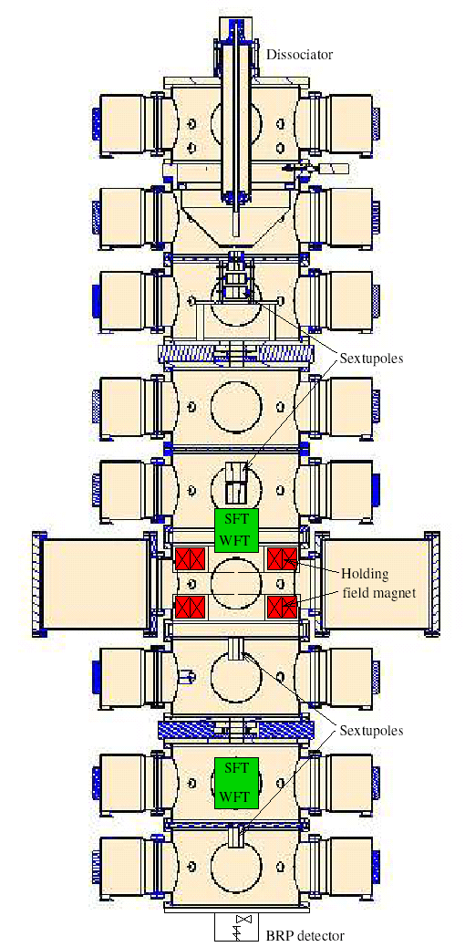
HJet target system
H = p⁺ + e⁻
|1> |2> |3> |4>
Hyper fine structure
H₂ desociater
Separating Magnet (Sextuples)
Atomic Beam Source
|1> |2>
RF transitions (WFT or SFT)
P₊ OR P₋
Scattering chamber
Holding magnet
|1> |3> |2> |4>
Breit-Rabi Polarimeter
|1> |2>
Separating magnet
2nd RF-transitions for calibration
Ion gauge
Ion gauge

Slide 6
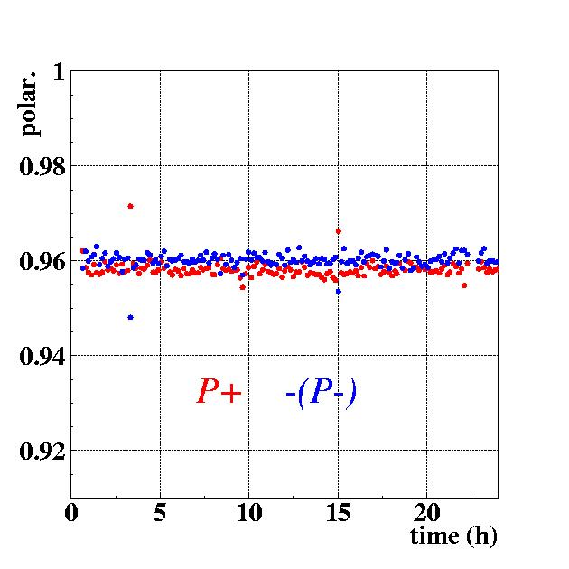
HJet: P_{target}
Source of normalization for polarization measurements at RHIC
Nuclear polarization of the atoms measured by BRP: 95.8% ± 0.1%
Nuclear polarization
Correct for H₂, H₂O contamination.
1 day
P_{target} = 92.4% ± 1.8%
Polarization cycle (+/ 0/ − ) = (500/50/500) seconds
Very stable for entire run period !

Slide 7
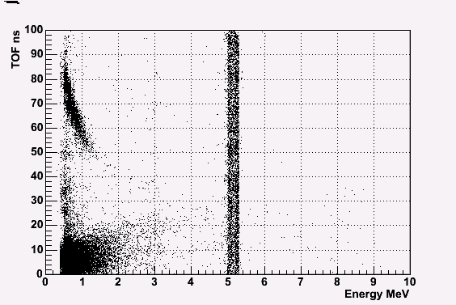
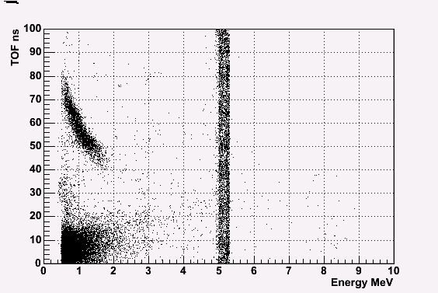
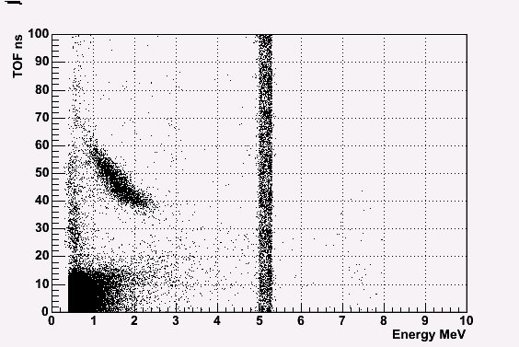
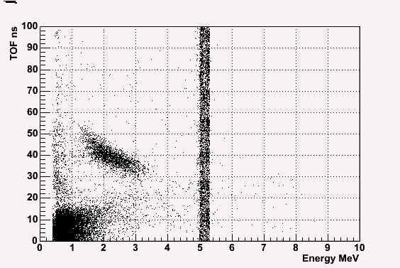
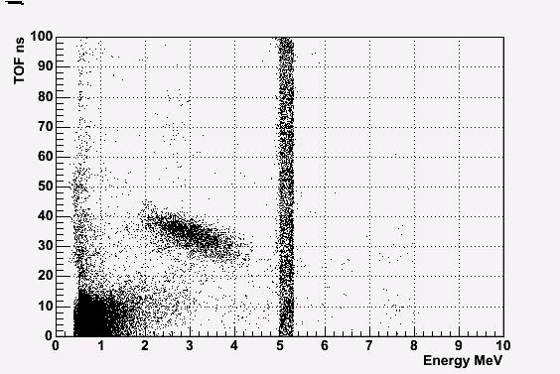
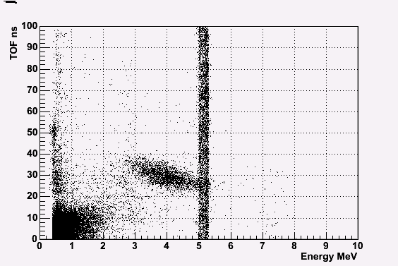
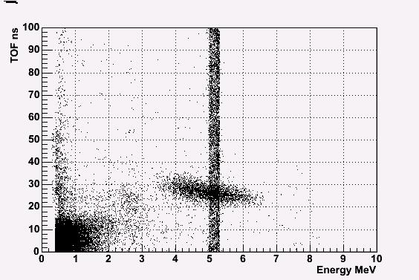
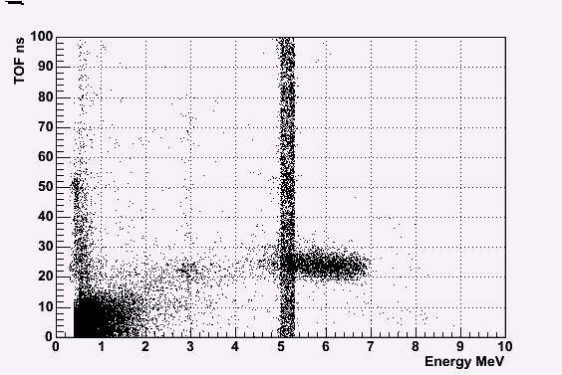
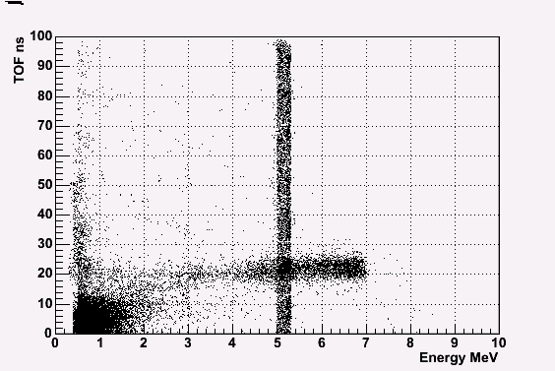
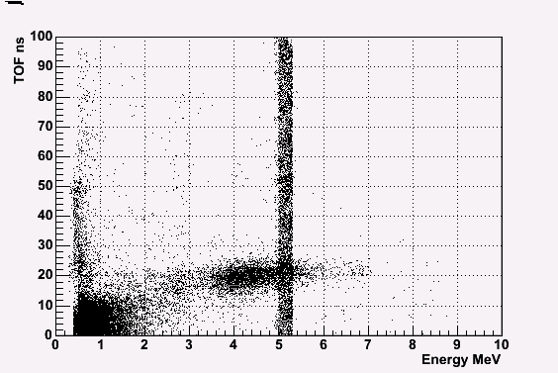
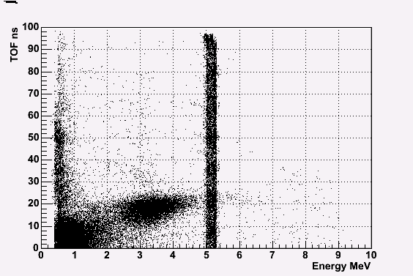
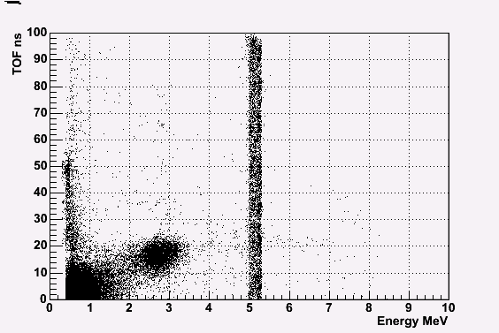
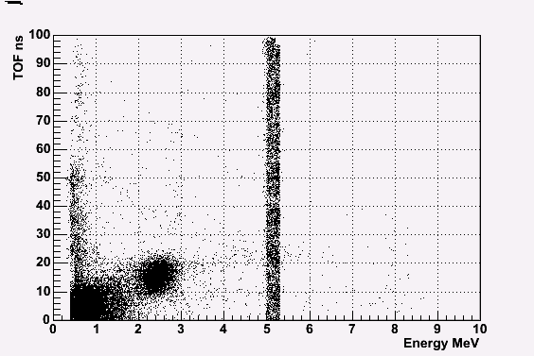
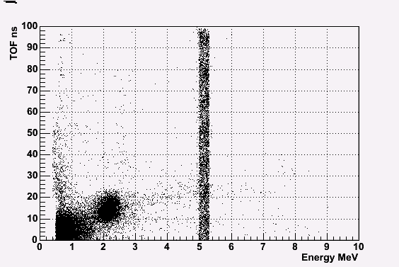
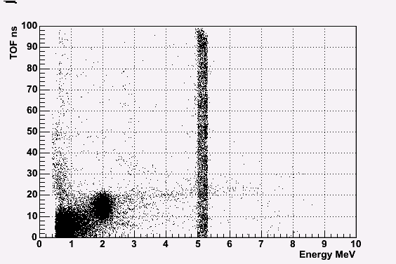
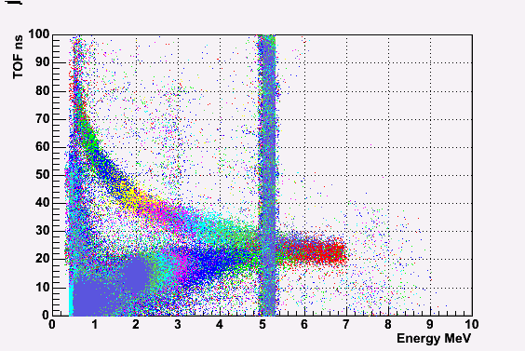
HJet: Identification of Elastic Events
Forward scattered
proton
proton beam
Ch#1
Ch#2
Ch#3
Ch#14
Ch#15
Ch#9
Ch#6
Ch#11,12
Ch#13
Ch#16
Ch#7
Ch#8
Ch#5
proton target
Ch#4
Ch#10
Ch#1-16
recoil proton
source for energy calibration
²⁴¹Am(5.486 MeV)
θ_{R}
#16
Ch#1
Array of Si detectors measures T_{R} & ToF of recoil proton.
Channel # corresponds to recoil angle θ_{R}.
Correlations (T_{R} & ToF ) and (T_{R} & θ_{R} ) → the elastic process

Slide 8
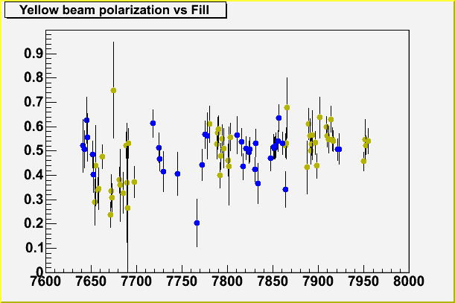
HJet:
Example from Run6
ε_{target}
ε_{beam}
Measures average over beam profile polarization with fill-by-fill stat. uncertainty ~10%
Data accumulated for a few fills provide normalization for pC polarimeter with uncertainty <5%

Slide 9
HJet
Target asymmetry vs T_{R}
❐ Run4 Blue
❐ Run5 Blue
● Run5 Yellow
❐ Run6 Blue
● Run6 Yellow
HJet performance is very stable through the Years
Background is small and doesn’t change from Year to Year, for Blue and Yellow
⇒ Beam polarization is measured reliably by HJet

Slide 10
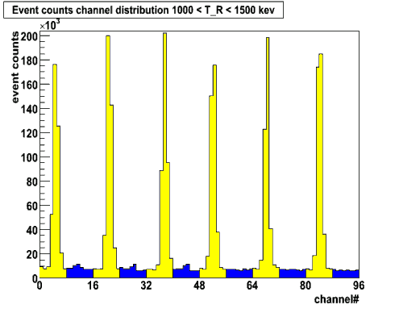
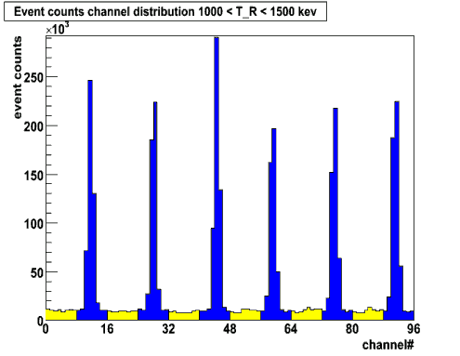
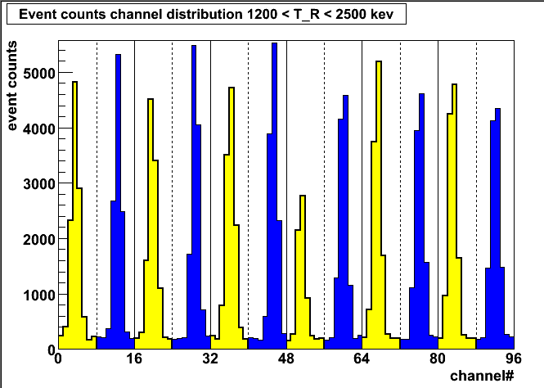
Hjet: Two Beam Mode
Yellow beam on target
Blue beam on target
Both beams on target
Successfully tested in Run8
Background level is the same as in single beam mode
Will allow to monitor both beam polarizations by HJet simultaneously in all fills

Slide 11
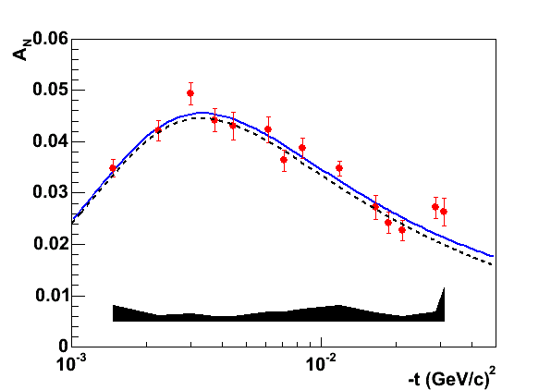
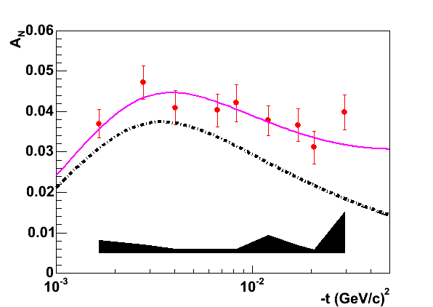
HJet: A_{N} in pp
PLB638, 450
100 GeV
100 GeV: calculations with no hadronic spin flip amplitude contribution are consistent with data
24 GeV: calculations with no hadronic spin flip amplitude contribution are not consistent with data
Preliminary
24 GeV
More data to come:
24 GeV: take more data in Run9/10
31 GeV: finalize analysis of data from Run6
250 GeV: take data in Run9/10

Slide 12
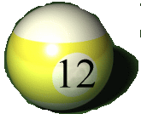
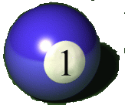

pC:
Elastic scattering: interference between electromagnetic and hadronic amplitudes in the Coulumb-Nuclear Interference (CNI) region
Carbon target
Polarized proton
Recoil carbon
6
1
Ultra thin Carbon ribbon Target
(5 μg/cm²)
18cm
5
2
Si strip detectors
(TOF, E_{C})
4
3

Slide 13
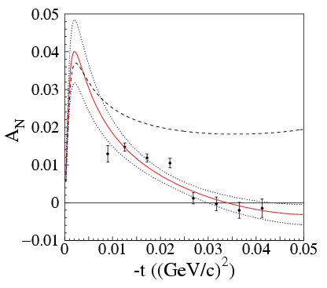
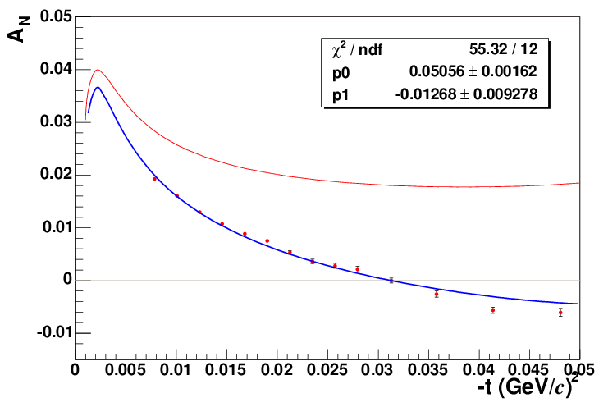
pC: A_{N}
Elastic scattering: interference between electromagnetic and hadronic amplitudes in the Coulumb-Nuclear Interference (CNI) region
pC Analyzing Power
Run04
zero hadronic
spin-flip
With hadronic
spin-flip (E950)
Phys.Rev.Lett.,89,052302(2002)
unpublished
E_{beam} = 21.7GeV
E_{beam} = 100 GeV

Slide 14
pC: goals/strategy
Polarization measurements for experiments
Target Scan mode
Provides polarization at beam center, polarization profile, average polarization over profile
20-30 sec per measurement
For stat. precision 2-3%
4-5 measurements per fill, per ring
Controls polarization decay vs time in a fill
Polarization profile, both vertical and horizontal
Normalized to HJet measurements over many fills
Knowledge on polarization profile in one transverse direction is required
Fill-by-fill polarization
Knowledge on polarization profile in both transverse directions is required
Feedback for accelerator experts
Beam emittance measurements, bunch-by-bunch
Polarization
Polarization profile, both vertical and horizontal
Polarization at injection (and polarization loss in transfer)
Polarization on the ramp (and polarization loss during ramp)

Slide 15
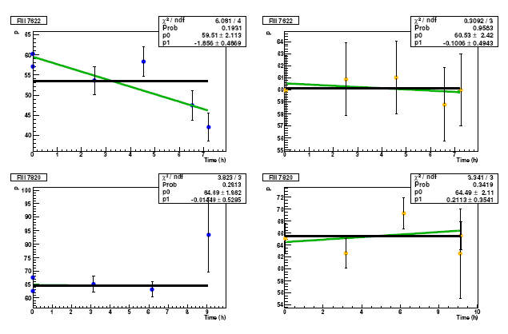
pC: polarization in a fill
Example from Run6
Blue
Yellow
Fill 7622
Fill 7820
Some fills may show polarization decay vs time

Slide 16
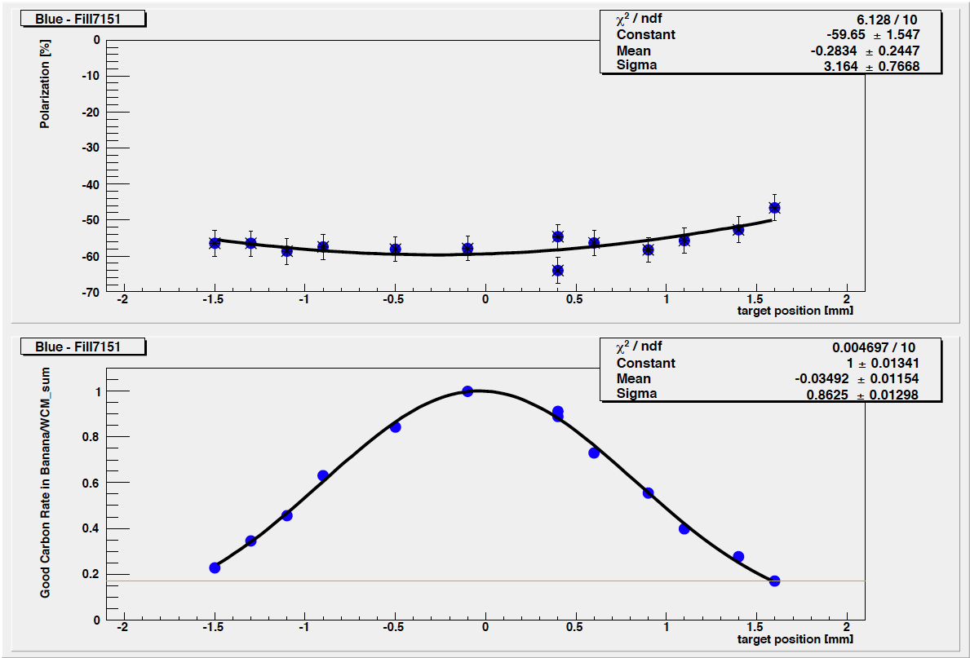
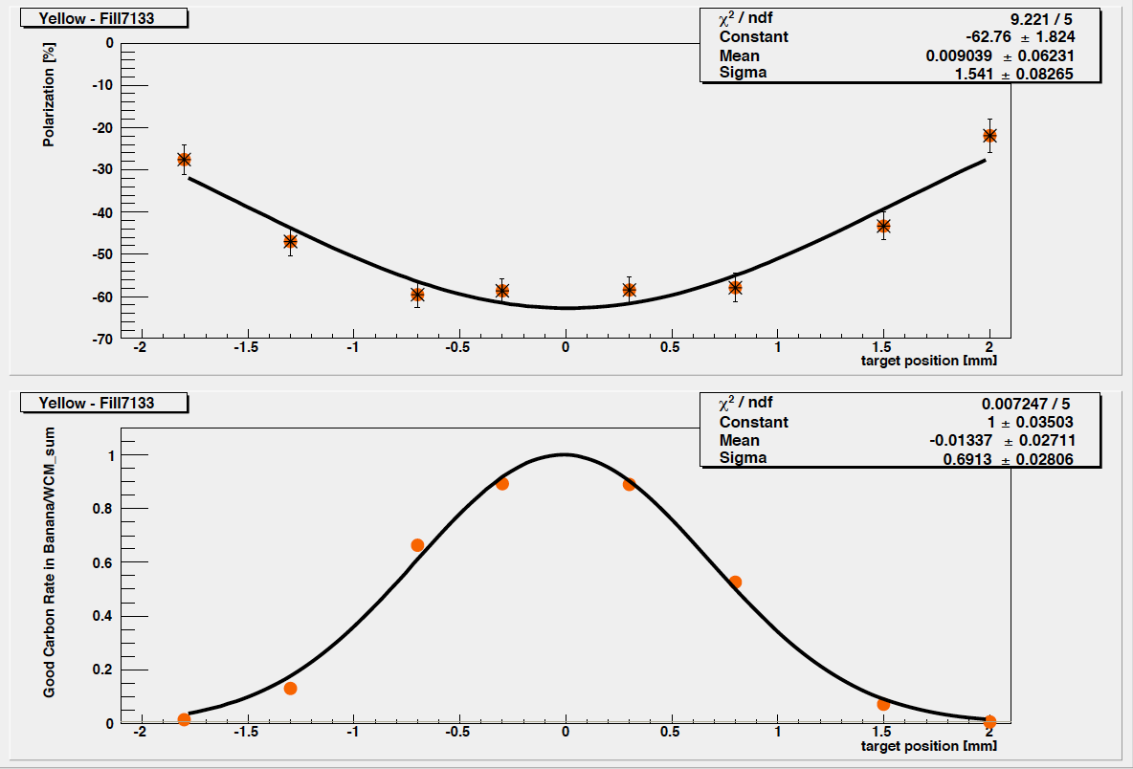
pC: Polarization Profile
Examples of pC measurements in Run5
Polarization
Polarization
Rate
Rate
Target Position
Target Position
Beam polarization profile is different for different beams, different fills ⇒
Correction for average polarization depends on beam/fill

Slide 17
Average Polarization
H-Jet
pC
Collider
Experiments
~1 mm
6-7 mm
x=x₀
P(x,y) – polarization profile, I(x,y) – intensity profile

Slide 18
Average Polarization
H-Jet
pC
If target positioned at beam
peak intensity/polarization
Collider
Experiment
If σ_{I1}= σ_{I2}= σ_{I}
Corrections due to polarization profiles are different when normalizing pC to H-Jet and when propagating pC measurements to experiments
Polarization profile in both trans. directions (X,Y) required

Slide 19
pC: Polarization Profile
pC
Scan C target over the beam cross:
1. Directly measure σ_{I} and σ_{P} :
Polarization
σ_{P}
P
2. Obtain R directly from the P(I) fit:
I
⎫
⎬
⎭
Intensity
σ_{I}
Target Position
Precise target positioning is NOT necessary

Slide 20
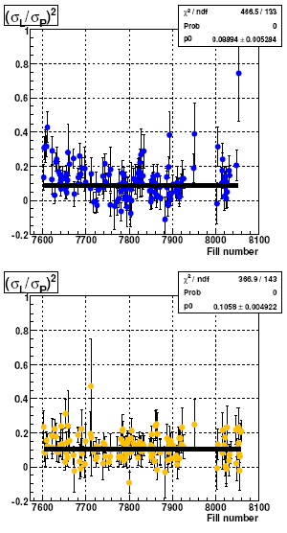
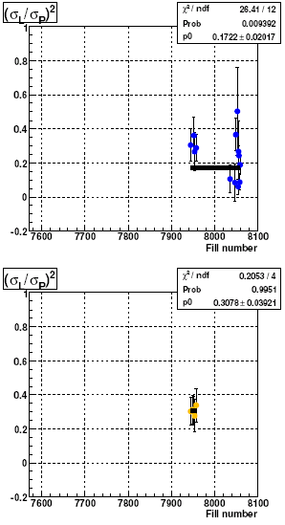
pC: Polarization Profile
Run6 data: R vs fill
P(L) in one fill
Horiz-blue
Vert-blue
R=0.29±0.07
Horiz-yellow
Vert-yellow
R~0.1–0.3 ⇒ 5–15% different polarization seen by HJet and by experiments

Slide 21
pC: Polarization vs Fill
Run6 results
100 GeV
31 GeV
100 GeV
31 GeV
Normalized to Hjet
Corrected for polarization profile

Slide 22
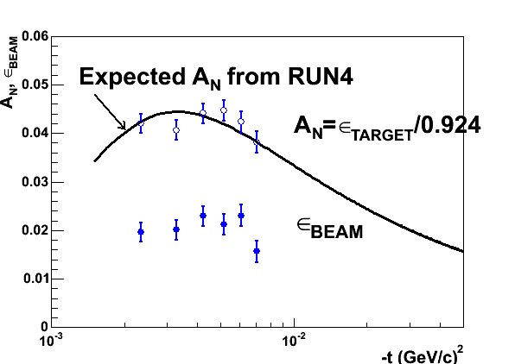
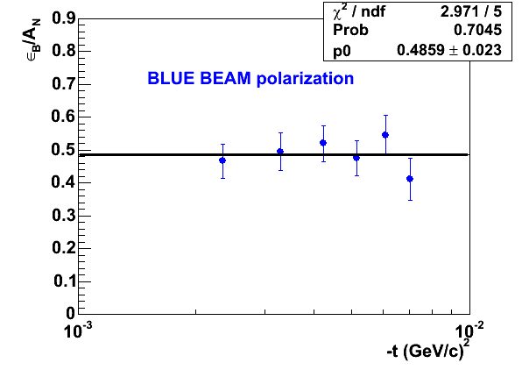
Hjet+pC: Run8 Analysis
Fast (~online) analysis – during the run
ε_{target} and ε_{beam} from HJet
Beam polarization from HJet
Beam polarization from HJet
Polarization vs fill:
normalized, profile corrected
pC-online/Jet: pC calibration
Offline analysis is almost completed and results will be released soon

Slide 23
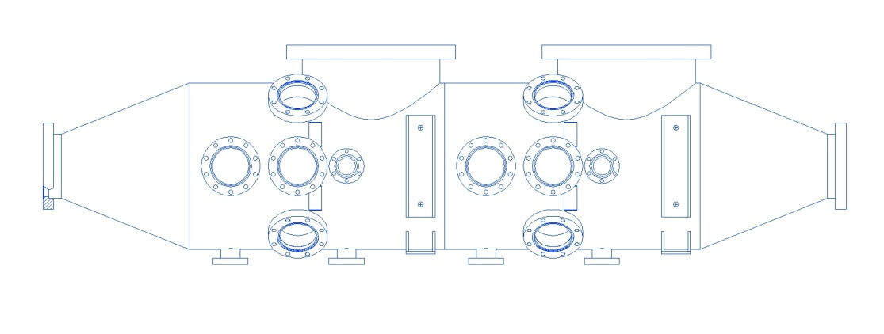
pC: Upgrade
Detector upgrade
Photo-diod instead of Si strips
Target upgrade
Possibility of using nano-tubes under investigation
pC vacuum chamber upgrade
Two polarimeter setups per ring
Double number of targets (to avoid a need to open chamber to install new targets during the run)
Reduce the time required for successive measurements of horiz. and vert. profiles
Allows installation and testing new detectors for higher rate capabilities

Slide 24
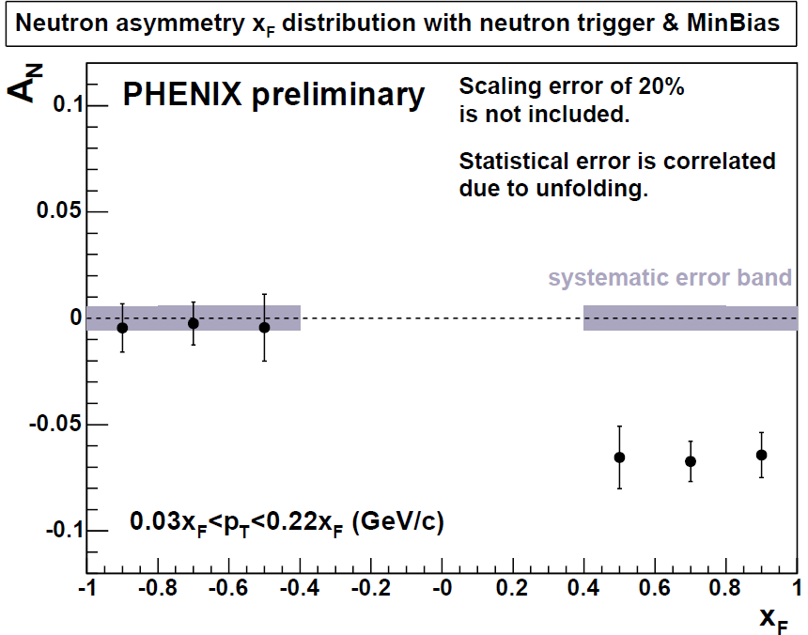
PHENIX Local Polarimeter
Utilizes spin dependence of very forward neutron production (PLB650, 325):
ZDC (energy) + SMD (position)
charged
particles
neutron
SMD
ZDC

Slide 25
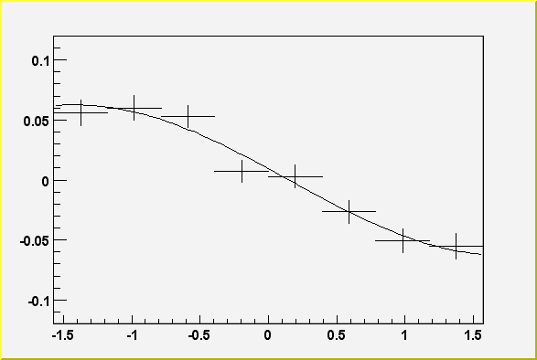
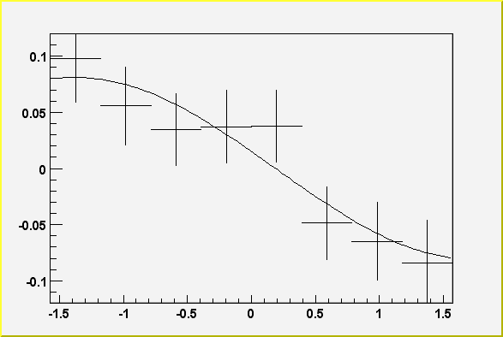
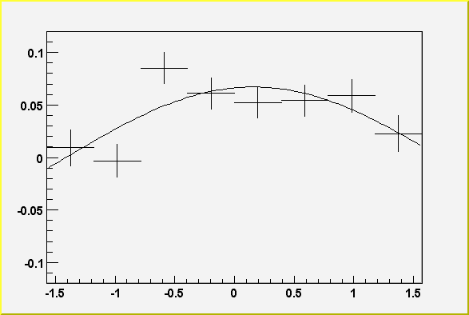
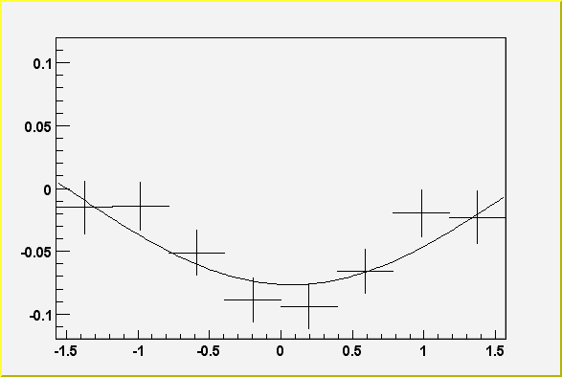
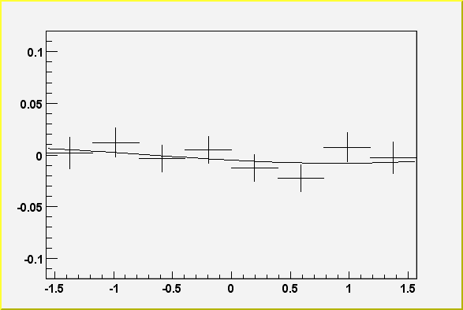
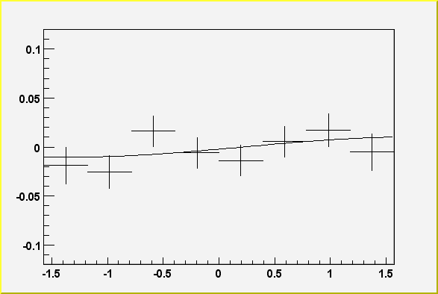
PHENIX Local Polarimeter
Asymmetry vs φ
Spin Rotators OFF
Vertical polarization
Blue
Yellow
Spin Rotators ON
Current Reversed
Radial polarization
Blue
Yellow
Spin Rotators ON
Correct Current !
Longitudinal polarization!
Blue
Yellow
Monitors spin direction in PHENIX collision region

Slide 26
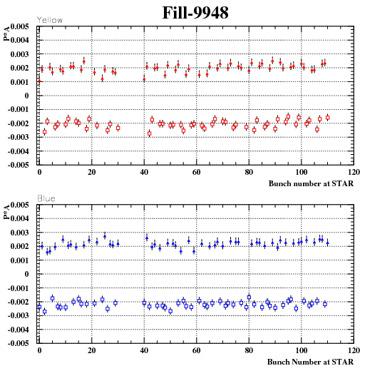
STAR Local Polarimeter
Utilizes spin dependence of hadron production at high x_{F}:
3.3<|η|< 5.0 (small tiles only)
Bunch-by-bunch (relative) polarization
Monitors spin direction in STAR collision region
Capable to precisely monitor polarization vs time in a fill, and bunch-by-bunch

Slide 27
Summary
RHIC Polarimetry consists of several independent subsystems
Hjet:
Absolute polarization measurements
Absolute normalization for other RHIC Polarimeters
pC:
Separate for blue and yellow beams
Normalization from HJet
Polarization vs time in a fill
Polarization profile
Fill-by-fill polarizations for experiments
PHENIX and STAR Local Polarimeters:
Monitor spin direction (through trans. spin component) at collision
Polarization vs time in a fill (for trans. pol. beams)
Polarization vs bunch (for trans. pol. beams)
Reliably provides RHIC beam polarizations
With relative uncertainty better than 5%
Continuously developing
Detector and target system upgrade to deal with high beam intensities, and to improve efficiency and reliability

Slide 28
Backups

Slide 29
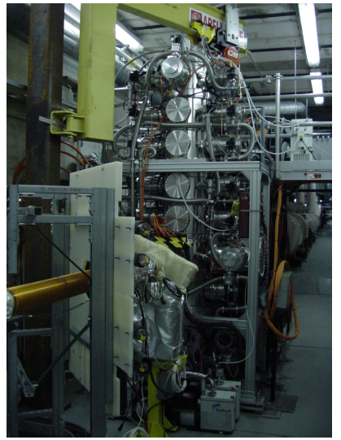
H-jet system
target
Height: 3.5 m
Weight: 3000 kg
Entire system moves along x-axis −10 ~ +10 mm to adjust collision point with RHIC beam.
Recoil proton
RHIC proton beam
IP12

