Slide 1
Internal hydraulic jumps and overturning generated by tidal flow over a tall steep ridge
Sonya Legg
Princeton University, NOAA-GFDL
Jody Klymak
University of Victoria

Slide 2
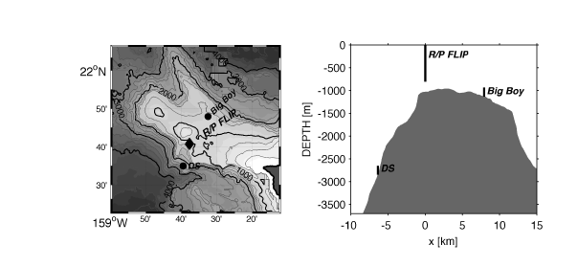

Hawaiian Ocean Mixing Experiment: Observations at Kaena Ridge
Klymak, Pinkel and Rainville, JPO 2007
Strong dissipation observed during transition from offslope to onslope tidal flow at top of ridge
Q: What is the cause of this high dissipation and associated overturning?

Slide 3
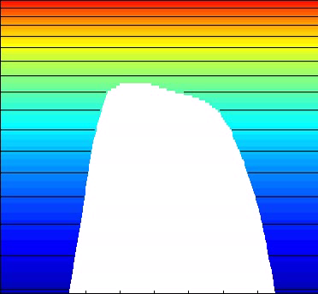
Hawaiian ridge simulations with MITgcm, stratification and topography from Kaena ridge
Buoyancy field for U0=5cm/s, M2 tidal forcing.
-700m
Model details:
2D nonhydrostatic simulations with resolution 115m X 9m near top of slope.
Total domain is 500km X 4300m.
Barotropic tide forced through a body forcing.
Open boundary conditions allow baroclinic tide to radiate away.
-1760m
46km
Hawaiian ridge is tall and steep.
γ> 1, RL < 1, Fr << 1, h/H -> 1.
Hydraulic jumps develop over steep slope during downslope flow: at flow reversal, jumps propagate upslope as internal bores.
Asymmetric response: details of slope are important.

Slide 4
Role of topographic slope in generating transient jumps
In steady state flows, strongly nonlinear leewaves are generated when
Fr << 1: flow is blocked by topography.
Fr >> 1: small amplitude linear leewaves.
In tidally oscillating flow, if RL < 1, fluid does not feel full height of topography within a tidal cycle. Instead the vertical scale of topography experienced by flow is the vertical tidal displacement:
By analogy with steady case, we expect strongly nonlinear waves if hω is large enough that
i.e.
So transient jump-like waves may be possible if slope is sufficiently steep that Frω < 1

Slide 5
Evidence for importance of Fr:
isopycnal displacement amplitude Δh
Δh v. U0/N
Δh v. vertical tidal excursion dh/dx U0/ω
Δh v. dh/dx U0/ω, U0/N/0.3
At large Fr, Δh is governed by tidal excursion distance, but at small Fr, Δh is proportional to U0/N, the limit based on KE to PE conversion. There is therefore a regime transition governed by Fr.

Slide 6
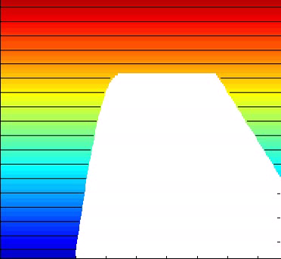
Understanding the overturning at the Hawaiian ridge: numerical experiments
Analysis suggests that the essential ingredients for the jump-like features with associated overturning are (a) large amplitude flow over large amplitude topography (b) steep topographic slope.
Simulation with idealized topography and uniform stratification. The behavior seen in the realistic simulation is reproduced when stratification at shelf-break and maximum slope are the same.

Slide 7
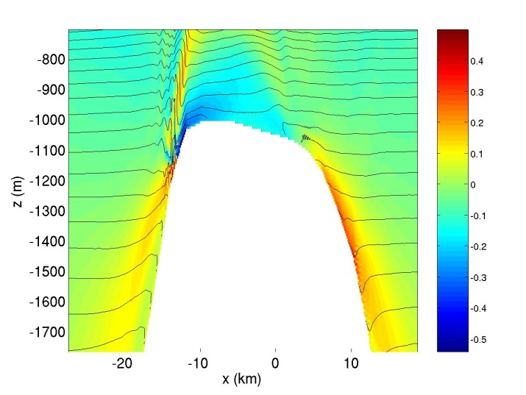
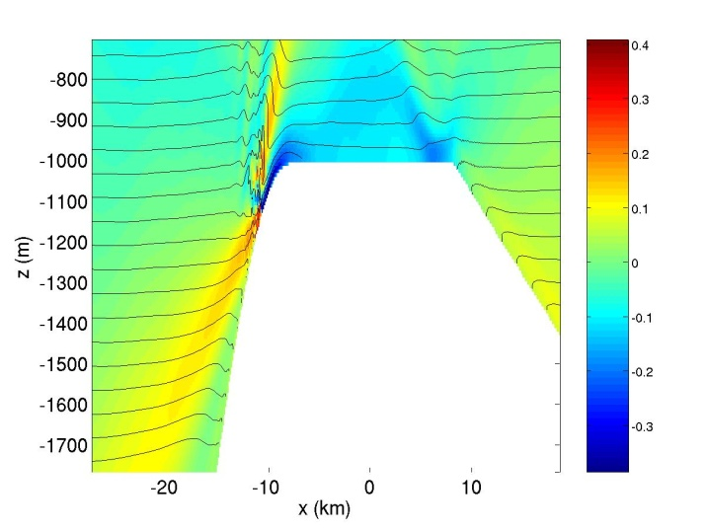
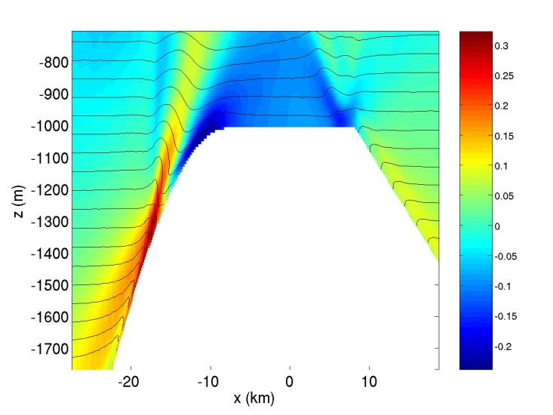
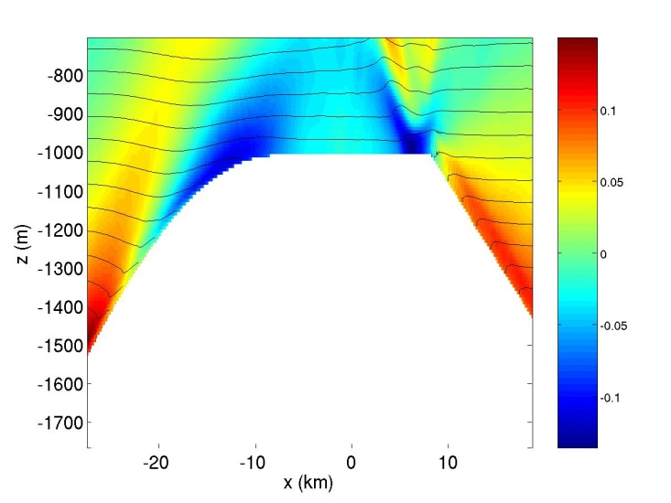
Dependence of overturning on slope
Real topography, Frω=0.3
dh/dx(max) = 0.2, Frω=0.3
dh/dx(max) = 0.1, Frω=0.6
dh/dx(max) = 0.06, Frω=1.0
Snapshots of U(color) and buoyancy (contours) just after flow reversal, all with U0=5cm/s
Borelike features are found only for Frω<<1.

Slide 8
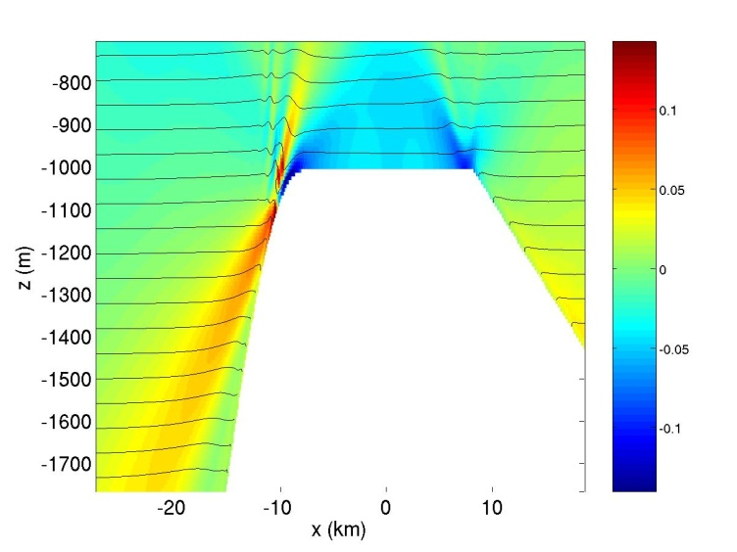
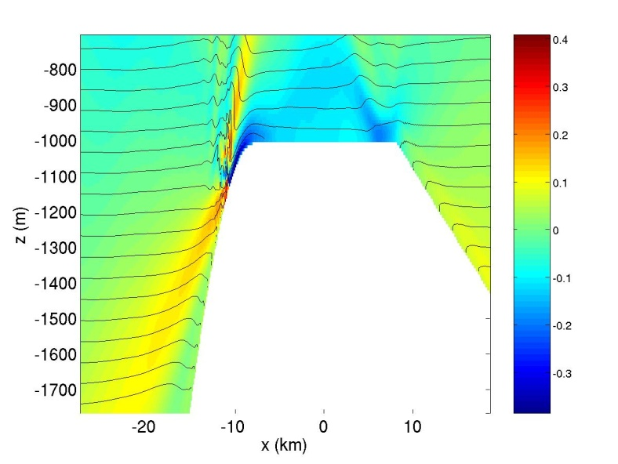
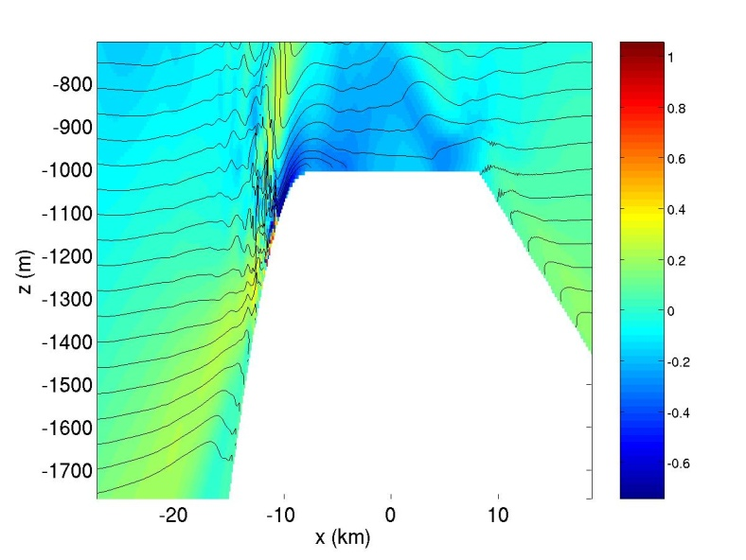
Dependence of overturning on flow amplitude
U0=2cm/s, λc=186m
U0=5cm/s, λc=465m
U0=10cm/s, λc=930m
Snapshots of U (color) and buoyancy (contours) just after flow reversal, for dh/dx(max) = 0.2. (Frω=0.3)
Larger amplitude flow increases vertical extent and vigor of overturning.

Slide 9
Evidence for overturning and internal bores
Height of Ri<1 layer at topographic depth of -1150m
Skewness of dT/dt at top of slope, h=-1028m.
Steeper slopes and stronger flows associated with deeper overturning layer, occurring just after flow reversal.
Negative dT/dt skewness for all low Fr runs indicates sudden drops in temperature, associated with upslope propagating internal bores.

Slide 10
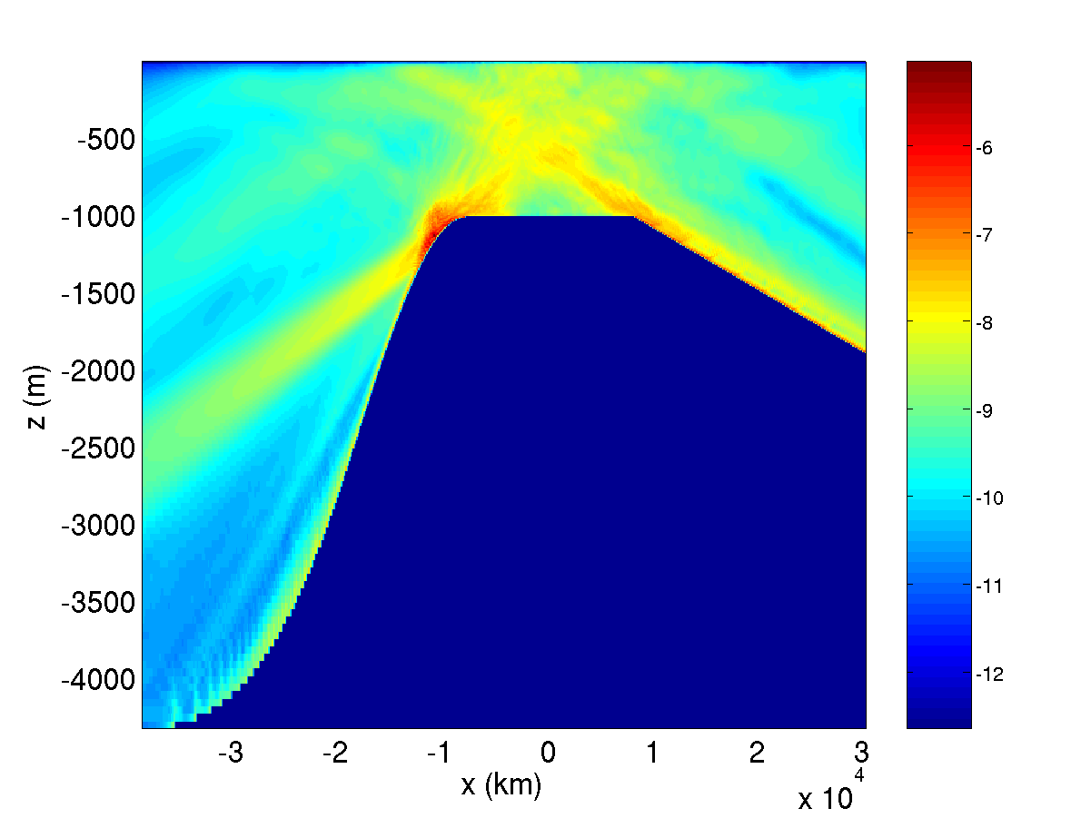
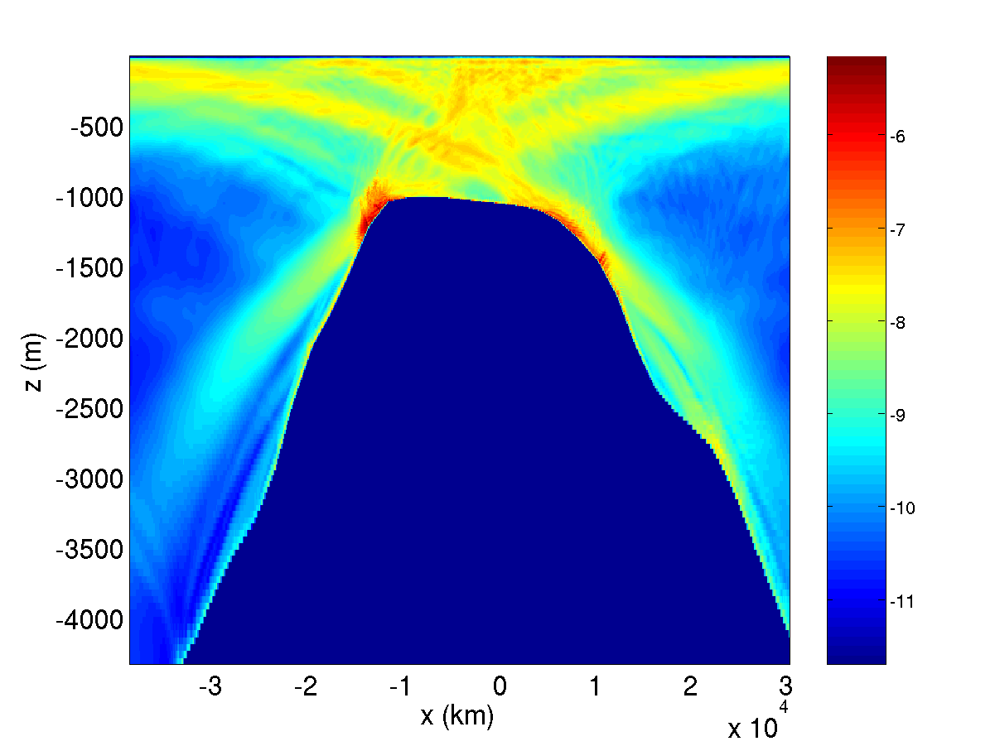
Influence of internal bores on dissipation
Log10 dissipation (time-averaged) for U0=5cm/s, dh/dx=0.2
Log10 dissipation (time-averaged) for U0=5cm/s, realistic topography and stratification
The region affected by internal bores has an order of magnitude higher dissipation than the internal wave beams.

Slide 11
Impact of different slopes, tidal velocities, on dissipation near shelf-break
Ratio between upper slope dissipation and total dissipation
Time-averaged dissipation for all simulations at location of maximum dissipation (h=-1170m)
Steep slopes and large amplitude flows have greatest enhancement of dissipation on upper slope. High frequency flows are complicated by Parametric Subharmonic Instability.

Slide 12
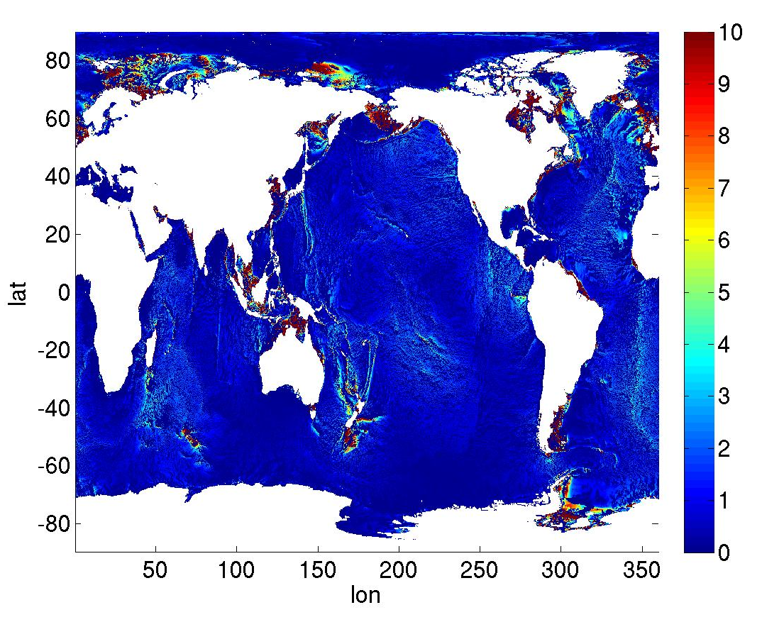
Do tidally driven transient hydraulic jumps matter on a global scale?
Amplitude of tidal velocity projected onto direction of topographic gradient (cm/s)
Frω (N/(ω dh/dx)) calculated on ¼ degree scale
Large velocities combined with Frω < 1 may lead to local overturning in jump-like features: seen in several interesting locations….

Slide 13
Conclusions
For steep slopes and large amplitude flows, overturning internal bores are generated.
The internal bores are locations of enhanced dissipation.
Probable cause: transient jump-like nonlinear lee-waves are generated during off-slope flow, propagate toward slope when flow relaxes, and cause overturning.
Nonlinear jump-like features only appear when Fr based on tidal excursion distance is small, implying steep slopes.
Vertical scale of nonlinear features depends on flow amplitude, stratification.

