Slide 1

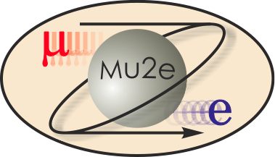
Overview and Challenges for Upgrades: Muon-Electron Conversion at FNAL
R. Bernstein
Fermilab
for the Mu2e Collaboration
R. Bernstein, FNAL AAC Seminar Jan 2009

Slide 2
60 physicists,
15 institutions
R.M. Carey, K.R. Lynch, J.P. Miller*, B.L. Roberts
Boston University
W. Marciano,Y. Semertzidis, P. Yamin
Brookhaven National Laboratory
Yu.G. Kolomensky
University of California, Berkeley
C.M. Ankenbrandt , R.H. Bernstein*, D. Bogert, S.J. Brice, D.R. Broemmelsiek, R. Coleman, D.F. DeJongh, S. Geer, R. Kutschke, M. Lamm,
M.A. Martens, S. Nagaitsev, D.V. Neuffer, M. Popovic, E.J. Prebys, M. Syphers, R.E. Ray, R. Tschirhart, H.B. White, K. Yonehara, C.Y. Yoshikawa
Fermi National Accelerator Laboratory
D. Dale, K.J. Keeter, E. Tatar
Idaho State University
W. Molzon
University of California, Irvine
P.T. Debevec, G. Gollin,D.W. Hertzog, P. Kammel
University of Illinois, Urbana-Champaign
F. Cervelli, R. Carosi, M. Incagli,T. Lomtadze, L. Ristori, F. Scuri, C. Vannini
Istituto Nazionale di Fisica Nucleare Pisa, Università Di Pisa
V. Lobashev
Institute for Nuclear Research, Moscow, Russia
D.M. Kawall, K.S. Kumar
University of Massachusetts, Amherst
R.J. Abrams, M.A.C. Cummings, R.P. Johnson, S.A. Kahn,S.A. Korenev, T.J. Roberts, R.C. Sah
Muons, Inc.
J.L. Popp
City University of New York, York
A. DeGouvea
Northwestern University
M. Corcoran
Rice University
R.S. Holmes, P.A. Souder
Syracuse University
M.A. Bychkov, E.C. Dukes, E. Frlez, R.J. Hirosky, A.J. Norman, K.D. Paschke, D. Pocanic
University of Virginia
Collaboration
G4beamline
64 collaborators
16 institutions

Slide 3
Outline
The search for muon-electron conversion
Experimental Technique
Project X Upgrades and Mu2e
Conclusions
R. Bernstein, FNAL AAC Seminar Jan 2009
3

Slide 4


What is μe Conversion?
muon converts to electron in the presence of a nucleus
Charged Lepton Flavor Violation (CLFV)
Related Processes:
μ or τ → eγ, e⁺e⁻e, KL→μe, and more
R. Bernstein, FNAL AAC Seminar Jan 2009
4

Slide 5
Endorsed in US Roadmap
FNAL has proposed muon-electron conversion as a flagship program for the next decade
Strongly endorsed by P5:
“The experiment could go forward in the next decade with a modest evolution of the Fermilab accelerator complex. Such an experiment could be the first step in a world-leading muon-decay program eventually driven by a next-generation high-intensity proton source. The panel recommends pursuing the muon-to-electron conversion experiment... under all budget scenarios considered by the panel”
Mu2e is a central part of the future US program
R. Bernstein, FNAL AAC Seminar Jan 2009

Slide 6
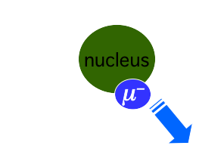
Experimental Signal
A Single Monoenergetic Electron
If N = Al, Ee = 105. MeV
electron energy depends on Z
e⁻
6
Notes:
will use this many times, so take a moment

Slide 7
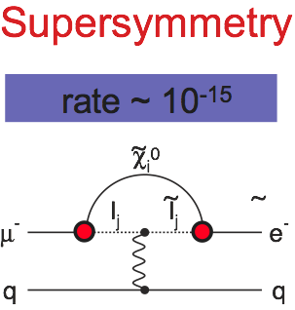
LFV, SUSY and the LHC
Access SUSY through loops:
signal of Terascale at LHC implies
~40 event signal /0.4 bkg in this experiment
~
R. Bernstein, FNAL AAC Seminar Jan 2009
Notes:
let’s look at some specific models

Slide 8
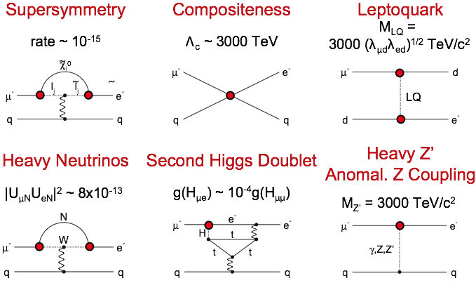
Contributions to μe Conversion
also see Flavour physics of leptons and dipole moments, arXiv:0801.1826
R. Bernstein, FNAL Mu2e Seminar Nov 2008
Notes:
note both loop processes and new particle exchange, will come back to this next slide. note article or excellent discussion

Slide 9
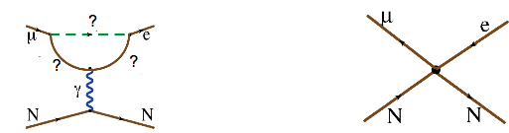
“Model-Independent” Picture
“Loops”
“Contact Terms”
Supersymmetry and Heavy Neutrinos
Exchange of a new, massive particle
Contributes to μ→eγ
Does not produce μ→eγ
Quantitative Comparison?
R. Bernstein, FNAL AAC Seminar Jan 2009
Notes:
We write down an effective lagrangian that breaks up the physics cleanly,
quantitative comparison: how can we use both experiments?

Slide 10
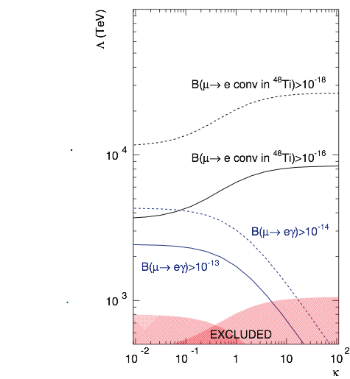
μe Conversion and μ→eγ
Λ (TeV)
1) Mass Reach to ~10⁴ TeV
2) about x2 beyond MEG in loop-dominated physics
Project X Mu2e
Mu2e
higher mass scale
MEG
MEGA
SINDRUM
κ
André de Gouvêa, Project X Workshop Golden Book
R. Bernstein, FNAL AAC Seminar Jan 2009
Notes:
generally acknowledge for experimental reasons mu e gamma will not get much better -- this improvement is only a factor of 5 --point to MEG/MEGA, but mu-e conversion can improve by 10,000 --SINDRUM to Mu2e. Independent of model! If supersymmetry, great -- but if not, can reach to 10^4 TeV for new physics. This is a unique contribution made by mu-e conversion. You know about COMET/PRISM proposed here in Japan: different design, similar sensitivities.

Slide 11
Outline
The search for muon-electron conversion
Experimental Technique
Project X Upgrades and Mu2e
Conclusions
R. Bernstein, FNAL AAC Seminar Jan 2009
11

Slide 12


Overview Of Processes
μ⁻ stops in thin Al foil
μ⁻ in 1s state
the Bohr radius is ~ 20 fm, so the μ⁻ sees the nucleus
Al Nucleus
~4 fm
60% capture
40% decay
muon capture,
muon “falls into” nucleus: normalization
Decay in Orbit:
background
R. Bernstein, FNAL AAC Seminar Jan 2009

Slide 13
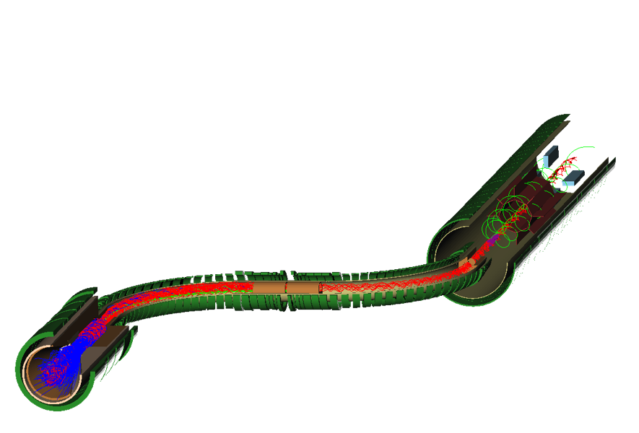
Detector and Solenoid
Tracking and Calorimeter
Decay into muons and transport to stopping target
Pictures from G4Beamline/MuonsInc
S-curve eliminates backgrounds and sign-selects
Production: Magnetic mirror reflects π’s into acceptance
R. Bernstein, FNAL AAC Seminar Jan 2009

Slide 14
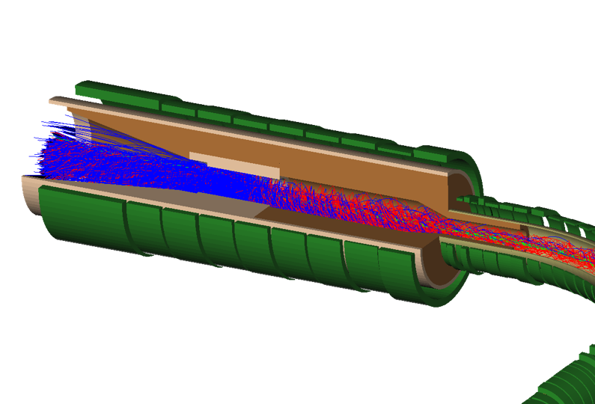
Production Solenoid:
Protons enter opposite to outgoing muons
Protons leave through thin window
π’s are captured, spiral around and decay
muons exit to right
Target Shielding
Proton Target
Pions
Protons enter here
4 m × 0.30 m
R. Bernstein, FNAL AAC Seminar Jan 2009

Slide 15
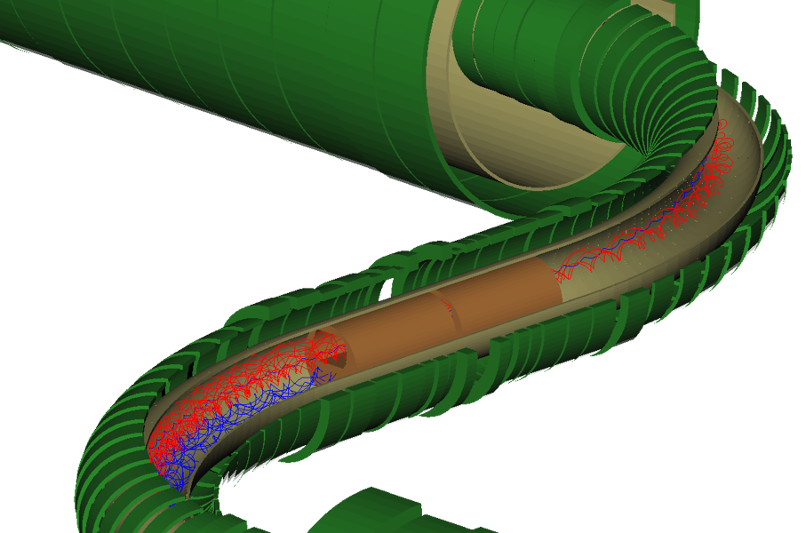
Transport Solenoid
Curved solenoid eliminates line-of-sight transport of photons and neutrons
Curvature drift and collimators sign and momentum select beam
occasional μ⁺
13.1 m along axis × ~0.25 m
R. Bernstein, FNAL AAC Seminar Jan 2009

Slide 16
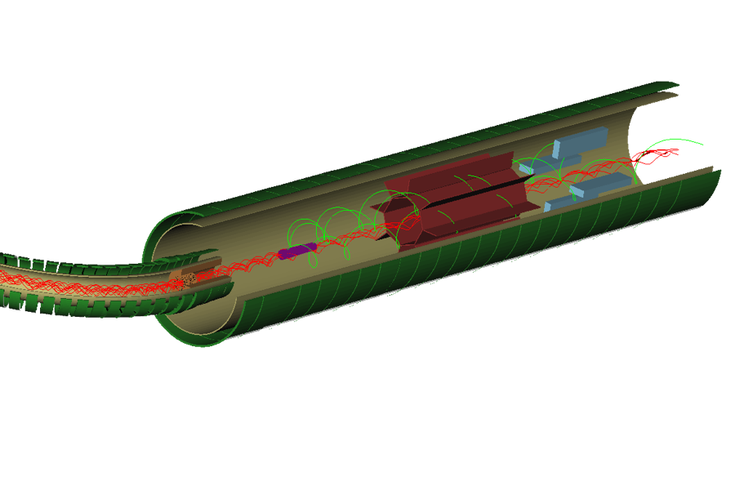
Detector Solenoid
octagonal tracker surrounding central region:
radius of helix proportional to momentum
low momentum particles and almost all DIO background passes down center
10 m × 0.95 m
Al foil stopping target
signal events pass through octagon of tracker
and produce hits
R. Bernstein, FNAL AAC Seminar Jan 2009
Notes:
so background goes down center and signal spirals out to tracker

Slide 17
Two Classes of Backgrounds
 | Prompt | Decay-In-Orbit
Source | Mostly π’s produced in target | Physics Background nearly indistinguishable from signal
Solution | Design of Muon Beam, formation, transport, and time structure | Spectrometer Design: resolution and pattern recognition
R. Bernstein, FNAL AAC Seminar Jan 2009

Slide 18

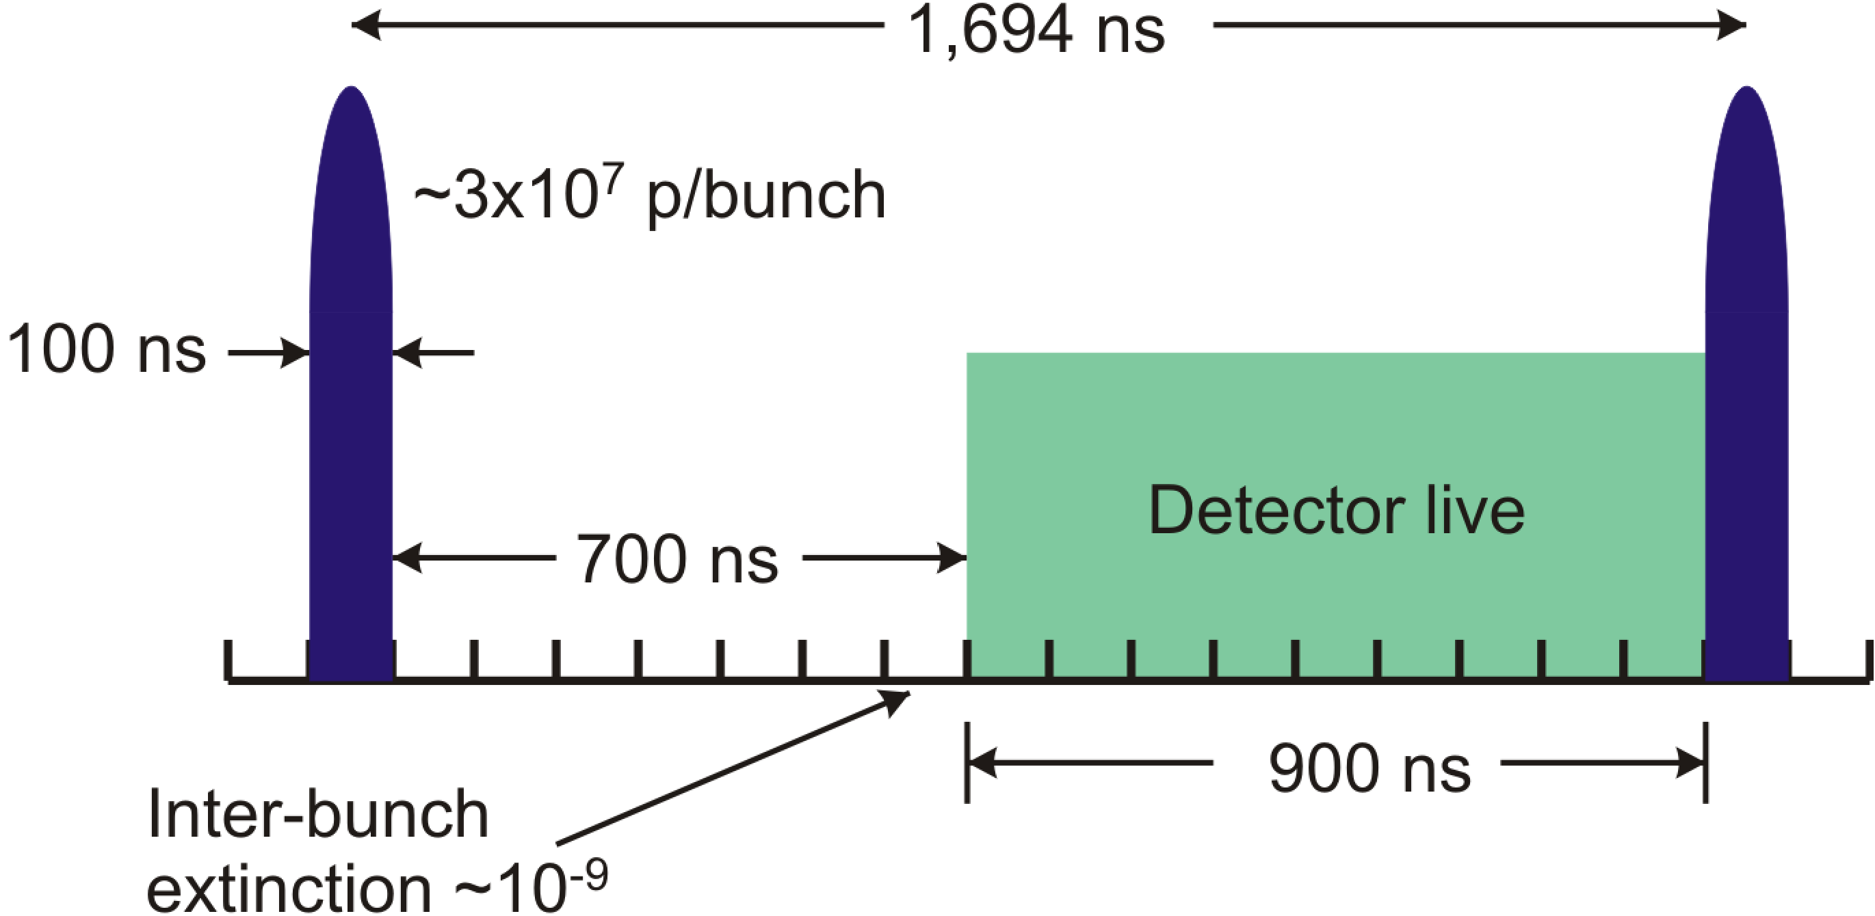
Pulsed Beam Structure
Tied to prompt rate and machine: FNAL near-perfect
Want pulse duration << , pulse separation ≥
FNAL Debuncher has circumference 1.7μsec !
Extinction between pulses < 10⁻⁹ needed
= # protons out of pulse/# protons in pulse
10⁻⁹ based on simulation of prompt backgrounds
R. Bernstein, FNAL AAC Seminar Jan 2009
18

Slide 19
Prompt Backgrounds
Particles produced by proton pulse which interact almost immediately when they enter the detector: π, neutrons, pbars
Radiative pion capture
π-+A(N,Z) →γ +X.
γ up to m_{π}, peak at 110 MeV; γ→ e+e- ;
if one electron ~ 100 MeV in the target, looks like signal: limitation in best existing experiment, SINDRUM II?
Why this wait?
R. Bernstein, FNAL AAC Seminar Jan 2009
Notes:
76 MeV from relativistic kinematics

Slide 20
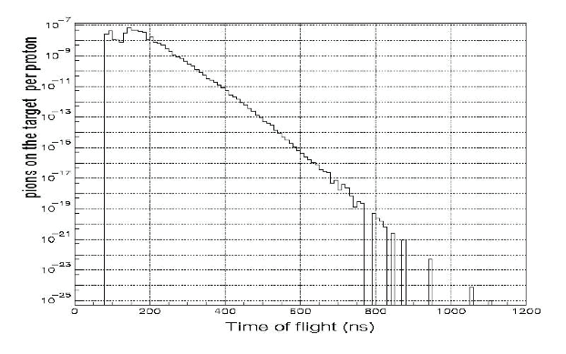
Radiative π vs. Time
π on target per proton
This is a main reason why we have to wait 700 nsec
would be really nice to eliminate pions another way!!
Gain 10¹¹ in π rejection by waiting 700 nsec
R. Bernstein, FNAL AAC Seminar Jan 2009

Slide 21
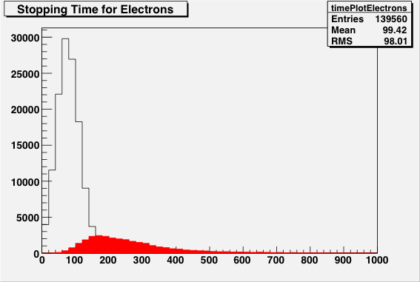
Beam Flash
Beam electrons: incident on the stopping target and scatter into the detector region.
Need to suppress e⁻ with E>100 MeV near 105 MeV signal
electrons
muons
R. Bernstein, FNAL AAC Seminar Jan 2009

Slide 22
Other Backgrounds
In-flight muon decays yielding electrons
If p_{μ} > 76 MeV/c, can get > 100 MeV electron
Late arriving electrons from spiraling in field
Momentum selection and a tighter timing distribution would help!
R. Bernstein, FNAL AAC Seminar Jan 2009

Slide 23
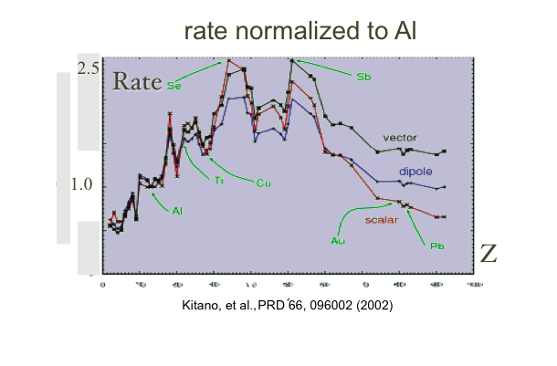
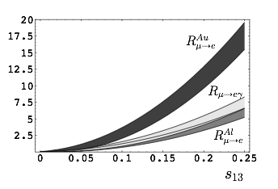
Choice of Stopping Material: rate vs wait
Stop muons in target (Z,A)
Physics sensitive to Z: with signal, can switch target to probe source of new physics
Why start with Al?
can see up to x4 effect!
s13 is NOvA mixing angle
< 0.2 or so
V. Cirigliano, B. Grinstein, G. Isidori, M. Wise Nucl.Phys.B728:121-134,2005. e-Print: hep-ph/0507001
R. Bernstein, FNAL AAC Seminar Jan 2009
23

Slide 24
Prompt Background and Choice of Z
choose Z based on tradeoff between rate and lifetime: longer lived reduces prompt backgrounds
Nucleus | Rμe(Z) / Rμe(Al) | Bound Lifetime | Conversion Energy | Fraction >700 ns
Al(13,27) | 1.0 | 864 nsec | 104.96 MeV | 0.45
Ti(22,~48) | 1.7 | 328 nsec | 104.18 MeV | 0.16
Au(79,~197) | ~0.8-1.5 | 72.6 nsec | 95.56 MeV | negligible
Too short!
R. Bernstein, FNAL AAC Seminar Jan 2009
24

Slide 25
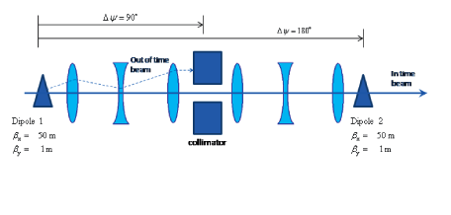
Extinction Scheme
Eliminate protons in beam in-between pulses:
“Switch” dipole timing to switch signal and background: accept only out-of-time protons for direct measurement of extinction
Continuous Extinction monitoring techniques under study
Cerenkov light with gated PMT for beam flash
achieving 10⁻⁹ is hard; normally get 10⁻² – 10⁻³
CDR under development
R. Bernstein, FNAL AAC Seminar Jan 2009
25

Slide 26
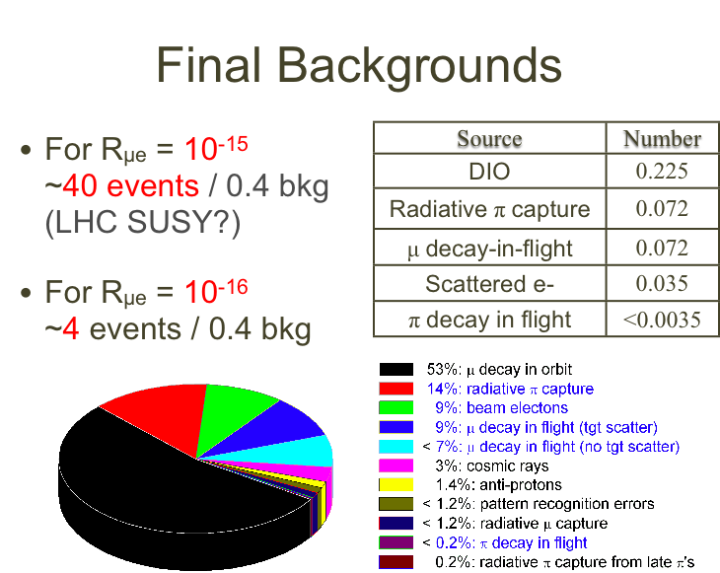
R. Bernstein, FNAL AAC Seminar Jan 2009

Slide 27
Outline
The search for muon-electron conversion
Experimental Technique
Fermilab Accelerator
Project X Upgrades and Mu2e
Conclusions
R. Bernstein, FNAL AAC Seminar Jan 2009
27

Slide 28
Project X Timing
Must run and analyze Mu2e Phase I
We will continue to refine our existing design and look for new ideas
solenoid? tracking? time structure?
Finish analysis Phase I around 2020 then
Project X makes a program possible, improving as we learn
R. Bernstein, FNAL AAC Seminar Jan 2009
28
Notes:
in principle, we could run at project x without significant upgrades -- run longer, and can take instantaneous rates x4 higher. So that would get about an order of magnitude right away. Getting additional x10 is hard and requires redesign.

Slide 29
Mu2e Upgrades
Signal?
Yes
No
1. Change Z of Target
to determine source of new physics
2. Need Project X to provide statistics
1. Probe additional two orders of magnitude made possible by Project X
2. Need upgrades to muon transport and detector
R. Bernstein, FNAL AAC Seminar Jan 2009
29

Slide 30
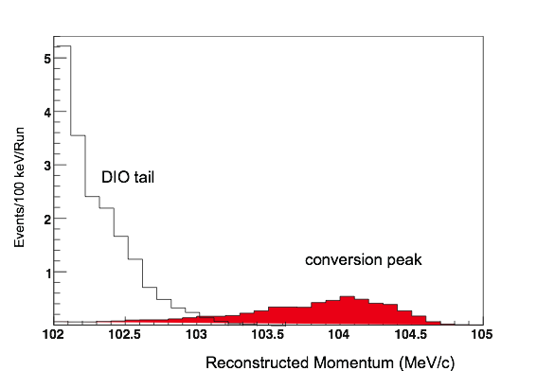

Upgrade Plans...
Signal?
No
Yes
1. Change Z of Target
to determine source of new physics
2. Prompt Rates will go up at higher Z, have to redesign detector and muon transport
1. Both Prompt and DIO backgrounds must drop to measure
R_{μe} ~ 10⁻¹⁸
2. Detector, Muon Transport, Cosmic Ray Veto, Calorimeter
R. Bernstein, FNAL AAC Seminar Jan 2009
30

Slide 31
Upgrade Challenges
If we want higher Z targets, must shorten the 700 nsec wait time, perhaps 700 → 70 nsec
Beam flash
Radiative pi capture
But without a signal, also need to improve resolution from decay-in-orbit background
Just the beam improvements are not enough: would only reduce radiative pi background x2
Resolution of spectrometer and pattern recognition algorithms; new hardware?
Extinction: need ~x100 better
R. Bernstein, FNAL AAC Seminar Jan 2009

Slide 32
Conclusions (physics)
Mu2e will:
Reduce the limit for Rμe by more than four orders of magnitude (Rμe <6x10⁻¹⁷ @ 90% C.L.)
Discover unambiguous proof of Beyond Standard Model physics or provide important information either complementing the LHC or probing up to 10⁴ GeV mass scales
Technically limited schedule: data-taking 2016:
We plan to use existing scheme, not major variations for beam delivery
R. Bernstein, FNAL AAC Seminar Jan 2009
32

Slide 33
Conclusions (upgrade)
Resolution and background issues are critical
Project X will get at least x10 in statistics,
With a signal
Explore different targets
Reduce radiative pion background
Decrease time spread of muons
And with a limit, the beam related sources are only ½ of background – resolution/misreconstructions becomes the limiting problem
R. Bernstein, FNAL AAC Seminar Jan 2009
33

