Slide 1
What’s the matter at RHIC ?
For the CTP symposium, Cairo, 11-14 March 2007
Raphaël Granier de Cassagnac
Laboratoire Leprince-Ringuet
PHENIX experiment

Slide 2
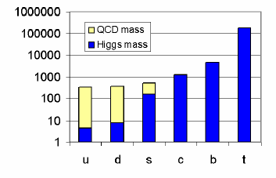
☺ The origin of (my) mass…
~ 98% from QCD + 02% from Higgs !
~ 98% poorly understood + 02% not yet seen…
We are mostly made of confinement…
Thus, let’s look at deconfinement…
(ok, this is only ~5% of the universe ☹)

Slide 3
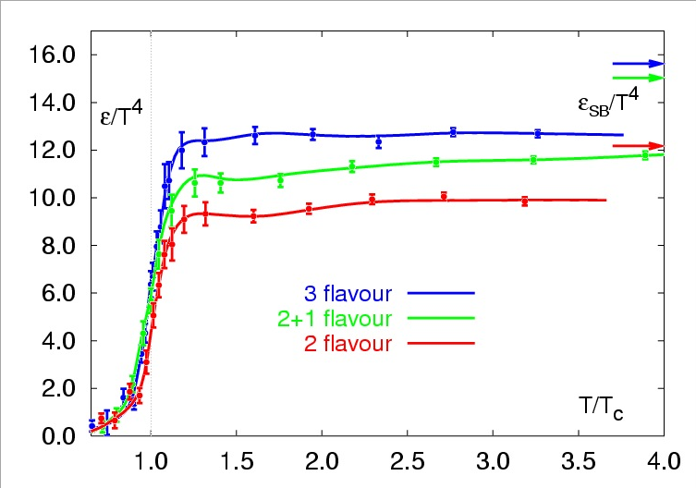
What tells QCD? (on the LATTice)
Strong interaction is weak at high energies
Asymptotic freedom
Lattice QCD predicts a phase transition from a Hadron Gas to a Quark Gluon Plasma (QGP)
T_{c} ~ 190 MeV (2x10¹² K)
ε_{c} ~ 1 GeV/fm³
Energy density / T ⁴
Karsch et al, hep-lat/0106019
Lect. Notes Phys.583 (2002) 209
Doesn’t tell us much about the matter’s properties
(equation of state, order of phase transition…)

Slide 4
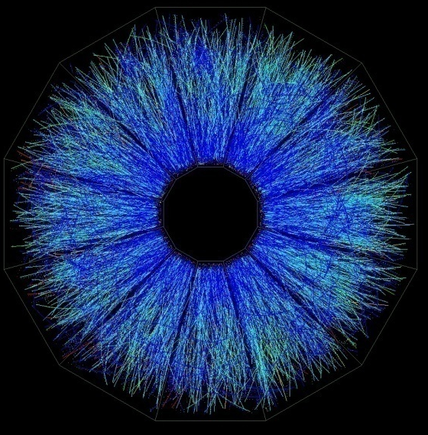
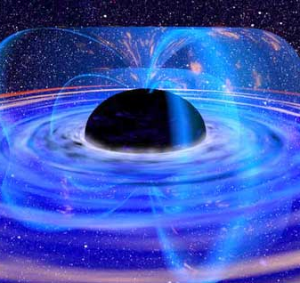
a link to our main topic?
Juan Maldacena,
ATMP 38 (1999) 1113
(>4500 citations)
Anti de Sitter/Conformal Field Theory correspondence
Strongly coupled N=4 super Yang Mills theory
Super QCD
Super QGP
Weakly coupled type IIB string theory on AdS₅xS⁵
Dual gravity
Black hole
Can predict
some properties
(viscosity/entropy,
quenching …)

Slide 5
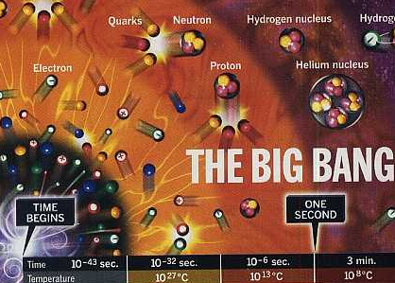
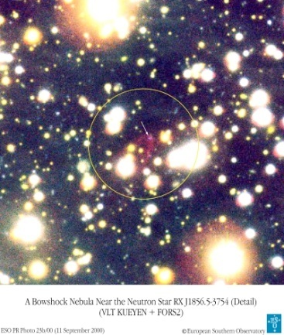
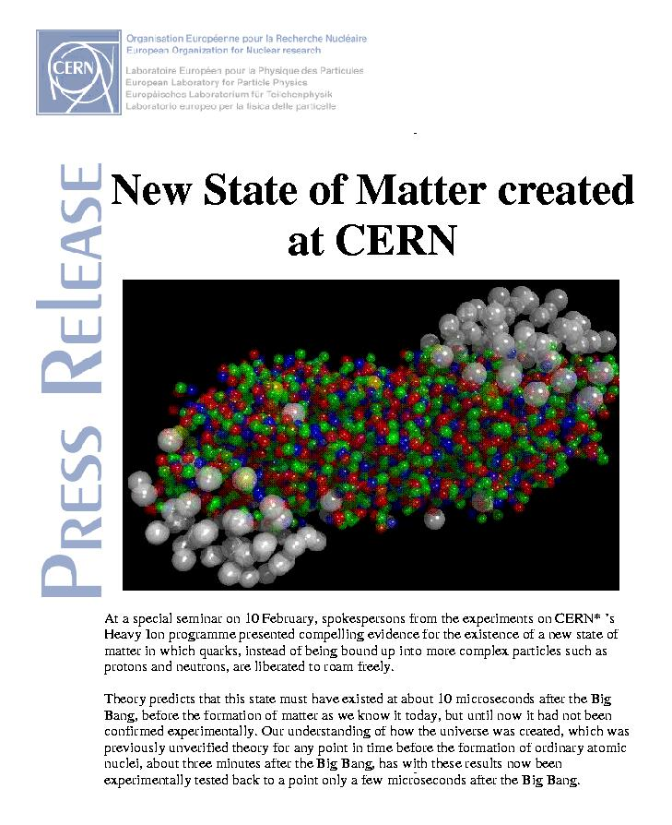
Where/when can we find the QGP?
Early in the universe (t < 10μs)
But very little chance to leave relics
Cold dark matter clumps ?
Inhomogeneous nucleosynthesis ?
Baryonic CDM (strange nuggets) ?
Core of a compact star
No smoking gun candidate so far
In the lab, by colliding heavy ions
Freedom for the quarks…
… for some 10^{–23} s

Slide 6
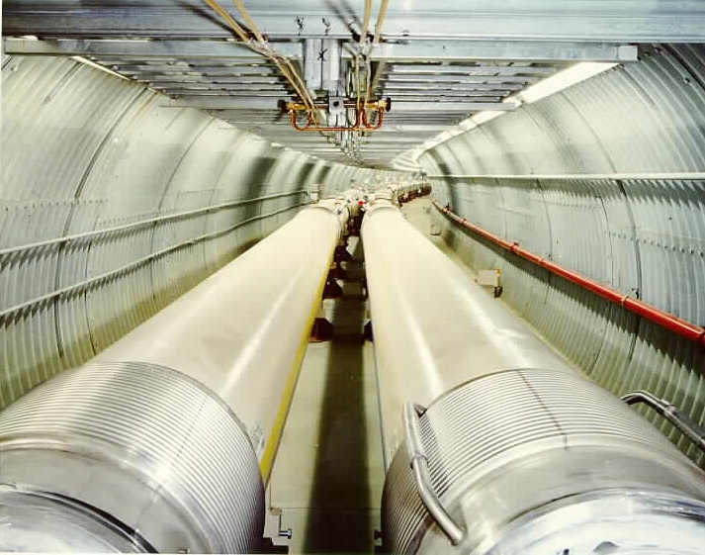

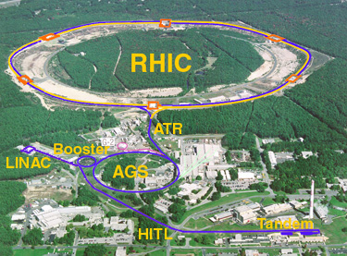
WHAT’s RHIC?
Relativistic Heavy Ion Collider
@ Brookhaven National Lab.
First collisions in 2000, running
2 large (STAR & PHENIX)
+ 2 small (PHOBOS & BRAHMS) experiments
Can collide anything from p+p (up to 500GeV)
to Au+Au (up to 200GeV per nucleon pairs)
PHOBOS
BRAHMS
PHENIX
STAR

Slide 7
What is the strategy?
Predict a QGP signature
Look at it versus A+A collision centrality →
Compare to p+p
Hard probes should behave R_{AA} = 1
Compare to p+A (or d+A)
Check that normal nuclear matter cannot account for deviations…
Non zero impact parameter
Number of spectators
Number of participants N_{part}
Number of NN collisions N_{coll}
d²N^{AuAu}/dydp_{T}
R_{AA} =
d²N^{PP}/dydp_{T}
x
<N_{coll}>
z
y
x
Derive a QGP property
(temperature, density…)

Slide 8
Which signatures?
Total multiplicity
High p_{T} suppression
Back to back jets
Elliptic flow
Baryon/meson
Heavy flavor
~ “Color Glass Condensate”
~ “Perfect fluid”
J/ψ suppression
Thermal radiation
~ “Jet quenching”
But they are not the only ones!
“There was a general feeling that if the quark-gluon plasma was indeed produced, it would manifest itself in a variety of unknown but dramatic ways, including… the end of the world”
H. Satz @ Lattice 2000 hep-ph/0009099

Slide 9
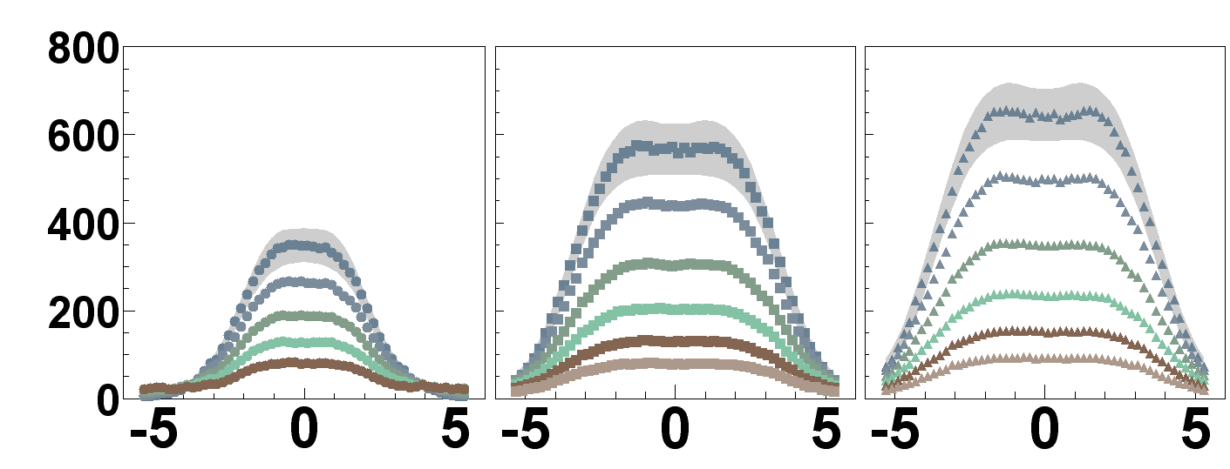


1. Total multiplicity (and E_{T})
dN_{ch}/dη|_{η=0} ~ 670
(6000 particles total)
Less than expected!
1000 from p+p fragmentation
Low x_{Bj} gluon start to overlap, recombine, saturate…
(even more at forward rapidity)
“Color Glass Condensate”
C
E
N
T
R
A
L
I
T
Y
dN_{ch}/dη
PRL 91 (2003) 052303
η
dE_{T}/dη|_{η=0} related to energy density
ε > 6 GeV/fm³ > ε_{c} !
The (initial) matter saturates
@ LHC, even worse ! x_{Bj} < 10^{–3}
dN_{ch}/dη|_{η=0} ~ 1600 – 2100

Slide 10


2. High p_{t} suppression
RHIC smoking gun signature !
Two PRL covers
Energy loss in the matter, looking at high p_{T} (>2GeV)
Mostly from jet fragmentation
“Jet quenching”
p-p
hadrons
leading
particle
q
q
hadrons
leading particle
hadrons
leading
particle
A-A
q
q
hadrons
leading particle
10

Slide 11
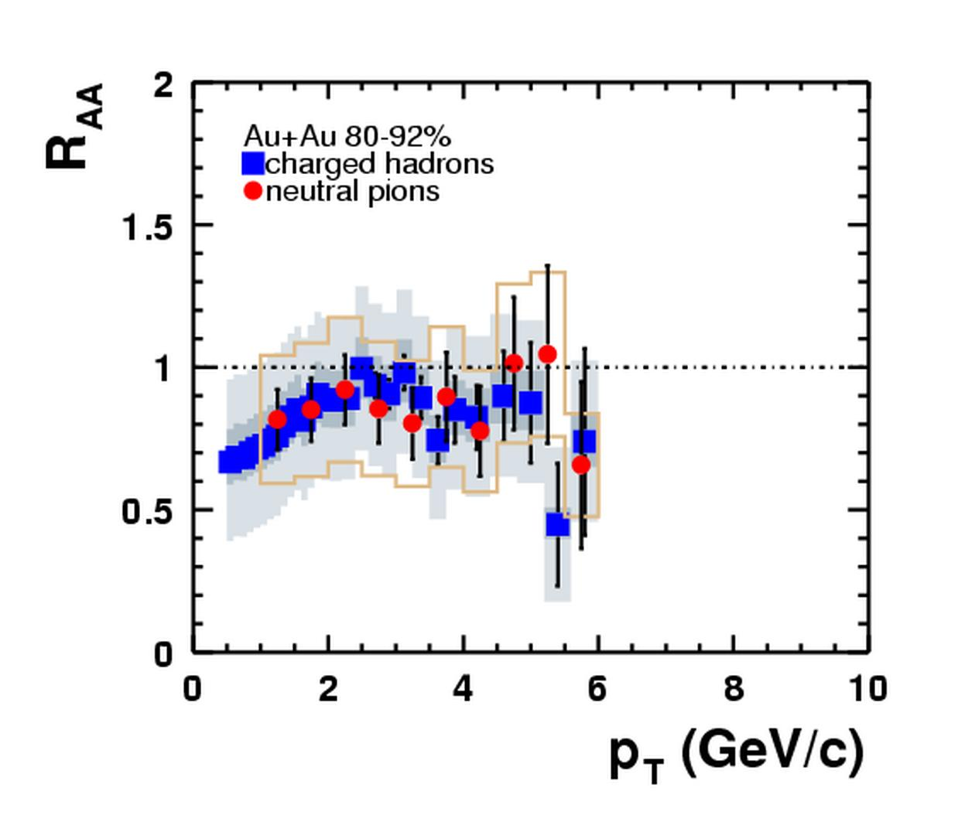
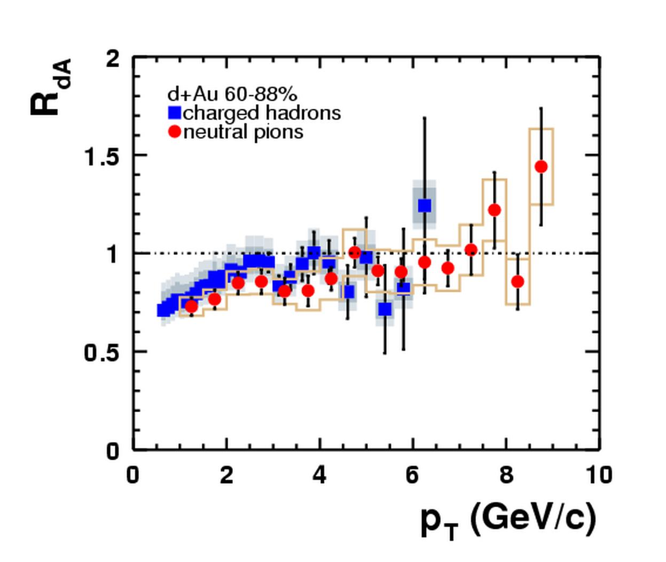
Most peripheral collisions…
Au-Au (80-92%)
d+Au (60-88%)
(slightly old, but pedagogical, data)
PHENIX, PRL 91 (2003) 072303

Slide 12
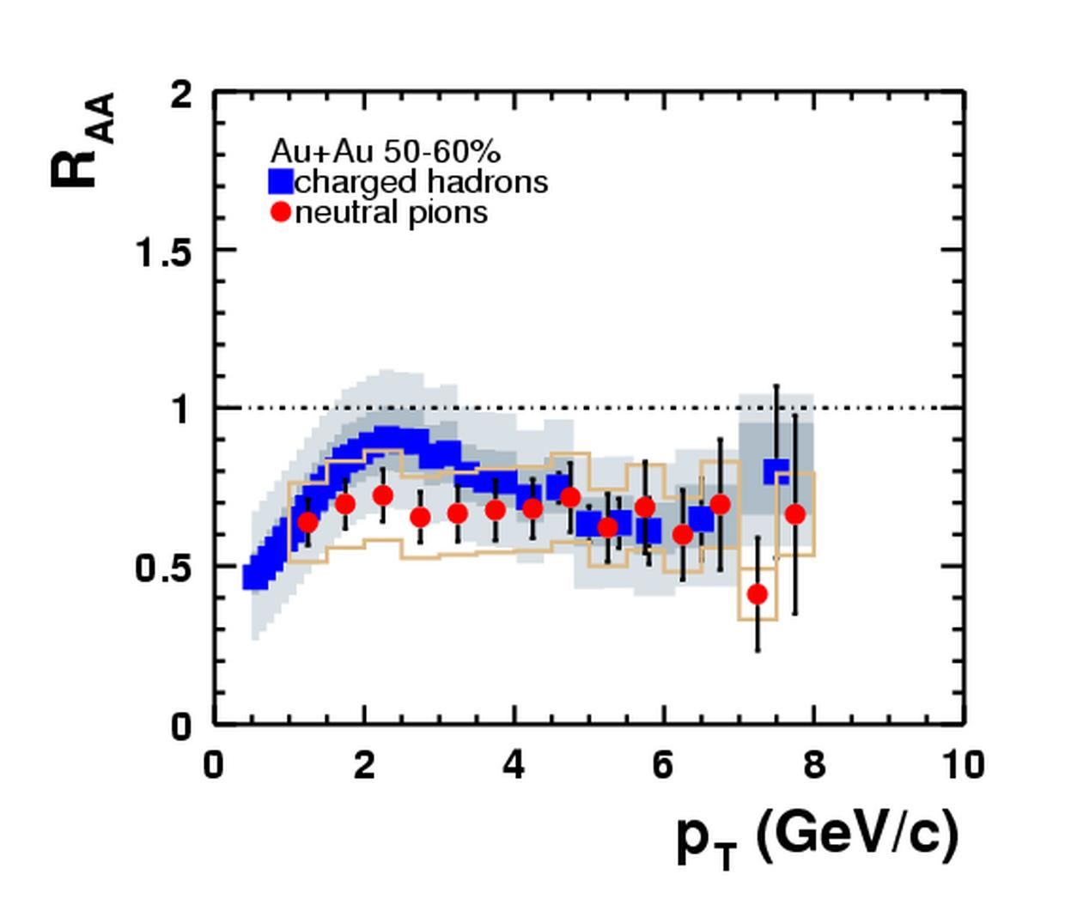
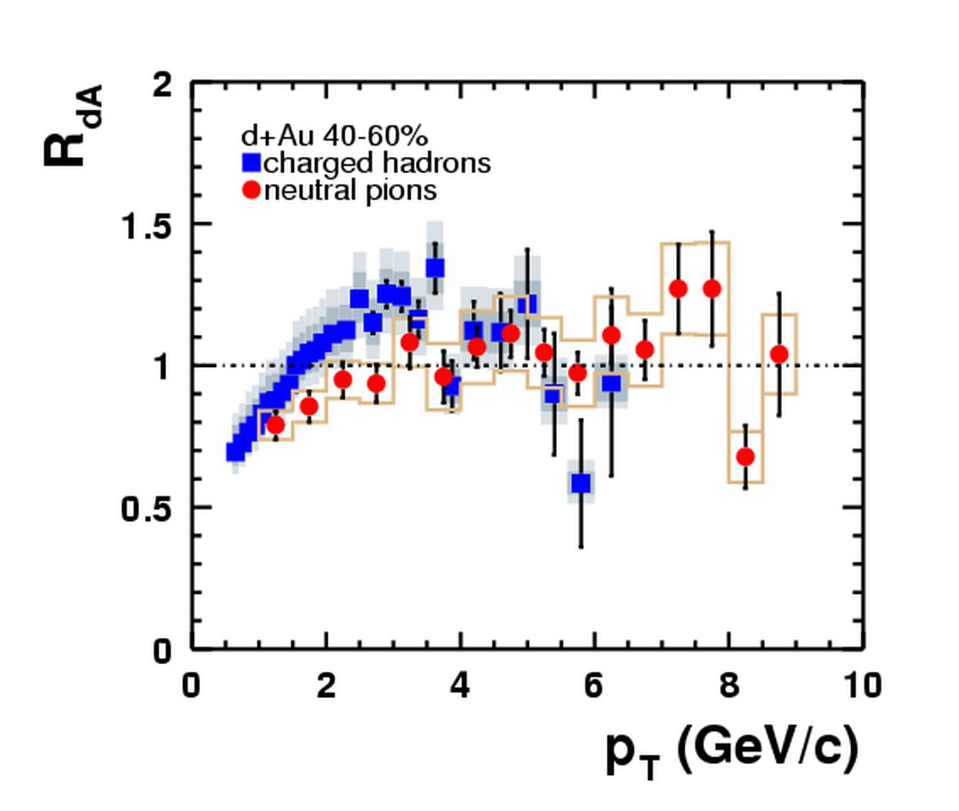
LEss peripheral collisions…
Au-Au (50-60%)
d+Au (40-60%)
(slightly old, but pedagogical, data)
PHENIX, PRL 91 (2003) 072303

Slide 13
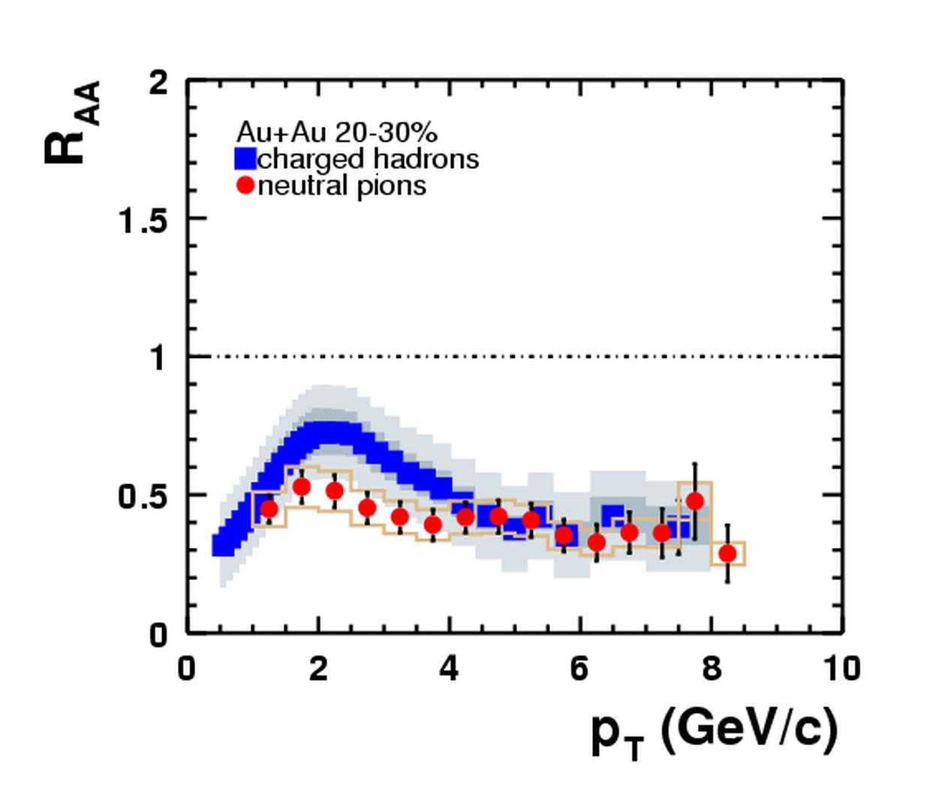
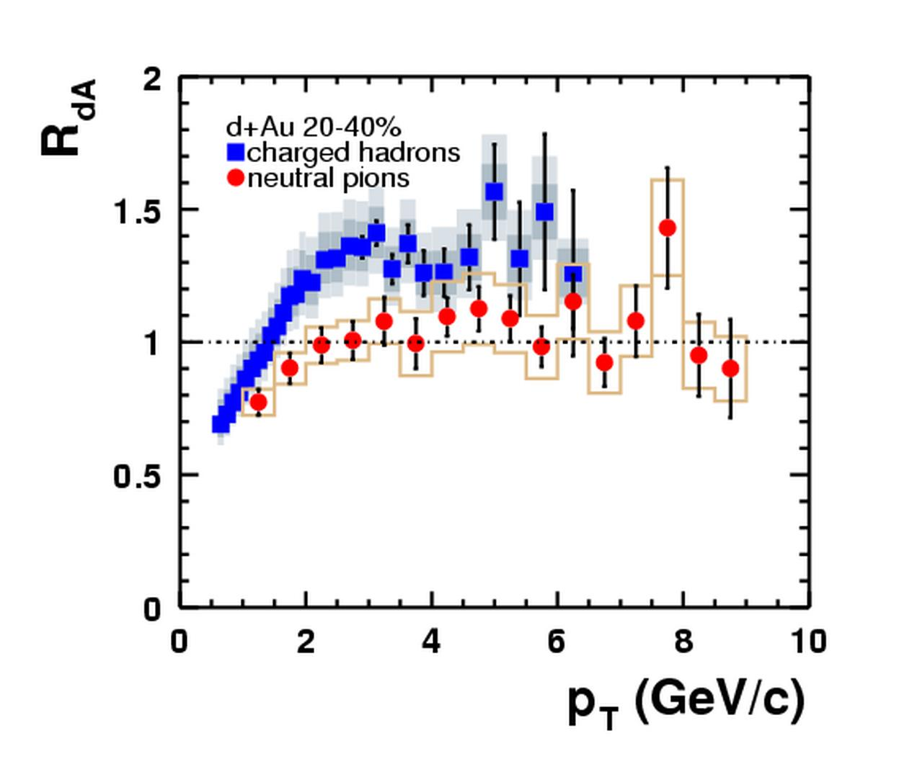
MoRE CeNTRAL collisions…
Au-Au (20-30%)
d+Au (20-40%)
(slightly old, but pedagogical, data)
PHENIX, PRL 91 (2003) 072303

Slide 14
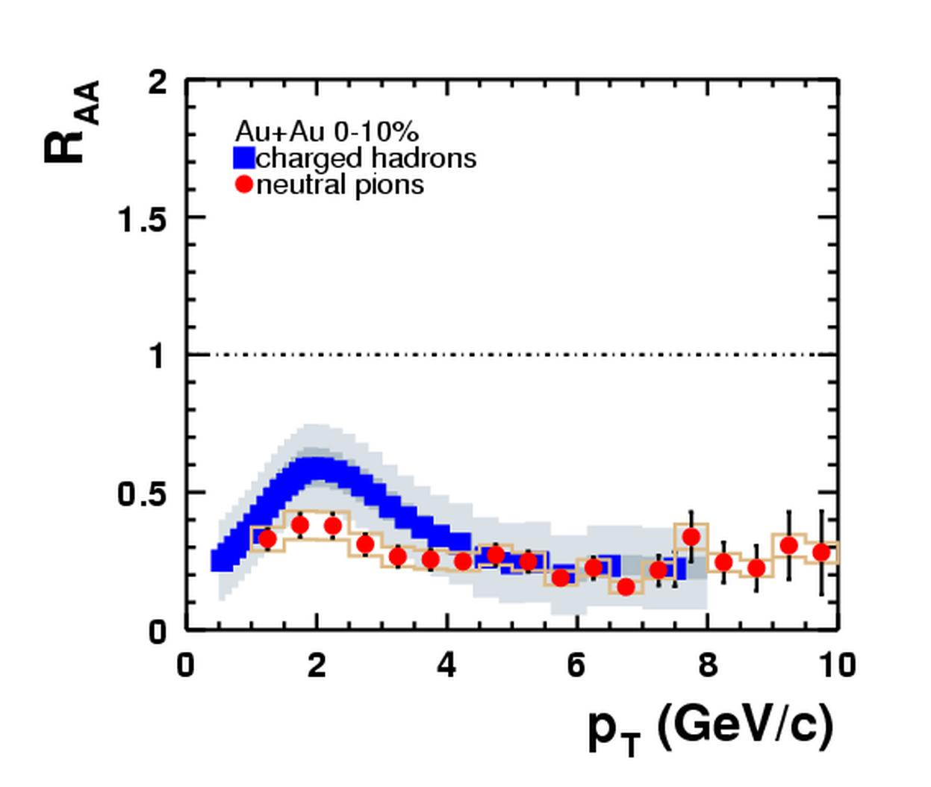
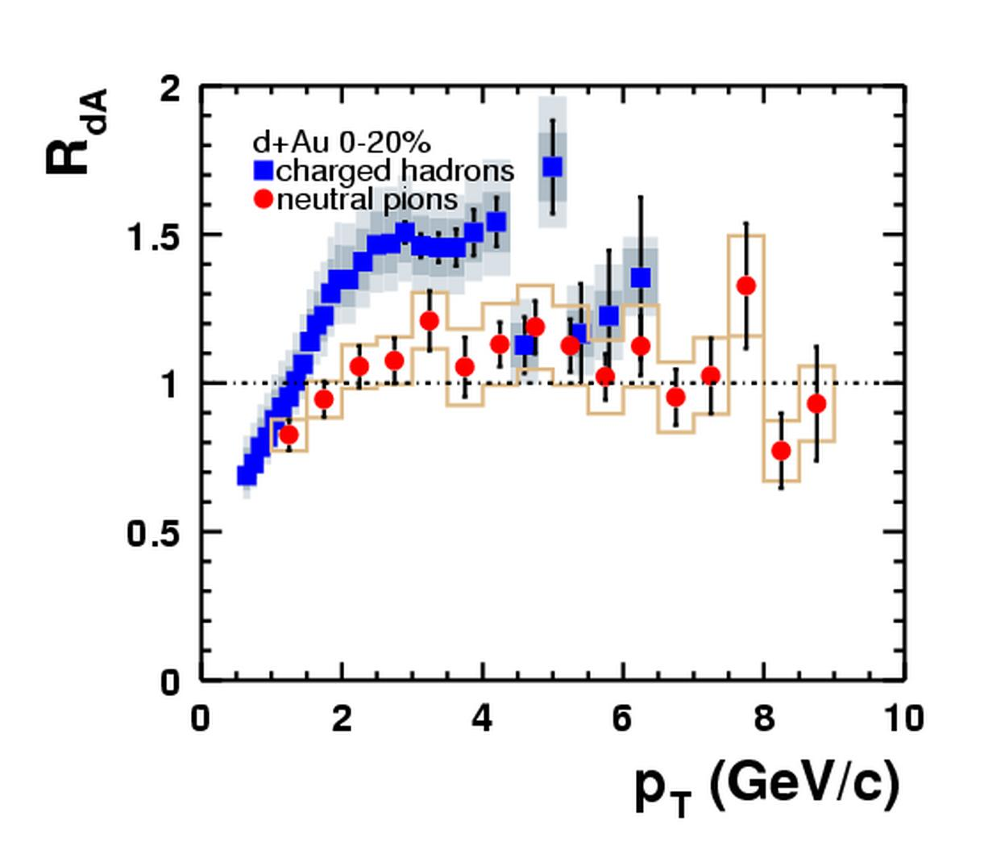
Most CENTRAL collisions!
Au-Au (0-10%)
d+Au (0-20%)
Suppression
by a factor 5 !
« Cronin effect »
Multiple scattering
of initial partons
(slightly old, but pedagogical, data)
PHENIX, PRL 91 (2003) 072303

Slide 15
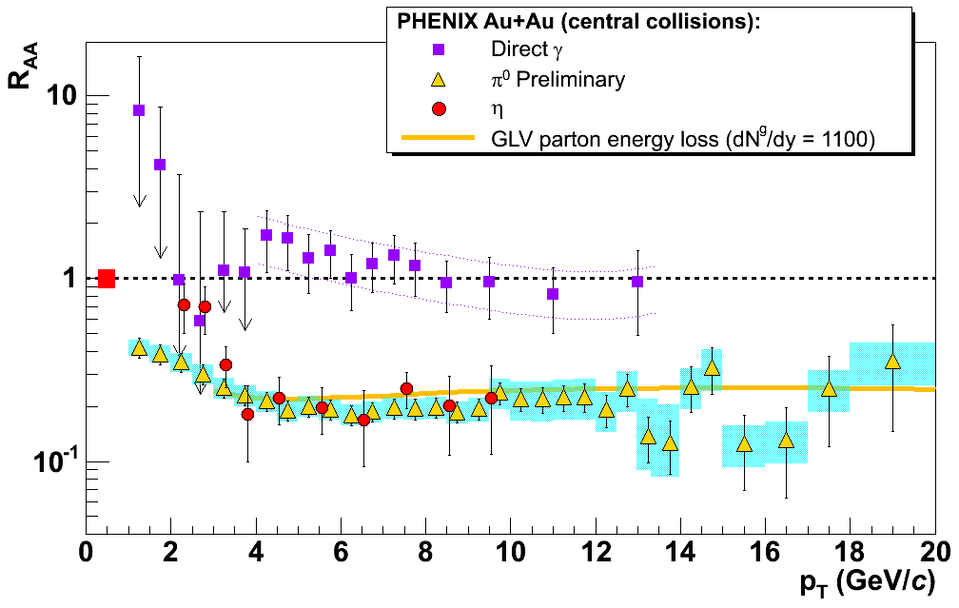
2. High p_{T} suppression
Photon: PRL94 (2005) 232301
Eta: PRC 75 (2007) 024909
Vitev & Gyulassy PRL82 (2002) 252301
Blind photons!
p_{T} (GeV)
→ The matter is dense ! >1000 gluons per Δy
@ LHC, gamma-jet studies will tell us more…
Notes:
(we’ll speak again about these ones)

Slide 16

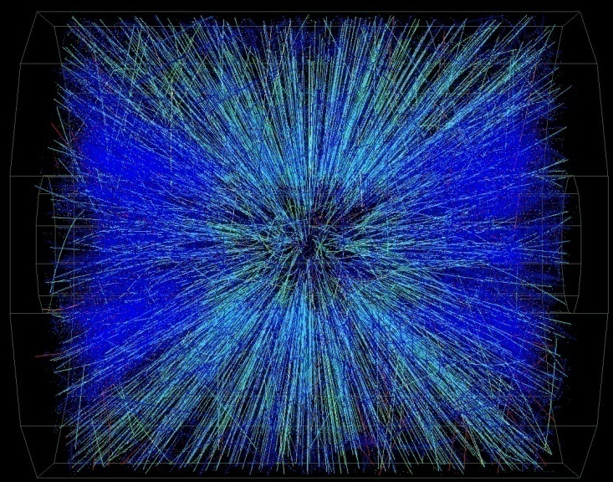
3. Back to back jets
Easy in 200 GeV proton+proton collisions
?
Quite difficult in Au+Au central collisions @ 200 GeV

Slide 17
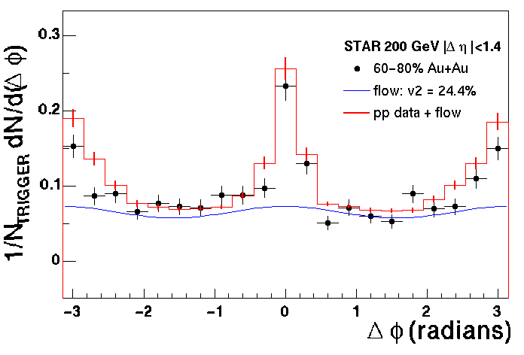
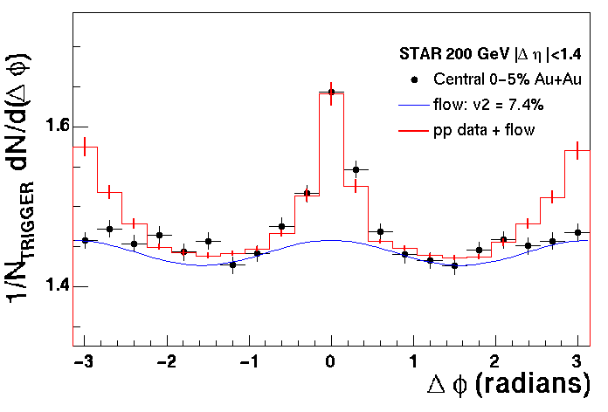
3. Back to back jets Another look to jet quenching…
Peripheral collisions (60-80%)
Central collisions (0-5%)
Same jet
Opposite jet
Take a “trigger” particle (p_{T}>4GeV) and look at the others (p_{T}>2GeV) azimuth
In central collision, opposite jets disappear because of jet quenching

Slide 18
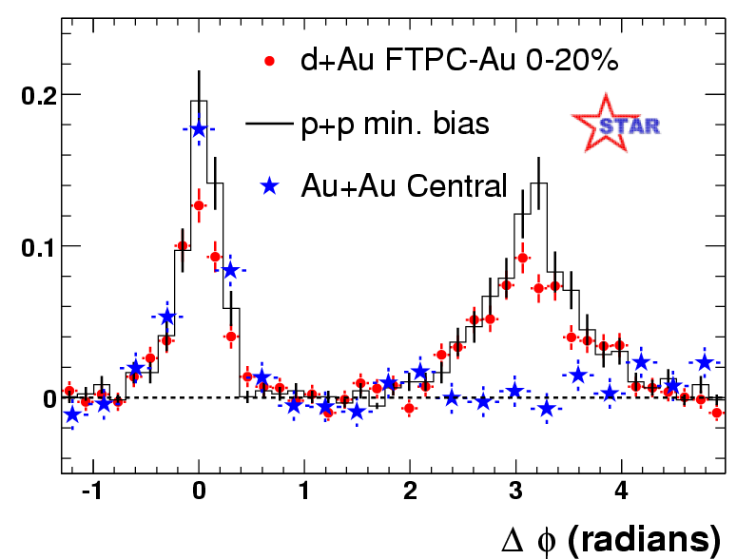
3. Back to back (d+Au)
STAR, PRL 91 (2003) 072304
As always, it is very important to check for d+Au
→ The matter is opaque!
@ LHC, full jet reconstruction…

Slide 19
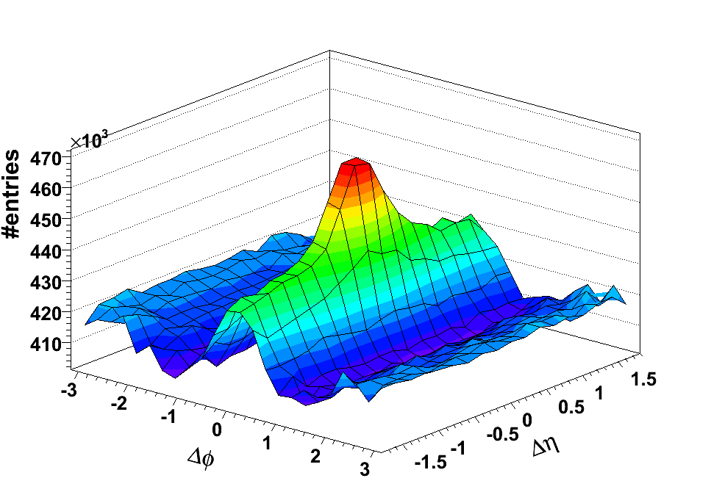
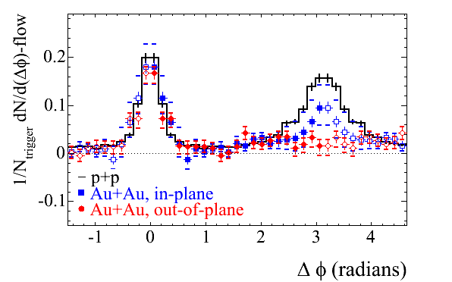
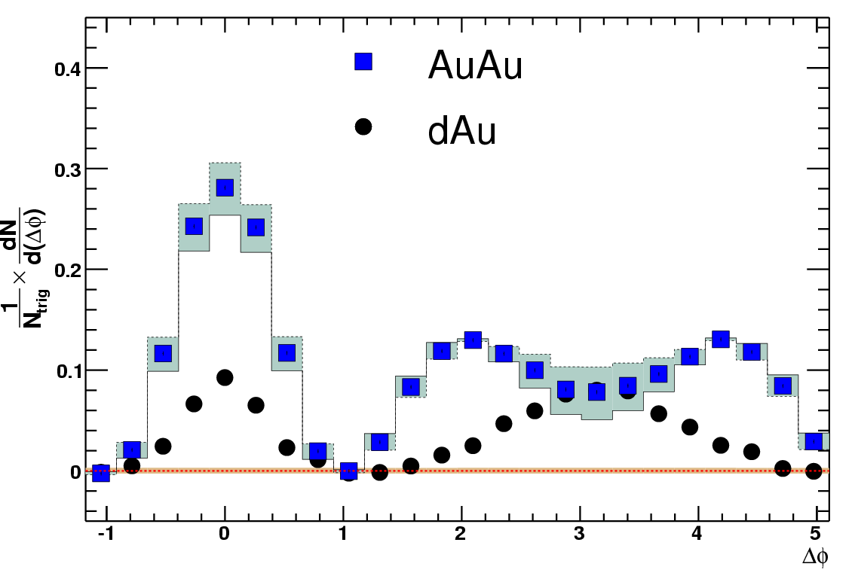
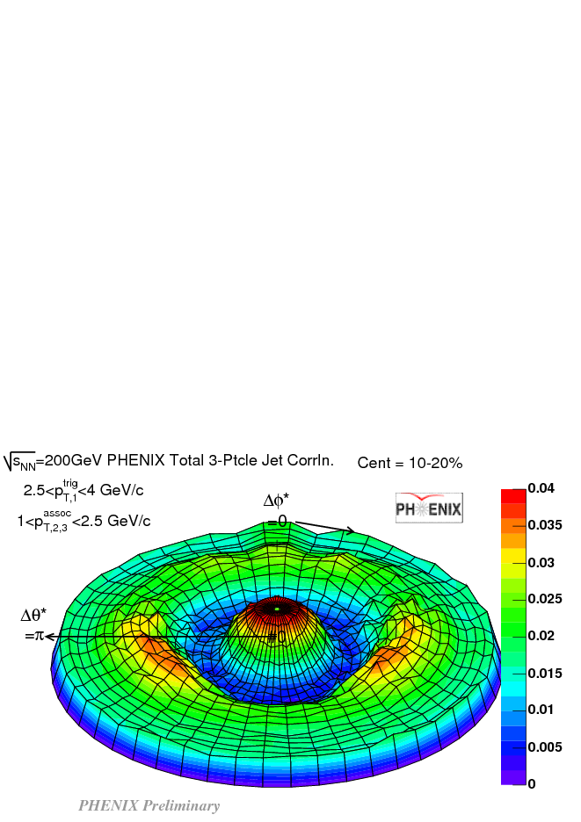
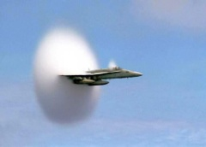
3. BACK TO BACK… and more
STAR, PRL93 (2004) 252301
The ridge…
In or out ?
Putschke, QM06
Mach cone ?
Zhang, QM06
Horner, QM06
Speed of
sound ~0.45 ?
3 particle correlation
Notes:
20 minutes here !
Conical : Horner QM06
Ridge : Putschke QM06
Three particle : Zhang QM06

Slide 20
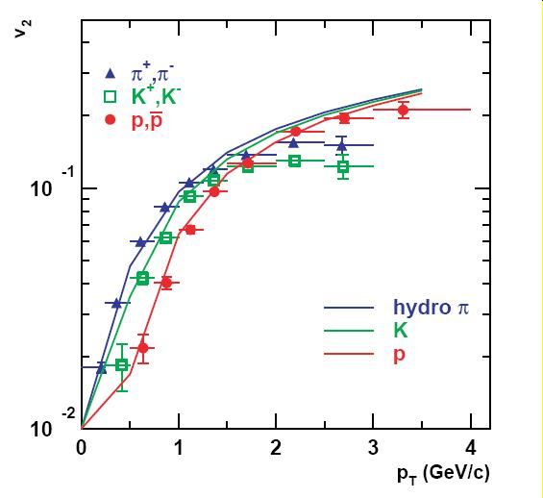
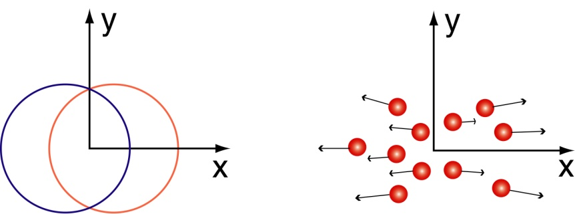
4. Elliptic flow “V₂”
PHENIX, PRL 91 (2003) 182301
Huovinen & al, PLB 503 (2001) 58
reaction plane
z
y
x
Pressure gradient
v₂ = <cos 2φ>
φ
Strong collective behavior
Notes:
(plot shinichi)

Slide 21
4. IDEAL HYDRODYNAMICS
Ideal hydrodynamics…
QGP EoS,
Early thermalization
(0.6 fm/c)
High density
(~30 GeV/fm³)
Little need for viscosity!
(first estimations approach the AdS/CFT estimates η/s = /4π)
… reproduces fairly well
Single hadron p_{T} spectra
(mass dependence)
<β_{T}> ~ 0.6
Elliptic flow
Not the foreseen ideal partonic gas!
→ “sQGP” (s stands for strong, not super ☺)
→ “Perfect fluid”
→ The matter is strongly interacting and liquid like
@LHC, could it approach a quark gluon gas ?

Slide 22
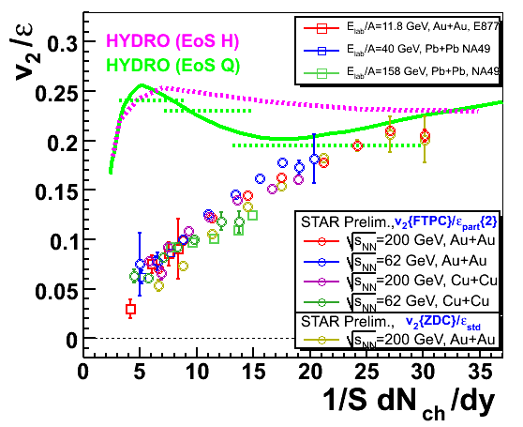
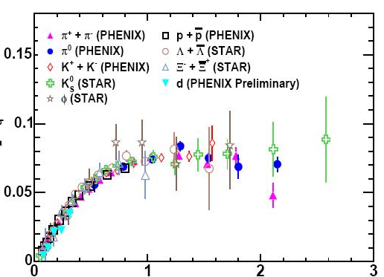
4. Elliptic flow (SCALINGS)
With eccentricity vs N_{ch} density
ε = <y² – x²> / <y² + x²>
With the kinetic energy
per constituent quarks
V₂/n_{q}
KE_{T}/n_{q}
Voloshin & Pokskanzer, PLB 474 (2000) 27
PHENIX, nucl-ex/0608033

Slide 23
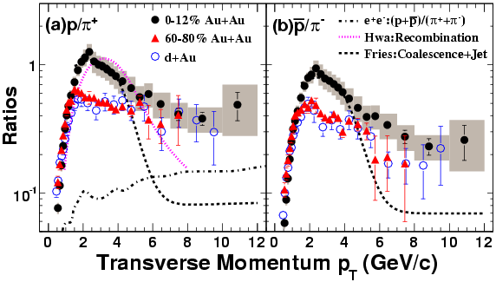
5. Baryons/Mesons
STAR, PRL 97 (152301) 2006
Baryon favored
Not fragmentation!
Coalescence or recombination
→ The matter is partonic
@LHC, even more thermalized
Notes:
David a des modèles en plus la-dessus…

Slide 24
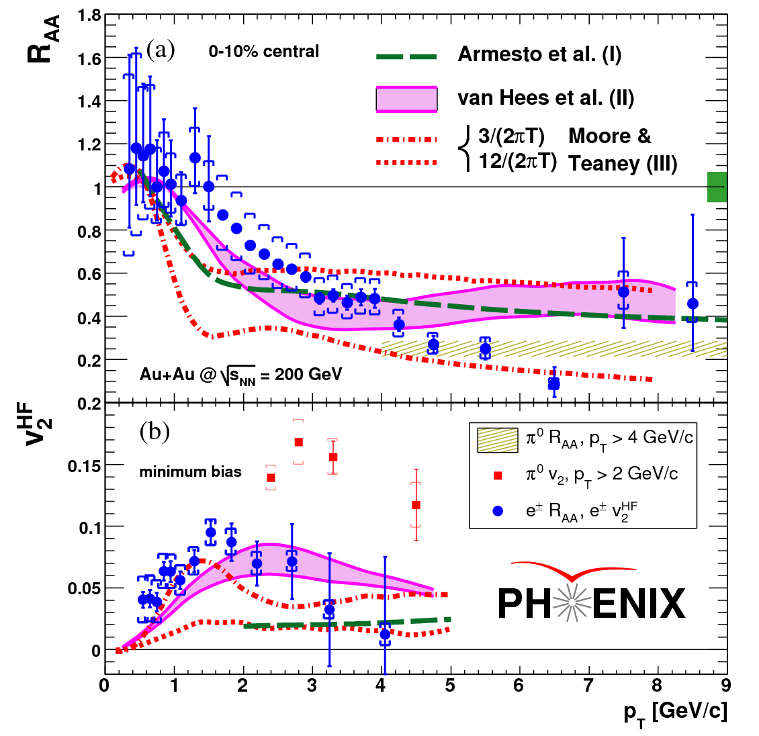
6. Heavy quarks ?
PHENIX, nucl-ex/0611018
D,B → e + …
Electrons from heavy flavor's decay suffer (large) quenching and flow! Was a surprise!
Thermalization?
What makes the charm quench ?
Gluon density is to low!
Beauty contribution?
Elastic energy loss?
Not well understood yet
→ The matter is tough…
Notes:
Ralf -> Kajihara, Sakai

Slide 25
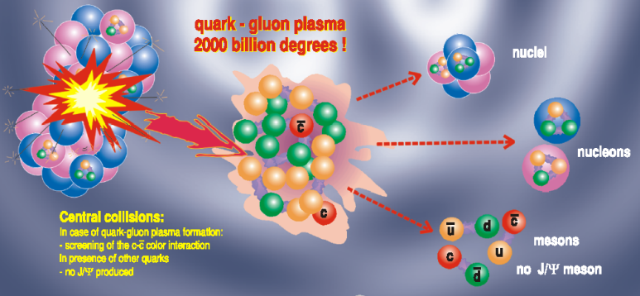
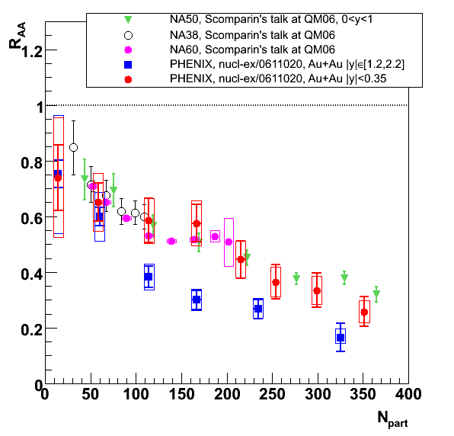
7. J/ψ suppression
J/ψ (cc) can melt in QGP
Golden signature @ SPS (@ CERN √s ~ 20 GeV)
→ QGP discovery claim
@RHIC, same rapidity, suppression look surprisingly similar
While density is higher
Stronger @ forward
While density is lower
But beware of cold matter!
PHENIX, nucl-ex/06110120

Slide 26
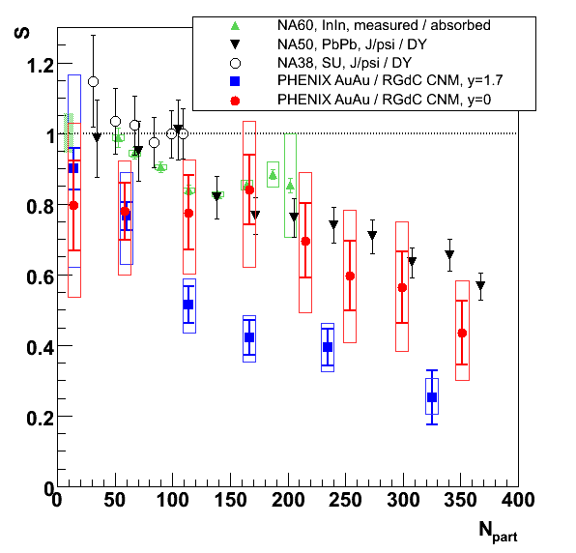
7. J/ψ suppression
RGdC, hep-ph/0701022
Cold nuclear matter effects extrapolated from d+Au collisions
Still, more suppression at forward than mid rapidity…
Could be a sign of recombination ?
However J/ψ do melt !
44±
23%
±11% global systematics
±35% global systematics
±30% global systematics
25±12%
→ The matter is deconfining
@ LHC recombination R_{AA} >1?
@ LHC Upsilon studies !

Slide 27
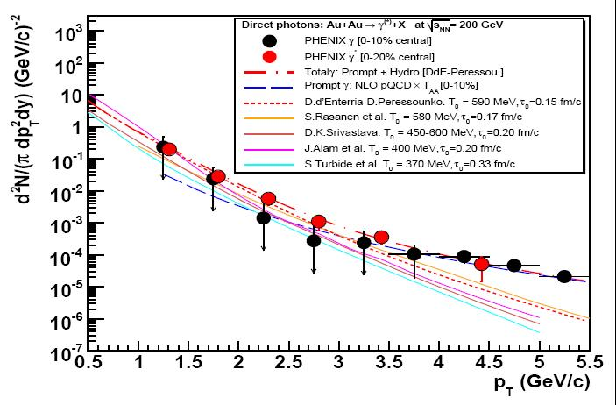
8. THERMAL RADIATION (photonS)
The matter is hot !
@LHC, T ~ 1 GeV ?
PHENIX, PRL94 (2005) 232301
Virtual photon are preliminary
+ various theory papers
Photon spectrum is fairly reproduced by:
@ high p_{T} prompt photon (pQCD)
@ low p_{T} thermal photons (T~400 – 600 MeV >> T_{c})

Slide 28
In summary…
Even if we have
Neither seen an order parameter of the phase transition
Nor counted its degrees of freedom
The matter is:
Gluon saturated, dense and opaque, strongly interacting and liquid-like, partonic and deconfining, tough and hot…
… thus likely to be a quark-gluon plasma
Bibliography :
Quark matter 2006 conference (Shanghai)
Experimental “white papers” :
Interesting reviews showing up, for instance:
http://www.sinap.ac.cn/qm2006/
NPA757 (2005), PHENIX : nucl-ex/0410003
D d’Enterria, nucl-ex/0611012

Slide 29
Back up slides…

Slide 30
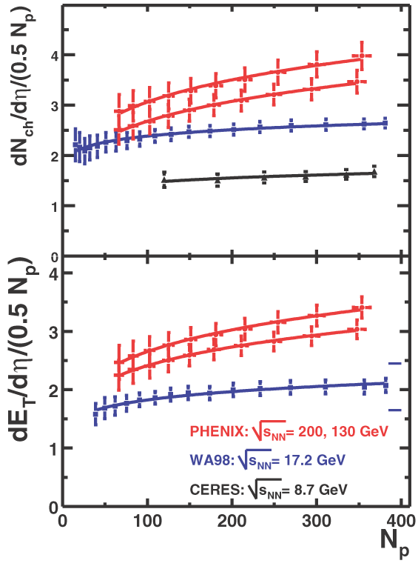
Energy density estimation
~ Transverse energy @ y=0
Bjorken formula
τ₀ formation time 0,35 à 1 fm/c
R = nuclear radius 1.18 A^{1/3} fm
1
dE_{T}
ε=
x
πR²τ₀
dy
y=0
ε > 6 GeV/fm³
Bjorken, PRD27 (1983) 140
Participants number

Slide 31
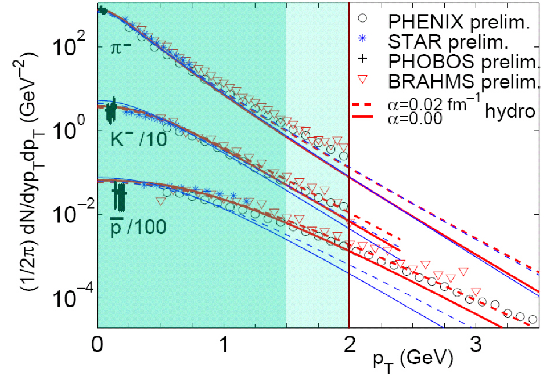
Hydro fit of spectra
P. Kolb and R. Rapp,
PRC 67 044903 (2003)

Slide 32
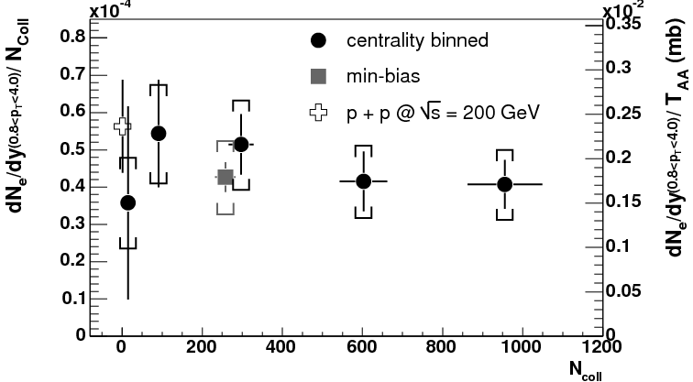
OPEN CHARM
10 to 20 cc pairs
N_{coll} scaling
25% systematics
(need for a vertex detector)
PHENIX, PRL 94 (2005) 082301

Slide 33
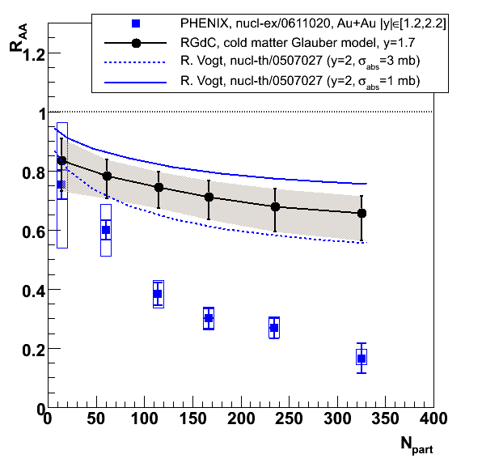
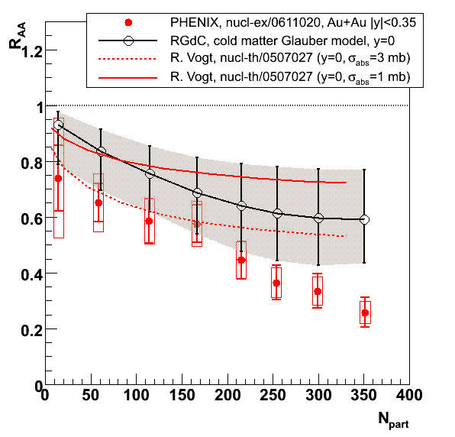
J/ψ and cold nuclear matter
y~1.7
y~0
R. Vogt, nucl-th/0507027
RGdC, Quark Matter 06
Two CNM methods agree quite well
(shadowing+absorption by Vogt and dA-driven Glauber by RGdC)
Clear anomalous suppression (stronger @ y~1.7)

Slide 34
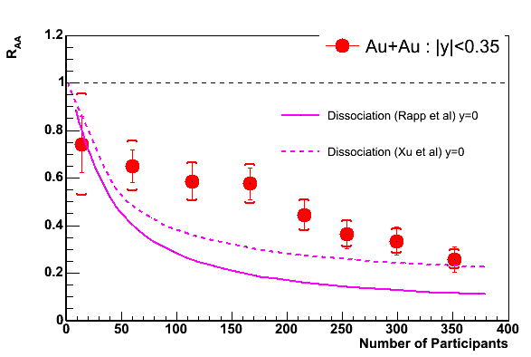
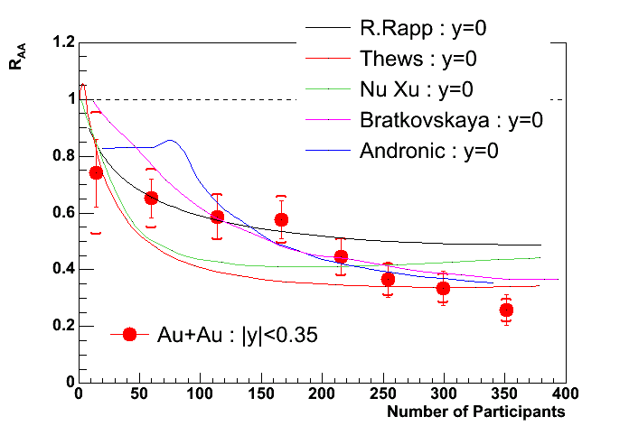
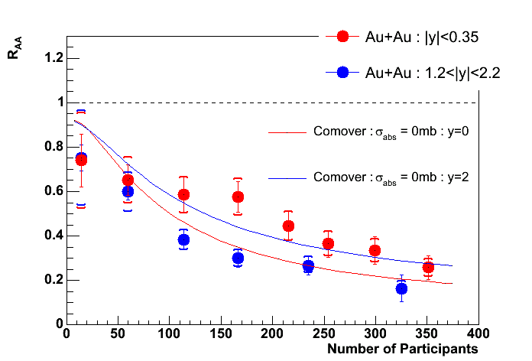
J/ψ versuS models…
R. Rapp & al., nucl-th/0608033
Yan, Zhuang, Xu, nucl-th/0608010
SPS like…
Recombination…
R. Rapp et al.PRL 92, 212301 (2004)
R. Thews et al, Eur. Phys. J C43, 97 (2005)
Yan, Zhuang, Xu, nucl-th/0608010
Bratkovskaya et al., PRC 69, 054903 (2004)
A. Andronic et al., nucl-th/0611023
Capella & Ferreiro,
hep-ph/0610313

