Slide 1

Rare Decays at CDF
Robert Harr
Wayne State University
ICHEP 2008, Philadelphia PA

Slide 2
Rare Decays at CDF
We have searched for the following 2-body rare decays:
B⁰_{d,s}→ μμ
B⁰_{d,s}→ eμ
B⁰_{d,s}→ ee
D⁰ → μμ
Each search is relative to a normalization mode
PRL 100, 101802 (2008)
Displaced vertex trigger

Slide 3
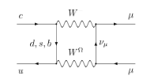
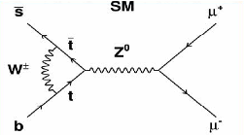
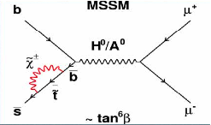
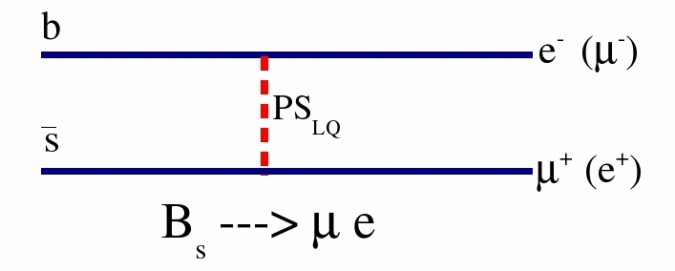
FCNC Decays: Sensitive to NP
FCNC decays forbidden at tree level, proceed through loops.
Higher order Diagrams are highly suppressed, allowing NP to
manifest itself.

Slide 4
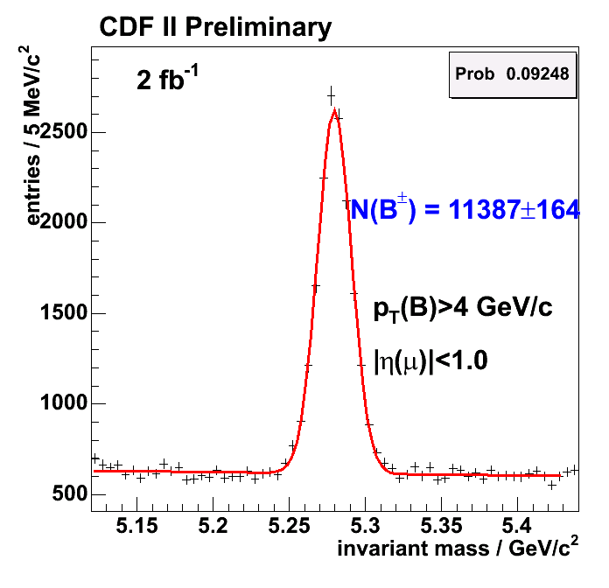
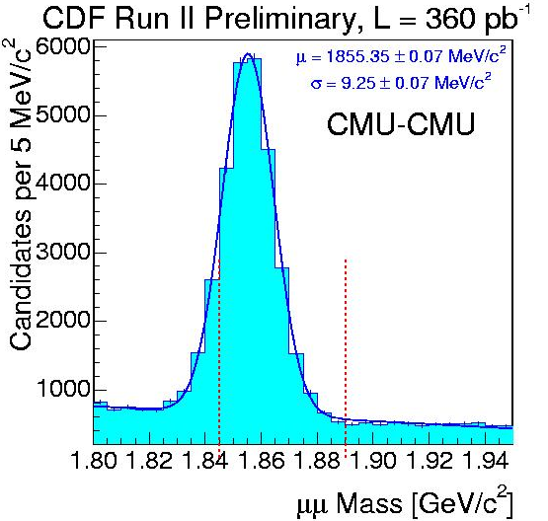
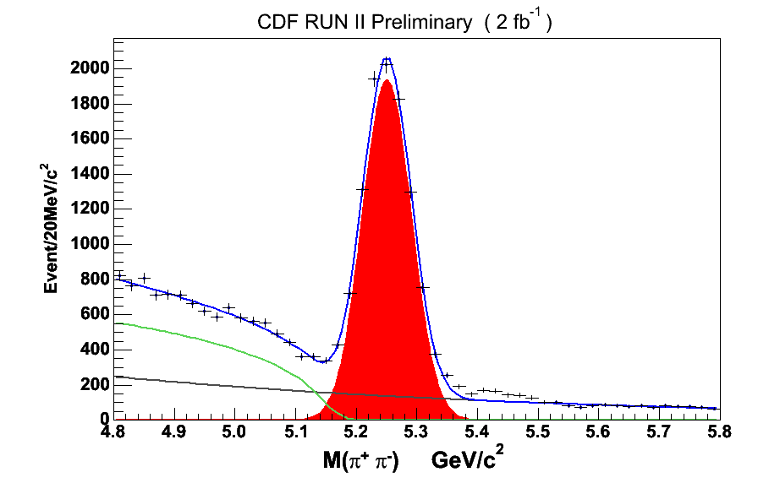
Normalization Modes
B⁰_{d}→ K⁺π⁻
for
B⁰_{d,s}→ ee, eμ
B⁺→ J/ψ K⁺
for
B⁰_{d,s}→ μμ
D⁰→ π⁺π⁻
For
D⁰→ μμ

Slide 5
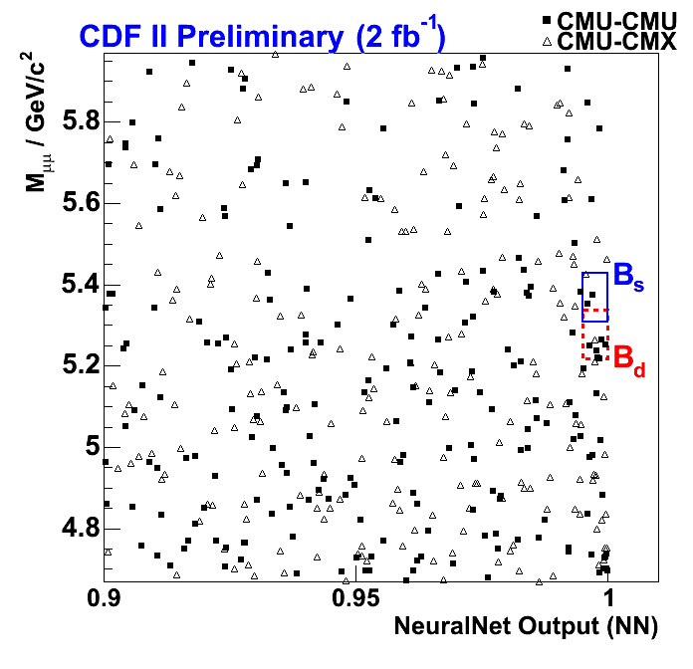
B → μμ Mass vs. NN Output
Neural net is used to
enhance signal
Inputs to neural net
are:
Decay time, decay time significance,
Isolation, and pointing deviation.

Slide 6
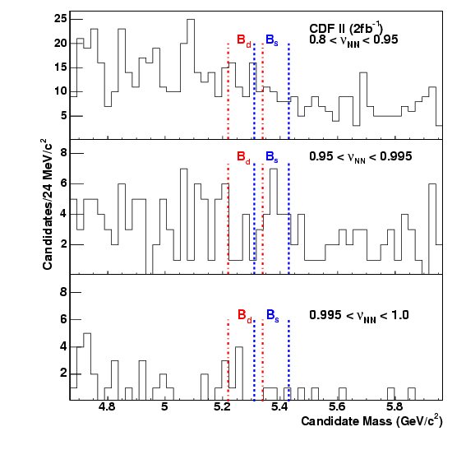
Zooming In On Slices
Limit is calculated using 5 bins in mass and 3 in neural net output from 0.8 to 1.0.

Slide 7
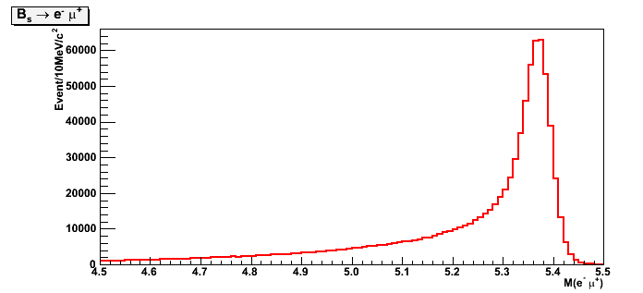
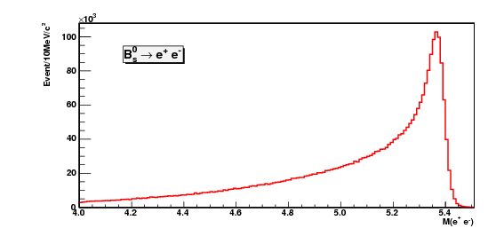
Bremsstrahlung in B→eμand B→ee
Long mass tail due to Bremsstrahlung.
Signal Events: full simulation
Search window for B_{s,d}⁰ → eμ is ±3σ around B_{s}⁰mass.
Search window for B_{s,d}⁰ → ee is (-6σ, +3σ).

Slide 8
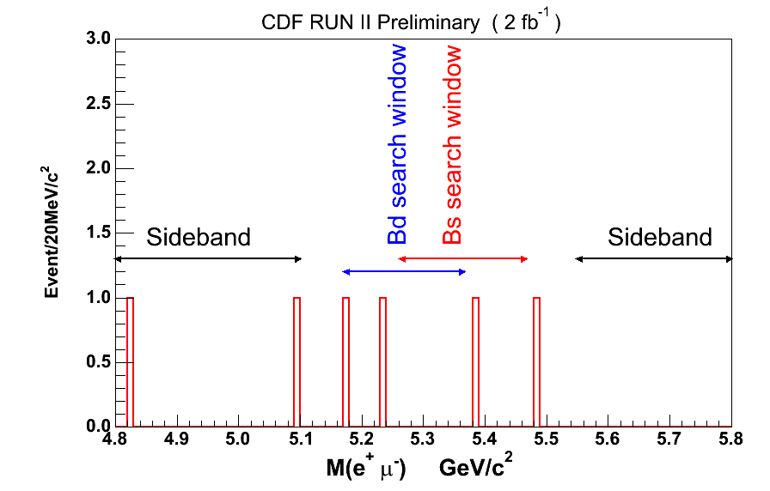
B→ eμ Signal after Lepton ID

Slide 9
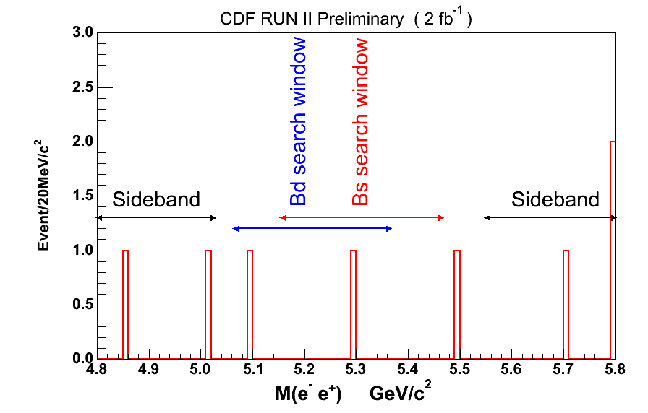
B→ ee Signal after Lepton ID

Slide 10
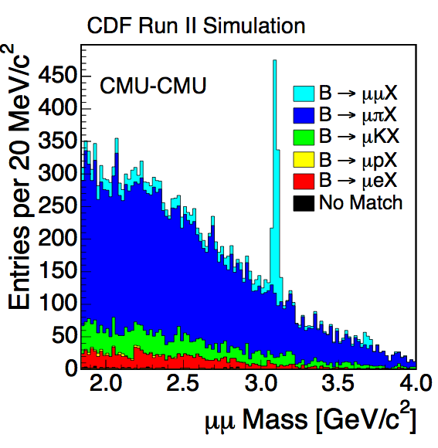
D⁰→ μμ Primary Background
Primary background comes from sequential B decays.
£100%
£ ~0.5%
£ ~1.0%
A likelihood ratio is used to suppress sequential B decays.
£ 0%

Slide 11
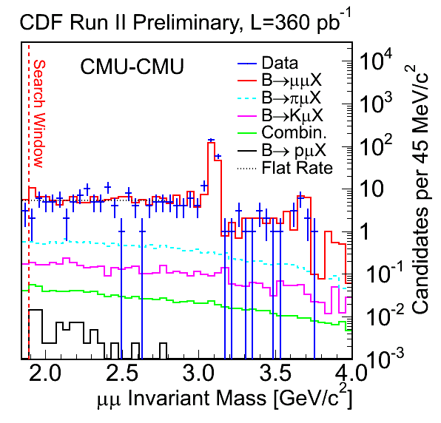
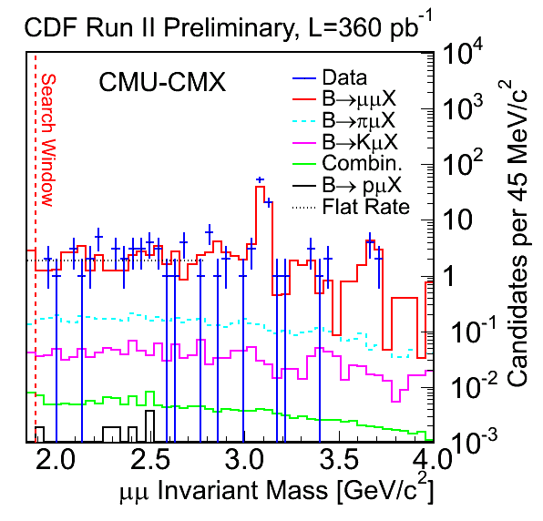
D⁰→ μμ Mass Plot after Lepton ID
Both muons in |η|< 0.6
One muon in |η| < 0.6, and
one in 0.6 < |η| < 1.0

Slide 12
Summary of Results
90% (95%) branching fraction limits × 10⁸
mode | CDF B.F. limit | Previous best
B⁰_{s}→ μμ | 4.7 (5.8) | 9.4
B⁰_{d}→ μμ | 1.5 (1.8) | 3.9
B⁰_{s}→ eμ | 20 (26) | 610
B⁰_{d}→ eμ | 6.4 (7.9) | 9.2
B⁰_{s}→ ee | 28 (37) | 5400
B⁰_{d}→ ee | 8.3 (10.6) | 11.3
D⁰ → μμ | 43 (53) | 130

Slide 13
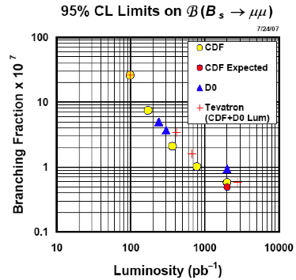
B⁰_{s}→ μμ and New Physics

Slide 14
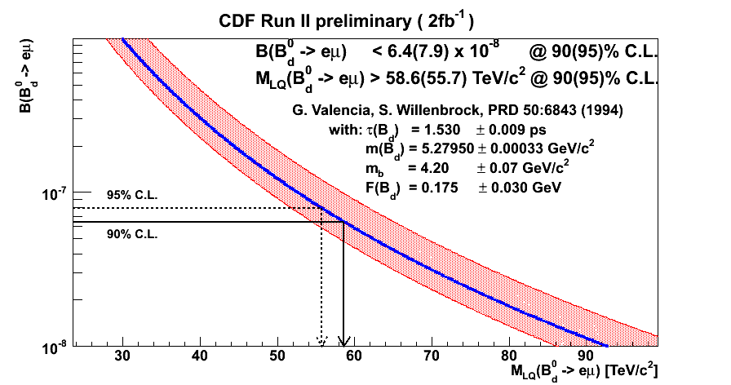
PS Leptoquark & RPV Couplings
B →eμ
From B(D⁰ → μμ)result, limit RPV SUSY couplings:

Slide 15
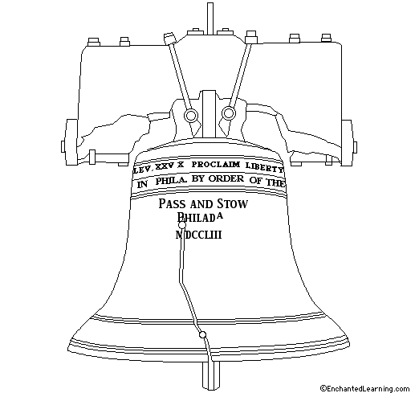
Summary
CDF has searched for the decays: B⁰_{d,s}→ μμ, eμ,ee, and D⁰ →μμ.
In the absence of signals, we set limits on the branching fractions of the decays ranging from ~ 4 × 10⁻⁷ to ~ 1 × 10⁻⁸.
All limits are the best achieved to date.
The limits constrain a number of new physics models.

Slide 16
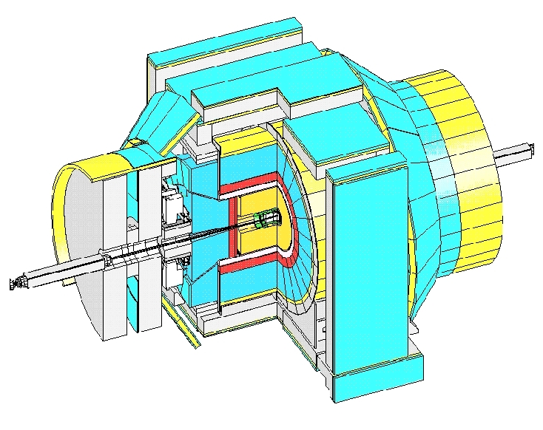
The CDF detector
Muon Chambers
Calorimeters
Central Drift Chamber
dE/dx, XFT Trigger
Silicon Vertex Detector
SVT: Silicon Vertex Trigger

Slide 17
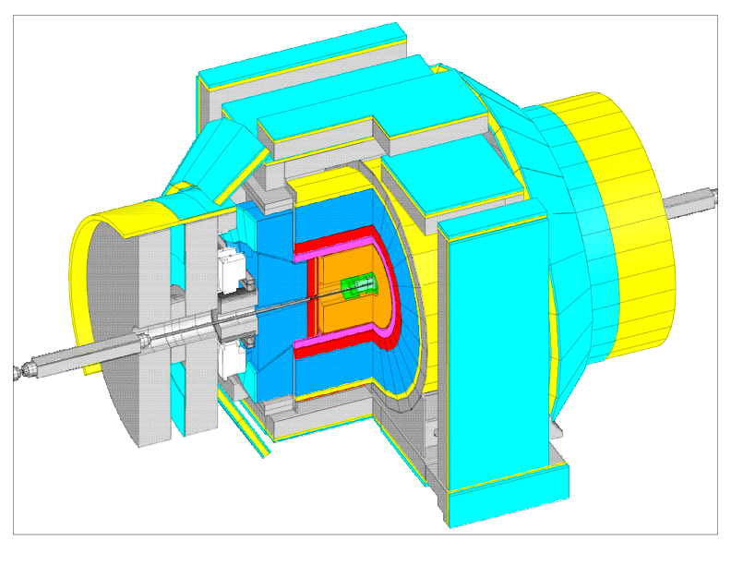

Slide 18
