Slide 1
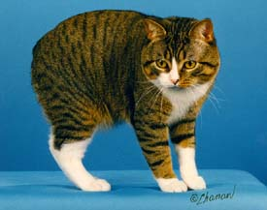
μ
Muons, Inc.
MANX- Toward Bright Muon Beams
for Colliders, Neutrino Factories, and Muon Physics
Rolland P. Johnson
Muons, Inc. (http://www.muonsinc.com/)
Abstract: New inventions are improving the prospects for high luminosity muon colliders for Higgs or Z’ factories and at the energy frontier. Recent analytical calculations, numerical simulations, and experimental measurements are coming together to make a strong case for a series of devices or machines to be built, where each one is a precursor to the next. If chosen correctly, each device or machine with its own unique experimental and accelerator physics programs can drive the development of muon cooling and acceleration theory and technology. This strategy can achieve an almost unlimited program of experimental physics based on the cooling and acceleration of muon beams. The very first step of the program is to develop stopping muon beams by using a 6D muon cooling segment (momentum-dependent Helical Cooling Channel with emittance exchange using a homogeneous energy absorber) to test the theory and simulations and to improve the mu2e experiment.
http://www.muonsinc.com/tiki-index.php?page=Papers+and+Reports

Slide 2
Ultimate Goal: High-Energy High-Luminosity Muon Colliders
μ
Muons, Inc.
precision lepton machines at the energy frontier
achieved in physics-motivated stages that require developing inventions and technology, e.g.
MANX
demonstrate HCC, HS, & EEX concepts
high-intensity proton driver
simultaneous intense muon beams
stopping muon beams
useful 6D cooling w HCC, EEX
neutrino factory
HCC with RF, RLA in CW Proj-X
Z’ factory
low Luminosity collider, HE RLA
Higgs factory
extreme 6D cooling, low beta, super-detectors
energy-frontier muon collider
more cooling, lower beta

Slide 3
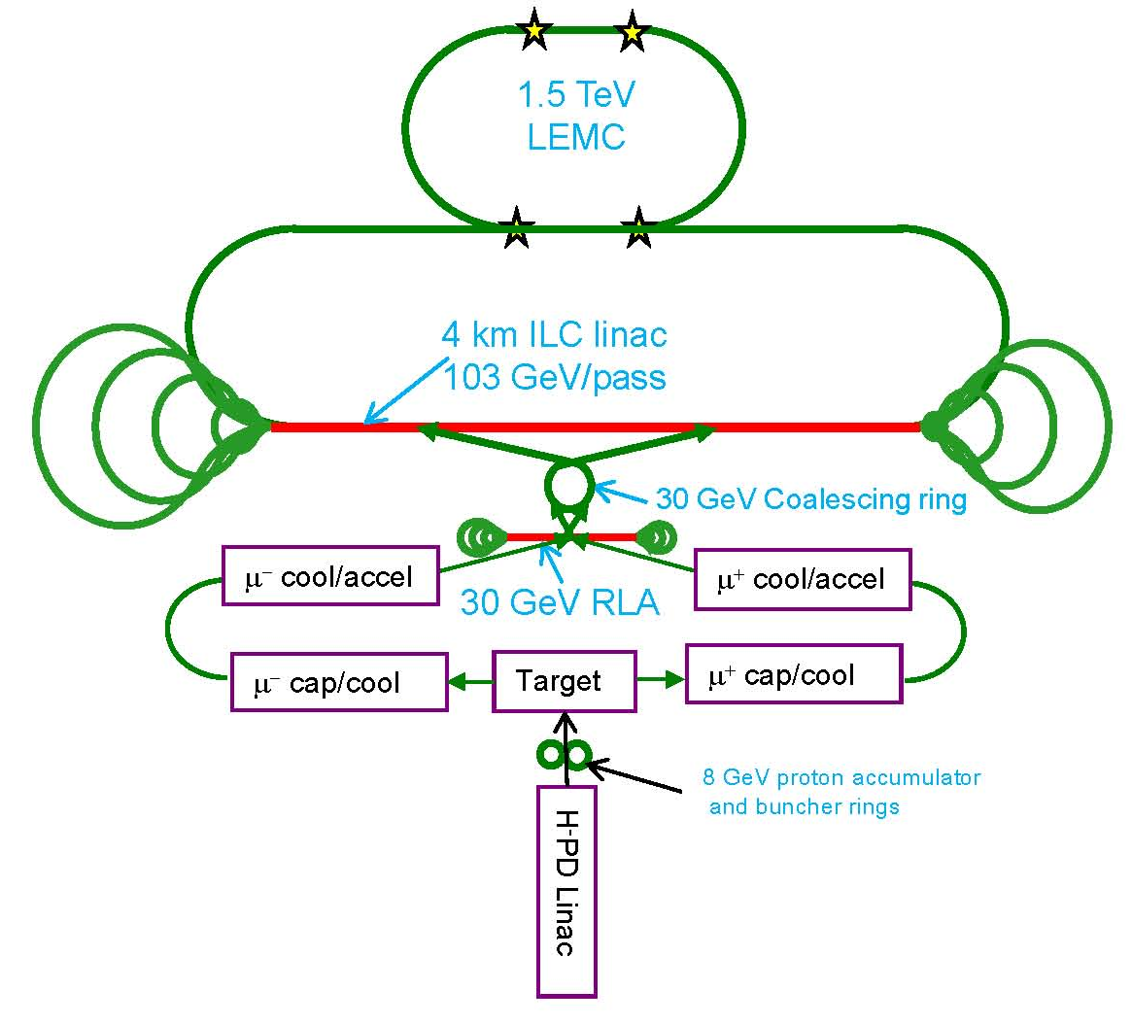
LEMC Scenario
μ
Muons, Inc.
Dogbone
Scheme

Slide 4
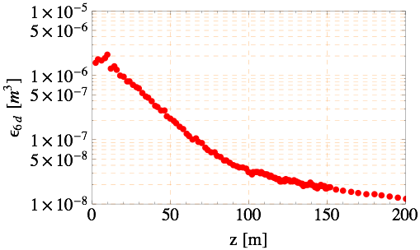
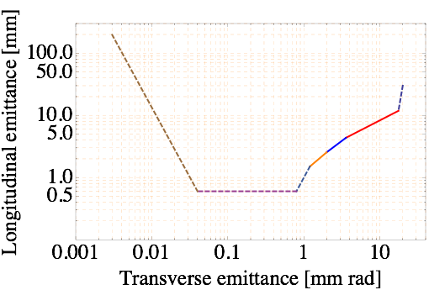
Simulation study of HCC for Muon Collider (MC)
400 MHz HCC
λ=1 m, κ=1
Goal for low emittance MC design
Reverse Emittance Exchange (REMEX)
Study II Front-end
200 MHz HCC
λ=2 m, κ=1
800 MHz HCC
λ=0.5 m, κ=1
Pre-cooler
200 MHz HCC
400 MHz HCC
800 MHz HCC
1600 MHz HCC
p=250 MeV/c
Parametric Ionization
Channel (PIC)
6D Phase space evolution in current HCC
Yonehara talk
Phase space evolution for Muon Collider
(solid line: complete simulation, dashed line: in progress)
5

Slide 5
Muons, Inc. Project History
μ
Muons, Inc.
Year Project Expected Funds Research Partner
2002 Company founded
2002-5 High Pressure RF Cavity $600,000 IIT (Dan K.)
2003-7 Helical Cooling Channel $850,000 Jlab (Slava D.)
2004-5† MANX demo experiment $ 95,000 FNAL TD (Victor Y.)
2004-7 Phase Ionization Cooling $745,000 Jlab (Slava D.)
2004-7 HTS Magnets $795,000 FNAL TD (Victor Y.)
2005-9 Reverse Emittance Exch. $850,000 Jlab (Slava D.)
2005-9 Capture, ph. rotation $850,000 FNAL AD (Dave N.)
2006-9 G4BL Sim. Program $850,000 IIT (Dan K.)
2006-9 MANX 6D Cooling Demo $850,000 FNAL TD (M. Lamm)
2007-10 Stopping Muon Beams $750,000 FNAL APC (Chuck A.)
2007-10 HCC Magnets $750,000 FNAL TD (Sasha Z.)
2007-8† Compact, Tunable RF $100,000 FNAL AD (Milorad)
2008-9 Pulsed Quad RLAs $100,000 Jlab (Alex B.)
2008-9 Fiber Optics for HTS $100,000 FSU (Justin S.)
2008-9 RF Breakdown Studies $100,000 LBNL (Derun L.)
2008-9 Rugged RF Windows $100,000 Jlab (Bob Rimmer)
2008-9 H2-filled RF Cavities $100,000 FNAL APC (Katsuya)
2008-9 MANX, Collider low beta $150,000 NIU DCEO(D. Hedin)
Underlined are explicitly related to HCC ~$3.5M spent, $1.3 M left

Slide 6
μ
Muons, Inc.
Principle of Ionization Cooling
Each particle loses momentum by ionizing a low-Z absorber
Only the longitudinal momentum is restored by RF cavities
The angular divergence is reduced until limited by multiple scattering
Successive applications of this principle with clever variations leads to small emittances for many applications
Early work: Budker, Ado & Balbekov, Skrinsky & Parkhomchuk, Neuffer

Slide 7
Transverse Emittance IC
μ
Muons, Inc.
The equation describing the rate of cooling is a balance between cooling (first term) and heating (second term):
Here ε_{n} is the normalized emittance, E_{µ} is the muon energy in GeV, dE_{µ}/ds and X₀ are the energy loss and radiation length of the absorber medium, β⊥ is the transverse beta-function of the magnetic channel, and β is the particle velocity.
Note that which implies a ~1.5 GeV linac for 10⁻⁶
Bethe-Bloch
Moliere (with low Z mods)

Slide 8
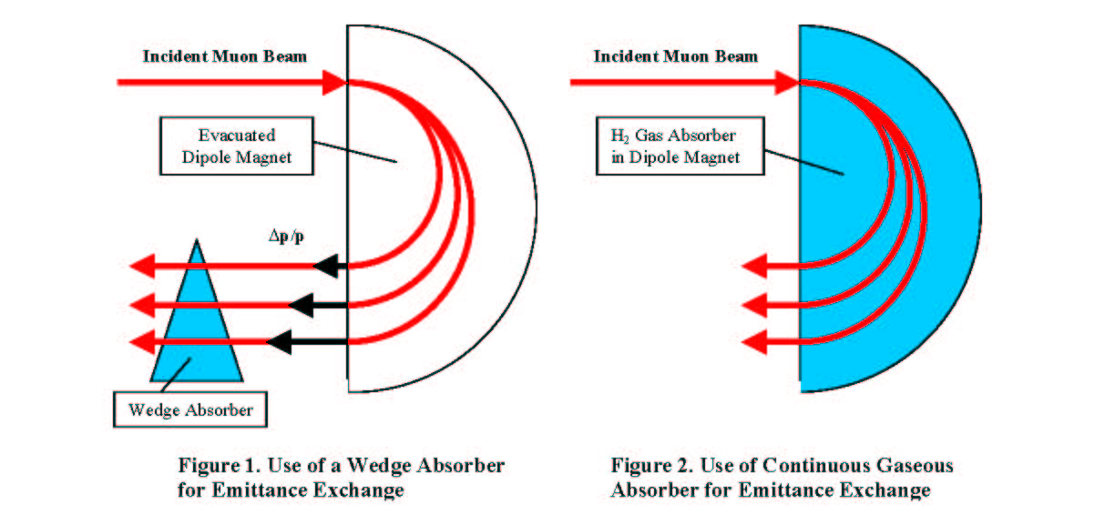
Wedges or Continuous Energy Absorber for Emittance Exchange and 6d Cooling
μ
Muons, Inc.
Ionization Cooling is only transverse. To get 6D cooling, emittance exchange between transverse and longitudinal coordinates is needed.
THIS RH CONCEPTUAL PICTURE BE REALIZED? A MANX GOAL!

Slide 9
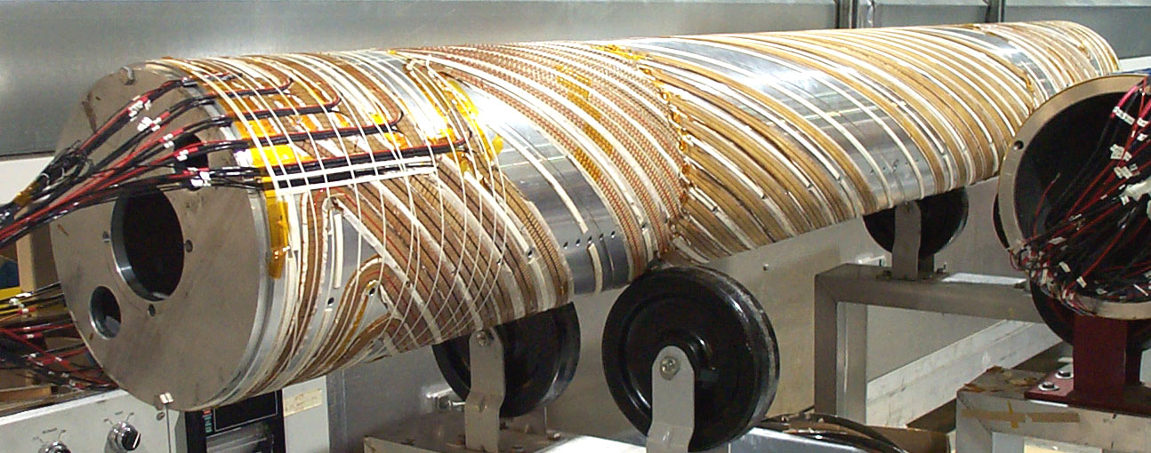
Helical Cooling Channel
μ
Muons, Inc.
Continuous, homogeneous energy absorber for longitudinal cooling
Helical Dipole magnet component for dispersion
Solenoidal component for focusing
Helical Quadrupole for stability and increased acceptance
BNL Helical Dipole Siberian Snake magnet for AGS spin control

Slide 10
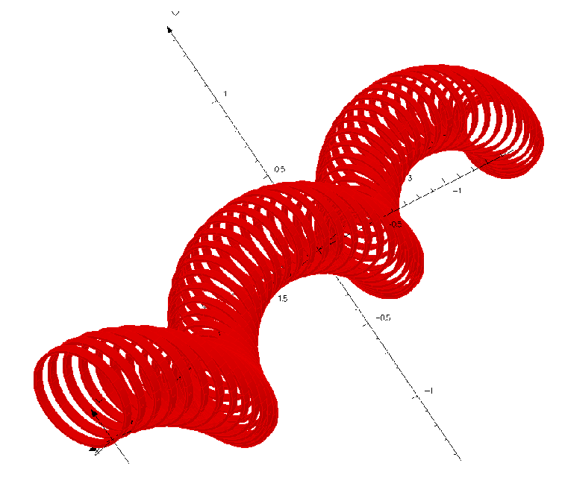
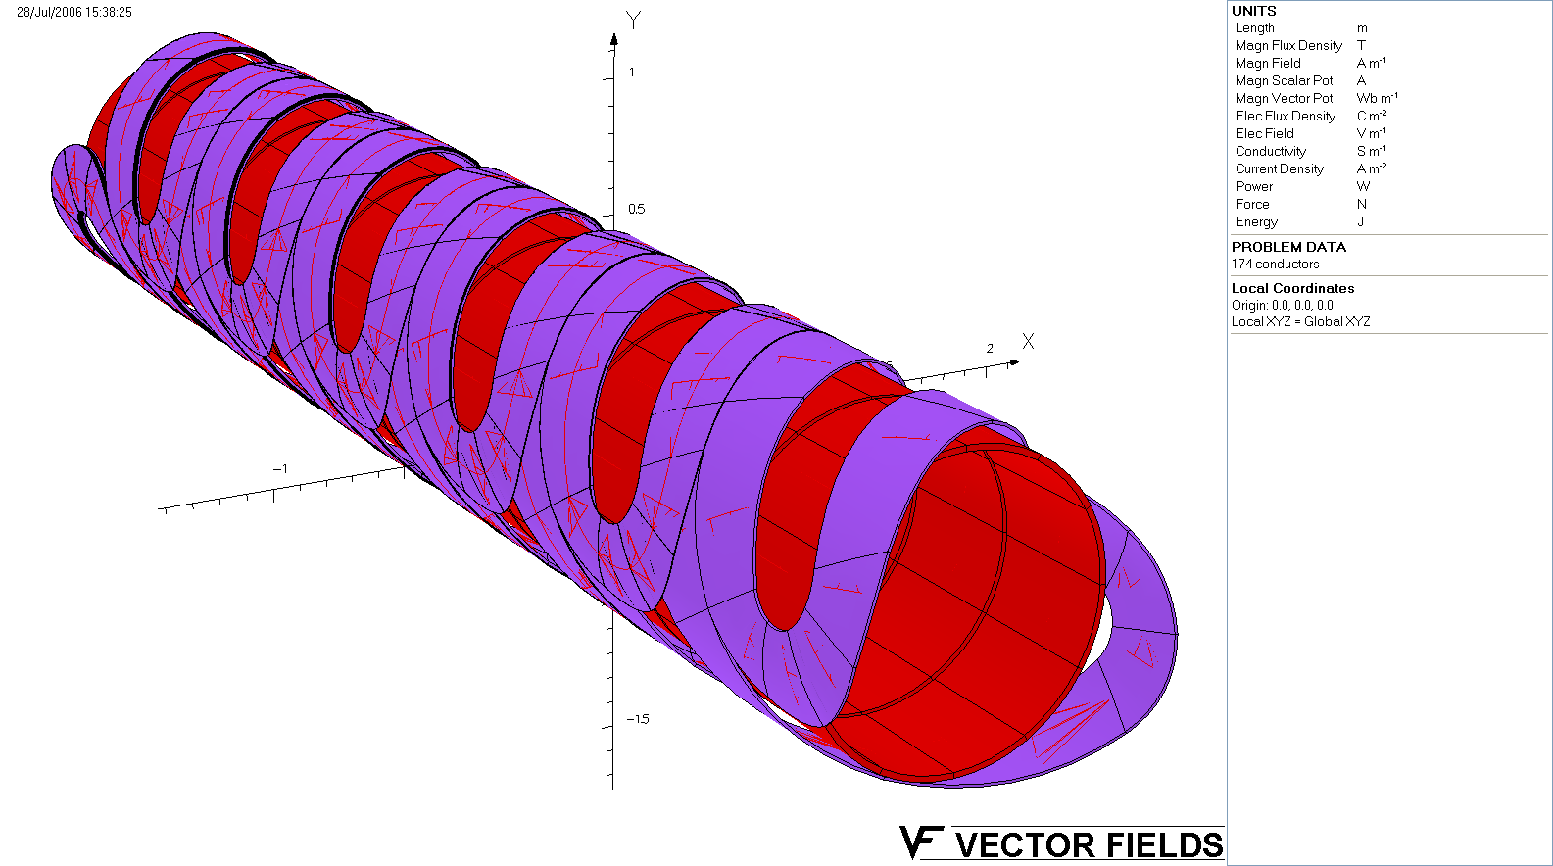
Two Different Designs of Helical Cooling Magnet
μ
Muons, Inc.
Great new Kashikhin-Yonehara innovation!
Large bore channel
(conventional)
Small bore channel
(helical solenoid)
Siberian snake type magnet
Consists of 4 layers of helix dipole to produce
tapered helical dipole fields.
Coil diameter is 1.0 m.
Maximum field is more than 10 T.
Helical solenoid coil magnet
Consists of 73 single coils (no tilt).
Maximum field is 5 T
Coil diameter is 0.5 m.

Slide 11
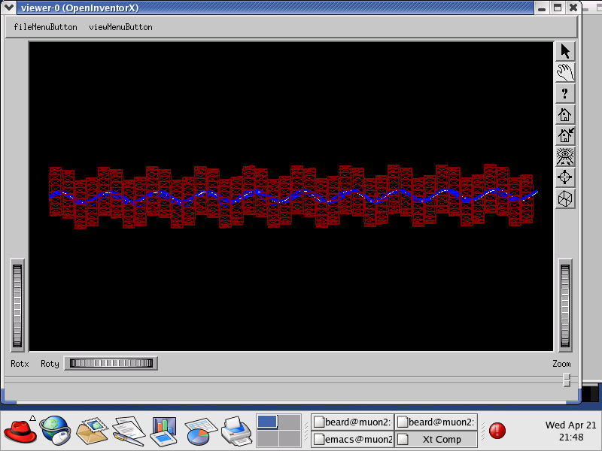
6-Dimensional Cooling in a Continuous Absorber
μ
Muons, Inc.
Helical cooling channel (HCC)
Continuous absorber for emittance exchange
Solenoidal, transverse helical dipole and quadrupole fields
Helical dipoles known from Siberian Snakes
z- and time-independent Hamiltonian
Derbenev & Johnson, Theory of HCC, April/05 PRST-AB
http://www.muonsinc.com/reports/PRSTAB-HCCtheory.pdf

Slide 12
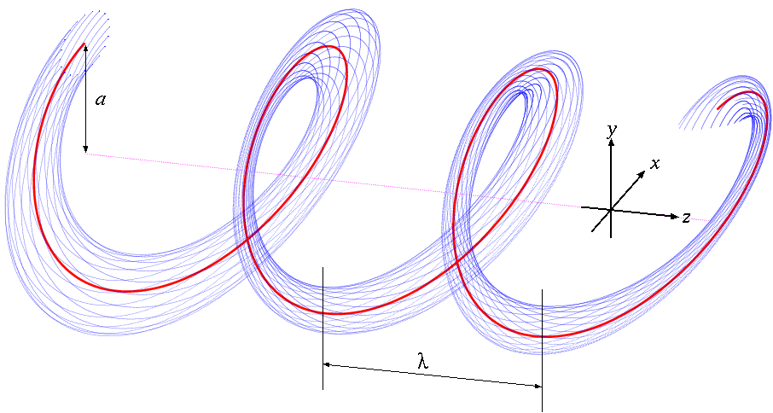
Particle Motion in a Helical Magnet
μ
Muons, Inc.
Combined function magnet (invisible in this picture)
Solenoid + Helical dipole + Helical Quadrupole
Red: Reference orbit
Blue: Beam envelope
Magnet Center
Dispersive component makes longer path length for higher momentum particles and shorter path length for lower momentum particles.
Opposing radial forces
Transforming to the frame of the rotating helical dipole leads to a time and z –independent Hamiltonian
b' added for stability and acceptance

Slide 13
Some Important Relationships
μ
Muons, Inc.
Hamiltonian Solution
Equal cooling decrements
Longitudinal cooling only
~Momentum slip factor
~

Slide 14
HCC Virtues
μ
Muons, Inc.
New concept
not FODO, but based on a theory (theory by Derbenev)
time and z-independent Hamiltonian
solenoid, helical dipole, helical quad fields
two versions: with or without RF
Large acceptance
for huge muon beam emittances
large resonance driving terms
Homogeneous field
minimal resonant losses
DE/E for a million in 6D reduction implies a long channel
Many uses for muon beams (overview by Mary Anne)

Slide 15
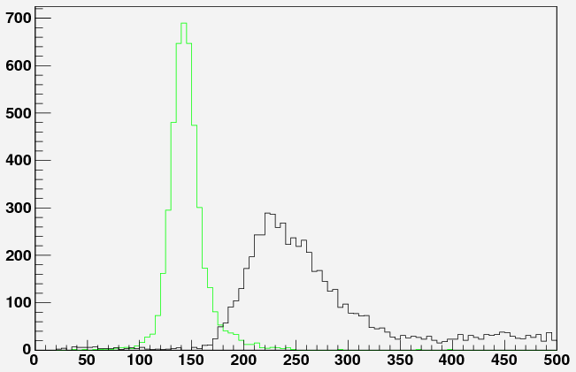
Example of longitudinal cooling in a HCC overcomes 1/β² dependence of energy loss to keep the momentum spread small while undergoing energy degradation to slow a muon beam.
MERIT-like targetry into NF/MC Front End up to End of Energy/Phase Rotator into HCC w/o RF w/ tapered LiH wedges variably spaced to match energy loss while maintaining reference radius of 50 cm. The z value refers to depth from start of HCC.
10k POT
z = 3 m
z = 0 m
p (MeV/c)

Slide 16
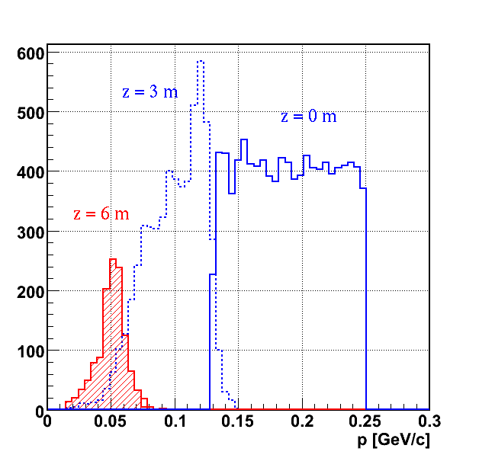
Example of HCC use for the mu2e experiment
discussed by Ankenbrandt and Yonehara

Slide 17

HCC Magnets using HTS
μ
Muons, Inc.
Beam cooling to reduce the size of a muon beam depends on the magnetic field strength. The Phase II proposal to develop this hybrid scheme has been approved. Here a hybrid magnet of Nb3Sn (green) and HTS (red) could provide up to 30 T in an HCC design.
Notes:
17

Slide 18
many new ideas under development:
μ
Muons, Inc.
H₂-Pressurized RF Cavities
Continuous Absorber for Emittance Exchange
Helical Cooling Channel
Parametric-resonance Ionization Cooling
Reverse Emittance Exchange
RF capture, phase rotation, cooling in HP RF Cavities
Bunch coalescing
Very High Field Solenoid magnets for better cooling
p-dependent HCC
precooler
HTS for extreme transverse cooling
MANX 6d Cooling Demo
improved mu2e design
See http://www.muonsinc.com/
“papers and reports”
42 Abstracts for PAC09
21 Papers from EPAC08
13 Papers from PAC07

Slide 19
MANX, A 6D MUON BEAM COOLING EXPERIMENT
Robert Abrams¹, Mohammad Alsharo’a¹, Andrei Afanasev¹, Charles Ankenbrandt¹, Emanuela Barzi², Kevin Beard¹, Alex Bogacz³, Daniel Broemmelsiek²,
Yu-Chiu Chao³, Linda Coney⁴, Mary Anne Cummings¹, Yaroslav Derbenev³,
Henry Frisch⁵, Ivan Gonin², Gail Hanson⁴, David Hedin⁶, Martin Hu², Valentin Ivanov¹,
Rolland Johnson¹, Stephen Kahn¹, Daniel Kaplan⁷, Vladimir Kashikhin²,
Moyses Kuchnir¹, Michael Lamm², James Maloney⁶, Michael Neubauer¹,
David Neuffer², Milord Popovic², Robert Rimmer³, Thomas Roberts¹, Richard Sah¹, Pavel Snopok⁴, Linda Spentzouris⁷, Melanie Turenne¹, Daniele Turrioni²,
Victor Yarba², Katsuya Yonehara², Cary Yoshikawa¹, Alexander Zlobin²
¹Muons, Inc.
²Fermi National Accelerator Laboratory
³Thomas Jefferson National Accelerator Facility
⁴University of California at Riverside
⁵University of Chicago
⁶Northern Illinois University
⁷Illinois Institute of Technology
* Contact, rol@muonsinc.com, (757) 870-6943

Slide 20
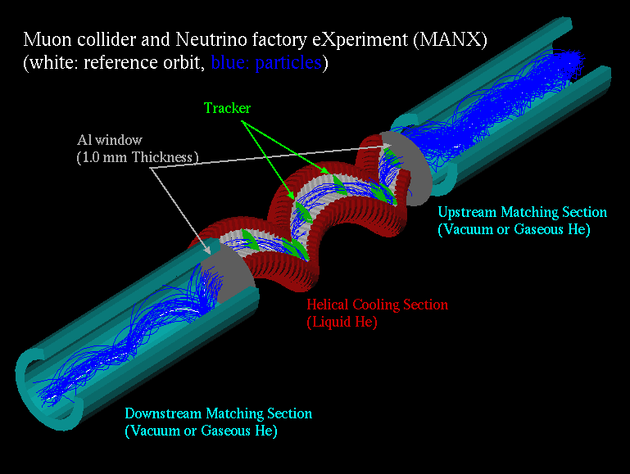
Overview of MANX channel
μ
Muons, Inc.
6DMANX
Use Liquid He absorber
No RF cavity
Length of cooling channel: 3.2 m
Length of matching section: 2.4 m
Helical pitch κ: 1.0
Helical orbit radius: 25 cm
Helical period: 1.6 m
Transverse cooling: ~1.3
Longitudinal cooling: ~1.3
6D cooling: ~2
Most Simulations use G4Beamline (Muons, Inc.) and/or ICOOL (BNL)
G4BL Simulation

Slide 21
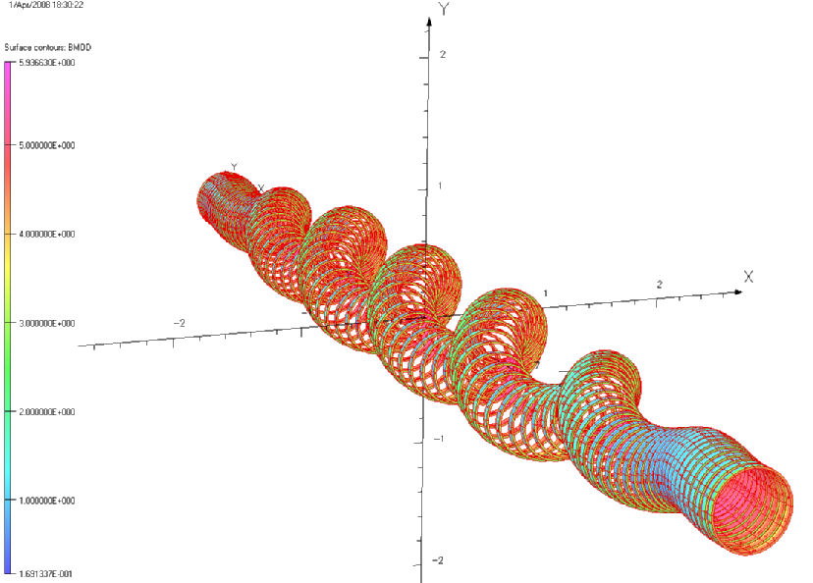
HS for Cooling Demonstration Experiment
μ
Muons, Inc.
Goals: cooling demonstration, HS technology development
Features: SSC NbTi cable, Bmax~6 T, coil ID ~0.5m, length ~10m
21
Notes:
21

Slide 22
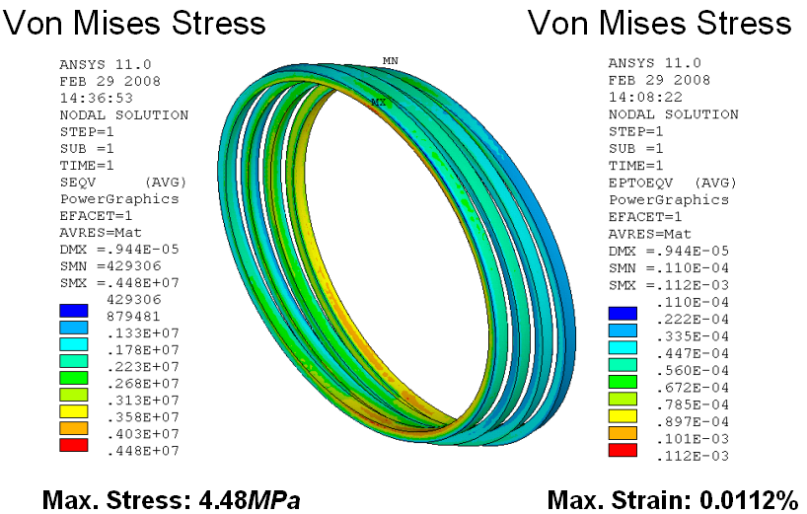
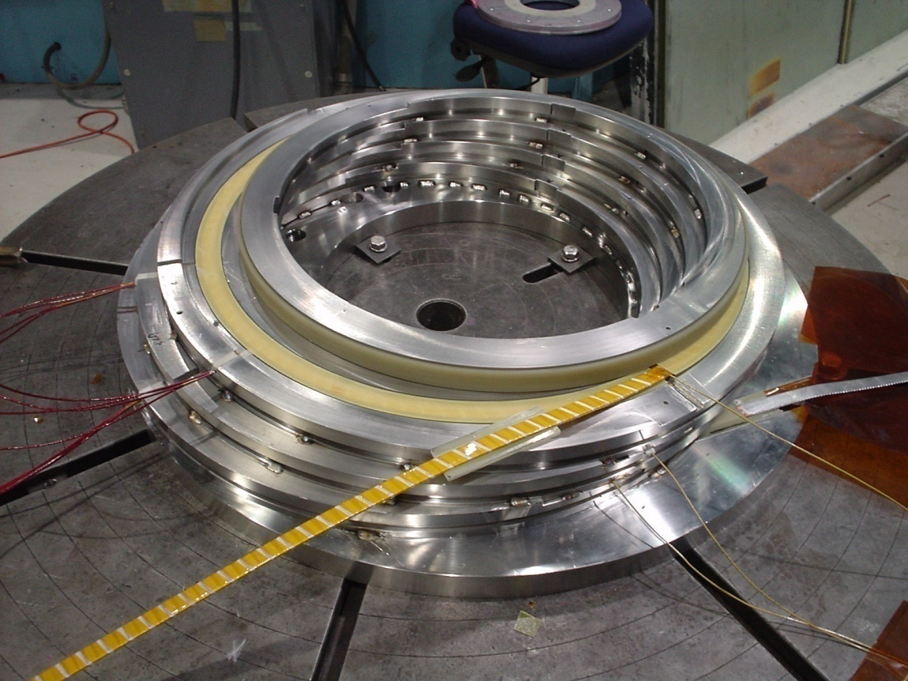
HCC Magnets for MANX
μ
Muons, Inc.
Prototype coils for MANX have been designed and modeled. Construction of a 4-coil assembly using SSC cable is complete. Tests in the TD vertical Dewar are complete. Since the MANX matching sections are made of coils with varying offset, they are more expensive than the cooling region. Consequently the total magnet cost can be drastically reduced if the matching sections are not needed. See talk by Kashikhin.
Notes:
22

Slide 23
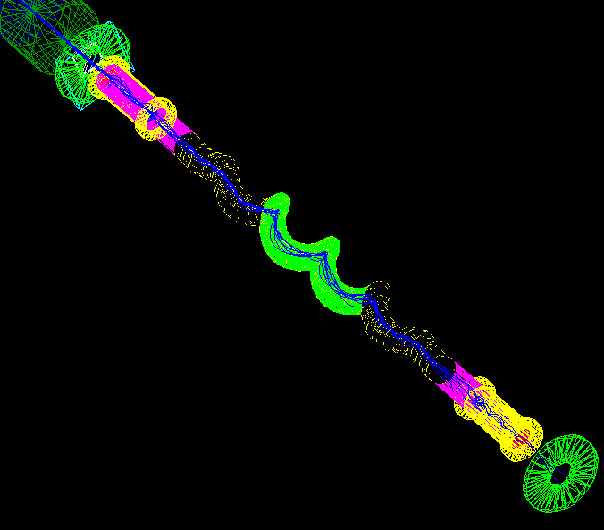
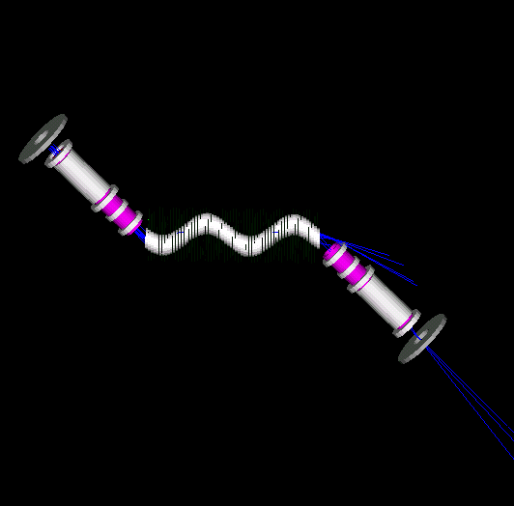
Simpler Option without Matching Sections
μ
Muons, Inc.
Magnet ~$10M
Magnet < $5M
LHe or LH2 region
Requires transverse displacement of downstream spectrometer & has additional engineering challenges
Matching sections
Notes:
23

Slide 24
Summary: MANX
μ
Muons, Inc.
Will Test:
Theory of Helical Cooling Channel (HCC)
p-dependent HCC with continuous absorber
Helical Solenoid Magnet (HS) and absorber
similar to those required to upgrade the mu2e experiment
Simulation programs (G4BL, ICOOL)
Encourages wider interest in muon cooling for Fermilab’s future
Adds Energy Frontier and Stopping Muon Beam HEP Experimenters
Local universities especially important
RAL and MICE connect to European and Asian communities
Minimizes costs and time
no RF, uses normalized emittance, ~5 m LHe E absorber
builds on MICE, improves 6-D capability, ~ps detectors
RF is developed in parallel with new concepts
Collaborators have been asked to address AAC charge:
Notes:
24

Slide 25
μ
Muons, Inc.
AAC Charge/Possible Responses
If successfully executed does the MANX proposal provide a validation of 6-D ionization cooling, based on requirements for a Muon Collider. What does the Committee view as the optimum mix of simulations and experimental demonstration required to provide such validations?
Collection, cooling, extreme cooling, transport, acceleration of muon beams for MC
Require several new techniques and technologies
MANX demonstrates a new HCC approach to cooling large emittance beams
Homogeneous magnetic fields can cope better with resonances
MANX demonstrates a new method of emittance exchange
If successfully executed does the MANX proposal provide a validation of an upgrade of the mu2e experiment based on a collection scheme that reduces “flash” deadtime and the use of the ionization-cooling energy-absorber to range out hadronic backgrounds? What does the Committee view as the optimum mix of simulations and experimental demonstration required to provide such validations?
Degrading the higher momentum, higher flux part of π and μ production spectra
Gets higher mu/proton, without magnetic mirrors that imply a long flash gate
Longitudinal cooling with EEX concentrates the stopping beam in the target while
Hadronic backgrounds are ranged out (also reduces flash gate time)

Slide 26
μ
Muons, Inc.
AAC Charge/Possible Responses
What are the primary technical risks within the MANX proposal and are they appropriately mitigated through the development period?
Timely commitment of manpower and funds
MICE delays
Engineering escalations for additional capabilities beyond liquid helium
vacuum, hydrogen E degrader
with Individually powered coils: power supplies, SC leads,
Given the anticipated timelines within the Muon Five-year Proposal and the mu2e development plan, what is the appropriate schedule for implementation of MANX, either at Fermilab or at RAL?
To follow MICE at RAL, coordination and continuity are required
Sooner would be better
Do the MANX resource requirements appear reasonably estimated?
Iteration on 4-coil design will improve magnet estimates
Cryostat, power supplies, matching sections, reuse of MICE detectors, designs
Can the MANX approach to a mu2e upgrade impact the outlook for Project X?
If the energy absorber approach works,
higher mu flux is possible, and higher p flux required

Slide 27
μ
Muons, Inc.
AAC Agenda
8:30-8:50 Slava Derbenev Theory of the HCC
History, derivation, epicyclic channel
8:50-9:10 Mary Anne Cummings Uses of the HCC
Muon collection, 6D and extreme cooling, for MC, NF, and mu2e
9:10-9:35 Chuck Ankenbrandt Mu2e applications
Overview, upgrade to HCC-MANX magnet, relationship to Project X
9:35-9:55 Vladimir Kashikhin Helical Solenoid
Magnet concept, 4-coil model, cost estimates
9:55-10:20 break
10:10-10:40 Katsuya Yonehara MANX HCC concepts, MC goals, simulations
10:40-11:00 Bob Abrams MANX design
Detectors, relationship to MICE
11:00-11:20 Tom Roberts G4 simulations, MANX@RAL
Simulation questions, timeline, MICE viewpoint

