Slide 1
Building A Scientific Data Analysis Server
Deb Agarwal
Berkeley Water Center, University of California, Berkeley
http://bwc.berkeley.edu
Collaboration with Microsoft Research

Slide 2
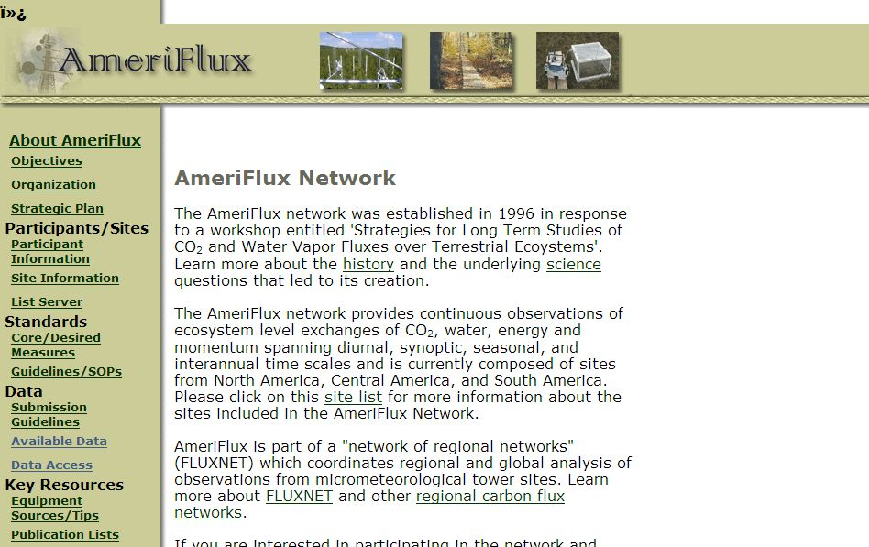
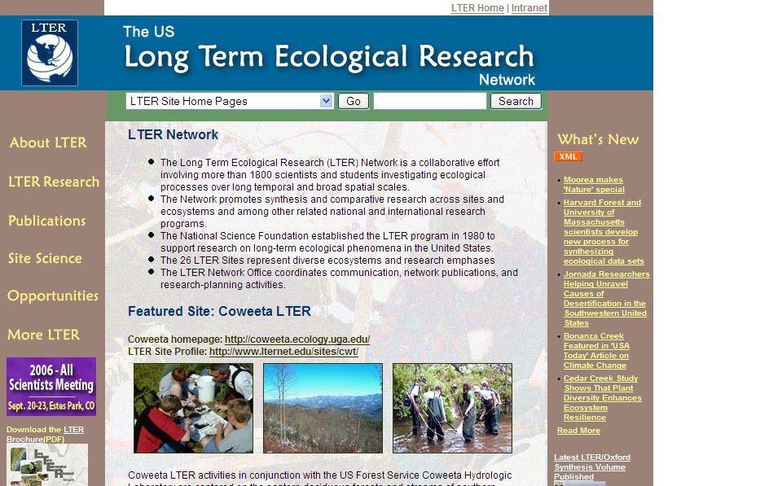
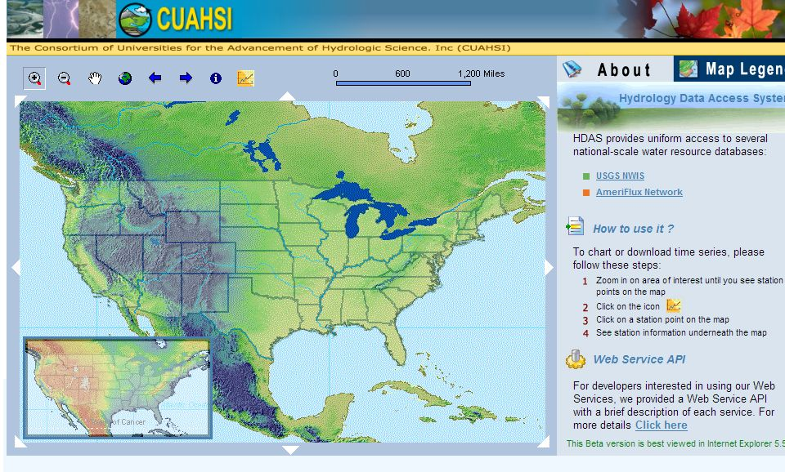
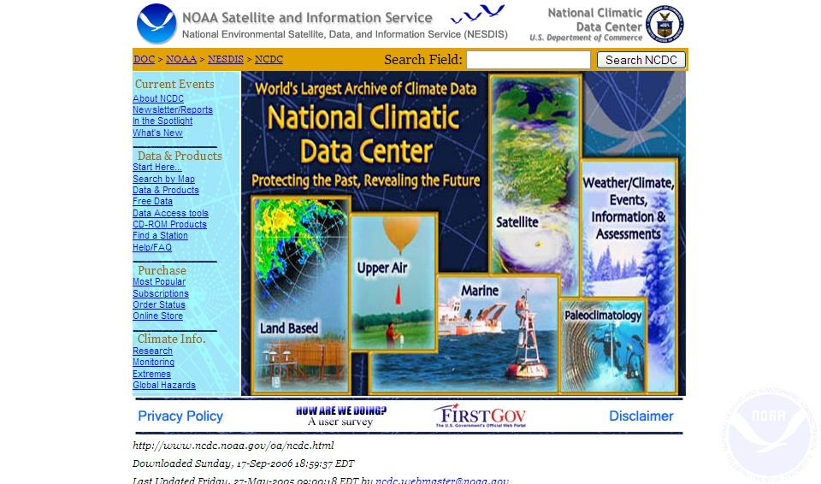
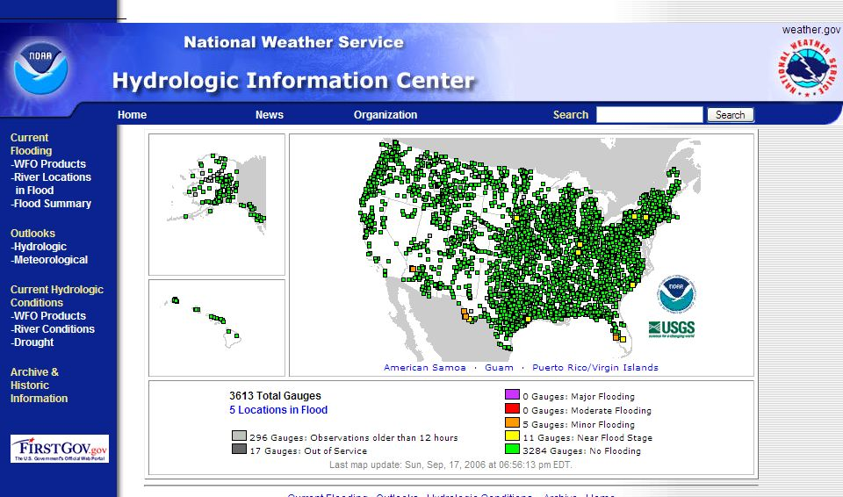
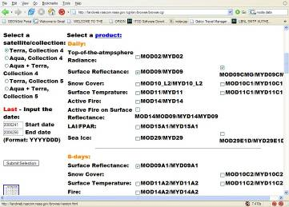
Excellent Data Archives Available

Slide 3
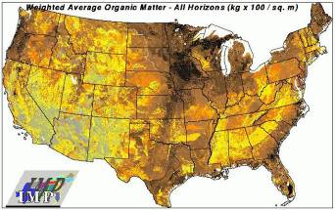
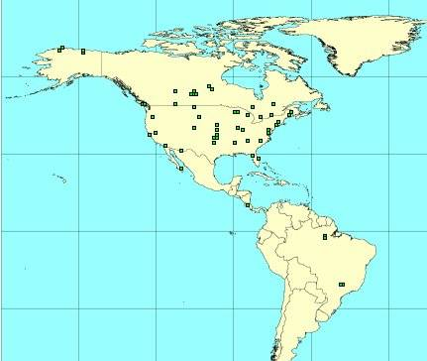
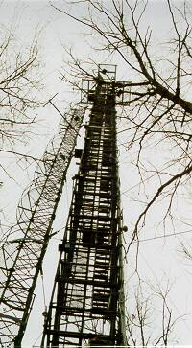
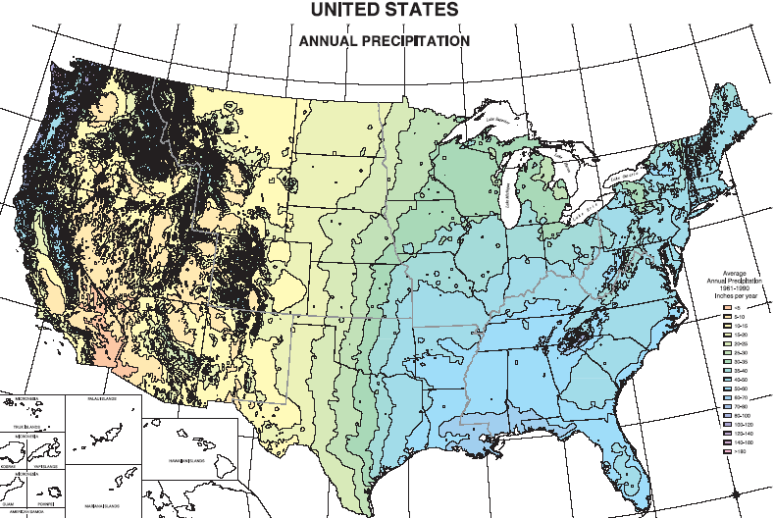
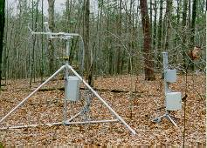
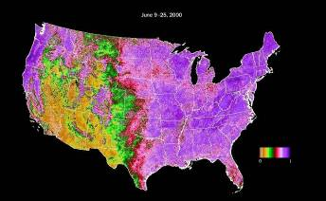
Typical Carbon-Climate Datasets
Soils
Climate
Remote Sensing
Observatory datasets
Spatially continuous datasets

Slide 4
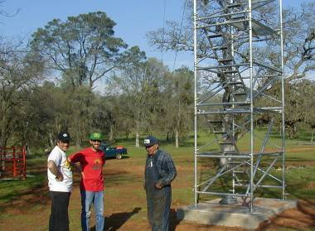
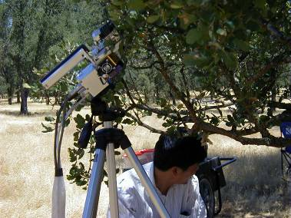
FLUXNET Synthesis Dataset Overview
240 Sites around the world and 921 site years of data
Each site reports a minimum of 22 and more typically 35 common measurements.
Total data reported to date on the order of 800M half-hourly measurements.
Communal science – each principle investigator acts independently to prepare and publish data.
Second level data published to and archived at regional networks.
Uniform quality, gap filling, and science variable derivation to generate higher level data sets.
http://www.fluxdata.org
4
Notes:
10/12/2007 2:59 PM
4
Microsoft Confidential© 2004 Microsoft Corporation. All rights reserved.
This presentation is for informational purposes only. Microsoft makes no warranties, express or implied, in this summary.
That’s “Tonzi” of “Tonzi Ranch”.

Slide 5
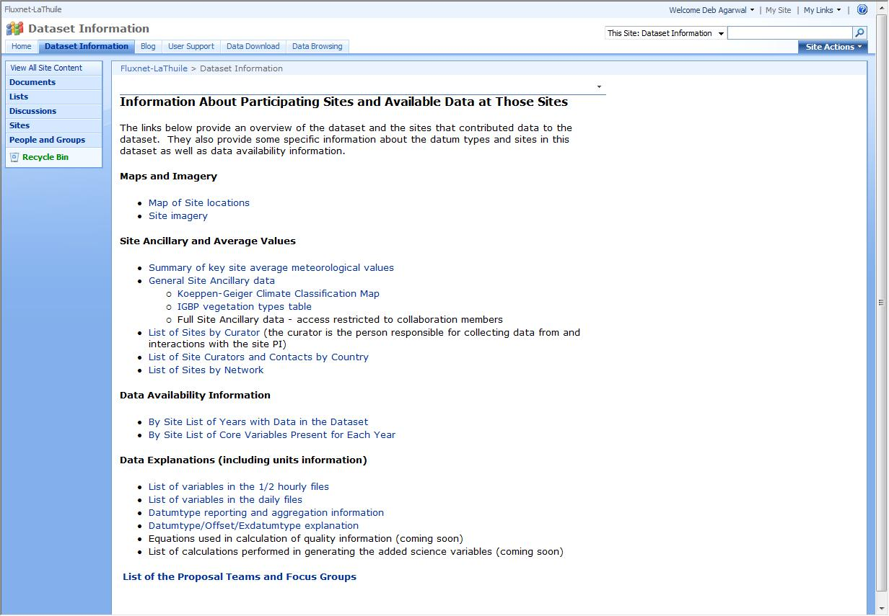
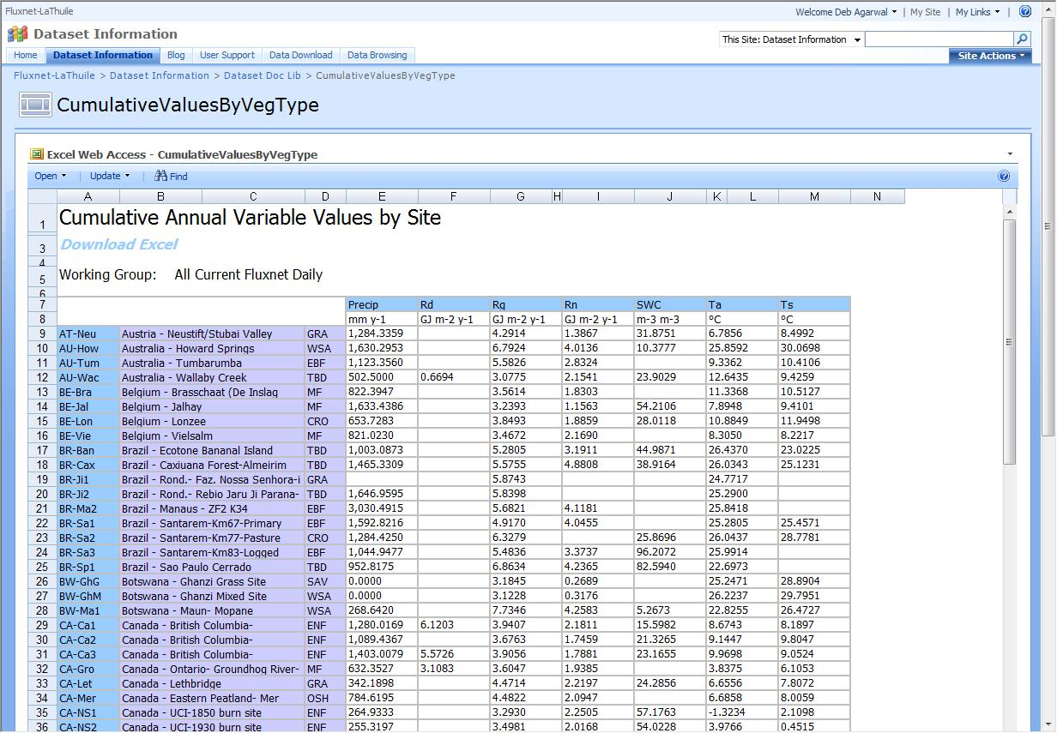
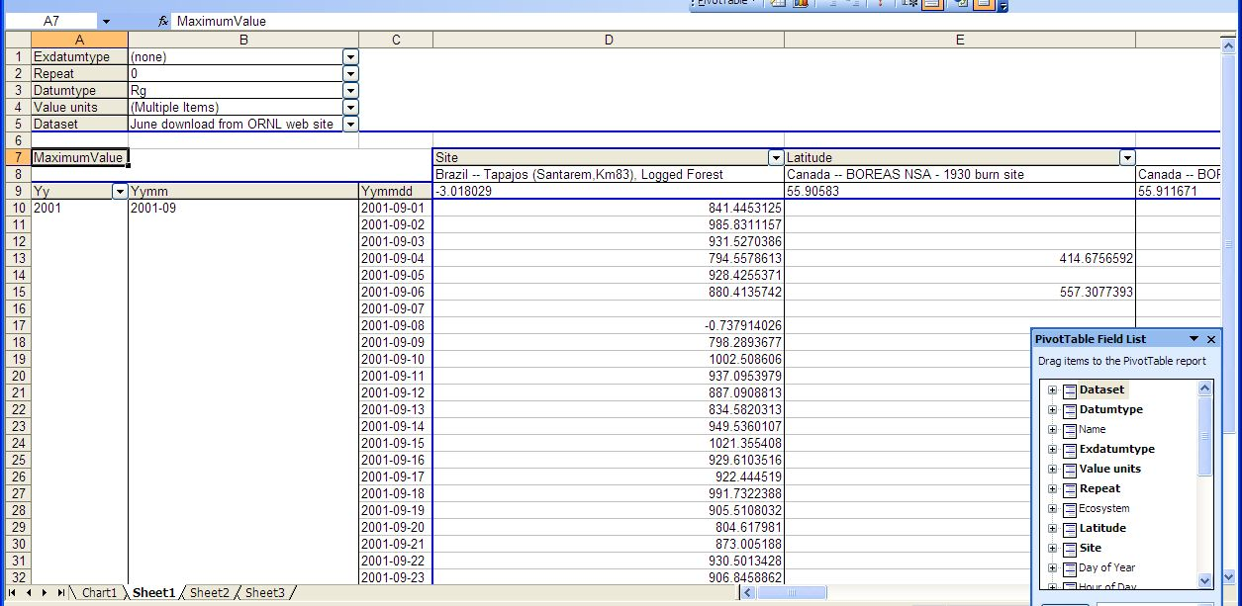
FLUXNET Synthesis Support Server

Slide 6
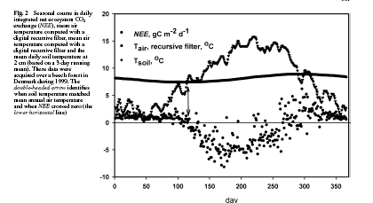
Example Carbon-Climate Investigations
Effects of early spring on carbon uptake
Role of vegetation, climate, and latitude on carbon flux
Effect of disturbances on atmospheric carbon
Linkages to remote sensing and other data sets just beginning
T SOIL
T AIR
Onset of photosynthesis

Slide 7
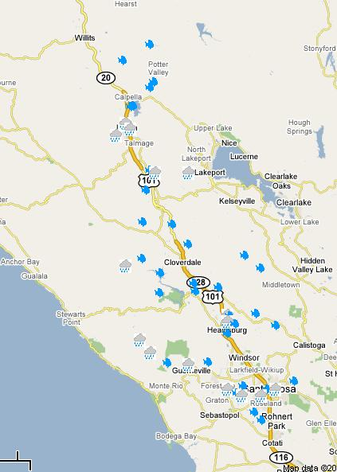
Russian River Data
USGS Stream Gages
NOAA Weather Stations
County water agency
Driller logs
EPA gages
Research team measurements
Data collected to date ~23M data points
http://bwc.berkeley.edu

Slide 8
Example Russian River Investigations
P: Precipitation
Annual water balance model for the watershed
Historical turbidity and correlation to fish population
ET: Evaporation
Transpiration
P = ET + R
R: Runoff

Slide 9
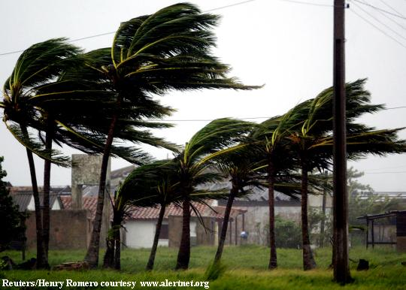
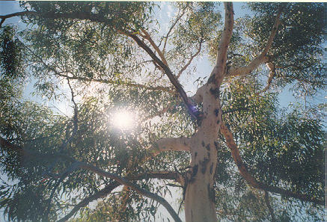
Measurements Are Often Not Simple or Complete
Gaps in the data
Quiet nights
Bird poop
High winds
Batteries die
Curious hikers/animals
Rivers flood
Difficult to make measurements
Leaf area index
Wood respiration
Soil respiration
Localized measurements – tower footprint
Local investigator knowledge important
Science goals and standards are often not uniform across the groups taking measurements

Slide 10
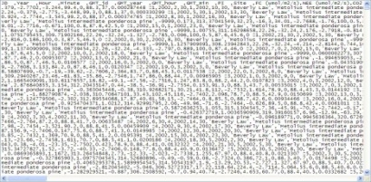
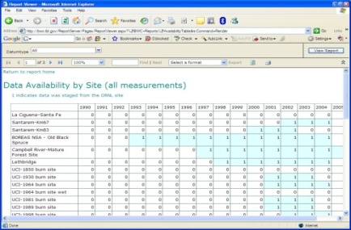
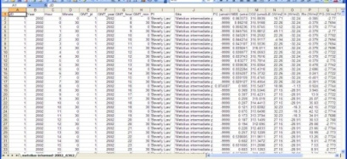

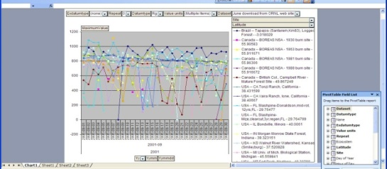
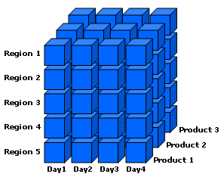
Scientific Data Server
Reports, Web Services, Pivot
Table and Pivot Chart, Matlab Interface, Statistics Packages
CSV Files
Data Archive
Web Site
Database Server
Data Cube

Slide 11
Scientific Analysis Server - Logical Overview
Data Mining
Data Ingest
Data Cubes
Data Server
Quality Assessment
Cross-Data Set Quality Assessment
Science Specific Computations
Regional and Global Level Synthesis of Data

Slide 12


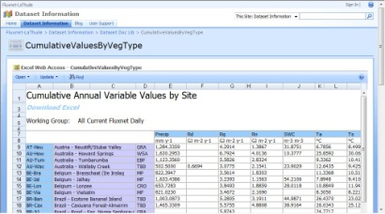
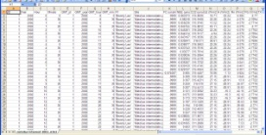
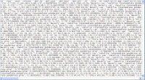
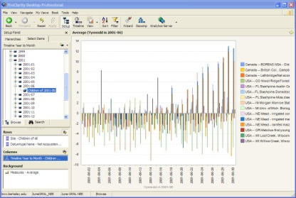
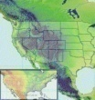
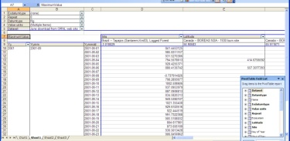
Ideal Science Server
Standardized Data Mining and Statistical Computations
Database
Ingest
Investigator Supplied Science Computations

