Slide 1
Use of the OSW Hydroacoustics Community Forum
OSW Webinar:
May 22 and 28 2008
Mike Rehmel
Notes:
During this session we are going to discuss how an ADCP measures velocity. This will set the stage for understanding the different water modes, lay the foundation for configuring some of the direct commands, and provide a basic understanding of the indicators used to assess the quality of the velocity measurement. This lecture by necessity has some theoretical concepts in it, but they have been reduced to the minimum needed to understand selected key concepts. We have attempted to give you the whole truth without the complex mathematics and without compromising the complexity and variables involved, however, for simplicity some of the complexity of the instrument is being ignored in this presentation.

Slide 2
Topics
Forum Uses
Forum Versus Mailing List
Overview of Functionality
Summary of issues…

Slide 3
Forum Uses
The Hydroacoustics Community forum is maintained by the USGS, Office of Surface Water for sharing information regarding the application of acoustics to the measurement of streamflow, water velocity, and other hydraulic parameters.
The forum can also be used to disseminate important information regarding quality assurance practices, training, etc.

Slide 4
How does the Forum differ from the Mailing list?
Mailing list
Good for sending out information to a large audience
Uses email - Allows people to send and receive topics without an additional interface
The Acoustics mailing list is still in use
Forum is more structured
Divided into categories with ability to add new
Topics are easy to follow
Allows people to only visit/receive updates on categories they are interested in
More efficient to exchange files
Requires people learn an additional interface

Slide 5
Interactive OverView

Slide 6
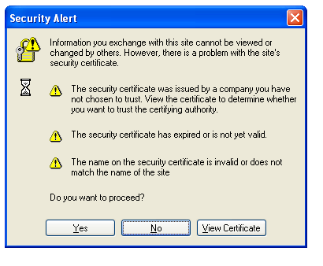
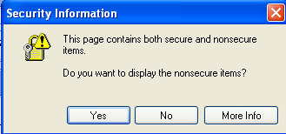
Current Issues
Forum Address
https://simon.er.usgs.gov/smf/ (note “s” is required)
Will like get a new name and url
Security Alerts
Security certificate issues should be resolved with future IT changes

Slide 7
Questions?
Spread the word….
If more people use the forum, the forum will become more useful to more people.
https://simon.er.usgs.gov/smf/

