Slide 1

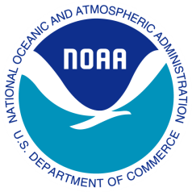
2008 Satellite Direct Readout Conference
Mary M. Glackin
Deputy Under Secretary for Oceans and Atmosphere NOAA December 8, 2008

Slide 2
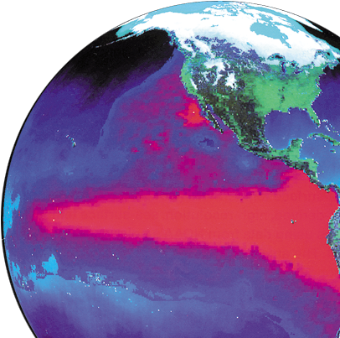
NOAA’s Mission
To understand and predict changes in Earth’s environment and conserve and manage coastal and marine resources to meet our nation’s economic, social, and environmental needs
Notes:
Picture of El Nino Event

Slide 3

NOAA’s Vision
An informed society that uses a comprehensive understanding of the role of the oceans, coasts, and atmosphere in the global ecosystem to make the best social and economic decisions
NOAA Touches The Lives Of
Every American Every Day

Slide 4
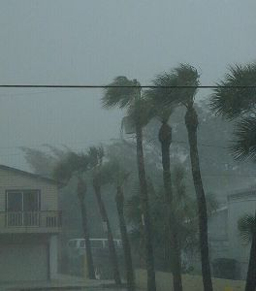
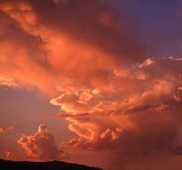


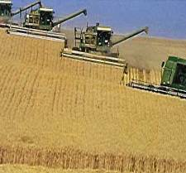
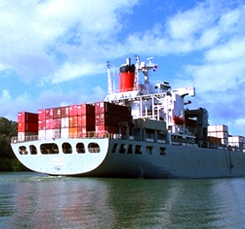


NOAA Data & Information are Essential for…
Hazards, Severe Weather, Watches, Warnings
Climate
Ocean
Transportation
Environmental
Monitoring
Agriculture
Commerce
Industry

Slide 5
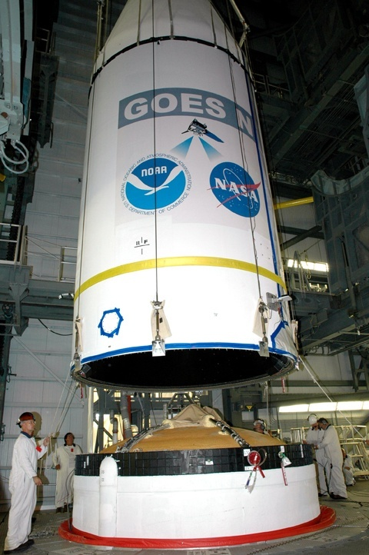
Supporting NOAA’s Mission Why are satellite-based observations key?
Satellite data allow for medium and long-range weather forecasting and climate analysis
Save lives and minimize property damage from severe weather
Assist with disaster mitigation
Support a broad range of environmental monitoring
Weather, climate, oceans, coasts, and ecosystems
Allow the general public to make informed decisions
NOAA satellite images are on TV every day

Slide 6
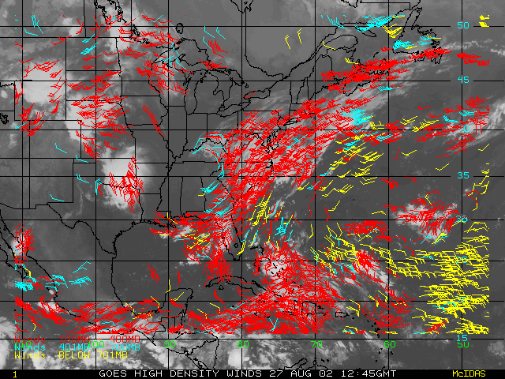
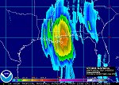
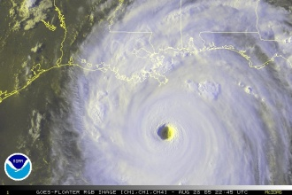
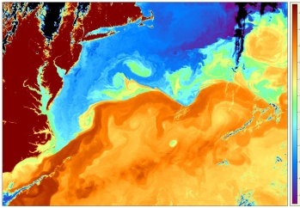
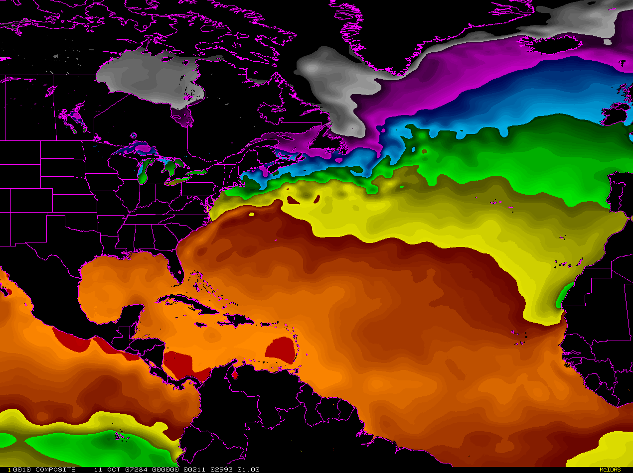
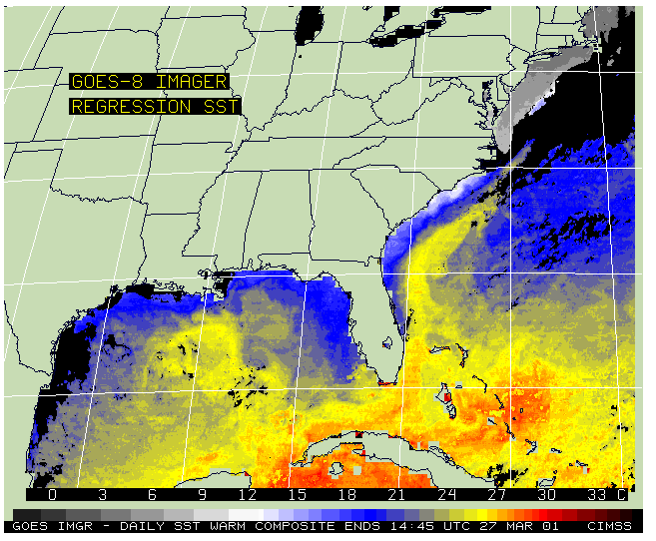
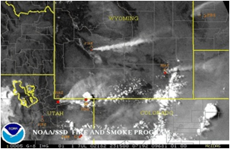
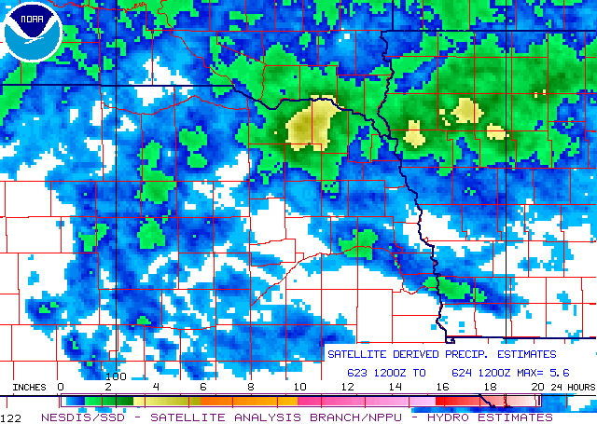
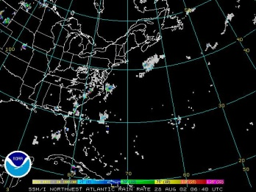
NOAA Products and Services
Atmospheric Products Aerosols, Clouds, Fire & Smoke, Ozone and Atmospheric Chemistry, Precipitation, Radiation Budget, Soundings, Volcanic Ash, Winds
Ocean Products Coral Bleaching, Ocean Color, Sea & Lake Ice, Sea Surface Height, Sea Surface Temperatures, Harmful Algal Blooms, Chlorophyll, Ocean Surface Wind Speed and Direction.
Land Products
Fire & Smoke, Rain, Snow & Ice, Surface & Hydrology, Vegetation
Notes:
6

Slide 7
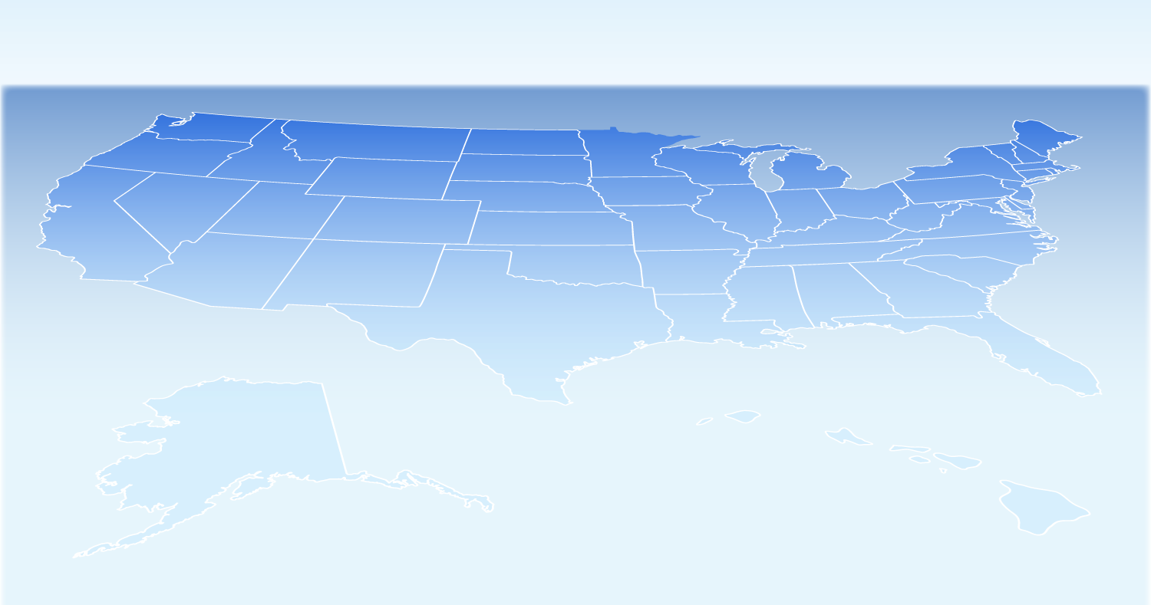
NOAA is Vital to the Economy and Lives
Tornado Warnings 1992-2004
prevented over 330 fatalities
prevented 7800 injuries
socioeconomic benefit of over $3 billion
Healthy coastal ecosystems provide clean beaches
host over 910 million trips/year
support millions of jobs
generate $44 billion in spending
Aviation Forecasts $580 million per year savings
Hurricane forecasts
Save $640,000 per mile
Flood losses
$240 million in economic benefits per year
Tsunami detection buoys faster and more accurate warnings protect lives and property

Slide 8
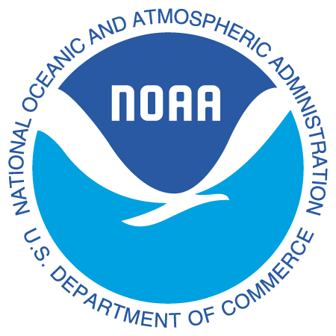

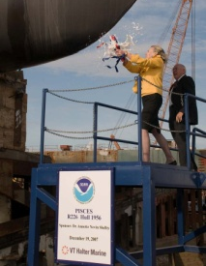














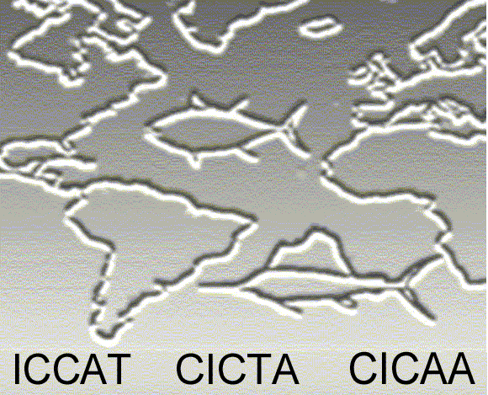


NOAA’s Partnerships
To meet today’s and tomorrow’s challenges, NOAA relies on active partnerships
GOVERNMENT
PRIVATE SECTOR
INTERNATIONAL
Non-GOVERNMENTAL ORGANIZATIONS
ACADEMIA

Slide 9
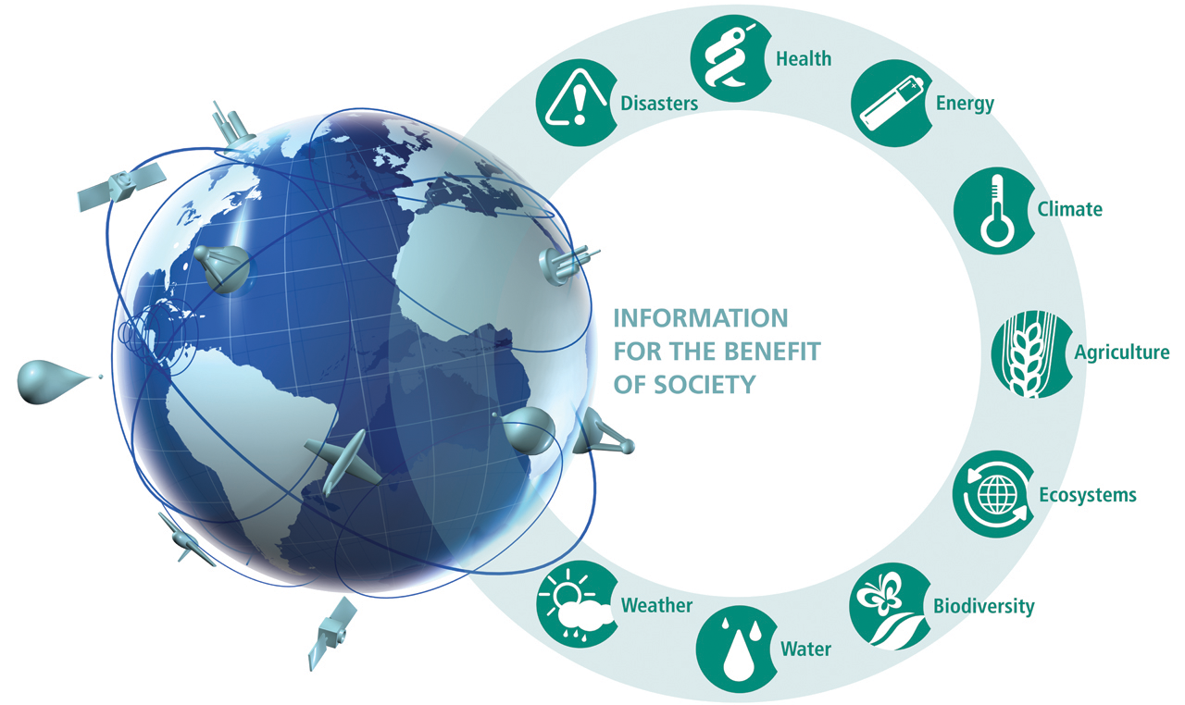

Group on Earth Observations (GEO)
GEO is coordinating international efforts to build a comprehensive, coordinated and sustained GEOSS
Notes:
9

Slide 10
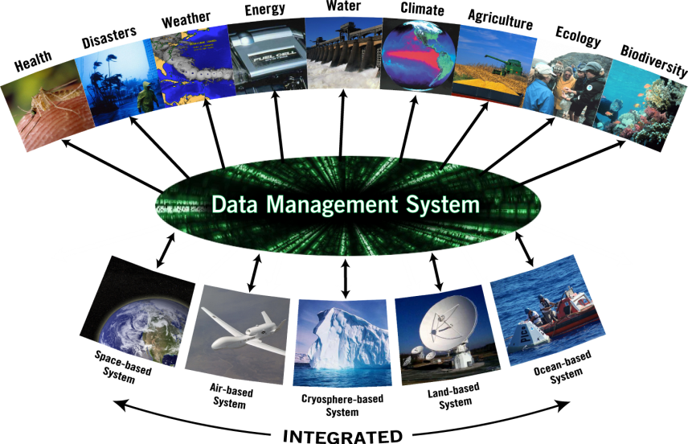
Global Earth Observation System of Systems (GEOSS)
Environmental Information Systems

Slide 11
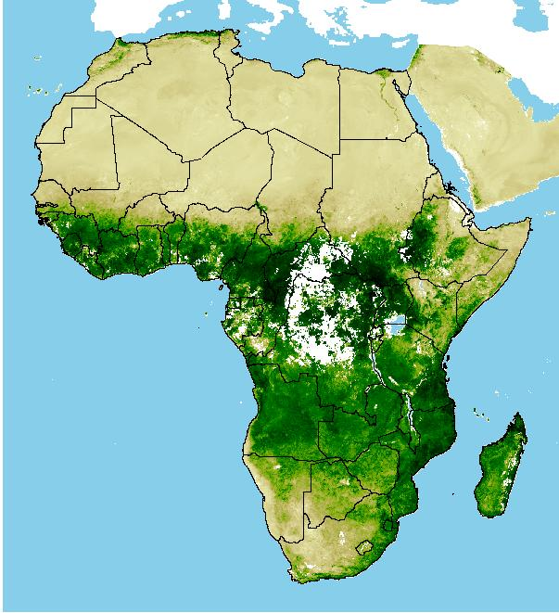
Predicting, Preventing, Preparing
NASA/USGS/NOAA

Slide 12
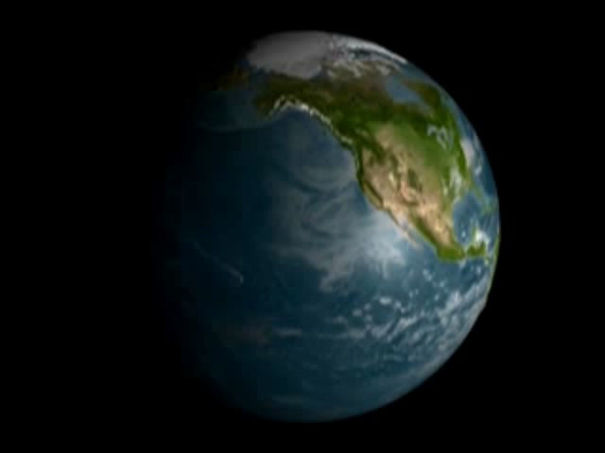
Visualizing Movement of Polluted Air

Slide 13
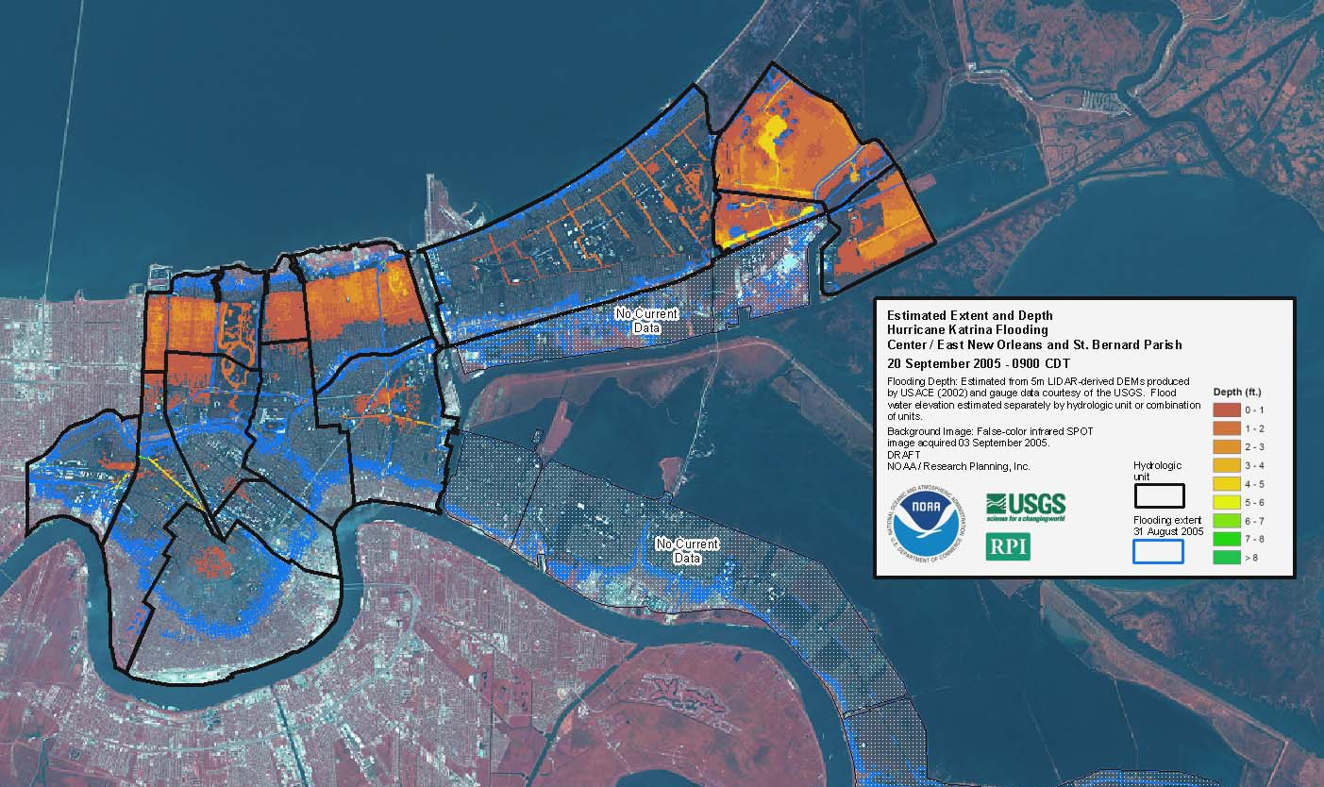
New Orleans Flood Map

Slide 14
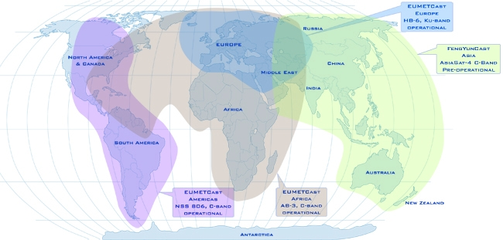
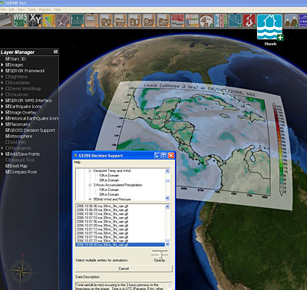
GEONetCast & SERVIR
Current GEONetCast Coverage
SERVIR Project
GEONETCast and SERVIR address key issues — data access and utilization — which are critical to every member of GEO
SERVIR Viz (IAGT ©)
Notes:
14

