Slide 1
Load Lock Gun2 Status Update & (Revisionist?) History
Load lock gun worked very well in the Test Cave, with very good photocathode lifetime.
Once installed in CEBAF (7/07) the gun functioned well, but with very poor lifetime.
During the 9 months of Physics we used every opportunity to investigate what changed…
Vacuum
Extractor gauge indicated vacuum OK, but what about small leak?
Leak checking suffered from no HV RGA and noisy Prep RGA
Hi-potting HV ion pump eventually lead to FE pump
HV chamber received RGA and new pump => found vacuum OK
New pump broke during bake out
Vacuum work has not been straight-forward, however, appears OK
Laser retroreflection
All measurements in Test Cave extracted the unused laser light
This is not the case in CEBAF
Very difficult to troubleshoot/fix with NEG tube and infrared laser
Primary job for the SAD is to understand and fix LLGUN2 problem.

Slide 2
6/12 – Virgin superlattice (SLSP-5246-1) + Verdi DC green laser installed
QE ~1% @780nm and ~15% @ 532nm
Verdi helps because the beam case be easily seen in a safe way
6/17 – Again, we tried to move the gun to see a laser retroreflection
Never a clean reflection from wafer, often a reflection from metal surface (NEG tube)
Single NEG bellows constrains location/angle of HV chamber (and photocathode)
Best effort alignment => lifetime still poor, with “mock up” of Test Cave
Lifetime still low in 0.25-0.4 mA range w/ fiber laser
Did not run w/ DC? Decided not right direction…
6/19 – Replace NEG tube with vacuum windows
Gun side
Take advantage of venting HV chamber, so replaced ion pump => goes well
Able to visually inspect photocathode in/with electrodes => looks OK
Added window
Valve side
Take opportunity to add “diagnostics cross” w/ RGA => leaky issues, but finally OK
Added window
Diagnosis
RGA leak check => OK, no leaks found
Visual alignment => clearly see laser window aperture is OK, although window hazy
Laser alignment => first time to see reflected Verdi from photocathode => ~1 deg off

Slide 3
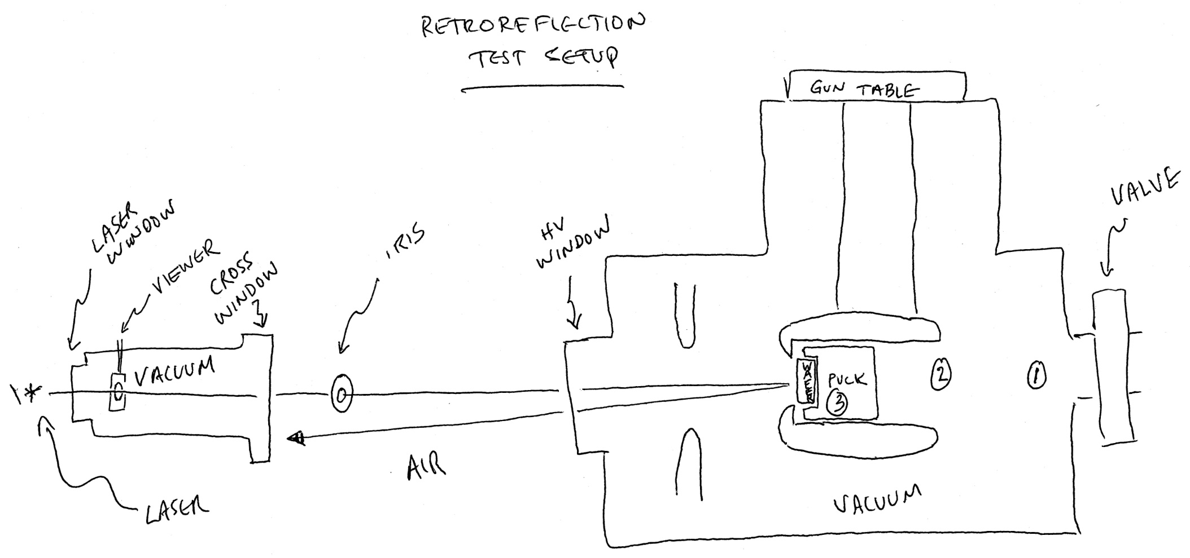
7/2 – Bake HV chamber so we can transfer pucks
Took opportunity to test integrity of HV support tube => OK, laser spot steady
HV chamber bakeout => goes very well
7/7 – Tested puck4 (bulk anodized wafer)
Very reproducible, laser spot reproduces
7/8 – Tested all 4 pucks
Put each in at 6 orientations, measured reflection at 3 locations

Slide 4
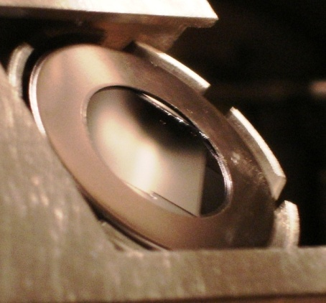
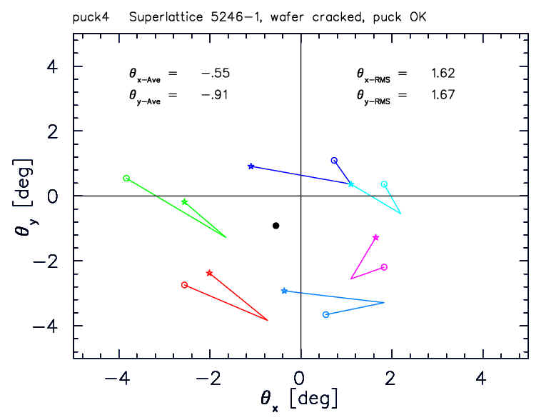
Puck 4

Slide 5
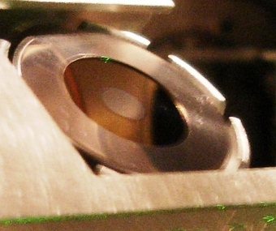
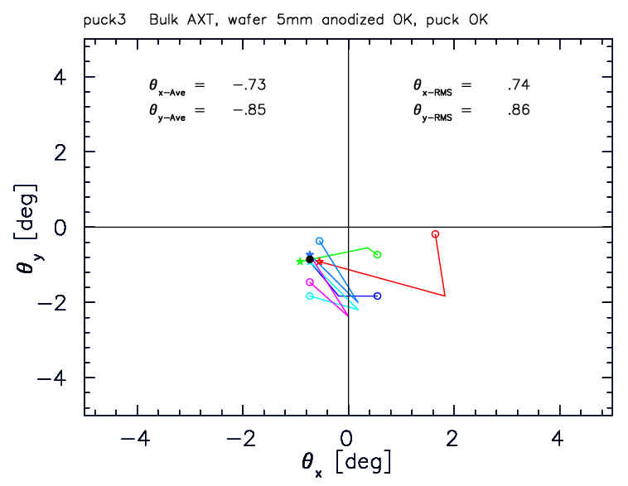
Puck 3

Slide 6
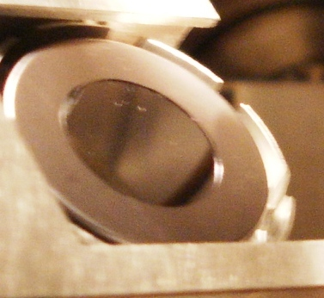
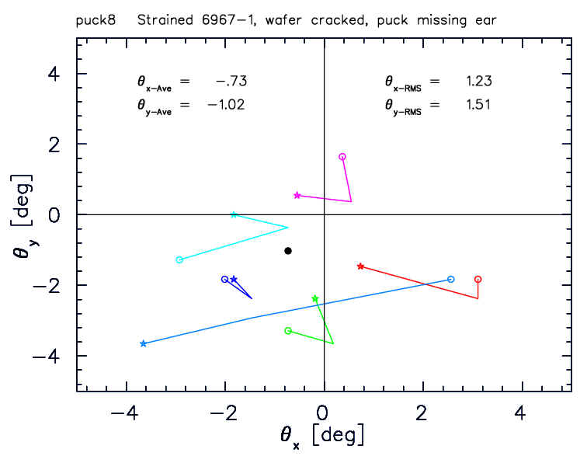
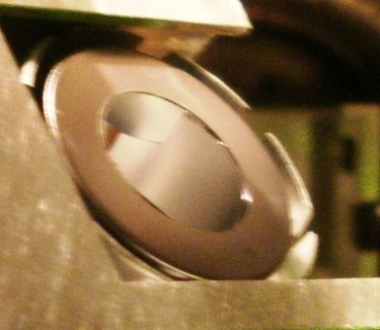
Puck 8
Test => cracked

Slide 7
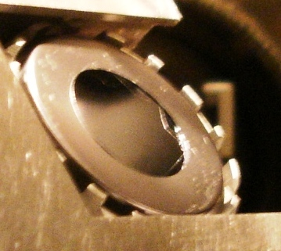
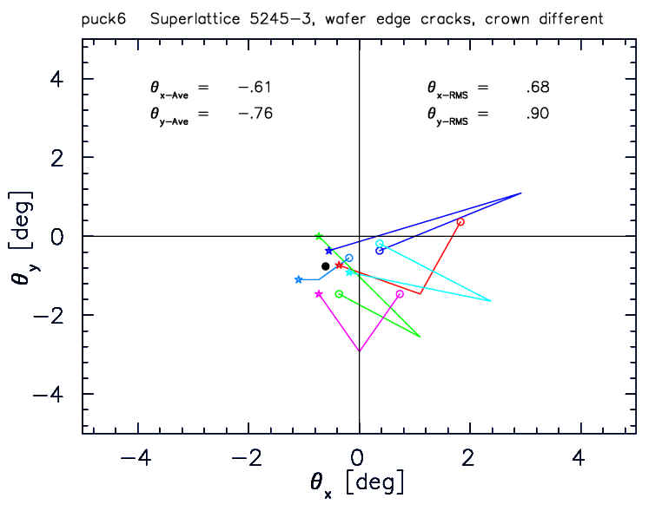
Puck 6

Slide 8
Retroreflection Summary
Puck | Wafer | Status | Puck | Retro | Mean [deg] | RMS [deg] | Tilt [deg]
#4 | SL5246-1 | Cracked | OK | BAD | -0.55, -0.91 | 1.62, 1.67 | 2.0
#3 | AXT-5mm | OK | OK | GOOD | -0.73, -0.85 | 0.74, 0.86 | 0.2
#8 | S6967-1 | Cracked | No ear | BAD | -0.73, -1.02 | 1.23, 1.51 | 1.4
#6 | SL5245-3 | OK (edge) | Crown | GOOD | -0.61, -0.76 | 0.68, 0.90 | 0.6
7/10 - To validate our conclusions, we’ll replace two BAD pucks with test pucks:
One polished to a mirror surface (removes uncertainty of wafer mounting)
One bulk mounted per “best practice”
Use “new” QA process (measure retroreflection from rotated puck or sample):
Mirror reference ~0.05 deg
Polished puck
w/ lint free ~0.2 deg
wo/ lint free ~0.1 deg
Puck w/ wafer wo/ lint free ~0.2 deg

Slide 9
7/17 - What’s now & next (last?)…
Complete puck transfer
Verify alignment with QA’d pucks (mirror puck & wafer puck)
If OK, set gun into final position
Survey group measure position of gun & laser reference line
Install new 2-bellows NEG tube (vent cross + HV + new pedestal)
HV + NEG bakeout
Survey group set solenoid on laser reference line, verify HV chamber still OK
Recheck laser retroreflection vs. rotation
If possible, make a photocathode, beam and check lifetime
If OK, load 4 final pucks
Pass out

