Slide 1
USGS Instantaneous Data Archive
D. Phil Turnipseed, P.E.
Office of Surface Water
Reston, Virginia
SWD USACE/NWS/USGS Meeting
March 27, 2007

Slide 2
What are USGS “Instantaneous Data”
Historically, USGS has primarily published daily data (mean, max, min);
“Instantaneous Data” – 5 minute to 60 minute data used to compute the daily values (typically 15-min);
Instantaneous data are stored in the WSC NWIS database from mid-1980s, but generally not “cleaned up” to publication standards;

Slide 3
What is the USGS Instantaneous Data Archive (IDA)
On-line publicly-accessible repository of available instantaneous data corresponding to the period of published daily data.

Slide 4
IDA Challenges
Numerous instantaneous data types (discharge, stage, water quality, precipitation, etc)
Various storage formats (NWIS, spreadsheets, paper tape, graphical charts, etc)
Instantaneous data not cleaned up to daily value “publication standards” (backwater, instrumentation problems, spikes, etc)
Multiple data sources (primary and backup recorders, instrumentation updates, etc)
Very time consuming and expensive to clean-up historical data (one site with 15-min data for 20 years has over 700,000 data points)

Slide 5
IDA Initial System Design
Discharge data only
Use historical data already in NWIS database (generally from mid-1980s)
Data quality assured using automated and manual checks, but not processed and corrected to similar “publication standards” as daily values

Slide 6
IDA Discharge Data Automated QA Tests
Compute daily mean value from instantaneous data, compare to published daily mean, assign QA code based on comparison.
Code 0 – near zero values
Code 1 – matches within 1 percent
Code 2 – matches from 1 to 5 percent
Code 3 – matches from 5 to 10 percent

Slide 7
IDA versus NWISWeb
NWISWeb – real-time instantaneous data, most recent 30 days
IDA – instantaneous data corresponding to period of published daily data
Potential gap up to 18 months between data in NWISWeb and data in IDA

Slide 8
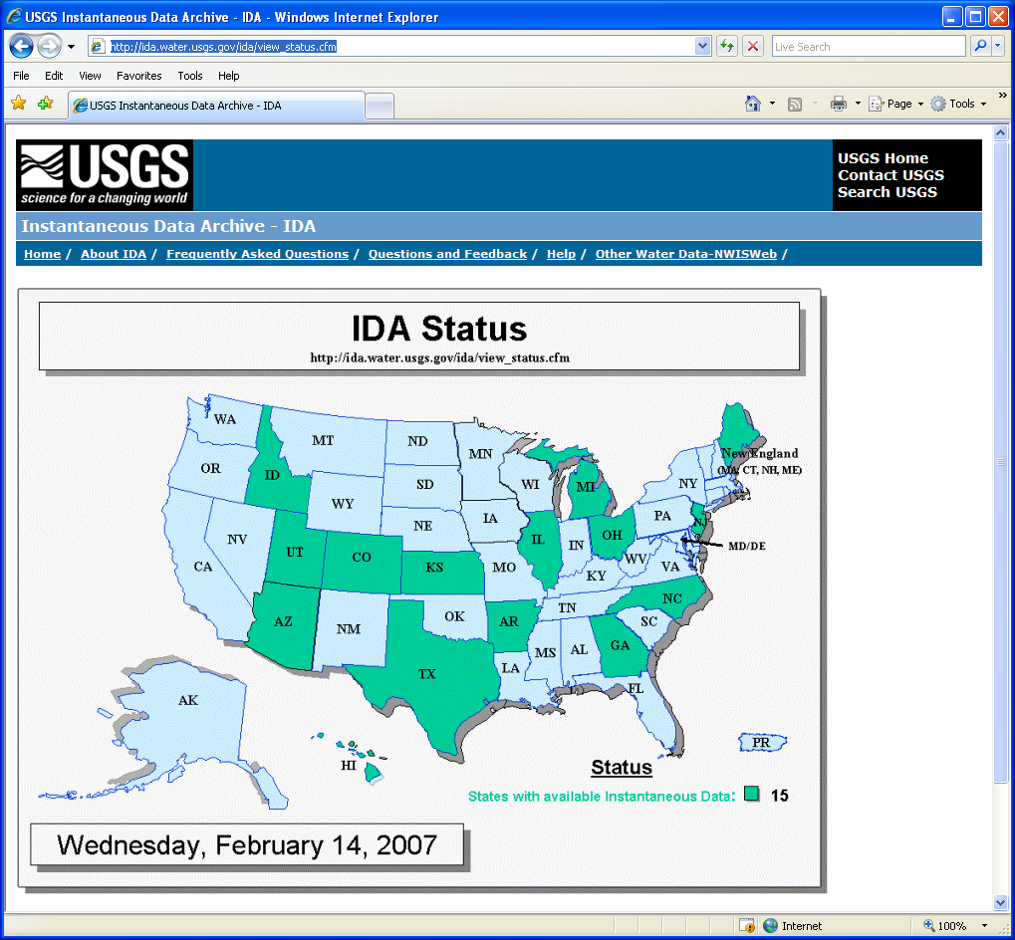
IDA Current Status
15 States

Slide 9
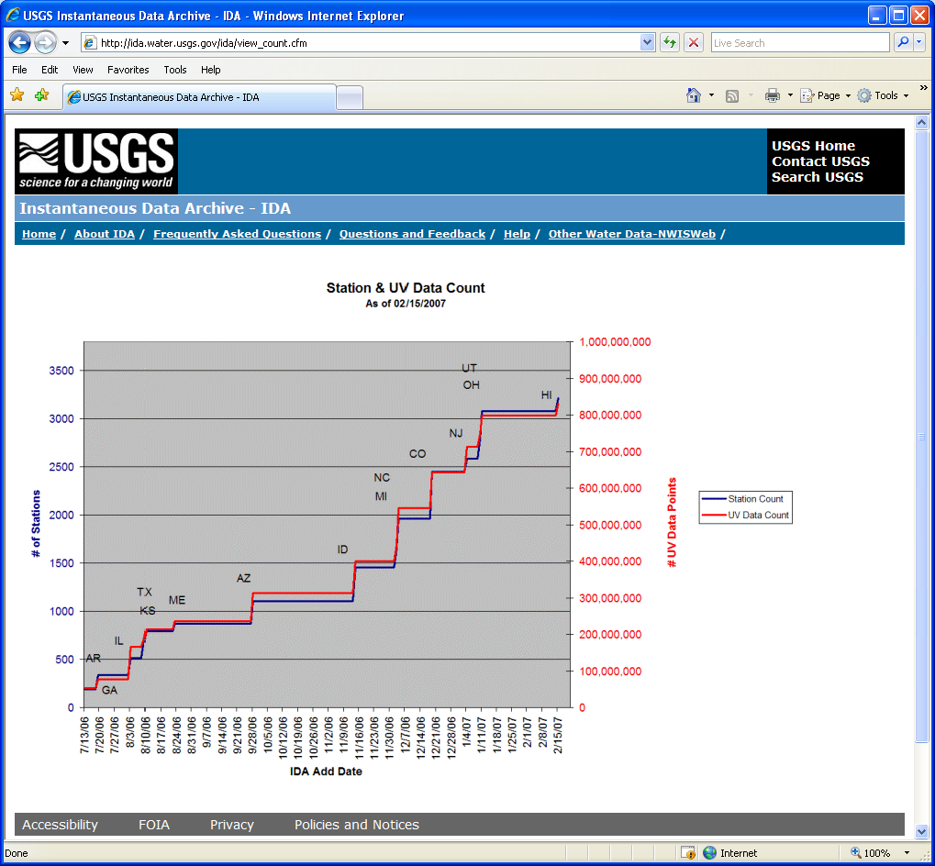
IDA Current Status

Slide 10
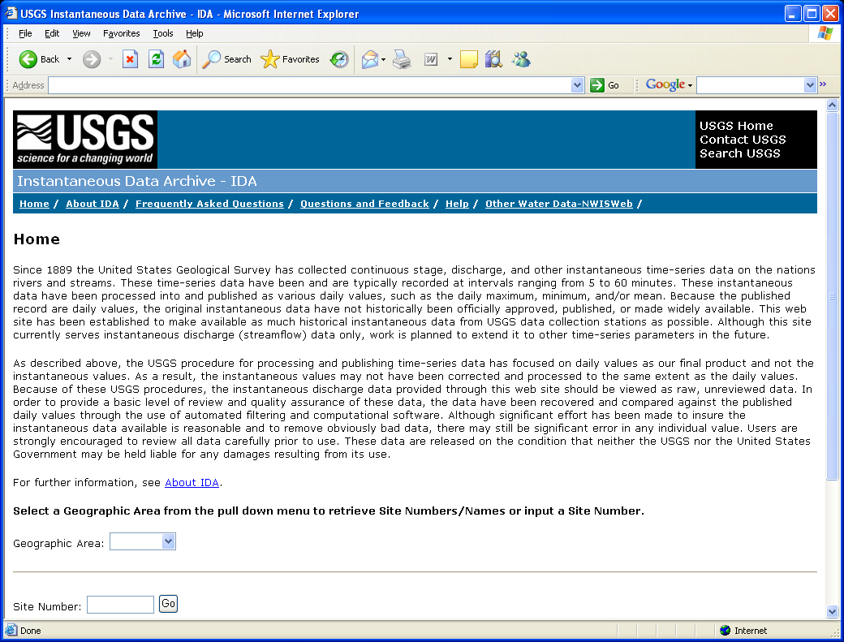
IDA Web Interface
Search by:
Geographic Area
Site Number

Slide 11
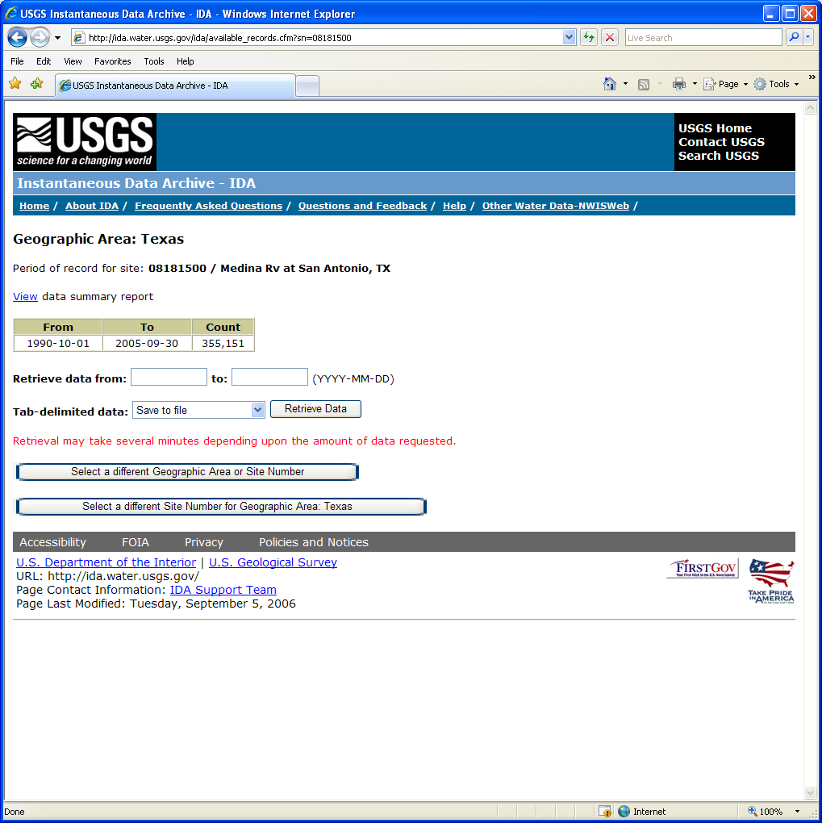
Example IDA Site Page
Period of available data
Number of data values
View summary report
Retrieve data

Slide 12
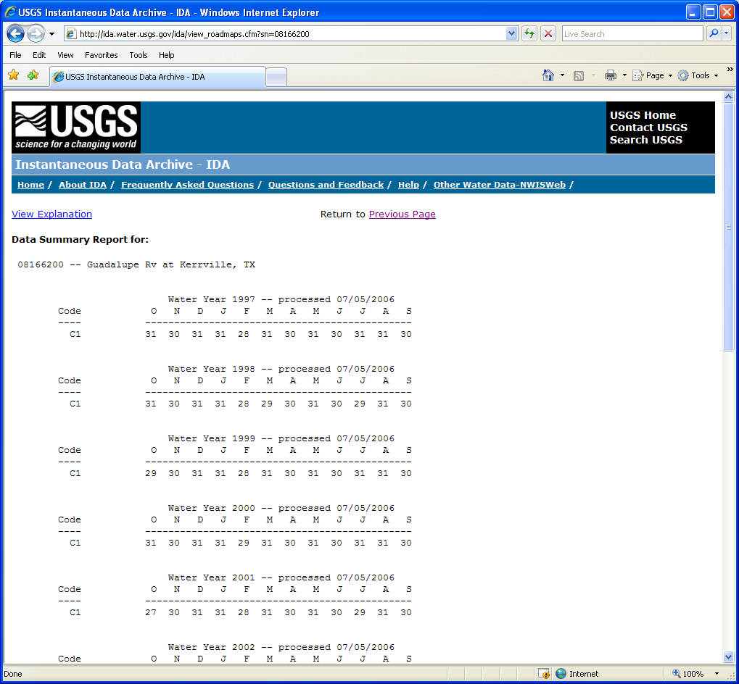
Example IDA Site Summary Report
Number of days per month with data, grouped by accuracy code and water year

Slide 13
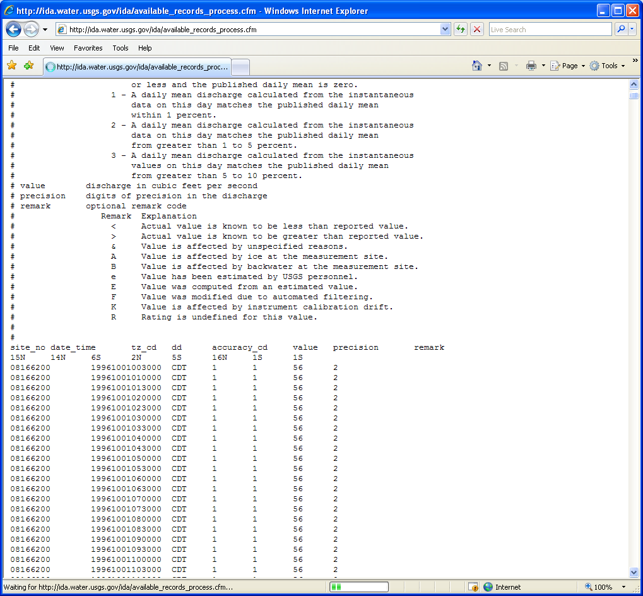
Example IDA Data Retrieval
Lists date retrieved
Header has field definitions
Data values
QA codes

Slide 14
IDA Plans
Short Term
Populate with discharge data from all WSCs
Open to USACE and NWS after additional WSCs have added data
Open to the Public
Long Term
Add other data types
Close 18 month gap between IDA and NWISWeb

