Slide 1
Automating One-loop Amplitudes For the LHC
Darren Forde (SLAC)
In collaboration with C. Berger, Z. Bern, L. Dixon, F. Febres Cordero, T. Gleisberg, D. Maitre, H. Ita & D. Kosower.

Slide 2
Overview
Why do we need one-loop amplitudes?
Why do we need new techniques?
The need for automation
“BlackHat”
Notes:
2

Slide 3
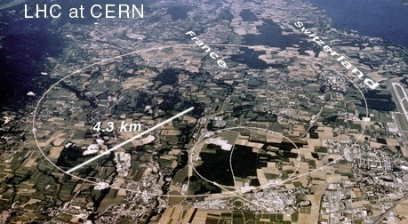
What’s the problem?
The LHC
Maximise its discovery potential

Slide 4

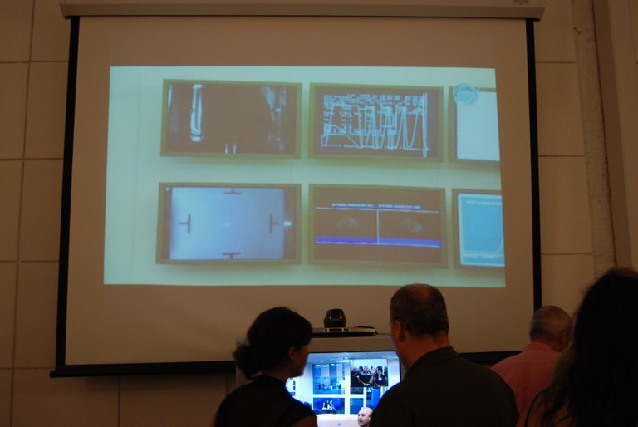

Switch On
A major event, even google commemorated it!
Celebrations, Swiss embassy annex in San Francisco.

Slide 5
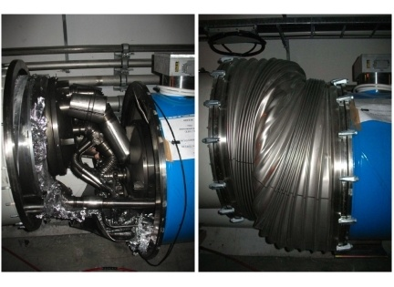
Started With A Bang
First beams successful circulated! Ran for 9 days.
Unfortunate incident caused by bad solder joint.
Delayed until Oct 2009.

Slide 6
New Physics
Use the LHC to discover new physics.
many possibilities: Higgs? SUSY? Extra-dimensions? …
“New” particles typically decay into Standard Model (SM) particles and/or missing energy.
Will we be able to distinguish this new physics from the SM?

Slide 7
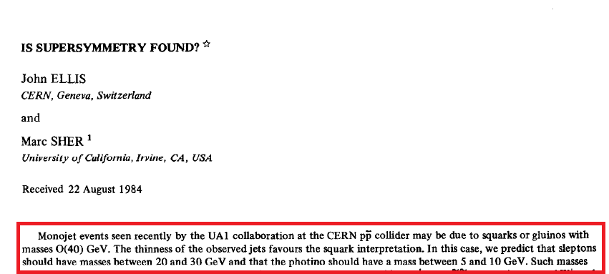
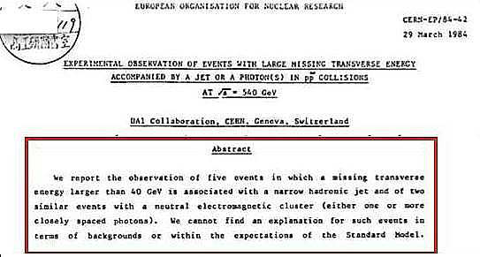
Avoid “Discovering” SUSY
No new physics. A precise understanding of the Standard Model accounted for this.
Need to be careful when claiming a discovery!

Slide 8
Searching for SUSY
Outline of a SUSY Search (Early ATLAS TDR).
Predict background using PYTHIA.
Compute background at Leading Order (ALPGEN) ⇒ better prediction.
SUSY Signal
Original background
⇒ easy to see signal
Signal and background now overlap and
have a similar shape.
[Gianotti,Mangano]

Slide 9
Is Leading Order Good Enough?
Look at data/theory.
CDF data for W + n jet cross sections. Theory Monte-Carlo + Parton Showers (incl. LO) and NLO computation. [T. Aaltonen et al. [CDF Collaboration]]
NLO using MCFM
Alpgen + Herwig
MadGraph + Pythia
Normalisation does not match experiment
No NLO results
for >2 jets
Notes:
Useful for verifying theory backgrounds in high multiplicity events

Slide 10
Normalisation & Shapes
NLO computations can give more than the correct normalization, (i.e. a K-factor).
Examine data/theory for the E_{t} distribution of the first jet. [T. Aaltonen et al. [CDF Collaboration]]
LO does not get the shape correct here, NLO does.
NLO : MCFM
NLO is flat
⇒ Match data
LO : Alpgen + Herwig

Slide 11
Shapes & Scale Dependence
Shapes of distributions become more accurate and scale dependence reduces at NLO.
Rapidity Distribution for an on-shell Z at the LHC. [Anastasiou,Dixon,Melnikov,Petriello]
Reduced scale dependence by going
to the next order.
Examine scale dependence to gauge our “trust” in our perturbative computation.
Complete result independent of scale choice.

Slide 12
Beyond NLO
Change of shape ⇒ K-factor differs for different rapidity's, [Anastasiou,Dixon,Melnikov,Petriello]
Also precise theory knowledge needed for luminosity determination, PDF measurements, extract couplings, etc.
NNLO/LO
NLO/LO
NNLO/NLO
⇒ NLO predicts
the shape well

Slide 13
NLO Corrections
Many important processes already know but some are still missing.
Example : W + n jets, an important process at the LHC, (backgrounds in searches etc.)
Loop amplitudes are the bottleneck.
“State of the art” using standard (Feynman) techniques is generally 5-point (limited 6-point results i.e. six quarks).

Slide 14
A History of One-Loop (W + n jets)
What about W+4 jets, another 15 years? No, within reach.
Amplitudes : | Early 80’s [Ellis, Martinelli, Petronzio] | 1996 [Bern, Dixon, Kosower], | 2008
NLO Corrections : | Mid 80’s [Arnold, Ellis, Reno], | MCFM 2002 [Campbell, Ellis] | 2009
W+1jet
~15 Years
W+2 jets
~15 Years
W+3 jets
Required new techniques
Required more new techniques

Slide 15
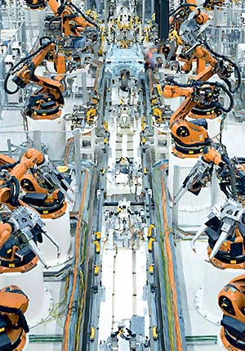
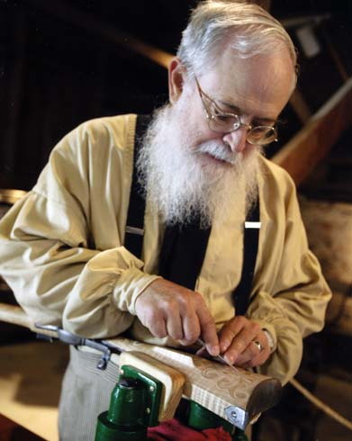
Automation
We want to go from
A_{n}(1⁻,2⁻,3⁺,…,n⁺), A_{n}(1⁻,2⁻,3⁻,…,n⁻),A
A_{n}(1⁻,2⁻,3⁺,…,n⁺)

Slide 16
Towards Automated Tools
Want numerical methods, let the computer do the hard work!
Numerical approaches using Feynman diagrams for high multiplicity amplitudes (n>5) difficult.
Challenge to preserve numerical stability.
New generation of automatic programs from new methods.
“BlackHat”- n-gluons, first computation of leading colour W+3 jet amplitudes. [Berger, Bern, Dixon, Febres Cordero, DF, Ita, Kosower, Maître]
“Rocket”- n-gluons, complete W+3 jets, tt+3 gluons. [Ellis, Giele, Kunszt, Melnikov, Zanderighi],

Slide 17
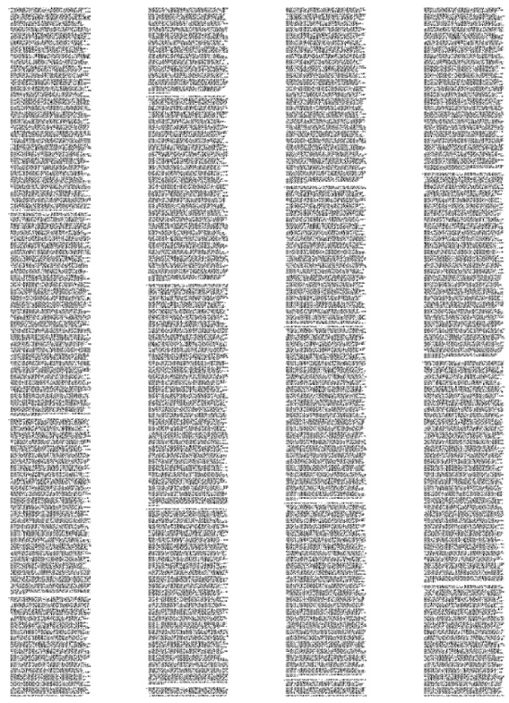
Why do we need new methods?
Schwinger and Feynman showed us how to compute loop amplitudes, so what’s the problem?
Use Passarino-Veltman to decompose a tensor one-loop integral into a sum of scalar integrals (one of many terms in an amplitude)

Slide 18
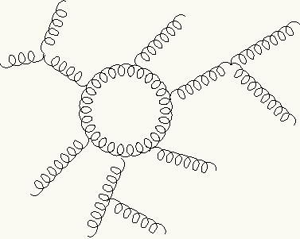
Complicated results
A Factorial growth in the number of terms.
“Each term effectively carries the same complexity as the combination of all the diagrams.”
6 gluons
~10,000 diagrams.
7 gluons
~150,000 diagrams.
n gluons
∞ diagrams.
Gauge dependant
quantities,
large cancellations
between terms.
Final results seem very large.

Slide 19
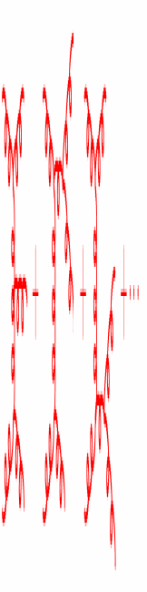
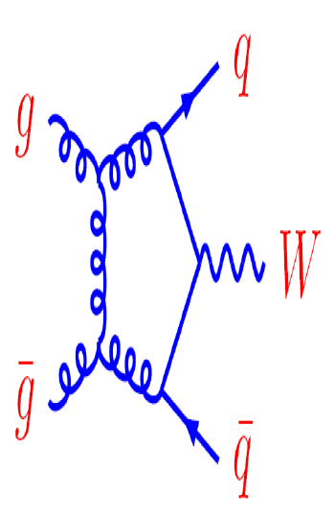
On-shell Off-shell
Propagators go off shell, all four components are free.
In a loop the loop momentum is off-shell.
Want to work with on-shell quantities only i.e. amplitudes.

Slide 20
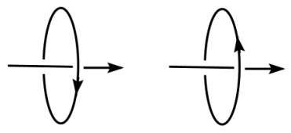
Spinor helicity
Appropriate choice of variables gives simpler/more compact results.
Describe all momenta using spinors carrying +’ve or -’ve helicity.
Rewrite all vectors in terms of spinors e.g. polarisation vectors.
Products of spinors are related to Lorentz products.

Slide 21
Simple results!
Calculated amplitudes much simpler than expected.
Look at different spin components of an amplitude (textbooks usually teach us to sum them all together).
Amazing simplifications! e.g. all gluon amplitudes. [Parke, Taylor] (proved using Berends-Giele recursion relations)
Need a better computational technique.
Maximally Helicity Violating (MHV) Amplitude
+
+
i⁻
+
A_{n}
A_{n}
±
=0
+
+
+
j⁻
+
Arbitrary number of legs.

Slide 22

New techniques & the Complex Plane
A key feature of new developments is the use of complex momenta.
We can then, for example, define a non-zero on-shell three-point function,
All other tree amplitudes can be built from just this. (For most field theories this is not obvious at all!)
Take better advantage of the analytic structure of amplitudes.
^{p}₁
^{p}₃
^{p}₂

Slide 23
Amplitudes and the Complex Plane
An amplitude is a function of its external momenta (and helicity).
Shift the momentum of two external legs so that they become complex. [Britto, Cachazo, Feng, Witten]
Keeps both legs on-shell.
Conserves momentum in the amplitude.
Introduces poles into the amplitude.
Only possible with
Complex momenta.

Slide 24
A simple idea
Tree amplitude contains only simple poles
Amplitude given by the sum of the residues at these poles.
pole
z
Contour Integral
Cauchy’s Theorem
A_{n}(0), the amplitude with real momentum.
This is what we want.

Slide 25
A simple idea
Amplitude is a sum of residues of poles.
Location of these poles given by factorisations of the amplitude.
Relate the two
On-shell recursion
A_{n}
A_{<n}
A_{<n}

Slide 26
On-shell recursion relations
A_{n}
A_{<n}
A_{<n}
Only need amplitudes as intermediate leg is on-shell.
Build larger amplitudes from smaller.
Reuse existing results ⇒ Compact efficient forms.
Build up from just the 3-pt vertex.
Everything is On-shell ⇒ Good.

Slide 27
What about one-loop amplitudes?
A “simple” 5 gluon amplitude, [Bern, Dixon, Kosower]
More complicated analytic structure.

Slide 28
Structure of a 1-loop Amplitude
Trees, completely rational, only simple poles.
Divide a One-loop amplitude into two parts.
Use knowledge from tree level to compute?
Rational terms
Loop amplitude
Log’s, Polylog’s, etc.
Invariants of external momenta
e.g.
“Cut pieces” contain
branch cuts
e.g.

Slide 29
One-loop integral basis
Cut pieces described by a basis of one-loop integrals
Rational terms
Loop amplitude
Log’s, Polylog’s, etc.
Decomposition of any
one-loop amplitude
Want these coefficients
l
1-loop scalar integrals all known
[Ellis, Zanderighi]

Slide 30
Unitarity cutting techniques
Basic idea, “glue” together tree amplitudes to form a loop. [Bern,Dixon,Dunbar,Kosower]
Relate product of cut amplitudes to known basis structure.
Compute coefficients of integral basis.
Only computes terms with Branch Cuts,
4 dimensional cuts will miss rational terms.
On-shell tree amplitudes ⇒ Good
l
l
Cut 2 propagators
l-K
Cut legs in 4 dimensions.

Slide 31
Box Coefficients
Generalised Unitarity, cut the amplitude more than 2 times.
Quadruple cuts freeze the box integral ⇒ coefficient [Britto, Cachazo, Feng]
4 delta functions
In 4 dimensions 4 integrals,
⇒
No free components in the integral.
l₁
l₂
l₄
l₃
Scalar Box coefficient
In general only solve all constraints
with complex l^{μ}
Simply write down the answer,
a product of 4 trees!

Slide 32
Two-particle and triple cuts
Isolates a single triangle
What about bubble and triangle terms?
Triple cut ⇒ Scalar triangle coefficients?
Two-particle cut ⇒ Scalar bubble coefficients?
How do we extract these unique coefficients?
Additional coefficients

Slide 33
Extracting coefficients
Two-particle Cut Unitarity technique. [Bern, Dixon, Dunbar, Kosower]
OPP method - Solve for all the coefficients of the general structure of a one-loop integrand. [Ossola, Papadopoulos, Pittau]
Use the large parameter behaviour of the integrand. [DF]
Approach is very general.
Applied even to computing gravity and super gravity amplitudes. [Bern, Carrasco, DF, Ita, Johansson], [Arkani-Hamed, Cachazo, Kaplan]

Slide 34
Triangle Coefficietns
Apply a triple cut to an amplitude.
Three cut constraints on l^{μ}
One unconstrained parameter, t.
Previously computed from quadruple cut

Slide 35
Large Parameter Behaviour
Which piece of the integrand corresponds to the scalar triangle coefficient?
Choose parameterization of l^{μ}(t) so that all integrals over t vanish.
Coefficient given by piece independent of t.
Analytically : Limit in large t isolates this term.
Numerically : Discrete Fourier Projection around t=0.
Similar approach for bubbles.

Slide 36
Rational Terms
What about the remaining rational pieces.
Rational terms
Loop amplitude
Log’s, Polylog’s, etc.
Two approaches
implemented in BlackHat
Unitarity cuts not in 4 dimensions
Compute rational terms from cuts.
[Bern, Morgan], [Anastasiou, Britto, Feng, Kunszt, Mastrolia],
[Ellis, Giele, Kunszt, Melnikov, Zanderighi], [Badger], [Ossola, Papadopoulos, Pittau]
Rational terms consist of poles, use on-shell recursion.
[Bern, Dixon, Kosower], [Berger, Bern, Dixon, DF, Kosower]

Slide 37
Loops, Branch cuts & Rational Terms
One-loop amplitude on the complex plane ⇒ more complicated structure.
Shift external momenta by z.
z
Branch cuts
Poles
T
T
+
T
L
Integrate over a
circle at infinity
On-shell
recurrence relations
Unitarity
techniques

Slide 38
Loop On-shell recursion relations
Very similar to tree level recursion.
At one-loop recursion using on-shell tree amplitudes, T, and rational pieces of one-loop amplitudes, L.
L
T
L
L
T
T
T

Slide 39

BlackHat
Numerical implementation of the unitarity bootstrap approach in c++.
Tree amplitudes
On-shell recursion ⇒ Rational
One-loop Amplitude
Unitarity cuts
⇒ Cut-constructible
Rational building blocks
Much fewer terms to compute
& no large cancelations compared
with Feynman diagrams.
“Compact” On-shell inputs

Slide 40
Numerical Stability
How can we know that we can trust our results?
Rare exceptional momentum configurations, lead to numerical instabilities.
Caused by spurious singularities (Gramm determinants) in pieces that cancel in the sum of terms.
Rare but will occur when evaluating 100,000’s of points.
BlackHat Strategy :
Use double precision for majority of points ⇒ good precision.
For a small number of exceptional points use higher precision (up to ~32 or ~64 digits.)

Slide 41
Testing Numerical Stability
Need to know when you have a “bad” point.
Detect exceptional points using three tests,
Bubble coefficients in the cut must satisfy,
For each spurious pole, z_{s}, the sum of all bubbles must be zero,
Large cancellation between cut and rational terms.

Slide 42
6 Gluon amplitude
Precision tests using 100,000 phase space points with some simple “standard” cuts.
E_{T}>0.01√s, Pseudo-rapidity η>3, Δ_{R}>4,
Apply tests
No tests
Log₁₀ number of points
Recomputed higher precision
Precision

Slide 43
W+3 jet amplitudes
First computation of Leading colour contribution for W+3jets.
The dominant terms in NLO corrections.
Log₁₀ number of points
Precision

Slide 44
Next Steps
BlackHat computes amplitudes, use these to compute observables and cross sections.
Interface with automated programs for the tree level pieces of an NLO computation.
Example : Use SHERPA
BlackHat produces one-loop amplitudes. (virtual part)
SHERPA computes tree amplitudes for the NLO term (real part).
SHERPA does the phase space integration of real and virtual. Including automatic subtraction of IR poles. (Catani-Seymour dipole subtraction)

Slide 45
W+3 jets at NLO
Compute all Leading Colour (large N_{c}) sub-processes.
From W+1 and 2 jets expect remaining sub-leading terms to contribute a few %.
Single sub-process. [Ellis, Melnikov, Zanderighi]

Slide 46
W+3 jets at NLO : E_{t} of third jet
Cuts : E_{T}^{e} > 20 GeV, |η_{e}| < 1.1, E _{T}  > 30 GeV, M^{W}_{T} > 20 GeV, and E_{t}^{jet} > 20 GeV.

Slide 47
Transverse Energy distribution, H_{t}
Total transverse energy

Slide 48
Di-jet Mass Distribution
Di-jet mass of
leading two jets.

Slide 49
Further Steps…
Produce more NLO results. (Full Colour W+3 jets, W+4 jets,…)
Interface with other phase space integration codes, e.g. MadGraph.
Incorporate BlackHat Amplitudes into NLO Parton shower programs.
Also expand the processes we can deal with, i.e. include more masses.
Straightforward to do, the procedure is completely general.

Slide 50
Conclusion
New Results
Leading colour W+3 jets at NLO
BlackHat
Uses unitarity and on-shell recursion.
Good control of numerical instabilities.
Automatic production of one-loop amplitudes.
Interfaced with SHERPA.
Tested many processes.

