Slide 1
Office of the Federal Coordinator for Meteorological Services and Supporting Research (OFCM)
Notes:
1

Slide 2
Overview
Mission
Perspective
Federal Coordinating Infrastructure
Partners and Affiliations
Flow of Information/Coordination
Primary Products and Services
High Priority Activities
Facilities and Personnel
Budget
Urgent Issues
Notes:
2

Slide 3
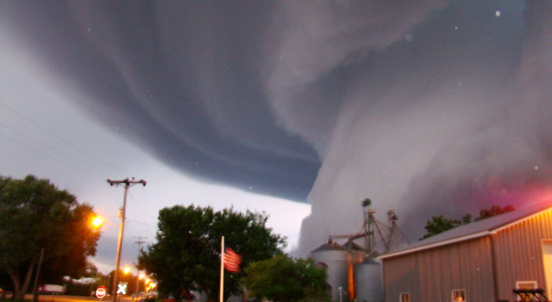
Mission
To ensure the effective use of federal meteorological resources by leading the systematic coordination of operational weather requirements, services, and supporting research, among the 15 stakeholding federal agencies and offices.
High-level focus on:
Needs and requirements
Issues and problems
Studies, reports, plans, and handbooks
Crosscut reviews, assessments, and analyses

Slide 4
Perspective 44+ Years of Results
R&D and Technological Breakthroughs
Interagency oversight of NEXRAD—1st successful tri-agency program
Improved reconnaissance – dropwindsondes, satcom, SFMR
Lightning Detection – national network established – late ’80s
Aviation Safety – Icing, hazards, support to FAA R&D program
Today: Phased Array Radar, Tropical Cyclone R&D
Leadership
World Weather Program – established US role, late ’60s
International Field Year for the Great Lakes – early 70’s
First steps in supercomputing for prediction – late ’70s
Today: Space Weather, Surface Transportation, Wildland Fire
Client Services
Three Mile Island observation equipment
GOES Data Communication System – telemetry coordination
Genesis of the IIPS Conference – AMS’ largest & most successful
Climate services, from World Wx Program onward – ’80s to present
Today: Operational Processing Centers, ATD models, Post-storm data acquisition, plans, reports, federal handbooks, etc.

Slide 5
Perspective – Organization History of Management and Structure
Early Years: 1964-70
Today
FCMSSR Chair: Asst. Sec. S&T, DOC
J. Herbert Holloman
John F. Kincaid
Myron Tribus
Federal Coordinator: Robert M. White
Chief, U.S Weather Bureau
Administrator, ESSA
Administrator, NOAA
FCMSSR Chair: NOAA Administrator
Dr. Bill Brennan
Federal Coordinator
Samuel P. Williamson
DOC
NOAA
OFCM
OFCM
Take away: Due to the interagency coordinating mission — involving significant policy issues — the OFCM has in the past and continues today to receive policy guidance from the NOAA Administrator and FCMSSR

Slide 6
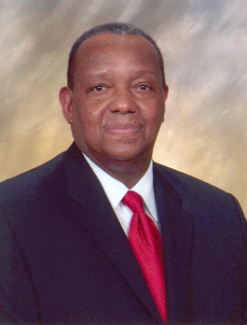
How We Accomplish Our Mission… Federal Meteorological Coordinating Infrastructure
Federal Committee for Meteorological Services and Supporting Research (FCMSSR)
Federal Coordinator for Meteorology
Samuel P. Williamson
Program Councils
Interdepartmental Committee for Meteorological Services and Supporting Research (ICMSSR)
National Space Weather Program Committee for Space Weather
Standing Committees
National Aviation Weather Program
Committee for Aviation Services and Research
Environmental Services, Operations, and Research Needs
Environmental Information Systems and Communications
National Operational Processing Centers Program
Committee for Operational Processing Centers
Climate Analysis, Monitoring , and Services
Integrated Observing Systems
Cooperative Research
Multifunction Phased Array Radar

Slide 7
Our Partners
Departments of:
Agriculture
Commerce
Defense
Energy
Homeland Security
Science & Technology
FEMA
Coast Guard
Interior
State
Transportation
Independent agencies:
Environmental Protection Agency
National Aeronautics and Space Administration
National Science Foundation
National Transportation Safety Board
Nuclear Regulatory Commission
Executive Office of the President:
Office of Management and Budget
Office of Science and Technology Policy

Slide 8
Our Affiliations
National Research Council (NRC)
Board on Atmospheric Sciences and Climate (BASC)
Climate Research Committee (CRC)
University Corp. for Atmospheric Research (UCAR)
National Science Foundation’s National Science Board
American Geophysical Union (AGU)
National Center for Atmospheric Research (NCAR)
American Meteorological Society (AMS)
US Climate Change Science Program (USCCSP)
National Science and Technology Council (NSTC)
Committee on the Environment and Natural Resources (CENR)
Subcommittee on Disaster Reduction (SDR)
Subcommittee on Air Quality Research
Subcommittee on Earth Observations (USGEO)

Slide 9
Primary Products and Services
Foster information sharing, planning, coordination, and collaboration
Facilitate interagency leveraging
Assess issues, capabilities, needs, requirements, priorities, shortfalls, and planning and make recommendations to decision makers
Resolve differences
Facilitate improved products and services
Focus supporting research and transition to operations
Coordinate interagency requests for Civil Air Patrol (CAP) aerial support services
Provide executive support to each of the coordinating infrastructure groups
SERVICES

Slide 10
Primary Products and Services
Annual conferences, symposia, workshops, and forums, e.g., Interdepartmental Hurricane Conference
Other conferences, symposia, workshops, and forums
Interagency Plans - coordinated and collaborative approaches to multi-agency problems
Interagency Reports - crosscutting analyses of activities and issues or the status and progress of interagency efforts and programs
Federal Meteorological Handbooks (FMHs) - prescribe standardized and coordinated procedures
PRODUCTS

Slide 11
High Priority Activities Overview
Multifunction Phased Array Radar
Space Weather
Wildland Fire Weather
Water Resources
Urban Meteorology
Weather for Transportation
Climate and Climate Change
Interagency Integration
Critical Skill Shortages
Operational Processing Centers
Plans and Handbooks
Environmental Literacy
International Affairs
Integrated Observing Systems
Building a future to improve services

Slide 12
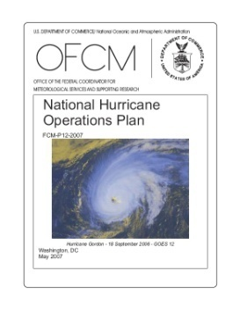
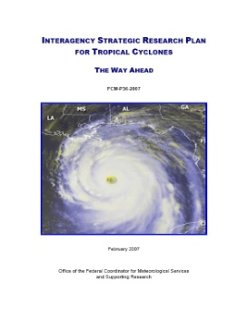
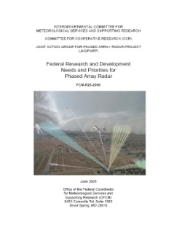
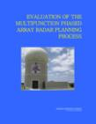
High Priority Activities
Tropical Cyclones – Operations and Research
Interdepartmental Hurricane Conference (IHC)
63rd IHC (March 2-5, 2009) – focus on R&D progress
National Hurricane Operations Plan for 2009
Interagency Strategic Research Plan for Tropical Cyclones: The Way Ahead
Underpinning of the NOAA Hurricane Forecast Improvement Project
Working group to develop 10-year R&D implementation strategy
Stepped Frequency Microwave Radiometer
Multifunction Phased Array Radar
Risk reduction, requirements, ops concepts
Symposium, Oct 07 (next in Oct 09) - Now is the time to invest in risk reduction
Developed implementation strategy

Slide 13
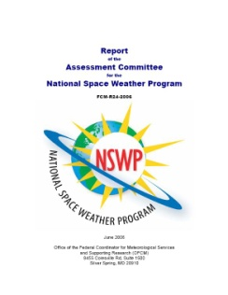
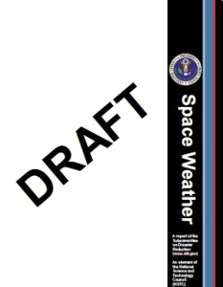
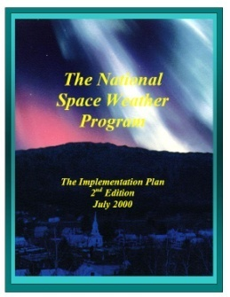
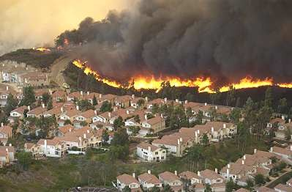
High Priority Activities
National Space Weather Program (NSWP)
Develop new Strategic and Implementation Plans
Assessment Committee review of NSWP progress
SDR Grand Challenge for Disaster Reduction
NPOESS – Nunn-McCurdy impacts & mitigation
Real Time Solar Wind replacement for ACE
Wildland Fire Weather Needs
Western Governors’ Association request
National needs assessment complete
Capabilities review and gap analysis
Establish framework to meet needs

Slide 14
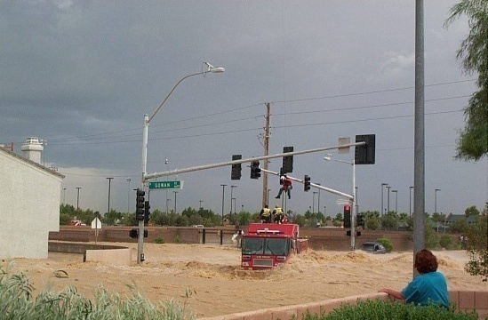
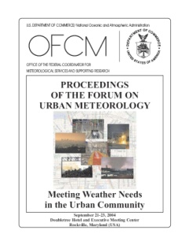
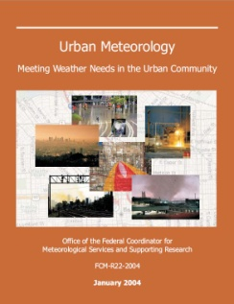
High Priority Activities
Hydrology Assessment—water resources supply/demand already a source of national and international conflict
Define needs and requirements across the entire community
Investigate agency plans and alternatives
Create more efficient and effective partnerships
Urban Meteorology
Unique aspects of the urban environment
Emerging energy meteorology needs
Understanding the impact of extreme events such as drought, heat, flood, and tornadoes
Making dispersion forecasts – terrorism or accidents
Improving response to hazards, high impact events, and climate change
Joint Urban Testbed
Courtesy of Las Vegas Review Journal

Slide 15
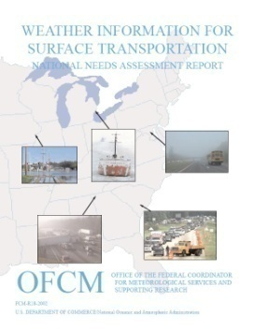
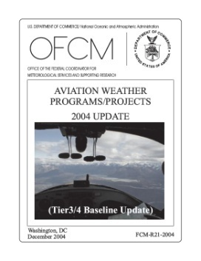
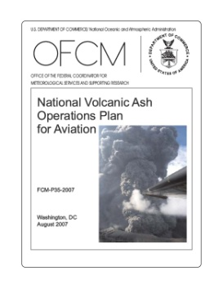
High Priority Activities
Wx Information for Surface Transportation (WIST)
3rd Symposium, July 2007
4th Symposium, June 2008
Safety in Mobility Conference, Austria, July 2008
Need for social science involvement; education & outreach
Opportunity for near-term, interagency Intermodal Initiative
National Aviation Weather Program
10-yr goal to reduce weather-related accidents by 80%
Final Assessment at 10-yr point: Did not meet the aggressive 80% goal, but achieved significant reduction
Developing framework to sustain success to date and to accelerate accident reduction
National Volcanic Ash Operations Plan for Aviation

Slide 16
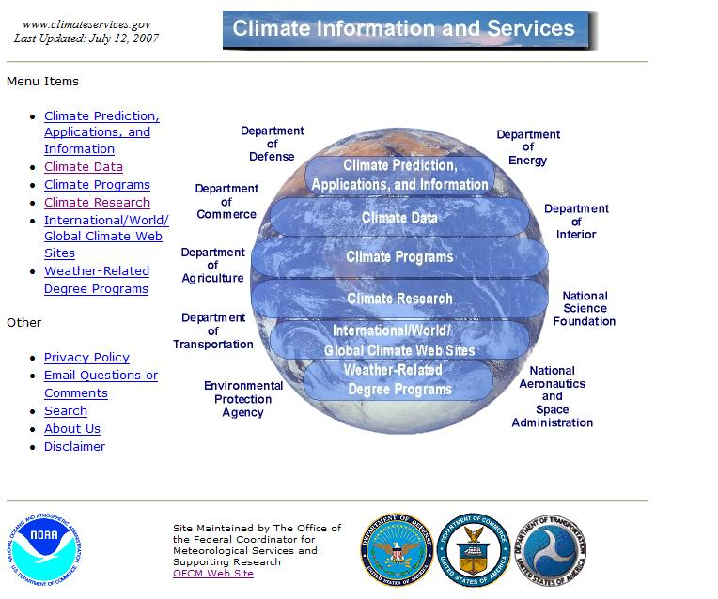
High Priority Activities
Climate and Climate Change
Committee for Climate Analysis, Monitoring, and Services
Product and service needs for climate-induced extreme weather events
Effectively communicating climate and weather information to the stakeholders
Climateservices.gov web site
Review & comment on CCSP Synthesis and Assessment Products, through CENR
Identified as key research area by 83% of 745 respondents to wildland fire weather needs survey
Critical Skill Shortages
Data assimilation skills already identified as a shortfall
Possible other areas of concern are tropical meteorology and probability and statistics
Establishing new group to assess

Slide 17
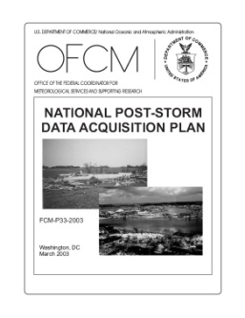
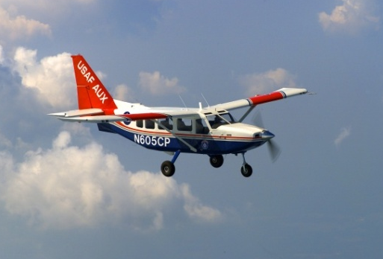
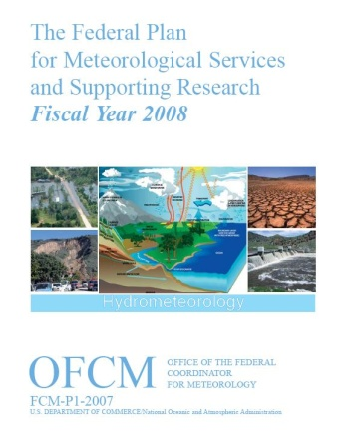
High Priority Activities
Post-Storm Data Acquisition
MOU with Air Force/Civil Air Patrol
24 missions flown in FY08
Operational Processing Centers
Program Council oversight
Cooperative Support and Backup
Improved efficiency and effectiveness
Annual Federal Plan for Meteorological Services and Supporting Research
Crosscutting review of agencies’ programs, plans, budgets, and activities
One-stop reference for the federal meteorological enterprise

Slide 18
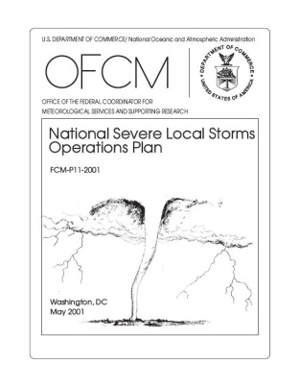
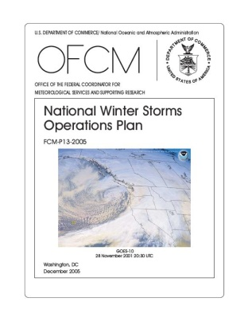

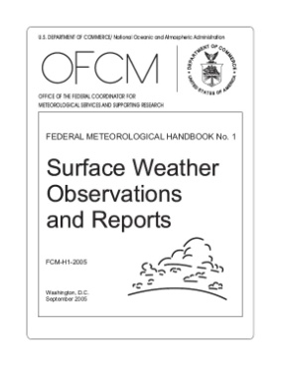
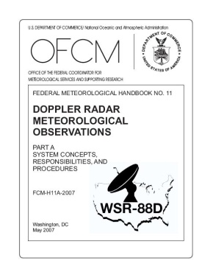
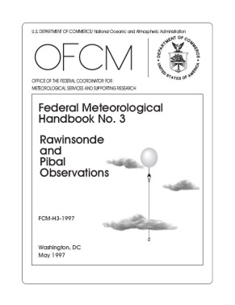
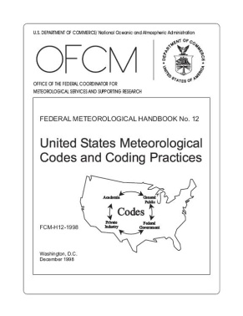
High Priority Activities
Operations Plans and Handbooks
National Severe Local Storms Operations Plan
National Winter Storms Operations Plan
Lightning Data Requirements
National Post-Storm Data Acquisition Plan
Federal Meteorological Handbooks
Surface Weather Observing
Doppler Weather Radar Observations
Rawinsonde and Pibal Observations
Meteorological Codes and Coding Practices

Slide 19
High Priority Activities
Environmental Literacy – Interdepartmental Collaboration
International Affairs
WIST report translated into Chinese
Extensible Markup Language (XML) and Web Services – supporting interagency coordination on data exchange model; assisting FAA with ICAO and NWS with WMO
Integrated Observing Strategies – Enable improved services across functional areas
Coordinated with US Group on Earth Observations
Numerous data assimilation challenges, e.g., volume, communications, quality control, format, exchange
Foundation of future environmental data cloud

Slide 20
Building a future to improve services… Network-enabled, data- & info-centric
Tomorrow
5-D Cloud?
3-D in space = x, y, z
1-D in time = t
1-D in probability = P or PDF
Environmental Data Cloud
5-D Data Cube/Cloud
NextGen
Potential Future
4-D Data Cube
Build on DOD experience today
Enable NextGen in near future
Expand the cube/cloud to support multiple applications
NWS NDFD
Today
DOD
Work with our partners to mutually advance the concept to benefit the federal meteorological enterprise
Notes:
20

Slide 21
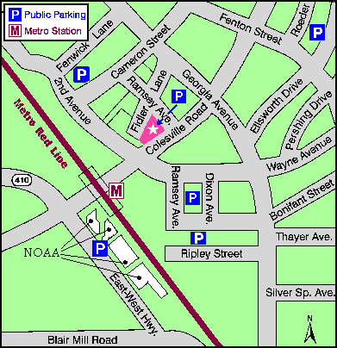
Facilities and Personnel
Office location:
8455 Colesville Road, Suite 1500
Silver Spring, MD
Personnel
11 NOAA Employees in Career Positions
One full-time detail from USAF
One part-time detail from USN
One full-time detail from FAA (vacant)
Silver Spring
SSMC I - IV

Slide 22
Summary
OFCM is:
A central touchstone for assessing needs, identifying requirements, developing strategies and implementation plans, and coordinating execution across the federal government’s meteorological services and supporting research enterprise
Experienced at developing needs from the bottom up
Experienced at building and sustaining consensus and collaboration to improve efficiency and effectiveness
Committed to interagency cooperation
Reliant on a degree of independence to act as an honest broker among the agencies and offices of the coordinating infrastructure
A recognized successful interagency facilitator
Notes:
22

Slide 23
Questions?

Slide 24
BACKUP SLIDES

Slide 25
FCMSSR Members
VADM CONRAD LAUTENBACHER, JR., USN (RET.) Chairman
DR. SHARON L. HAYS Office of Science and Technology Policy
DR. RAYMOND MOTHA Department of Agriculture
DR. JACK HAYES Department of Commerce
MR. ALAN SHAFFER Department of Defense
DR. ANNA PALMISANO Department of Energy
MR. KEVIN “SPANKY” KIRSCH Department of Homeland Security (OS&T)
DR. HERBERT FROST (Acting) Department of the Interior (NPS)
MR. KENNETH HODGKINS Department of State
MR. RANDOLPH LYON Office of Management and Budget
MS. VICTORIA COX Department of Transportation (DOT/FAA)
MR. DAVID MAURSTAD Department of Homeland Security (FEMA)
DR. EDWARD WEILER National Aeronautics and Space Administration
DR. Tim Killeen National Science Foundation
MR. PAUL MISENCIK National Transportation Safety Board
MR. MICHAEL JOHNSON U.S. Nuclear Regulatory Commission
DR. LAWRENCE REITER Environmental Protection Agency
MR. SAMUEL P. WILLIAMSON Federal Coordinator
SECRETARIAT: MR. MICHAEL BABCOCK, OFCM

Slide 26
ICMSSR Members
MR. SAMUEL P. WILLIAMSON, Chairman Federal Coordinator
MR. THOMAS PUTERBAUGH Department of Agriculture
Dr. JACK HAYES Department of Commerce
RADM DAVID GOVE, USN Department of Defense (U.S. Navy)
DR. FRED LEWIS, USAF Department of Defense (U.S. Air Force)
MR. RICKEY PETTY Department of Energy
MR. KEVIN “SPANKY” KIRSCH Department of Homeland Security (OS&T)
MR. JOHN VIMONT Department of the Interior (NPS)
MR. ROBERT ARNOLD Department of Transportation (FHWA)
MR. KENNETH M. LEONARD Department of Transportation (FAA)
DR. JONATHAN M. BERKSON Department of Homeland Security (USCG)
MR. NORMAN BARTH (Acting) Department of State
DR. S. T. RAO Environmental Protection Agency
MR. DANIEL CATLETT Department of Homeland Security (FEMA)
DR. RAMESH KAKAR National Aeronautics and Space Administration
DR. JARVIS MOYERS National Science Foundation
MR. DONALD E. EICK National Transportation Safety Board
MS. JOCELYN MITCHELL U.S. Nuclear Regulatory Commission
MS. GRACE HU Office of Management and Budget
SECRETARIAT: MR. MICHAEL BABCOCK, OFCM

Slide 27
Background
Jan 1964: OFCM formed in response to Public Law 87-843
Accountable to Congress and OMB
Coordinate agency budgets and activities
Report budgets and activities in annual Federal Plan
1980: GAO study revitalizes OFCM
Independent function with full-time staff
1985: DOC IG reviewed OFCM and made two specific recommendations, directing OFCM to:
Perform crosscut studies to review agency weather programs and requirements
Document OFCM studies; make information available to interested parties in the decision-making and budgeting processes
Notes:
27

Slide 28
Feedback
Secretary of Transportation Mary Peters
Sen Ted Stevens, AK
Western Governors’ Association Gov Rounds of South Dakota, Chairman
Director, NCAR Tim Killeen
FAA Air Traffic Systems Requirements Service Jim Washington
Oceanographers of the Navy RADM Richard West RADM Steve Tomaszeski
Air Force Director of Weather Brig Gen Lawrence Stutzriem
Chinese Translation of WIST report – Li Jian, Jiangxi Prov. Meteorological Bureau
Dan Rather, Dan Rather Reports

Slide 29
Leadership
Federal Coordinator for Meteorology
Deputy Federal Coordinator for Meteorology
and
Secretariat, Federal and Interdepartmental Committees for Meteorological Services and Supporting Research
Michael Babcock
Chief Scientist/Assistant Federal Coordinator for Supporting Research
Mark Welshinger
Assistant Federal Coordinator for Air Force and Army Affairs
Lt Col Charles Harris, USAF
Assistant Federal Coordinator for Navy and Marine Corps Affairs
Mr. Kurt Nelson, USN
Assistant Federal Coordinator for DOT(FAA) Affairs
(vacant)
Personnel: 11 Federal employees in career positions, one full-time detail from USAF, and one part-time detail from USN

