Slide 1
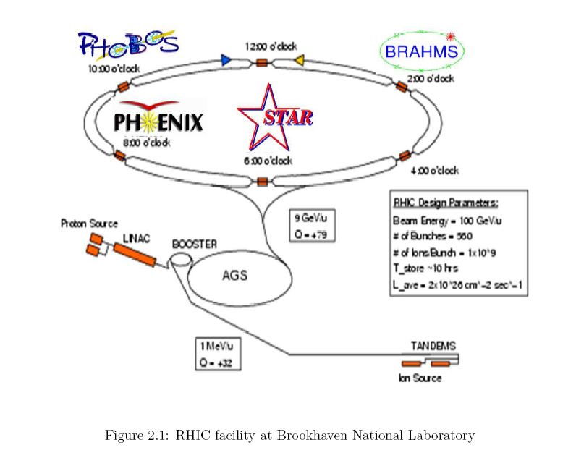
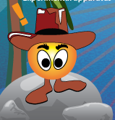
The STAR Experiment
Direct γ-charged hadrons
Measurements
One more
ingredient
for energy loss
quantification
Hot Quarks 2008, 18-23th August, Estes Park Colorado
Texas A&M University A. M. Hamed for the STAR collaboration

Slide 2
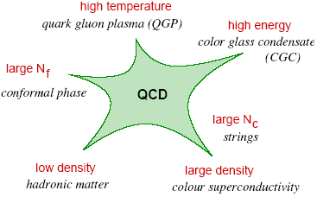
Table of Contents and Disclaimer
Table of Contents:
The Road Behind
Analysis
Results
Summary
The multiple facets of QCD
D. d’Enterria and adapted from T. Schafer
Disclaimer: The road behind is personal view, so biases and mistakes are expected.

Slide 3
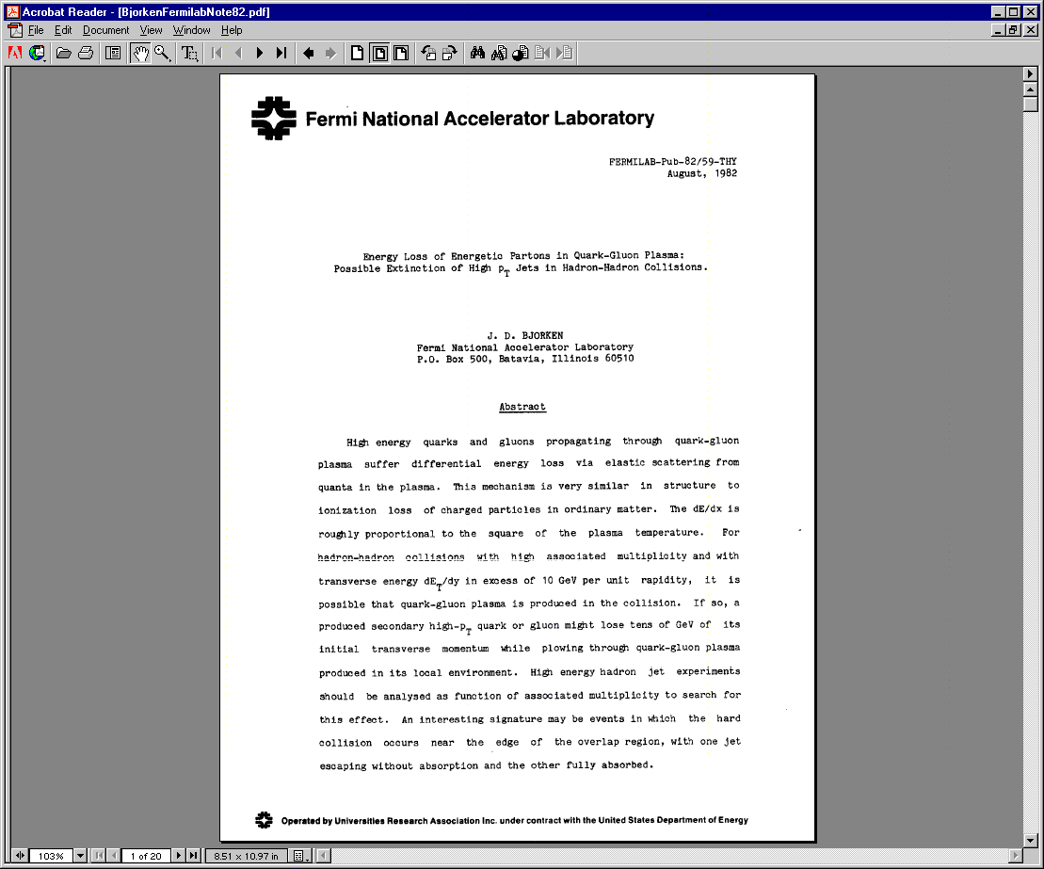
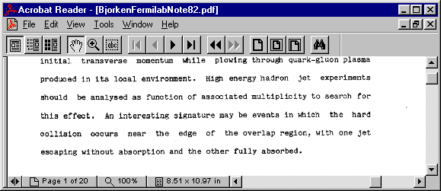
The Road Behind
J.D.Bjorken 1982

Slide 4
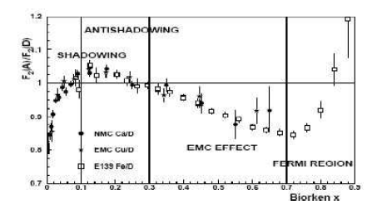
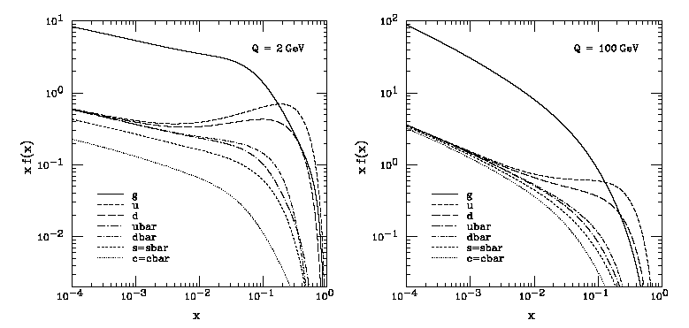
The Road Behind
High-p_{T}: Nuclear modification factor R_{AA} of light quarks,
heavy quarks and gluons at mid rapidity!
High-p_{T} particles are produced from the hard scattering processes.
Hard processes take place at early time of collisions (0.1 fm/c).
pQCD
V~5 fm³ and τ~10 fm/c
Nuclear modification factor
R_{AA} is a measure of the deviation from the incoherent superposition
of nucleon-nucleon collisions assumption.
At mid rapidity at RHIC
CTEQ6M
The ratio of quark structure functions
x≈2P_{t}/√s
0.01
RHIC
0.2
RHIC
Soft
RHIC
Hard
Proton Parton distribution functions.

Slide 5
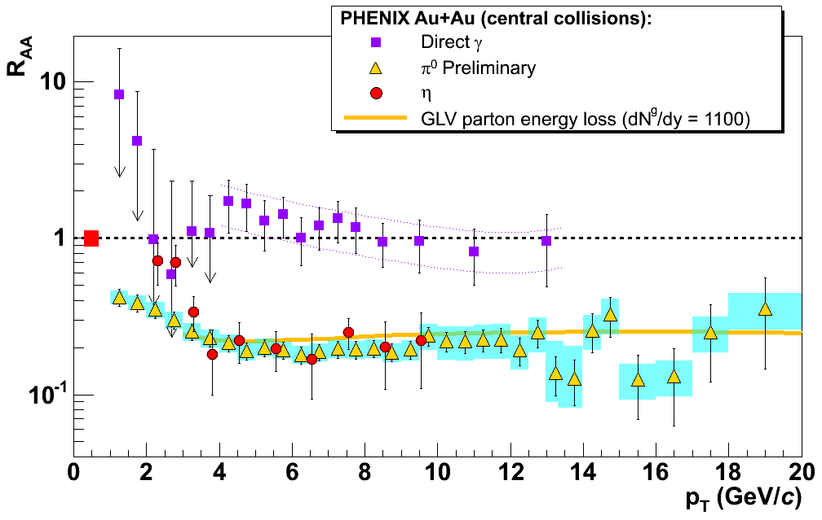
The Road Behind
High-p_{T}: Nuclear modification factor R_{AA} of light quarks,
heavy quarks and gluons at mid rapidity!
PRL. 96, 202301 (2006)
R_{AA} of light quarks is p_{t} independent as expected by the radiative energy loss.
Direct photons follow the binary scaling.

Slide 6
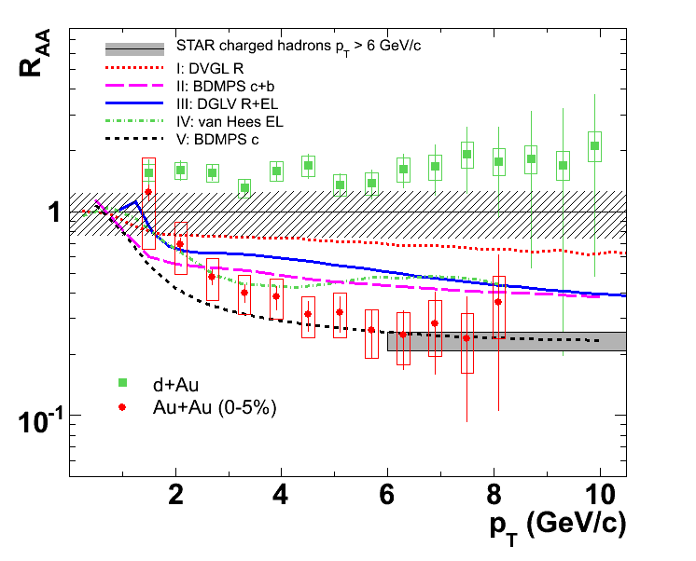
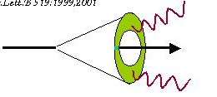
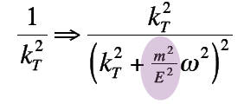
The Road Behind
High-p_{T}: Nuclear modification factor R_{AA} of light quarks,
heavy quarks and gluons at mid rapidity!
PRL 98 (2007)192301
Unexpected level of suppression for the heavy quarks.
Dead cone
effect
According to QCD at zero temperature
ΔE_{quark,m=0} > ΔE_{quark,m>0}
Vacuum and medium radiation is suppressed due to quark mass
Dokshitzer, kharzeev.
PLB 519 (2001) 199

Slide 7
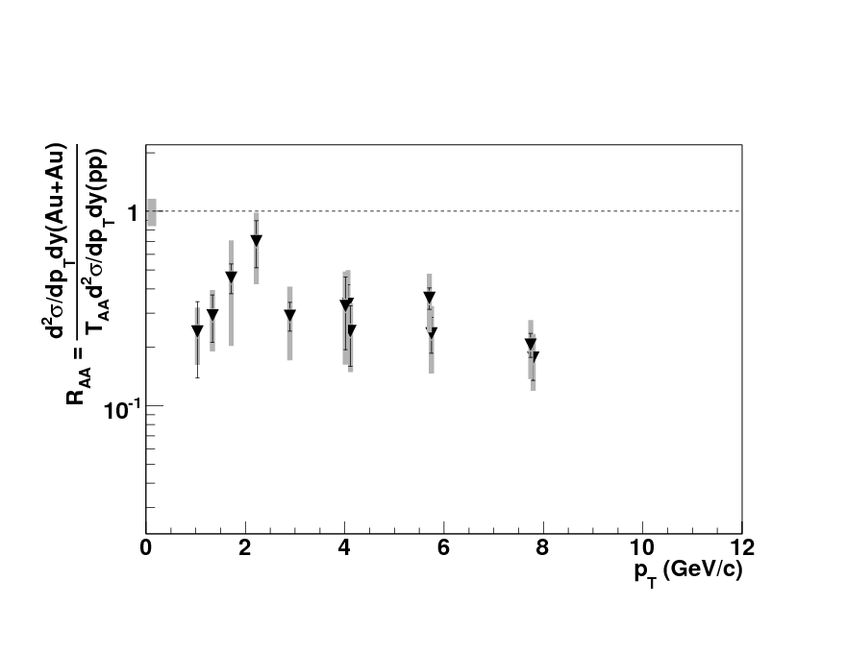
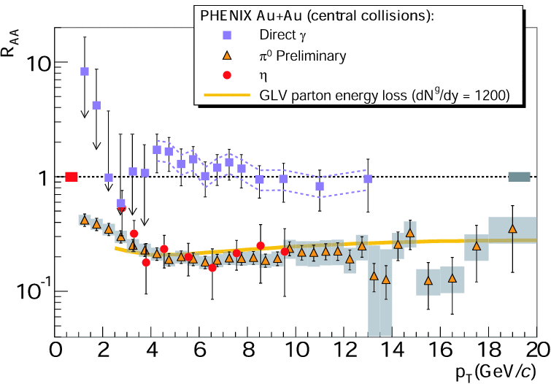
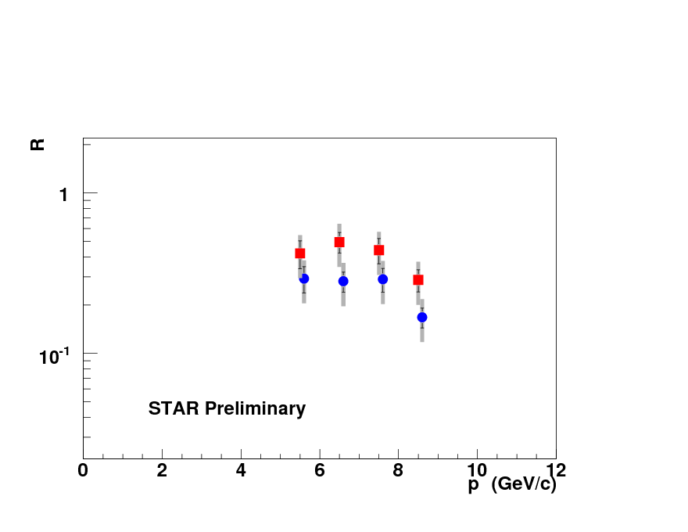
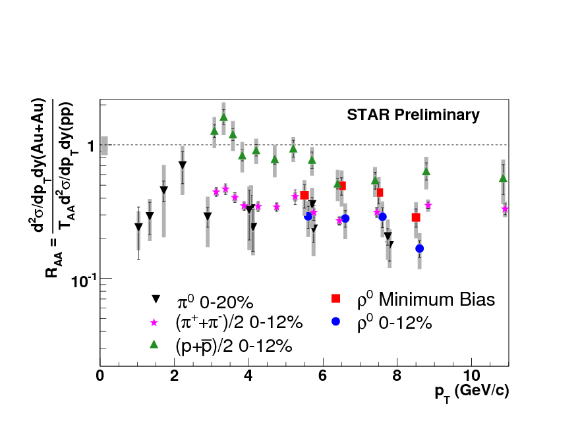
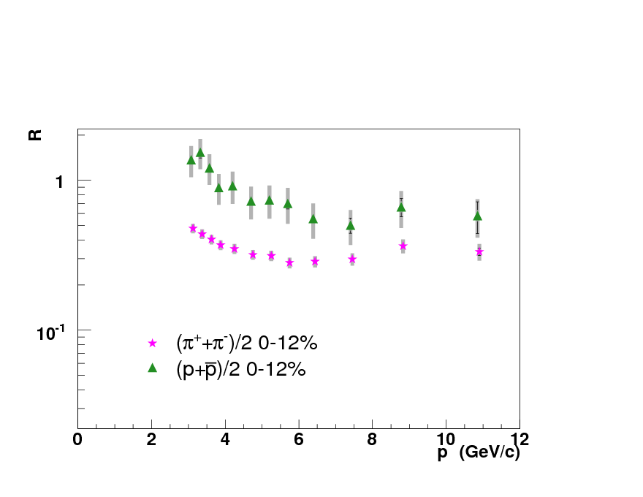
The Road Behind
High-p_{T}: Nuclear modification factor R_{AA} of light quarks,
heavy quarks and gluons at mid rapidity!
STAR QM08
No sign for the color factor effect on energy loss.
According to QCD at zero temperature
Gluon should show stronger coupling to the medium.
ΔE C_{R}
∝
Casimir factor (C_{F}=4/3 “quarks” , C_{A}=3 “gluons” ), i.e 2.25
ΔE_{gluon} > ΔE_{quark}

Slide 8
The Road Behind
High-p_{T}: Nuclear modification factor R_{AA} of light quarks,
heavy quarks and gluons at mid rapidity!
PRL. 96, 202301 (2006)
PRL 98 (2007)192301
STAR QM08
“But nature cannot realize contradictions. Paradoxes focus our attention, and we think harder”
F. Wilczek “Nobel Lecture 2004”

Slide 9
The Road Behind
Weakly coupled or Strongly coupled medium!
What happens to empty space, if you keep adding heat?
The fundamental theoretical result regarding the asymptotic high temperature
phase is that it becomes quasi-free. That is, one can describe major features
of this phase quantitatively by modeling it as a plasma of weakly interacting
quarks and gluons. In this sense the fundamental degrees of freedom of the
microscopic Lagrangian, ordinarily only indirectly and very fleetingly visible,
become manifest (or at least, somewhat less fleetingly visible).
In particular, chiral symmetry is restored, and confinement comes completely undone.
F. Wilczek hep-ph/0003183v1

Slide 10
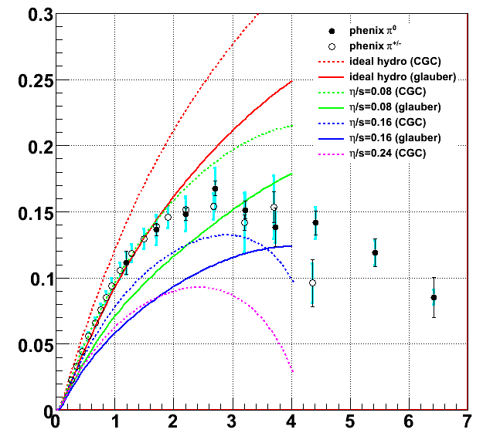
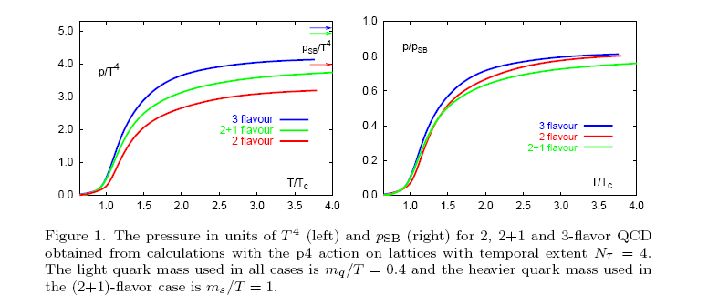
The Road Behind
Weakly coupled or Strongly coupled medium!
v₂ of hadrons at RHIC data are in agreement with the ideal relativistic fluid dynamics predictions η/s=0-0.8
η/s ~ 1 pQCD calculations of a weakly coupled quark gluon plasma.
η/s ~ 0.08 is reached in strongly coupled supersymmetric gauge theories.
Lattice QCD
Romatschke & Romatschke, arXiv:0706.1522
F. Karsch, E. Laermann, A. Peikert, CH. Schmidt, S. Stickan
v₂
Hep-lat/00010027v1
~20%
p_{T} (GeV/c)

Slide 11
The Road Behind
Weakly coupled or Strongly coupled medium!
“We will not have done justice to the concept of weakly interacting plasma of quarks and gluons until some of the predictions are confirmed by experiment”
F. Wilczek
IMHO
The applicability of pQCD in describing the parton-matter interaction has been increasingly challenged by the “speculated” strongly coupled nature of the produced matter at RHIC.

Slide 12
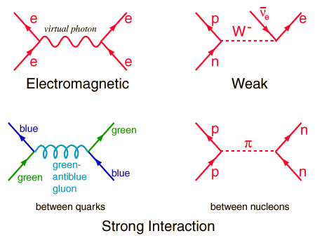
The Road Behind
^
On the jet quenching parameter q
The four major models use pQCD framework to estimate energy loss.
Different assumptions in various models lead to similar descriptions of the
light quark suppression with different model-dependent parameters.
Differences
Modeling the medium evolution/structure.
Hierarchy of scales.
Energy loss
^
<ΔE> α_{s}C_{R}qL²
∝
“Static medium”
Medium
E
^
q
Scattering power of the medium
q_{T}∼μ
^
q≡ ρσ⟨k²⟩=μ²/λ
μλ>>1
λ
^
L
q
ASW and GLV: Similar models different
^
q
AMY and Higher twist: Different models same

Slide 13
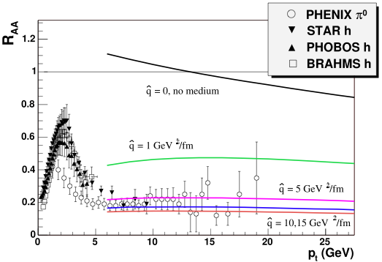
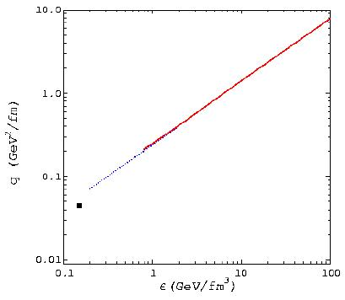
The Road Behind
^
On the jet quenching parameter q
The Baier plot
Ideal QGP
Pion gas
Cold nuclear matter
radiative energy loss
If α_{s}(T) were weak…
^
q∼1 GeV²/fm
Baier Schiff
^
q extracted via comparison with RHIC data is larger…
^
q ∼ 8 GeV²/fm Armesto,Cauiari Hirono Salgado
∼8-19 GeV²/fm
PHENIX; at 2σ, neglecting
theoretical uncertainties
∼3 GeV²/fm
Zhang Owens Wang Wong
∼4-14 GeV²/fm
Dainese Loizives Palc
^
Strong coupling calculation of q is required !
Nonperturbative calculation is needed !

Slide 14

The Road Behind
On the pQCD framework
All four major models utilize factorization:
Extracted from data,
but evolution is
perturbative
Expansion in the
coupling constant
(LO,NLO,NNLO…)
The entire effect of energy
loss in concentrated in the
modification of FF
Factorization validity
The characteristics time and length scale of the parton-parton interaction is
short compared to the soft interactions between the bound partons in the initial
state and to those of the fragmentation process of the scattered partons in
the final state.
Factorization is used without proof!
Summary
There is no single commonly accepted calculation of the underlying physics to describe in-medium energy loss for different quark generations as well as for the gluon.

Slide 15
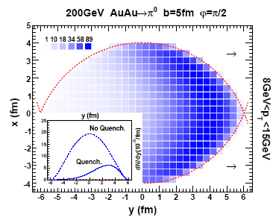
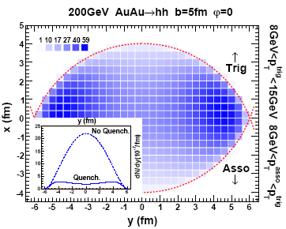
The Road Behind
Single particle spectra and di-hadron azimuthal correlations
R_{AA} saturates!
^
at some point, large changes in q do not map into large changes of R_{AA}, or:
If the medium is black somewhere already, you can’t see it getting even blacker.
Di-hadron azimuthal correlations
No Glauber calculation is required for the suppression measurements.
Different geometric bias and different fragmentation bias.
PRL 98 (2007) 212301
Single jet
Dijet
I_{AA} is a quantity that measure the medium effect on the FF on dijet analysis.
Model dependent calculations show that I_{AA} is more sensitive
than R_{AA} but both have diminished sensitivity at
high gluon density.

Slide 16
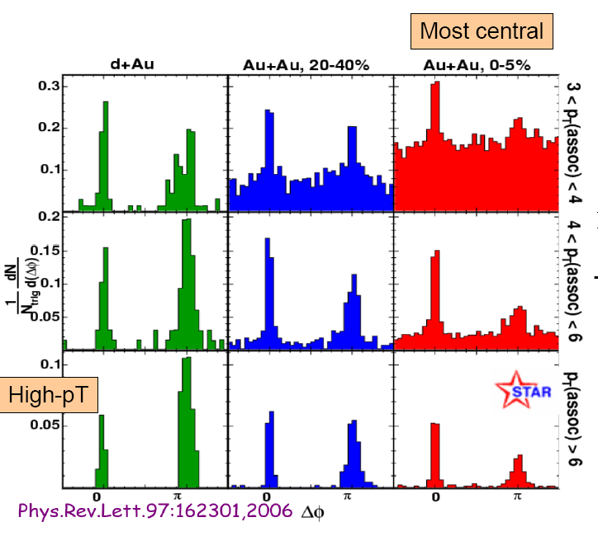
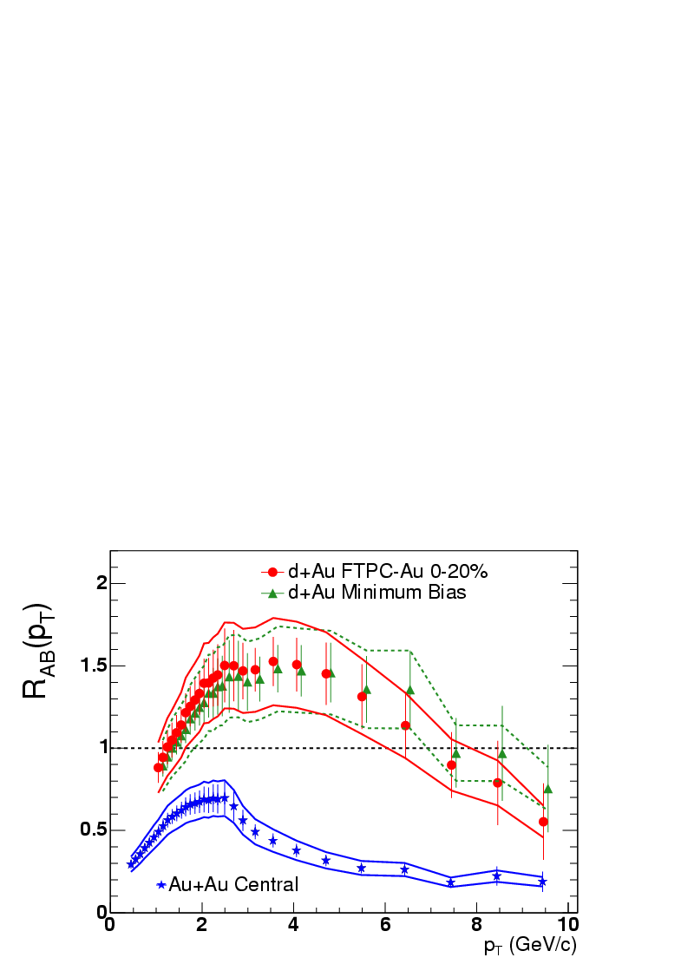
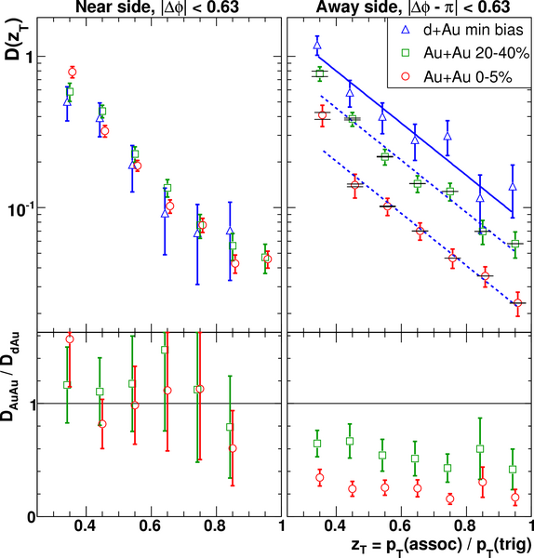
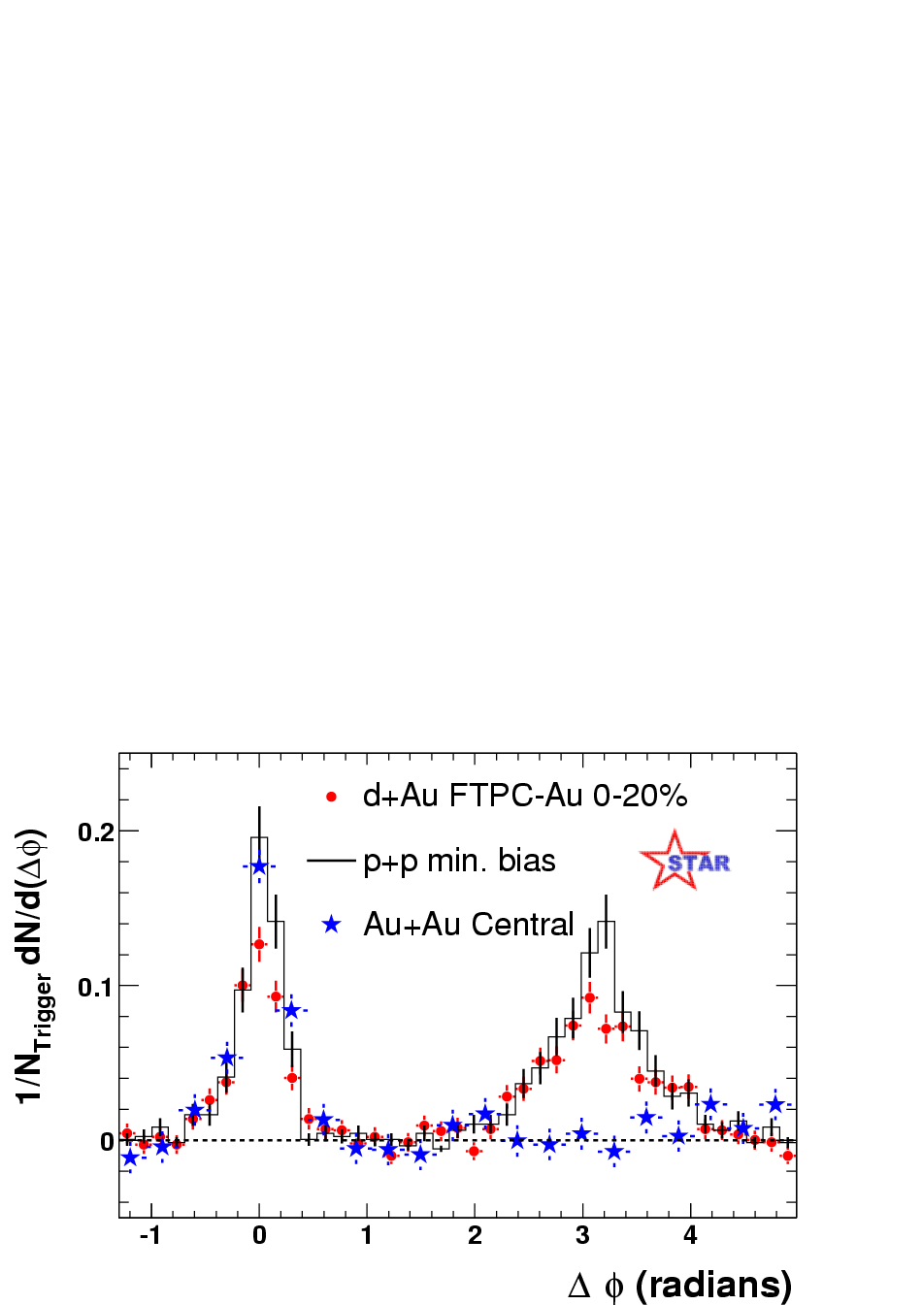

The Road Behind
High-p_{T}: di-hadron azimuthal correlations “conservation of p”
PRL. 91, 072304 (2003)
4 < p_{T},trig < 6 GeV/c
2 < p_{T},assoc < p_{T},trig
Background is subtracted
Away side Δφ≈π
In the near-side p+p, d+Au, and Au+Au are similar while in the away-side
“back-to-back” Au+Au is strongly suppressed relative to p+p and d+Au.
Clear jet-like peaks seen on near and away side in Au+Au at high trigger p_{T} and high associated p_{T}
Away-side yield neither depend on z_{T} nor broaden in ΔΦ.
Away-side yield strongly suppressed to level of R_{AA}
Surface bias free probe is needed
An access to the parton initial energy is required in order to better quantify the energy lost

Slide 17
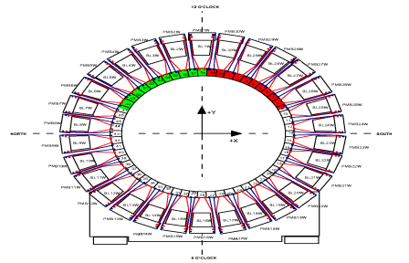
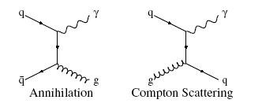
The Road Behind
Jet-energy calibration “Direct γ”
“Mid-rapidity”
Fast Detector
“Calorimeter”
Fast Detector
“Calorimeter”
zero near-side yield
for direct photons
Leading particle
“trigger”
Direct photon
“trigger”
Background
P
0
π
P
xP
xP
xP
Due to fragmentation full jet reconstruction
is required to access the initial parton energy
xP
OR
P
get the initial parton energy
with a powerful alternative method:
“Direct γ-hadron azimuthal correlations”
P
Associated
particles
Direct photon is not a surface bias probe.

Slide 18
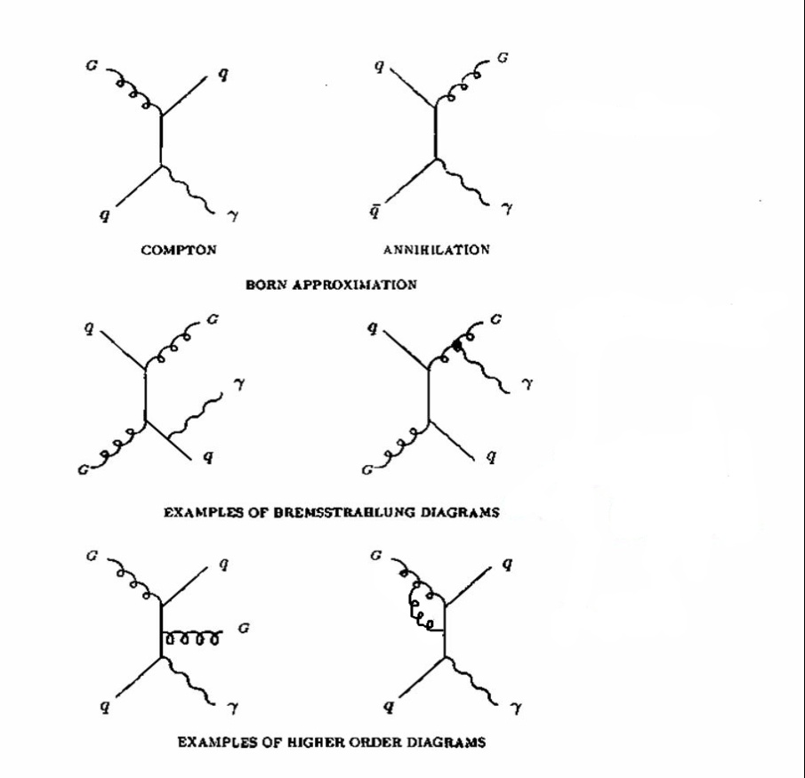
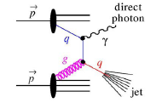
The Road Behind
Direct photon
Direct photon-hadron correlations
Direct photon energy balances the outgoing parton.
O(αα_{s})
Photon doesn’t couple to the medium.
Calibrated probe of the QGP – at LO.
No Surface Bias
Hard process
Compton
Annihilation
O(α_{s}²α(1/α_{s}+g))
Possible candidate for quark/gluon jet discrimination.
Examples of Bremsstrahlung
diagrams
Challengeable measurements!
O(αα_{s}²)
π⁰ is suppressed at high p_{T} by a factor of ~5 in central
AuAu collisions.
Examples of higher order
diagrams

Slide 19
Analysis technique
Build correlation function for neutral “triggers”
with “associated” charged particles
Use transverse shower profile to distinguish 2-photon
from single-photon showers
Comparison of π⁰ – triggered yields with previously measured
charged-hadrons- triggered yields.
Extract the yields associated with direct
photon triggers

Slide 20
Analysis technique
Correlate photon candidate “triggers” with “associated tracks”
p_{T},trig > 8 GeV/c
Charged hadrons
Use γ triggers
to explore
fragmentation functions
in p+p and Au+Au
BEMC
One tower out of 4800
towers (0.05 x 0.05)
TPC
~2.2m
E_{γ} = E_{parton}
γ
2
π⁰
Beam axis
No track with
p > 3 GeV/c points
to the trigger tower
E_{π} ‹ E_{parton}
180°
0
Associated
charged
particles
“3 <p_{T},assoc
< 8 GeV/c”
BEMC: Barrel
Electro-Magnetic Calorimeter
TPC: Time Projection Chamber
Full azimuthal coverage
How to distinguish between π⁰/ γ?

Slide 21
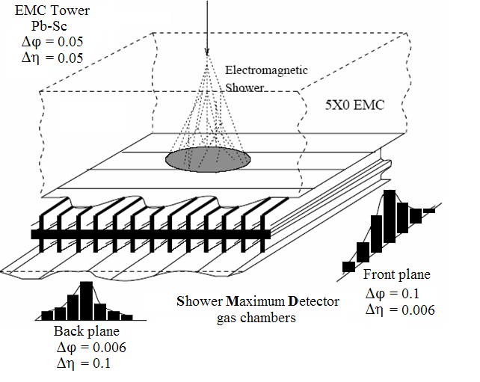
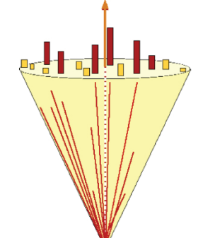
Analysis: Shower Shape Analysis
The two photons originated from π⁰ hit the same tower at p_{T}>8GeV/c
STAR Shower Maximum Detector is embedded at ~ 5x₀ between the lead-scintillator layers “BEMC”
ε_{i} : strip energy
r_{i} : distance relative
to energy maxima
∼ 7 R_{M}
π⁰
Use the shower-shape analysis to separate the two close photons shower from one photon shower.

Slide 22
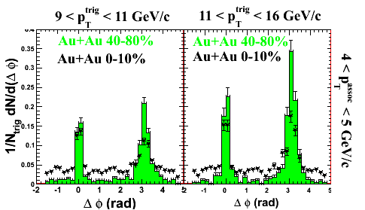
Trigger photons-charged particles azimuthal correlations
STAR Preliminary
Near side is suppressed with centrality which might
due to the increase of γ/π⁰ ratio .

Slide 23
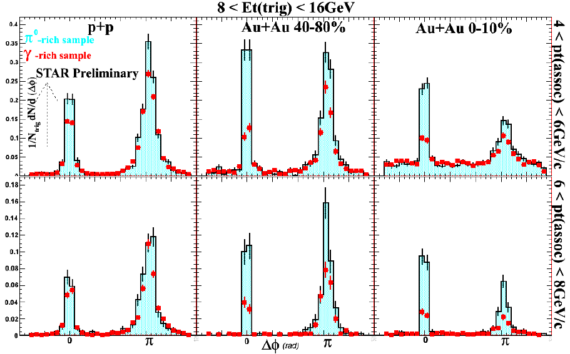
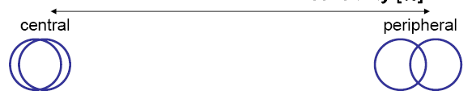

Results: Effect of shower-shape cut
Centrality
Centrality
Vacuum QCD
Medium effect
The away-side correlation strength is suppressed compared to pp and peripheral Au+Au.
The γ-rich sample has lower near-side yield than π⁰ but not zero.
γ-sample is not pure direct γ ! How about the π⁰ ?

Slide 24
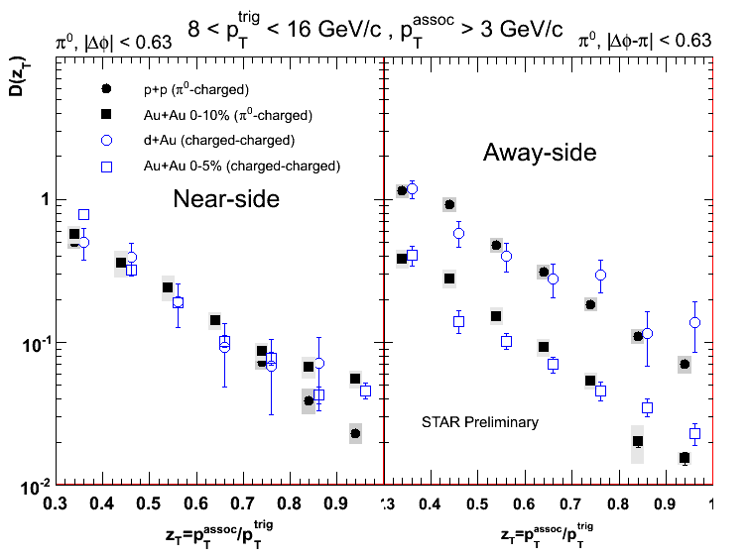

Comparison of π⁰-triggered yields to charged-hadron triggered yields
Completely different data set from different RHIC runs, different detectors were
involved in the analysis too.
This analysis
Surface bias
PRL 97
162301 (2006).
Associated yields per trigger
?
Central Au+Au
Near side: Yields are similar for p+p and central Au+Au
Away side: Yields show big difference between p+p and central Au+Au
π⁰-charged and charged-charged results are consistent.
π⁰ sample is pure.

Slide 25

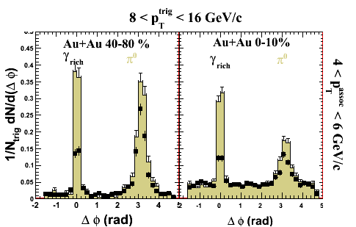

Method of extract direct γ associated yield
Extraction of direct γ away-side yields
near
near
R=Y_{γ-rich+h}/Y_{π0+h}
Assume no near-side yield
for direct γ then the away-side yields per
trigger obey
0
π
away
away
Y_{γ+h} = (Y_{γ-rich+h} - RY_{π0+h} )/(1-R)
This procedure removes correlations due to contamination (asymmetric
decay photons+fragmentation photons) with assumption that correlation
is similar to π⁰ – triggered correlation at the same p_{T}.

Slide 26
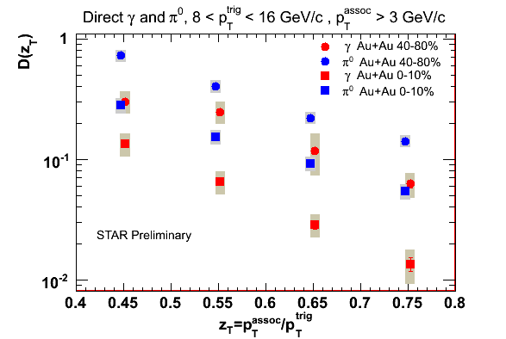

Fragmentation function of direct γ triggers and π⁰ triggers
Direct γ
Differences between γ
and π⁰ triggers
π⁰
π⁰ -triggers are resulted from
higher parton energy than
γ-triggers.
Associated yields per trigger
π⁰ -triggers are surface
biased.
Color factor effect.
The away-side yield per trigger of direct γ triggers shows smaller value
compared to π⁰ triggers which is consistent with
partons loose energy “dense medium” and then fragment.
What is the medium color charge density?

Slide 27
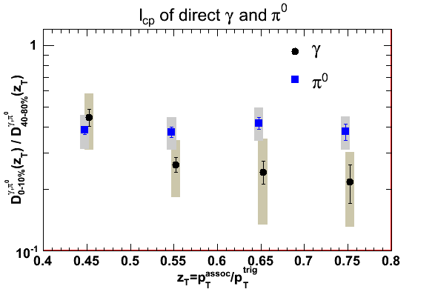
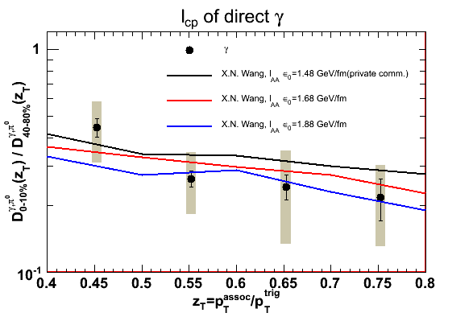
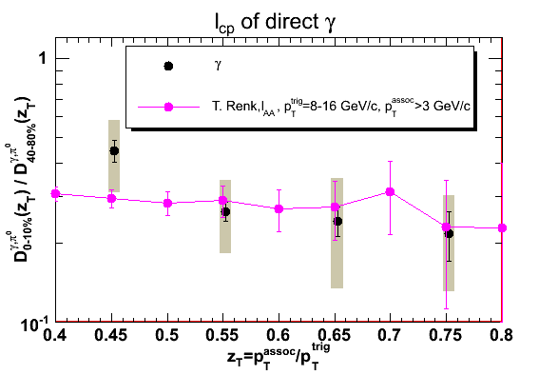
Results: Medium effect on fragmentation function
D_{0-10%} (z_{T})
D_{AA} (z_{T})
I_{cp}(z_{T}) =
I_{AA}(z_{T}) =
Data points
D_{40-80%} (z_{T})
D_{pp} (z_{T})
trig
I_{cp}(z_{T}) = 1
8 < p_{T} < 16 GeV/c
If there is no medium effect
assoc
p_{T} > 3 GeV/c
Strong medium effect
trig
7 < p_{T} < 9 GeV/c
STAR Preliminary
STAR Preliminary
I_{cp} agrees with theoretical predictions.
More precision is needed for the measurements to distinguish
between different color charge densities.
Within the current uncertainty in the scaling the
I_{cp} of direct γ and π⁰ are similar.

Slide 28
Summary and Outlook
First result of γ-jet azimuthal correlations and fragmentation
function D(z_{T}) in AuAu at RHIC energy is reported.
Away-side yield for direct photons is significantly suppressed in heavy ion events. Suppression level agrees with theoretical expectations.
All results of π⁰’s near and away-side associated particle yields shows consistency with that of charged hadron triggers.
Large luminosity at RHIC enables these measurements. Expect reduced uncertainties from further analysis and future runs.

Slide 29
Thank you for your
attention and
thanks to all STAR
Collaborators

Slide 30
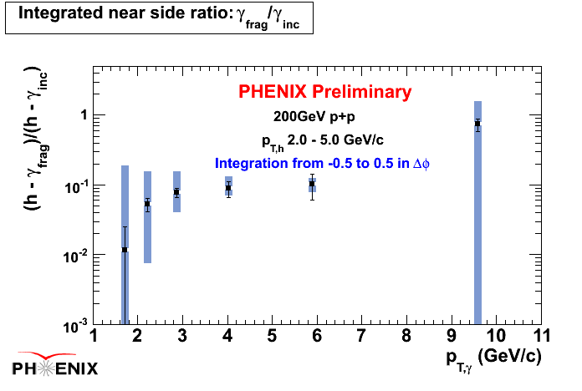
Limitations of the shower shape cut
Shower Shape Cuts:
Reject most of the π⁰’s.
But do not reject photons from:
highly asymmetric π⁰ decay.
∼10% of all π⁰ with p_{T} > 8 GeV/c
η’s - similar level of background as asymmetric π⁰
fragmentation photons
∼10% of inclusive γ at intermediate p_{T} in p+p
~30-40% of direct γ at P_{T} > 8 GeV/c.

Slide 31
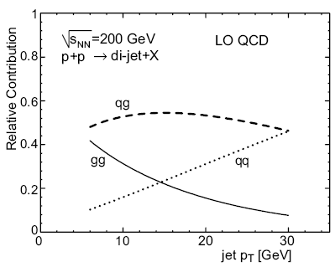
Breakdown of factorization claimed in dijets at N³LO Collins, Qiu ‘07
Measurement of the differential cross section for the production of an isolated photon
with associated jet in p¯p collisions at √s =1.96 TeV
arXiv:0804.1107v2

