Slide 1

Computational Biomedical Engineering and Systems Biology
RAMS Faculty/Mentor Workshop
Kara Kruse
Richard Ward
Jim Nutaro
Barbara Beckerman
Computational Sciences and Engineering Division
Oak Ridge, Tennessee
December 10, 2007

Slide 2
Summer Interns
Elizibeth O’Quinn, Woffard College, 2005, 2006, 2007
Mathew Woerner, Oak Ridge High School, 2006, 2007
Abigail Snyder, Oak Ridge High School, 2007
Nathan Summers, Univ. of Tennessee, 2007
Angela Reedy, Alabama A&M Univ., 2006
Cassie Armstead-Williams, Stanford Univ., 2006
Erin Lennartz, Virginia Tech. Univ., 2006
Rowena Ong, Southern Methodist Univ, 2004 & 2005
Pearl Flath, Cornell Univ., 2005
Mitchel Ladd, Univ. of Tennessee, 2004
Stephanie Barnes, Univ. of Tennessee, 2003
Jennifer Lilly, Univ. of Tennessee, 2003
Joel Outten, Univ. of Tennessee, 2002
Bill Jenkins, Univ. of Tennessee, 2001

Slide 3
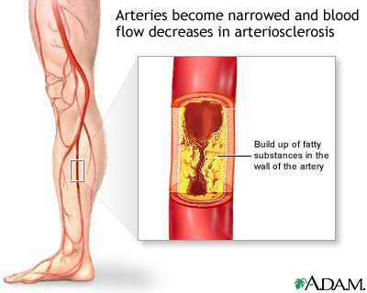
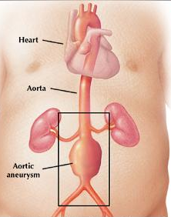
Vascular Diseases Can Be Life Threatening
Arteriosclerosis or Atherosclerosis
Narrowing of artery
Adominal Aortic Aneurysm (AAA)
Dilatation of artery

Slide 4
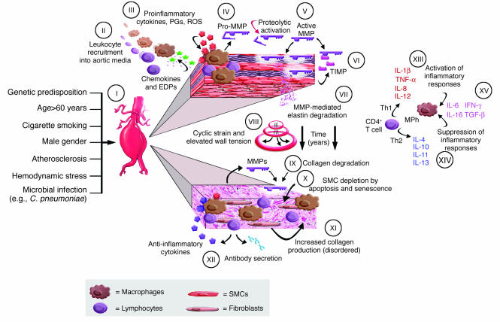
Disease Associated With Biochemical Changes

Slide 5
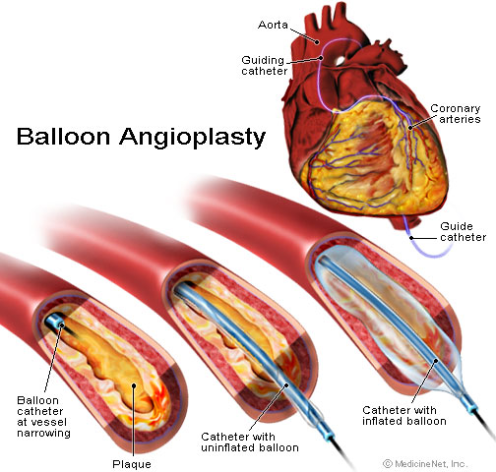
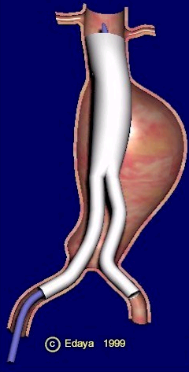
Treatment Via Intravascular Surgery
http://www.medicinenet.com/coronary_angioplasty/article.htm
Arteriosclerosis treated with balloon angioplasty & sometimes stent
Aneurysm treated with stent-graph

Slide 6
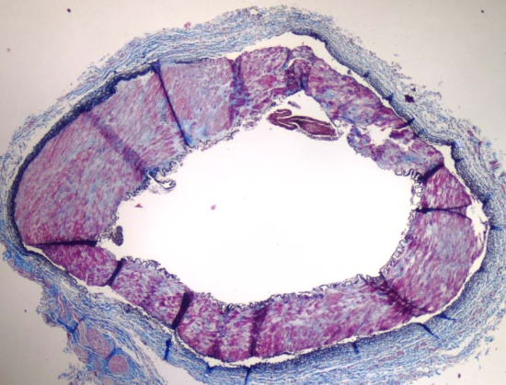
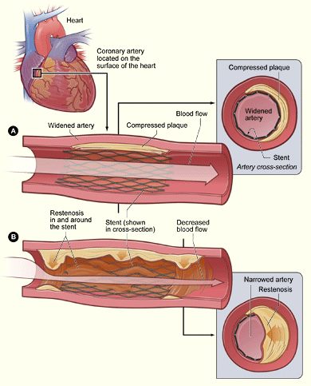
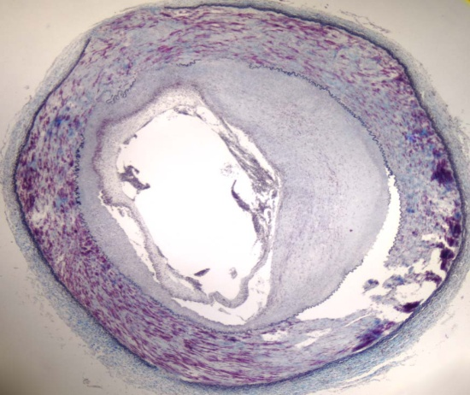
Potential Adverse Effects of Treatment
Little to no IH present
IH present
http://www.nhlbi.nih.gov/health/dci/Diseases/Angioplasty/Angioplasty_All.html
Intimal Hyperplasia (IH) - Thickening of the intima layer of an artery
Restenosis – Secondary narrowing of an artery after treatment to widen

Slide 7
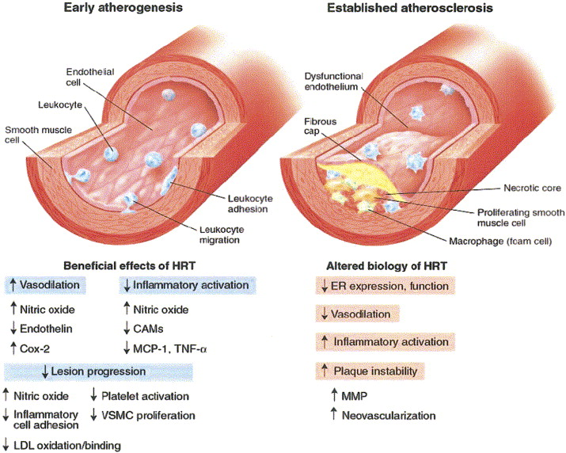
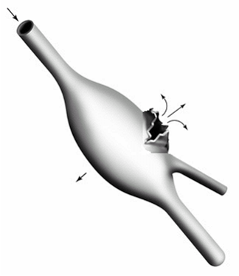
Critical Questions About Treatment
Atherosclerosis:
Who will be helped or hurt with balloon angioplasty treatment?
Does hormone replacement therapy (HRT) help or hurt?
Aneurysm:
What is best predictor of impending rupture?
Current criterion is max diameter
Wall stress should be better predictor

Slide 8
Use Mathematical/Computer Modeling To Answer Critical Questions
Abdominal Aortic Aneurysm (AAA):
Finite Element engineering models of mechanical stress in walls

Slide 9
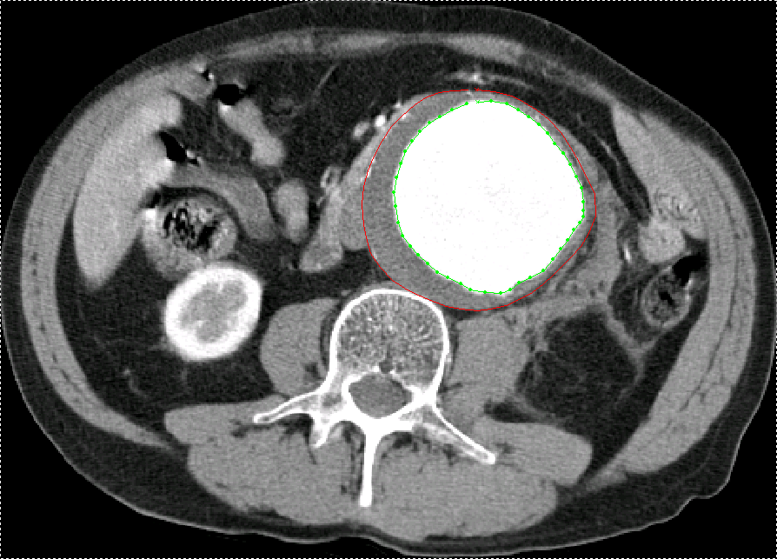
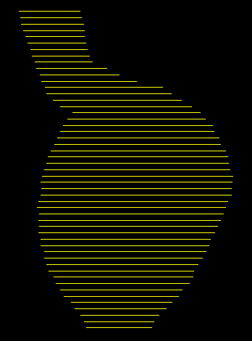
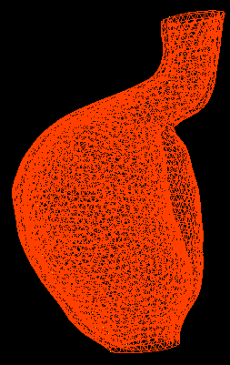

Predicting Abdominal Aortic Aneurysm Rupture
Collaboration with UTGSMK Department of Surgery and Vascular Research Lab
CT scan obtained 1 hour prior to aneurysm rupture
CT slices segmented to obtain vessel & thrombus boundaries
Aneurysm geometry model constructed from stacked layers of segments

Slide 10
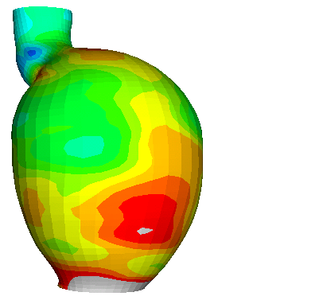
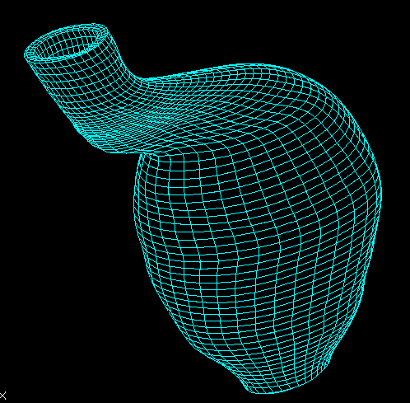
Predicting AAA Rupture 1 Hour After CT Scan
Von Mises Stress
(N/cm²)
61
11
Rupture Site
Engineering software used to mesh geometry & calculate mechanical stress distribution on aneurysm wall
Correctly predicted location of AAA rupture

Slide 11
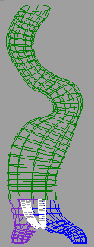
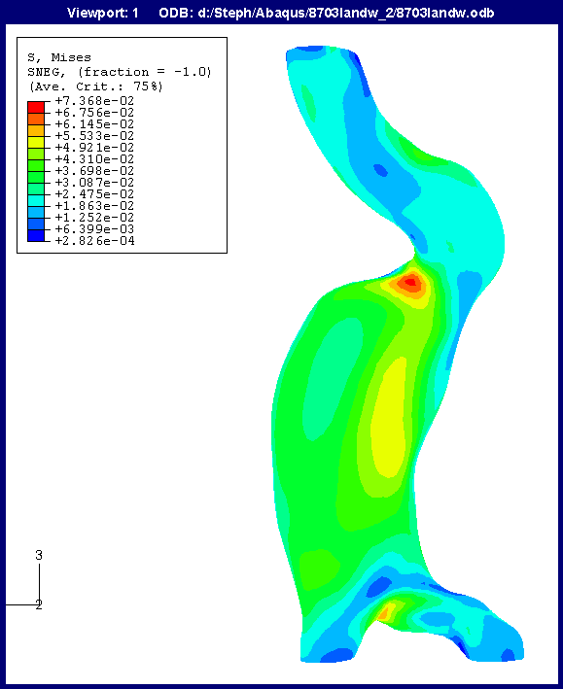
Current Project: Predict Rupture in Bifurcated AAA with Thrombus
Rupture Site
Need student with experience in Finite Element Analysis software (Abaqus, Ansys), Computer Aided Design software (Patran, Abaqus, Rhino3D), mechanical stress, non-linear elastic material properties.

Slide 12
Use Mathematical/Computer Modeling To Answer Critical Questions
Intimal hyperplasia due to balloon injury:
Cellular models of disease process
Kinetic models of biochemistry

Slide 13
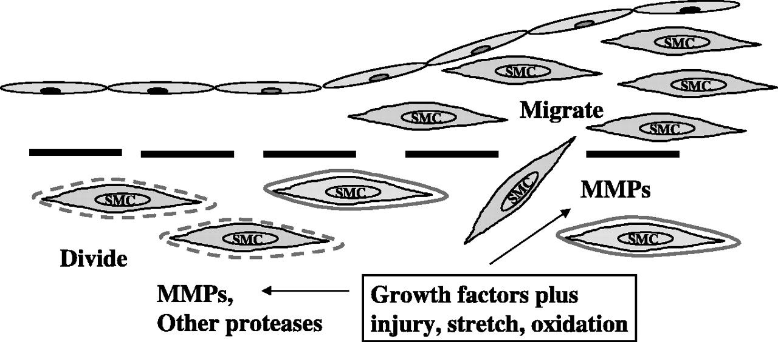
Response of Artery to Balloon Injury
Intima
EC layer
Newby, A. C. Physiol. Rev. 85: 1-31 2005
Media
Lumen
Adventitia
IEL
Balloon angioplasty causes mechanical injuries to endothelial cells (ECs), vascular smooth muscle cells (VSMCs), & internal elastic lamina (IEL)
Platelets in blood adhere to injured endothelium & release PDGF
Inflammatory cells in blood invade intima and release cytokines
VSMCs release matrix degrading enzymes & other biochemicals
VSMCs proliferate & migrate from media to intima in response

Slide 14

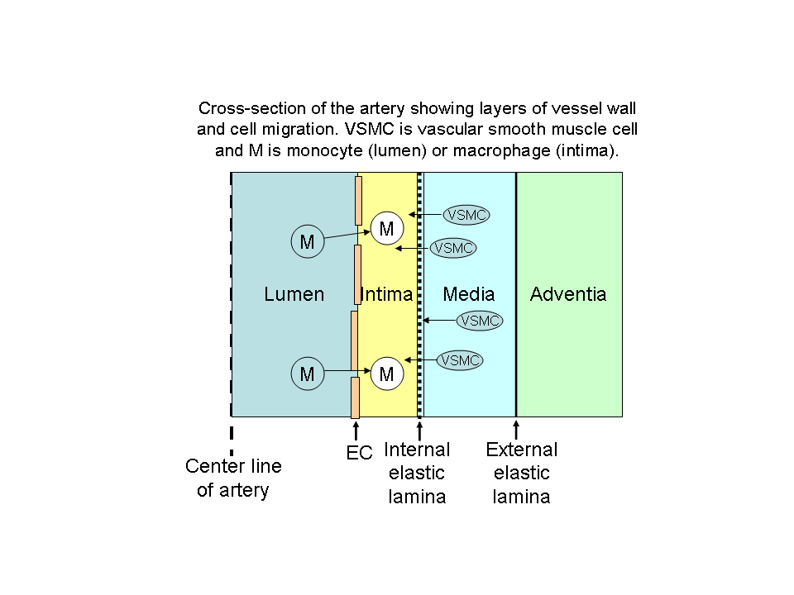
Conceptual Model of Cell Migration in Response to Biochemical Changes
M
VSMC
M
VSMC
artery
center
Released PDGF attracts VSMC
MMP enzymes
breakdown collagen

Slide 15
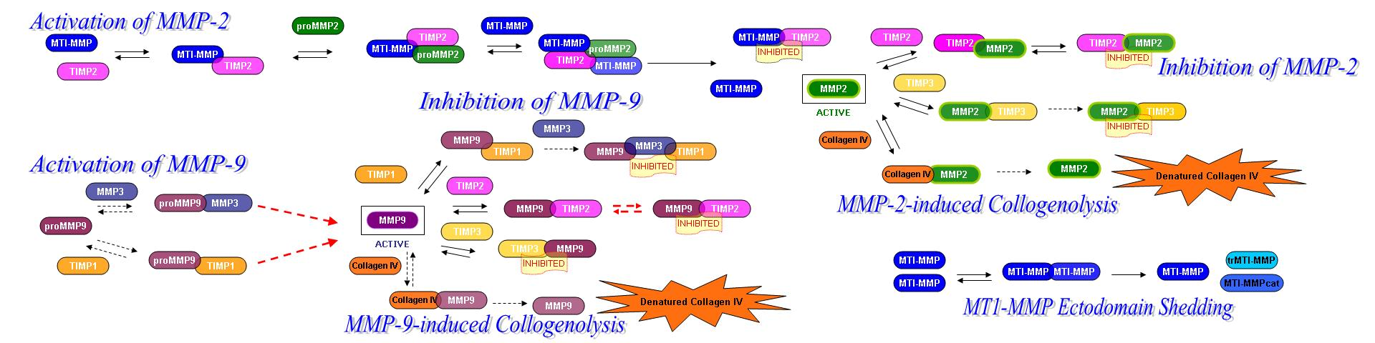
Conceptual Model of Matrix Degrading Enzyme Pathways
proMMP
TIMP
MMP
Inactive
Inhibited
+
MMP
TIMP
Active
Denatured Collagen
Collagen

Slide 16
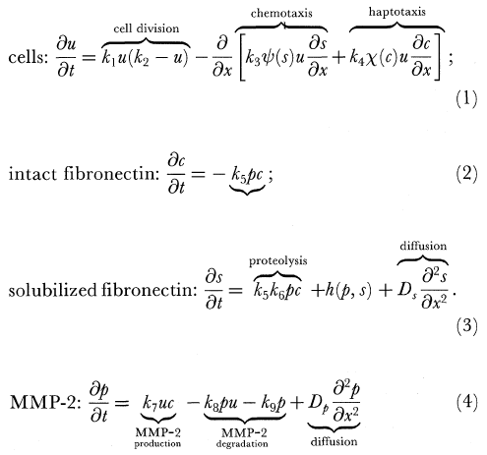
Mathematical Model of Cell Migration in Response to Biochemical Changes
Haptotaxis agent
Chemotaxis agent
From: Perumpaniani, A. J., et al, Proc of Royal Soc of London Series B 265(1413):2347-2352, 22 Dec 1998

Slide 17
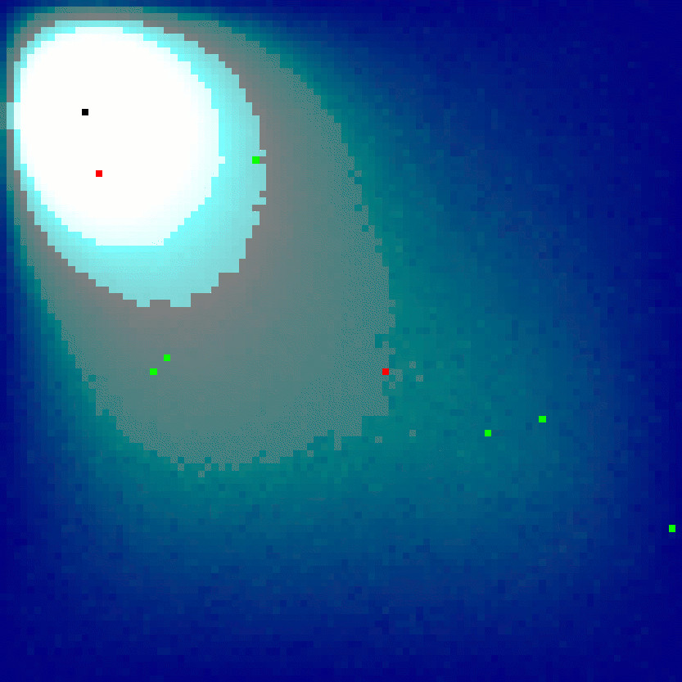
Open holes produce a chemo-attractant that diffuses into the surrounding area
Cells migrate along the gradient, trying to fill the holes
If a cell reaches an open hole, it plugs the hole and the production of chemo-attractant stops

Slide 18
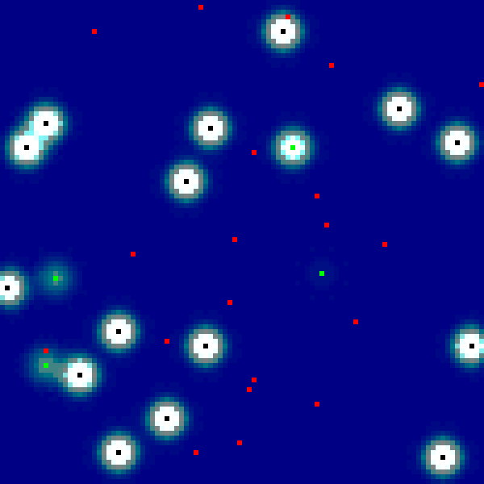
The complete model combines these processes

Slide 19
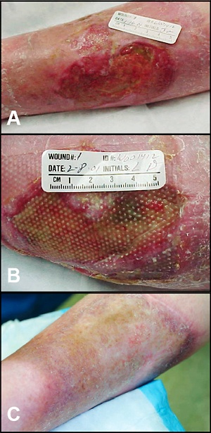
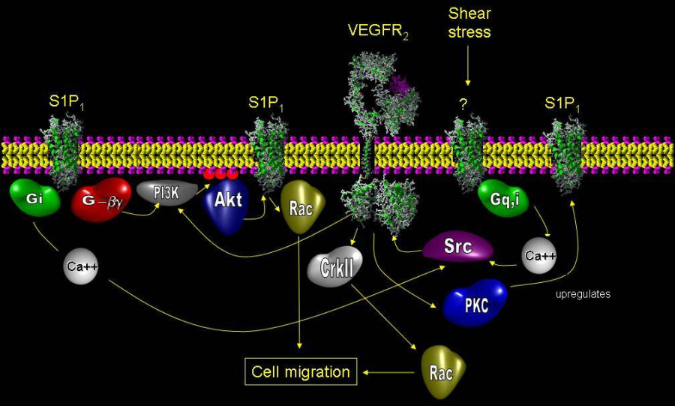
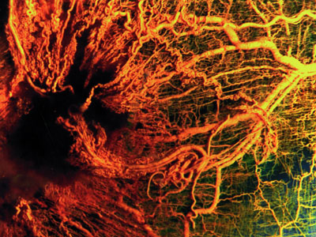
Engineering Approaches Facilitate Improvements in Tissue Functionality and Rate of Wound Healing
Dermal substitute material in burn patients
Guide the organization, maturation, and remodeling of cells
Improve angiogenesis in tissue replacement
http://labs.seas.wustl.edu/bme/elbert/endothelial_cell_biology.htm
http://www.erc.montana.edu/biofilmbook/MODULE_07/Mod07_S04-4_Blue.htm
http://www.ccs.k12.in.us/chsBS/kons/kons/images/angiogenesis.jpg

Slide 20
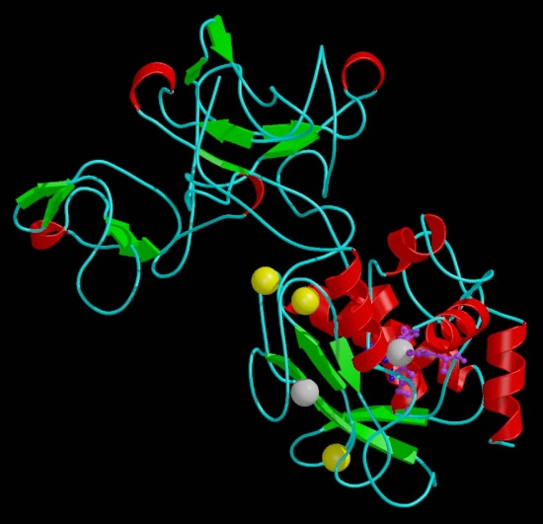
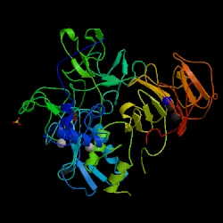
Questions?
Math
Computational Science
Biomedical Sciences
MMP-9
Computer Science
MMP-2
MMP-9

