Slide 1
Uses of the HCC
Mary Anne Cummings
February 4, 2009
Fermilab AAC

Slide 2
Characteristics of Helical Cooling Channels
Compactness
Field homogeneity (continuous solenoid)
HCC theory straightforward to apply
Variability in the following:
Absorber
Fields
Channel geometry
Coil construction
RF or no RF
HCC R & D is relevant to many stages of MC/NF design
HCC R & D can be an upgrade to MICE experiment
HCC techniques relevant to FNAL near and long-term program

Slide 3
Survey of HCC Applications
Ability to cool in any or all dimensions enables many uses
Pre-cooler* Yonehara talk
Quasi-isochronous π decay channel* EPAC08 Yoshikawa/
Muon Collider/Neutrino Factory Front End Neuffer
Stopping Muon Beams* Ankenbrandt talk
6D Cooling for Muon Colliders Yonehara talk
Transition and matching sections*
Extreme Cooling: PIC and HCC Derbenev talk
Transport to pbar trap* new Roberts invention
Cooling Demonstration: MANX* Yonehara talk
* no RF required
http://www.muonsinc.com/tiki-index.php?page=Papers+and+Reports
for relevant EPAC08 papers and other conference references

Slide 4
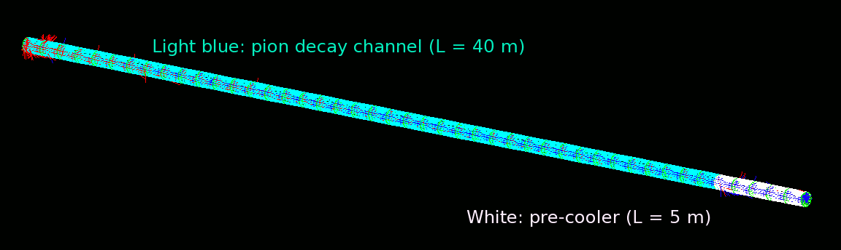
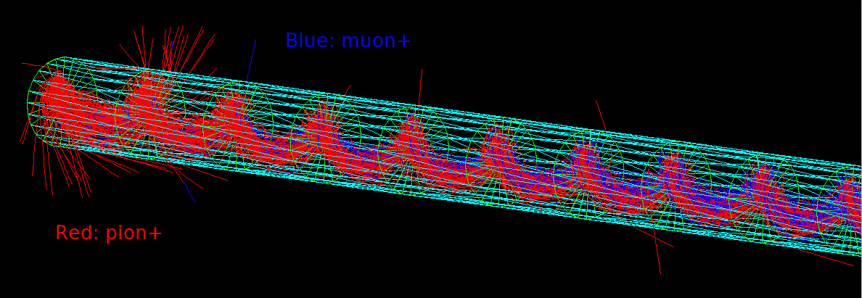
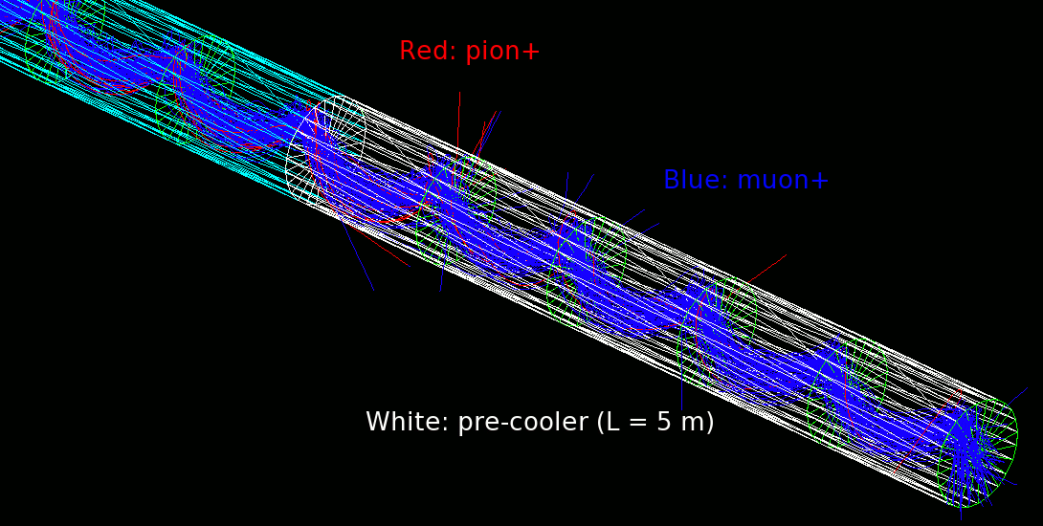
Pre-cooler
Some examples of parameter manipulation from the Derbenev-Johnson HCC theory, to address specific “front-end” applications:
As a decay channel:
- no absorber
- no RF
As precooler:
- absorber
- no RF.

Slide 5
Quasi-isochronous pion decay channel
Momentum (MeV/c) vs. time (ns) of μ⁺s generated with Gaussian momentum spread of 200 ± 50 MeV/c. (a) Muons at 14 meters in straight drift channel. (b) Muons at 10 meters in an IHTC operating at γ_{t} for muons with p=200 MeV/c

Slide 6
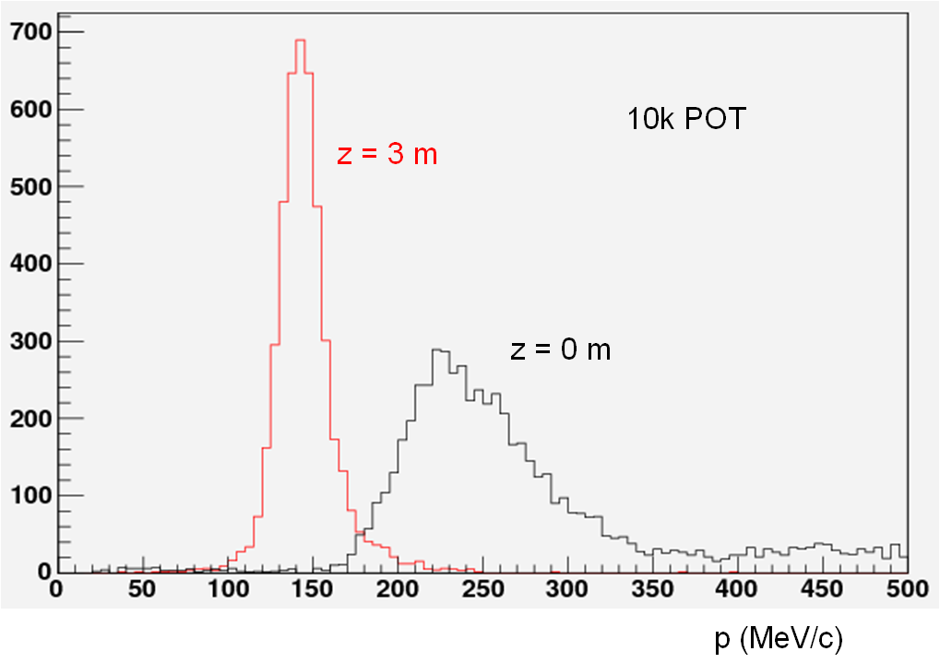
MC or NF Factory Front Ends
1. Tapered Capture Solenoid into HCC
2. Energy/Phase Rotator into HCC
NF/MC Front End up to End of Energy/Phase Rotator into HCC w/o RF w/ tapered LiH wedges variably spaced to match energy loss while maintaining reference radius of 50 cm. The z value refers to depth from start of HCC.

Slide 7
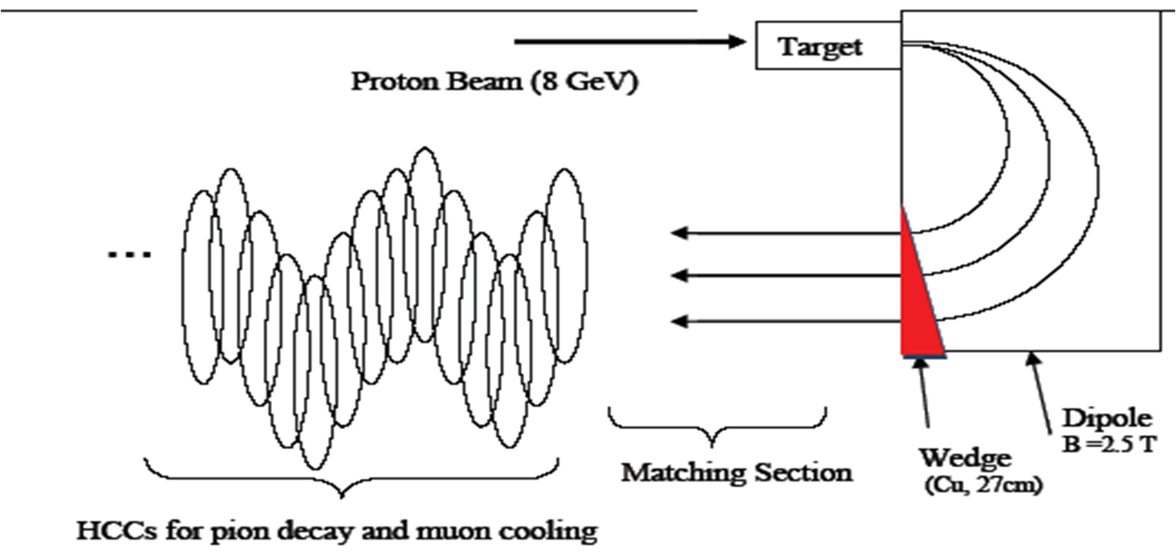
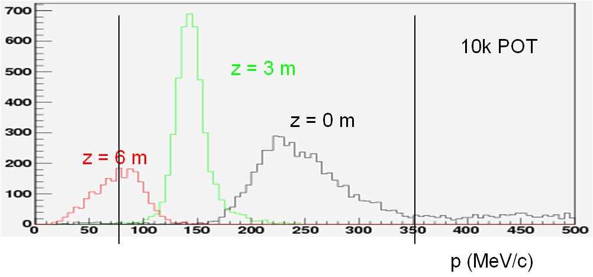
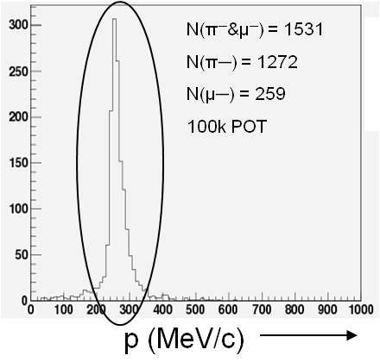
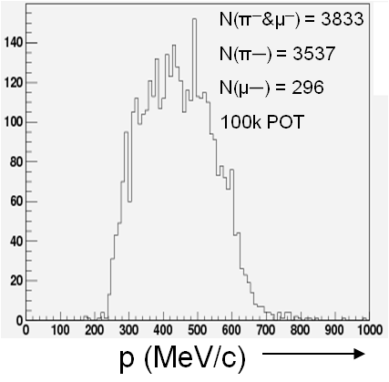
Intense Stopping Muon Beams
Dipole and Wedge
Into HCC
+
180° dipole bend removes large neutral backgrounds.
Muons with a narrow time and momentum spreads will enable the use of higher Z target, and maintain the necessary “extinction” factor.
Matching into the HCC which degrades muons to stop in target
Wedge narrows P distribution

Slide 8
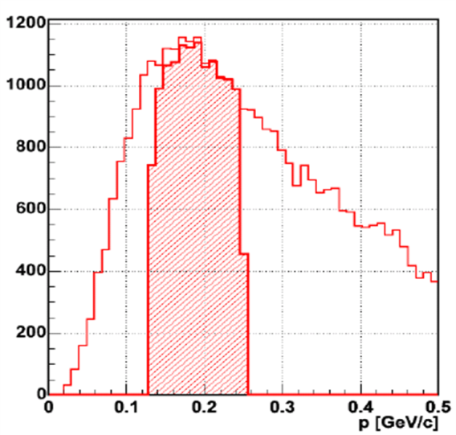
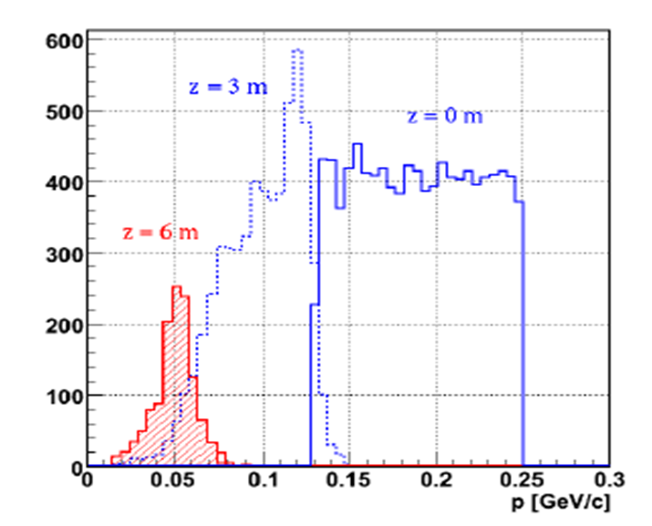
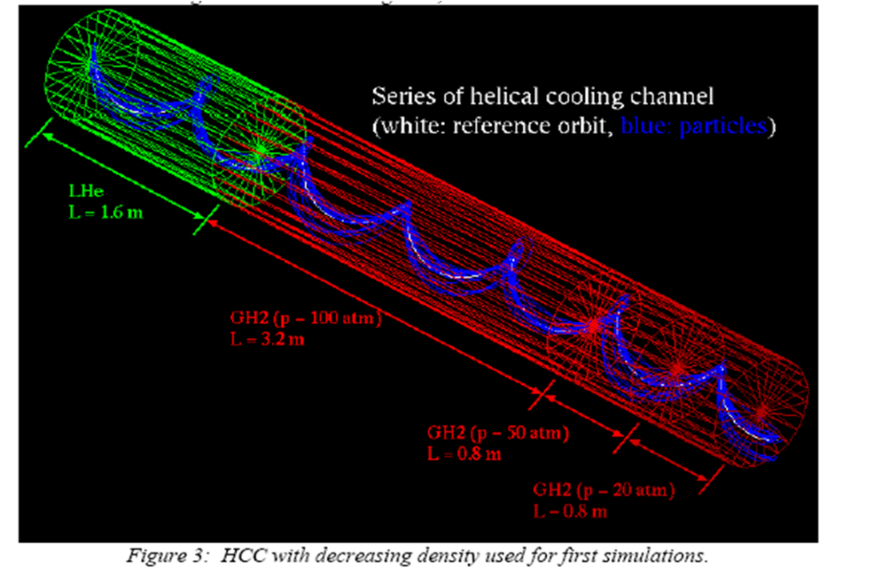
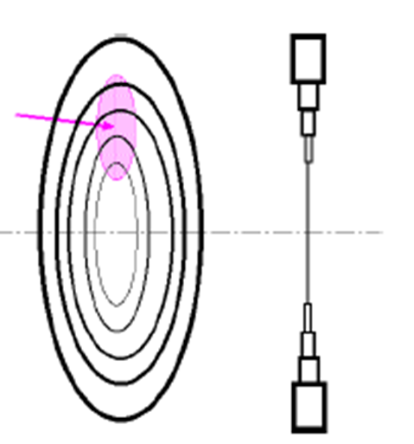
Stopping Muon Beams for mu2e
Using an HCC to reduce the energy spread of the secondary pion beam which produces the muons, decrease backgrounds and increase mu/p production.
Mu/p production can be optimised by capturing pions at the production peak. Cooling brings down the mean momentum low enough to stop in the detector target.
“Tapered-density” absorber HCC channel: “concept” study (1), and a element of a realistic absorber (2), a thin radial LiH wedge. Density is decreased by increased wedge spacing.
(1)
(2)
See C. Ankenbrandt’s talk

Slide 9
6D Cooling for Muon Colliders
Series of HCCs
1. HP GH2 absorber
2. RF inside the solenoids
For MCs, this cools down to the equilbrium emittance of the final channel
~ 10⁶ cooling factor
HCC parameters:
parameters | λ | κ | Bz | bd | bq | bs | f | Inner d of coil | Maximum b | E | rf phase
unit | m |  | T | T | T/m | T/m2 | GHz | cm | Snake | Slinky | MV/m | degree
1st HCC | 1.6 | 1.0 | -4.3 | 1.0 | -0.2 | 0.5 | 0.4 | 50.0 | 12.0 | 6.0 | 16.0 | 140.0
2nd HCC | 1.0 | 1.0 | -6.8 | 1.5 | -0.3 | 1.4 | 0.8 | 25.0 | 17.0 | 8.0 | 16.0 | 140.0
3rd HCC | 0.5 | 1.0 | -13.6 | 3.1 | -0.6 | 3.8 | 1.6 | 12.5 | 34.0 | 17.0 | 16.0 | 140.0

Slide 10
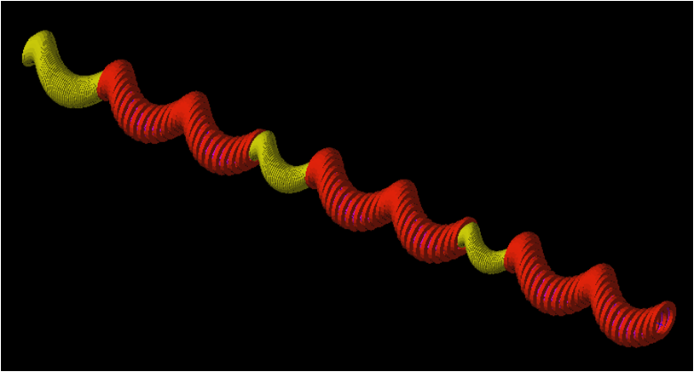
Transition and matching
Possible need for transitional sections for optimal transmission into or between different cooling sections
Proper absorber choice for momentum selection
Example 1: Series of HCC sections with RF and pressurized gas
Precooler
Series of HCCs
Example 2: Interleaving RF/non-RF sections:

Slide 11
Extreme Cooling: PIC and HCC
X’
X’
X
X
sinΨ = 0 decouples x and x’
Old PIC:
Absorber plates
Parametric resonance lenses
PS area is reduced in x due to the dynamics of the parametric resonance and reduced in x’ by ionization cooling.
λ/8
λ
“epicycle HCC” PIC
HCC with 2 periods: an additional helical field of opposite helicity to create alternating dispersion – modified orbit from simple spiral
Y. Derbenev’s talk

Slide 12
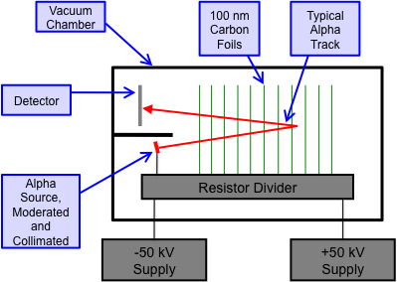
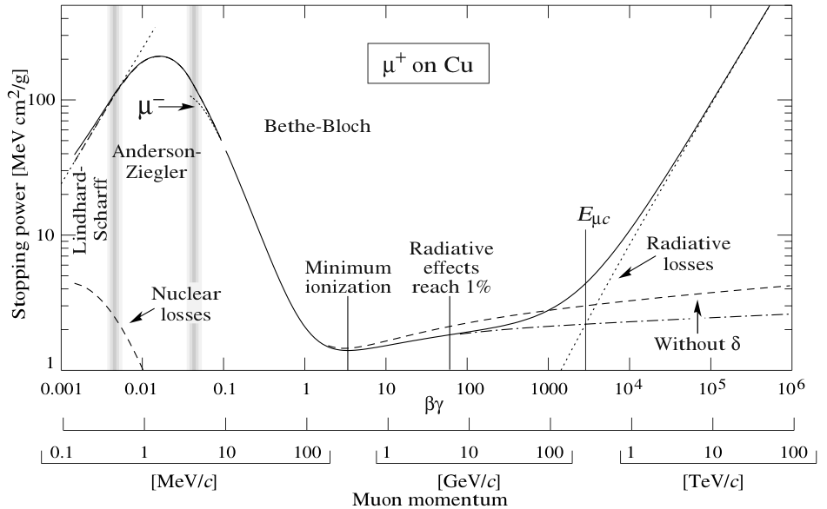
Transport to Pbar Trap
HCC Transport Channel
Frictional cooling can provide exceptionally low-emittance beams of unstable ions, alphas and antiprotons. The particle refrigerator makes it practical to do so with high intensities.
T. Roberts, SBIR proposal

Slide 13
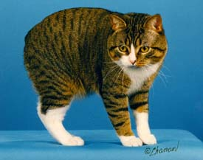
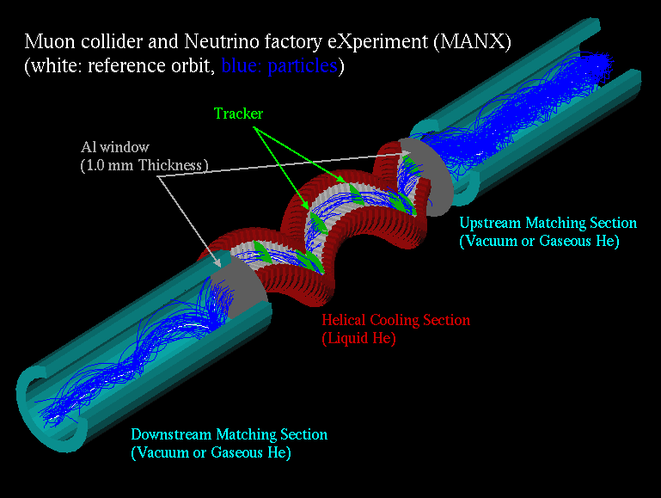
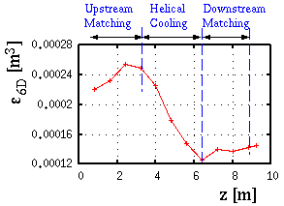
MANX channel
Use Liquid He absorber
No RF cavity
Length of cooling channel: 3.2 m
Length of matching section: 2.4 m
Helical pitch k: 1.0
Helical orbit radius: 25 cm
Helical period: 1.6 m
Transverse cooling: ~1.3
Longitudinal cooling: ~1.3
6D cooling: ~2
Innovative superconducting Helical Solenoidal (HS) magnet is the major component of a momentum-dependent Helical Cooling Channel (HCC)
G4BL Simulation
13
Notes:
13

Slide 14
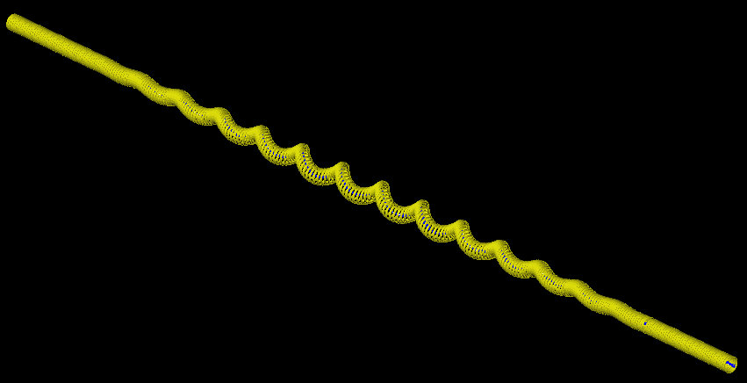
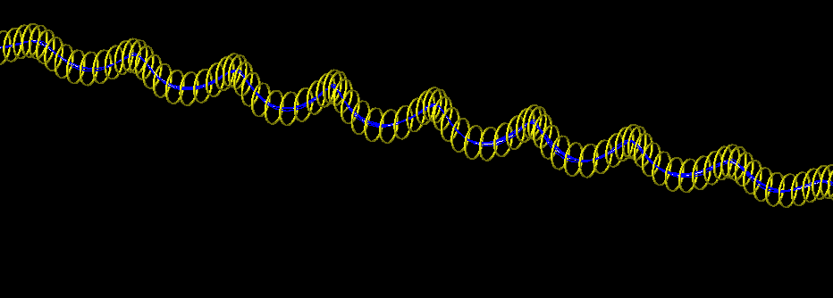
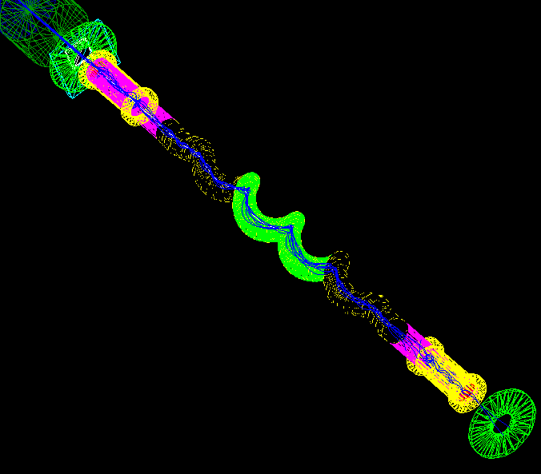
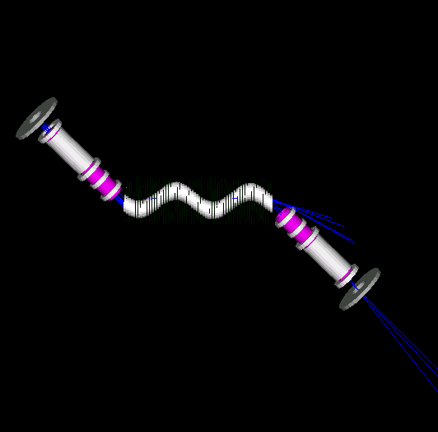
Possible MANX configurations
Increase gap between coils
from 20 mm to 100 mm
Matching
HCC
Matching
Helix period = 1.2 m
Coil length = 0.05 m
Gap between coils = 0.01m
Without matching – requires transverse displacement of downstream spectrometer (with MICE spectrometers)
Matching sections
14

Slide 15
HCC and FNAL
HCC development is relevant to Project X physics and all initial stages of MC/NF
MTA HP RF beam tests are about to start
HCC theory is being simulated and refined:
RF studies can influence the HCC MANX design
HCC HS 4-coil tests a start on practical engineering
Parallel projects working on critical engineering challenges of a HCC channel
Consistent with and complimentary to the 5-year plan in critical cooling channel component testing, primarily through additional SBIR-STTR funds
Muons, Inc. joined MICE – natural MANX collaborators, with many similar problems and interests

