Slide 1
Computational nuclear physics in the next decade
David Dean
LACM-EFES-JUSTIPEN Workshop
24 February 2009

Slide 2
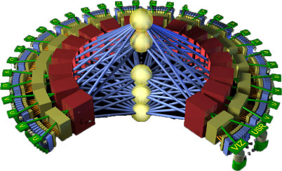

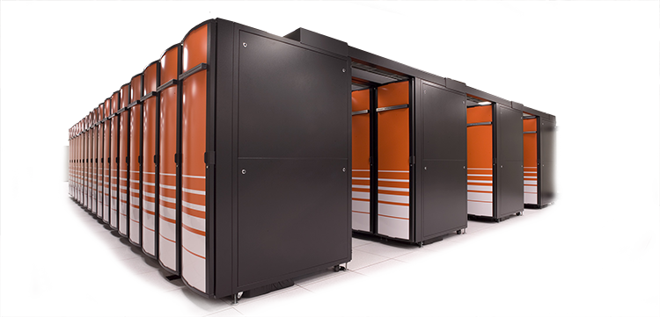
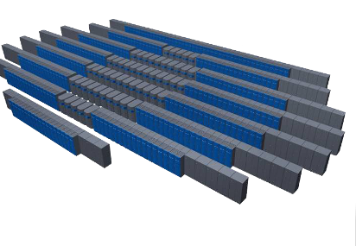

Million-fold increase in computing and data capabilities (ORNL)
Cray “Baker”
8-core, dual-socket SMP
1.4 PF
300 TB, 10 PB
2018
Cray XT4 Quad-core
263 TF
62 TB, 1 PB
2015
Future system 1000 PF (1 EF)
2011
Cray XT4
119 TF
2009
Future system 100–250 PF
Cray XT3
Dual-core
54 TF
2008
DARPA HPCS 20 PF
2007
Cray X1
3 TF
Cray “Baker”
8/12-core, dual-socket SMP
~1 PF
100 TB, 2.5 PB
2006
Cray XT4
Quad-core
166 TF
18 TB, 0.3 PB
2005
2004
Cray XT3
Single-core
26 TF

Slide 3
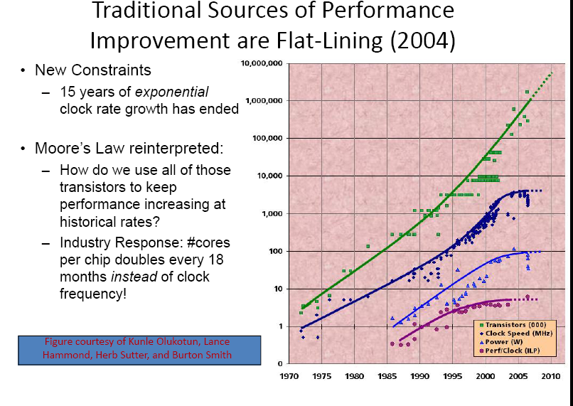

Slide 4
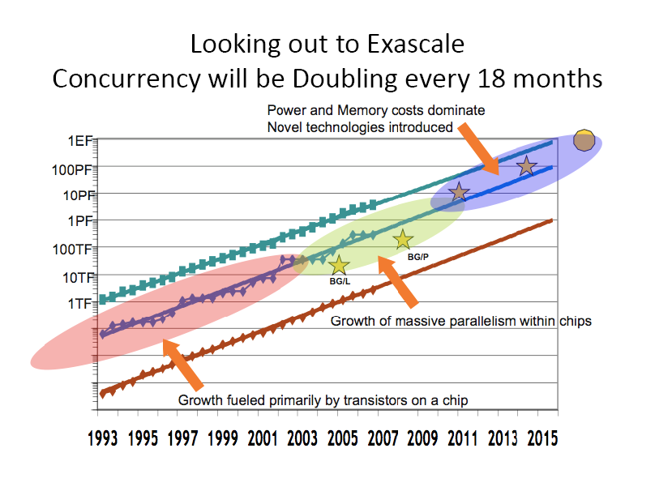

Slide 5
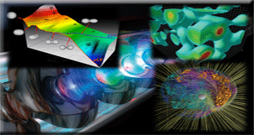

Scientific Grand Challenges Workshop Series
Enabling science communities to address scientific grand challenges through extreme scale computational science
Workshop series:
Climate Science
High-Energy Physics
Nuclear Physics
Fusion Energy Sciences
Nuclear Energy
Biology
Materials Science and Chemistry
26-28 January 2009, Washington, DC
109 participants; DOE/NSF/NNSA reps
The Nuclear Physics Workshop defined Priority Research Directions in
Nuclear Astrophysics
Cold QCD and Nuclear Forces
Nuclear Structure and Reactions
Accelerator Physics
Hot and Dense QCD

Slide 6
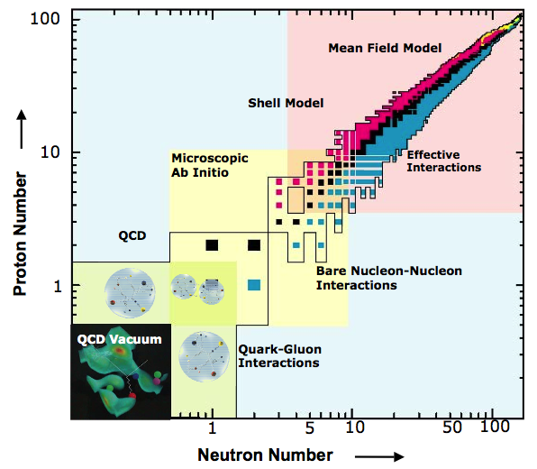
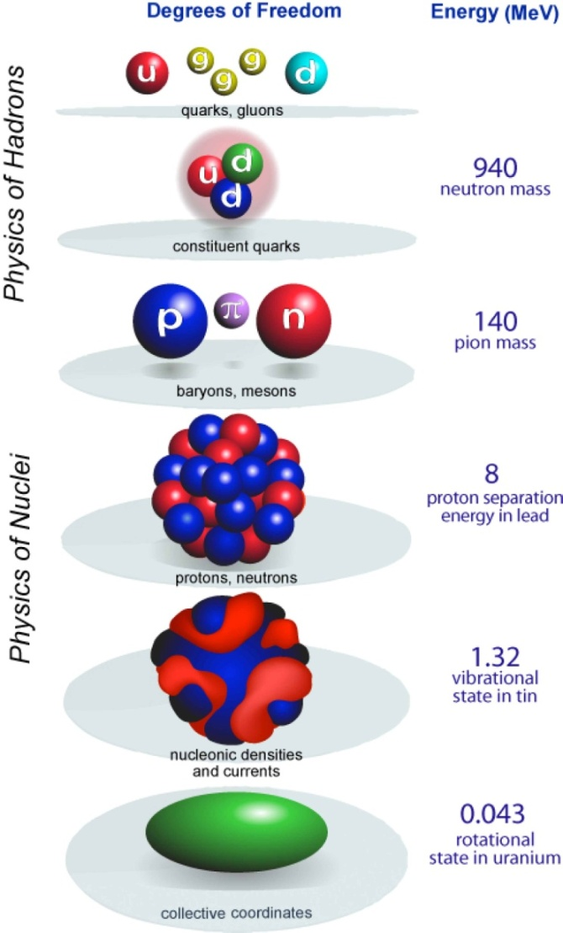
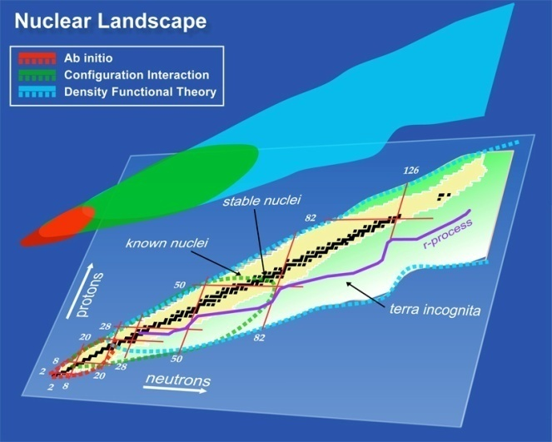
Exa-scale computing will unify nuclear physics
QCD
Nuclear
Structure
Applications in astrophysics,
defense, energy, and medicine

Slide 7
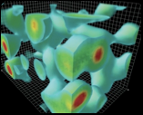
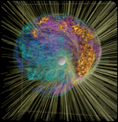
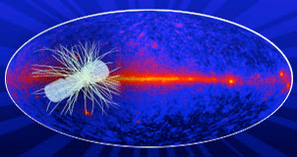
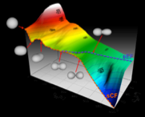
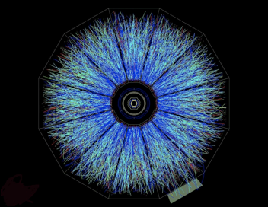
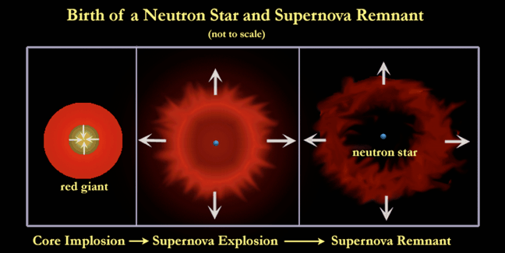
Exa-scale computing will unify nuclear physics
Cold QCD and
Nuclear Forces
Nuclear
Astrophysics
HEP
neutrino
Equation of state of nuclear material?
Kaon (strange meson) Condensates?
Sigma (strange) Baryons?
Is SN1987A a black hole or a neutron star?
Nuclear Structure
and Reactions
Hot and Dense
QCD

Slide 8
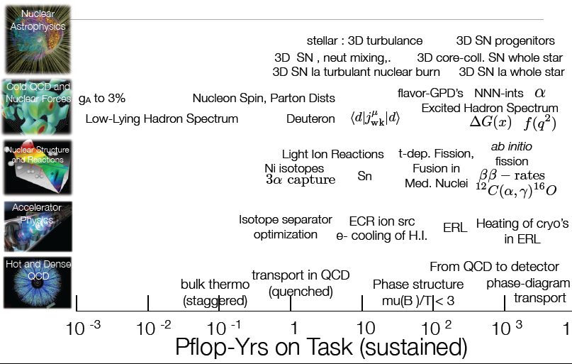
Nuclear Physics Requires Exascale Computing

Slide 9
Other Observations
Extreme scale computing requires collaborations
Among domain specific scientists, applied mathematicians, and computer scientists
Some of the most interesting physics outcomes will be at the interfaces:
QCD to forces to structure
structure and reactions with nuclear astrophysics
Opportunity to increase knowledge and leverage large investments in experimental facilities
Technology breakthroughs must occur

