Slide 1
Adoption of caBIG® Tools: Project Outcome Presentation
Washington University School of Medicine
and the Alvin J. Siteman Cancer Center
Saint Louis
January, 2009

Slide 2
caBIG ® Overview
caBIG™ is an information network enabling all constituencies in the cancer community – researchers, clinicians, patients – to share data and knowledge to accelerate the discovery of new diagnostics and therapeutics, and improve patient outcomes.
caBIG™ Vision
Connect the cancer research community through a shareable, interoperable infrastructure
Deploy and extend standard rules and a common language to more easily share information
Build or adapt tools for collecting, analyzing, integrating and disseminating information associated with cancer research and care

Slide 3
Scope of Adoption Activity at WUSM
The Alvin J. Siteman Cancer Center (SCC) Bioinformatics Core adopted caBIGTM tools to primarily support two research groups
Acute Myelogenous Leukemia Group: 13 PIs
Neuro-Oncology Research Group:16 PIs

Slide 4
Acute Myelogenous Leukemia (AML) Research Group
AML
AML is the most common acute leukemia affecting adults, and its incidence increases with age.
Accounts for approximately 1.2% of cancer deaths in the United States, its incidence is expected to increase as the population ages.
As an acute leukemia, AML progresses rapidly and is typically fatal within weeks or months if left untreated.
Dr. Timothy Ley and his collaborators are integrating comprehensive clinical information, pathology and cytogenetics data, and profiling data sets (expression, aCGH, SNP, proteomics, and mutation profiling) to determine the molecular mechanisms underlying AML.

Slide 5
Neuro-oncology Research Group
Juvenile Pilocytic Astrocytoma
Most common astrocytic tumors in children (peak incidence:5-14 yrs).
Accounts for 80-85% of cerebellar astrocytomas and 60% of optic gliomas.
Many PAs are slow-growing or clinically indolent, others exhibit more aggressive features with tumor recurrence and death.
MPNST
Cancer of the connective tissue surrounding nerves
About half the cases are diagnosed in people with NF1
MPNSTs are often metastatic and are a frequent cause of death among people with NF1.
Dr. Gutmann and his collaborators are studying a wide range of neuro-oncological tumors and are correlating molecular markers with clinical observations such as outcome and survival.

Slide 6
Our Workflow Prior To caBIG® Tools Adoption
End users send request to Director of SCC Tissue Procurement Core Facility for sample(s) availability
Availability of molecular specimens (RNA/DNA) checked
Unavailable molecular specimens are requested to be made
Samples identified
Microarray data made available to researchers for download through Washington University Biomedical Informatics Core web page
Molecular specimens sent to Laboratory for Clinical Genomics for Microarray Hybridization
End users download CEL files
Identifies and installs each of the tools required for analyzing SNP microarray data for Copy Number variations..
Download all the supporting files required for analysis
Performs manual processing of output files to make them compatible for other analytical tools
Notes:
Our workflow for obtaining molecular specimens, microarray data procurement and analysis before the adoption of caBIGTM tools at WashU. The steps denoted by star are modified/simplified as a result of caBIGTM tools adoption at WashU.

Slide 7
Objectives
To address the needs of the research community by providing-
(a) A standards-based biospecimen repository containing QA/QC data and associated pathology and clinical annotations.
(b) A centralized, standards-compliant repository for microarray data.
(c) Tools to analyze SNP microarray data to identify copy number aberrations.

Slide 8
caBIG® tools adoption
caTissue Core : Storage of biospecimen data. v1.2.0.1 to manage ALL the biospecimens housed by the SCC Tissue Procurement Core. A subset of de-identified biospecimen data is shared through a publicly available caTissue Core v1.2.2 instance.
caArray: Storage of microarray data (expression and SNP). v1.5, v1.6 ,v2.0 and v2.1
Analytical services: Development of SNP microarray Analytical Services for identifying copy number aberrations.

Slide 9
caTissue Core
Prominent Features of caTissue Core include:
Web-based application for entering or searching for biospecimens.
Tracking of multiple specimens from the same participant.
Tracking of refined materials (RNA, DNA, Protein) that are used for molecular analysis.
Role-based permission scheme for repository personnel and researchers.
Tracking of quality assurance, distribution, derivation, and aliquotting of biospecimens.
Finding and requesting specimens required by researchers.
(http://cabig.cancer.gov/action/tools.asp;caTissue_toolsheet_31208v1_Final.pdf)

Slide 10
Our instance of caTissue
Our instance of caTissue Core v1.2.2 can be accessed at http://catissueshare.wustl.edu:48080/catissuecore
The caGrid service URL is- https://128.252.227.214:58443/wsrf/services/cagrid/CaTissueCore

Slide 11
Our instance of caTissue
Investigators may register and be approved for access to this instance.
Information on a total of 450 specimens including 103 cell specimens, 122 tissue specimens, and 225 molecular specimens are available on our caTissue Core instance.

Slide 12
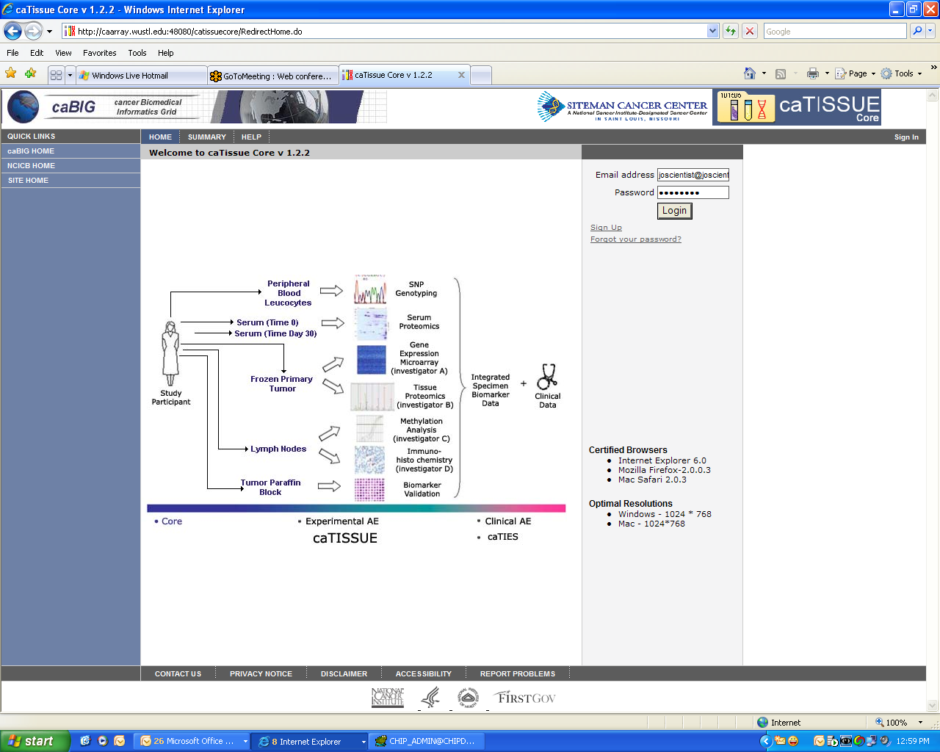
caTissue Core v1.2.2

Slide 13
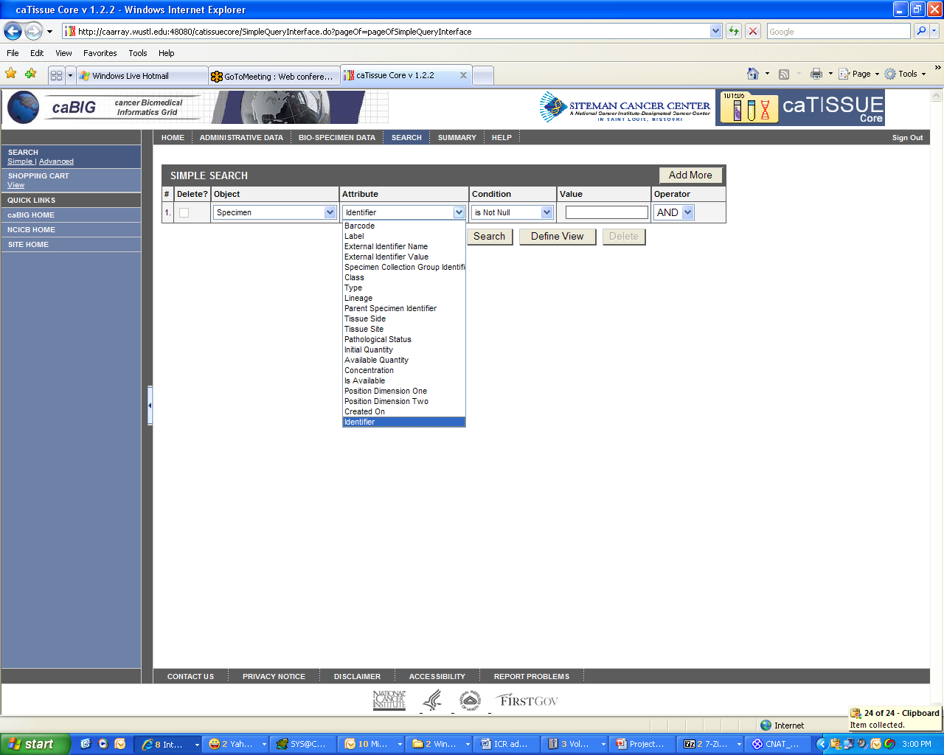
Searching caTissue Core

Slide 14
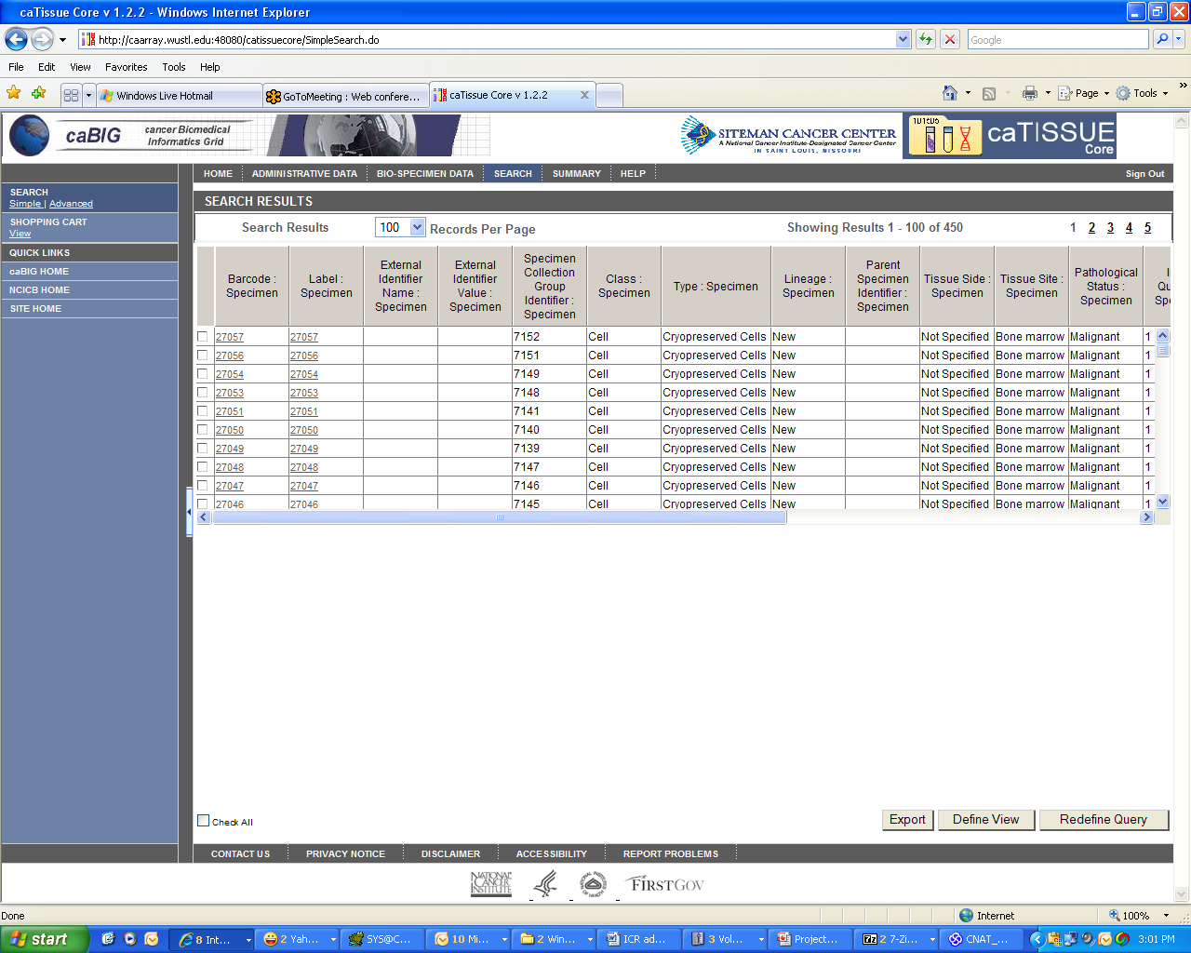
Searching caTissue Core

Slide 15
caArray v2.x
caArray is an open-source, web and programmatically accessible array data management system.
caArray guides the annotation and exchange of array data using a federated model of local installations whose results are shareable across the cancer Biomedical Informatics Grid (caBIG®).
caArray furthers translational cancer research through acquisition, dissemination and aggregation of semantically interoperable array data to support subsequent analysis by tools and services on and off the Grid.

Slide 16
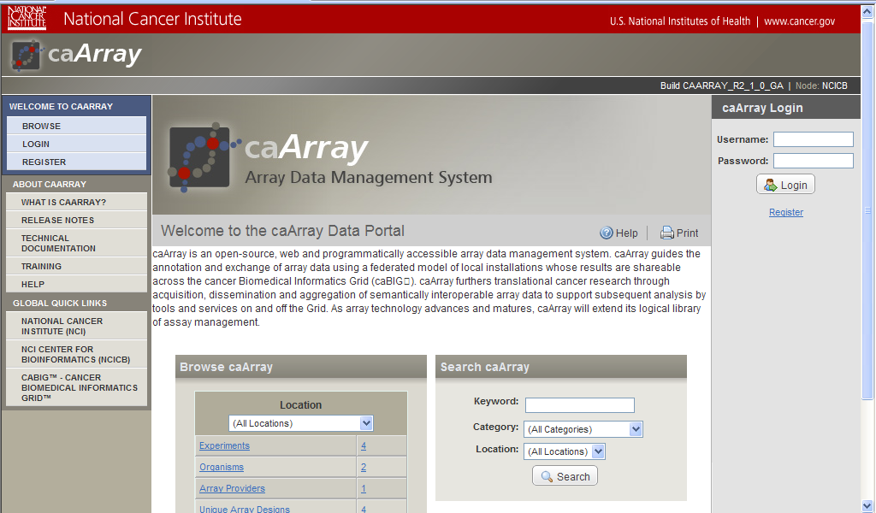
Our instance of caArray v2.1

Slide 17
Our instance of caArray v2.1
Our instance of caArray v2.1 can be accessed at http://caarray.wustl.edu/caarray
To access our instance as a caGrid service, please use the following information:
For firing queries and fetching objects from caArray v2.1: http://caarray.wustl.edu:18080/wsrf/services/cagrid/CaArraySvc
For downloading CEL files, use:
SERVER_NAME = "caarray.wustl.edu"
JNDI_PORT = 11099
GRID_SERVICE_PORT = 18080

Slide 18
Our instance of caArray v2.1
There are four public experiments
Acute Myeloid Leukemia Project : 185 CEL files
Gene Expression profiling in Pilocytic Astrocytoma : 41 CEL files
Gene regulation in murine APL cells : 53 CEL files
Pilocytic Astrocytoma : Genome-wide copy number profiling: 40 CEL files

Slide 19
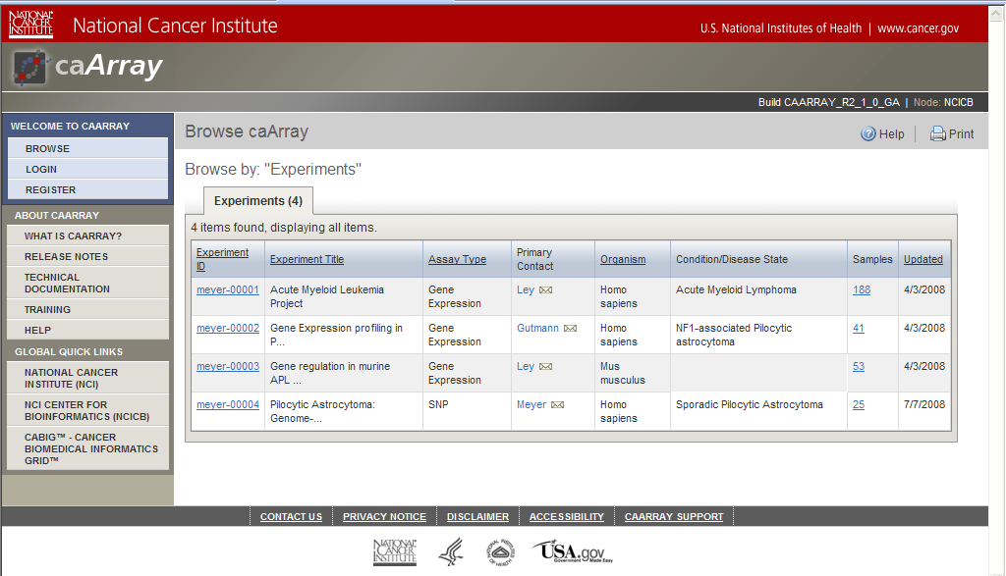
caArray v2.1

Slide 20
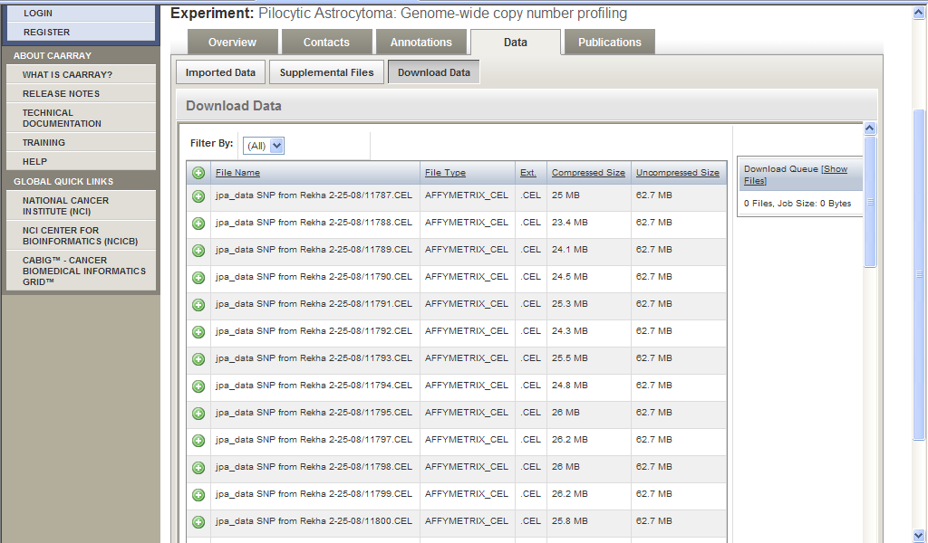
Data For Download

Slide 21
Why we need SNP analytical services?
While independent tools exist to analyze SNP array data, there are no tools that facilitate the entire analysis workflow.
The SNP array analysis tools available to date are not very user-friendly (i.e. for a bench scientist or translational researcher).
Most often the workflow becomes very complicated when multiple tools are used.
We aimed at providing “one-stop shop” software that analyzes SNP data for copy number changes utilizing some newly developed and other available tools.
Notes:
While independent tools exist to analyze SNP array data, there are no tools that facilitate the entire analysis workflow (e.g. obtain SNP array data, analyze single SNP data, generate amplified or deleted chromosomal segments and prioritize the segment level output).

Slide 22
SNP Microarray Analytical Services
The analytical services we developed for SNP Microarray Analytical Services for identifying copy number aberrations-
Copy Number Analysis Tool (CNAT) Analytical Service
GenePattern Based Copy Number Analytical Service
DNAcopy Analytical Service
Chromosomal Segment Overlap Finder Across Sources
Chromosomal Segment Overlap Finder Across Samples

Slide 23
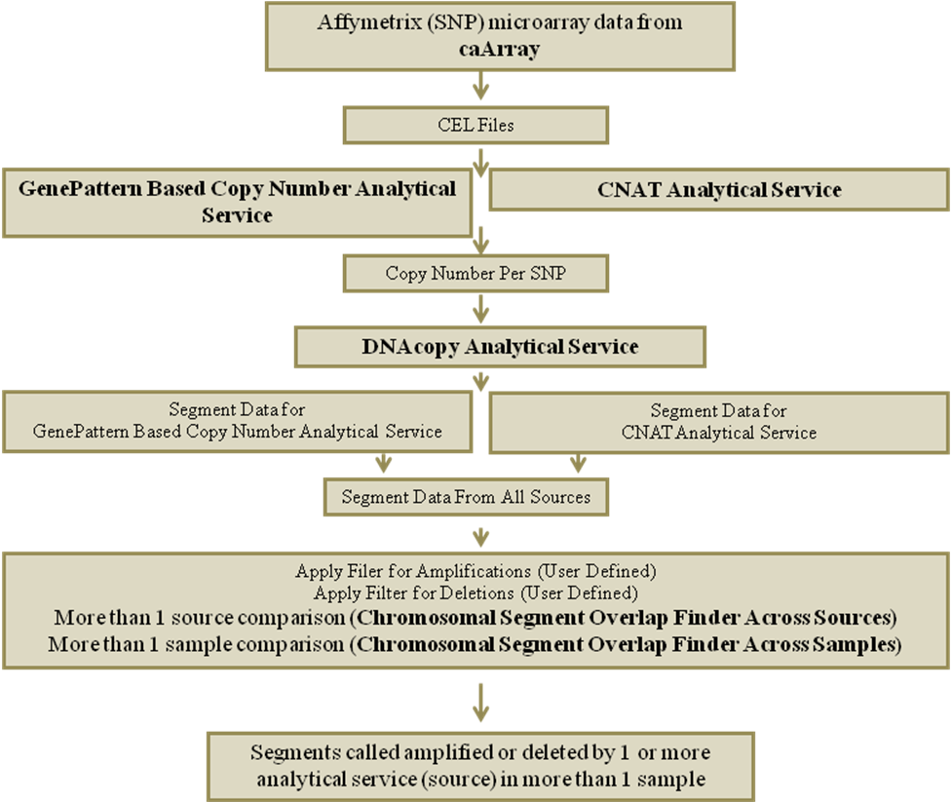
Segment Level Unpaired SNP Copy Number Analysis

Slide 24
Copy Number Analysis Tool (CNAT) Analytical Service
Implementing GeneChip® Genotyping Analysis Software (GTYPE) and CNAT (http://www.affymetrix.com).
GTYPE is used to convert SNP microarray .CEL file to .CHP files and obtain the summary files. .CHP files and summary files are required by CNAT as input.
CNAT will calculate the gains and losses in the copy number and output the results as a .TXT file at a single SNP level.
Chromosome and Physical Location columns in the output file are populated based on the human genome build 35.
Service URL http://linuxcomp64.wustl.edu:9880/wsrf/services/cagrid/CNAT

Slide 25
GenePattern Based Copy Number Analytical Service
Adopting SNPFileCreator and CopyNumberDividedByNormals modules from GenePattern (http://www.broad.mit.edu/cancer/software/genepattern/).
The SNPFileCreator module creates a GenePattern .snp file from a set of individual Affymetrix SNP chip CEL files.
The CopyNumberDivideByNormals module determines the raw copy number of a target SNP.
Chromosome and Physical Location columns in the output file are populated based on human genome build 35.
Service URL http://linuxcomp64.wustl.edu:9880/wsrf/services/cagrid/CopyNumberByGenePatternAnalyticalService

Slide 26
DNAcopy Based Analytical Service
From Bioconductor’s DNAcopy package we are implementing (http://bioconductor.org/packages/1.8/bioc/html/DNAcopy.html).
Create Copy Number Array data object (CNA),
Smooth a Copy Number Array data object (Smooth.CNA),
Genome Segmentation Program (Segment)
CNA creates a 'copy number array' data object used for DNA copy number analyses by programs such as circular binary segmentation (CBS).
Smooth CNA, detect outlier and smooth the data prior to analysis by programs such as CBS.
The program" Segment", segments DNA copy number data into regions of estimated equal copy number using circular binary segmentation (CBS).
Service URL http://linuxcomp64.wustl.edu:9880/wsrf/services/cagrid/DnaCopy

Slide 27
Chromosomal Segment Overlap Tools
The Chromosomal Segment Overlap Tool can be used to identify segments of chromosome that represent the amplified or deleted by
More than one source (Chromosomal Segment Overlap Finder Across Sources).
In more than 1 sample (Chromosomal Segment Overlap Finder Across Samples).
A detailed algorithm is available in our white paper available at the project’s Gforge site.
Chromosomal Segment Overlap Finder Across Sources (http://linuxcomp64.wustl.edu:9880/wsrf/services/cagrid/ChromosomalSegmentOverlapAcrossSources)
Chromosomal Segment Overlap Finder Across Samples (http://linuxcomp64.wustl.edu:9880/wsrf/services/cagrid/ChromosomalSegmentOverlapAcrossSamples

Slide 28
Our Workflow Subsequent To caBIG™ Tools Adoption
End users uses caTissue Core and checks for availability of molecular specimens and submits request for required specimens
Molecular Specimens sent to Laboratory for Clinical Genomics for Microarray Hybridization
Microarray data available through caArray 2.1
Analyzes SNP Copy Number Data using Analytical Tools developed as part of the present project
Notes:
Our workflow for obtaining molecular specimens, microarray data procurement and analysis after the adoption of caBIGTM tools at WashU.

Slide 29
Future Work
Integration of these various tools and analytical services developed as part of caBIGTM tools adoption project at Washington University with cancer Bed to Bedside (caB2B).
caB2B will be utilized to acquire microarray and biospecimen data from caArray and caTissue Core and will then be used to analyze and visualize these data sets.

Slide 30
Useful Links
WashU’s caTissue Core v1.2.2 public instance, http://catissueshare.wustl.edu:48080/catissuecore
WashU’s caArray 2.0 public instance, http://caarray.wustl.edu/caarray
WashU’s caBIGTM tools adoption Gforge site, http://gforge.nci.nih.gov/projects/icradopt-washu/
caB2B, https://cabig.nci.nih.gov/tools/caB2B
Demonstration movies for SNP Microarray Analytical Services, https://gforge.nci.nih.gov/docman/index.php?group_id=388&selected_doc_group_id=4600&language_id=1
URL for SNP microarray Analytical Services
CNAT (http://linuxcomp64.wustl.edu:9880/wsrf/services/cagrid/CNAT)
GenePattern Based Copy Number (http://linuxcomp64.wustl.edu:9880/wsrf/services/cagrid/CopyNumberByGenePatternAnalyticalService)
DNAcopy (http://linuxcomp64.wustl.edu:9880/wsrf/services/cagrid/DnaCopy)
Chromosomal Segment Overlap Finder Across Sources (http://linuxcomp64.wustl.edu:9880/wsrf/services/cagrid/ChromosomalSegmentOverlapAcrossSources)
Chromosomal Segment Overlap Finder Across Samples (http://linuxcomp64.wustl.edu:9880/wsrf/services/cagrid/ChromosomalSegmentOverlapAcrossSamples

Slide 31
Teams involved in adoption process
Washington University School of Medicine
Hrishikesh Deshmukh (Bioinformaticist)
Burr Fontaine (Bioinformaticist)
David Gutmann (PI)
Sunita Koul (Software Engineer; co-Project Manager)
Tim Ley (PI)
Rakesh Nagarajan (Faculty Lead)
Jackie Payton (End User)
Mukesh Sharma (Bioinformaticist; co-Project Manager)
Mark Watson (PI)
Jinsheng Yu (End User)
Yiye Zhang (End User)
BAH
Elaine Freund
Li Kramer
Kevin Groch
Curt Lockshin
Persistent Systems Ltd
Srikanth Adiga (Project Manager)
Madhurima Bhattacharjee (Domain Expert)
Srinath Krishnamurthy (Developer)
Rahul J. Ner (Developer)
Ashwini Patil (Domain Expert)
Chetan Patil (Developer)
Hrishikesh Rajpathak (Developer)
Deepak Shingan (Developer)
Jasbir Sachdeva (Developer)
Chandrakant J. Talele (Developer)
Rajesh Vyas (Developer)
caArray Team
Juli Klemm
Brent Gendleman
Eric Tavela

