Slide 1
NOAA’s Workforce Management Office (WFMO)
Serving NOAA’s Most Valuable Asset—People

Slide 2
Summary of Content (in order of appearance)
Mission
Vision
Outputs: Products and Services
Budget
Leadership
Facilities and Personnel

Slide 3
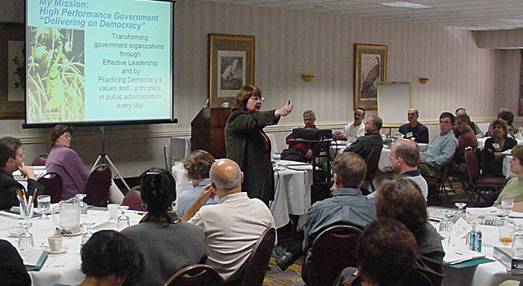
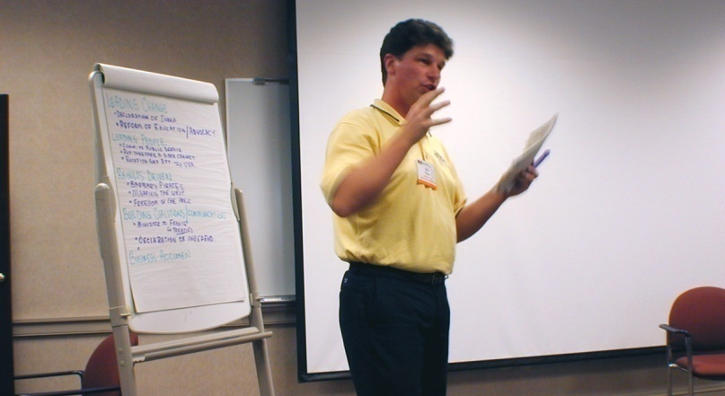
Mission and Vision
Partner with stakeholders to create and enable the systems and processes to achieve NOAA’s mission through effective planning, recruitment, development, management, and retention of NOAA’s workforce
A strong partnership between the Workforce Management Office and Line/Staff Office workforce management community in delivering high-value products and services to clients, enabling the achievement of NOAA’s Human Capital strategy

Slide 4
Outputs Products & Services
DRIVERS
Title 5 of the U.S. Code
SERVICES
Hiring, Benefits, Retirement, Employee & Labor Relations, Payroll Services & SES Staffing
Support strategic management of human capital, HR IT systems development and HR policy formulation
OUTCOME
A diverse, skilled, motivated, and effective workforce capable of accomplishing NOAA’s mission
Title 5 of the Code of Federal Regulations
NOAA Human Capital Council Priorities
Department Administrative Order 202-250
NOAA Strategic Human Capital Management Plan

Slide 5
WFMO Budget
*

Slide 6
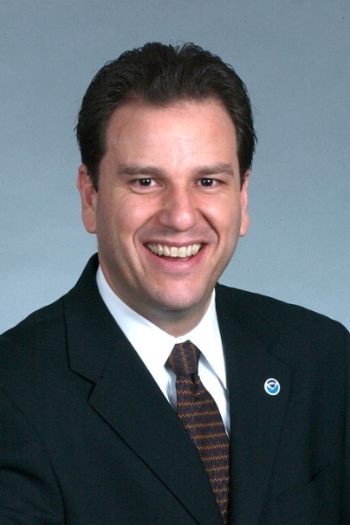

Who We Are: AGO Leadership
Eduardo (Eddie) J. Ribas
Director, Workforce Management
(Career)
Vacant
Deputy Director, Workforce Management
(Career, SES)

Slide 7




Facilities and Personnel
Seattle
Silver Spring
Boulder
Kansas City
Norfolk
Legend:
Weather Division
Ecosystems Division
Oceans Division
Benefits & Retirement
APKM Staff
All Other Offices

Slide 8
NOAA Workforce Management
Office of the
Director
Business
Office
Executive
Resources
Policies &
Program
Management
Corporate &
Strategic Human
Capital Initiatives
Client
Services
APKM
Staff
WFM IT
Systems
B&R Team
Human Capital
Planning
Division
Learning
Resources
Division
Ecosystems
Client Services
Division
Weather
Client Services
Division
Oceans
Client Services
Division

Slide 9
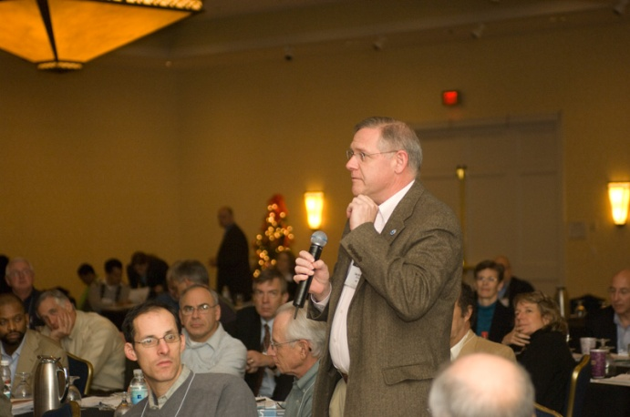
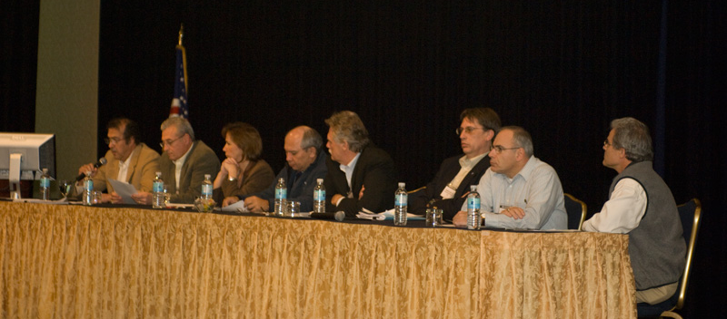
Office of the Director
In addition to providing for overall leadership of WFMO, the Office of the Director houses the following functions/programs:
WFMO Budget & Property Management
Senior Executive Service, Senior Level, Scientific/Professional Policy and Operations
Advisor to NOAA Executive Resources Board and Performance Review Board
Senior Executive Summits

Slide 10
Client Services Office
Provides for day-to-day human resources products and services:
Time & Attendance/Payroll Services
National Finance Center Liaison
Benefits & Retirement Counseling
Staffing and Recruitment Services
Classification/Position Management
Downsizing/Reduction in Force
Labor & Employee Relations Consultation
Performance Management and Awards Advisory Services
Processing NOAA Reorganizations

Slide 11
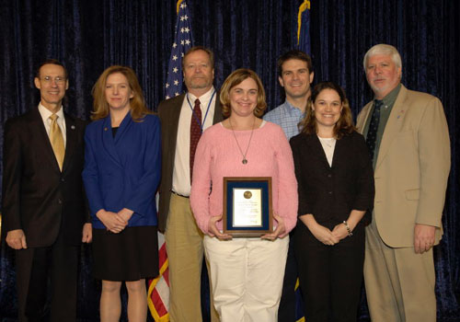
Policies & Program Management Office
Provides for policy formulation and program management for the following human resources functions:
Classification/Position Management
Pay/Compensation
Labor & Employee Relations
Program Management Evaluations
Performance Management & Honor/ Incentive Awards Ceremonies
Staffing
Telework
Bronze Medal Award Ceremony

Slide 12
Office of Corporate & Strategic Human Capital Initiatives
Supports the alignment of human capital policies, programs and systems to necessary to accomplish NOAA’s mission:
Human Capital Accountability Program Management
Workforce & Succession Planning
Corporate Recruitment Program Management
Workforce Analysis Services
Special Employment Programs
Human Capital Council & Workforce Management Committee Support
Competency Model Development & Assessment
Alternative Dispute Resolution Program
NOAA Diversity Officer
Worklife Center & Programs
Leadership Competencies Development Program
NOAA Leadership Seminar & Training Program
NOAA Rotational Assignment Program
Organization Development Services
Instructional Design, Distance Learning & Training Policy

Slide 13
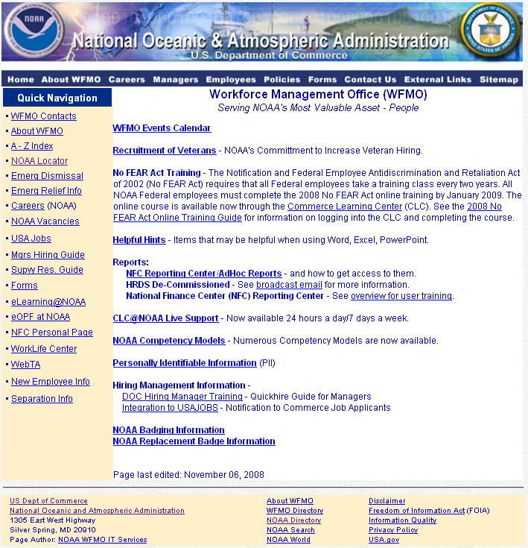
Office of Human Resources Information Technology Systems
Provides information technology support to WFMO via:
WFMO Web Page and Sharepoint Site Administration
Report Generation, Data Management & Organization Code Management
OPM Data Reporting

Slide 14
Back Up Slides

Slide 15
Office of the Director
Office of the Director
Eddie Ribas, Director
Vacant, Deputy Director
Business
Office
Linda Adkins
Executive
Resources
Claudia McMahon
Administrative
Budget
Property Management
SES, SL, ST Policy and Operations
Advisor to NOAA ERB and PRB

Slide 16
Client Services Office
WebTA/Leave Transfer
COOP-HR
NFC Liaison
Quality Control
CSO Program Functions
CSO Knowledge Management
Accountability, Programs, &
Knowledge Management Staff
Shirley Purcell
Client
Services
Roger Mason
Director
Benefits & Retirement Team
Pamela Sellman
Benefits
Retirement
Staffing
Classification/Position Mgt.
Downsizing/RIF Assistance
4Rs
HR Functional Training
HR Processing
IPAs
A-76 Assistance
Labor & Employee Relations
Performance Management
Reorganizations
Ecosystems
Client Services
Division
(Serves NMFS, NMAO)
Diane Moseley
Director
Weather
Client Services
Division
(Serves NWS)
Paul Kountzman
Director
Oceans Client Services Division
(Serves NOS, NESDIS,
OAR, PPI, CO/SOs)
Janet Day
Acting Dirctor

Slide 17
Policies & Program Management Office
Classification/Position Management Policy
Pay/Compensation Policy
Labor & Employee Relations Policy
Program Management Evaluations
Performance Management Policy
Staffing Policy
Telework Policy
Honor/Incentive Awards Policy & Ceremonies
Policies &
Program
Management
James Faulkner
Director

Slide 18
Office of Human Resources Information Technology Systems
System Development and Support
WFMO Web Page and Sharepoint Site
Systems Administration
Report Generation
Data Management, Organization Codes
OPM Data Reporting
Human Resources
IT Systems
Judith Westbrook
Director

