Slide 1
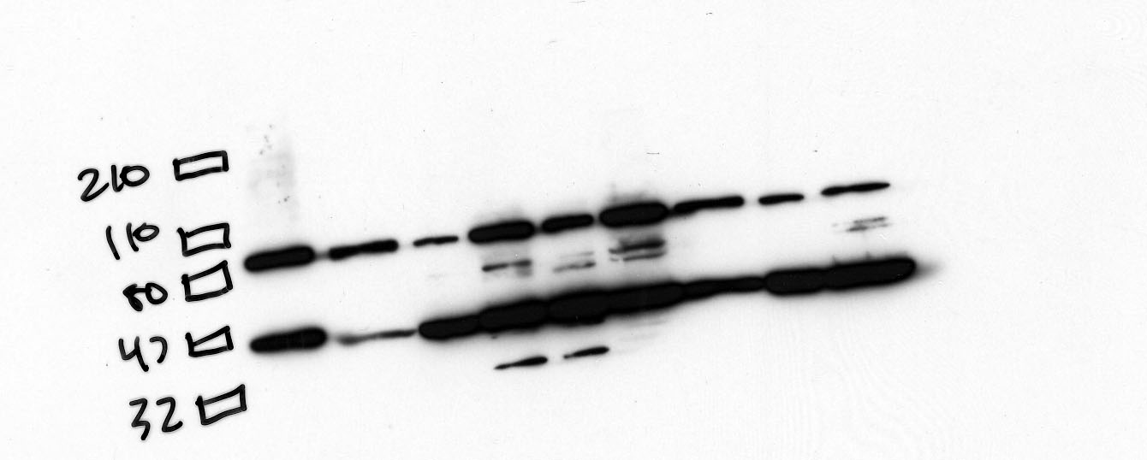
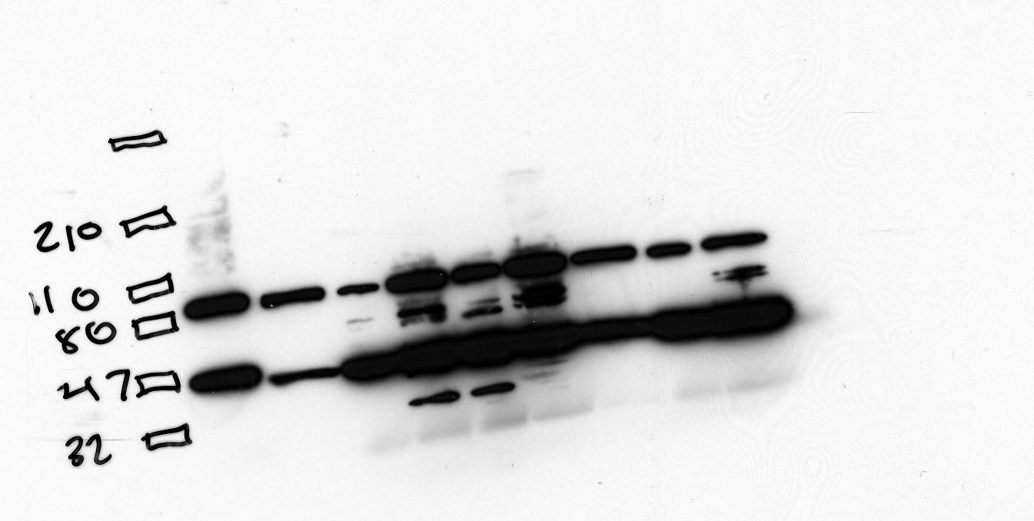
Ezrin Normal tissue 80 kDa 06-08-06
10 sec
30 sec
Large Intestine
Brain
Pancreas
Kidney
Spleen
Lung
Liver
Cardiac
Positive Control A431
Rainbow Marker

