Slide 1
Microsoft Technologies Information Fusion
George Robertson
Microsoft Research
May 15, 2007
NVAC Consortium Meeting

Slide 2
Relevant Microsoft Products
Sharepoint, Office, Virtual Earth
Convergence builds Fusion Center support on these
SQL DataMining
Analytic techniques, including trend projection
Azyxxi
Medical information system; data management

Slide 3
Relevant Microsoft Research
Polyarchy
View relationships of people in many dimensions
FacetMap
Graphical faceted browsing of large info space
FaThumb
Smartphone faceted browsing of large info space
PaperLens
Visual trend analysis
FacetLens (in progress)
Combine faceted browsing with trend analysis

Slide 4
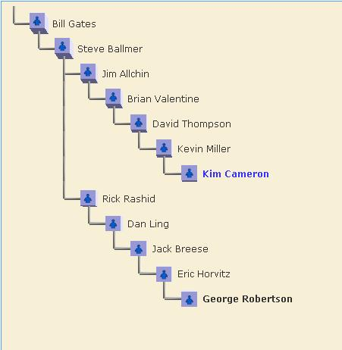
Polyarchy Visualization (CHI 2002)
Multiple Intersecting Hierarchies
Show multiple hierarchies
Show other relationships
Search results in context

Slide 5
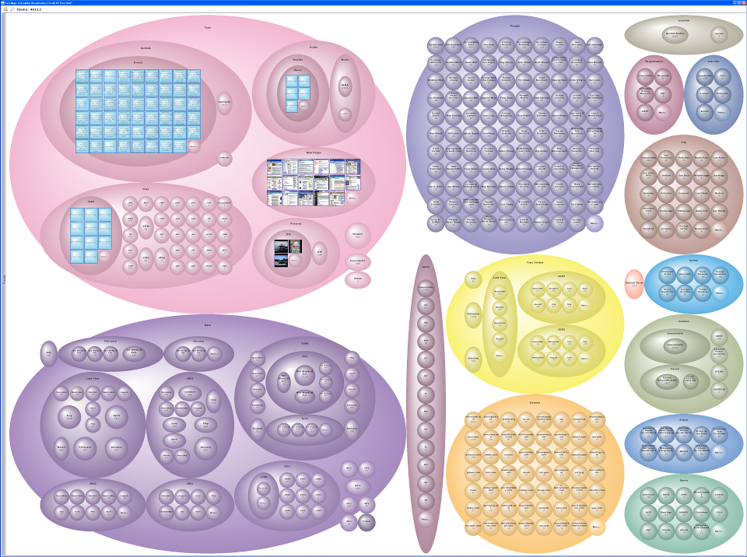
FacetMap-Faceted Search of all your stuff (InfoVis 2006)

Slide 6
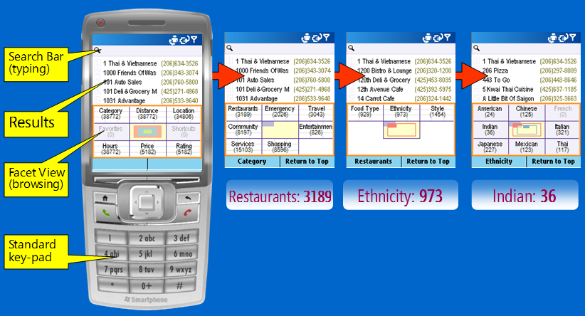
FaThumb (CHI 2006) Facet-based Mobile Search
Hierarchical Metadata
8 branches at every level: maps to keypad
Organized into hierarchy

Slide 7
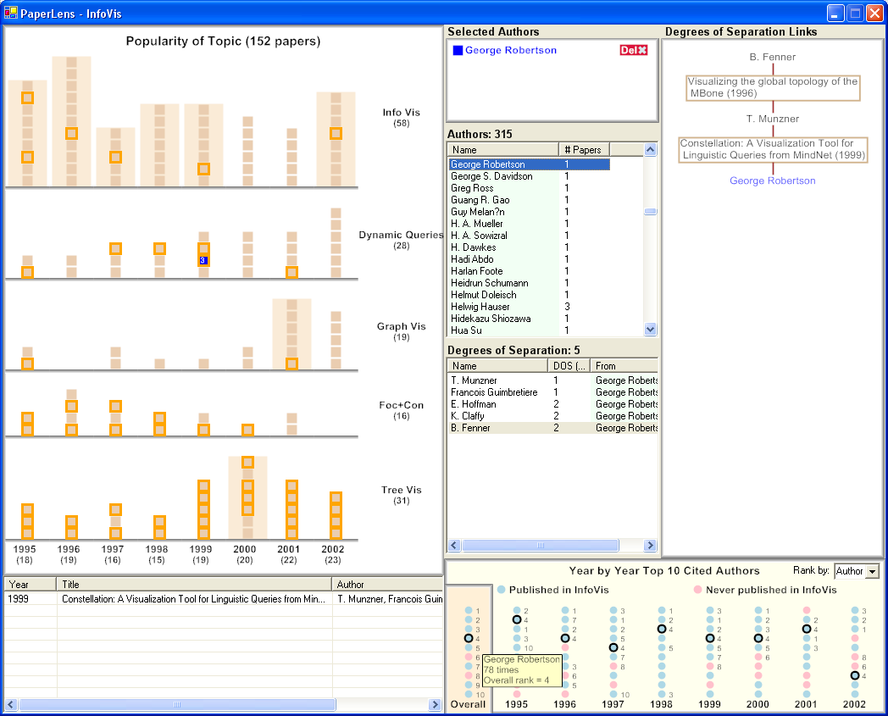
PaperLens (InfoVis 2004, CHI 2005) Topic Trends Visualization:
Understanding a conference
InfoVis (8 years)
CHI (23 years)
Helps understand:
Topic evolution
Frequently published authors
Frequently cited papers/authors
Relationship between authors

Slide 8
Summary
Fusion
MS has several relevant products
MSR has several relevant research prototypes
MSR work in progress can be address some issues
MSR does user studies on resulting prototypes

