Slide 1
VA Heart Failure Network
9/17/2007
Notes:
VA Heart Failure Network
9/17/2007

Slide 2
Improving Early Follow-up Following Heart Failure Hospitalization
Paul Heidenreich MD, MS
Barry Massie MD
Anju Sahay PhD
Robert Jesse MD, PhD
Notes:
Improving Early Follow-up Following Heart Failure Hospitalization
Paul Heidenreich MD, MS
Barry Massie MD
Anju Sahay PhD
Robert Jesse MD, PhD

Slide 3
Questions
Improving Early Follow-up Post Discharge
Is this worth addressing?
What can we do with current resources?
Notes:
Questions
Improving Early Follow-up Post Discharge
Is this worth addressing?
What can we do with current resources?

Slide 4
Background
How is the US Medicare doing?
How is the VA doing?
Institute for Healthcare Improvement (IHI) initiative
Notes:
Background
How is the US Medicare doing?
How is the VA doing?
Institute for Healthcare Improvement (IHI) initiative

Slide 5
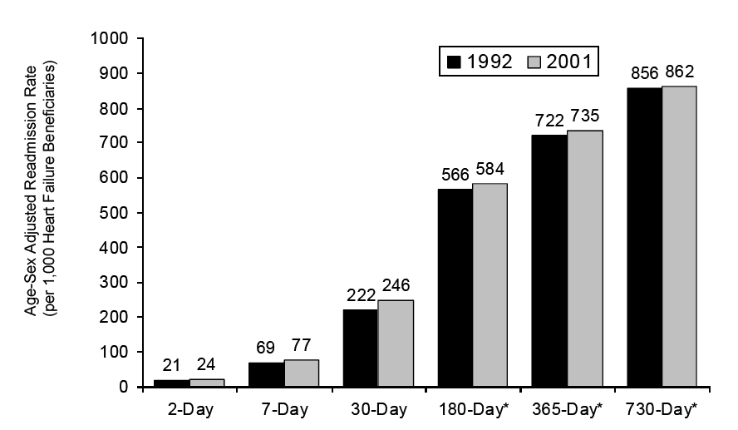
All Cause Readmission: Medicare
Medicare Quality Monitoring System (MQMS) Report: Heart Failure, 1992-2001
Notes:
All Cause Readmission: Medicare

Slide 6
HF Readmission Rates: Medicare
Medicare Quality Monitoring System (MQMS) Report: Heart Failure, 1992-2001
Notes:
HF Readmission Rates: Medicare

Slide 7
HF Readmission Rates: Medicare
Medicare Quality Monitoring System (MQMS) Report: Heart Failure, 1992-2001
Notes:
HF Readmission Rates: Medicare

Slide 8
VA Heart Failure 30-Day Readmission
Heidenreich, CHF QUERI 2006
Notes:
VA Heart Failure 30-Day Readmission

Slide 9
Regional Variation: HF Readmission in Medicare
Medicare Quality Monitoring System (MQMS) Report: Heart Failure, 1992-2001
Notes:
Regional Variation: HF Readmission in Medicare

Slide 10
VA Heart Failure 30-Day Mortality
Heidenreich, CHF QUERI 2006
Notes:
VA Heart Failure 30-Day Mortality

Slide 11
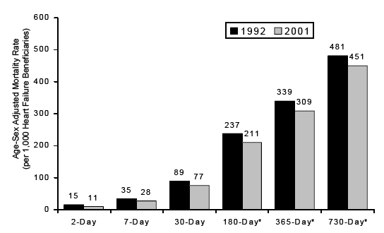
Medicare Heart Failure Mortality
Medicare Quality Monitoring System (MQMS) Report: Heart Failure, 1992-2001
Notes:
Medicare Heart Failure Mortality

Slide 12
Summary of Administrative Data
Apparently Stable readmission rates
Can we improve?
Notes:
Summary of Administrative Data
Apparently Stable readmission rates
Can we improve?

Slide 13

Notes:
Protecting 5 million Lives From Harm

Slide 14

The Institute for Healthcare Improvement (IHI)
Save 100,000 lives campaign
Reduce hospital mortality
Rapid response teams
Better acute MI Care
Prevent adverse drug events
Prevent central line infections
Prevent ventilator-associated pneumonia
Prevent surgical site infections
Notes:
The Institute for Healthcare Improvement (IHI)
Save 100,000 lives campaign
Reduce hospital mortality
Rapid response teams
Better acute MI Care
Prevent adverse drug events
Prevent central line infections
Prevent ventilator-associated pneumonia
Prevent surgical site infections

Slide 15
100K Lives Campaign
3100 Hospitals participated
18 months
124,000 lives saved
Notes:
100K Lives Campaign
3100 Hospitals participated
18 months
124,000 lives saved

Slide 16
The Institute for Healthcare Improvement
Many more patients are harmed than killed
37 million hospitalizations/year in the US
40-50 injuries/100 admissions
15 million are harmed/year in US hospitals
40,000 / day
Goal: Eliminate harm to 5 million patients over the next two years
Notes:
The Institute for Healthcare Improvement
Many more patients are harmed than killed
37 million hospitalizations/year in the US
40-50 injuries/100 admissions
15 million are harmed/year in US hospitals
40,000 / day
Goal: Eliminate harm to 5 million patients over the next two years

Slide 17
IHI Definition of Medical Harm
Unintended physical injury resulting from or contributed to by medical care (including the absence of indicated medical treatment), that requires additional monitoring, treatment or hospitalization, or that results in death.
Notes:
IHI Definition of Medical Harm
Unintended physical injury resulting from or contributed to by medical care (including the absence of indicated medical treatment), that requires additional monitoring, treatment or hospitalization, or that results in death.

Slide 18
IHI Save 5 Million Lives From Harm
Prevent pressure ulcers
Reduce MRSA
Prevent harm from high-alert medications
Reduce Surgical Complications
Deliver reliable evidence-based care for heart failure
Get boards on board
Notes:
IHI Save 5 Million Lives From Harm
Prevent pressure ulcers
Reduce MRSA
Prevent harm from high-alert medications
Reduce Surgical Complications
Deliver reliable evidence-based care for heart failure
Get boards on board

Slide 19
IHI 5 Million Lives Campaign: Heart Failure
Goal: Deliver reliable evidence-based care for congestive heart failure … to reduce admissions.
Reduce the readmission rate by 50% by December 2008
Notes:
IHI 5 Million Lives Campaign: Heart Failure
Goal: Deliver reliable evidence-based care for congestive heart failure … to reduce admissions.
Reduce the readmission rate by 50% by December 2008

Slide 20
Discharge Checklist
IHI 5 Million Lives Campaign
Reconcile Medications
Teach Back
Follow up phone call in 48 hours
Medication check
Physician visit
1 week for average risk patients
48 hours for high risk patients
Case management for high risk patients
Notes:
Discharge Checklist
Reconcile Medications
Teach Back
Follow up phone call in 48 hours
Medication check
Physician visit
1 week for average risk patients
48 hours for high risk patients
Case management for high risk patients

Slide 21
Heart Failure Key Interventions
IHI 5 Million Lives Campaign
Measure Left Ventricular Ejection Fraction (EF)
ACE inhibitor or ARB at Discharge if EF<40%
Anticoagulation if Atrial Fib. at Discharge
Influenza vaccine
Pneumoccocal vaccine
Smoking Cessation counseling
Discharge instructions
CMS: in 2005 only 54% of eligible patients received all interventions
Notes:
Heart Failure Key Interventions
Measure Left Ventricular Ejection Fraction (EF)
ACE inhibitor or ARB at Discharge if EF<40%
Anticoagulation if Atrial Fib. at Discharge
Influenza vaccine
Pneumoccocal vaccine
Smoking Cessation counseling
Discharge instructions

Slide 22
Heart Failure Other Interventions to Consider
Beta-Blocker at Discharge if EF<40%
Discharge Contract
Statins for coronary disease
Spironolactone for certain high risk patients
Notes:
Heart Failure Other Interventions to Consider
Beta-Blocker at Discharge if EF<40%
Discharge Contract
Statins for coronary disease
Spironolactone for certain high risk patients

Slide 23
The VA Does Well on Medication Use for Heart Failure
% of Heart Failure Patients
Heidenreich, CHF QUERI 2005 data
Notes:
The VA Does Well on Medication Use for Heart Failure

Slide 24
Questions
How many patients are called within 48 hours of discharge?
How many are seen by a provider within 2 weeks? 1 week?
Have sites improved follow-up without an increase in staff?
If so, what was done?
Have you eliminated advance appointments to make room for post-discharge visits?
Are the IHI goals (1 week follow-up) worth pursuing?
Possible collaborative of interested sites
Notes:
Questions
How many patients are called within 48 hours of discharge?
How many are seen by a provider within 2 weeks? 1 week?
Have sites improved follow-up without an increase in staff?
If so, what was done?
Have you eliminated advance appointments to make room for post-discharge visits?
Are the IHI goals (1 week follow-up) worth pursuing?
Possible collaborative of interested sites

