Slide 1
PHENIX EM probes
Kensuke Okada
RIKEN-BNL Research Center
For the PHENIX collaboration
HP08 June 13, 2008
Notes:
25+5 minutes talk

Slide 2
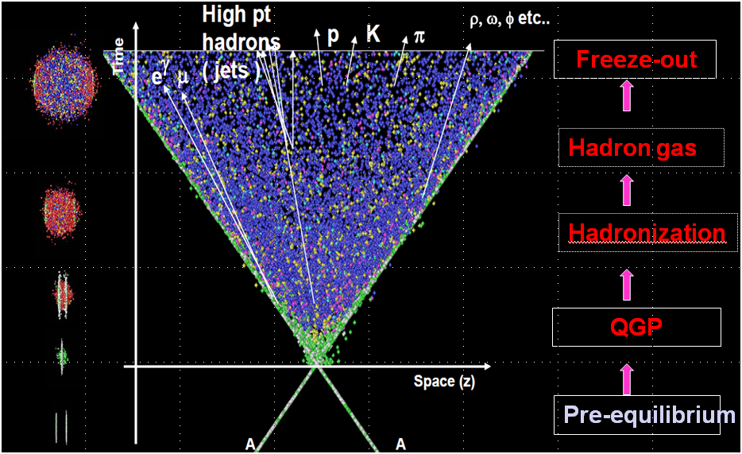
EM probe introduction
Penetrating probe
Emerges at every stage

Slide 3
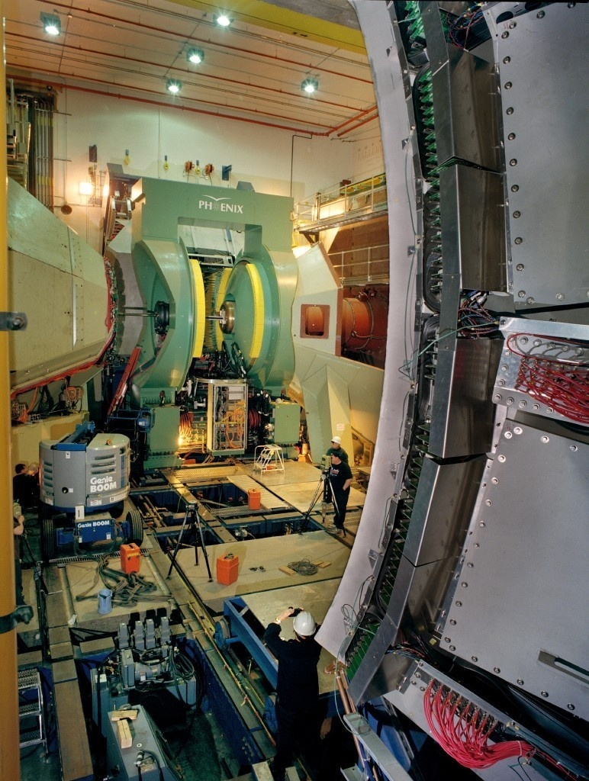
Why with PHENIX
Fine segmented EMCal
Electron identification
+
High DAQ rate
Trigger
―Outline of this talk
Direct photons at high pT
Low mass dileptons
Thermal photons via di-electrons
(Only for the mid rapidity)

Slide 4
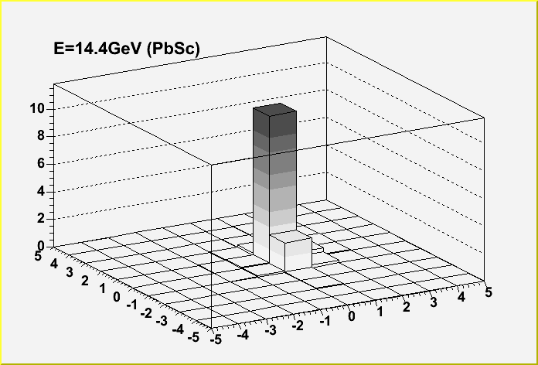
Direct photon
Measurement
EMCal hit example
Background subtraction
π⁰ to 2γ
Eπ⁰=10GeV
π⁰ 2gamma distance
> 28 tower / Eπ⁰ [GeV]
#cell_y
#cell_z
Eπ⁰=5GeV
Thanks to the fine granularity!

Slide 5
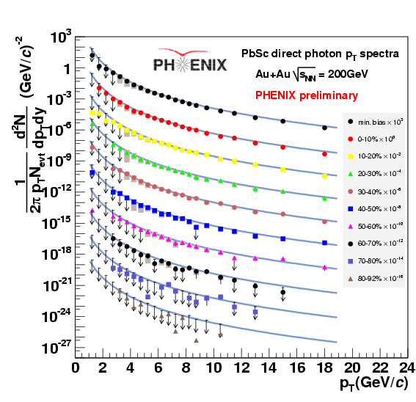
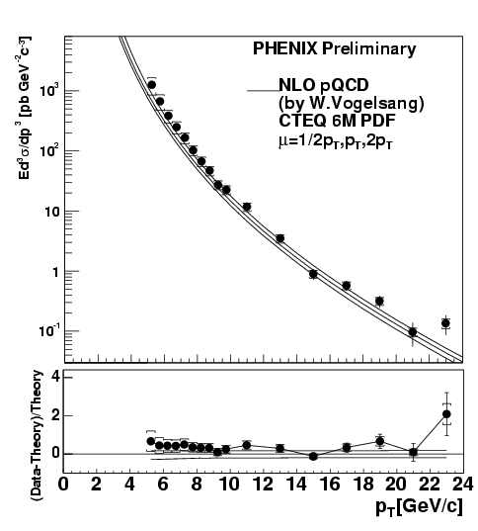

Direct photon spectra
p+p 200GeV
Good agreement with pQCD
Au+Au 200GeV
Run4
Run5pp
Consistent to
Run3 final
PRL98,012002(2007)
Notes:
Au+Au: from peripheral to central.
In p+p, there is a slight enhancement in the low pT region.

Slide 6
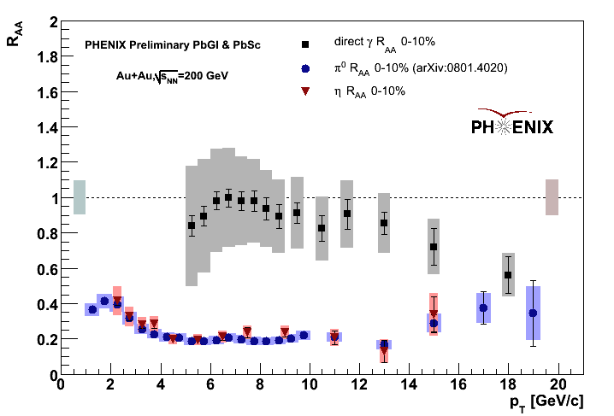
Direct photon R_{AA}
R_{AA} (since QM06)
This plot is already shown
many times as a preliminary.
Comments
A difficulty in high pT region.
(=pi0 merging, very rare.)
We need to be careful.
Various checks are done.
It is confirmed that the
decrease of R_AA at high pT
is real, but with a slight
increase.
γ
π⁰, η
The final plot is coming soon!
Curves : F.Arleo JHEP09(2006)015
Isospin effect
+cold nuclear effect (EKS)
+energy loss 20<ω_{c} <25GeV
Notes:
Other theory calculations.
Comment on cosmic ray clusters in p+p
They are more consistent with
the prediction only taking into
account the isospin effect. ?

Slide 7
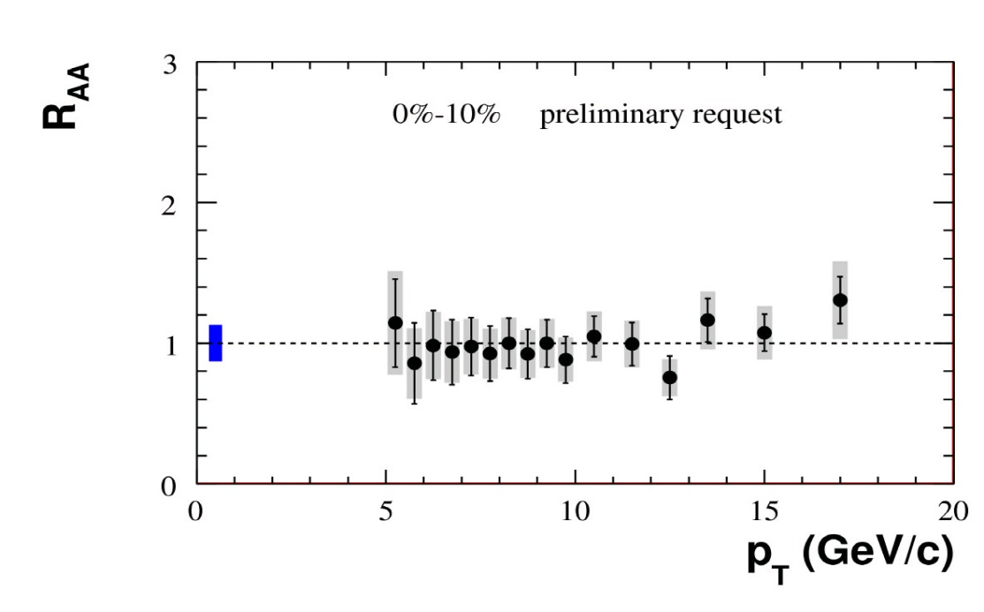
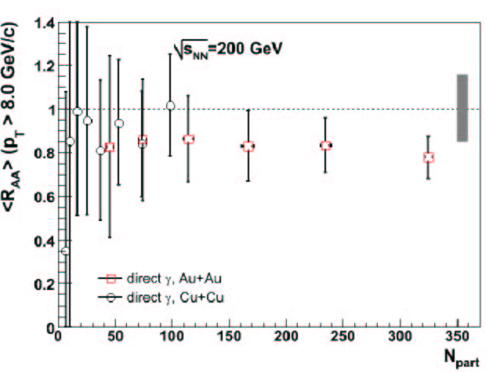
Cu+Cu √s=200GeV
(Run 5)
Direct γ R_{AA} vs N_{part}
PHENIX Preliminary
Baseline = NLO pQCD
Au+Au
PHENIX
Preliminary
Cu+Cu
Direct γ R_{AA} ∼ 1
Is there other evidence for nuclear effects?
Reduced/enhanced radiation due to jet quenching
Notes:
Slide 6. Comment: I really think you are getting too far with the statement. "It is not allowed... " You belong to phenix, so you need to agree ;-) Question: What do the curves correspond too? Isospin? Eloss?

Slide 8
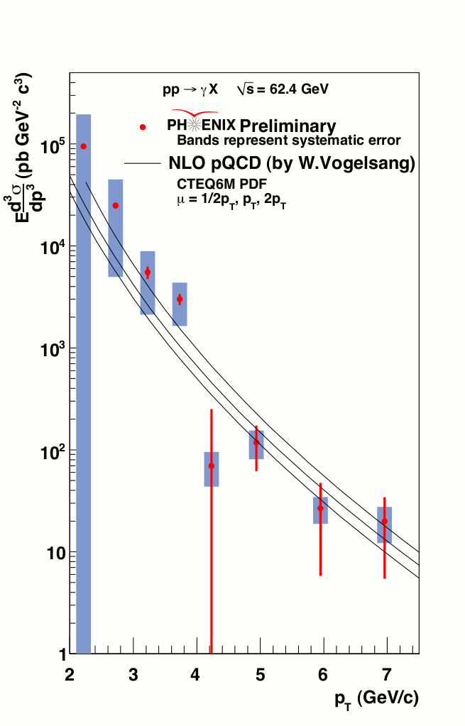
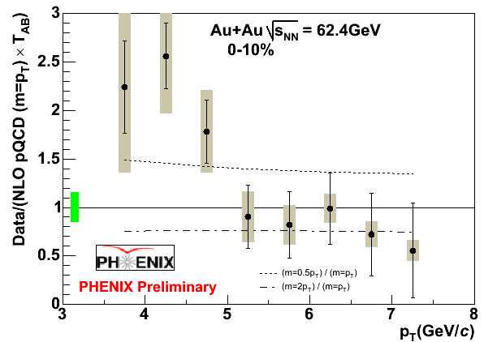
Au+Au and p+p √s=62.4GeV
pT=21GeV at √s=200GeV corresponds to
pt=7GeV at √s=62GeV in x_{T}
Free from the difficulty of pi0 photons merging.
The isospin effect should appear.
Au+Au
Au+Au
p+p
√s=200GeV pT=21GeV
at the same xT

Slide 9
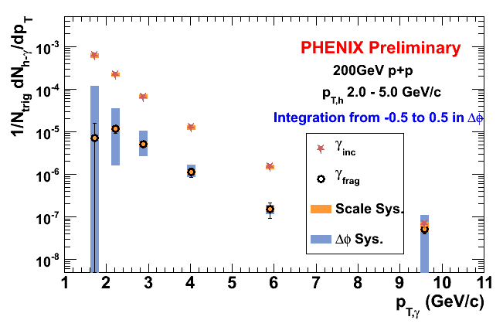
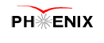
Fragmentation photons
Components
Direct = prompt + fragmentation + medium effect
It is important to include the jet quenching effect to understand the direct photon yield
―Decomposition study (for p+p case to begin with.)
γ(Isolated)/γ(all direct)
Hadron tagged events Δφ correlation
Near side
R
Eγ
PHENIX, PRL98, 012002 (2007)
An isolation cut
(high pT region : easy to understand
Low pT region : underlying activity effect.
Difficult with a limited acceptance?)
A. Hanks (Parallel 8)
Notes:
Decomposition study.
It might be hard to control the underlying activity and a bias.

Slide 10
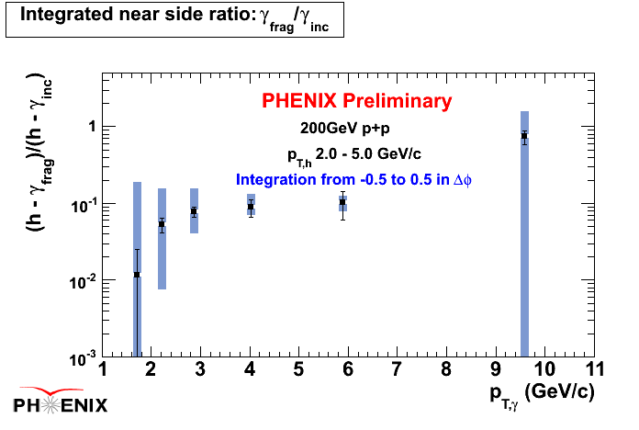
Fragmentation photons
Hadron tagged events Δφ correlation

Slide 11
Electron(s)
Another EM probe in PHENIX
It is the main player in low pT region.
It is hard to analyze the EMCal photons
- low signal to background ratio (nature and far from the collision)
- poor resolution
e
e
e
Charm,
bottom
γ*
e
e
→Another topic
(A.Dion Wednesday)
π⁰,η
φ, ω
Dalitz decay,
External conversion
?
q+q
π+π
And combinations
(= background)

Slide 12
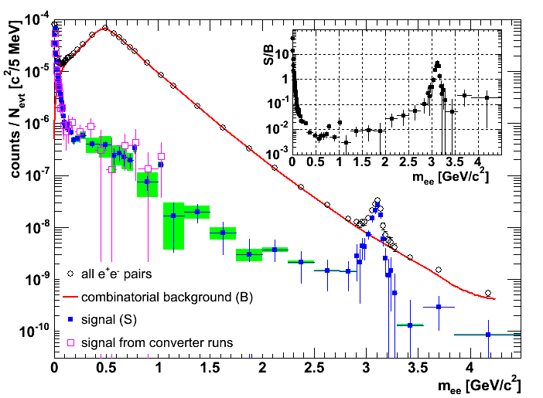
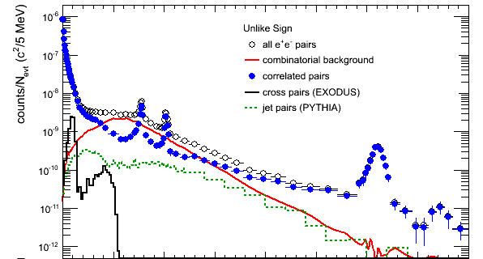
Dielectron analysis
Signal extraction from the ee sample
Signal definition : from the same origin or open charm/beauty pair origin
Au+Au
There are huge combinatorial background.
But it is well controlled.
p+p
The signal contains Dalitz decays of mesons, let’s see the cocktail calculation!
Notes:
Au+Au 8e8 events
Mention about the converter method.

Slide 13
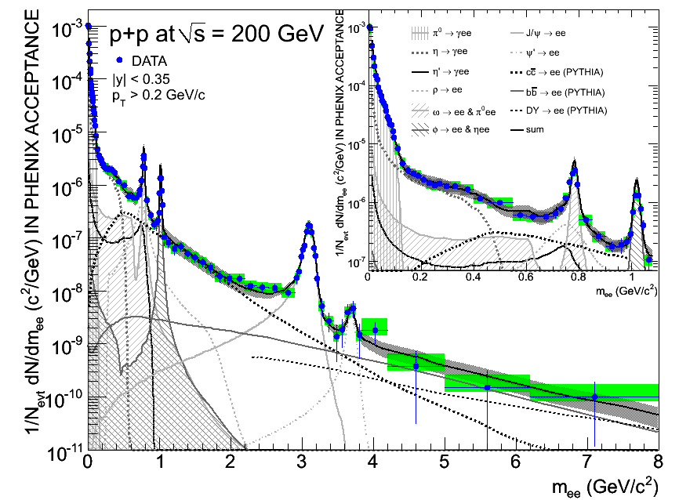
p+p cocktail comparison
What’s in p+p?
Data absolutely normalized
Excellent agreement data-cocktail
Extract charm and bottom cross section ( →heavy quark A.Dion)
submitted to Phys. Lett.B
arXiv: 0802.0050
Charm: integration after cocktail subtraction
σ_{cc}=544 ± 39 (stat) ± 142 (sys) ± 200 (model) μb
Simultaneous fit of charm and bottom:
σ_{cc}=518 ± 47 (stat) ± 135 (sys) ± 190 (model) μb
σ_{bb}= 3.9 ± 2.4 (stat) +3/-2 (sys) μb
Notes:
I don’t need to mention about the charm.
13

Slide 14
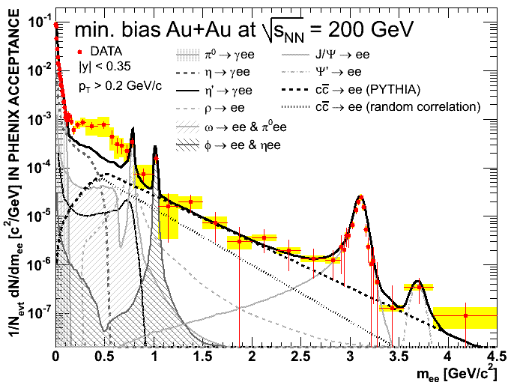

Au+Au Cocktail comparison
submitted to Phys. Rev. Lett
arXiv:0706.3034
A huge excess is seen in the low mass continuum.
Charm correlation is unknown. (2 assumptions: random and PYTHIA)

Slide 15
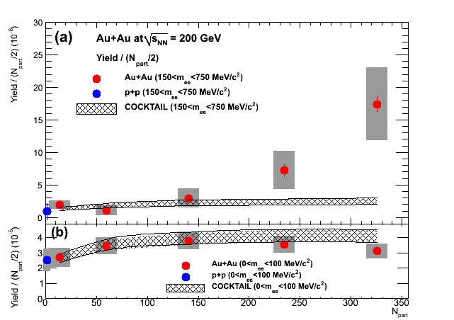
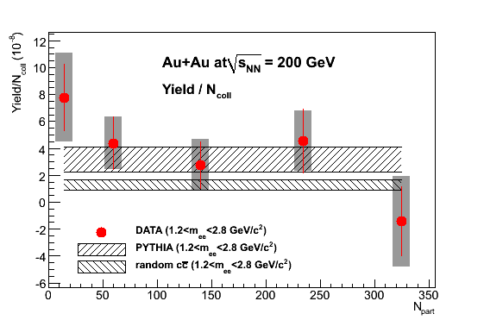
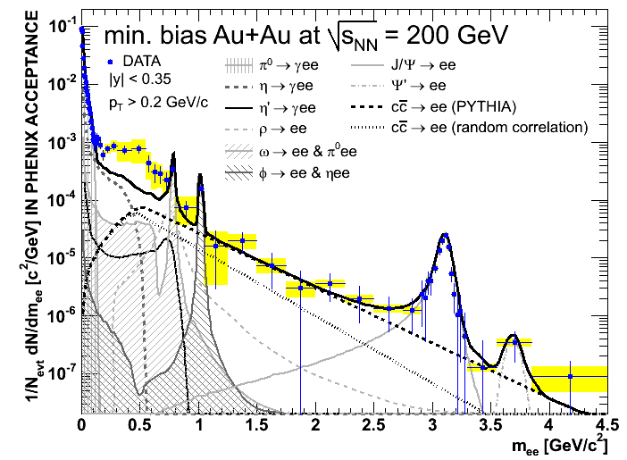
Centrality Dependence
LOW MASS
π⁰ region:
Agreement with cocktail
Low Mass:
yield increases faster than proportional to N_{part} → enhancement from binary annihilation (ππ or qq) ?
Intermediate Mass:
yield increase proportional to N_{coll} → charm follows binary scaling
Notes:
15

Slide 16
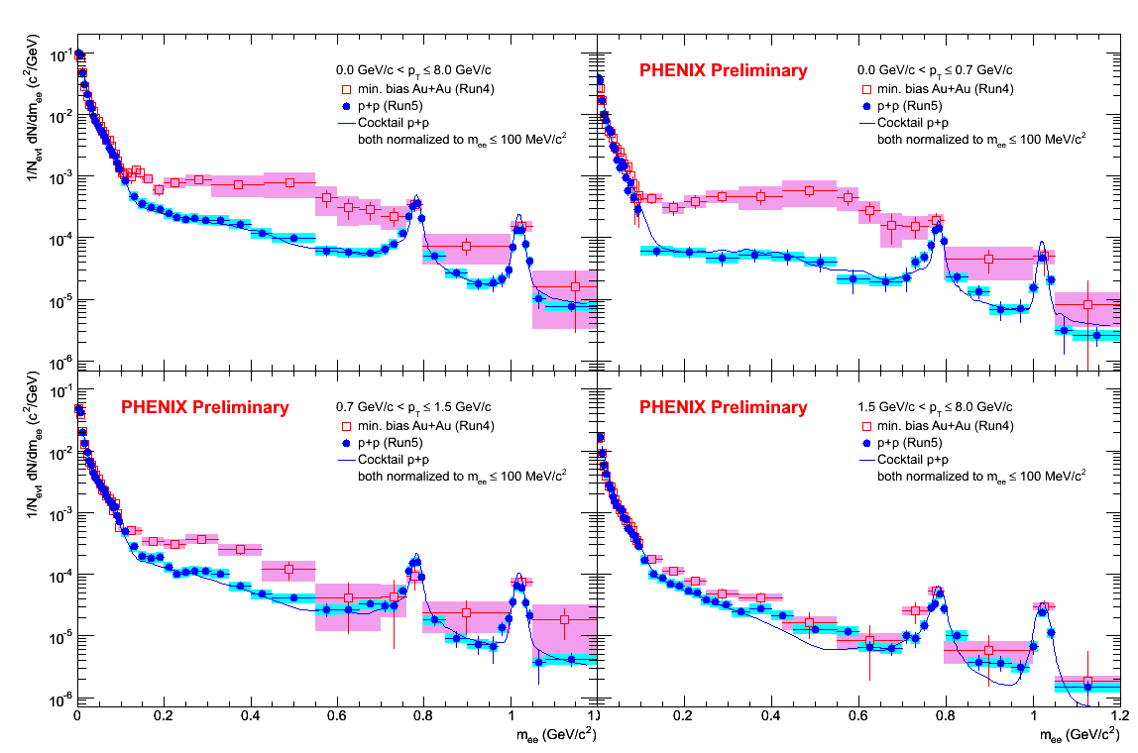
Dielectrons
The p_{T} dependence of the excess in AuAu.
(pp is normalized with m<0.1GeV region.)
Au+Au
p+p
All p_{T}
0<p_{T}<0.7 GeV/c
0.7<p_{T}<1.5 GeV/c
1.5<p_{T}<8 GeV/c
p+p: follows the cocktail
The pT dependence is not explained
by a model of vector meson modification.
(the detail is in the backup slide.)
The enhancement is
dominant in the low pT region.
Notes:
pp is normalized with m<0.1GeV region.

Slide 17
Dielectons
There are three dimensions ; m_{ee}, pT_{ee}, Centrality.
p_{T}
1GeV
m_{ee}
Centrality
: The low mass enhancement.
pT >1, low mass region to be attributed
to direct photon production.

Slide 18
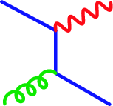
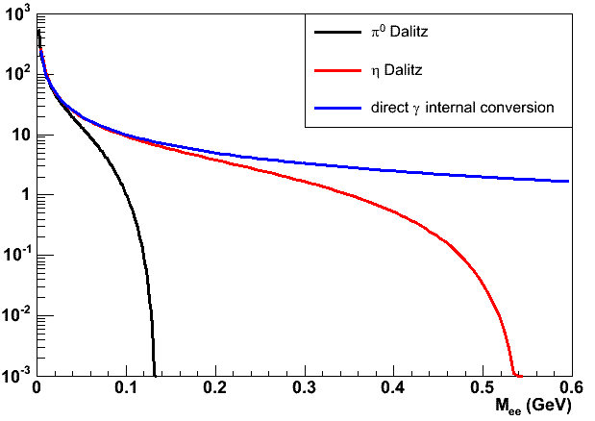
Dielectron = photon?
They have the same quantum number.
e⁺
Kroll-Wada formula connects the real γ and (ee) yield.
q
e⁻
γ∗
g
q
When
, S=1 for photons.
Independent of the origin in the very low mass region (M_{ee} < ~30MeV)
Pi0 Dalitz dies out above the pi0 mass. → The key to improve the S/N ratio.
Direct photon follows 1/M_{ee}.
Procedure
Cocktail
Normalized in the very low mass region
Extract the direct photon component
m_{π}

Slide 19
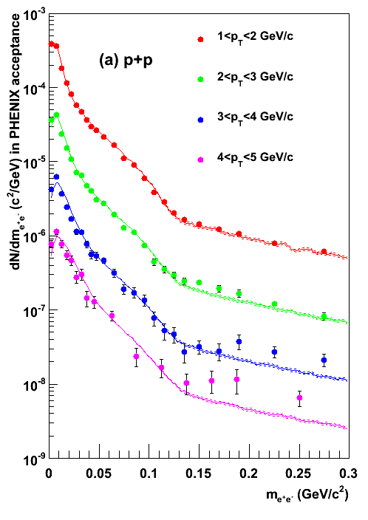
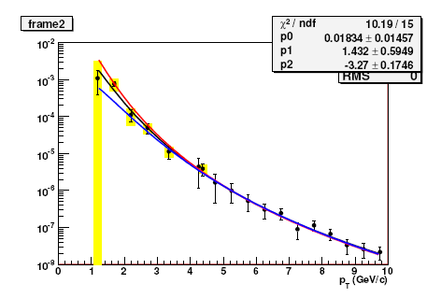
Dielectron=photon
In p+p, the signal appears above pT=2GeV/c.
The result agrees with the EMCal result.
From dielectron
Fit to M_ee
PHENIX EMCal
(PRL98, 012202)
Ed³σ/dp³ [mb GeV⁻²c⁻³]
The first direct photon measurement below pt at 3GeV/c.
Surprisingly the pQCD calculation agrees down to 1 Gev/c.
(the comparison is not on the plot.)
Notes:
pQCD curve should be on the plot.

Slide 20
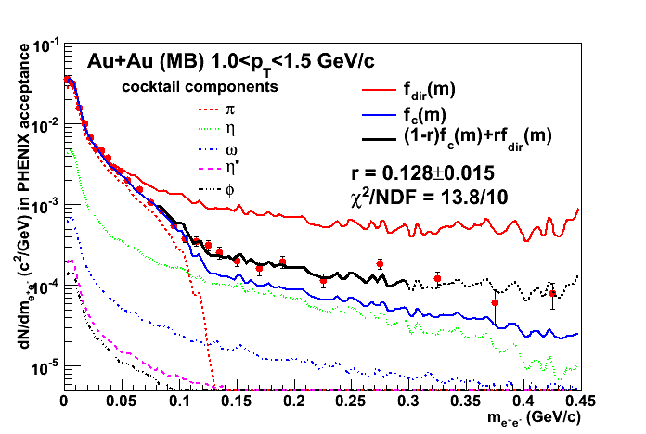
Dielectron=photon
In Au+Au,
Independent of the origin in the very low mass region (M_{ee} < 30MeV)
The effect of the low mass
Enhancement is thought to
be small
qq,ππ : Mee<0.3GeV
The fit follows
the data points.
Notes:
Here I show the procedure in detail. Why Mee<0.3GeV cut reduces qq-bar process?

Slide 21
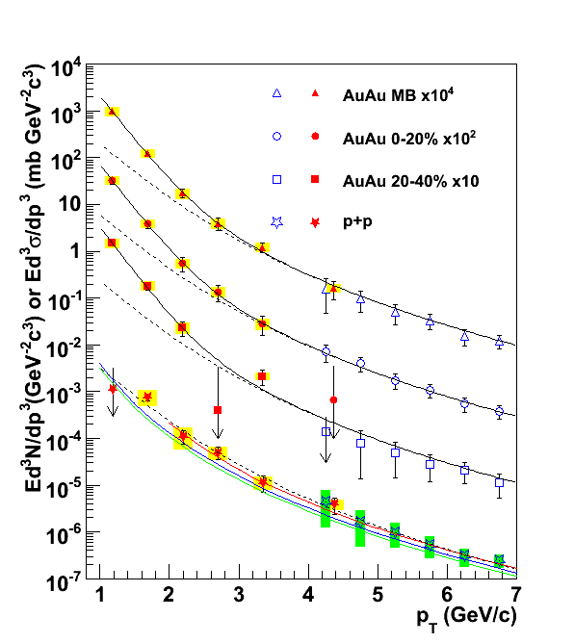
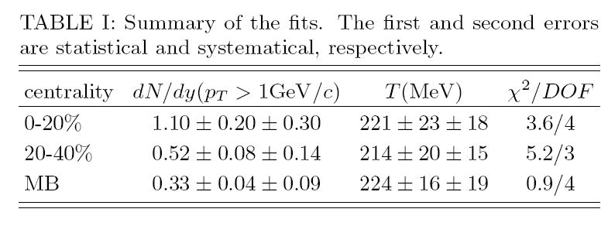
Dielectron=photon
The Au+Au result is compared to p+p.
From the slope, the temperature is extracted.
Submitted to PRL, arXiv:0804.4168
exp + TAA scaled pp
Significant yield of the exponential component (excess over the scaled p+p)
The inverse slope is ~220MeV. (If power-law is used for the pp component, the value of T would increase by ~24MeV)
Since it’s an integration of the entire evolution, the result ~220MeV indicates the initial temperature much higher than the critical temperature.
Fit to pp
NLO pQCD (W. Vogelsang)

Slide 22
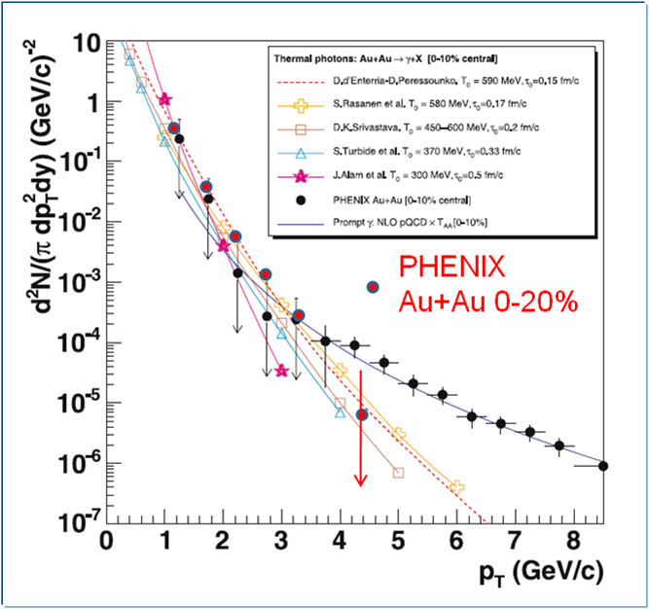
Theory comparison
Thery compilation by D. d’Enterria and D. Peressounko
EPJC46, 451 (2006)
D.d’Enterria &D.Peressounko
T=590MeV, τ₀=0.15fm/c
S. Rasanen et al.
T=580MeV, τ₀=0.17fm/c
D. K. Srivastava
T=450-600MeV, τ₀=0.2fm/c
S. Turbide et al.
T=370MeV, τ₀=0.33fm/c
J. Alam et al.
T=300MeV, τ₀=0.5fm/c
Hydrodynamical models are agreement with the data within a factor of 2 in spite of these models have wide-ranging conditions.

Slide 23
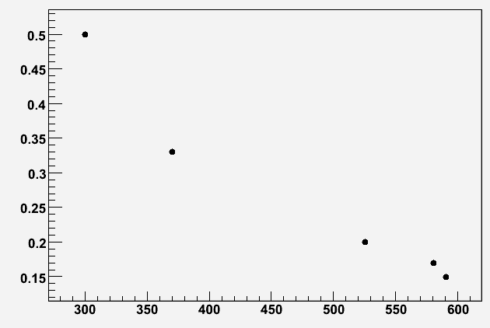
Initial temperature (with aid of models)*
Hydrodynamical models in
qualitative agreement with the
data: Eur.Phys.J. C46 (2006) 451
D.d’Enterria &D.Peressounko
T=590MeV, τ₀=0.15fm/c
S. Rasanen et al.
T=580MeV, τ₀=0.17fm/c
D. K. Srivastava
T=450-600MeV, τ₀=0.2fm/c
S. Turbide et al.
T=370MeV, τ₀=0.33fm/c
J. Alam et al.
T=300MeV, τ₀=0.5fm/c
τ₀ (fm/c)
T_{init} (MeV)
T_{init} > T_{c} even for simple exponential!
* and 1 billion events …

Slide 24
RP dependence
Ideas
hard scatter
v₂ = 0
photons
from jet
annihilation
compton scattering
Jet Brems.
v₂ < 0
v₂ > 0
Jet Fragment
v₂ > 0
Bremsstrahlung
(energy loss)
v₂ < 0
sQGP
v₂ ≥ 0
It is an additional sight of the matter.
Notes:
Kentaro’s presentation, what is sQGP?

Slide 25
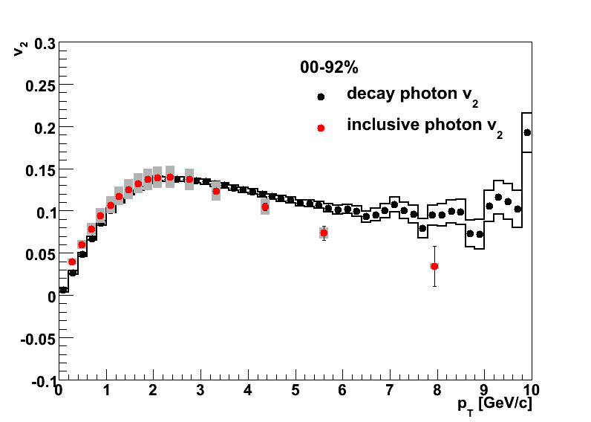
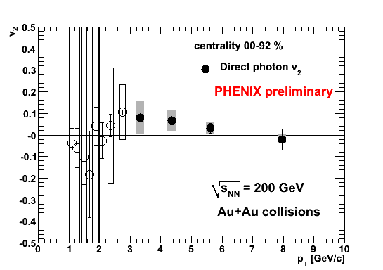
v₂ Measurement
Run4 MB
Au+Au 200GeV
Decay photon v2
Inclusive photon v2
The v2 is small at high pT !
How can we improve the precision?
Statistics Run7=3*Run4, and *4 equivalent with RXPN.
S/N improvement with the dielectron method.
Notes:
Kentaro Run4.
90%-> 99% true?

Slide 26
Summary
Results
The PHENIX detector is powerful for the EM probes.
Direct photon cross section is measured from pT = 1GeV/c to 20GeV/c.
R_AA drops at highest pT, it can be explained by the isospin effect.
At low pT, there is an excess in Au+Au. From the inverse slope, the temperature
is estimated to be ~220MeV.
The v2 is small at high pT.
In the dielectron mass spectra, a large enhancement is seen in the low mass region.
We see it is dominated in low pT region.
Next
Run7 Au+Au statistics (3*Run4) with reaction plane detector
Run8 dAu Check the cold nuclear effect.
HBD for dielectron analysis.
NCC extends the coverage to forward.
High luminosity enables more precise correlation analysis.

Slide 27
BackUPs

Slide 28
Something not in the slide
d+Au
photon HBT analysis
Direct photon consistency with external conversion method and pi0 tagging method.

Slide 29
PHENIX Data Sets
30 x dAu
3 x AuAu
Collided 4 different species in 8 years: Au+Au, d+Au, p+p, Cu+Cu
6 energies run: 9.2 GeV, 19 GeV, 22.5 GeV, 62.4 GeV, 130 GeV, 200 GeV

Slide 30

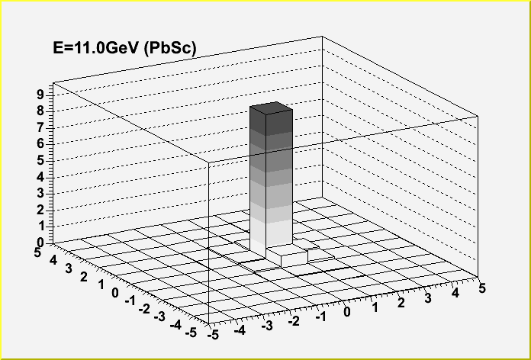
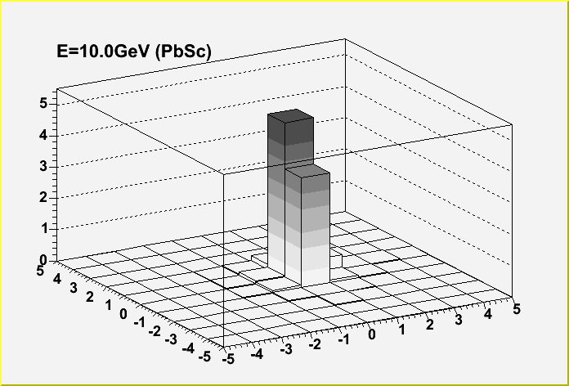
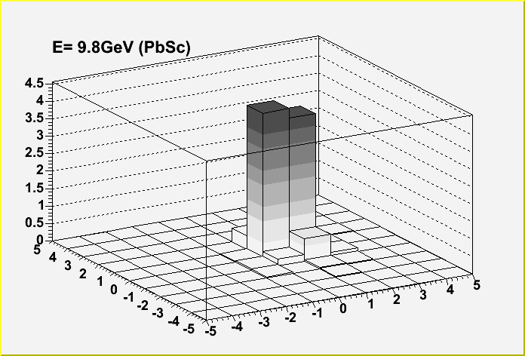
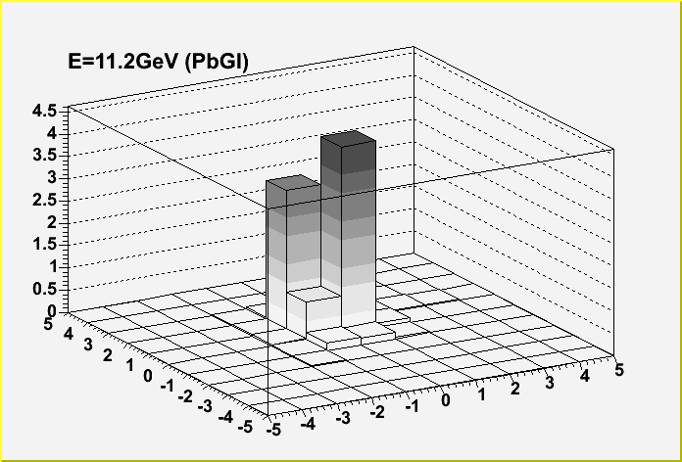
Direct photon
EMCal hit examples
Measurement
Background subtraction
π⁰ to 2γ
#cell_y
#cell_z
π⁰ 2gamma distance
> 28 tower / Eπ⁰ [GeV]
Eπ⁰=10GeV
Thanks to the fine segmentation!
Eπ⁰=5GeV

Slide 31
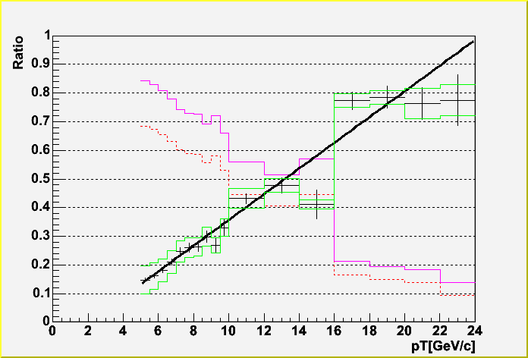
Direct photon
Signal : direct photons
Noise : hadronic decay photons (mostly from π⁰)
Au+Au
(S+N)/N
p+p
S/(S+N)
all hadron
all pi0
(tagged
+ missing partner)
Direct photon
The signal is significant for pT more than 3~5 GeV/c.
Notes:
Isobe AN490; (N^g_all/N^pi0)_meas/(N^g_BG/N^pi0)_MC
In p+p, “N” is suppressed at high pT, since merged pi0s are rejected by the shape cut. Is it confusing?

Slide 32
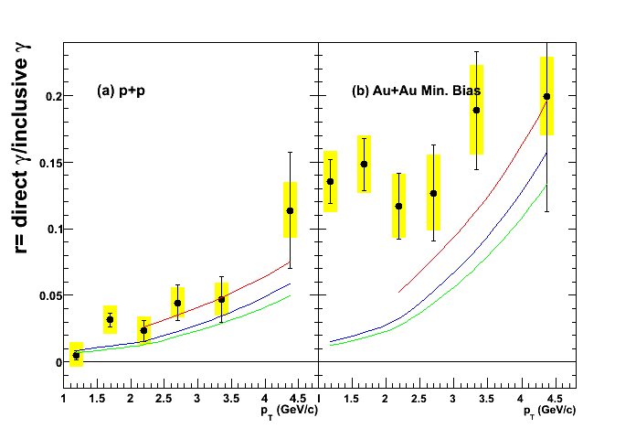
Fraction of direct photons
Fraction of direct photons
Compared to direct photons from pQCD
p+p
Consistent with NLO pQCD
favors small μ
Au+Au
Clear excess above pQCD
p+p
Au+Au (MB)
μ = 0.5p_{T}
μ = 1.0p_{T}
μ = 2.0p_{T}
NLO pQCD calculation is provided by Werner Vogelsang

Slide 33
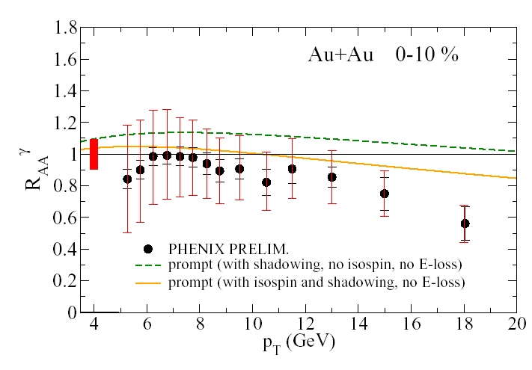
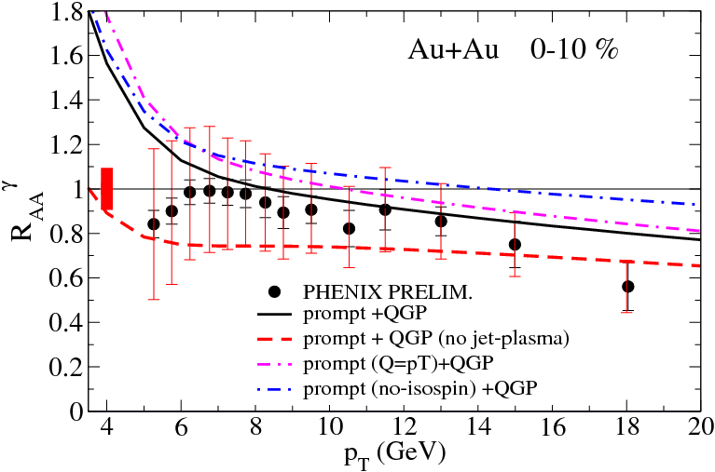
Results: R_{AA}
The discrimination between models is dependent
on the high p_{T} photons
See also F. Arleo, JHEP (2007)

Slide 34
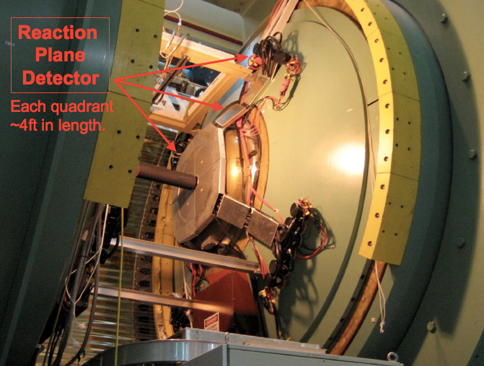
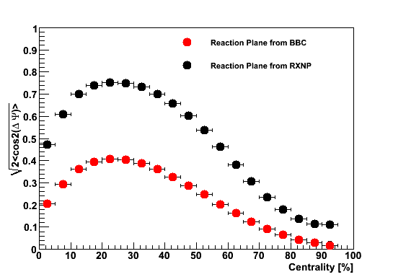
Reaction plane detector (RXNP)
Run7 has new detector for reaction plane definition.
RXNP has twice better resolution
than BBC.

Slide 35
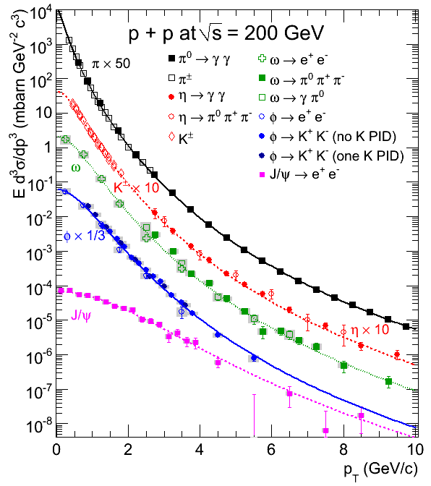
Hadronic cocktail
Origins
Hadronic cocktail from our
measurements.
An excellent data set!
PHENIX Preliminary
Other mesons well measured in electronic and hadronic channel
Other mesons are fit with:
m_{T} scaling of π⁰ parameterization p_{T}→√(p_{T}²+m_{meson}²-m_{π}²) fit the normalization constant

Slide 36
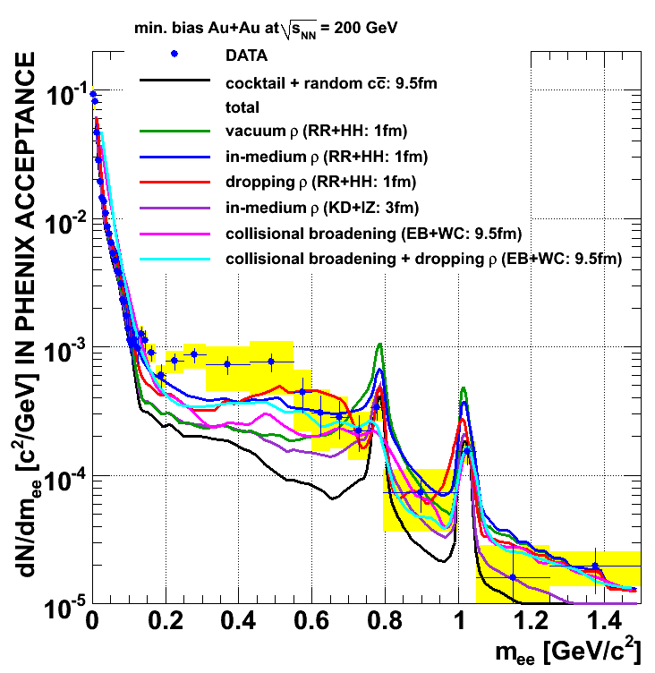
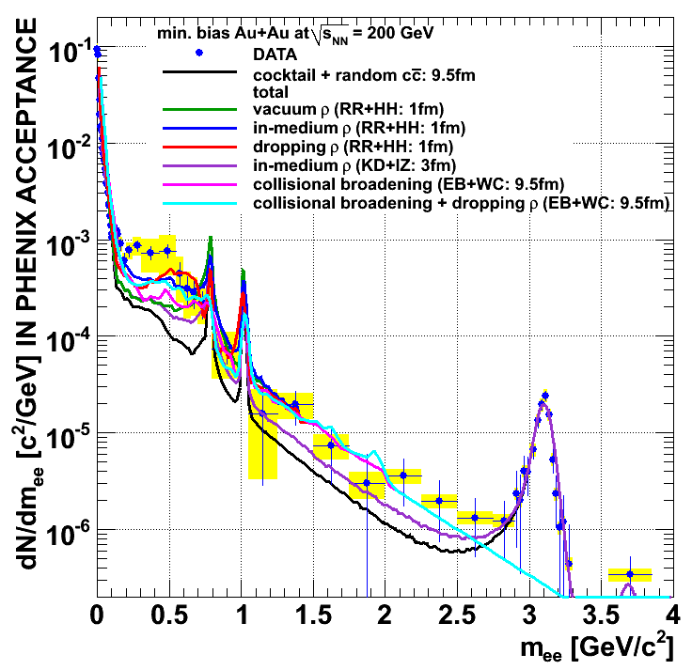
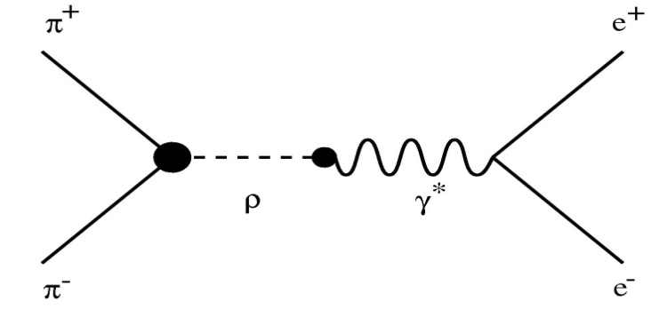
Theory comparison
R.Rapp + H.vanHees
K.Dusling + I.Zahed
E.Bratkovskaja + W.Cassing
Freeze-out Cocktail + “random” charm + ρ spectral function
Low mass
M>0.4GeV/c²: some calculations OK
M<0.4GeV/c²: not reproduced
Intermediate mass
Random charm + thermal partonic may work
PARTONIC
HADRONIC
q
Gluon Compton
e⁺
γ∗
e⁻
q
g
q
π-π annihilation
q
q-q annihilation

Slide 37
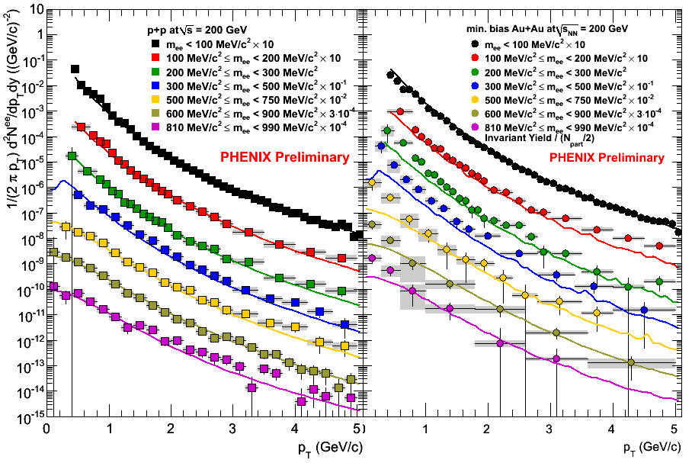
p_{T} dependence II
p+p
Au+Au
p+p: follows the cocktail for all the mass bins
Au+Au: significantly deviate at low p_{T}

Slide 38
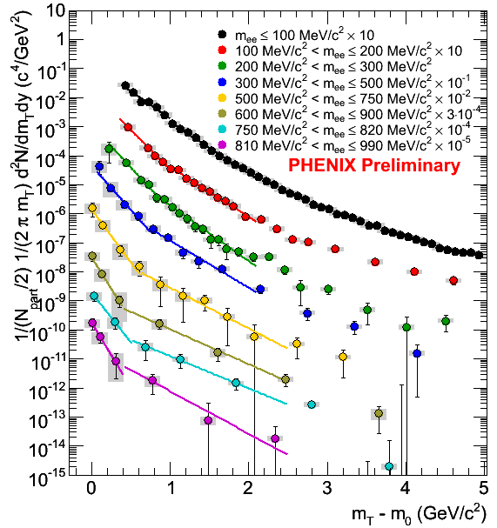
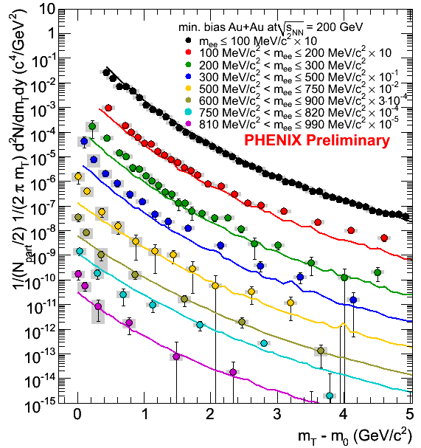
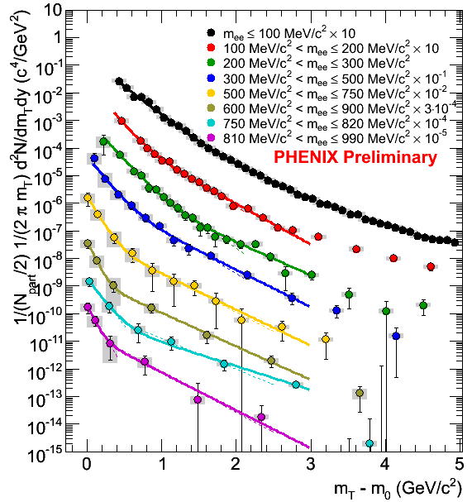

Understanding the p_{T} dependence
Comparison with cocktail
Single exponential fit:
Low-p_{T}: 0<m_{T}<1 GeV
intermediate-p_{T}: 1<m_{T}<2 GeV
2-components fits
2exponentials
m_{T}-scaling of π⁰ + exponential
Low p_{T}:
inverse slope of ~ 120MeV
accounts for most of the yield

Slide 39



Yields and Slopes
SLOPES
YIELDS
Low-p_{T} yield
2expo fit
m_{T}-scaling +expo fit
Total yield (DATA)
Intermediate p_{T}: inverse slope increase with mass, consistent with radial flow.
Low p_{T}:
inverse slope of only ~ 120MeV!!!
accounts for most of the yield!!!
Cold and Bright
Notes:
Intermediate pT= high pT in the previous slide
What is the relation to the radial flow?

Slide 40




Theory Comparison II
Calculations from
R.Rapp & H.vanHees
K.Dusling & I.Zahed
E.Bratovskaja & W.Cassing (in 4π)
The cold component is not yet explained

Slide 41
Dielectons
There are three dimensions ; m_{ee}, p_{Tee}, Centrality.
p_{T}
1GeV
m_{ee}
Centrality
: The low mass enhancement.
The following slides show
The centrality dependence of integrated pT
The pT dependence of integrated centrality.

