Slide 1





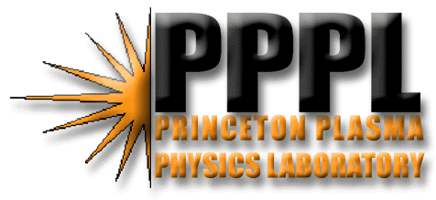

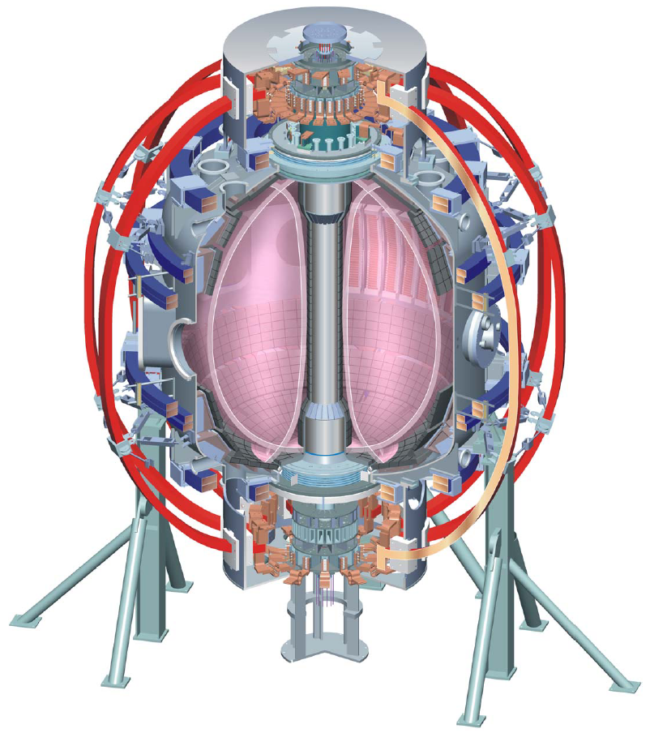


Office of
Science
Divertor Heat Flux Mitigation in High-Performance H-mode Discharges in NSTX
V. A. Soukhanovskii¹, R. Maingi², D. A. Gates³, J. E. Menard³, S. F. Paul³, R. Raman⁴, A. L. Roquemore³, R. E. Bell³, C. E. Bush², R. Kaita³, H. W. Kugel³, B. P. LeBlanc³, D. Mueller³, and the NSTX Research Team
¹ Lawrence Livermore National Laboratory, Livermore, CA, USA
² Oak Ridge National Laboratory, Oak Ridge, TN, USA
³ Princeton Plasma Physics Laboratory, Princeton, NJ, USA
⁴ University of Washington, Seattle, WA, USA
Poster EX/P4-22

Slide 2
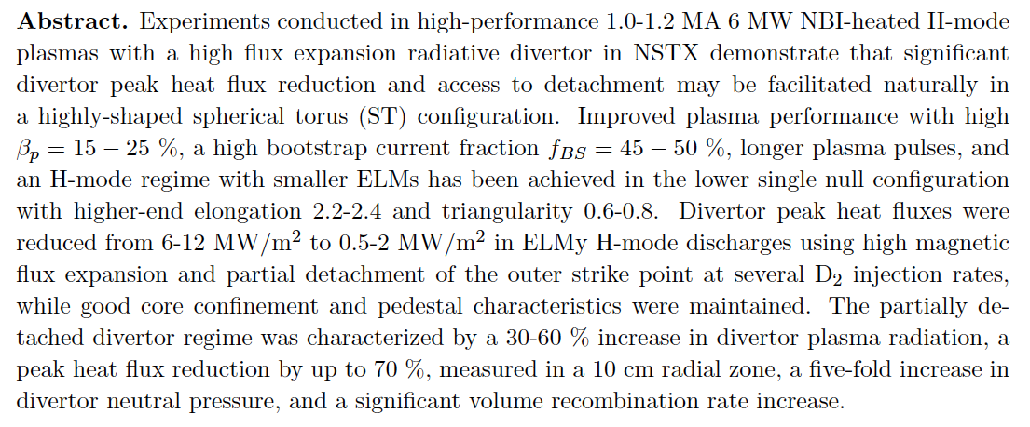
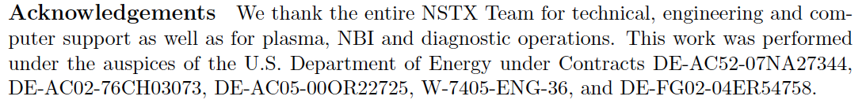
Abstract and Acknowledgments

Slide 3
Conclusions
Significant divertor peak heat flux reduction has been demonstrated in highly shaped high-performance H-mode plasmas in NSTX using divertor magnetic flux expansion and radiative divertor simultaneously with high core plasma performance
Good synergy of high performance H-mode regime with partially detached divertor
Detachment characteristics in NSTX
Steady-state PDD regime achieved only with additional gas injection into a high flux expansion divertor
High divertor radiated power, neutral pressure, volume recombination rate measured
PDD properties appear to be similar to those observed in tokamak
SOL geometry limits radiated power and momentum losses to the separatrix region

Slide 4
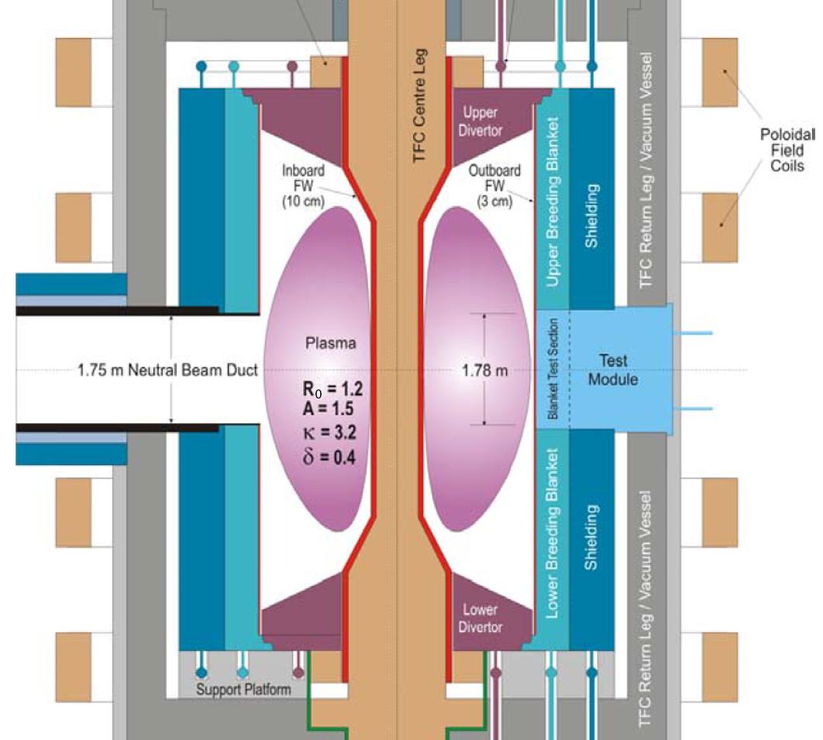

Divertor heat flux mitigation is key for present and future fusion plasma devices
Radiative divertor is envisioned for
present and future devices (e.g. ITER) as
the steady-state heat flux mitigation
solution
Divertor q_{peak} < 10 MW/m²
Large radiated power fractions
(f_{rad} = 0.50 - 0.80)
Integration with pedestal and core
Partially detached divertor (PDD) is the
most promising regime
Radiative divertor in NSTX
Does radiative divertor work in a spherical torus (ST) with a compact high q|| divertor? What are the limitations?
Experimental basis for radiative divertor optimization and projections to ST-CTF
Peng et al, PPCF 47, B263 (2005)

Slide 5
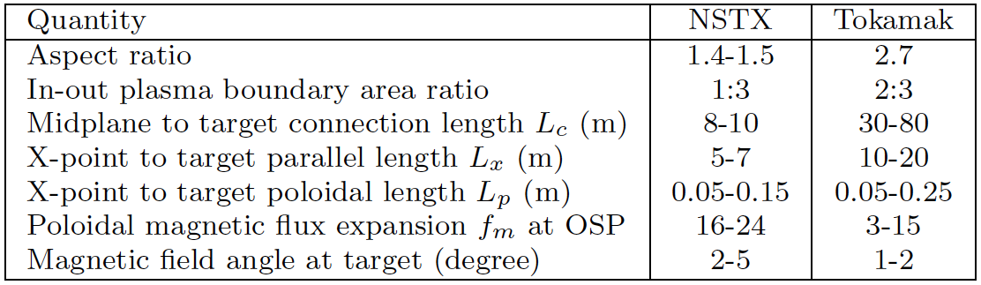
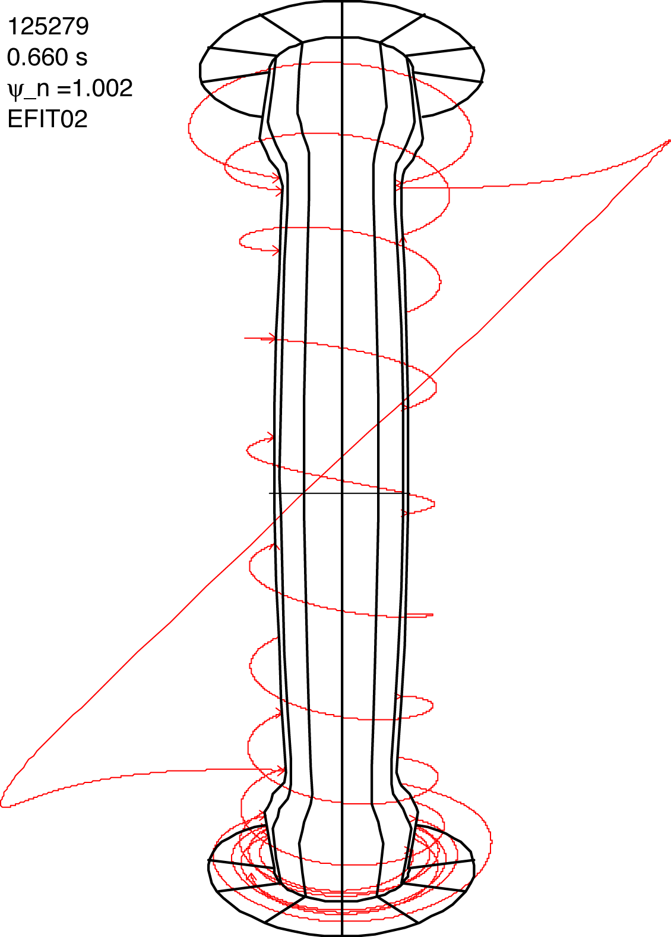
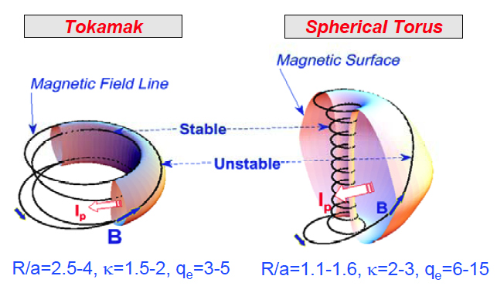
SOL / divertor geometric properties are different in spherical tori and large aspect ratio tokamaks
D

Slide 6
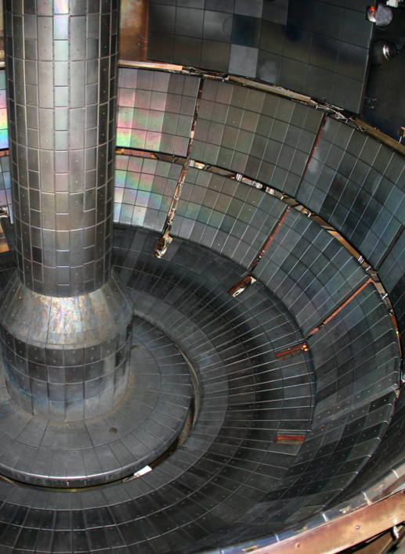
Open geometry NSTX divertor enables flexibility in plasma shaping
Plasma facing components
ATJ and CFC tiles
Carbon - erosion, sputtering
Max P_{rad} fraction limited by carbon radiation efficiency
Typical divertor tile temperature in 1 s pulses T < 500 C
(q_{peak} ≤ 10 MW/m²)
No active divertor pumping
Experiments with lithium coatings for reduced recycling (see Kaita et al., EX/P4-9)

Slide 7
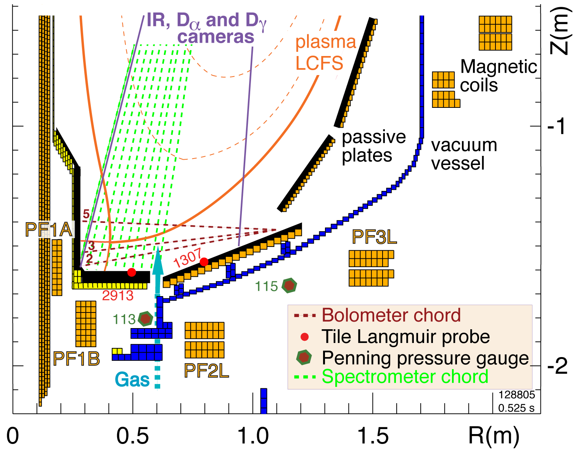
Multiple diagnostic measurements are analyzed to elucidate on radiative divertor physics in NSTX
Diagnostic set for divertor
studies:
IR cameras
Bolometers
Neutral pressure gauges
Tile Langmuir probes
Dα, Dγ filtered CCD arrays
UV-VIS spectrometer
(10 divertor chords)
Midplane Thomson scattering and CHERS systems
Divertor gas injector
Γ_{gas} = 20-200 Torr l / s

Slide 8
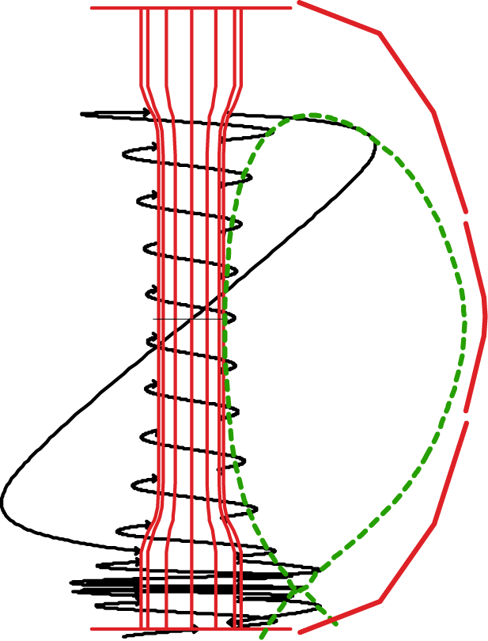
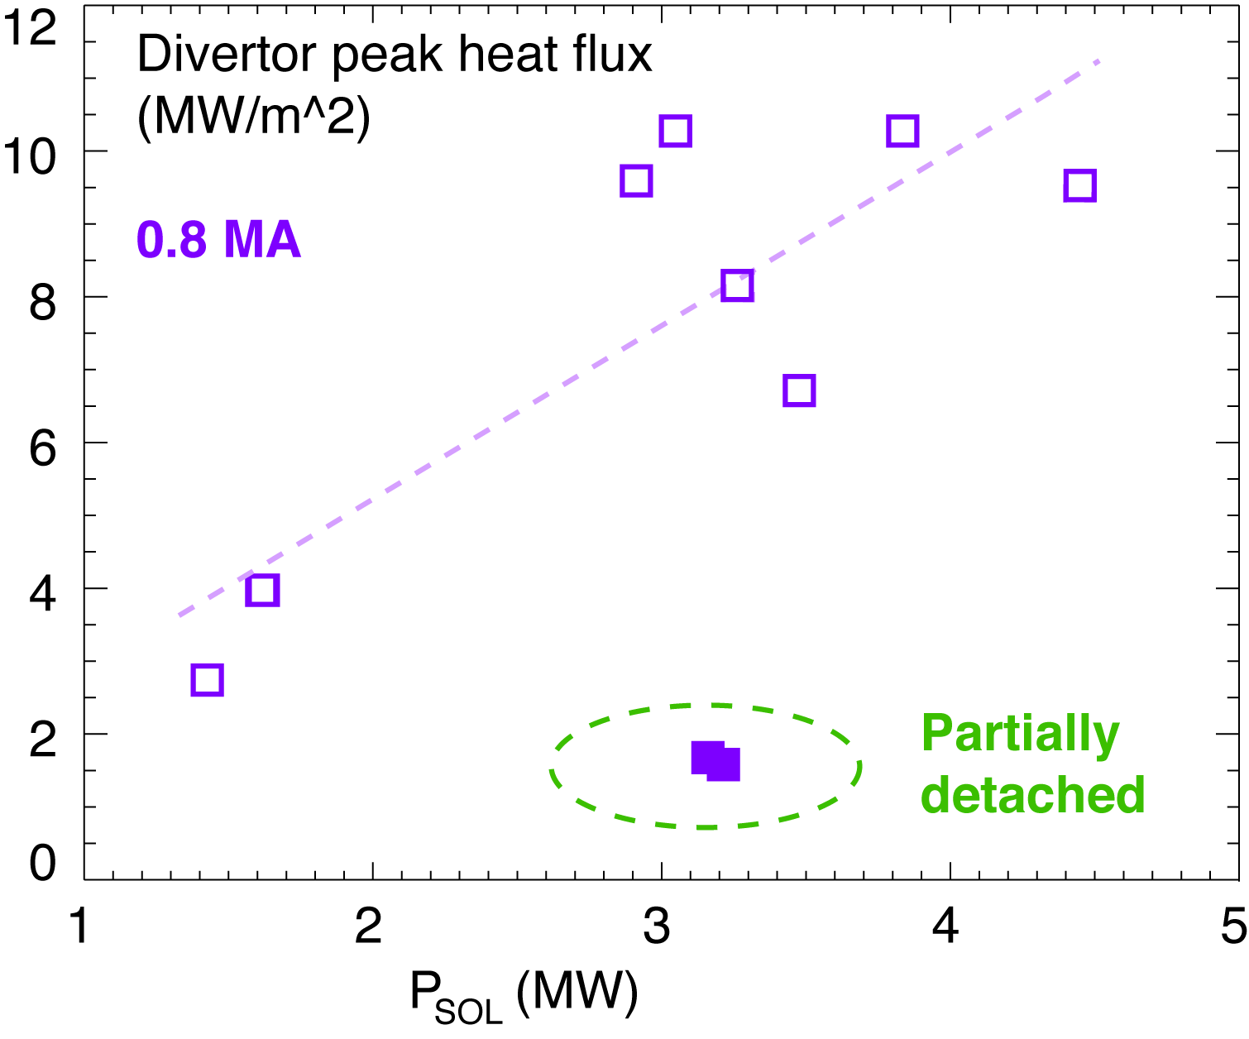
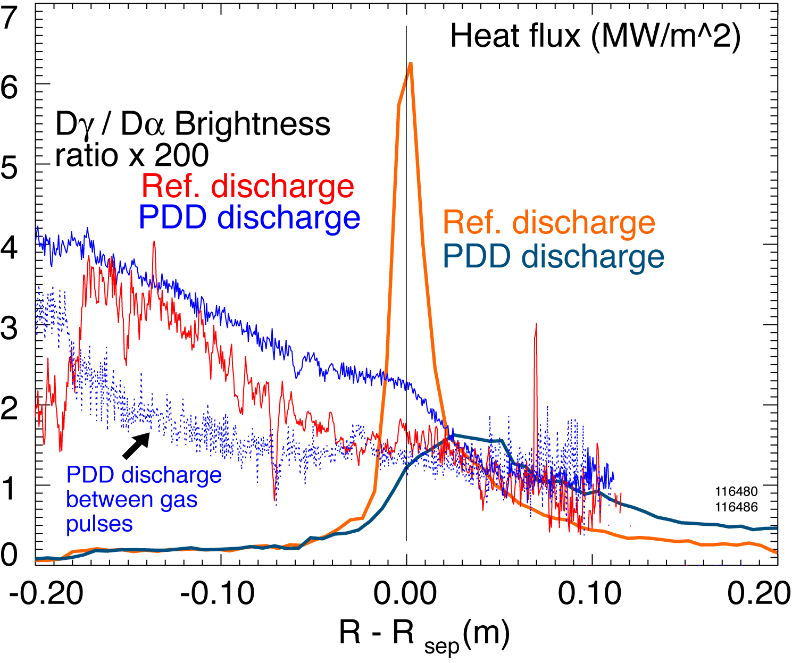
In low κ, δ configuration with rad. divertor, q_{peak} reduced albeit with confinement degradation
Peak heat flux in outer divertor (Maingi JNM 363-365, 196 (2007)):
ITER-level q_{out}< 10 MW/m²
Scaling of q_{peak}: linear with P_{sol} (P_{NBI}), linear-monotonic with I_{p}
Large q_{peak} asymmetry - 2-10; inner divertor always detached
Experiments using D₂ injection (Soukhanovskii IAEA 2006):
q_{peak} reduced by up to 60 % in transient PDD regime
X-point MARFE degraded confinement within 2-3 x τ_{E}

Slide 9
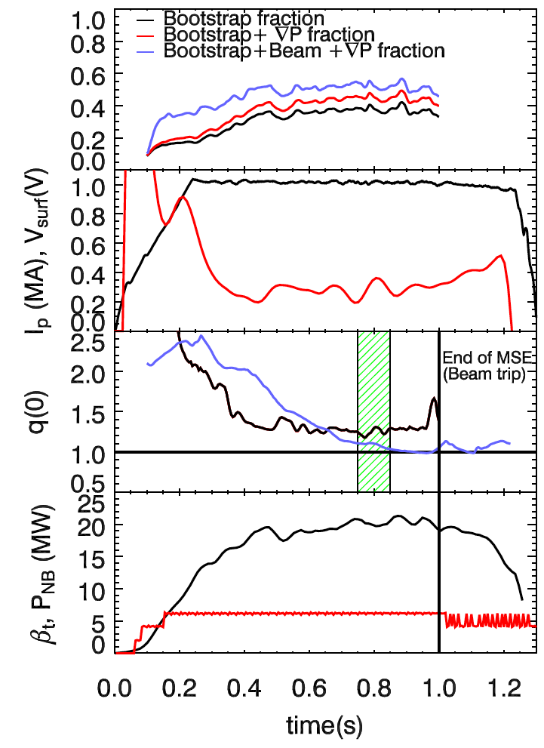
High plasma performance and reduced q_{pk} are attained in highly shaped plasmas
Shot 120001
High performance H-mode
(Gates APS 2005, Maingi APS 2005, Menard IAEA 2006)
κ = 2.2-2.3, δ = 0.65-0.75, drsep ~ 5-10 mm
H89P ~ 2.0
β_{t} = 15 - 25 %
f_{bs} = 45 - 50 %
longer pulses ~50 x τ_{E}
smaller ELMs
Divertor in highly shaped plasmas
High flux expansion, area expansion (q_{peak} ↓ )
Higher isothermal SOL volume (P_{rad} ↑)
Lower L_{p} (neutral penetration ↑)
Neutrals recycle toward separatrix
τ_{cr} (=μ₀σ_{nc}a²/6)
TRANSP
MSE

Slide 10
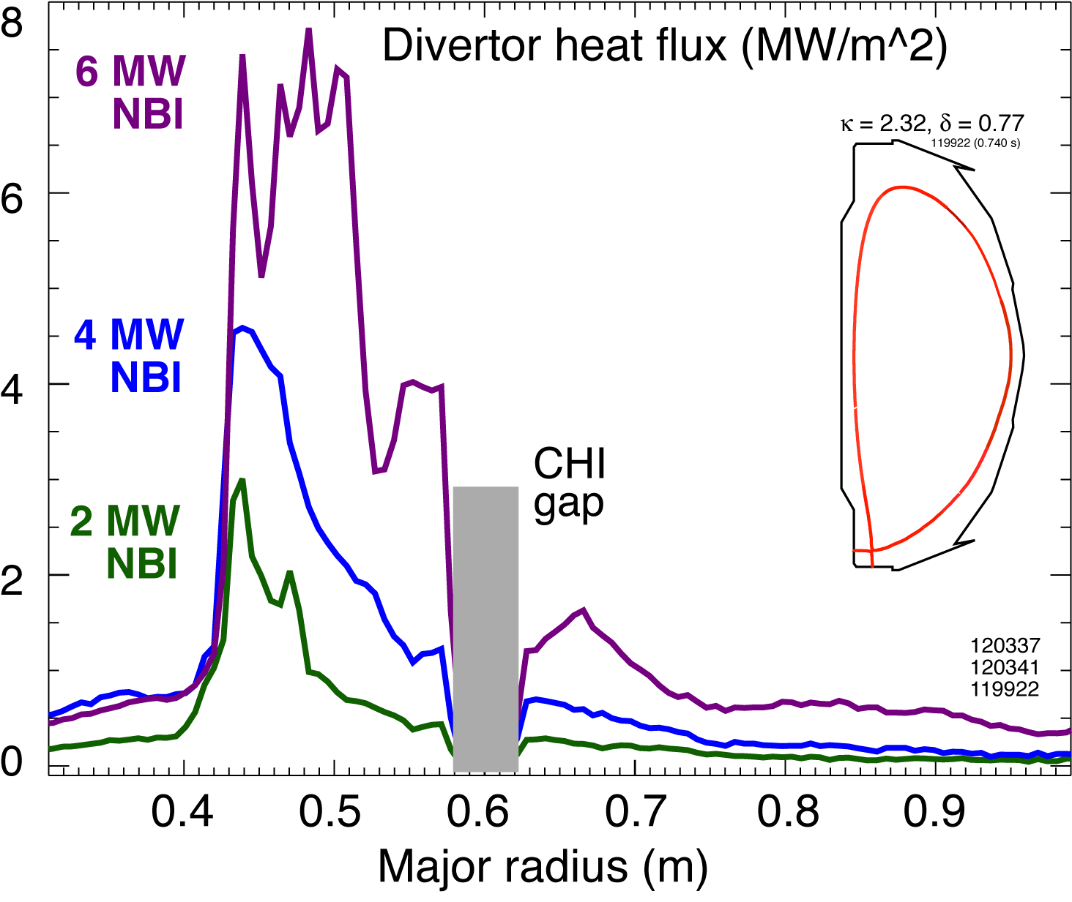
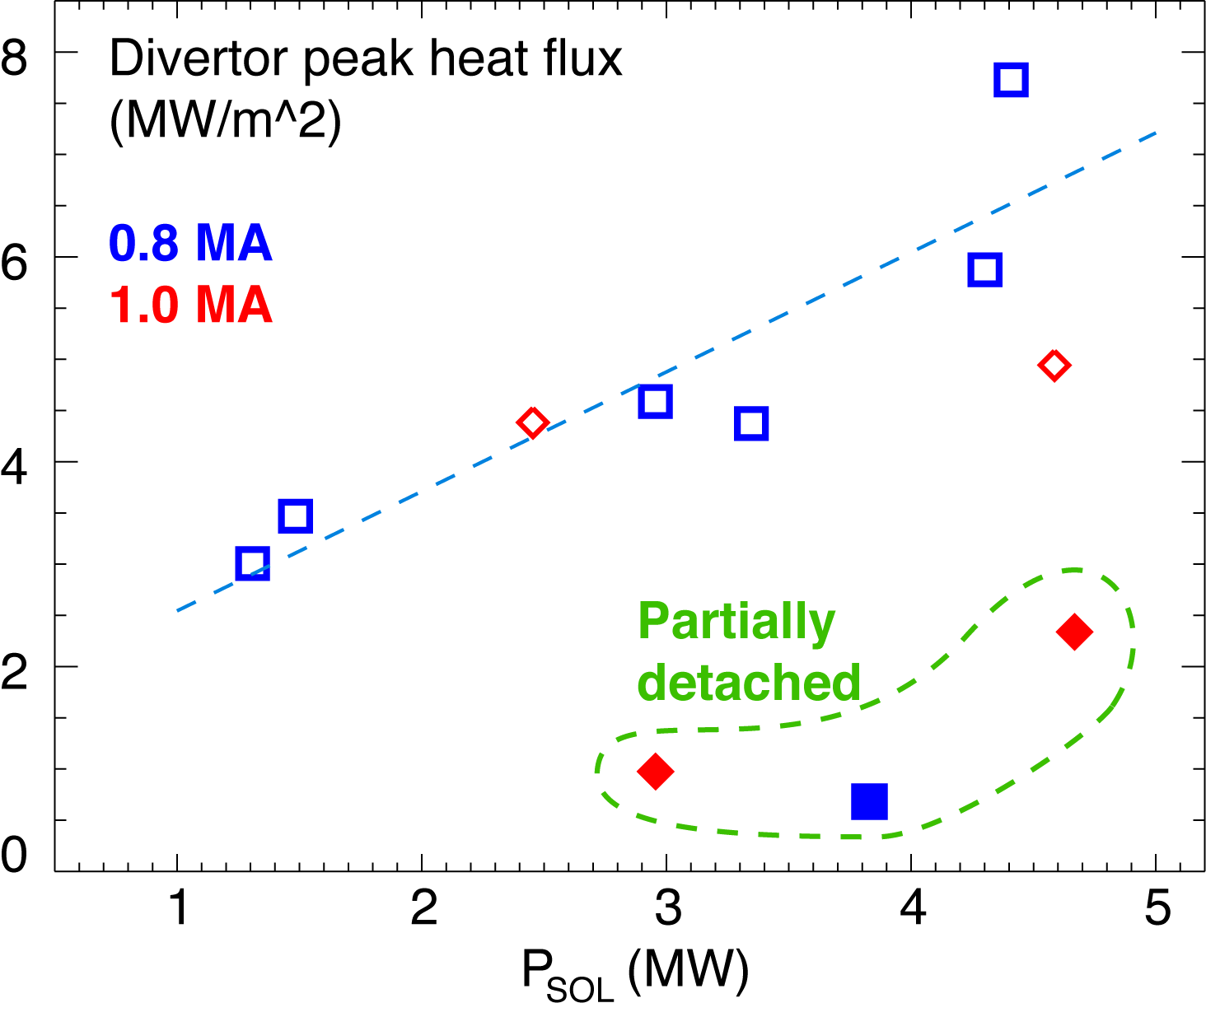
Good core plasma performance and significant q_{peak} reduction with PDD obtained at high κ, δ
Experiments conducted in 0.8-1.0 MA 4-6 MW NBI discharges with κ=2.2-2.3, δ=0.6-0.75 (Soukhanovskii APS 2007)
Obtained partially detached divertor (PDD) outer strike point using divertor D₂ injection, however, P_{rad} due to intrinsic carbon and helium
q_{peak} reduced by 60 - 80 % in PDD phase with min. confinement degradation

Slide 11
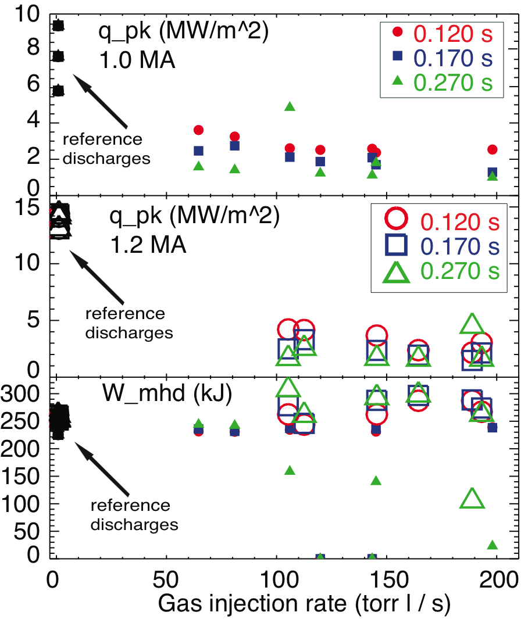
Radiative divertor conditions were optimized in 1.0 MA and 1.2 MA 6 MW H-mode discharges
Criteria of optimization - find gas injection rate to obtain PDD with minimal confinement degradation
q|| was higher in 1.2 MA discharges thus more gas was needed to reduce q_{pk}
After 0.250-0.270 ms peak heat flux reached low steady-state level
Optimal gas injection found (used 300 ms pulses)
50-100 Torr l /s for 1.0 MA discharges
110-160 Torr l /s for 1.2 MA discharges

Slide 12
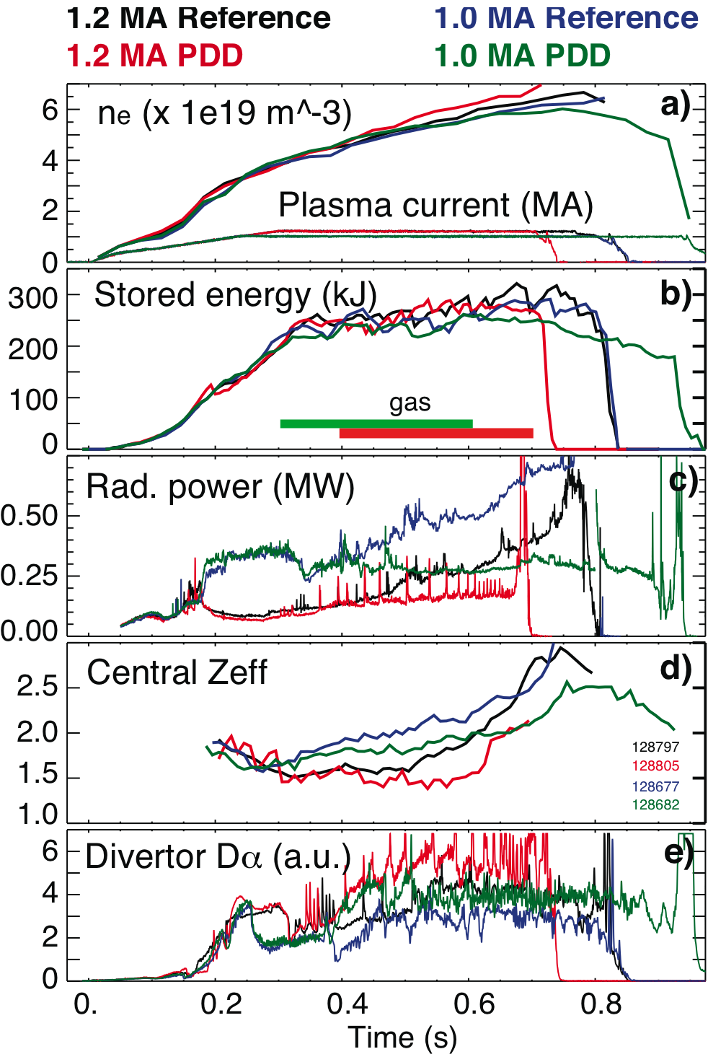
High core and pedestal plasma performance during PDD is achieved in high κ, δ configuation
These experiments
I_{p} = 1.0-1.2 MA
P_{NBI} = 6 MW
n_{e}=(0.7-0.8) x n_{G}
D₂ injection in divertor
q||=P_{SOL}/(4πR(B_{p}/B_{tot})λ_{q}) =
50-80 MW/m²
Carbon is main impurity
High core plasma performance during PDD phase
Minimal effect on W_{MHD} or pedestal
Core P_{rad} and n_{c} decreased
Small ELMs (ΔW_{MHD} /W_{MHD}< 1%) and mixed ELMs

Slide 13
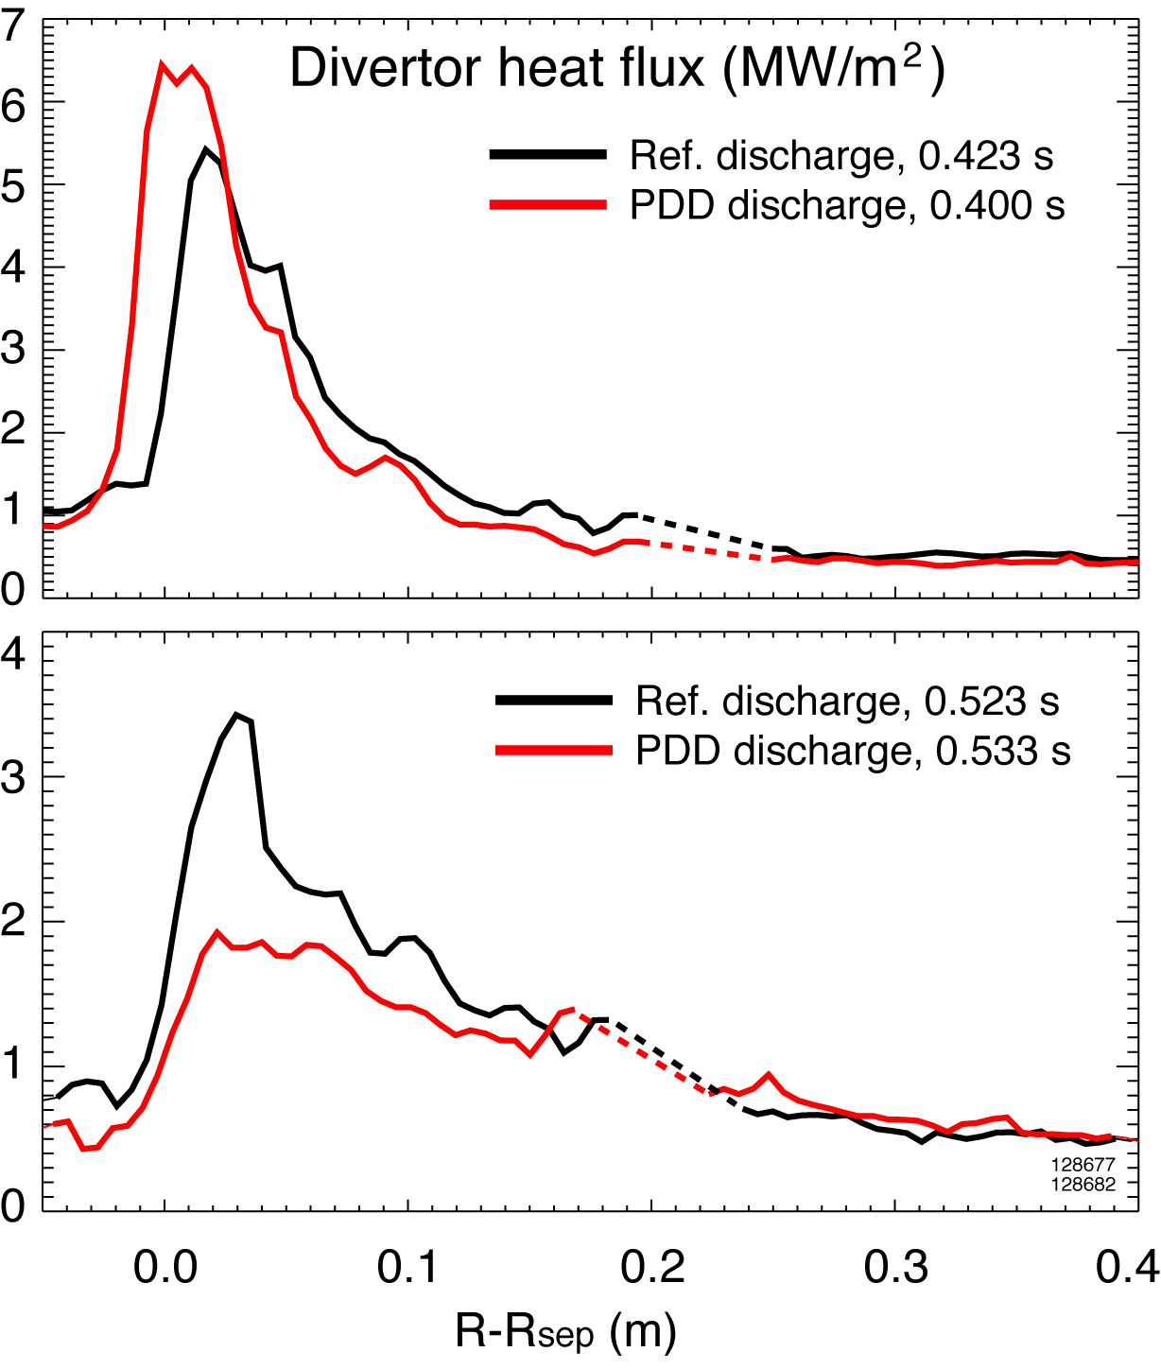
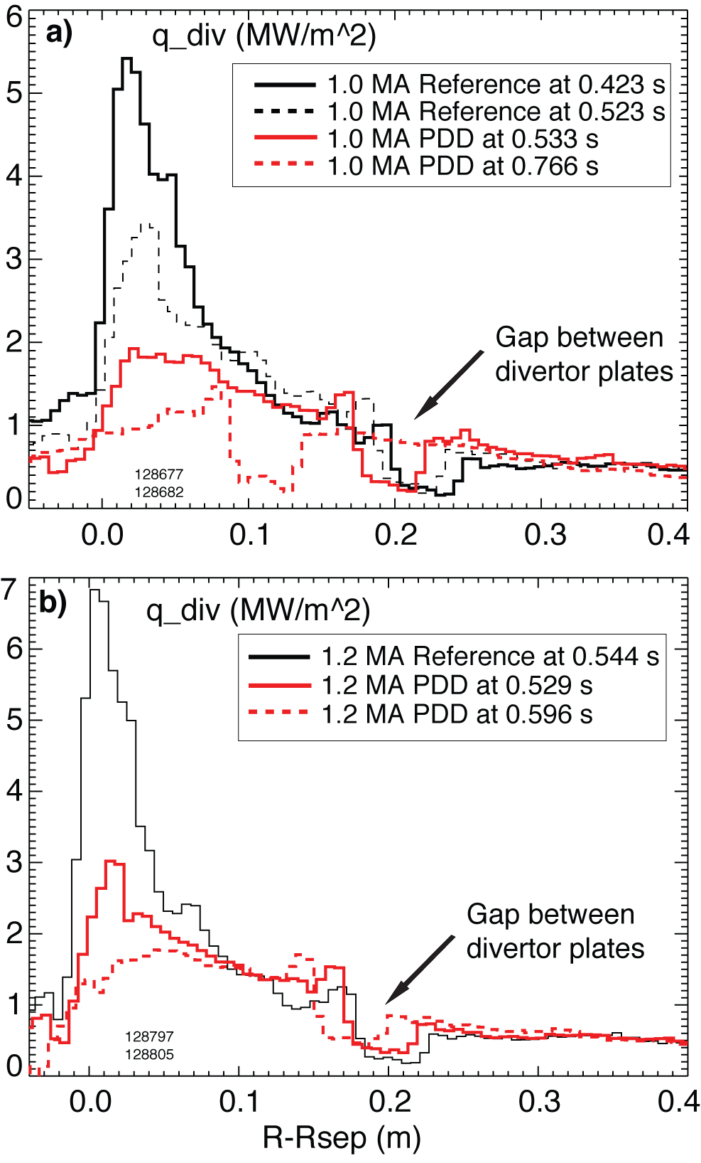
Peak heat flux reduced by up to 60 % as a result of outer strike point partial detachment
λ_{q} changed from 5-10 cm to 10-15 cm
PDD zone 10-15 cm
No q reduction outside of PDD zone

Slide 14
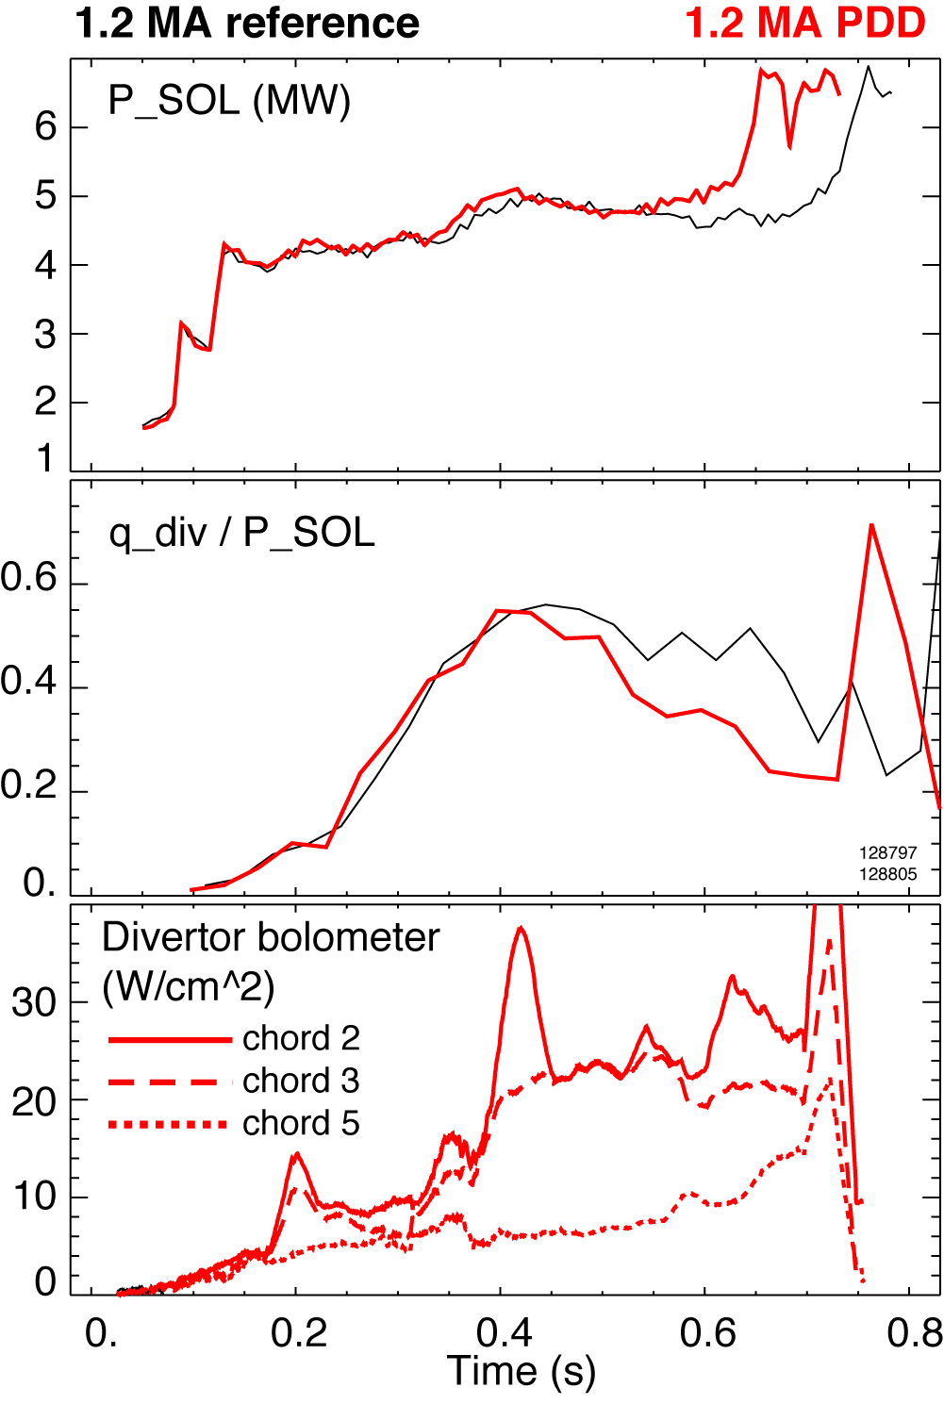
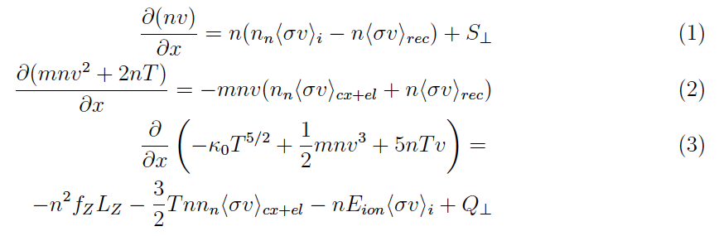
Divertor heat flux reduction was attributed in part to divertor radiated power loss
Total P_{SOL} = 4.5 - 5 MW
Q_{out.div.}= 2-3 MW (reference discharge)
Q_{out.div.}= 1-2 MW (PDD discharge)
Outer leg radiated power estimate:
V=0.1 m³
Total P_{rad}=0.5 MW

Slide 15
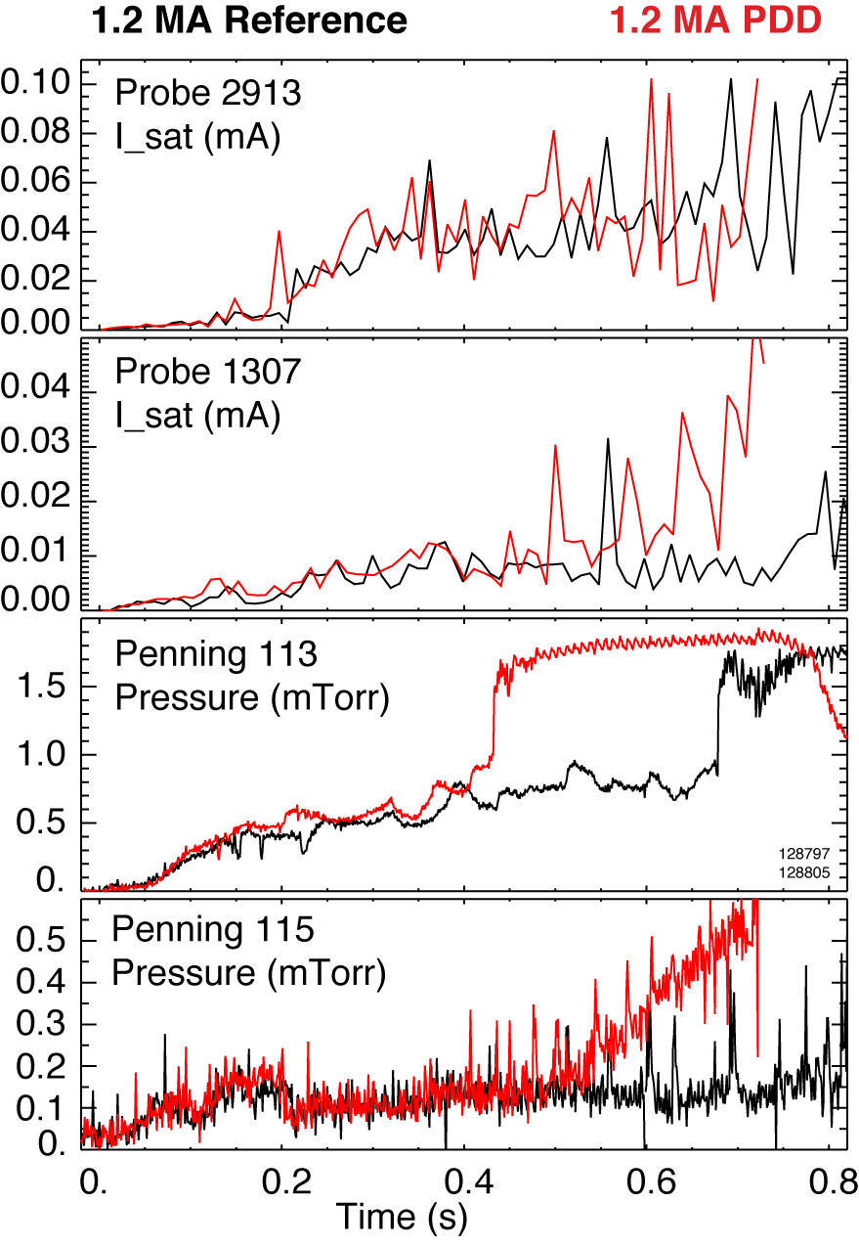

Momentum loss was evidenced by divertor neutral pressure increase and particle flux decrease
Langmuir probe in PDD zone showed particle flux decrease during gas puff
Langmuir probe outside of PDD zone showed particle flux increase during gas puff – as expected in high-recy. regime
Neutral pressure increased in outer div. region from 0.5 to 2-3 mTorr
Neutral pressure of 2-3 mTorr is required to explain plasma pressure drop of dp/dx = 9-10 Pa/m

Slide 16
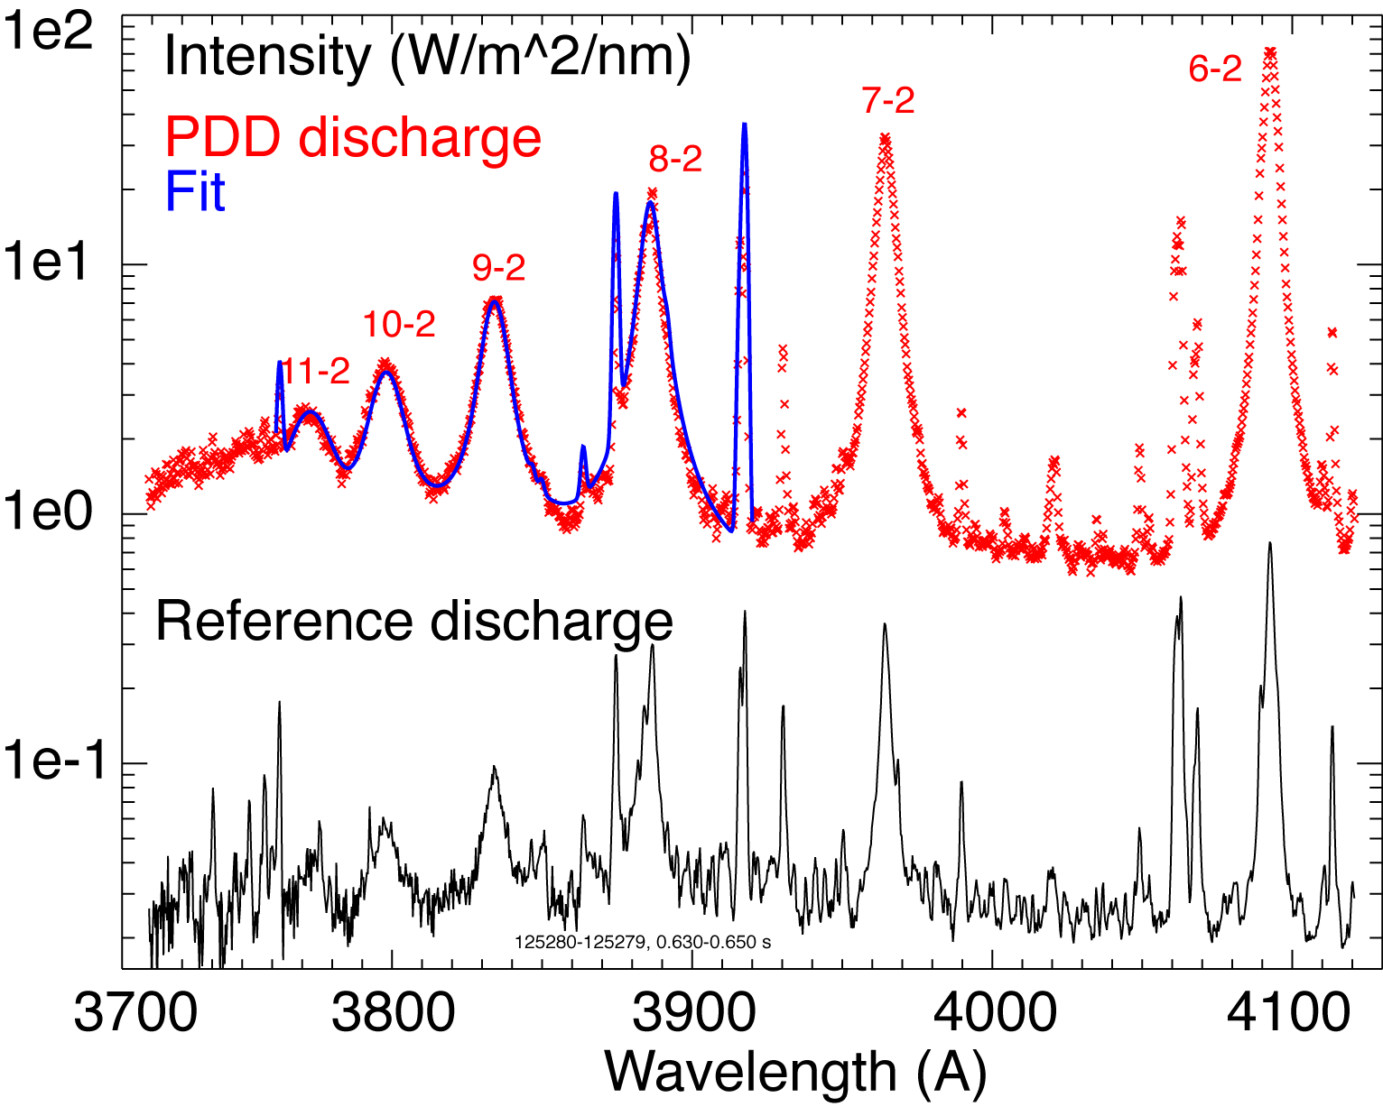
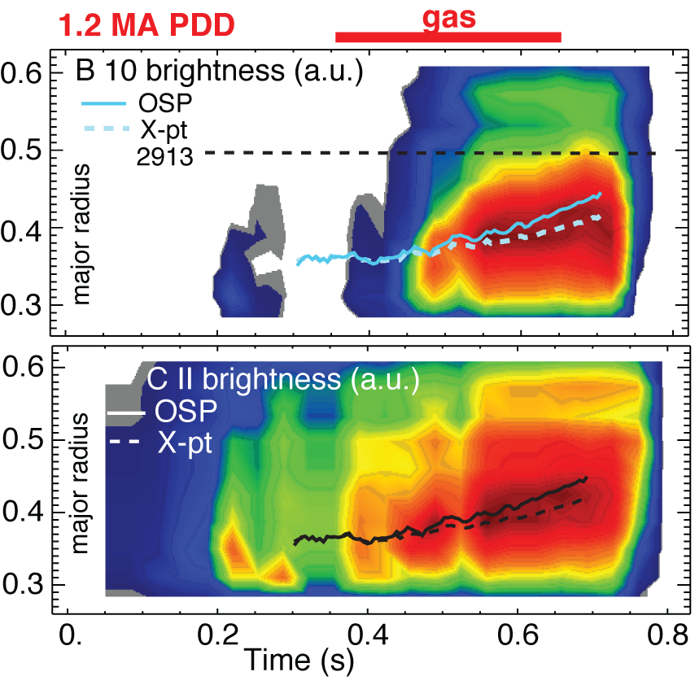
Carbon radiation and ion recombination rates increased in divertor detachment phase
x 10
Increase in recombination rate
D I Balmer spectra (8…11 - 2) indicate
T_{e} < 0.7-1.2 eV (from line intensity ratio according to Saha-Boltzman formula)
n_{e} ~ 2-6 x 10²⁰ m⁻³ (from Stark broadening and MMM calculations)

Slide 17
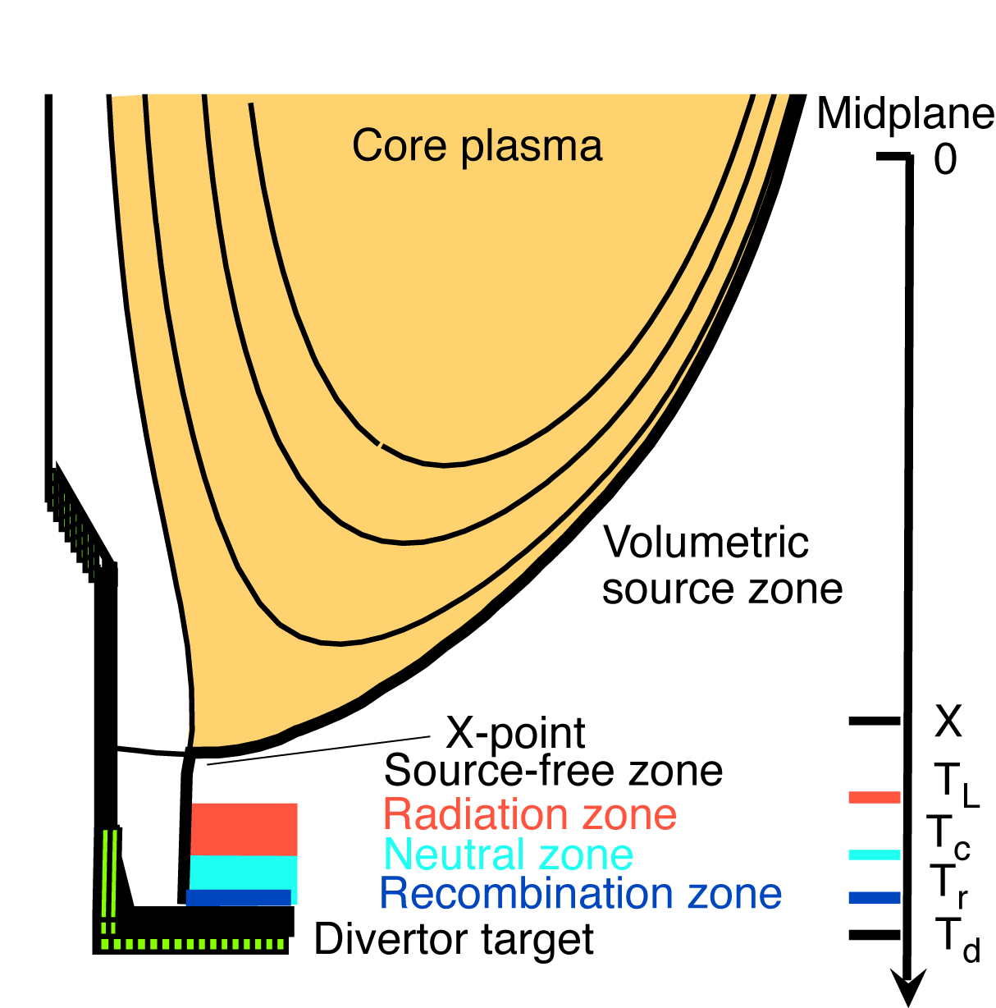
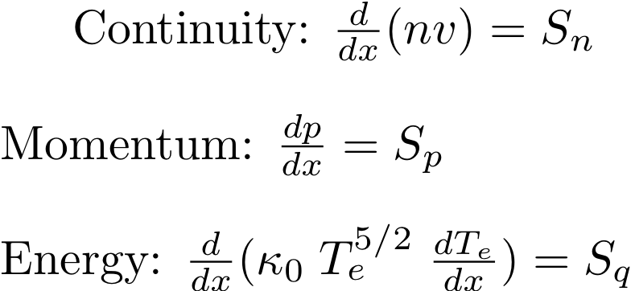
Six-zone 1D analytic SOL / divertor model captures essential features of detachment
Goswami PoP 8, 857 (2001)
Zone locations defined by temperature of process
Sources and sinks Q⊥, S⊥,
Γ_{i-div}, f_{rad}, R_{rec}, ν_{i-n} as input

Slide 18
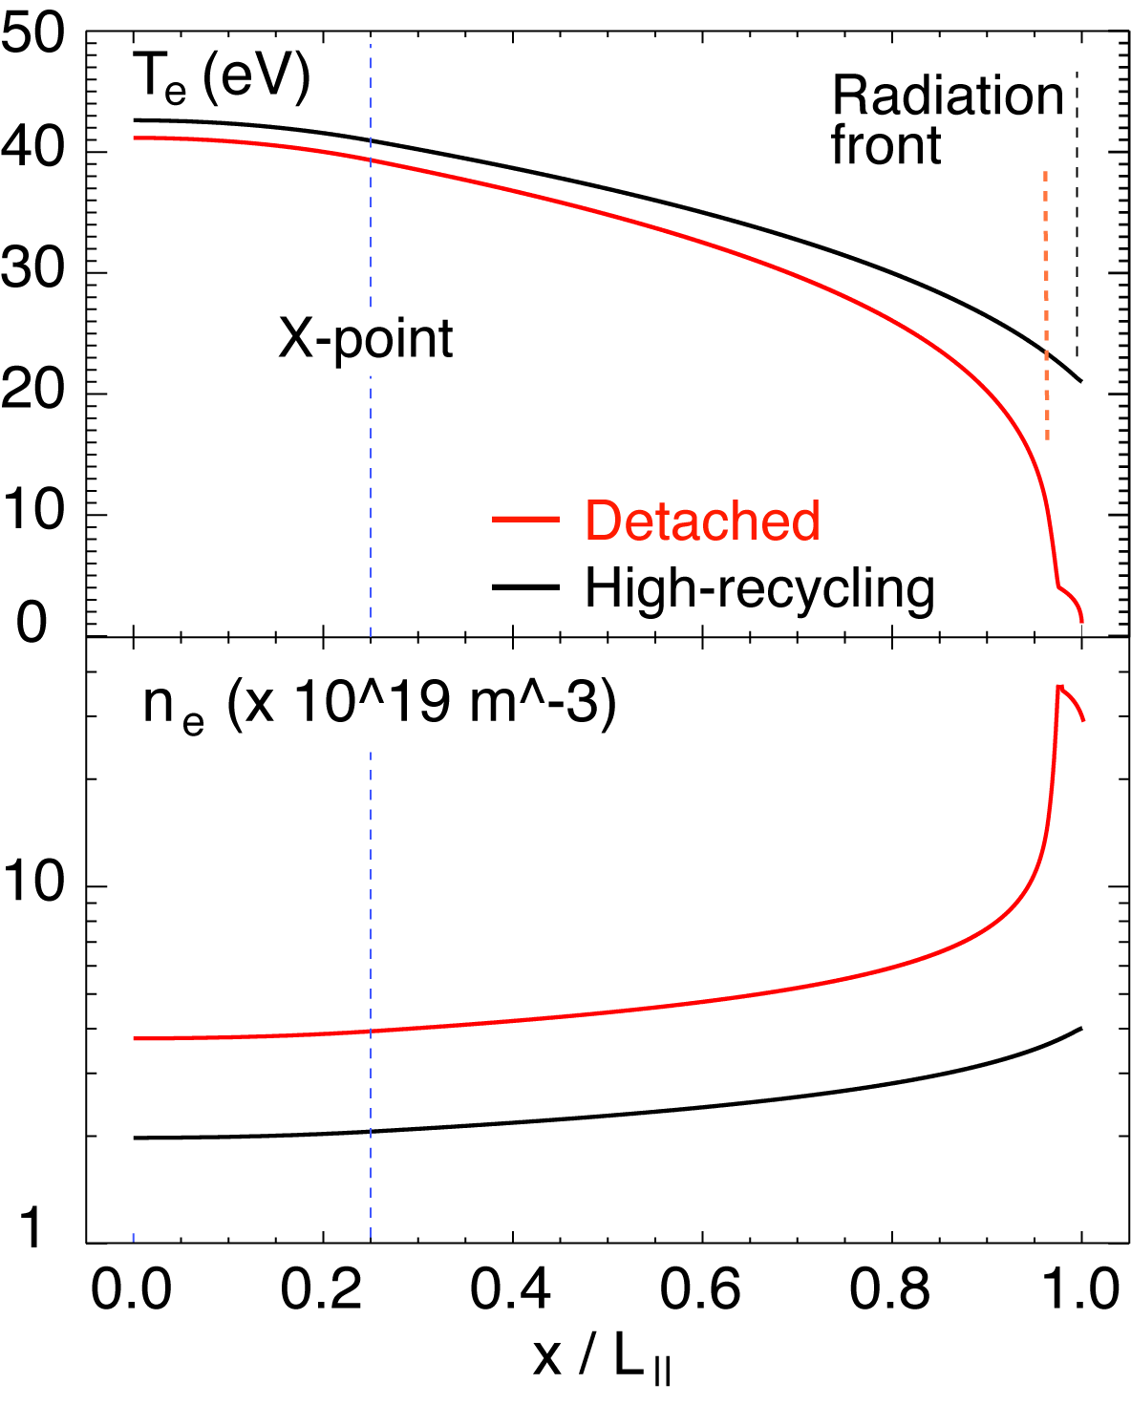
Model predictions consistent with experiment within NSTX range of SOL parameters
NSTX SOL / divertor parameters
Q⊥ = 0.5 - 20 MW m⁻³ (high)
S⊥ = 0.01-3 x10²³ s⁻¹ m⁻³
L_{x} = 5-10 m (low)
R_{rec} = 10²³ s⁻¹ m⁻³
Example calculation
Q⊥ = 10 MW m⁻³
S⊥ = 6 x 10²² s⁻¹ m⁻³
f_{rad} = 0.3 (attached)
f_{rad} = 0.9 (detached)
Recombination onset at T_{e} < 1.5 eV
Detachment at T_{e} < 1.0 eV
Detached
Attached

Slide 19
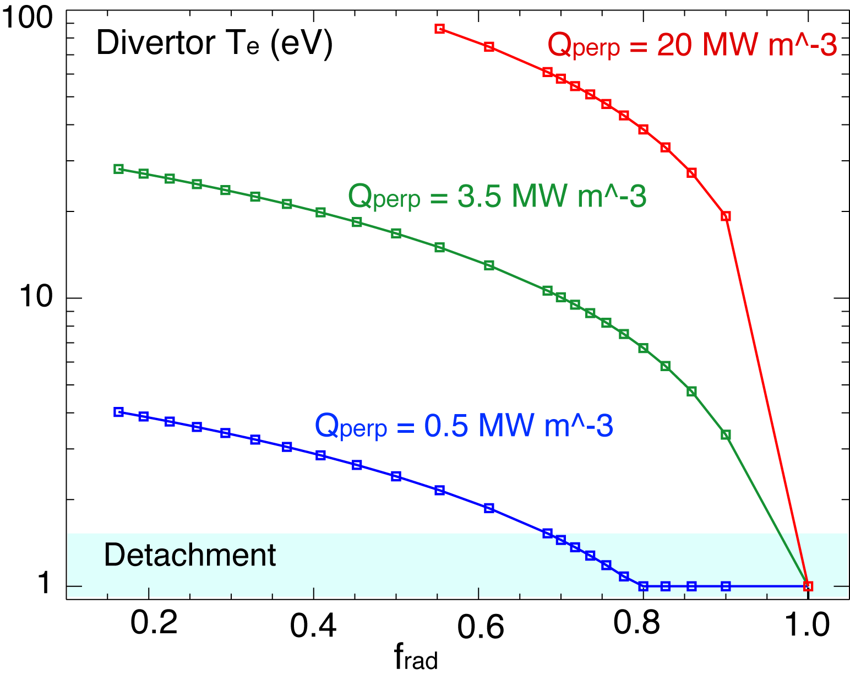
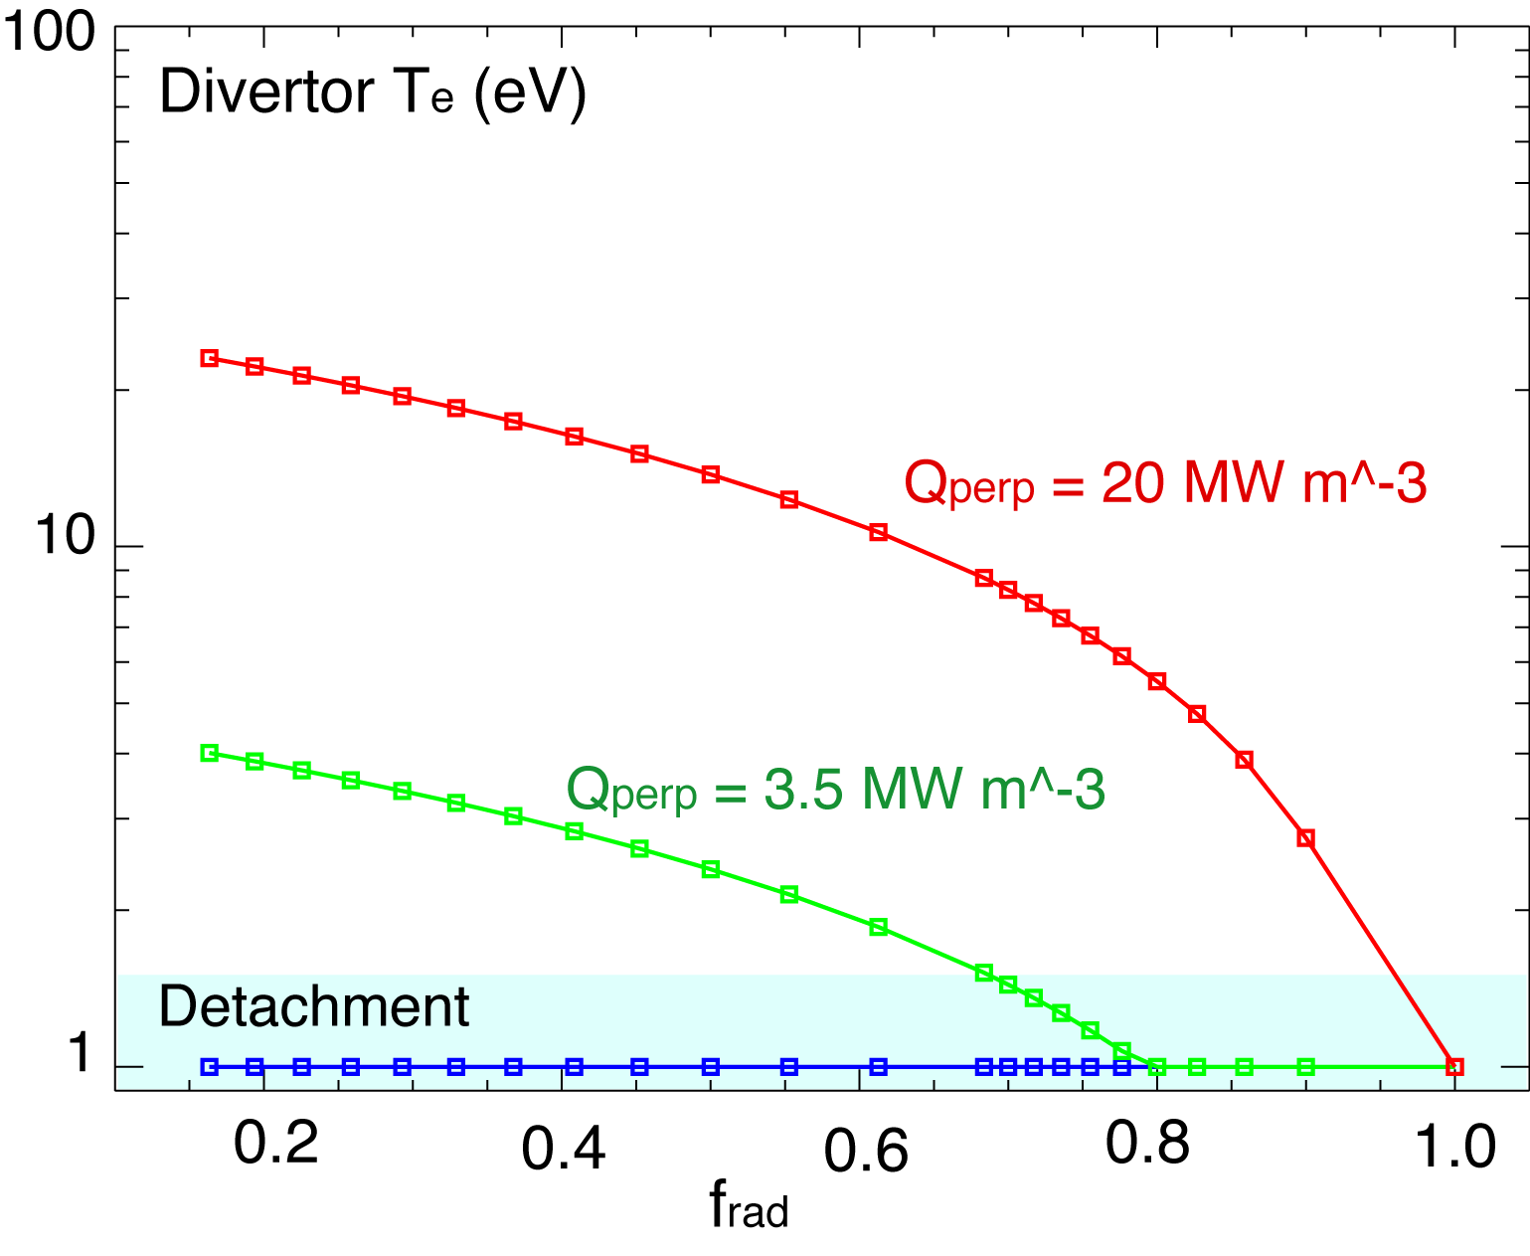
All routes to detachment predicted by model involve high f_{rad}
Detachment at NSTX-range of Q⊥, S⊥ can be achieved in model by
increasing f_{rad} (shown)
increasing Γ_{i-div} (gas puff)
increasing S⊥ (not shown)
Γ_{i-div}
x 10

Slide 20
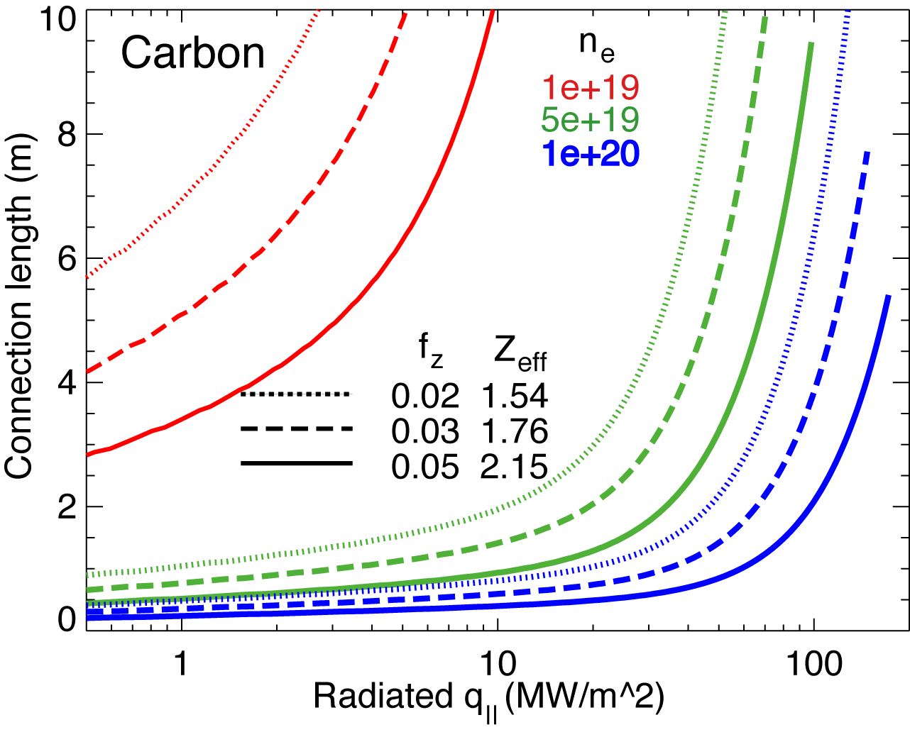
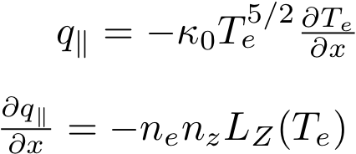
High f_{rad} can be achieved with carbon in NSTX divertor at high n_{e} and n_{z}
Hulse-Post non-coronal radiative cooling curves for low Z impurities for n₀/n_{e}, n_{e}-τ_{recy}
Calculate max q|| that can be radiated
Express max q|| as function of distance from heat source for range of f_{z}
(Post JNM 220-222, 1014 (1995) )
Power losses due to deuterium P_{rad} and ionization not considered
For NSTX, use n₀ = 0.1 % and n_{e}-τ_{recy} = n_{e} x 1e-3 s

Slide 21
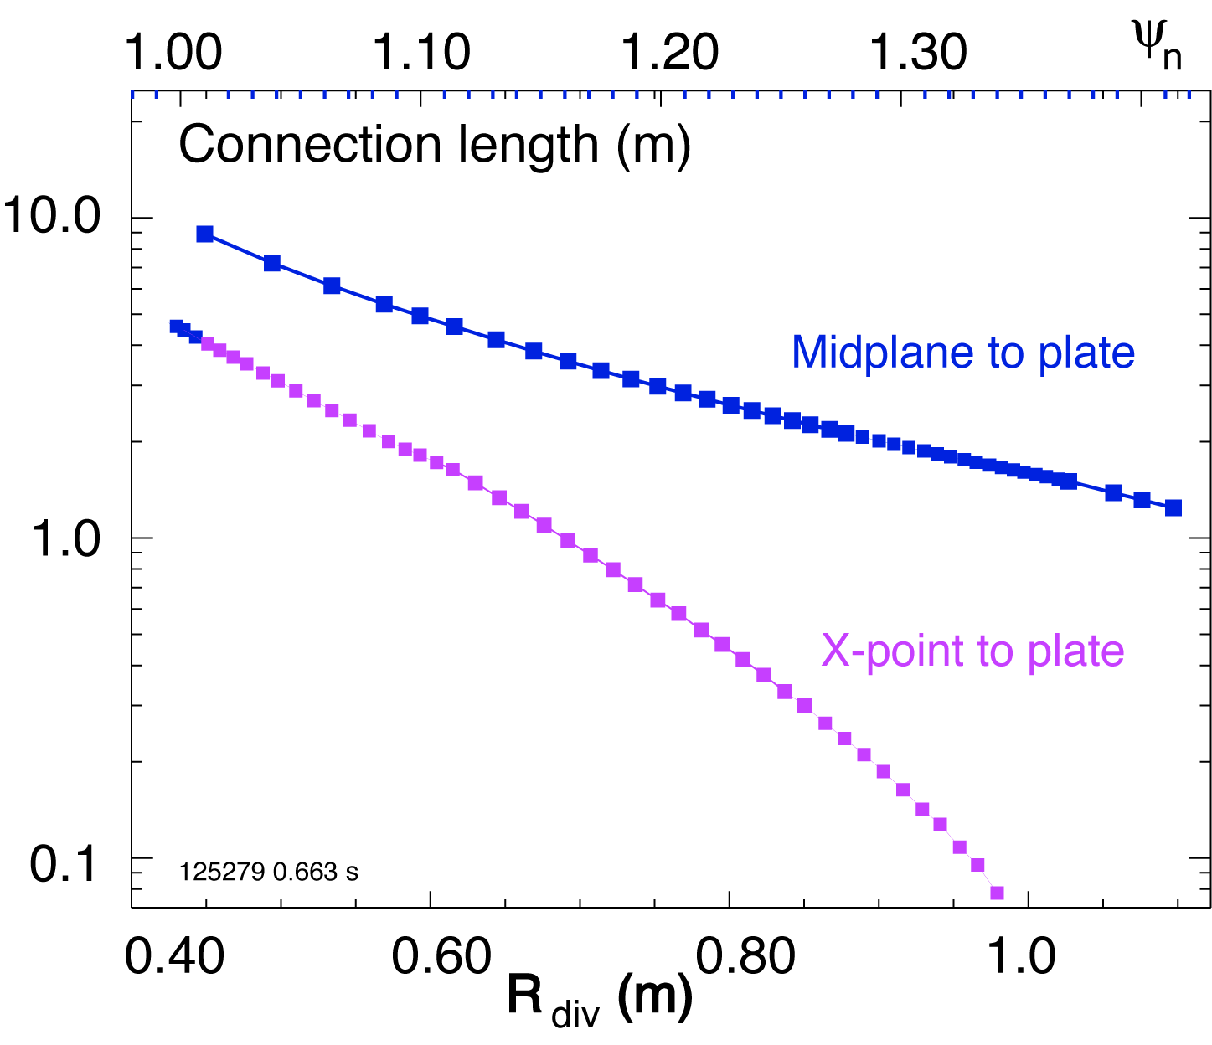
Volumetric power and momentum losses are limited by L_{x} (R ) at high magnetic field shear
Fraction of q|| to be radiated is a function of L_{x} for given impurity
high f_{rad} only where L_{x} longest
Electron-ion recombination rate depends on divertor ion residence time
Ion recombination time: τ_{ion}~ 1−10 ms at T_{e} =1.3 eV
Ion residence time: τ_{ion} ≤ 1 ms
possible to detach
L_{x} ~ 5-6 m
SOL width
difficult (impossible)
to detach L_{x} ~ 1-2 m

Slide 22
Discussion
PDD regime with reduced q_{pk} and good core confinement demonstrated in open geometry un-pumped divertor in a high power spherical torus
In an ST, modest q|| can yield high divertor q_{pk}
in NSTX, q||= 50-80 MW/m² and q_{pk}=6-12 MW/m²
Large radiated power and momentum losses are needed to reduce q||
In NSTX density ramp discharges do not necessarily lead to PDD
n_{sep} weakly coupled with n-bar
In NSTX, PDD regime is accessible only
in highly-shaped plasma configuration with high flux expansion divertor (high plasma plugging efficiency, reduced q_{||)}
modest divertor D₂ injection still needed
ST SOL geometric effects appear to play dominant role in the above

