Slide 1
NOAA Planning, Management & Support Services Office of the Chief Administrative Officer (OCAO)
Supporting NOAA’s Program Mission Success

Slide 2
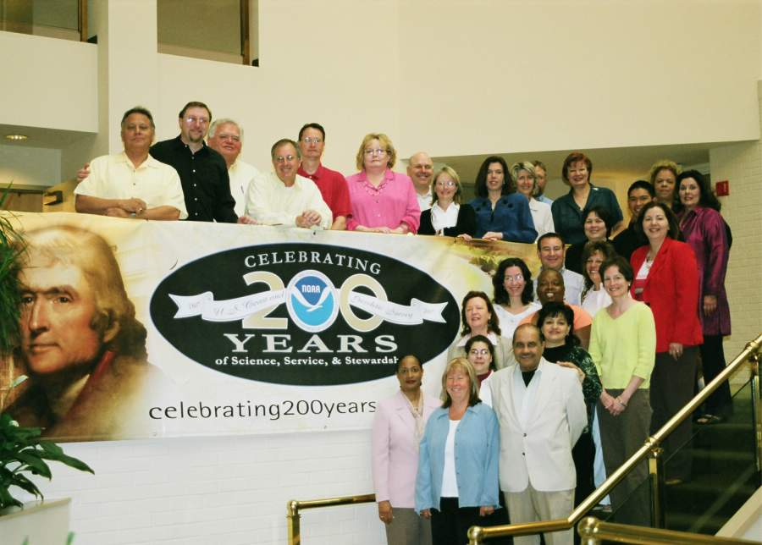
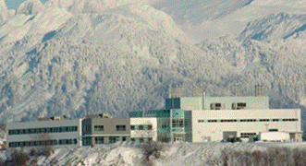
OCAO
To provide high-quality customer driven service to NOAA in the areas of Facilities and Logistics Management, Freedom of Information Act, Safety and Environmental Compliance, Civil Rights and Equal Employment Opportunity, NOAA Deemed Exports and other administrative support programs
A NOAA workplace that provides all of its employees with a positive work environment that fosters value-added services, creative thought and innovative science

Slide 3
OCAO Business Units
Real Property, Facilities & Logistics Office (RPFLO)
Logistics Division
Project Planning & Management Division (PPMD)
Real Property Management Division (RPMD)
Service Offices/Programs/Teams
Audit, Internal Control & Information Mgmt. Office (AICIM)
Office of Civil Rights
Safety & Environmental Compliance Office (SECO)
Deemed Export Program
Business Development Team
Pacific Regional Center Development Team (PRCDT)

Slide 4
RPFLO Roles & Responsibilities
Logistics Division
Building Management & Admin. Services Contract Oversight
Manages NOAA Personal Property Program
Manages NOAA shipping /handling/ warehousing functions
Manages NOAA Vehicle Fleet
PPMD
Major Construction Project Management
Restoration & Repair Project Management
Facility Emergency Response Support
Construction Grant Program Support
RPMD
Lease Management Services
Real Property Acquisition Planning & Assistance Services
GSA Leasing Assistance
Real Property Disposal Management
Facility Condition Reporting
Real Property Portfolio Management
Notes:
Detailed Projects and Services of RPFLO Divisions
Logistics
Products
Standard Policies and Processes for Directing and Integrating NOAA Logistics
Unreconciled Property Reports
Personal Property Inventory Report
Services:
Oversees Delivery of Facility Admin Svcs.
Manages NOAA’s Programs for Personal Property and Logistics Services including:
Shipping/handling/warehousing
NOAA-wide fleet management (transportation and vehicles)
Permanent Change of Station (PCS) moves
Printing and publications (including forms management and photocopy services
Space, warehousing and distribution management
Coordinates with DOC Office of Security
Oversees NOAA-wide implementation of Homeland Security Presidential Directive 12 (HSPD-12)
RPMD
Products
NWR Antenna Leases
Building Leases
Land Leases
Real Estate Fee Acquisitions
Withdrawals from Public Domain
Inventory Data Reports
Financial Statement Accountability Reports
Facility Condition Reports
Services:
GSA Rent Payment
Real Property Acquisition Planning
GSA Leasing Assistance
Real Property Acquisition Services
Real Property Disposal Management
PPMD
Products
Major Construction Progress Reporting
Restoration Progress Reporting
Deputy Under Secretary (DUS) Summary Reports
National Environmental Policy Act (NEPA) Studies
Services:
Major Construction Design and Project Management
Restoration Design and Project Management
Facility and Structure Assessments
Conduct Facility Feasibility Studies
Facility Emergency Response Assistance
Review Construction Grants
Long and Short term Facility Planning

Slide 5
Service Offices/Programs/Teams Roles & Responsibilities
AICIM
Coordinate OIG/GAO Reviews
Administer NOAA FOIA Program
Oversee NOAA Commercial Services Management Program
Office of Civil Rights
Manages NOAA EEO Program
Sponsors Cultural Awareness & Education programs
Promotes NOAA workforce Diversity
SECO
Manage NOAA Safety Program
Manages NOAA Env. Compliance Program
Deemed Export Program
Sets NOAA Policy for Technology Controls and Foreign National Access
Business Development Team
Responsible for Long Range Facilities Planning
Develops Annual Facility Modernization Plan
PRCDT
Manages Design & Construction of NOAA’s Pacific Regional Center in Honolulu, HI

Slide 6
OCAO Budget
*

Slide 7
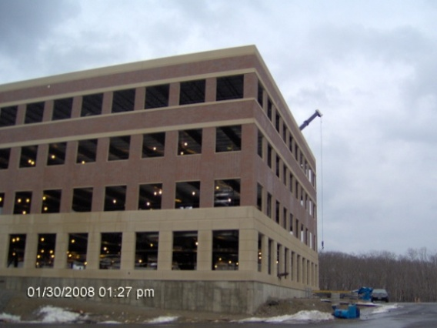
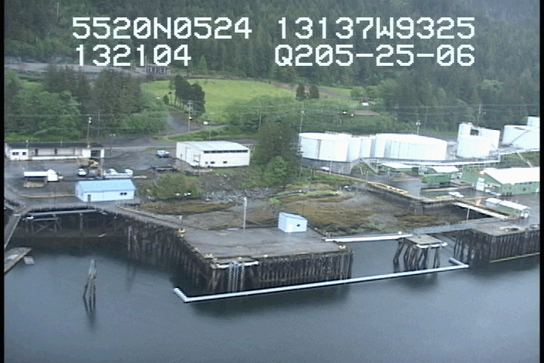
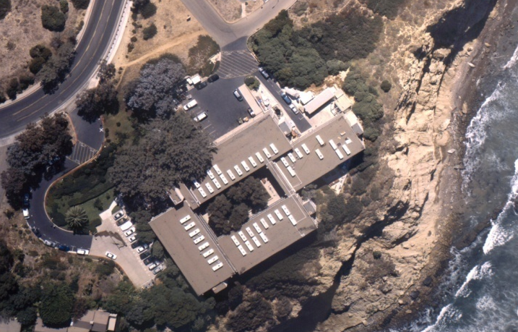
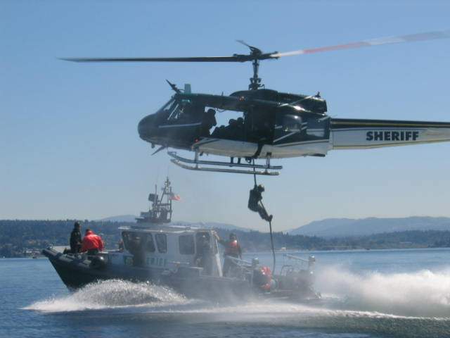

Who We Are/What we Do OCAO Employees

Slide 8
Who We Are, Where We Work
Leadership
Service Offices/Programs/Teams
William F. Broglie
NOAA Chief Administrative Officer
Sandra R. Manning
NOAA Deputy Chief Administrative Officer
Roger M. Natsuhara
Director, Real Property, Facilities and Logisitics office
Office Of Civil Rights
Director: Vacant
Audit, Internal Control & Information Management Office
Director: Mack Cato
Safety & Environmental Compliance
Director: CDR James Verlaque
PRC Project Team
Ben Roth
Deemed Export Program
Anne Murphy
Logistics Division - HQ Branches
Logistics Division – Field Managers
Personal Property Management Branch
Warehouse Management Branch
Jon Pinner
Debra Pickerign
8 Contractors
11 FTE
2 FTE
X Contractors
Logistics Management Branch
Joy Taylor
4 FTE
0 Contractors
Building Management Branch
Evelyn Williams
9 FTE
8 Contractors
Boulder
Boulder Building Manager
Seattle
Seattle Building Manager
Norfolk Building Manager
Kansas City
Hank Kordek
David Petre
Norfolk
Anita Holley
Richard Cook
Kansas City Building Manager
Director
Ezekiel Dennison
Chien V. Le
Andrew Duran
Director, Logistics Office
Director, Real Property Management Division
Director, Project Planning and Management Division
RPMD
RPMD Eastern Region – Kansas City/Norfolk
RPMD Western Region – Seattle/Boulder
Nancy King
David Garton
X Contractors
0 Pol Appointees
0 Vacant Positions
5 FTE
10 FTE
X Contractors
0 Pol Appointees
0 Vacant Positions
PPMD
PPMD Eastern Region – Kansas City/Norfolk
PPMD Western Region – Seattle/Boulder
Roger D. Mccollum
Dan Strandy
9 FTE
2 Contractors
0 Pol Appointees
X Vacant Positions
8 FTE
0 Contractors
0 Pol Appointees
X Vacant Positions

Slide 9
Forums/Processes for Information Communication & Management
RPFLO
Key Decision Point Process for Construction Process
OMB-300 Process for Prospectus Level Projects
Facilities Committee Meetings – Various Issues
Acquisition Review Boards
Lease Review Boards
PPBES Process
Facility Condition Assessment Process
Service Offices/Programs/Teams
OIG & GAO Audit Processes
EEO Processes & Reports
Safety Training Programs
NOAA Safety Advisory Board
Notes:
Transition Tasker 3, Part 2, Flow of Information
Question: Describe how information flows within the line office?
NOAA’s Office of Oceanic and Atmospheric Research (OAR) has a robust two-way communication strategy. The “Chop Chain” (See attached) is OAR’s formal standard flow of information process for exchanging and reviewing critical information concerning NOAA and OAR, controlled correspondence, actions from NOAA Executive Panel (NEP) and NOAA Executive Council (NEC), and supporting decision making activities within the organization. The flow of information may originate anywhere in the organization. The entry point to the Chop Chain is any of the OAR Headquarters Offices, with approximately eighty percent originating from the Office of Policy, Planning, and Evaluation or Chief Financial Officer (CFO). The routing of the information follows the outline of the OAR organizational chart. The Chop Chain provides information and a review mechanism the information as it proceeds from its origin to the Assistant Administrator for OAR. As appropriate, information gained from the review of Chop Chain documents may also go down from Headquarters and staff offices to lower levels of the organization, but its primary focus is to coordinate views and information from the staff, program, and laboratories up through the organization to the Assistant Administrator (AA). Documents in the Chop Chain are controlled and tracked through the review process by OAR‘s Correspondence Unit.
Additional information exchange activities occur at the following:
The (AA) or his designee chairs the Weekly Senior Management Meetings where a complete range of topics from personnel issues to the latest scientific findings affecting the line office are exchanged. Attendance in person, by video teleconference, or by telephone is mandatory for all program and staff offices and laboratories.
The AA holds twice weekly OAR Headquarters Senior Staff meetings.
All divisions, laboratories, and program office further distribute information in individual staff meetings, memorandums and e-mails on a routine basis.
The AA OAR Update email is sent to all employees bi-weekly with information of interest to all of OAR
The OAR Communications Office organizes quarterly OAR All Hands Webcasts for the AA, which are archived on the OAR intranet.
OAR holds quarterly Town Hall meetings for Silver Spring employees, and town hall meetings are also scheduled when OAR leadership is at the laboratories
The Laboratories and Program Offices upload information regularly to OAR’s internal, password-protected “Hot Items” portal where it can be viewed by all OAR employees.
Official policy and memoranda notices are sent as needed.
OAR’s Senior Research Council (SRC) meets no less than three times per year (1 ½ to 2 days) and is a major decision making body for OAR where the complete evaluation of the research science and related issues facing NOAA can be discussed in an open forum with a wide range of policy, scientific, and programmatic information.
The OAR Deputies meeting is chaired every two weeks by the OAR Chief Financial Officer (CFO) – the focus is on administrative business.
Question: Describe how information flows out of the line office?
All official correspondence goes through the “Chop Chain” and out to other line offices, constituents, or individuals and organizations requesting information from OAR. The “Chop Chain” is an informational and decisional process. Depending on the nature of the information, the exchange process may be executive correspondence and through NOAA headquarters (more information below) or information coordinated through the Program Coordination Office (PCO). Information and findings from the OAR SRC or senior management meetings may also be provided in correspondence to other line offices or constituents. The OAR Communications Office frequently works to facilitate consistent messages and prepare material to convey scientific information, policy, and program information to constituents and other line offices. OAR uses the oar.noaa.gov website to highlight recent research findings and accomplishments. The Communications Office also produces audio and video podcasts and makes them available on the web. The Communications Office holds an average of four high-level constituent roundtables annually where participants are invited to share information, and express their needs on topics of interest to the OAR AA for priority setting and direction. Roundtable summaries are posted on the oar.noaa.gov website. As appropriate, the Public Affairs Office provides assistance in the communication of information from OAR.
There are routine Assistant Administrator (AA) to Assistant Administrator meetings with those AA’s that have routine interactions, questions, or issues impacting OAR and NOAA. Each division within OAR, has distinct contact points in the other line offices to work with on a case by case, or issue by issue basis to exchange information that is relevant to that line offices. All the information is exchanged up and down through the divisions and program offices. It is the directors of the divisions and program offices judgment on how to disseminate this information to the other divisions, programs, or to the AA. This can be done through the above mechanisms described in the “within” line office flow of information.
Research papers or other types of scientific memoranda are used to articulate scientific findings. In this process all NOAA and OAR policy or directives are used to communicate this information. The NOAA Communications Office and OAR Communications Office provide support for these types of activities as well as for OAR’s website. Chief Financial Officer (Budget Office), Office of International Activities, Legislative Affairs, and Public Affairs issues can be related directly at the working level between different line offices of these organizations when appropriate.
Question: How do information/decisions make their way to NOAA headquarters?
Information or decisions to be provided to NOAA Headquarters are first approved by the AA or his representatives. This information has gone through the OAR “Chop Chain” or has been reviewed by the senior leadership through internal correspondence for clearance before being sent to the AA. There are two formal ways for information to be exchanged between OAR and NOAA Headquarters: via Official Executive Correspondence Unit (Executive Secretariat in NOAA Headquarters) or via the Program Coordination Office (PCO), linked through the Office of Policy, Planning and Evaluation (PPE). The OAR Communications Office contributes regularly to the NOAA Executive Management Team Reports and the NOAA Weekly Report. Somewhat less formal, but important specific information may be exchanged between the OAR Chief Financial Officer (CFO), OAR Communications Office, Legislative Affairs Office, Public Affairs, and their NOAA Headquarters counterparts. The exchange of this information, as appropriate, may also be communicated internally via the mechanisms described above.
Question: Describe the line office decision making process?
Decisions in NOAA’s OAR are made throughout the organization, with the highest authority of approval at the Assistant Administrator’s office. Before getting to this level, information has gone through a formal communications and review process, through the utilization of the formal OAR “Chop Chain” described in section one above. That policy is applicable to official correspondence, information exchange, and decisions on various scientific and managerial activities in OAR. Below are a number of other mechanisms used to inform decision makers in OAR:
OAR’s Senior Research Council (SRC) deliberations.
All NOAA Goal Program Operating Plans, NOAA decision memoranda (Planning, Programming, Budgeting, and Evaluation System documents).
NOAA 5 Year Plan, 20 Year Vision, and Strategic Plans.
NOAA Executive Panel Decisions and NOAA Executive Council decision memoranda.
Presidential directives, Congressional interest, and capabilities.
Internal and external review findings.
The “scientific method” and scientific achievements of the projects.
NOAA’s OAR performs research based on requirements (and thus makes decisions) provided to OAR by NOAA line offices or related constituents i.e. National Weather Service Operations and Services Improvement Process (OSIP).
Findings of the NOAA Transition Board, NOAA Councils, NOAA Science Advisory Board (SAB) and other NOAA directives or policies are used to provide a flow of information.

Slide 10
Questions?

