Slide 1
Lattice QCD: building a picture of hadrons
David Richards (Jefferson Laboratory)

Slide 2
How quarks and gluons form hadrons and nuclei?
Spectroscopy
QCD is a complicated many-body theory
What are the effective low-energy degrees of freedom?

Slide 3
Hadron Spectrum Collaboration
University of Pacific
J Juge
JLAB
S Cohen
J Dudek
R Edwards
B Joo
H-W Lin
D Richards
C Thomas
CMU
J Bulava
J Foley
C Morningstar
UMD
E Engelson
S Wallace
Tata (India)
N Mathur
Trinity College (Dublin)
Mike Peardon
Sinead Ryan
Resonance spectrum for both mesons and baryons composed of uds quarks
Radiative Transitions and properties of resonances
Charmonium physics
Hadronic Interactions (NPLQCD)

Slide 4

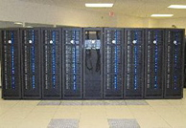
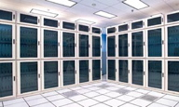

USQCD: Computing Resources
www.usqcd.org
Chroma, MILC,QDP
Leadership-class – JAGUAR at ORNL
QCDOC at BNL
Clusters at FNAL and JLAB
LQCD2: Proposal to DOE for computational facility 2010-2014

Slide 5
Hadron Spectroscopy
Spectroscopy is classic tool for gleaning information about structure of theory
Both experimental and ab initio N* and Exotic-meson programs aim at discovering effective degrees of freedom of QCD, and resolving competing low-energy models
HP2009 and HP2012 milestones
Excited Baryon Analysis Center (EBAC) at Jefferson Lab
Spectroscopy of Exotic Mesons flagship component of CEBAF@12GeV
“Calculate the masses of strongly interacting particles and obtain a qualitative understanding…..”

Slide 6
N* Spectroscopy - I
|q³>
|q²q>
Are states Missing, because our pictures are not expressed in correct degrees of freedom?
Do they just not couple to probes?
Capstick and Roberts, PRD58 (1998) 074011

Slide 7
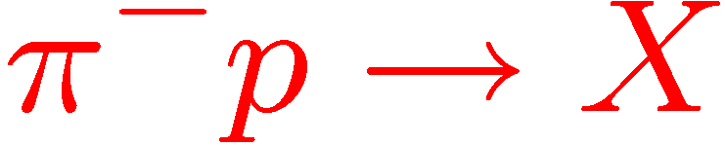
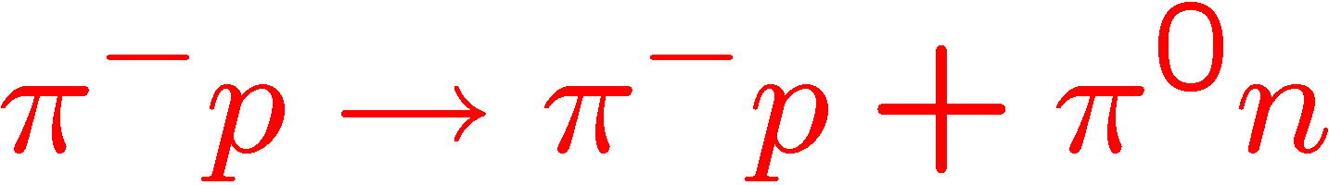
N* Spectroscopy – II
dσ/M_{π+,π-} GeV (μ b/GeV)
M_{π+,π-}(GeV)
Excited Baryon Analysis Center

Slide 8
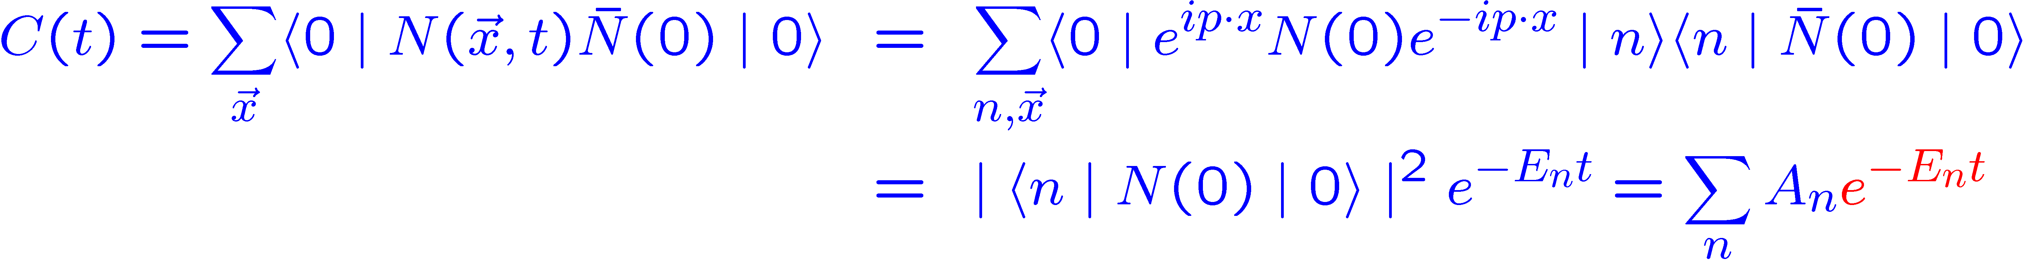
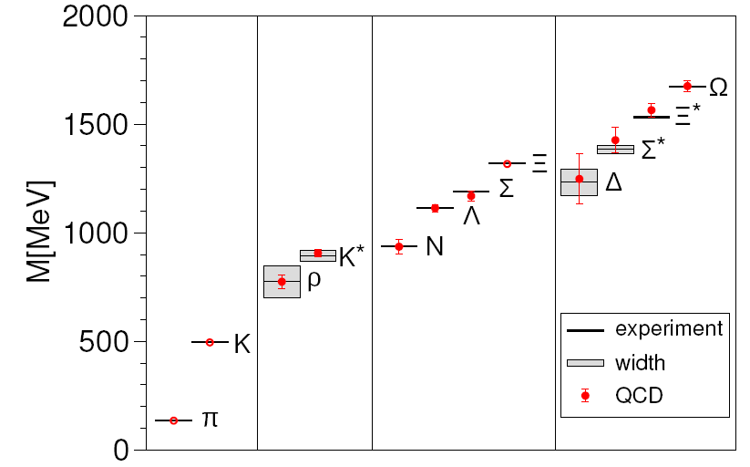
Low-lying Hadron Spectrum
Durr, Fodor, Lippert et al., BMW Collaboration
Science 2008
Control over:
Quark-mass dependence
Continuum extrapolation
finite-volume effects (pions, resonances)

Slide 9
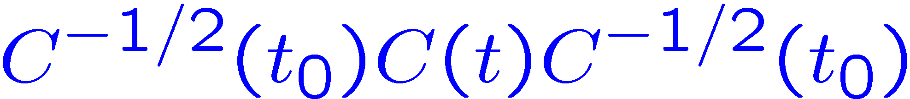
Variational Method
Extracting excited-state energies described in C. Michael, NPB 259, 58 (1985) and Luscher and Wolff, NPB 339, 222 (1990)
Can be viewed as exploiting the variational method
Given N £ N correlator matrix C_{αβ}(t) = h 0 j O_{α}(t) O_{β}(0) j 0 i, one defines the N principal correlators λ_{i}(t,t₀) as the eigenvalues of
Principal effective masses defined from correlators plateau to lowest-lying energies
Eigenvectors, with metric C(t₀), are orthonormal and project onto the respective states

Slide 10
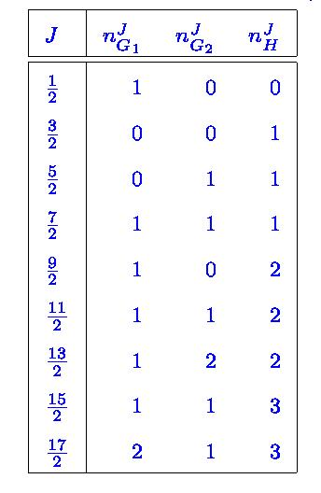
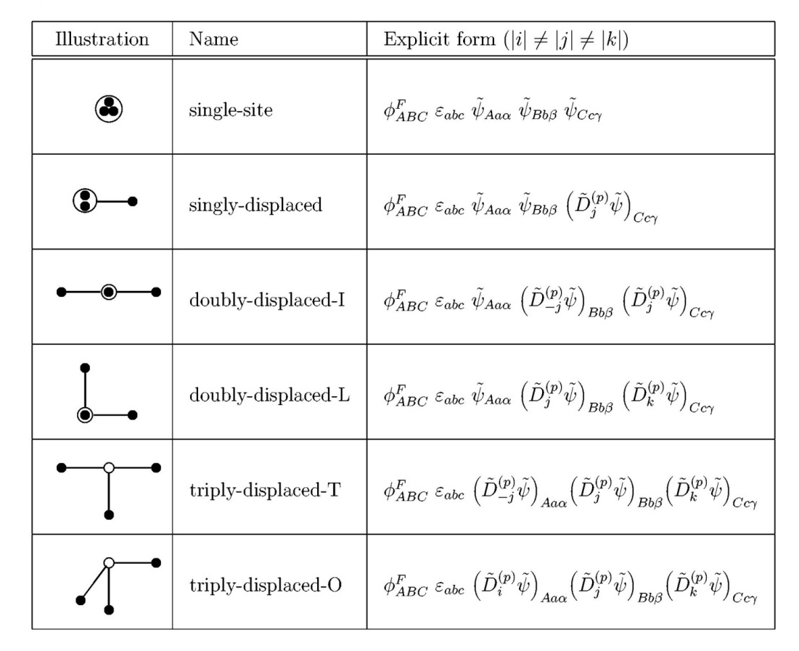
Variational Method - II
Spectrum on lattice looks different – states at rest classified by isospin, parity and representation under cubic group
M_{H}
M_{5/2}
M_{G2}
Spins: from degeneracies in continuum limit – or by using continuum behavior of operators
a

Slide 11
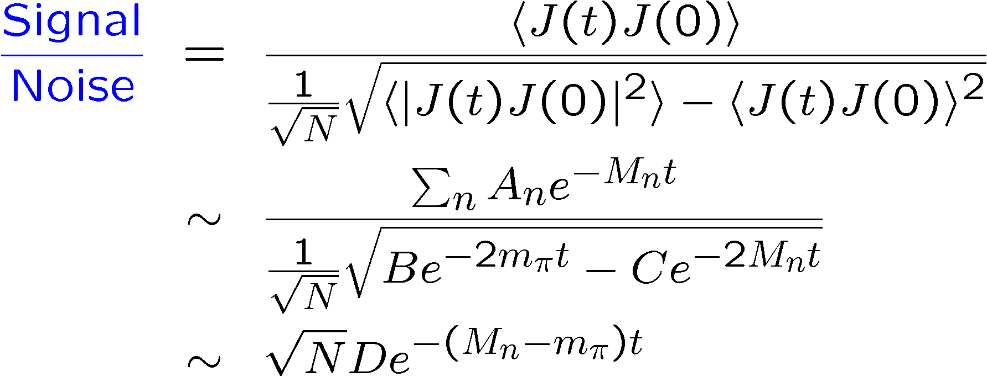
Challenge I – Statistics!
Vacuum contribution for scalar glueball
Anisotropic lattice a_{t} < a_{s}
Resolve correlator at small times; compare and contrast with heavy-quark physics
Pure Yang-Mills glueball spectrum
Morningstar and Peardon,
PRD60, 034509

Slide 12
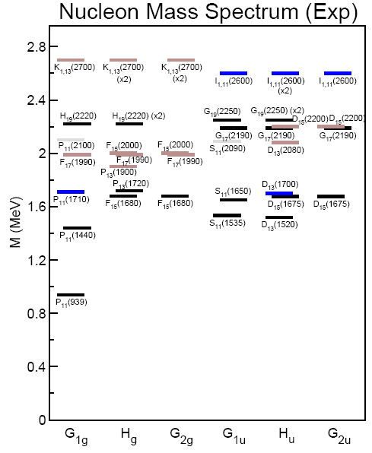
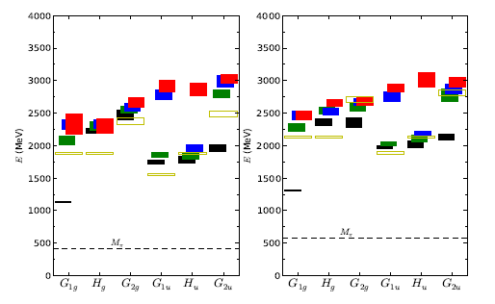


Lattice QCD and Baryon Spectrum
Hadron Spectrum Collaboration, arXiv:0901.0027
Lattices generated at ORNL
Emergence of pattern scene in experiment!

Slide 13
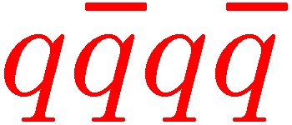
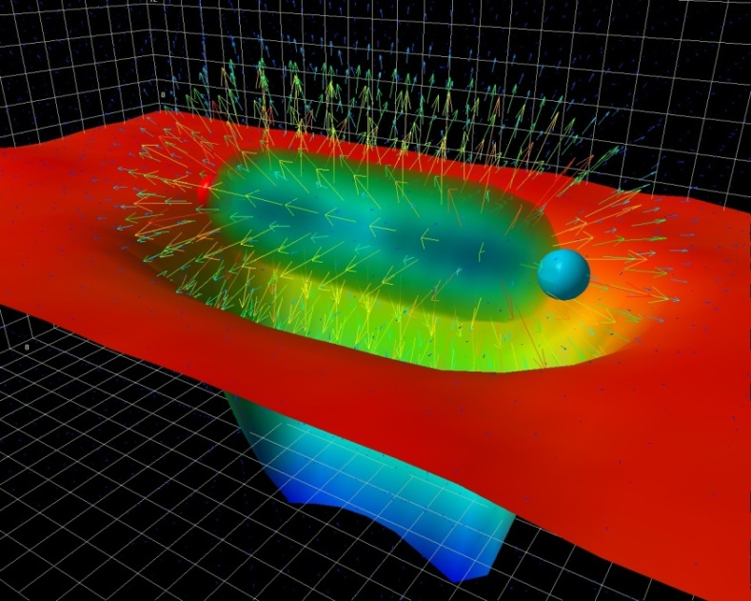
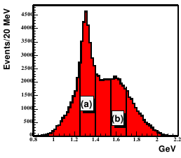
Exotics – I
Exotic Mesons are those whose values of J^{PC} are in accessible to quark model
Multi-quark states:
Hybrids with excitations of the flux-tube
Study of hybrids: revealing gluonic and flux-tube degrees of freedom of QCD.
Gluonic Hybrid?
p₁(1600)

Slide 14
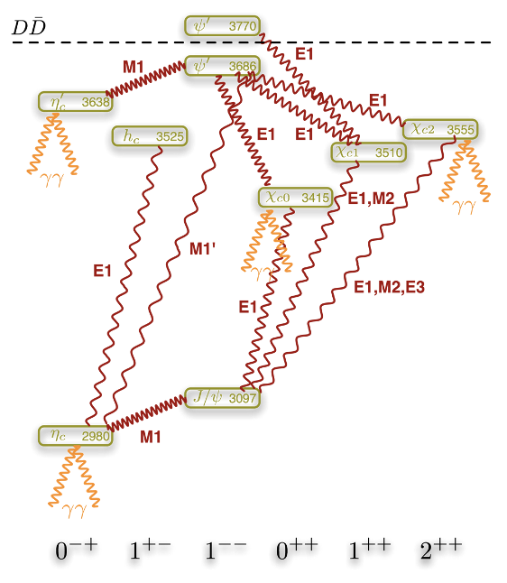
Charmonium
Wealth of new experimental results:
BaBar, Belle, CLEO
Below threshold

Slide 15
Charmonium Spectroscopy
Mesons comprised of heavier charm quarks important test bed.
Resolve higher states
Dudek, Edwards, Mathur, DGR,
PRD77, 034501 (2008)

Slide 16
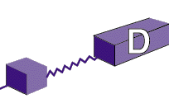

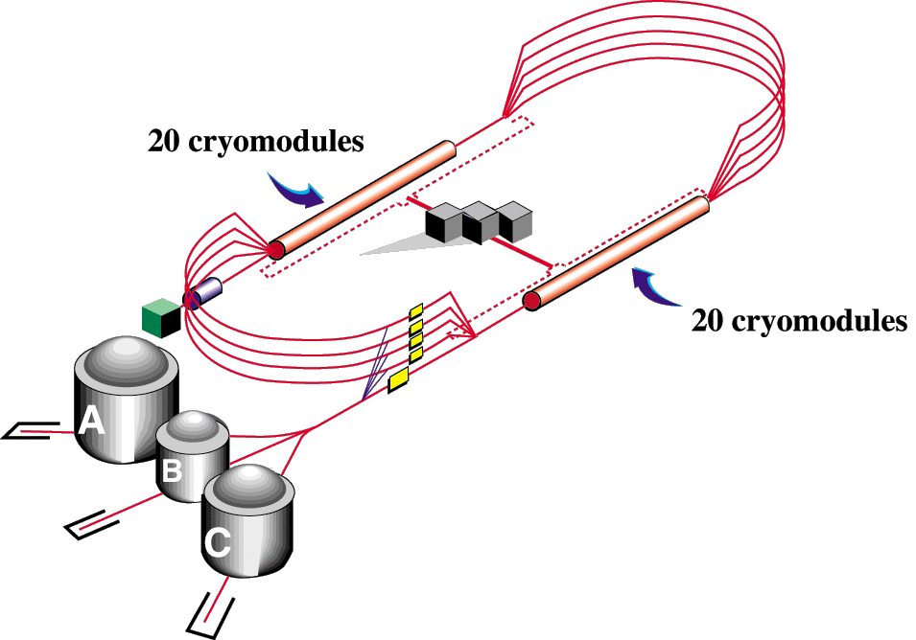
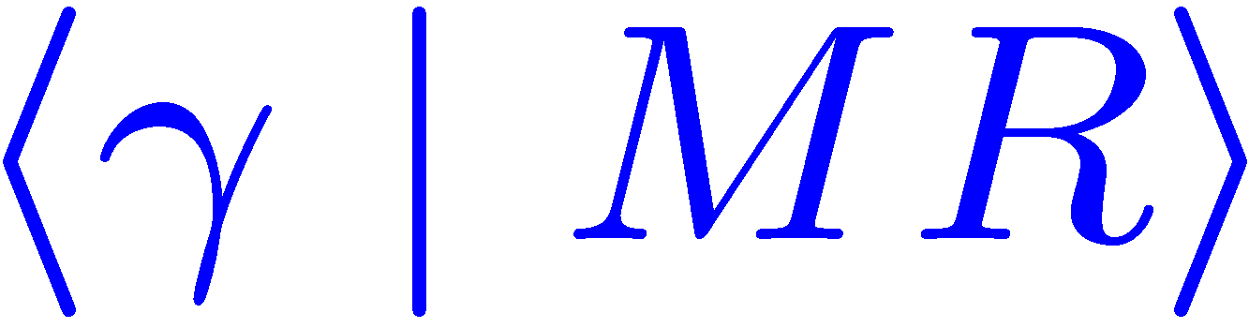
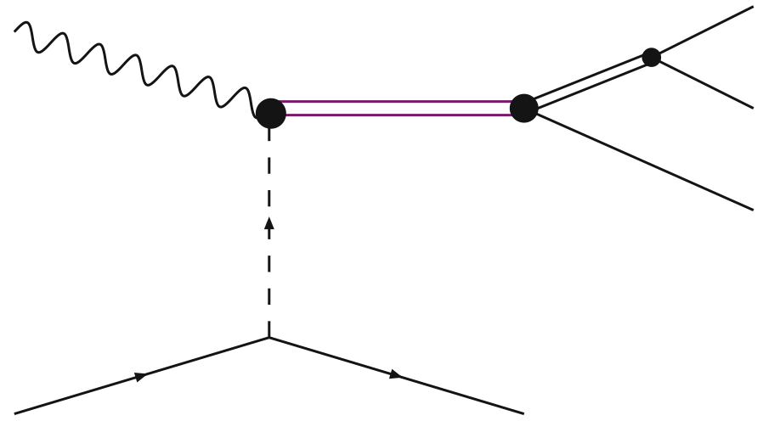
Lattice QCD: Hybrids and GlueX - I
GlueX aims to photoproduce hybrid mesons in Hall D.
Lattice QCD has a crucial role in both predicting the spectrum and in computing the production rates
R
M
Important goal for LQCD

Slide 17
Light Exotic Mesons
Summary of calculations of “lightest” 1⁻⁺
Calculations (and physics!) entering resonance regime: need full panoply of techniques discussed above
“Lattice says lightest hybrid 1.6-1-9 GeV” from this region
ORNL LATTICES

Slide 18
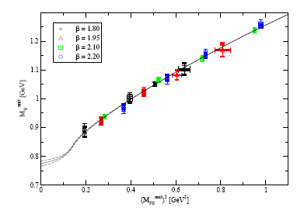
Challenge II – Chiral Extrapolations
Calculations performed at values of the quark masses corresponding to pion masses above 250 MeV
Chiral extrapolation to physical light-quark masses
Armor et al., J Phys G32, 971 (2006)
2 m_{π} threshold
Requires knowledge of g_{ρππ} coupling; known for excited states?

Slide 19
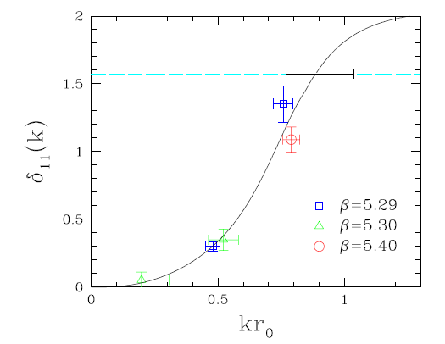

Challenge III – Unstable resonances
In QCD, even ρ is unstable under strong interactions
Spectral function continuous; finite volume yields discrete set of energy eigenvalues
Energy shift at finite volume to scattering phase shifts (Luscher)
G. Schierholz, Lattice 2008

Slide 20
How quarks and gluons form hadrons
Structure of Hadrons

Slide 21
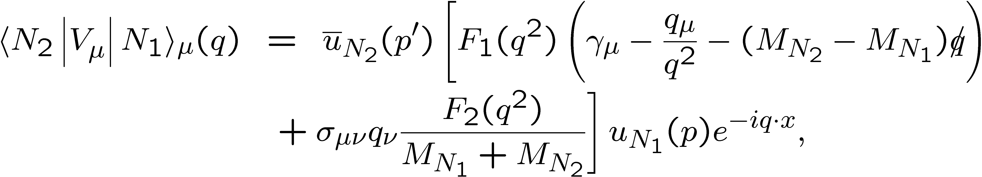
Anatomy of a Calculation - I
Lattice QCD computes the transition between isolated states
q
p’=p+q
γ
p
N₂
N₁

Slide 22
Anatomy of a Calculation - II
Complete set of states
At large t_{f} – t, and t, correlator is dominated by lowest lying state
Lattice calculations of electromagnetic properties of some lowest-lying states well established, eg:
EM form factors of nucleon and pion
Moments of GPDs in DVCS for nucleon
N-Delta transition Form Factor

Slide 23
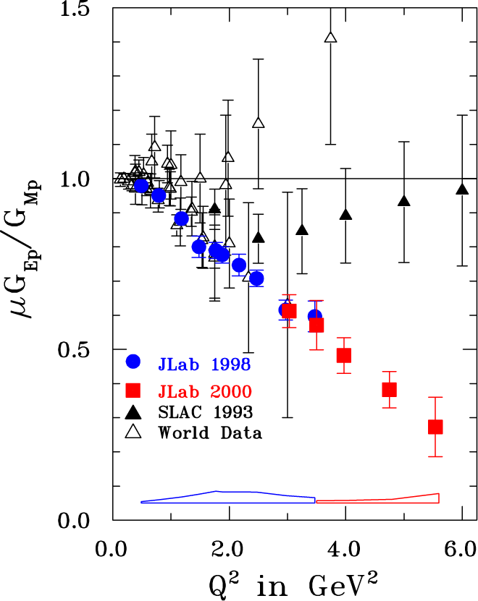
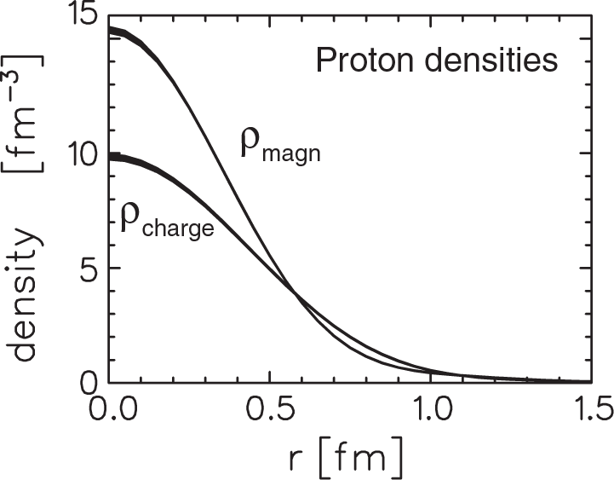
Electric and Magnetic Form Factor
Electric and Magnetic Form Factors encapsulate distribution of charge and current within a nucleon → fundamental measure of nucleon structure
Core of Jefferson Laboratory Experimental Program

Slide 24
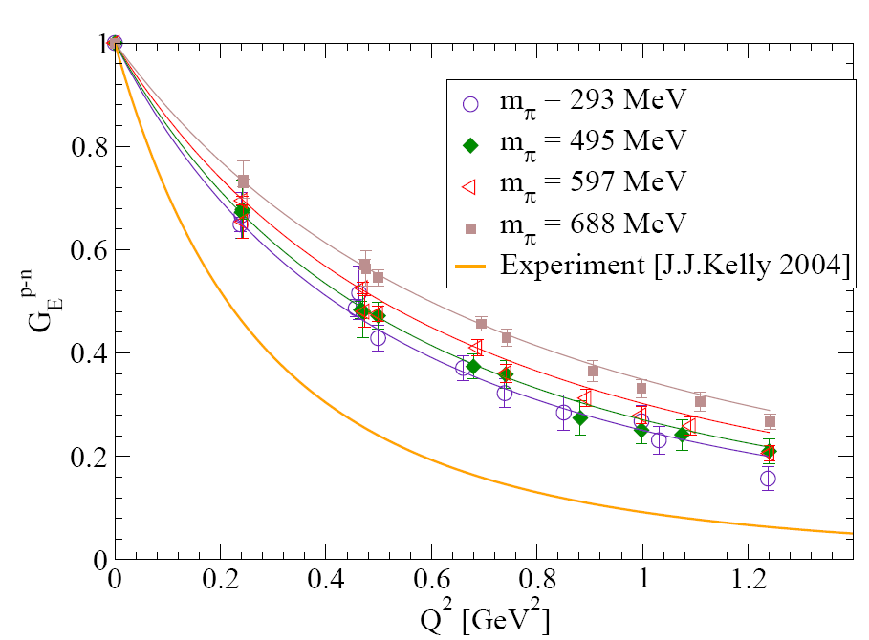
Isovector Form Factor
J.D.Bratt et al (LHPC),
arXiv:0810.1933
Euclidean lattice: form factors in space-like region
Extension to higher Q²

Slide 25
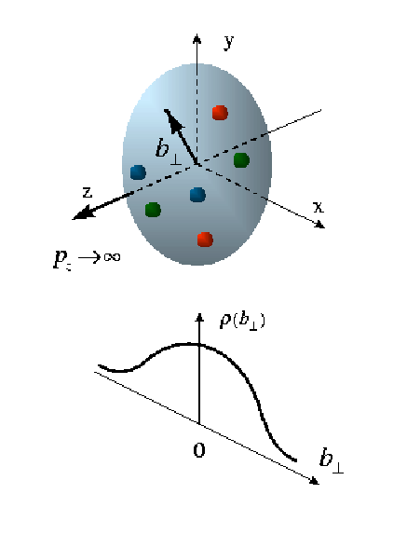
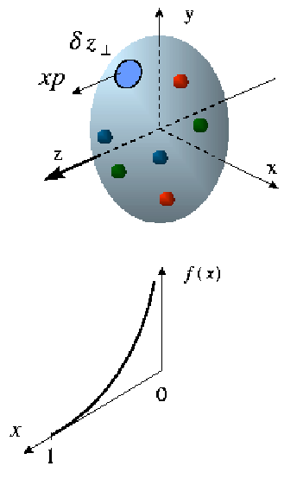
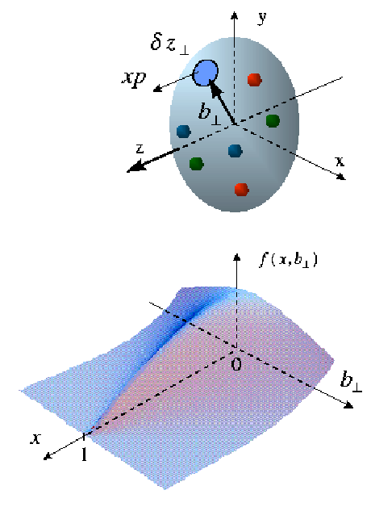
GPDs: Different Regimes in Different Experiments
Form Factors
transverse quark
distribution in
Coordinate space
GPDs
Fully-correlated
quark distribution in
both coordinate and
momentum space
Structure Functions
longitudinal
quark distribution
in momentum space

Slide 26
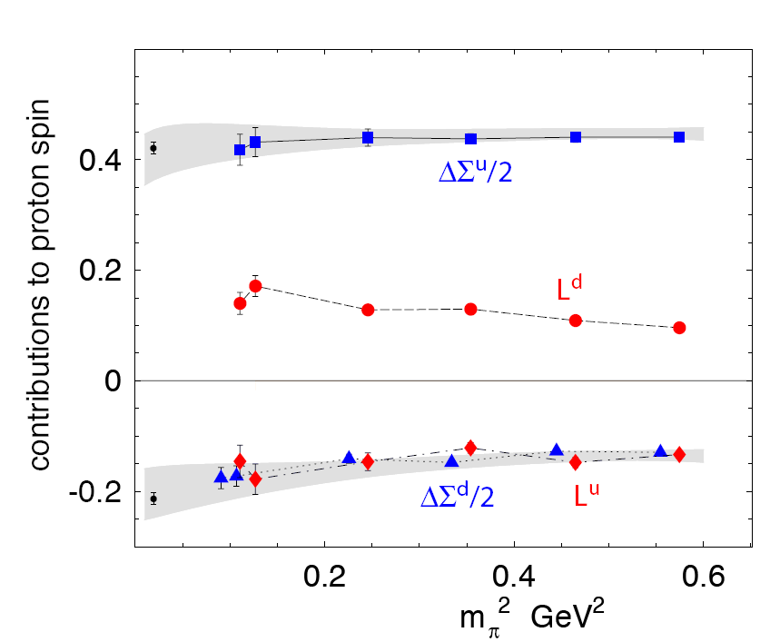
Origin of Nucleon Spin - I
How does the spin of the nucleon arise from quark spin, quark orbital angular momentum, and gluons?
Total Quark OAM negligible: that of individual flavors substantial.

Slide 27
Origin of Nucleon Spin - II
Jlab measurement of DVCS on Neutron
Hermes Measurement of DVCS on Proton
Quarks have negligible net angular momentum in nucleon
Inventory: 68% quark spin
0% quark orbital, 32% gluon

Slide 28
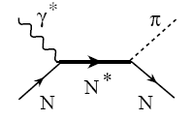
EM Transitions and Lattice QCD
Example: Single-pion photoproduction
Radiative transition amplitudes
Axial-vector Couplings?

Slide 29
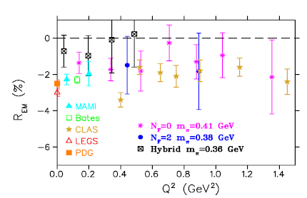
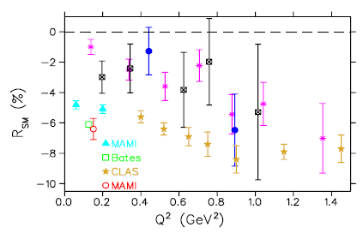
N-Δ Transition Form Factor
Transition between lowest lying I=3/2, J=3/2 (Δ), and I=1/2, J=1/2 (N)
R_{EM} → +1
Alexandrou et al, arXiv:0710.4621
Deformation in nucleon or delta

Slide 30
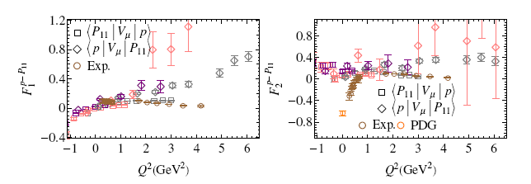
Nucleon-P11 Transition
H-W. Lin, S. Cohen, R. Edwards, D. Richards, Phys.Rev.D78:114508,2008
First measurement of nucleon-P11 transition form factor
Pion masses of 480, 720, 1100 MeV
CLAS

Slide 31
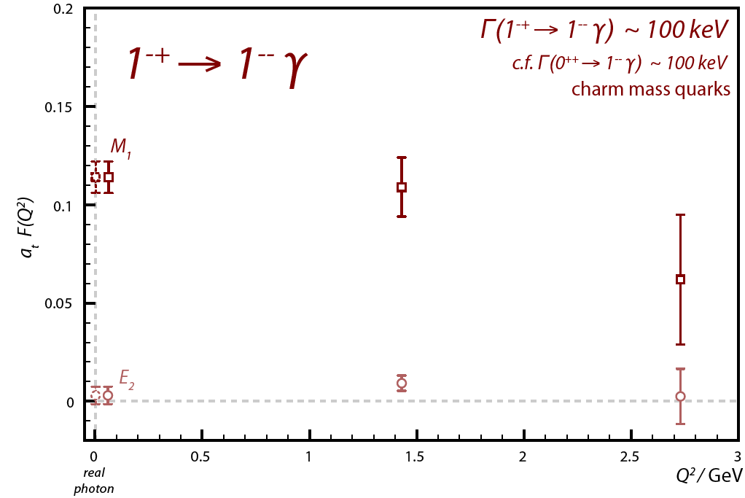
Radiative Transitions for Mesons
Baryon resonance spectrum on N_{f} = 2 Wilson Lattices: revealing pattern of states of continuum
Recall – GlueX aims to photoproduce exotic mesons
Charmonium theatre
Dudek, Edwards, Richards, PRD73, 074507
Exploration in charmonium → First lattice calculation of radiative transition between conventional and hybrid mesons
Radiative width of hybrid comparable to that of conventional meson
J. Dudek, R.Edwards, C.Thomas, arXiv:0902.2241

Slide 32
Anisotropic Clover - I
Anisotropic Lattices designed for investigations of resonances
Non-perturbative determination of parameters of three-flavor anisotropic-clover action completed.
R.G. Edwards, B. Joo, H-W Lin, Phys.Rev.D78:054501 (2008)
Prescription for setting of strange mass and lattice spacing

Slide 33
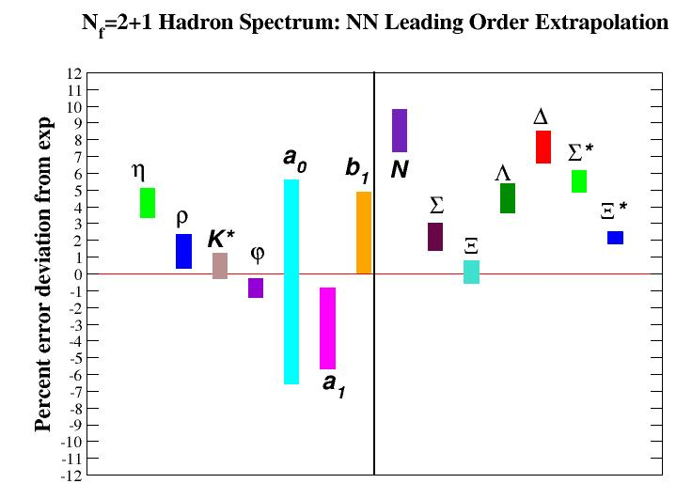
Anisotropic Clover - II
“Clover” Anisotropic lattices a_{t} < a_{s}: major new gauge generation program under INCITE at ORNL
Low-lying hadron spectrum for states comprised of u, d, s quarks to 5-10%
H-W Lin et al (Hadron Spectrum Collaboration), PRD79, 034502 (2009 )
Gauge configurations at pion masses down to 220 MeV
Spectrum
Hadronic Interactions (NPLQCD)

Slide 34
Summary
Tools developed and demonstrated for hadron spectroscopy
Baryon resonance spectrum in quenched QCD
Spectroscopy and radiative transitions in charmonium
Lattices with 3 flavours of sea quarks: INCITE AT ORNL
Lattice QCD calculations essential to our understanding of hadronic structure
Distribution of charge of current
Orbital angular momentum
Transverse narrowing with increasing x
Recent “exascale” workshop – four priority areas
Spectrum of QCD
How does QCD make a Proton?
From QCD to Nuclei
Fundamental Symmetries

Slide 35

The road to exascale for Spectroscopy
Spectrum and properties of mesons, in particular with exotic quantum number
N-N* transition form factors
N* Spectrum
GlueX
Photocouplings in charmonium
Cascade Spectrum
Spectrum and photoproduction of isovector mesons
Meson and baryon spectrum with m_{π} ~180 MeV
Precise computations of ground-states
10x tera
100x tera
peta
10x peta
100x peta
exa

Slide 36
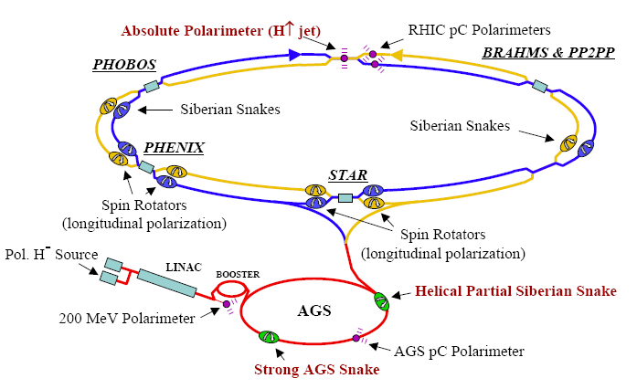
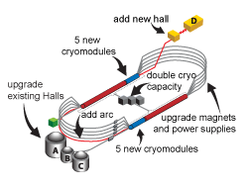
The road to exascale for Hadron Structure
Contribution of gluons to the nucleon mass and spin; low moments of the gluon distributions g(x) and Δg(x).
EIC
Flavor-separated contn. to FF, moments of PDFs and GPDs
Precision calculations of the flavor-non-singlet form factors, moments of PDF, and moments of GPDs
10x tera
100x tera
peta
10x peta
100x peta
exa

Slide 37
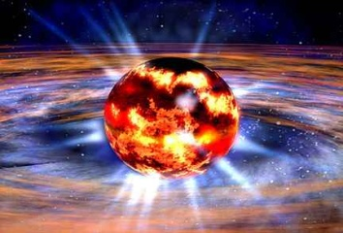
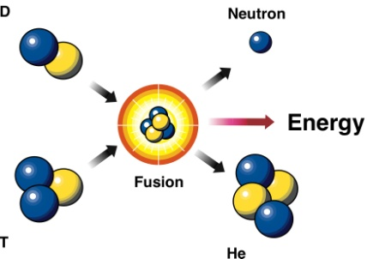
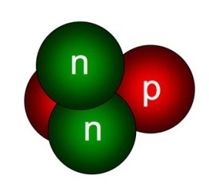
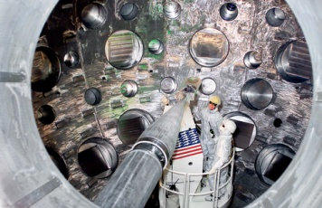
The road to exascale for nuclear forces
NNN interaction from LQCD
K
Deuteron axial-charge
Alpha particle
N
Baryon-baryon interactions
EFTs and LQCD
10x peta
100x peta
-flop year sustained
10x tera
100x tera
peta
exa

Slide 38
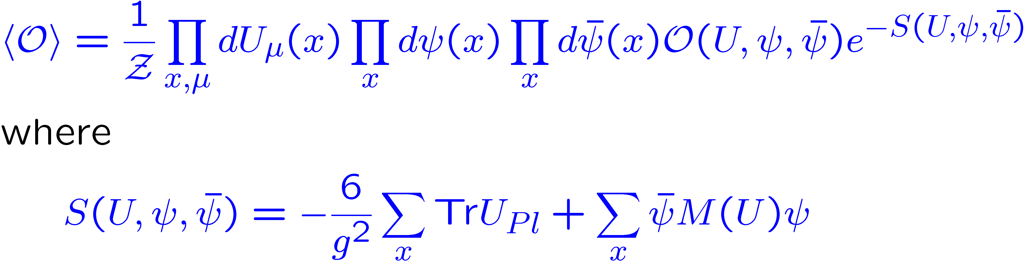
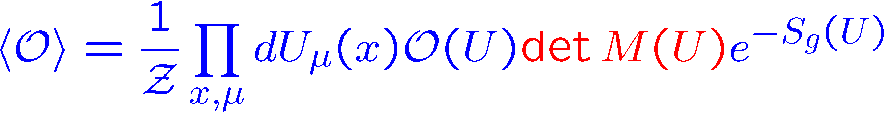
Lattice QCD - I
Lattice QCD enables us to undertake ab initio computations of many of the low-energy properties of QCD
Continuum Euclidean space time replaced by four-dimensional lattice – current typical sizes 24³ £ 12
Importance Sampling
ψ, ψ are Grassmann Variables

Slide 39
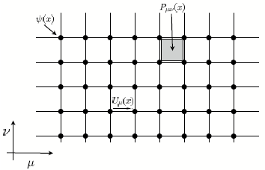
A Two-Dimensional Lattice
Highly regular problem, with simple boundary conditions – very efficient use of massively parallel computers using data-parallel programming.

Slide 40
Why are we here?
Describe how the fundamental building blocks of the nucleus, the protons and neutrons, are built from the primordial quarks and gluons - the fundamental fields of Quantum Chromodynamics (QCD).
What are the effective degrees of freedom of QCD?
Explain how the force that binds nucleons into nuclei arises from QCD
Search for evidence of physics beyond the “Standard Model” of particle physics – complementary to the high-energy experiments at, say, the LHC
We do this by Experiment, Theory, and Computation, and by the confrontation of the three

