Slide 1

Measurements of F₂ and R=σ_{L}/σ_{T} on Deuteron and Nuclei in the Nucleon Resonance Region
Jlab E02-109/E04-001 (Jan05)
Ya Li
January 31, 2009

Slide 2
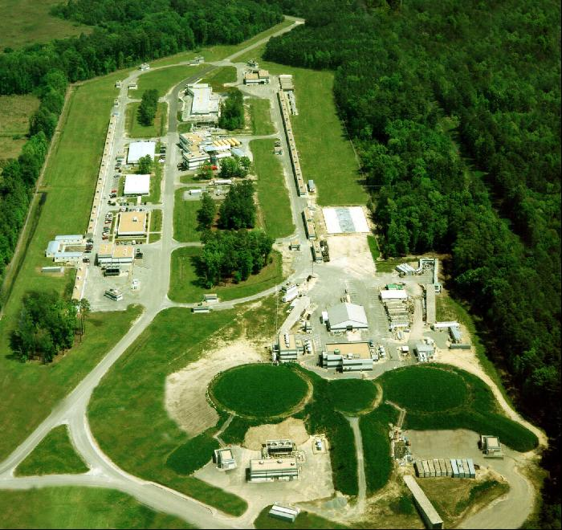
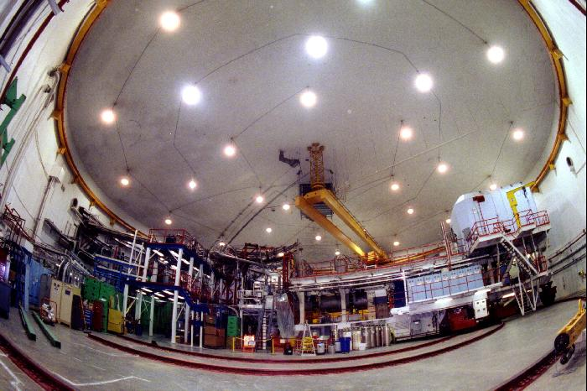
Outline
Physics Motivation
Experiment Brief
Analysis Update
Problems and Solutions
Summary

Slide 3
Physics Motivation
F_{L}, F₁, F₂ Fundamental Structure Function Measurements on Deuteron and Nuclei
• Structure Function Moments
– Lattice QCD comparisons
– Singlet and non-singlet distribution functions from deuteron and proton
• Support Broad Range of Deuteron Physics
– Elastic form factors
– BONUS neutron structure functions
– Input to extract spin structure functions from asymmetry measurements.
Quark-hadron duality studies
In QE region (W²~mp²), obtain information on Coulomb Sum Rule
Search for Nuclear Pions on heavy nuclei
Important input for neutrino physics

Slide 4
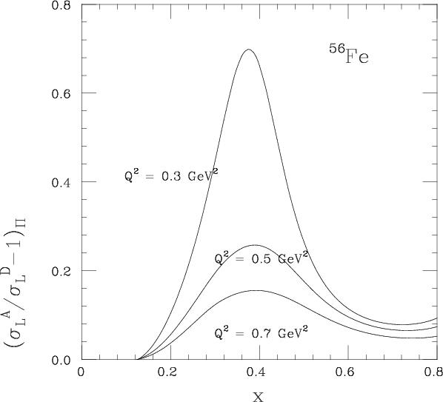
Nuclear Pions on heavy nuclei?
The model for the pionic components of nuclear wave function from light front dynamical calculations of binding energies and densities.
The pion effects are large enough to predict substantial nuclear enhancement of the cross section for longitudinally polarized virtual photons for the kinematics accessible at Jlab.
I I I I I I
G. Miller, Phys.Rev.C64:022201,2001.

Slide 5
Motivation from Neutrino Experiments
Neutrino Oscillations ∆m² ~ E / L, requires E in few GeV range (same as JLab!)
Existing neutrino data set is poor
Input for neutrino cross section models, needed for oscillation experiments around the world
Jlab measurements can provide input on vector couplings for MC model
Resonance region is a major contribution!
(A. Bodek, NUANCE model used)

Slide 6
Experiment Description
JLab, HallC, ~2 weeks in January 2005
E02-109: Meas. of F₂ and R on Deuterium.
E04-001: Meas. of F₂ and R on Carbon, Iron, and Aluminum.
Beam Energies used were: 4.6, 3.5, 2.3, and 1.2 GeV.
Cover 0.05 < Q² < 2 (GeV)² and 0.5 <W² < 4.25 (GeV)².

Slide 7
Kinematic Coverage
Rosenbluth Separation Data
Targets: D, C, Al, Fe , and some H
Final Uncertainties estimated at ~1.6 % pt-pt in e (2% normalization).
Low Q² data for ν modeling
Targets: H,D, C, Al
Final Uncertainties estimated at ~3 - 8% (Much larger RCs and rates)
Rosenbluth separations at multi. energies

Slide 8
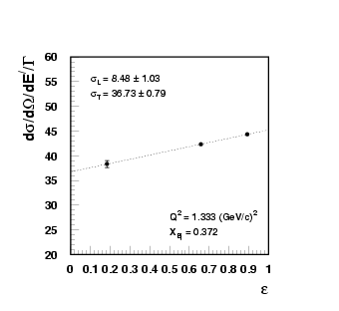
Inclusive e + A -> e + X Scattering
One-Photon-exchange Approximation
At ε =1, ∝ F₂
At ε =0, ∝ F₁
Diff. ∝ F_{L} {
Transverse
longitudinal
mIxEd
Notes:
Try to put formula in one slide

Slide 9
Analysis Status
Detector Calibration completed
Calorimeter Eff. completed
Cerenkov Eff. completed
Tracking Eff. completed
Trigger Eff. problem
Computer Dead Time completed
Acceptance Corrections completed
Beam Position Stability Study completed
Beam Position Offsets completed
Target Position Offsets completed
Optics Checks Preliminary Sieve Slit
Charge Symmetric Background completed
Radiative Corrections iterating
Cross Sections iterating

Slide 10
Analysis Updates
Finalized Charge Symmetric Background
Finalized (Momentum dependent) Cerenkov efficiency correction
Iterated Electron Cross Sections
Preliminary ε dependent A/D Cross Section Ratios

Slide 11
Charge Symmetric Backgrounds
Subtract off Charge Symmetric electrons by subtracting off positron Cross-Sections.
Parameterized e+ CS
Polynomial Fit across Theta
Notes:
Put a plot before and after CSB subtraction

Slide 12
Cerenkov Efficiency Correction
Check Cerenkov for Momentum Dependent Efficiency
Identify Electron with Calorimeter (hsstrk > 0.7)
Cerenkov cut (npe >2) efficiency is position dependent
-> ∆p/p dependence
Weighted average over all the runs
Cerenkov
C₄F₁₀ , 0.6 Atm
Mirrors
Gap between the mirrors

Slide 13
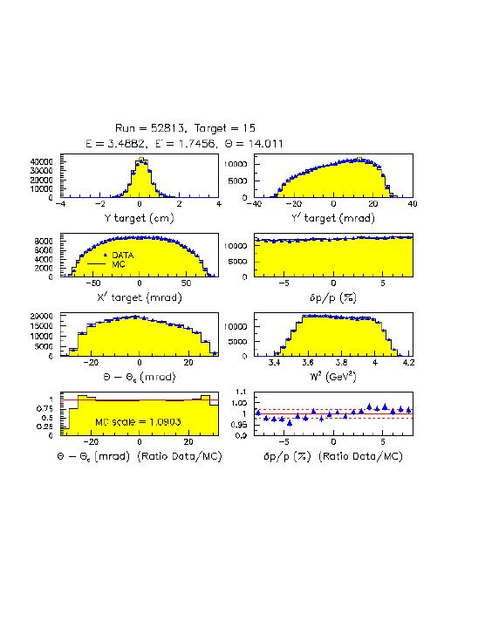
Monte Carlo Ratio Method
Generate MC events with σ model weighting (radiative contributions included).
(2) Scale the MC yield by L_{Data}/L_{MC}, where L_{MC} is that needed to produce N_{gen} for the given σ_{mod} and phase space generated into.
(3) Add background contributions to MC
(4) dσ (δ, θ) = dσ_{mod} (δ, θ) * Y_{data}/Y_{MC}
Where Y is the yield for events with any value of θ, i.e. this integrates over θ

Slide 14
Electron Cross Sections
Christy (proton) /Bosted (nuclear) Model
Currently in iterating process
Small Correction to Cross Sections in next iterations
Preliminary
M.E. Christy, P. Bosted, arXiv:0712.3731 [hep-ph]
P. Bosted, M.E. Christy, Phys.Rev.C77:065206,2008.

Slide 15
Electron Cross Sections
Over all, the model has good agreement with data.
Some discrepancies mainly at Quasi-Elastic peak for heavy nuclei.
Preliminary

Slide 16
cross section ratio σ^{A}/σ^{D}
ε_{Δ}=0.9011
ε_{p}=0.9164
ε_{Δ}=0.8171
Preliminary
ε_{p}=0.8437
ε_{Δ}=0.5171
ε_{p}=0.5629
16

Slide 17
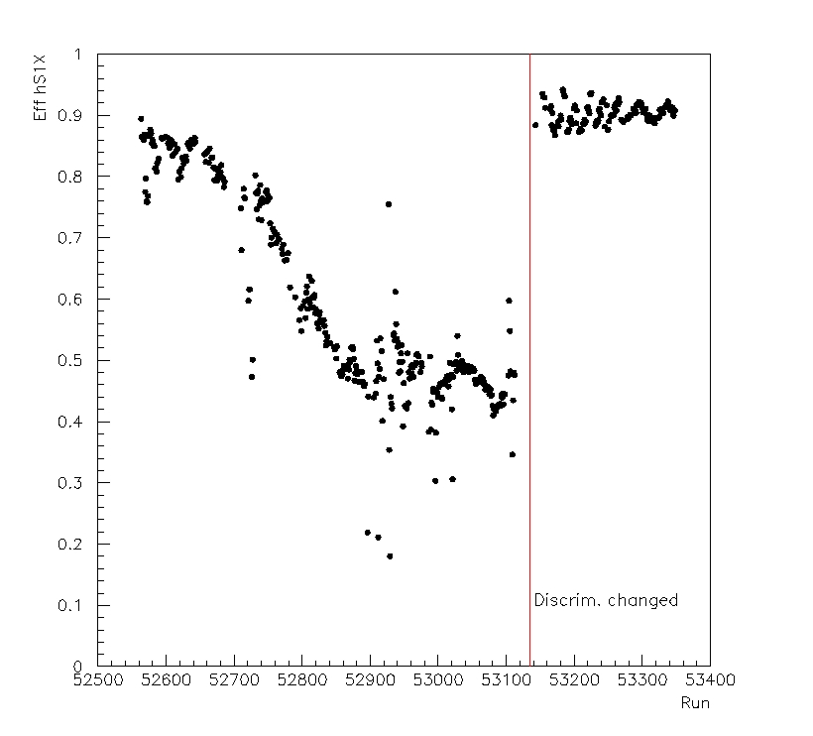
Faulty Discriminator
Sx1 hodoscopes faulty discriminator caused low efficiency in some channels
Solution: Implementing Position dependent trigger efficiency (∆p/p)

Slide 18
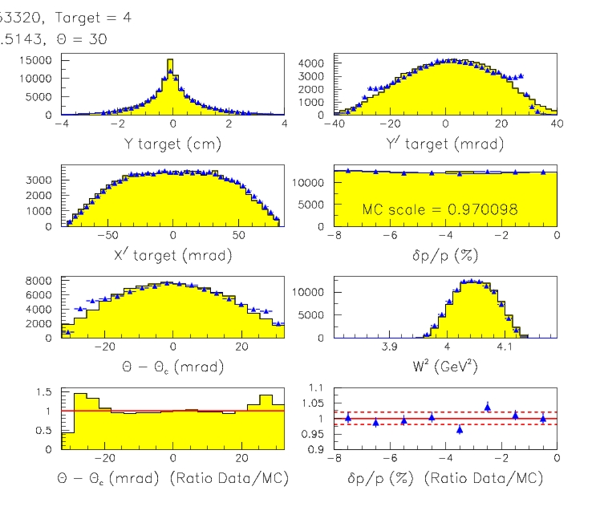
Reconstruction Problem at Low E/
Large additional multiple scattering at low E/ (E/<1GeV) caused by thick HMS exit window ( 20mil Titanium!)
The fitted reconstruction MEs are not well behaved at the edge of the FP distribution. (COSY MEs in MC are.)
Only 6-8% of the events effected in the worst case
Solution: Apply different MEs for the data depending on the region of the FP which the event occupies.
18

Slide 19
Summary
Jan05 experiment measure F₂ and R on Deuteron and nuclei in the nucleon resonance region
Most detector calibration and corrections are finalized.
Electron Cross Sections be iterated with new model
Preliminary Cross Section Ratio σ^{D}/σ^{A}
Working on trigger efficiency and low E/ reconstruction problems.
Future Plan
Finalize Cross Sections
Rosenbluth Separations (F₁, F₂, F_{L})
Nuclear Dependence research

