Slide 1
Harvard CGCC
Thanks to the members of our team including
John Zhang
Alexei Protopopov
Tae-min Kim
Richard Park
Sandy Aronson
Narayanan Sathiamoorthy
Raju Kucherlapati
Lynda Chin
Peter Park
Jon Seidman

Slide 2
Ovarian Samples Update
Completed Batches 9 and 11
75 tumor/normal pairs received
73 pairs profiled; 2 pairs failed, awaiting repeat
Level I-III data uploaded to DCC
Level IV analysis:
Define MCR across samples using a heuristic approach
1458 MCRs (717 gains and 741 losses) defined as regions of interest (ROI)
Prioritize 298 MCRs (172 gains and 126 losses)
Recurrence of 5% or more
Amplitude >= 1.5 or <= -1.5 (peak log 2 ratio)
Not CNPs or non-coding regions
Calculate GISTIC and GTS scores for ROIs
70% of the ROI have high GISTIC and GTS scores
Contains known cancer genes
CCND1, CCND2, HOXD11, HOXD13, PBX1, PTEN, RB1, etc)
Deletion of RB1 is most prominent
Identified by all 3 algorithms as focal event
Integrated with Level III expression data from Broad
Samples with RB1 deletion had significantly lower expression (p < 0.005)
Copy Number
Expression
WT
Del/Loss

Slide 3
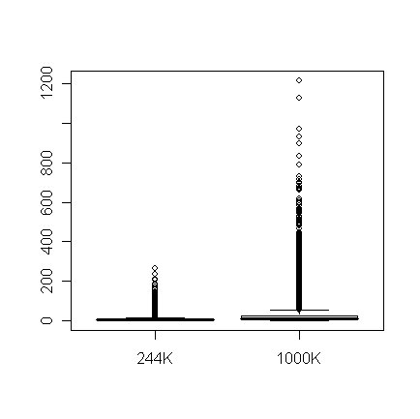
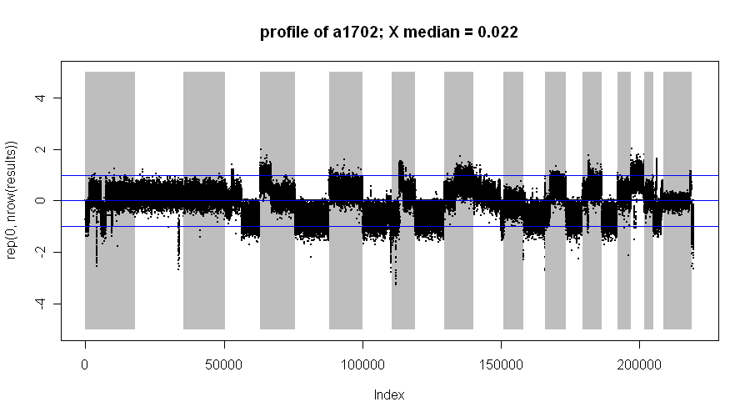
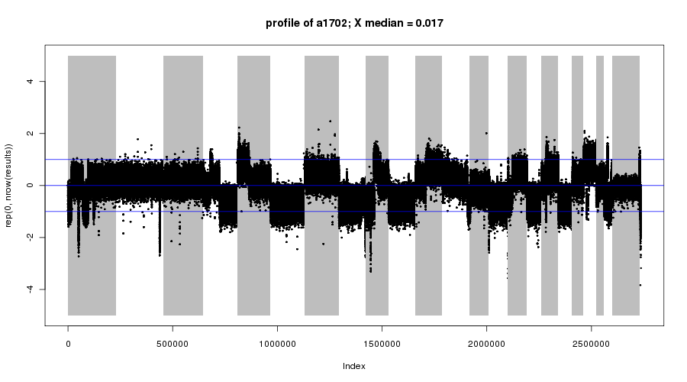
Evaluation of 1M density array
Coverage
2582 more genes covered than 244K array (n=18613)
Increased median # probes/gene from 3 (244K) to 8 (1M)
Large gaps between probes remain similar
Profiles
1M array produces similar results as 244K but with some increase in resolution
However, not ALL 600K new probes contribute to increase in resolution
1M array also tends to be noisier due to suboptimal probes
Plan: Fill in the gap by adding optimal 160K probes to generate custom 400K array
Can provide similar resolution as 1M array
Fewer suboptimal probes
Reduce costs by almost half
Reduce 50% amount of DNA input
Design in progress
 | In 244K | Not in 244K
# Probes on array | 219,843 | 694,488
# Genes covered | 18613 | 2582
Probes per gene
244K
1000K

Slide 4
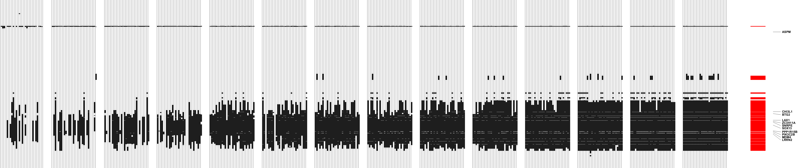
How many samples do we need?
We now have GBM data from ~300 patients
How much would our copy number results be different if we had done a smaller set?
Perform simulation to see how much of “true” regions (defined by the full data) we recover if we had a smaller set of samples.
10 30 50 70 90 110 130 150 170 190 210 230 250 270
Sample size
full data
Each vertical line is one random sample of given size

Slide 5
How many observed aberrations are “true”?
Harvard Agilent data, using q-value thresholds (GISTIC)
How many “true”
aberrations are recovered?
For example, with 100 samples, we recover ~82% of the aberrations obtained by the full data set. But 6%, 11%, 25% of the large (>.5Mb), medium, and small (<20kb) aberrations we identify are false positives

Slide 6
Cross-Platform Copy Number Paper
How do we derive a single copy number for biologists and clinicians who use the TCGA data?
One issue: SNP platforms are noisier but have higher coverage. Some regions can be called more reliably than others; one solution is to estimate error bars at each location
Main problem: only ~150 common samples can be found from data archives for the four platforms

Slide 7
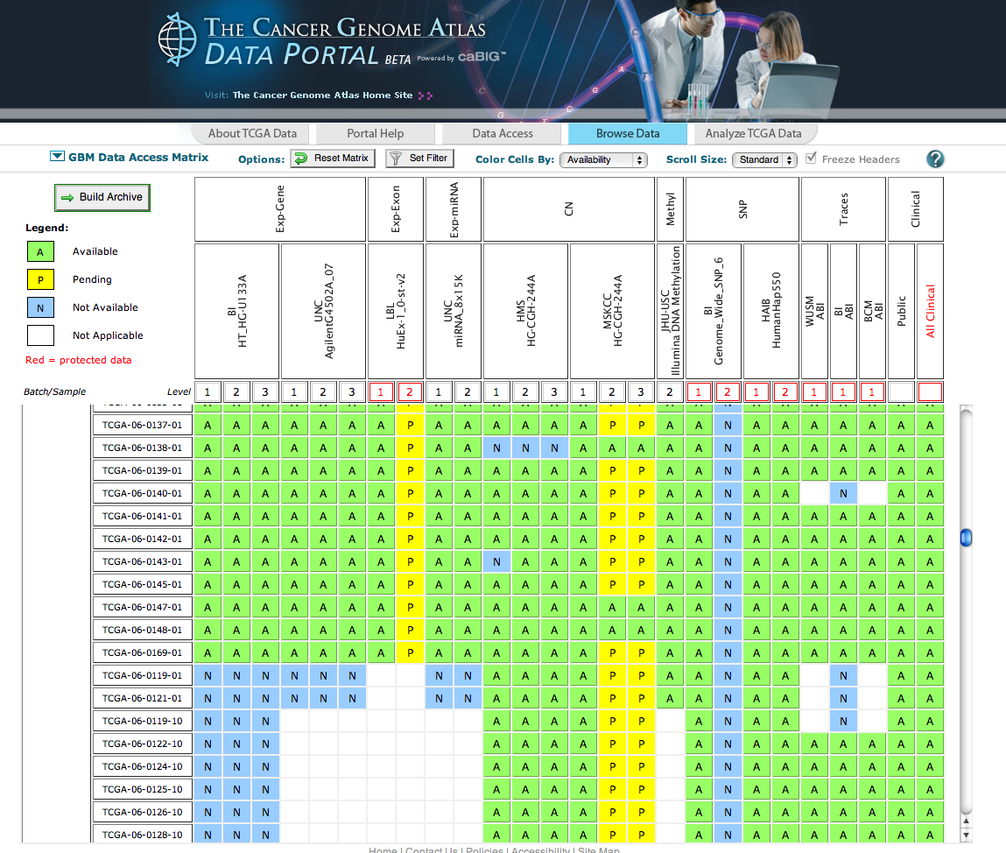
The following centers reported back: UNC, USC, Harvard, MSKCC, WashU
No information from Broad, LBL, HudsonApha, Baylor

