Slide 1

Computational analysis of advanced control methods applied to RWM control in tokamaks
Oksana N. Katsuro-Hopkins
Columbia University, New York, NY, USA
with S.A. Sabbagh, J.M. Bialek
US-Japan Workshop on MHD Control,
Magnetic Islands and Rotation
November 23-25, 2008 University of Texas, Austin, Texas, USA

Slide 2
Control theory terminology used in this talk
Advanced controller

Slide 3
Control theory terminology used in this talk
Advanced controller
State-space based controller

Slide 4
Control theory terminology used in this talk
Advanced controller
State-space based controller
Linear Quadratic Gaussian Controller (LQG)

Slide 5
Control theory terminology used in this talk
Advanced controller
State-space based controller
Optimal Controller
Linear Quadratic Gaussian Controller (LQG)
Optimal Observer

Slide 6
Control theory terminology used in this talk
Advanced controller
State-space based controller
Optimal Controller
Linear Quadratic Gaussian Controller (LQG)
Optimal Observer
Kalman Filter

Slide 7
LQG controller is capable to enhance resistive wall mode control system
Motivation
To improve RWM feedback control in NSTX with present external RWM coils
Outline
Advantages of the LQG controller
VALEN state space modeling with mode rotation and control theory basics used in the design of LQG
Application of the advanced controller techniques to NSTX

Slide 8
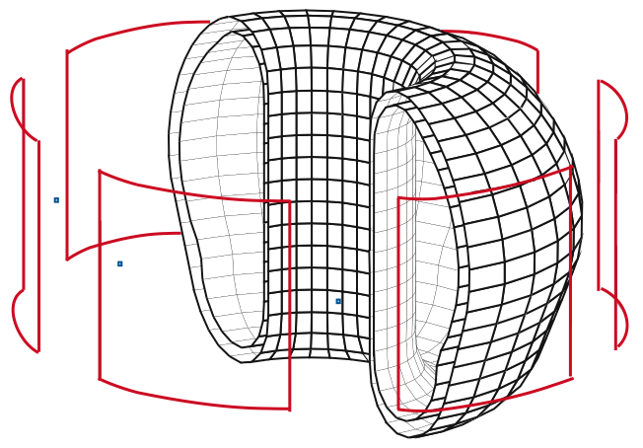
Limiting β_{n} RWM in ITER can be improved with LQG controller* and external field correction coils
Simplified ITER model includes
double walled vacuum vessel
3 external control coil pairs
6 magnetic field flux sensors on the midplane (z=0)
*Nucl. Fusion 47 (2007) 1157-1165

Slide 9
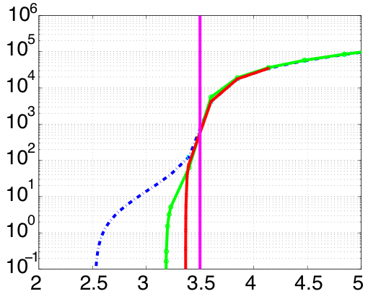
Limiting β_{n} RWM in ITER can be improved with LQG controller* and external field correction coils
Ideal Wall
Growth rate γ, 1/sec
Passive
LQG C_{β} = 86%
PD C_{β} = 68%
Simplified ITER model includes
double walled vacuum vessel
3 external control coil pairs
6 magnetic field flux sensors on the midplane (z=0)
10 Gauss sensor noise RWM
LQG is robust for all C_{β} < 86% with respect to β_{N}
β_{N}
*Nucl. Fusion 47 (2007) 1157-1165

Slide 10
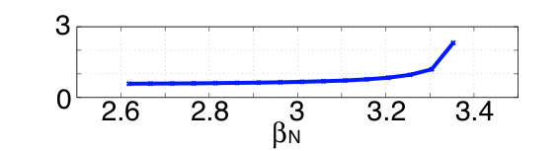
Limiting β_{n} RWM in ITER can be improved with LQG controller* and external field correction coils
Ideal Wall
Growth rate γ, 1/sec
Passive
LQG C_{β} = 86%
PD C_{β} = 68%
Simplified ITER model includes
double walled vacuum vessel
3 external control coil pairs
6 magnetic field flux sensors on the midplane (z=0)
10 Gauss sensor noise RWM
LQG is robust for all C_{β} < 86% with respect to β_{N}
β_{N}
RMS, Control Coil Power
MWatts
*Nucl. Fusion 47 (2007) 1157-1165

Slide 11
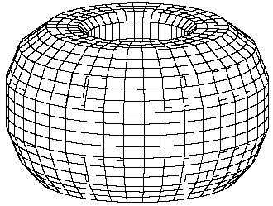
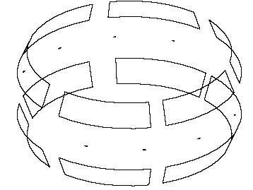
DIII-D LQG is robust with respect to β_{N} and stabilizes RWM up to ideal wall limit
DIII-D with internal control coils

Slide 12
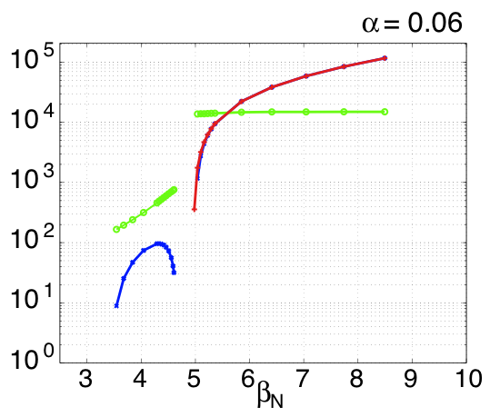
DIII-D LQG is robust with respect to β_{N} and stabilizes RWM up to ideal wall limit
Ideal Wall
LQG γ, 1/s
Passive ω, rad/s
Passive γ, 1/s
LQG is robust with respect to β_{N} and stabilize RWM up to ideal wall limit for 0.01 < torque < 0.08
DIII-D with internal control coils

Slide 13
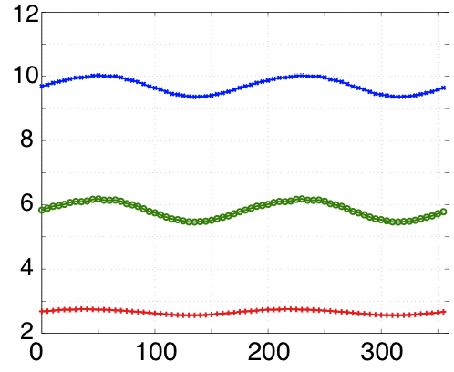
DIII-D LQG is robust with respect to β_{N} and stabilizes RWM up to ideal wall limit
Ideal Wall
RMS Control coils Voltage, V
PID controller
PID controller & Kalman Filter
LQG γ, 1/s
Passive ω, rad/s
LQG controller
Passive γ, 1/s
Mode phase, degrees
LQG is robust with respect to β_{N} and stabilize RWM up to ideal wall limit for 0.01 < torque < 0.08
LQG provides better reduction of current and voltages compared with proportional gain controller
DIII-D with internal control coils

Slide 14
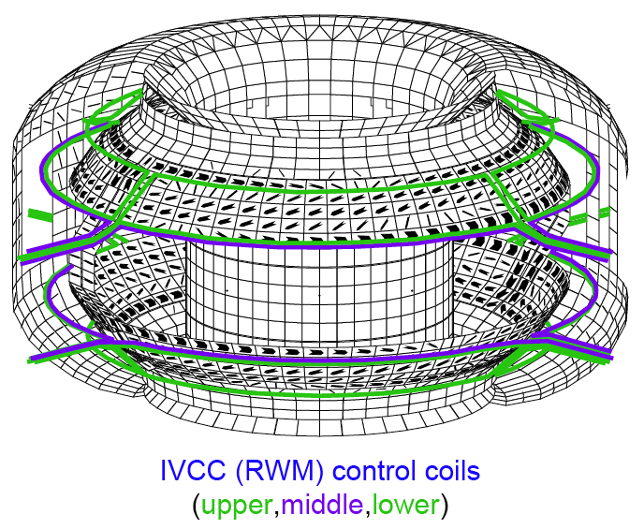
Initial results using advanced Linear Quadratic Gaussian (LQG) controller in KSTAR yield factor of 2 power reduction for white noise*
n=1 RWM passive stabilization currents
Conducting hardware, IVCC set up in VALEN-3D* based on engineering drawings
Conducting structures modeled
Vacuum vessel with actual port structures
Center stack back-plates
Inner and outer divertor back-plates
Passive stabilizer (PS)
PS Current bridge
* IAEA FEC 2008 TH/P9-1 O. Katsuro-Hopkins

Slide 15
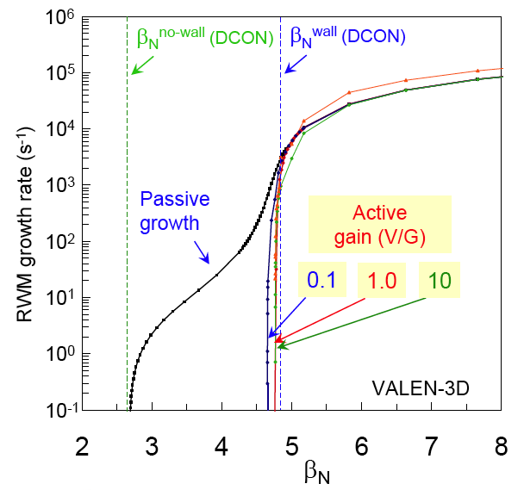
Initial results using advanced Linear Quadratic Gaussian (LQG) controller in KSTAR yield factor of 2 power reduction for white noise*
n=1 RWM passive stabilization currents
10⁶
10⁵
10⁴
10³
10²
10¹
10⁰
10⁻¹
RWM growth rate, 1/s
no wall with wall
Conducting hardware, IVCC set up in VALEN-3D* based on engineering drawings
Conducting structures modeled
Vacuum vessel with actual port structures
Center stack back-plates
Inner and outer divertor back-plates
Passive stabilizer (PS)
PS Current bridge
IVCC allows active n=1 RWM stabilization near ideal wall β_{n} limit, for proportional gain and LQG controllers
3 4 5 6 7 8
β_{N}
* IAEA FEC 2008 TH/P9-1 O. Katsuro-Hopkins

Slide 16
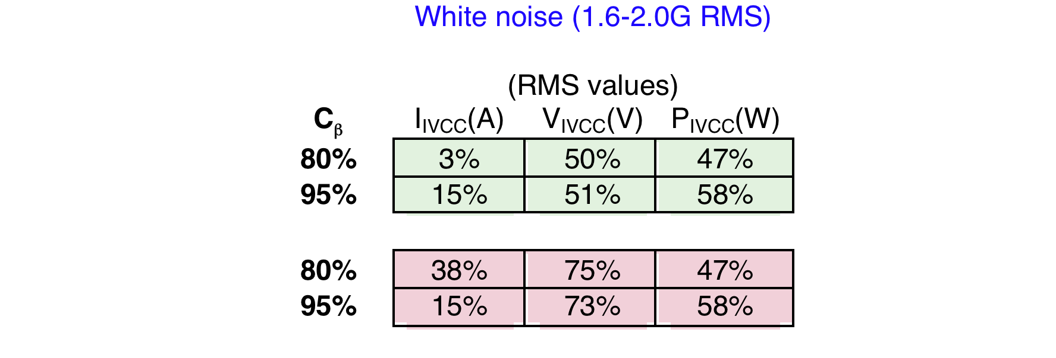
Initial results using advanced Linear Quadratic Gaussian (LQG) controller in KSTAR yield factor of 2 power reduction for white noise*
n=1 RWM passive stabilization currents
White noise (1.6-2.0G RMS)
Unloaded IVCC
L/R=12.8ms
FAST IVCC circuit
L/R=1.0ms
10⁶
10⁵
10⁴
10³
10²
10¹
10⁰
10⁻¹
RWM growth rate, 1/s
no wall with wall
Conducting hardware, IVCC set up in VALEN-3D* based on engineering drawings
Conducting structures modeled
Vacuum vessel with actual port structures
Center stack back-plates
Inner and outer divertor back-plates
Passive stabilizer (PS)
PS Current bridge
IVCC allows active n=1 RWM stabilization near ideal wall β_{n} limit, for proportional gain and LQG controllers
3 4 5 6 7 8
β_{N}
* IAEA FEC 2008 TH/P9-1 O. Katsuro-Hopkins

Slide 17
Tutorial on selected control theory topics

Slide 18
Digital LQG controller proposed to improve stabilization performance
disturbances and noise
diagnostics
RWM measured or simulated
control vector (applied voltages or current to control coils)
measurements (magnetic field sensors)
LQG Controller
Optimal Observer
Optimal Controller
Linear Quadratic Estimator
Linear Quadratic Regulator
state estimate

Slide 19
Detailed diagram of digital LQG controller
LQG Controller
Optimal Observer
Optimal Controller
state process control filter estimate matrix matrix gain
controller gain
measure- measure ment ment matrix
State estimate stored in observer provides information about amplitude and phase of RWM and takes into account wall currents
Dimensions of LQG matrices depends on
State estimate (reduced balanced VALEN states)~10-20
Number of control coils ~3
Number of sensors ~ 12-24
All matrixes in LQG calculated in advance using VALEN state-space for particular 3-D tokamak geometry, fixed plasma mode amplitude and rotation speed

Slide 20
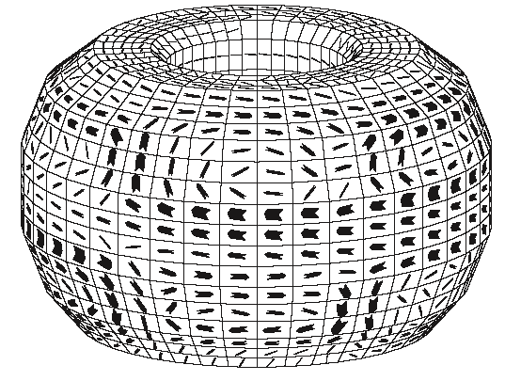
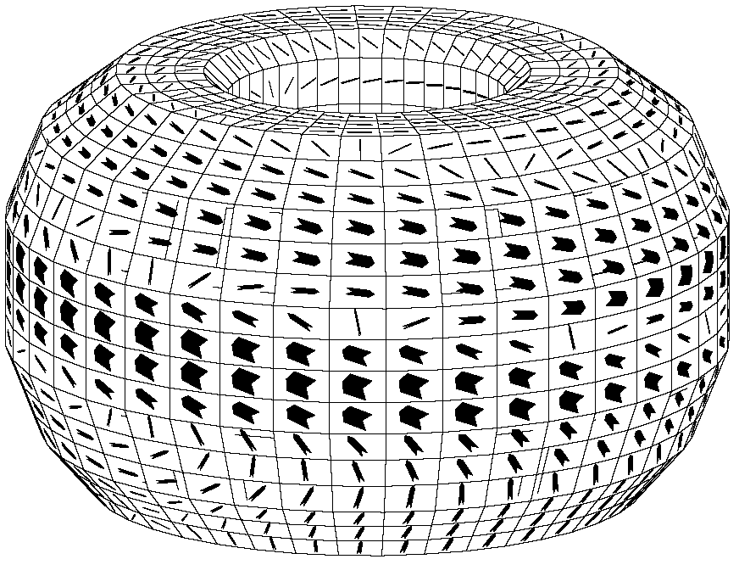
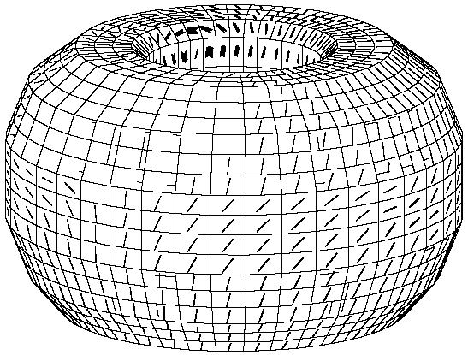
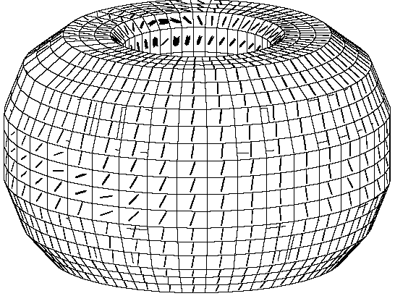
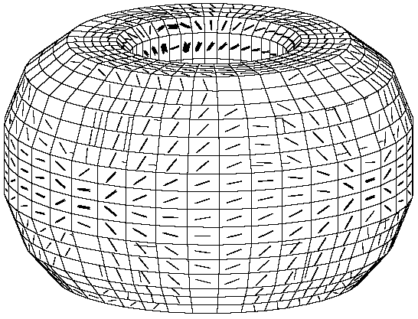
Balanced truncation significantly reduces VALEN state space
Full VALEN computed wall currents:
Balanced realization:
I
~3000 states
Balancing transformation
RWM fixed phase
2999 Balanced states:
II
…
Truncation
sensor mutual fluxes inductance matrix
III
State reduction:
~3-20 states
I
What is VALEN state-space?
How to find balancing transformation ?
How to determine number of states to keep ?
II
III

Slide 21
State-space control approach may allow superior feedback performance
I
VALEN circuit equations after including unstable plasma mode. Fluxes at the wall, feedback coils and plasma are
Equations for system evolution
In the state-space form where & measurements are sensor fluxes. State-space dimension ~1000 elements!
Classical control law with proportional gain defined as

Slide 22
VALEN formulation with rotation allows inclusion of mode phase into state space*
VALEN uses two copies of a single unstable mode with π/2 toroidal displacement of these two modes
The VALEN uses two dimensionless parameter normalized torque “α” and normalized energy “s”
The VALEN parameters ‘s’ and ‘α’ together determine growth rate γ and rotation Ω of the plasma mode
LQG is optimized off line for best stability region with respect to ‘s’ and ‘α’ parameters.
*Boozer PoP Vol6, No. 8, 3190 (1999)

Slide 23
Measure of system controllability and observability is given by controllability and observability grammians
II
Given stable Linear Time-Invariant (LTI) Systems
Observability grammian, , can be found be solving continuous-time Lyapunov equation, , provides measure of output energy:
defines an “observability ellipsoid” in the state space with the longest principal axes along the most observable directions
Controllability grammian, , can be found be solving continuous-time Lyapunov equation, , provides measure of input(control) energy:
defines a “controllability ellipsoid” in the state space with the longest principal axes along the most controllable directions
most observable
most controllable

Slide 24
Balanced realization exists for every stable controllable and observable system
II
Controllable, observable & stable system called balanced if where - Hankel Singular Values
Balancing similarity transformation transforms observability and controllability ellipsoids to an identical ellipsoid aligned with the principle axes along the coordinate axes.
The balanced transformation can be defined in two steps:
Start with SVD of controllability grammian and define the first transformation as
Perform SVD of observability grammian in the new basis: the second transformation defined as
The final transformation matrix is given by:

Slide 25
Determination of optimal controller gain for the dynamic system
III
For given dynamic process:
Find the matrix such that control law:
minimizes Performance Index:
where tuning parameters are presented by - state and control
weighting matrixes,
Controller gain for the steady-state can be calculated as
Where is solution of the controller Riccati matrix equation
Solution:

Slide 26
Determination of optimal observer gain for the dynamic system
III
For given stochastic dynamic process:
with measurements:
Find the matrix such that observer equation
minimizes error covariance:
where tuning parameters are presented by - plant and measurement noise
covariance matrix
Observer gain for the steady-state can be calculated as
Where is solution of the observer Riccati matrix equation
Solution:

Slide 27
Closed system equations with optimal controller and optimal observer based on reduced order model
III
Measurement noise
Full order VALEN model
Optimal observer
Optimal controller
Closed loop continuous system allows to
Test if Optimal controller and observer stabilizes original full order model and defined number of states in the LQG controller
Verify robustness with respect to β_{n}
Estimate RMS of steady-state currents, voltages and power

Slide 28
Advanced controller methods planned to be tested on NSTX with future application to KSTAR
VALEN NSTX Model includes
Stabilizer plates
External mid-plane control coils closely coupled to vacuum vessel
Upper and lower Bp sensors in actual locations
Compensation of control field from sensors
Experimental Equilibrium reconstruction (including MSE data)
Present control system on NSTX uses Proportional Gain

Slide 29
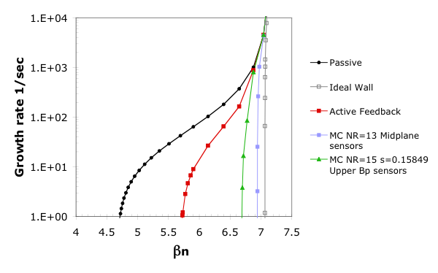
Advanced control techniques suggest significant feedback performance improvement for NSTX up to = 95%
Experimental (control off)
(β collapse)
Experimental (control on)
With-wall limit
Classical proportional feedback methods
VALEN modeling of feedback systems agrees with experimental results
RWM was stabilized up to β_{n} = 5.6 in experiment.
Advanced feedback control may improve feedback performance
Optimized state-space controller can stabilize up to C_{β}=87% for upper Bp sensors and up to C_{β}=95% for mid-plane sensors
Uses only 7 modes for LQG design
DCON
no-wall
limit
Advanced
Feedback
M-P sensors
passive
growth
active control
Growth rate (1/s)
active
feedback
Advanced
Feedback
Bp sensors
β_{N}

Slide 30
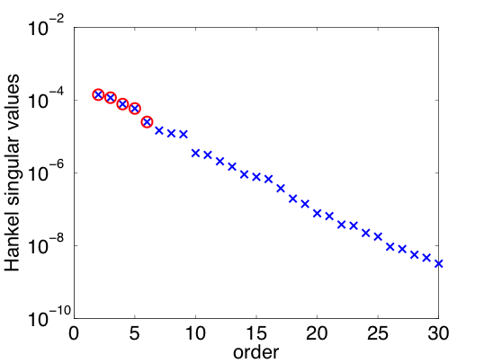
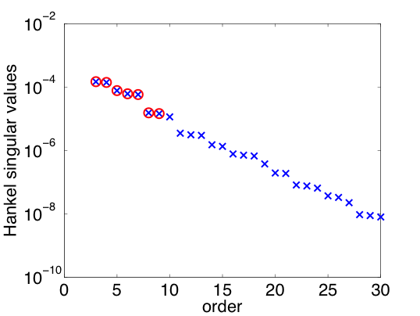
LQG with mode phase needs only 9 modes using B_{p} upper and lower sensors sums and differences
Unstable
Stable
Unstable
Stable
Fixed mode (fixed phase)
7 states (1 unstable mode + 6 stable balanced states)
LQG(β_{N}=6.7,N=7)
Rotating mode (phase included)
9 states (2 unstable modes + 7 stable balanced states)
LQG(α=0,β_{N}=6.7,N=9)

Slide 31
LQG(0,6.7,9) stabilizes slow rotating RWM mode up to β_{N}<6.7
Ideal Wall
10³
10²
10¹
10⁰
10⁻¹
10⁻²
RWM stable
RWM unstable

Slide 32
LQG(0,6.7,9) stabilizes slow rotating RWM mode up to β_{N}<6.7
β_{N}=6.7
Ideal Wall
10³
10²
10¹
10⁰
10⁻¹
10⁻²
β_{N}=6.65
RWM unstable
RWM stable
RWM unstable
increasing
α
β_{N}=6.4
β_{N}=6.1
β_{N}=5.9
RWM stable

Slide 33
LQG(0,6.7,9) stabilizes slow rotating RWM mode up to β_{N}<6.7
β_{N}=6.7
Ideal Wall
β_{N}=6.65
RWM unstable
RWM stable
RWM unstable
increasing
α
β_{N}=6.4
β_{N}=6.1
β_{N}=5.9
RWM stable
LQG unstable
LQG unstable

Slide 34
LQG(0,6.7,9) stabilizes slow rotating RWM mode up to β_{N}<6.7
β_{N}=6.7
LQG unstable
Ideal Wall
β_{N}=6.65
RWM unstable
RWM stable
RWM unstable
increasing
α
β_{N}=6.4
β_{N}=6.1
β_{N}=5.9
RWM stable
LQG unstable
LQG unstable
LQG unstable

Slide 35
>90% power reduction for white noise driven time evolution of the controlled RWM
White noise 7 gauss in amplitude with 5kHz sampling frequency
Power is proportional to white noise amplitude² and sampling frequency⁻¹
No filters on B_{p} sensors in proportional controller was used in this study
Proportional gain only
 | RMS values |  |  | Peak Values
C_{β} | I_{CC}, A | V_{CC}, V | P, Watts | I_{CC}, A | V_{CC}, V | P, Watts
10% | 70% | 84% | 94% | 66% | 84% | 93%
20% | 73% | 85% | 95% | 68% | 84% | 94%
30% | 77% | 86% | 96% | 73% | 85% | 95%
40% | 85% | 90% | 98% | 82% | 89% | 98%

Slide 36
Advanced controller study continuing…
Conclusions
NSTX advanced controller with mode phase has been tested numerically, 9 modes needed, large stability region for slow rotating mode. (RWM is usually locked in the NSTX experiments.)
Next Steps
Study LQG with different torque, to improve robustness with respect to β_{N} and mode rotation speed.
Off line comparison for mode phase and amplitude calculated with reduced order optimal observer and the present measured RWM sensor signal data SVD evaluation of n = 1 amplitude and phase from the experimental data
Redesign state-space for control coil current controller input
Analyze time delay effect on LQG performance

Slide 37
Thank you!

