Slide 1
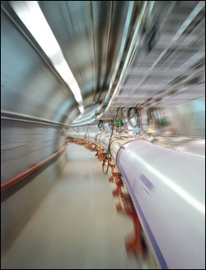
Proton-Proton Elastic Scattering at RHIC
Donika Plyku
Old Dominion University
HUGS 2008 at Jefferson Lab

Slide 2
Outline
Relativistic Heavy Ion Collider (RHIC)
RHIC as a Polarized Proton Collider
Proton-Proton Elastic Scattering
Theoretical Approach
PP2PP Experiment at RHIC
Detection of elastic scattering events

Slide 3
RHIC at Brookhaven National Laboratory (BNL)
Built to collide heavy ions in order to create quark-gluon plasma
At present, the most powerful heavy-ion collider in the world
Distinctive in its capability to collide spin-polarized protons

Slide 4
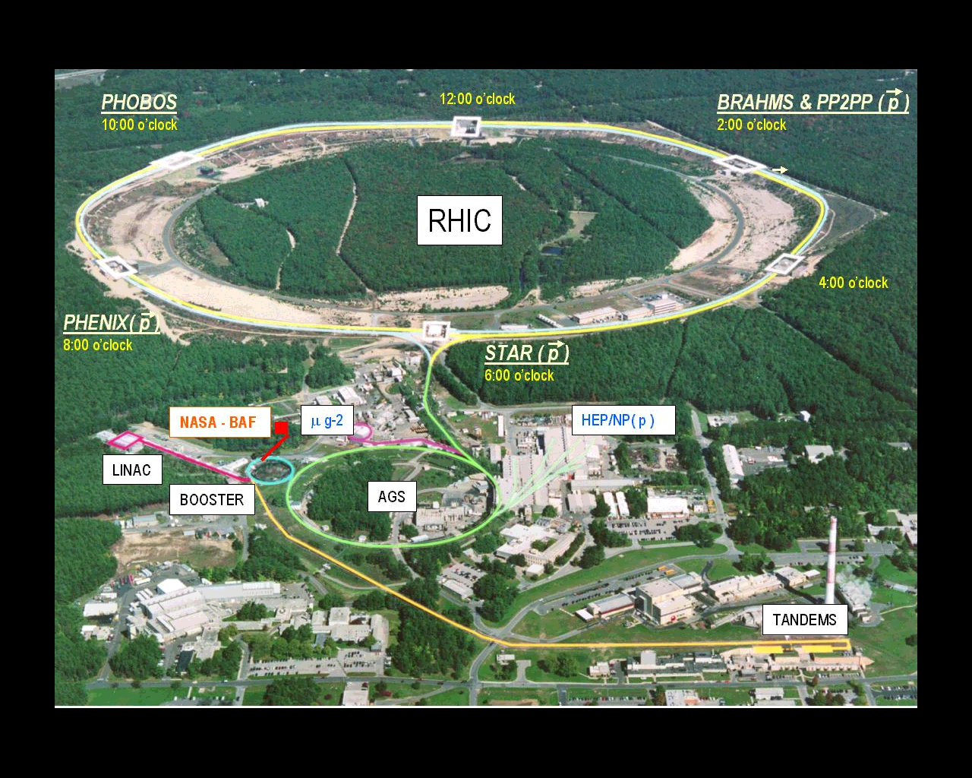
Birds Eye View of RHIC
+ PP2PP

Slide 5
RHIC at BNL
Absolute Polarimeter (H↑ jet)
RHIC pC Polarimeters
PHOBOS
BRAHMS
Siberian Snakes
Siberian Snakes
PHENIX
STAR
Spin Rotators
(longitudinal polarization)
Spin flipper
Spin Rotators
(longitudinal polarization)
Pol. H⁻ Source
Solenoid Partial Siberian Snake
LINAC
BOOSTER
Helical Partial Siberian Snake
200 MeV Polarimeter
AGS
AGS Internal Polarimeter
Rf Dipole
AGS pC Polarimeters
Strong Helical AGS Snake

Slide 6
Proton-Proton Elastic Scattering
In elastic scattering protons remain intact.
Protons interact via a Pomeron (IP) exchange.
Pomeron is an hypothetical particle described as a color singlet combination of gluons.
1 + 2 -> 1’ + 2’

Slide 7
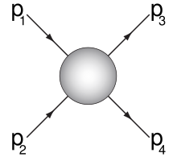
Some useful variables…
Mandelstam Variables:
p₁, p₂ and p₃, p₄ are the four-momenta of the incoming
and outgoing particles, respectively.

Slide 8
Past, present, future…
ISR at CERN (past)
p-p collisions at √s = 62.8 GeV with unpolarized beam and at 20 GeV with polarized beam
p-pbar at √s = 53 GeV
Tevatron at Fermilab (past)
p-pbar collisions at √s = 1.8 TeV
RHIC at BNL (present & future)
polarized p-p collisions up to √s = 500 GeV
LHC at CERN (future)
unpolarized p-p collisions at √s = 14 TeV

Slide 9
PP2PP Experiment at RHIC
Designed to study polarized proton-proton elastic scattering, at a previously unexplored cms energy range of : 50 GeV < √s < 500 GeV and
4•10^{–4} GeV² ≤ |t | ≤ 1.3 GeV², in order to explore:
The dynamics of the hadronic interaction in p-p elastic scattering-------UNPOLARIZED CASE
Spin dependence of the hadronic interaction in polarized p-p elastic scattering--------POLARIZED CASE

Slide 10
Optical Theorem
The total cross section (1 + 2 -> anything) is proportional to the imaginary part of the elastic
(1 + 2 -> 1 + 2) scattering amplitude at t = 0.
Elastic Scattering
Amplitude
at t=0
(forward direction)
The very existence of scattering requires scattering in the forward direction.

Slide 11
Differential Elastic Cross Section
Ratio of the real to imaginary part of the nuclear amplitude at t = 0
Nuclear slope parameter
Spin Independent Hadronic Amplitude
Fine structure constant
Proton electric form factor
Coulomb Amplitude
Coulomb Phase

Slide 12
Differential Elastic Cross Section
Coulomb Amplitude
Hadronic Amplitude
Coulomb Nuclear Interference Term, (CNI) region, small t:
4•10^{–4} GeV² ≤ |t | ≤ 0.03 GeV²
By courtesy of S. Bueltmann

Slide 13
Measurements in p-p and p-pbar Collisions
At large s:
Measure p-p total cross
section at the uncovered
energy range and
compare to p-pbar
ρ: ratio of real to
imaginary part of nuclear
amplitude at t = 0
b: the nuclear slope
parameter
ISR at CERN
Tevatron

Slide 14
Roman Pots
Cylindrical
vessels that
house the
detectors.
Can be
inserted
close to the
beam for
data taking.

Slide 15
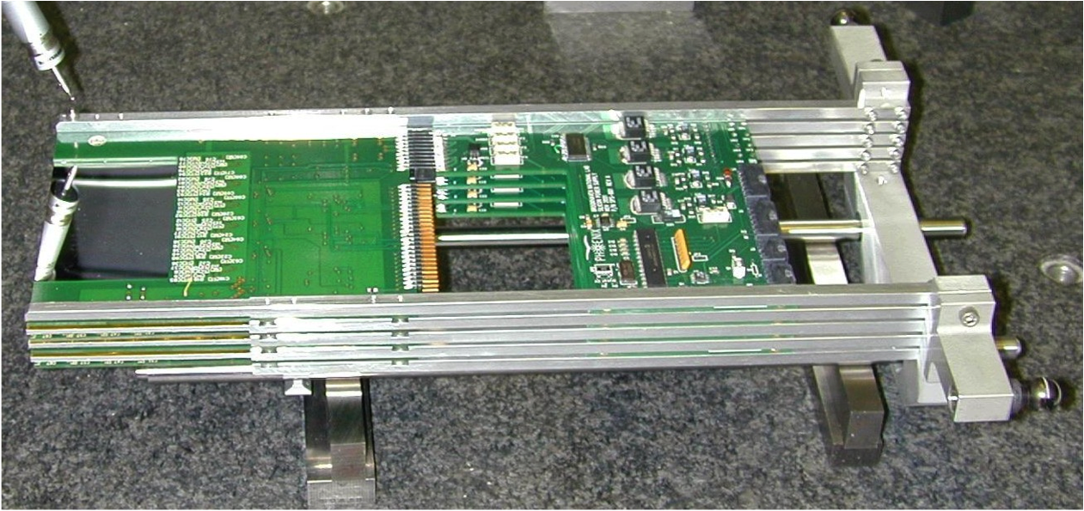
Silicon Strip Detectors
Silicon Detector Package for One Pot
Hamamatsu Silicon Strip Detectors
Two types:
X-View : vertical strips
Y-View : horizontal strips
500 um cut edge to first strip closest to beam
74 x 45 mm area, 400 um thick

Slide 16
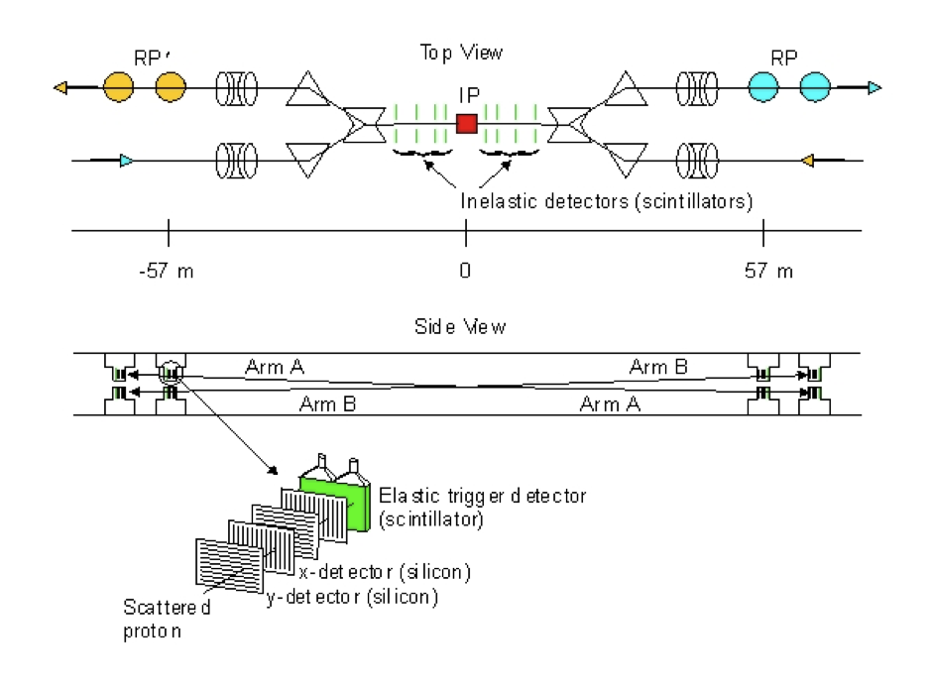
Experimental Layout
Collinearity condition for elastic events

Slide 17
Measurement Technique
Very forward detectors detect protons that scatter elastically at very small angles.
Detectors are at a position where the scattered protons are well separated from beam protons.
Trajectories of scattered particles are determined by the beam transport equations: (* = at IP)
a₁₁, L_{eff}, a₁₂, a₂₂ are the beam transport matrix elements
y = a₁₁y* + L_{eff}θ*_{y}
θ_{y} = a₁₂y* + a₂₂θ*_{y}
Let a₁₁~0, “parallel to point focusing”, measure only y and extract the scattering angle θ*_{y}

Slide 18
Slope Parameter (at √s = 200 GeV)
-t = (p*θ)²
Fit with equation that represents differential elastic cross section. Using σ_{tot} = 51.6 mb, ρ = 0.13 and the final selection of 58.511 elastic events, extract b:
b = 16.3 ± 1.6(stat.)
± 0.9(sys.) (GeV/c)⁻²
By courtesy of S. Bueltmann

Slide 19
RHIC
Heavy Ion Collisions
Polarized Proton Collisions
Elastic Scattering
PP2PP
Inelastic Scattering
Forward Scattering
(small t)
Existing PP2PP
Elastic Differential Cross Section
Coulomb Interaction
Hadronic Interaction
CNI

Slide 20
Best Wishes to Everybody
and
Success in Your Studies!

