Slide 1
Measurement of proton spin structure at RHIC-PHENIX
Kensuke Okada (RBRC)
for the PHENIX collaboration
WWND2009
February 5, 2009

Slide 2
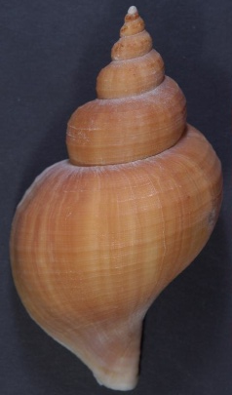
The proton
The most fundamental hadron.
Spin ½
What is the origin of the spin?
lepton
γ*
Deep inelastic scattering (DIS) experiments
has led the field.

Slide 3
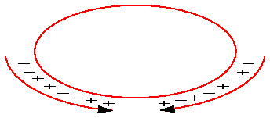
RHIC : the polarized p+p collider
The polarization is kept during the acceleration and at the store.
Any polarization direction can be set at the interaction points (STAR, PHENIX).
Alternative spin pattern for bunches to reduce the time dependent systematic.
Gluon interaction in leading order
High Q² (√s is up to 500GeV)

Slide 4
Accumulated data (PHENIX)
Longitudinal polarization
Year | √s [GeV] | Recorded L | Pol [%] | FOM (P⁴L)
2003 (Run 3) | 200 | .35 pb⁻¹ | 27 | 1.5 nb⁻¹
2004 (Run 4) | 200 | .12 pb⁻¹ | 40 | 3.3 nb⁻¹
2005 (Run 5) | 200 | 3.4 pb⁻¹ | 49 | 200 nb⁻¹
2006 (Run 6) | 200 | 7.5 pb⁻¹ | 57 | 690 nb⁻¹
2006 (Run 6) | 62.4 | .10 pb⁻¹ | 48 | 5.3 nb⁻¹
Transverse polarization
Year | √s [GeV] | Recorded L | Pol [%] | FOM (P²L)
2001 (Run 2) | 200 | .15 pb⁻¹ | 15 | 3.4 nb⁻¹
2005 (Run 5) | 200 | .16 pb⁻¹ | 47 | 38 nb⁻¹
2006 (Run 6) | 200 | 2.7 pb⁻¹ | 51 | 700 nb⁻¹
2006 (Run 6) | 62.4 | .02 pb⁻¹ | 48 | 4.6 nb⁻¹
2008 (Run 8) | 200 | 5.2 pb⁻¹ | 46 | 1100 nb⁻¹

Slide 5
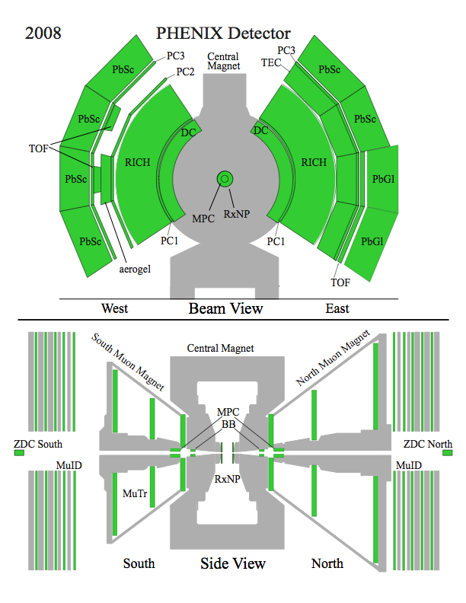
PHENIX Detector
Philosophy (initial design):
High rate capability & granularity
Good mass resolution & particle ID
Sacrifice acceptance
π⁰, γ, η
Electromagnetic Calorimeter, MPC
π±, e, J/ψ∀e⁺e⁻
Drift Chamber
Ring Imaging Cherenkov Counter
Electromagnetic Calorimeter
μ, J/ψ∀μ⁺μ⁻
Muon Id/Muon Tracker
Relative Luminosity
Beam Beam Counter (BBC)
Zero Degree Calorimeter (ZDC)
Local Polarimetry – ZDC
Spin direction monitoring

Slide 6
Unpolarized Cross Section
Unpolarized = spin averaged
Before going to asymmetry measurements,
we need to confirm the applicability of pQCD factorization.
pQCD calculation is the baseline (for example sensitive x region)
Is the PDF measured by DIS experiments valid for p+p collisions?

Slide 7
Cross section measurements
pp→π⁰ X :
PRD76,051106
Sqrt(s)=200GeV
Mid rapidity (|η|<0.35)
pp→γ X :
PRL 98, 012002
And also eta, h±, single electron (from charm)
All measurements support the pQCD calculation.
pQCD our theory baseline is OK!

Slide 8

Longitudinal spin structure

Slide 9
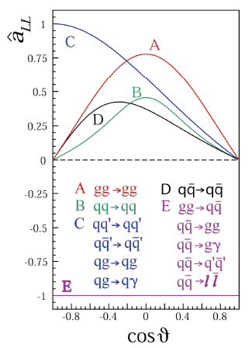
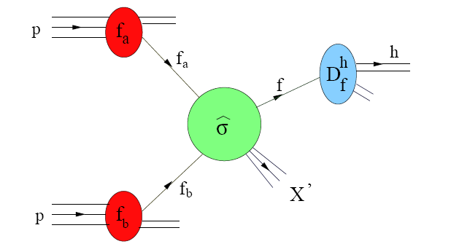
Probing ΔG
Spin dependence
pp → hX
PDF
Double longitudinal spin asymmetry A_{LL} is sensitive to ΔG

Slide 10
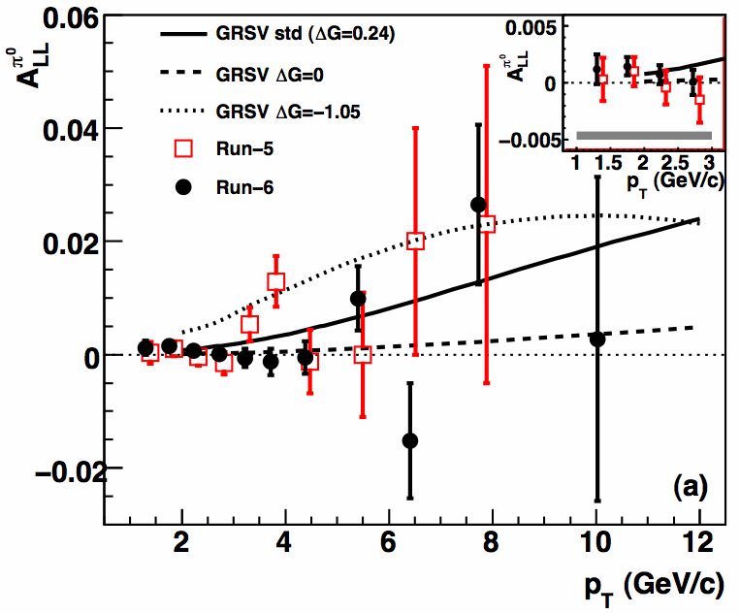

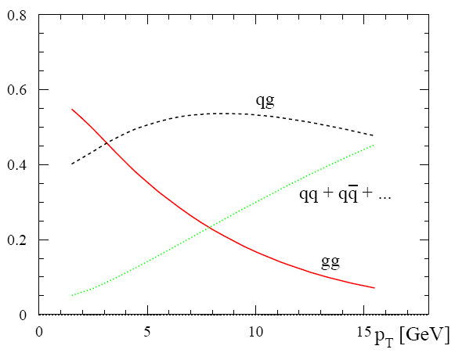
π⁰ A_{LL}
π⁰ p_{T} w_{BG}
2 GeV/c 20%
5 8%
10 5%
The most abundant probe in PHENIX
(triggering + identification capability)
arXiv:0810.0694
8.3% scale
uncertainty
from pol meas.
5
10
pT(GeV)
Notes:
new publication 2008-10-06

Slide 11
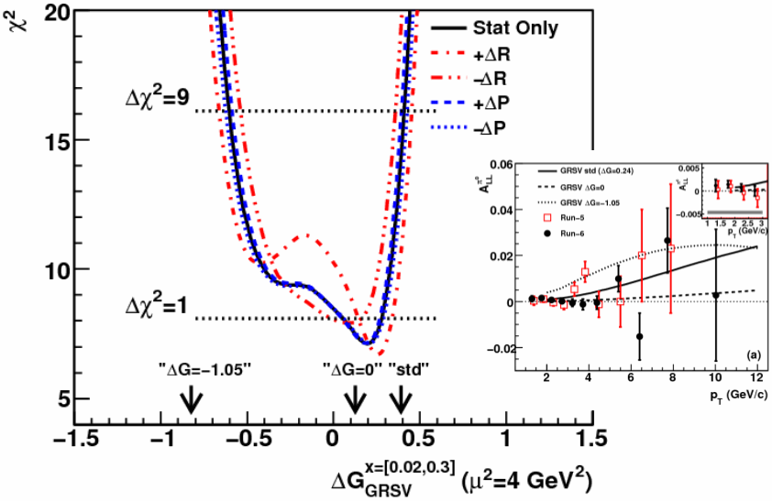
From A_{LL} to ΔG (with GRSV model)
Generate Δg(x) curves for different (with DIS refit)
Calculate A_{LL} for each ΔG
Compare A_{LL} data to curves (produce χ² vs ΔG)
pol PDF
arXiv:0810.0694
A_{LL}
The gluon contribution is not large.

Slide 12
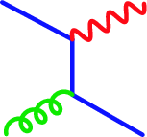
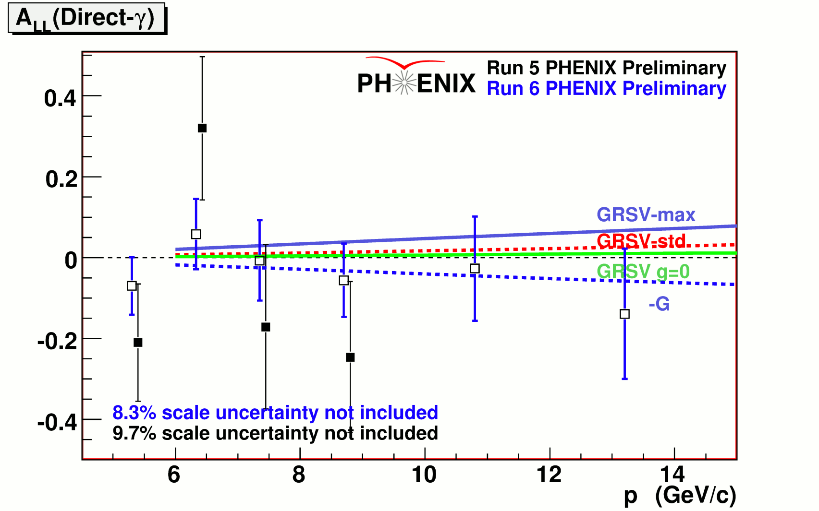
Direct photon A_{LL}
q
γ
clean channel
sensitive to the sign
g
q
need more data
p_{T}
Notes:
new data Spin2008

Slide 13
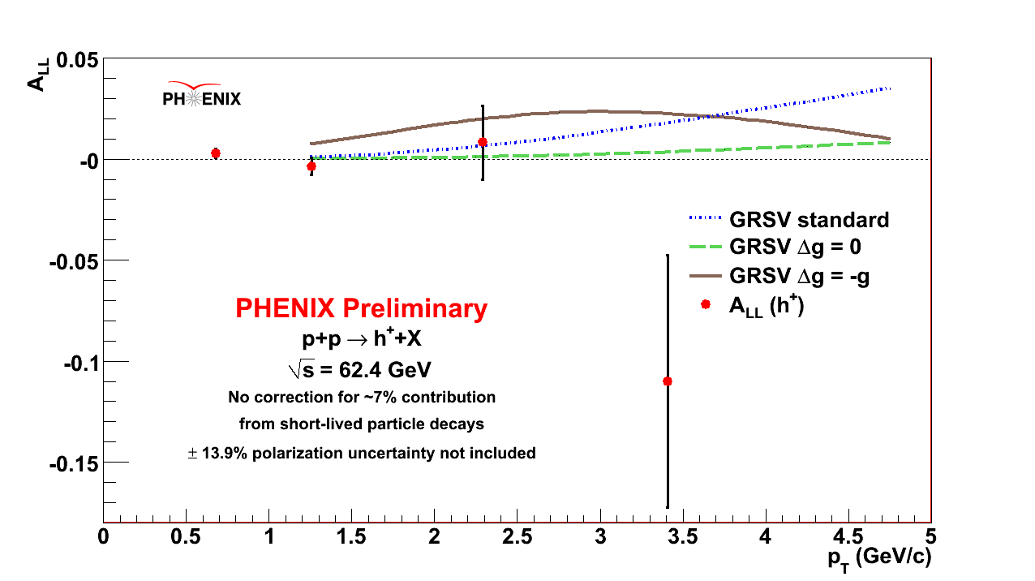
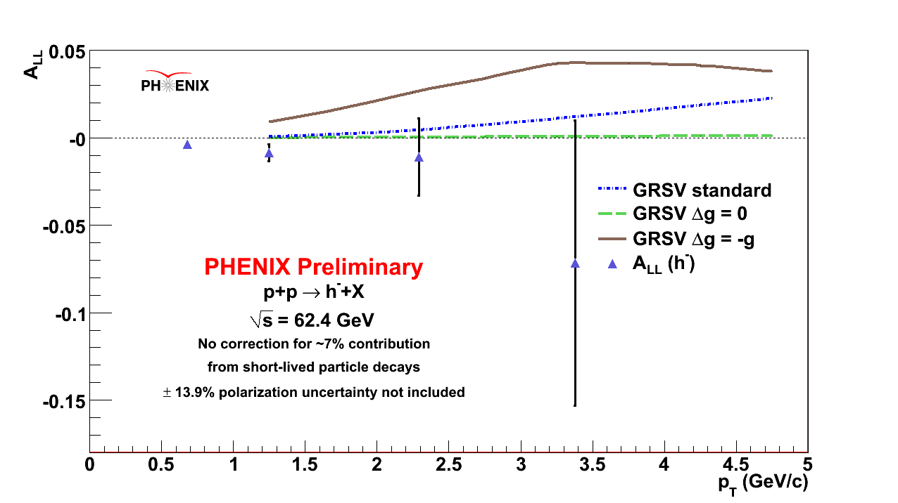
Other probes to access ΔG
charged pions : u,d quark difference
eta : an additional information
heavy flavor : the gluon fusion process
h± A_{LL} at √=62GeV
Notes:
Amaresh h+- in sqrt(s)=62GeV Oct,2008

Slide 14
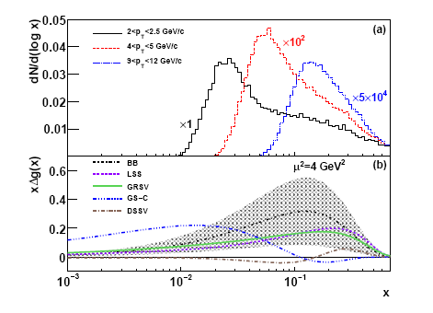
Issue 1
A poor resolution to x range in the inclusive measurements.
It’s impossible to check the x-dependence.
10⁻³
10⁻²
10⁻¹
x
Multi particles for the x mapping. (jet+jet, photon+jet)
Other collision energies (higher √s lower the x)

Slide 15
Issue 2
Very small asymmetry
Systematic
uncertainty
~0.1%
Statistics limit from the experimental data acquisition.
Systematic uncertainty on the relative luminosity measurement.
(= relative A_{LL})

Slide 16
The next step
direct photon, charged pions
Explore the other kinematical regions
√s=500GeV small-x. Along with the W-program.
Forward region for small-x.
Mapping x by using away side particles.
In the beam use proposal (for ~5 year plan),
we request 25/pb recorded with 70% pol at √s=200GeV
(~10x in terms of the figure of merit (LP⁴))

Slide 17
Transverse spin structure

Slide 18
Transverse spin structure
‘
The transverse spin structure is not a rotation of the helicity structure.
(true only for non-relativistic.)
Global picture including both is one way theorists try to.

Slide 19
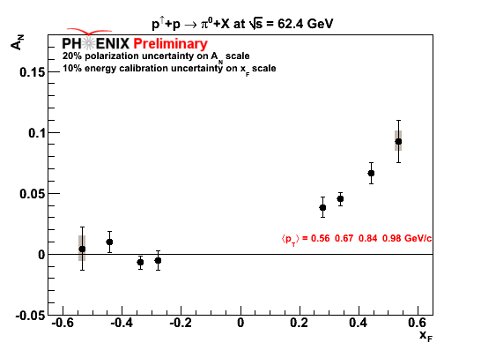
Single spin asymmetry A_{N}
Naive pQCD (in a collinear picture) predicts A_{N} ~ m_{q}/sqrt(s) ~ 0
However, large A_{N} observed in forward pions.
(also confirmed at PHENIX)
With MPC
Left
-Right
Proposed mechanisms
- Sivers
- Collins
- twist-3 process
- ...
Very hot topic recently

Slide 20


Possible mechanisms (ex.)
Sivers mechanism: correlation between proton spin & parton k_{T}
Collins mechanism: Transversity (quark polarization) × jet fragmentation asymmetry
quark, gluon motion
in the polarized proton.
quark polarization,
needs an analyzer to be observed.
(no gluon effect)
S_{P}
S_{P}
S_{q}
S_{q}
p
k_{T,q}
p
p
p
S_{q}
k_{T,π}
FSI : SIDIS
ISI : Drell-Yan

Slide 21
Looking for evidences
MPC pi0 result (Run6 sqrt(s)=62.4GeV)
is already shown.
Other signals?

Slide 22
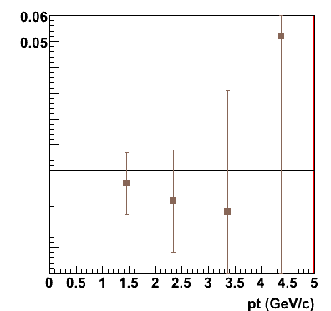
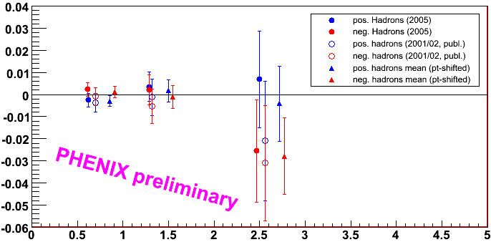
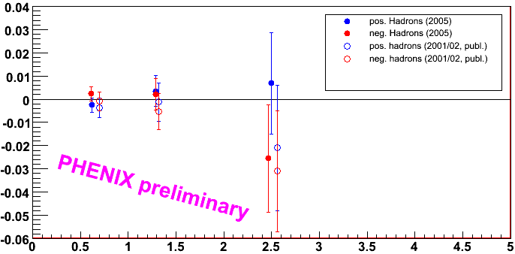
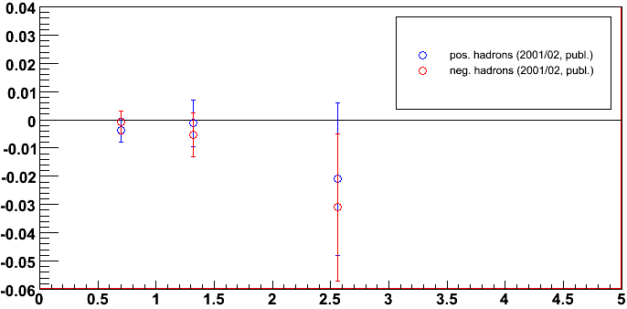
Midrapidity hadron A_{N}
Left
-Right
A_{N} π⁰
Run-02
A_{N} h^{+/-}
Run-05
|η| < 0.35
hep-ex/0507073
|η| < 0.35
p_{T} (GeV/c)
p_{T} (GeV/c)
PRL 95, 202001 (2005)
A_{N} is zero within 1%
It constrains Sivers distribution function for gluons not very large. (Anselmino et al., PRD74, 094011 (2006))
Updated π⁰ analysis with >10x smaller stat. error underway.

Slide 23
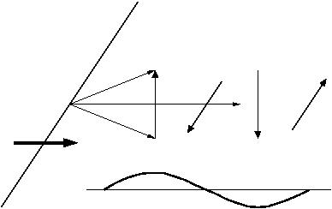
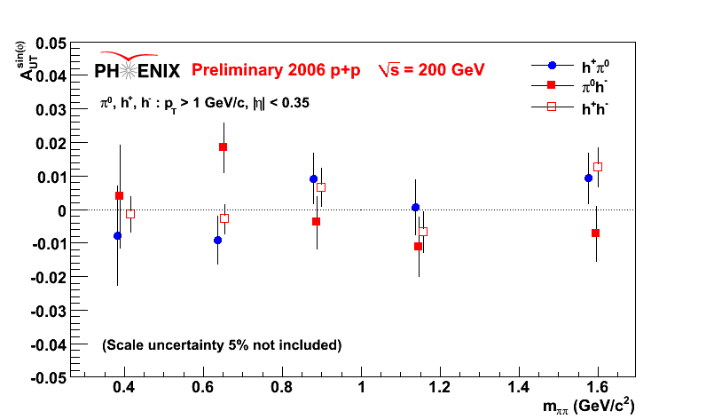
Interference FF as an analyzer
p
Transversity *IFF
2 hadrons in the central arm.
h₁
spin
(radial)
h₂
p
It’s consistent
with zero.
IFF from
e+e collider data
The transversity
will be constrained.
m_{ρ}=0.77
Notes:
new data June,2008

Slide 24
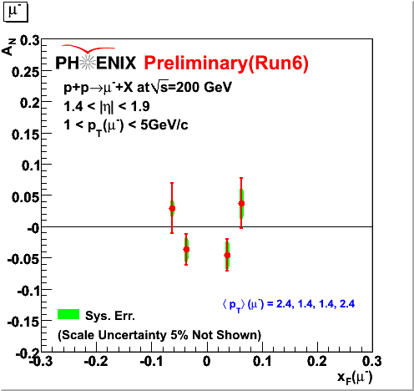
open charm A_{N}
gluon fusion process
sensitive to the gluon Sivers effect.
g
c
g
c
c→μ, e
It’s consistent with zero.
Consistent with the small gluon Sivers.
An analysis on the electron
channel is on going.
Notes:
New data May, 2008

Slide 25
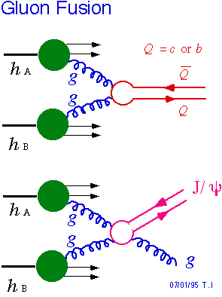
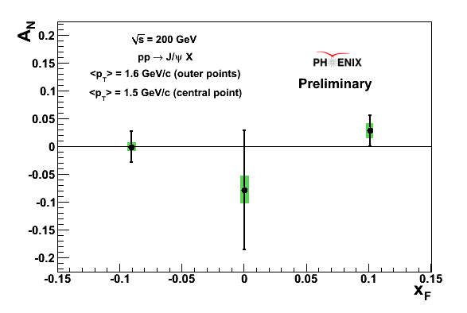
J/Ψ A_{N}
J/Ψ’s are detected via di-lepton decay.
It is also sensitive to the production mechanism (PRD 78,014024)
The SSA survives in the color singlet model in p+p collisions.
Notes:
J/pi > ee New data Dec,2008

Slide 26

Other probes
―Di-jet angle via 2 particle correlations : kT asymmetry
Central arm – Central arm
Central - Forward
Calculations based on observed Sivers effect in SIDIS.
STAR published a di-jet result (small <~1%) (PRL 99,142003)
A cancellation between (PRD 75, 075029)
ISI vs. FSI and
u-quark and d-quark
There is a possibility to decompose
by the charge of the leading hadron.
―Sivers effect in Drell-Yan process (PLB536,43,… , arXiv:0901.3078)
FSI vs. ISI
A fundamental test of the QCD.
Direct photon (forward) + jet (mid-rapidity) :
The same trick with larger cross section. (PRL 99,212002)

Slide 27
The next step
―It’s not clear how large the asymmetry is ( that’s why we measure.)
This is a difficulty for the planning.
―Drell-Yan process is the cleanest and the size of non-zero asymmetry is
predicted by QCD from SIDIS results.
(It’s a fundamental test of QCD.) ~250/pb is required.
Direct photon + jet process is more reachable.
(With a forward photon detector, large enough to eliminate the pi0 decay photons.)
―Large improvements on statistical precision to come from Run8 data.
(It’s our largest transverse data set.)

Slide 28
W program in √s=500GeV

Slide 29
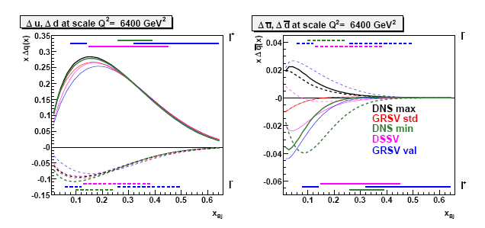
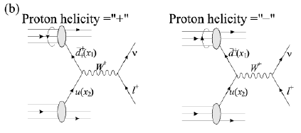
(Anti-) quark components of the proton spin
xΔu
xΔu
xΔd
xΔd
x_{Bj}
From Semi Inclusive Deep Inelastic Scattering (SIDIS)
relying on the fragmentation models
W program at RHIC
d-bar+u →W+
u-bar+d →W-
proton
d-bar, u-bar is always
positive helicity
d-bar
W+ A_{L}: Longitudinal single spin asymmetry
information of d-bar in the proton

Slide 30
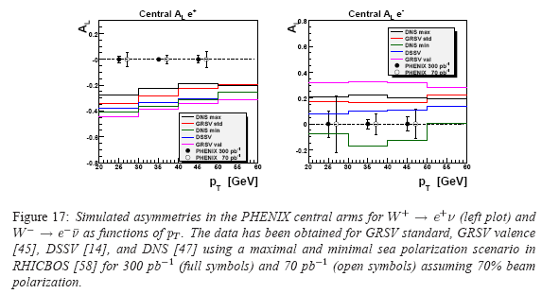
Central W→e channel
A_{L}
e+
e-
300/pb
70/pb
-0.4
⎯ Estimation for the near future (Run9)
3 weeks physics run (preparation is about 5 weeks)
7.5/pb/week *3 = 22.5/pb (recorded)
The first non-zero
asymmetry from the PHENIX
Central Arm is expected!
420e+,
70e-
δA_{L}=0.07 (with 50% pol)
Notes:
数字要チェック
はじめの勢いが大分衰えてきていますが、まだ実際の測定について述べていません。

Slide 31
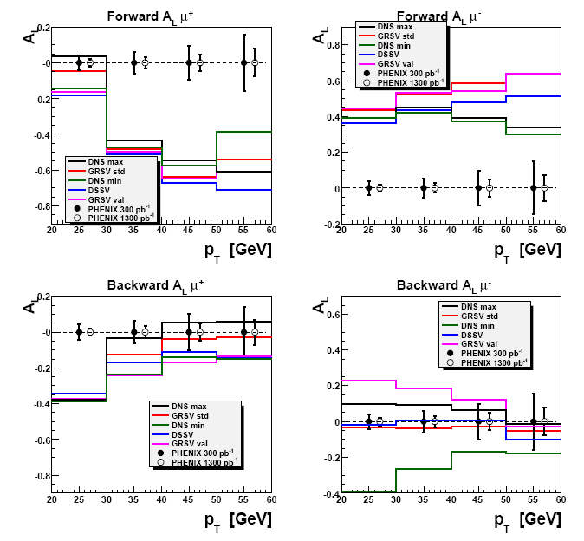
Forward W→μ channel
300/pb
1300/pb
It’s more sensitive to d-bar helicity.
The high momentum μ trigger will be ready by 2010.

Slide 32
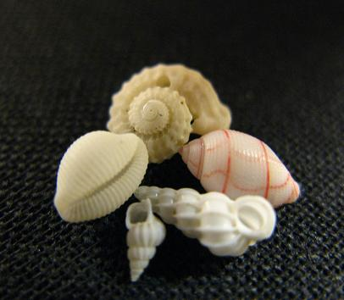
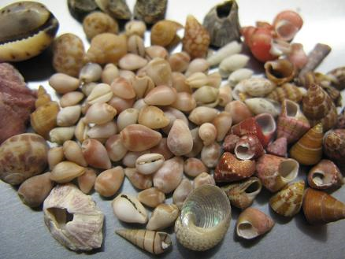
Others related to the spin

Slide 33
Others related to the spin
Very forward (<4mrad) neutron single spin asymmetry … non-zero!
Jet kT asymmetry
(a probe of quark orbital
angular momentum?)
new data (run5+6)
•×: Beam momenta
Spin transfer analysis
with self-analyzing decay channel (Λ)
Access to strange quark components?
It can be a good tool. But no good trigger.
(new data)
Can J/Ψ be an analyzer?
Jet 2 w/<k_{T}>=0
Jet 1
Jet 2
Jet 2 w/<k_{T}>=0
Jet 2
Jet 1
Notes:
Imran Oct, 2008,
Lambda A_LL, spin transfer Vladimir Oct, 2008

Slide 34


Summary
In the longitudinal spin program, the primary goal is to find the gluon spin component
in the proton.
For now, the measurement tells the gluon carries a small fraction of the missing spin
component.
Our measurement is limited in a relatively large x, is insensitive to the shape of pol-PDF.
In the transverse spin program, experimental results leads the field (including pol-DIS).
For a few years, we need to collect more evidence on the table.
The W program (single helicity asymmetry in √s=500GeV) is about to start.
It will be the first non-zero spin asymmetry signal in the PHENIX central arm.
There are many observables related to the spin.
Which one do you bet?

