Slide 1
Interactions between Atmospheric Variability over the Pacific and North Atlantic basin – Role of Transient Eddies
Ying Li
AOS Program, Princeton University
Advisor: Gabriel Lau

Slide 2
Outline
Introduction
Relation between ENSO and NAO
Seasonal dependence
Dynamical Mechanism
Stationary wave propagation
Storm track activity, transient eddy fluxes of momentum and heat
Conclusion

Slide 3
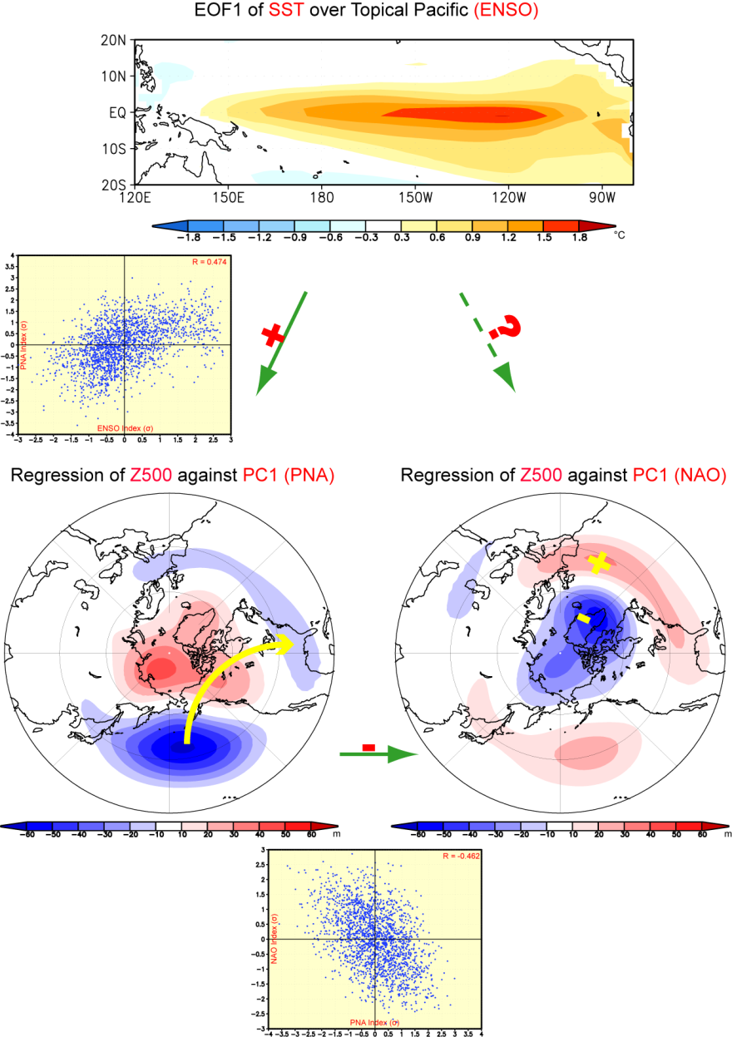
Introduction
ENSO is associated with the PNA wavetrain
The PNA wavetrain is correlated with the NAO pattern
To what extent is North Atlantic variability influenced by ENSO?
Which dynamical processes contribute to this relationship?

Slide 4
Model
MODEL: Geophysical Fluid Dynamics Laboratory (GFDL) Climate Model version 2.1 (CM2.1)
A coupled ocean-atmosphere-land-ice model (Delworth et al. 2006)
A 2000-yr integration is performed after a 220-yr spinup period.
Fixed 1860 radiative forcings, including atmospheric trace gases, solar irradiance, and distribution of land cove
Anthropogenic aerosols are not considered.
Model resolution (atmosphere): 2° latitude ×2.5 °longitude; 24 vertical levels.

Slide 5
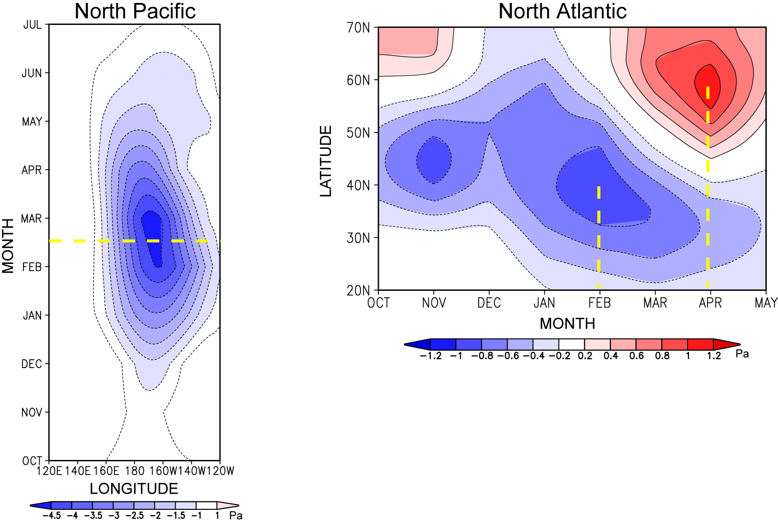
Strong Seasonal Dependence in Late Winter
Left: regression of 35-55°N mean SLP vs ENSO index
Right: regression of 70-20°W mean SLP vs ENSO index
The north-south dipole of anomalous SLP over north Atlantic resembles the negative phase of NAO, and peaks in late winter
The anomalous low pressure over North Pacific peaks in Feb and Mar

Slide 6
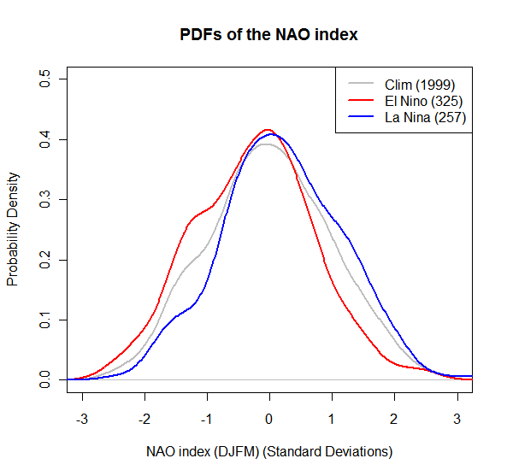
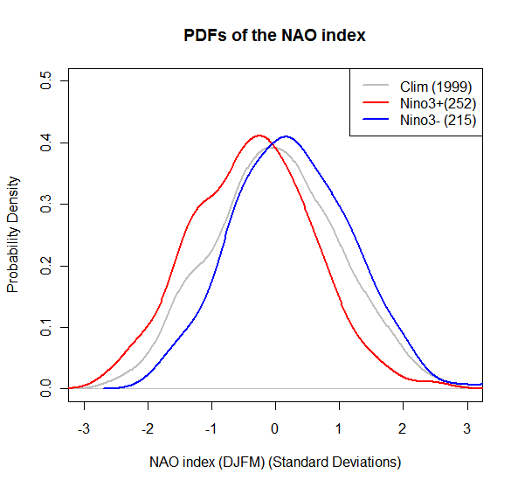
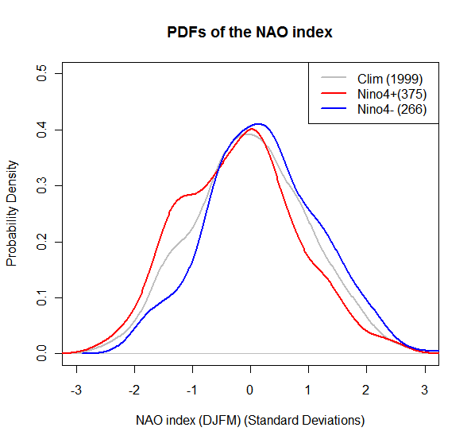
PDFs for the normalized seasonal mean NAO index
El Nino
La Nina
PC index
Nino3 index
Nino4 index
Values of NAO index greater than 1.0σ are more likely during La Niña events than El Niño events
Values of NAO index less than -1.0σ are more likely during El Niño events than La Niña events

Slide 7
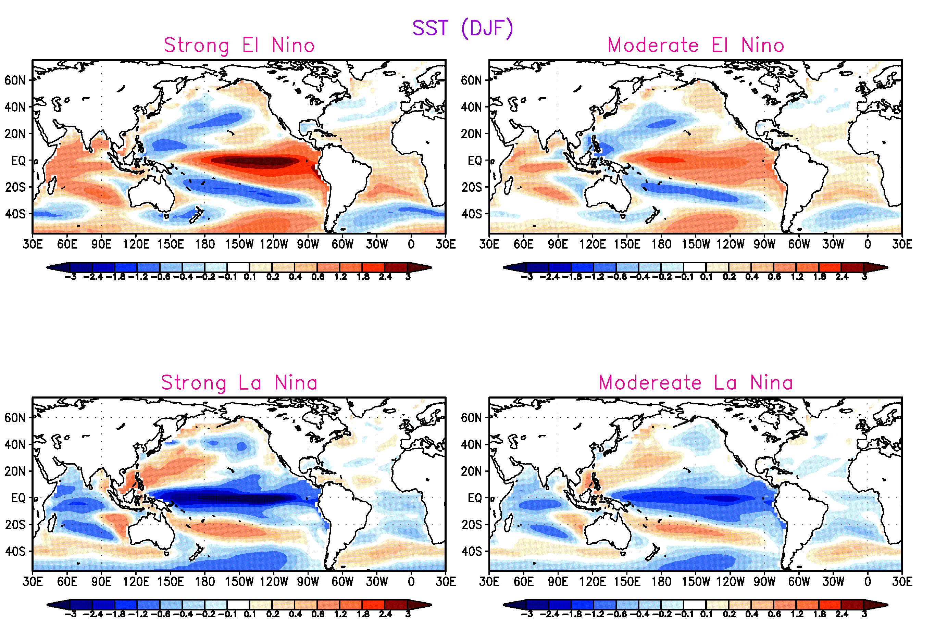
Eastern and Central Pacific
Western Pacific

Slide 8
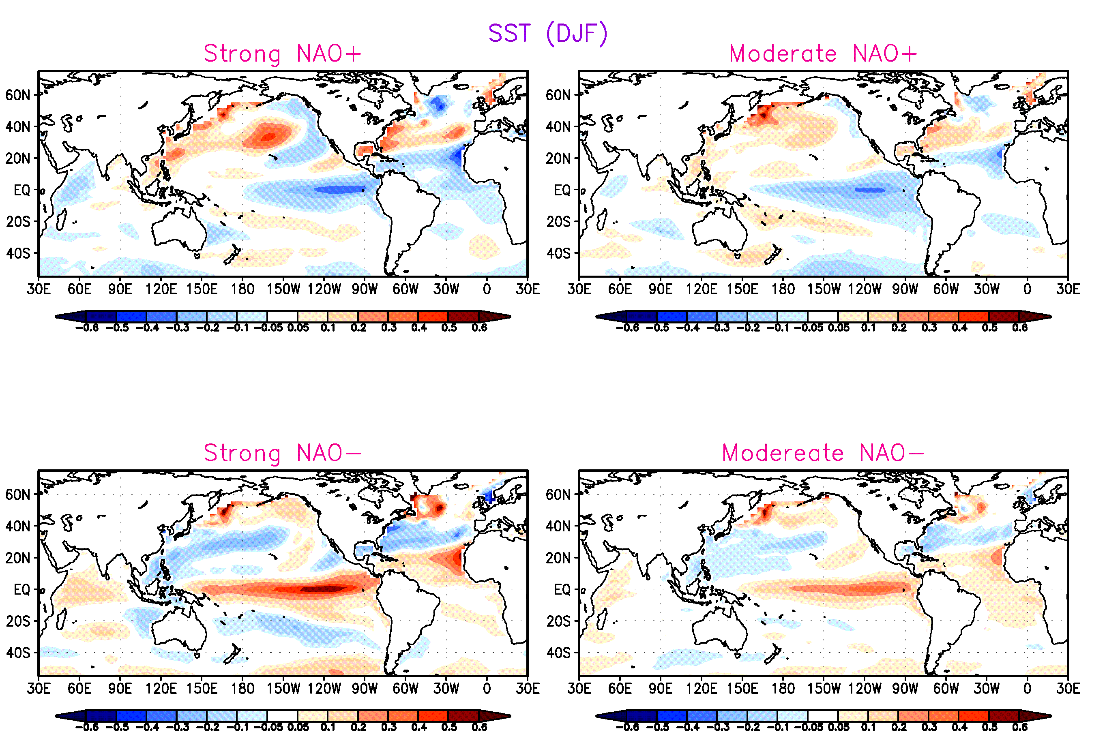
Eastern and Central Pacific

Slide 9
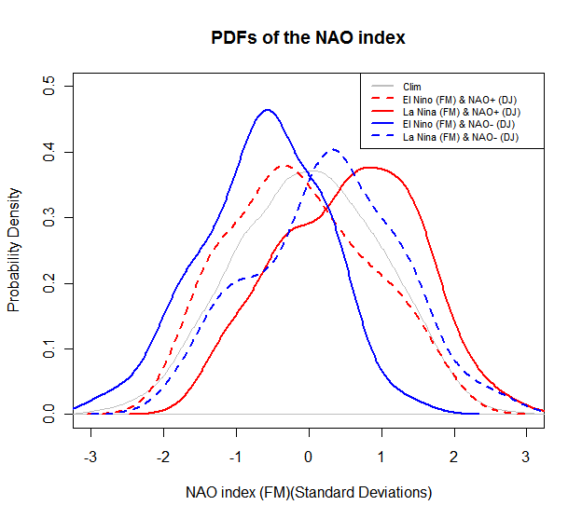
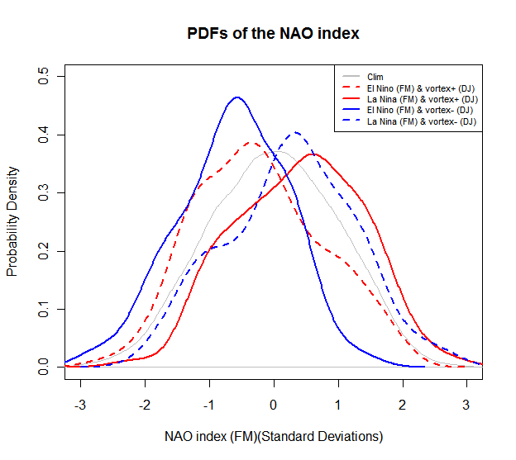
PDFs for the normalized seasonal mean NAO index
El Nino
La Nina
Precondition of NAO(-)
Precondition of stratospheric vortex
For the precondition of NAO(-) or weak stratospheric vortex in DJ,
NAO<-1.0σ in FM is more likely under the El Niño condition.
For the precondition of NAO(+) or strong stratospheric vortex in DJ, NAO>1.0σ in FM is more likely under the La Niña condition.

Slide 10
Part II: Dynamical Mechanisms a) Stationary Wave Propagation

Slide 11
Stationary Wave Activity Flux
Application
Propagation of wave activity; Interaction between stationary waves and time mean flow.
Horizontal components of F flux by Plumb (1985):
σ: pressures/1000hPa
λ, φ: longitude and latitude
u, v: horizontal geostrophic
velocities computed from Φ
overbar: time mean
asterisk: deviations from the zonal mean
Properties
F flux is parallel to the group velocity in the WKB sense.
Its divergence (convergence) is where the wave train is strongly forced (dissipated).

Slide 12
Method
Composite charts was constructed based on the PC1 of the EOF analysis
Type | Criteria | Number of Cases
Strong El Nino | PC1>1.5σ | 192
Strong La Nina | PC1<-1.5σ | 83
Strong NAO+ | PC1>1.5σ | 144
Strong NAO- | PC1<-1.5σ | 143
All the composites are averaged over Feb. and Mar.

Slide 13
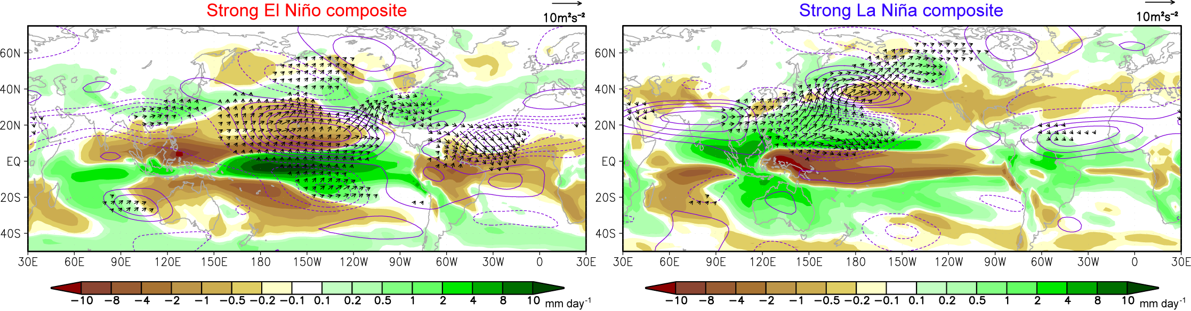
Stationary Wave Propagation
Shading: Anomalous Precipitation
Contour: Anomalous streamfunction at 250hPa
Arrow: Anomalous wave activity flux
The wave activity fluxes forced by tropical Pacific forcing do not propagate sufficiently far to the North Atlantic basin; equatorward propagation prevails over the tropical Atlantic.

Slide 14
b) Storm Track Activity: Transient Eddy Fluxes of Momentum and Heat

Slide 15
Data Processing
2000 yr-long daily data
Partition the filtered time series into individual months
Calculating the transient variance or covariance for each monthly segment
41 weights
Lanczos method (Duchon 1979)
2-10 day “band-pass” filtering

Slide 16
Extended EP Vector
Illustrate local interactive processes between transient eddies and the time mean flow
Horizontal components of E vector by Trenberth (1986) :
u, v: horizontal wind
prime: deviations from the corresponding time mean quantities
overbar: time mean
Properties (Hoskins et al 1983)
y
y’
The angle of the tilt:
x
ϕ
2ϕ
x’
E

Slide 17
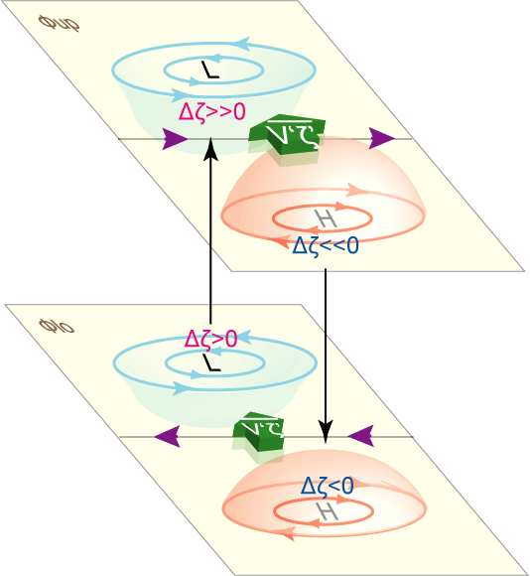
The transient forcing: geopotential height tendency due to the synoptic-scale eddy vorticity flux convergence
Barotropic component:
Physical explanation:
Lau and Holopainen (1984)
Lau and Nath (1991)

Slide 18
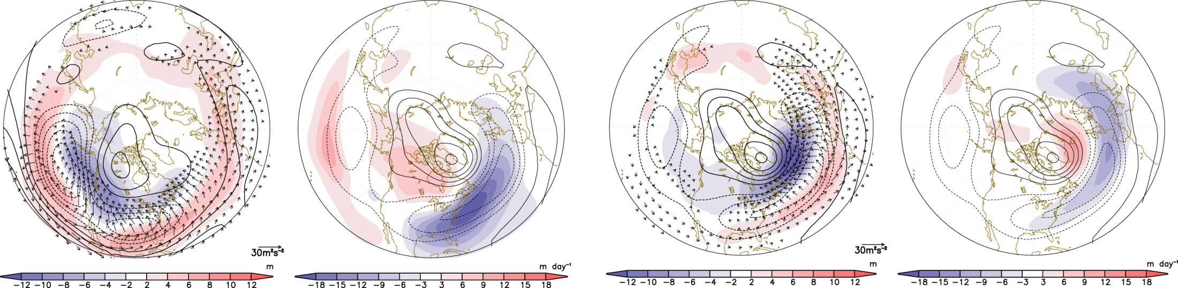
Storm Track Activity: El Niño, NAO(-)

Slide 19
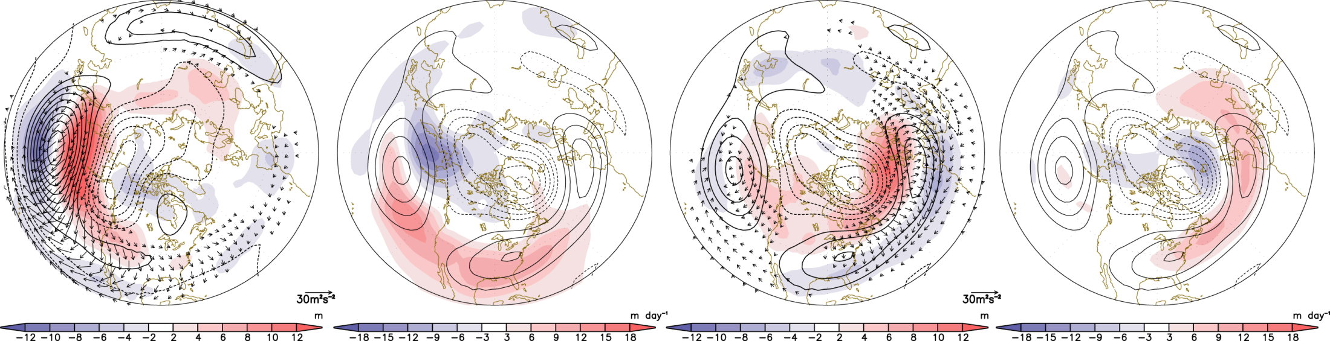
Storm Track Activity: La Niña, NAO(+)

Slide 20
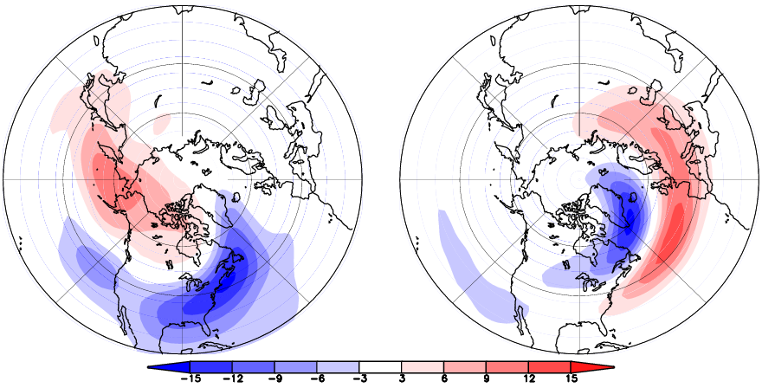
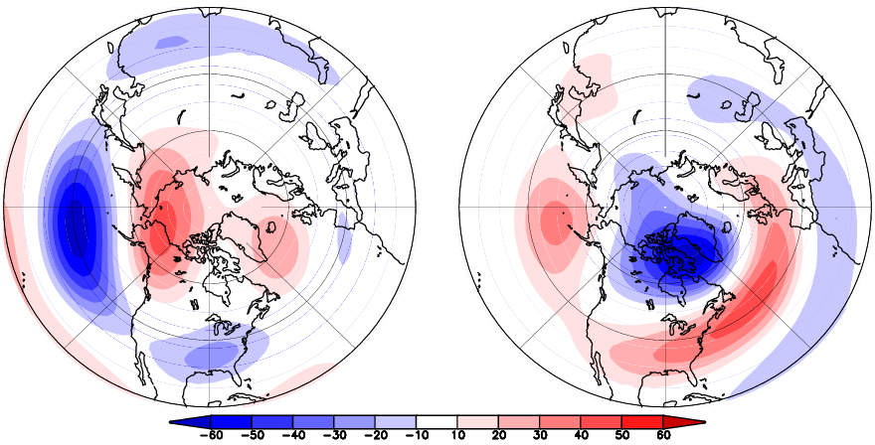
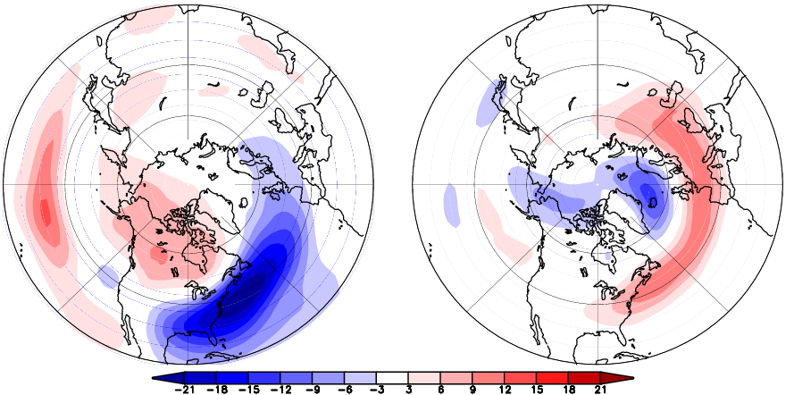
Regr Z₂₅₀ vs PC
EOF 1 of dz/dt 17.0%
EOF 2 of dz/dt 8.2%
El Nino composite dz/dt
NAO+composite dz/dt
EOF 1- related
PNA
EOF 2 -related
WA

Slide 21
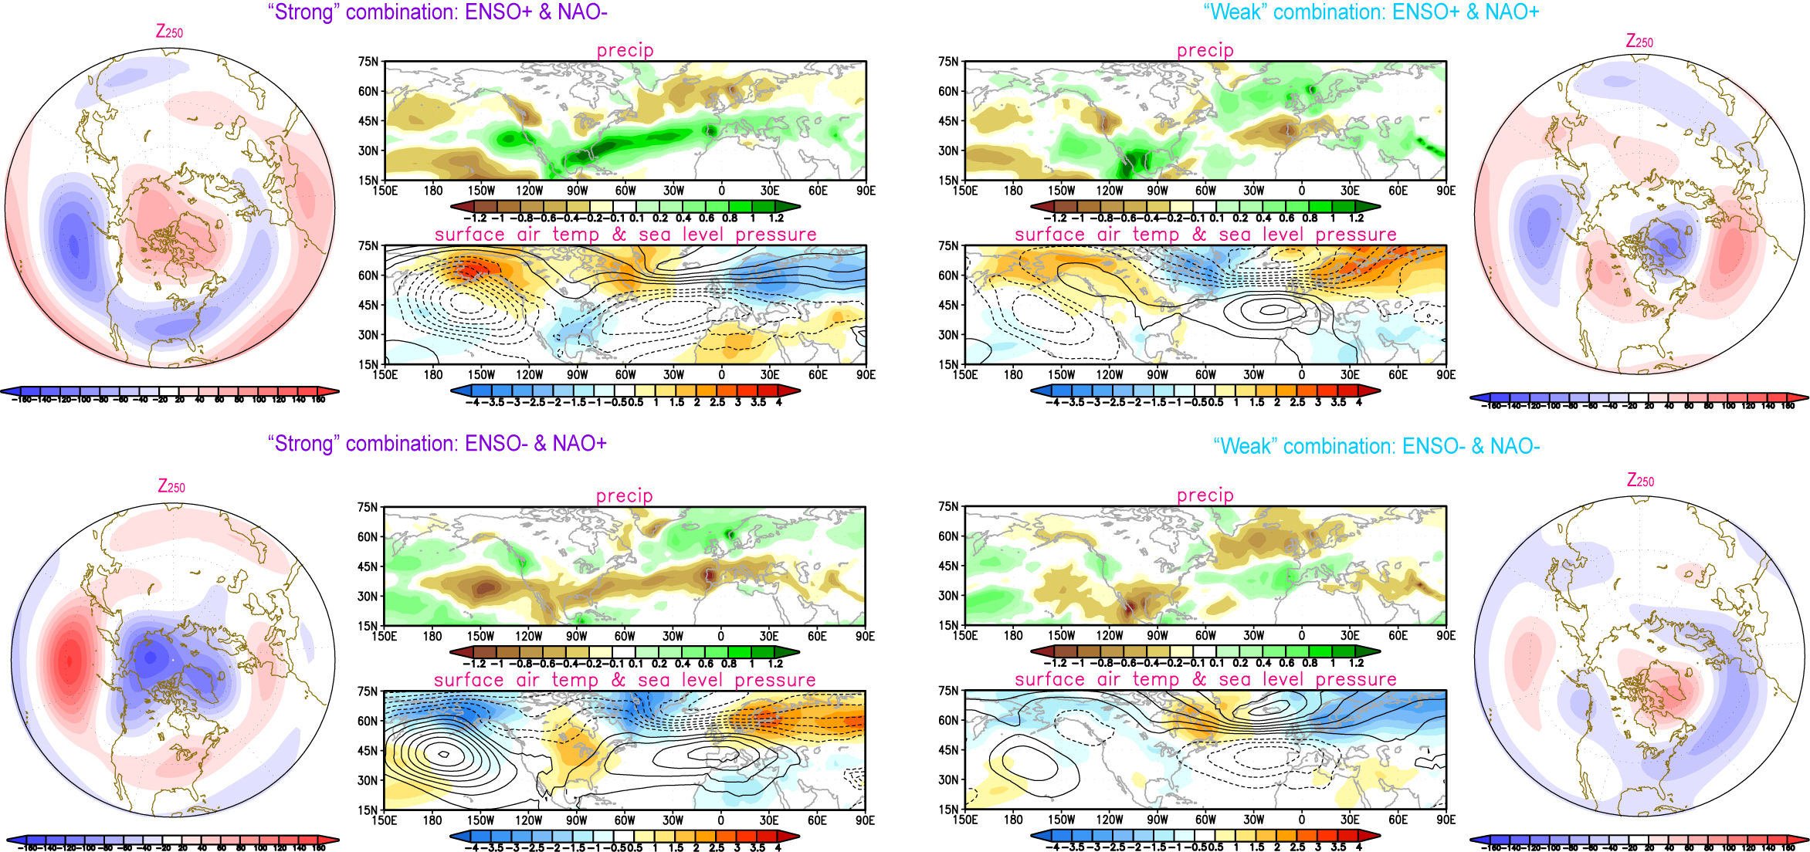
Features of the “strong” combination (i.e. ENSO+ & NAO-, ENSO- & NAO+)
Z250: a high degree of zonal annularity, because of the similar latitudinal dependence of anomalies over North Pacific (in ENSO) and North Atlantic (in NAO)
Precipitation: zonally elongated pattern, associated with the elongated jet stream and storm track
Surface air temperature / sea level pressure: three-pole temperature pattern, accompanied by the strong low pressure anomalies over both North Pacific and North Atlantic

Slide 22
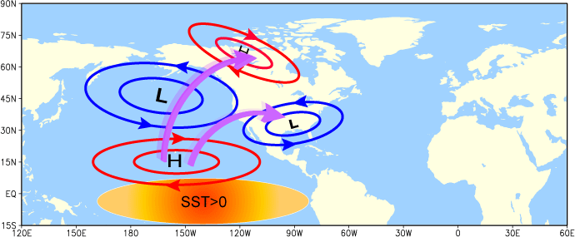
Summary-1
Stationary wave propagation does not seem to explain ENSO influences on atmospheric variability over the North Atlantic, since ENSO-related stationary wave train is characterized by equatorward propagation over the North Atlantic
GCM reproduces the Nonlinearity associated with the El Nino and La Nina.
However, the ENSO-related SST anomalies in tropical Pacific in CM2.1 is shifted westward relative to observations. This spatial displacement of the SST forcing may lead to underestimation of the ENSO impacts on the simulated North Atlantic variability.
Propagation of the stationary wave in the El Niño scenario

Slide 23
Summary-2
The barotropic component of the transient eddies may play an important role in linking ENSO to North Atlantic variability
The ENSO-induced transient eddy forcing over the North Atlantic resembles the western portion of NAO pattern
The characteristic pattern of eddy-induced geopotential height tendency variability associated with ENSO and NAO are themselves the principal modes of tendency variability in the model
Reinforcement of the NAO-like pattern by ENSO-related transient eddy forcing over the North Atlantic leads to patterns with high degree of zonal symmetry. This process may contribute to the formation of hemispheric-scale annular modes
The strong and weak combination of ENSO and NAO have different implications on the climate over the North America and North Atlantic

Slide 24
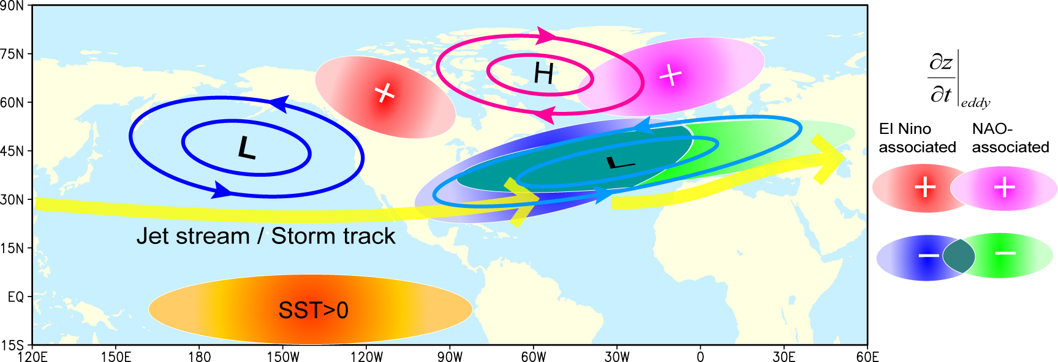
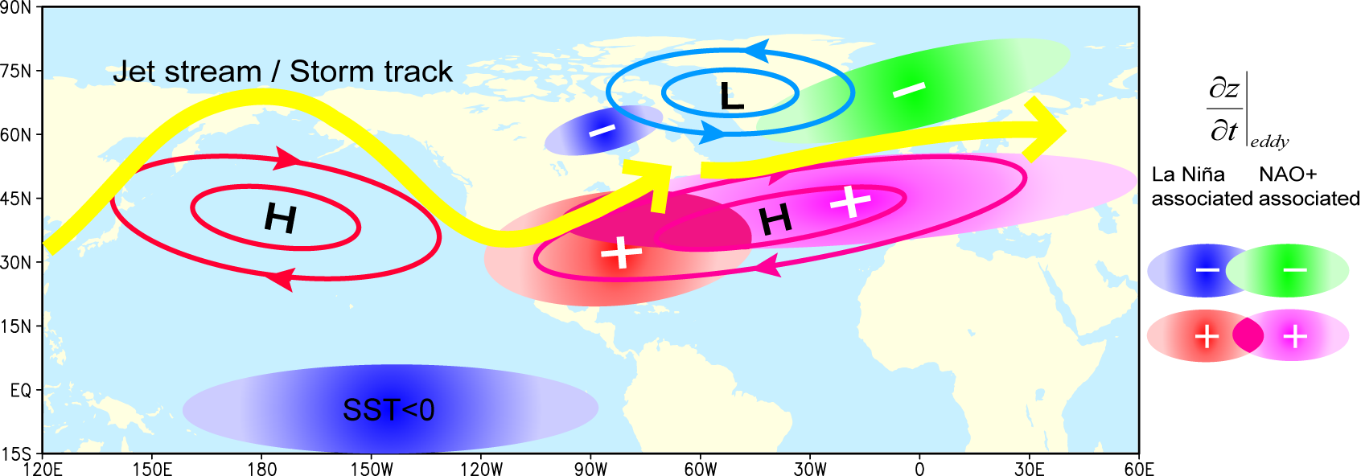
Schematic graph for transient eddy forcing
El Niño + NAO(-)
La Niña + NAO(+)

Slide 25
Envelop Function
Local instantaneous upper-level storm-track activity is measured by the square rot of the envelope function (Nakamura and Wallace 1990)
Envelop Function:
Prime: 2-10 day band-pass filtered Z250
Overbar: smoothing with an 10-day low-pass filter
Low-frequency circulation patterns were obtained from the 10-day low-pass filtering.

Slide 26
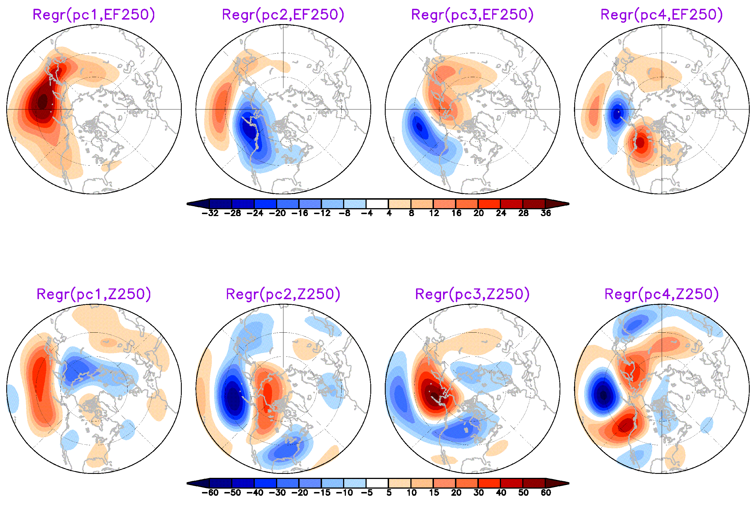
EOF of Envelop Function over N. Pac

Slide 27
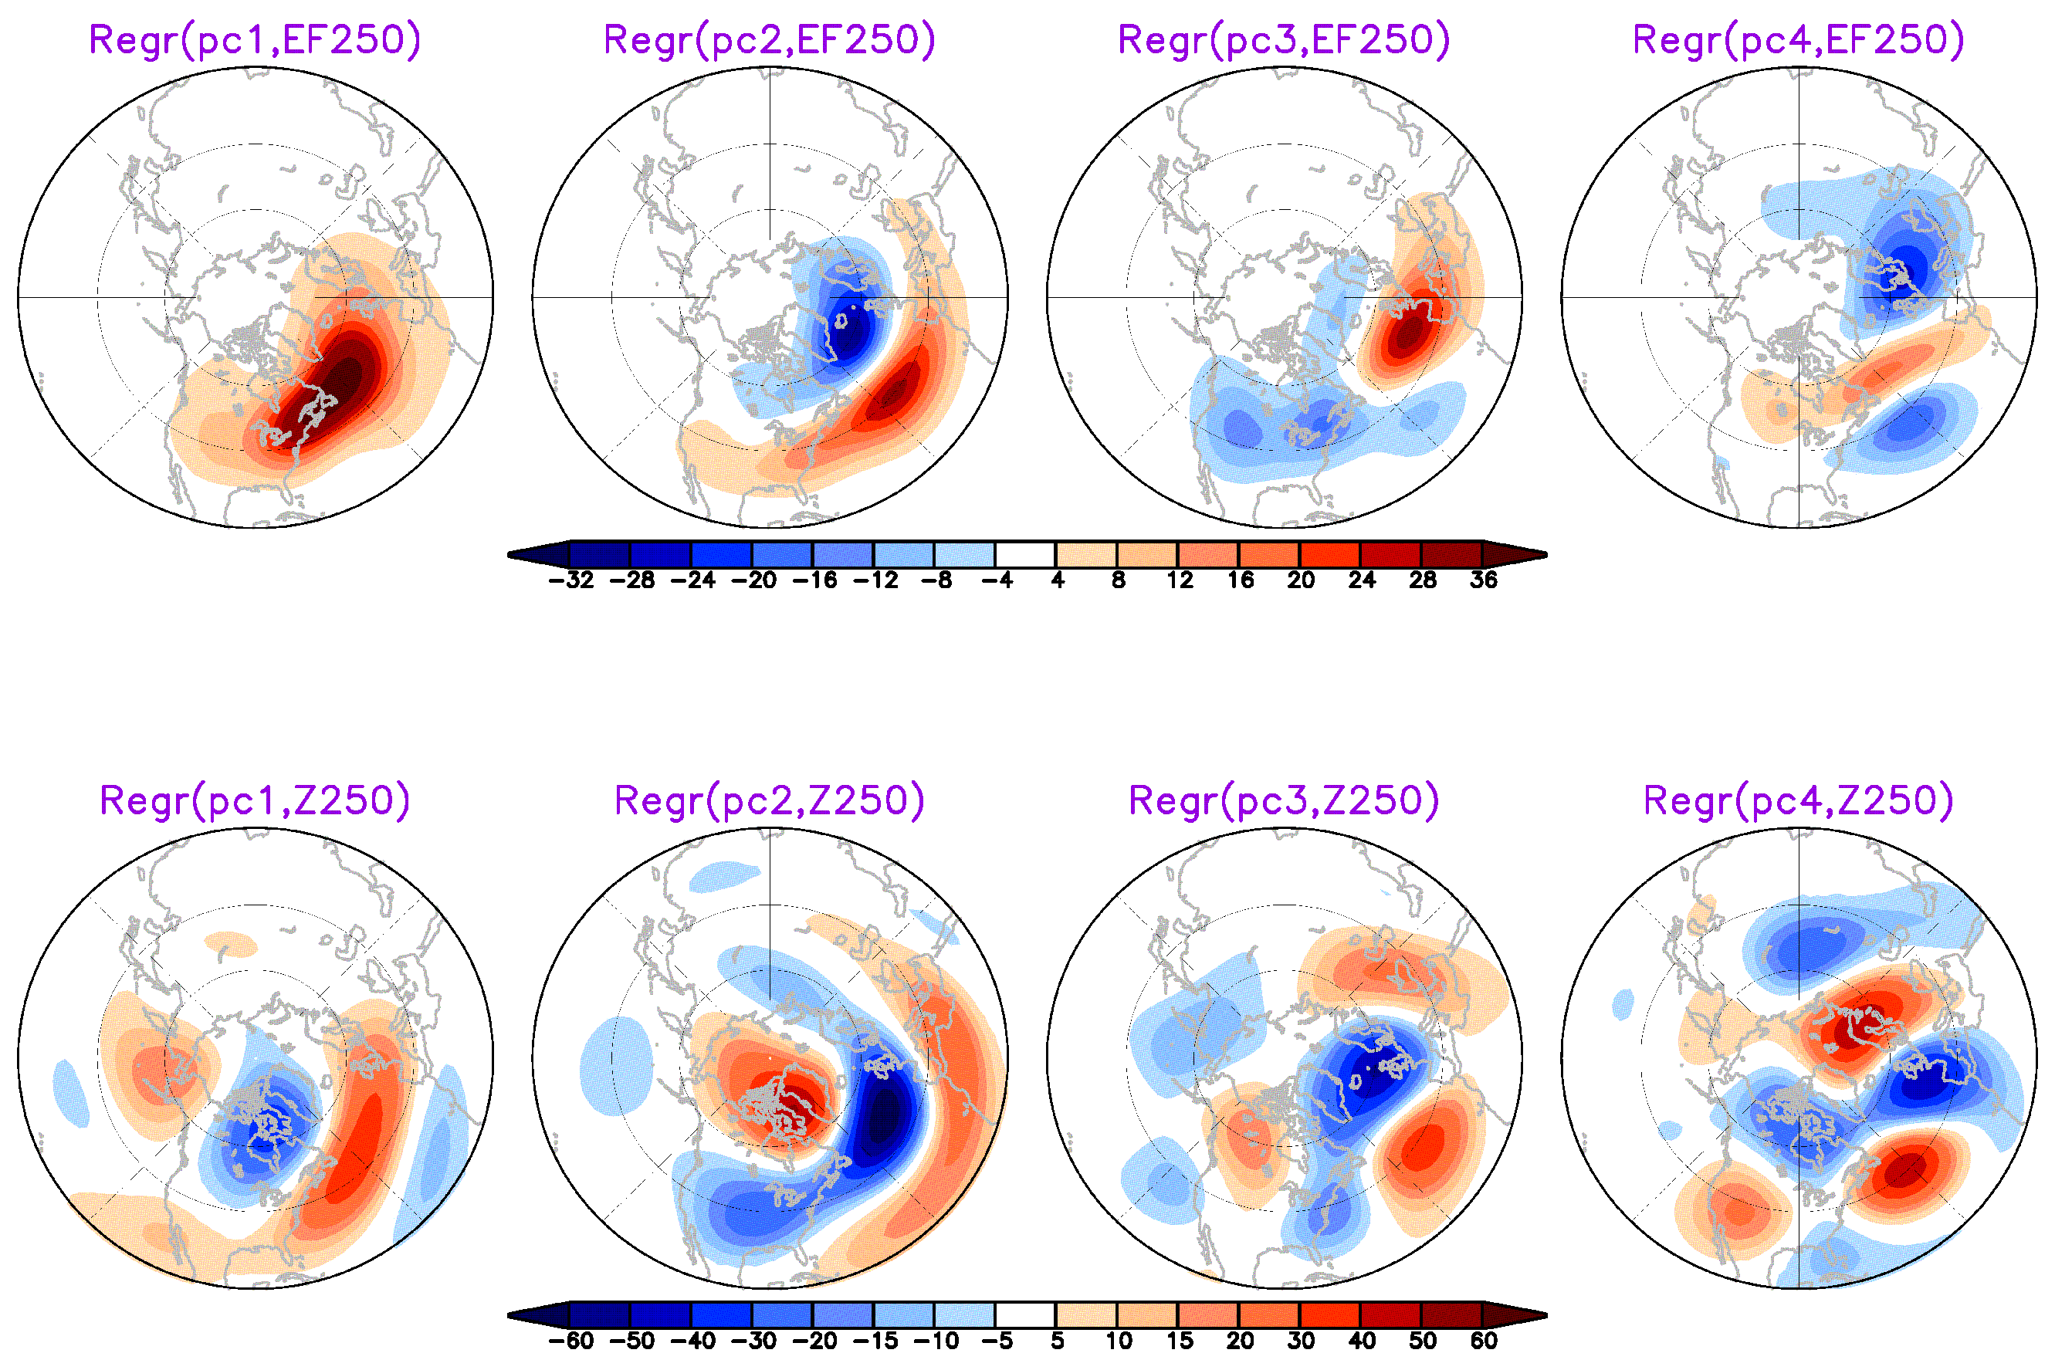
EOF of Envelop Function over N. Atl

