Slide 1
caBIG Competency Center
Persistent Systems
by:
Srikanth Adiga

Slide 2
Persistent Systems – Introduction
Overview | 18+ years focus on Outsourced Product Development (OPD) 4000+ employees, 180+ clients Presence in most verticals: life sciences, telecom, databases, email, messaging, identity management, storage, VLSI Global presence including US and Europe CMM 3 Certified
Life sciences and caBIG™ | Involved in caBIG™ since 2004, i.e. day-one of the program 10+ clients in leading medical research centers in US and Europe NCI Certified caBIG Service provider on all four support categories Funded participant of the VCDE workspace Applications developed: caTissue, caBench-To-Bedside, caFunctionExpress, GeneConnect, VCDE Compatibility Review System, caElmer

Slide 3
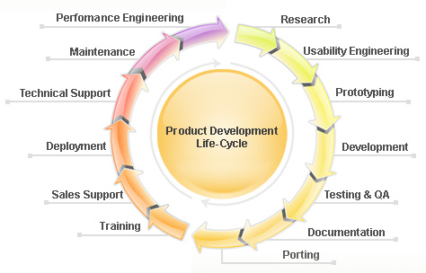
Persistent Advantage
One-stop-shop for all your software development needs
Vast experience working with academic organizations
Rich mix of domain and IT resources
Time-to-market accelerators for open-source solutions
“This is truly a unique and a powerful collaboration that we have established. We can leverage the wealth of biomedical domain expertise within our own medical center; together with the talents of a top-notch and nimble software design company, to rapidly design and deploy bioinformatics software applications that could never be created by either team in isolation. The synergy is tremendous and it really sets the standard for future software development in this field.”
Dr. Mark A. Watson (Director, Tissue bank, Washington University and brain behind caTissue)

Slide 4




















Representative Customers
Average length of engagement is 4.5 years
150+ Customers….1000+ Product Releases

Slide 5
caBIG Competency Center
caBIG application development and local customizations
Porting legacy non-caBIG applications to caBIG
Legacy data migration
Integration of caBIG applications with other IT systems (e.g. ADT, HL7 feeds, Cerner, path. reports, etc.)
Onsite and webinar based demos and trainings
Development training materials like eLearning portals, user manuals and guides

Slide 6
caTissue Professional Services
Get support from the people who developed caTissue!
Barcode printing
Interfacing with IT Systems
Local Customizations
Legacy data migration
Onsite Training
Gap Analysis, optimize workflows
Annual Maintenance Contract
Helpdesk: 1-877 –CATISSUE (9AM – 5PM ET)
Guaranteed to Go-Live within 1-3 months

Slide 7
caTissue/caBIG Experience
 | Interfacing (HL7, Print) | Data migration | Support | Customizations / Software dev. | Training
Washington University |  | √ | √ | √ | √
Yale University |  | √ | √ | √ | √
Indiana University |  | √ | √ | √ | √
Christiana Care Health Systems | √ | √ | √ |  | √
NCI CBIIT (EA Support Program) |  |  | √ |  | √
Emory University |  | √ |  | √ | √
University of Michigan |  |  | √ | √ | √
Dana Farber Cancer Institute | √ | √ |  | √ | √
Louisiana Cancer Research Consortium |  |  | √ |  | √
University of Edinburg (Scotland) |  |  |  | √
Accelerated Community Oncology Research Network, Inc. (ACORN) |  |  | √ | √ | √
Loma Linda University |  |  | √ |  | √
University of California, Davis |  |  | √ | √
Jackson Laboratories |  |  | √

Slide 8
Thanks
Call us 1-877-CATISSUE
cabig_services@persistent.co.in

