Slide 1
Digital RFC QPF Availability
Interagency Water Resource Meeting
March 28,2007

Slide 2
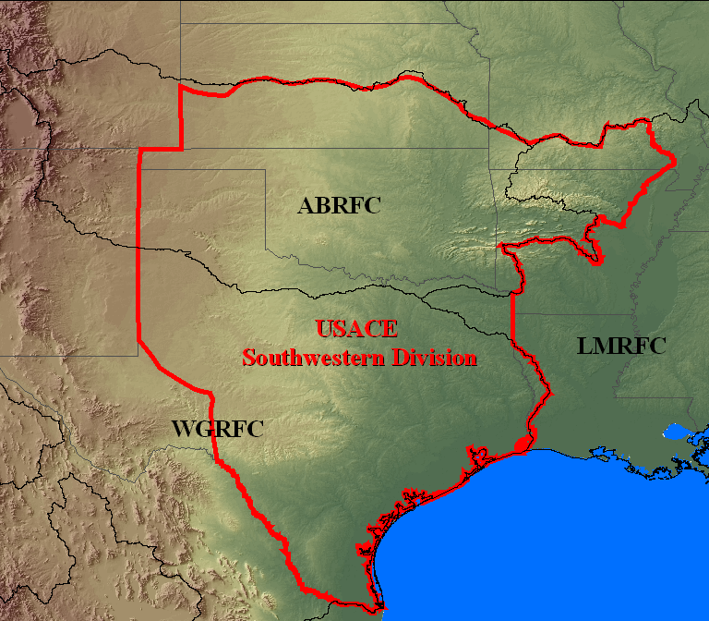
RFCs in the Southwestern Division

Slide 3
QPF Process
The Hydrometorological Prediction Center (NWS national center) issues national QPF forecasts
HPC issues 6 hour QPF forecasts out to 3 days based on guidance from the meteorological models
RFC HAS Forecasters incorporate local expertise and latest data to refine the HPC forecast
Coordinate with local forecast offices and HPC

Slide 4
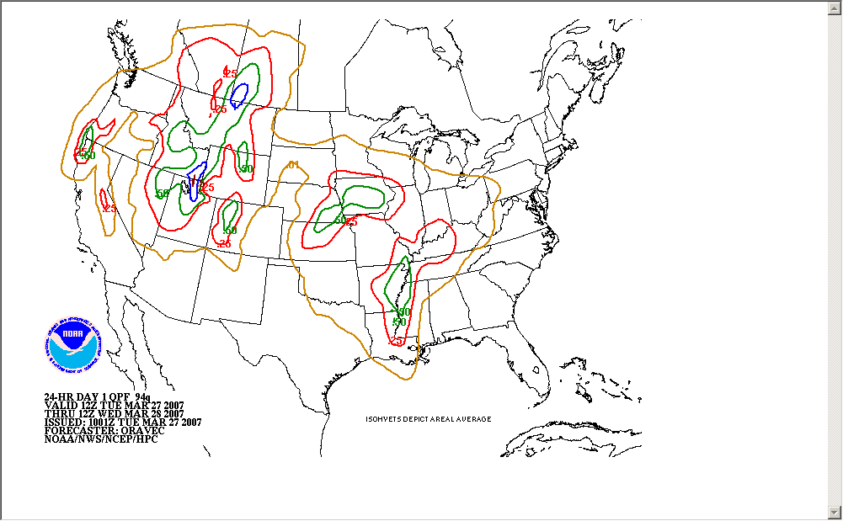
HPC QPF
24 Hour QPFs
Product | Issuance Time
94q (preliminary Day 1) | 0600Z & 1800Z
94q (final Day 1) | 1000Z & 2200Z
98q (preliminary Day 2) | 0600Z & 1800Z
98q (final Day 2) | 1000Z & 2200Z
99q (Day 3) | 0800Z & 2000Z
Forecast Discussion (QPFPFD)
Preliminary Day 1 | 0700Z & 1900Z
Preliminary Days 1-3 | 0900Z & 2100Z
Final Days 1-3 | 1100Z & 2300Z

Slide 5
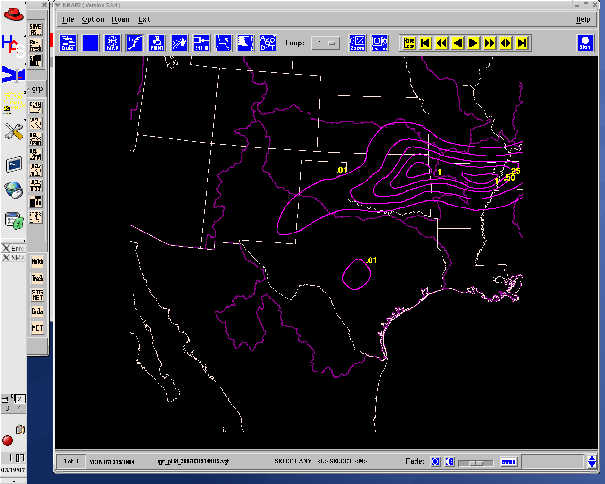
NMAP Program

Slide 6
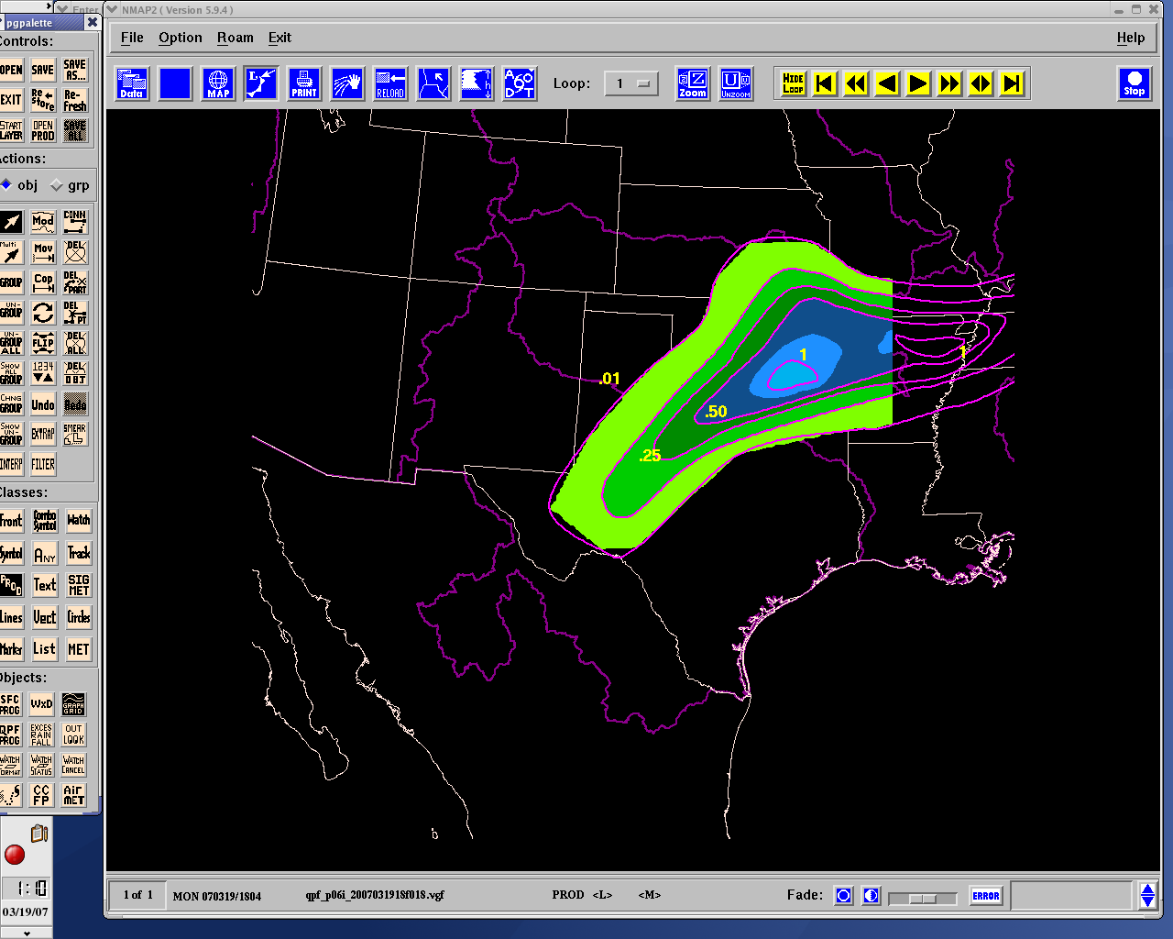
NMAP Program

Slide 7
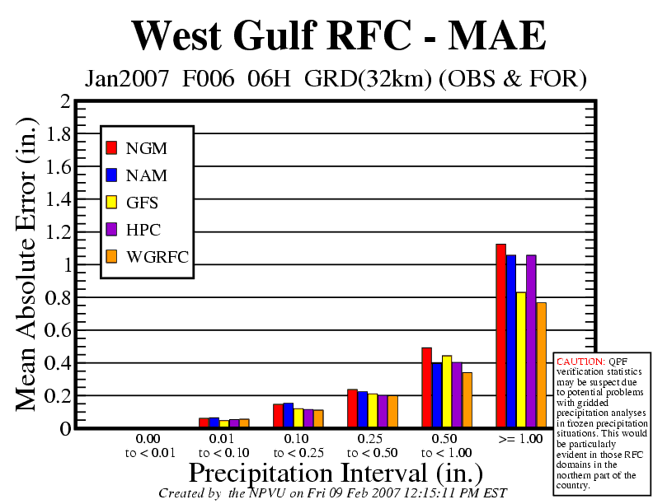
Adding Local Expertise

Slide 8
RFC QPF Metrics
Up to 72 hours of QPF generated
Discrete 6 hour periods
Number of periods generated dependent on issuance time and issuing RFC
Gridded precipitation produced on 4x4 km grid (HRAP)
NWS hydrologists normally incorporate first 1 to 4 periods (6 to 24 hours) into hydrologic models
Dependent on RFC, type of rain event, time of year
Up to all 12 periods (72 hours) can be used during significant events, such as tropical systems

Slide 9
RFC QPF Availability
RFC | Regular Issuances | Number of Hours | Digital Data Available? (Where?) | Digital Format
 | Supplemental
ABRFC | 12z 18z 00z | 48 24 48 | Yes ABRFC web page | netCDF
 | 06z (as staffed) | 24
LMRFC | 12z 18z 00z | 72 54 72 | Yes NWS SR Server | XMRG
 | 06z (as staffed) | 54
WGRFC | 12z 00z | 72 72 | Yes NWS SR server | GRIB XMRG
 | 18z (flood events) 06z (as staffed) | 54 54

Slide 10
Digital Data Formats
XMRG – Internal NWS format used for transferring gridded precipitation into the NWSRFS river forecast model
GRIB – GRIdded Binary format approved by the World Meteorological Organization (WMO)
NetCDF – Network Common Data Format developed by Unidata
Shapefile – Standard GIS format developed by ESRI
VGF – Vector Graphic Format used by HPC to transfer QPF to RFCs

Slide 11
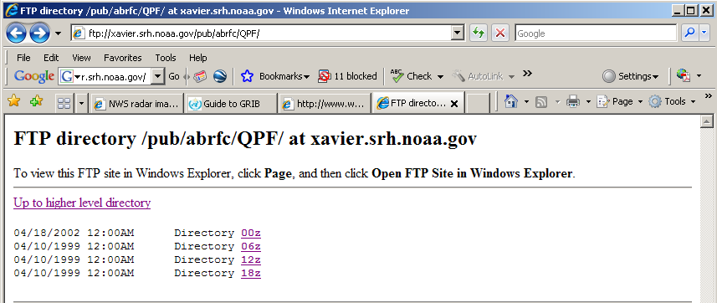
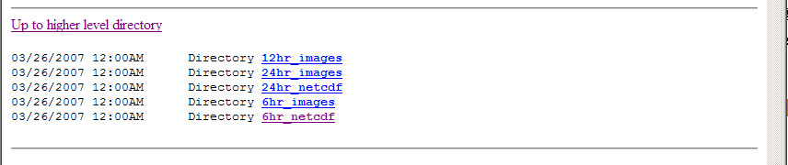

ABRFC QPF Availability

Slide 12
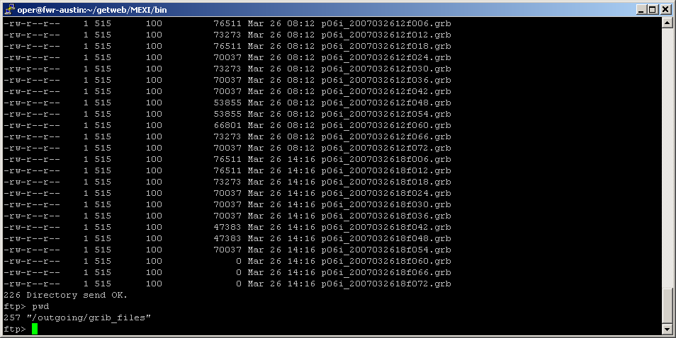
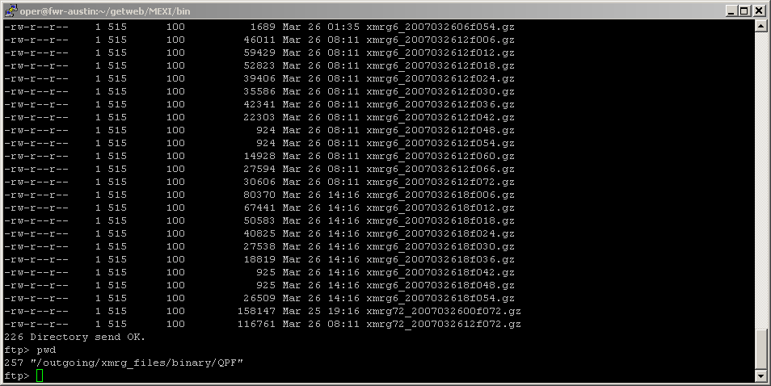
WGRFC & LMRFC QPF Availability
Password protected site ftp://ftp.srh.noaa.gov/wgrfc/

Slide 13
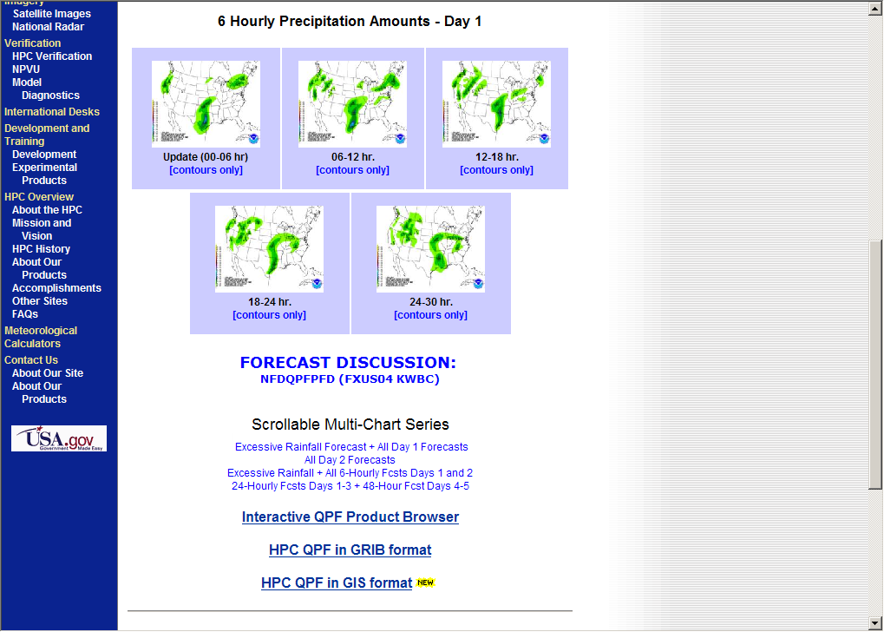
HPC QPF Availability
http://www.hpc.ncep.noaa.gov/qpf/

Slide 14
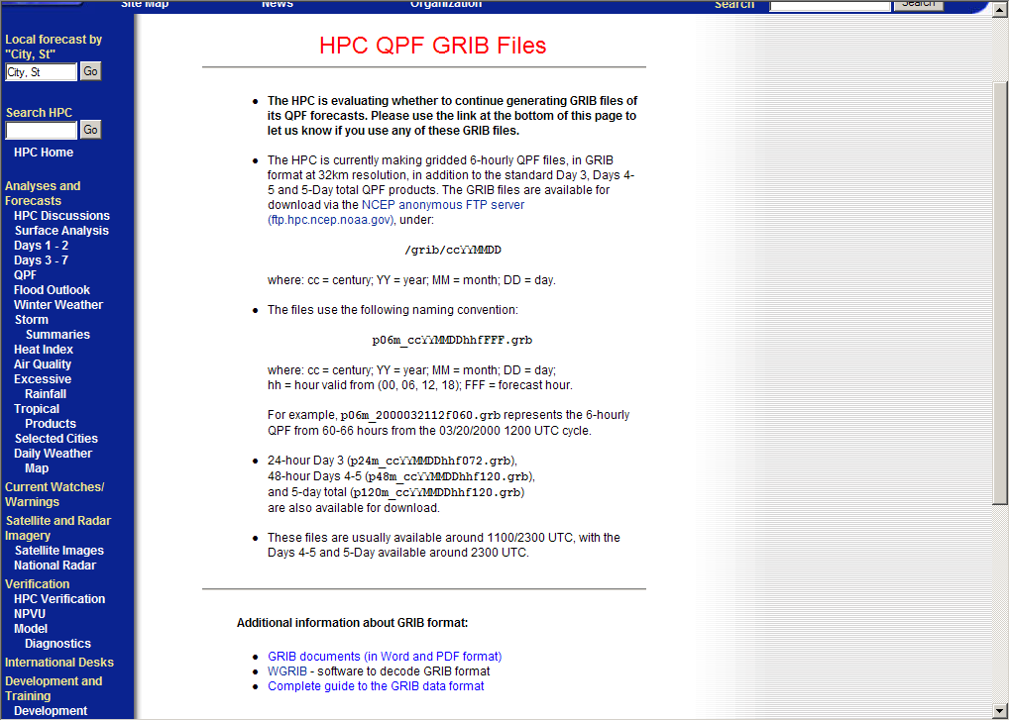
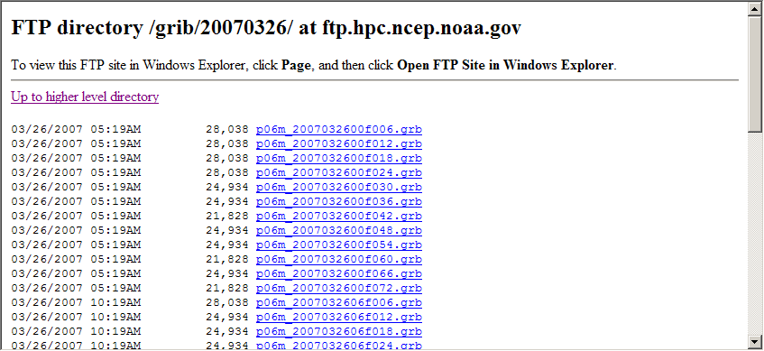
HPC QPF Availability

Slide 15
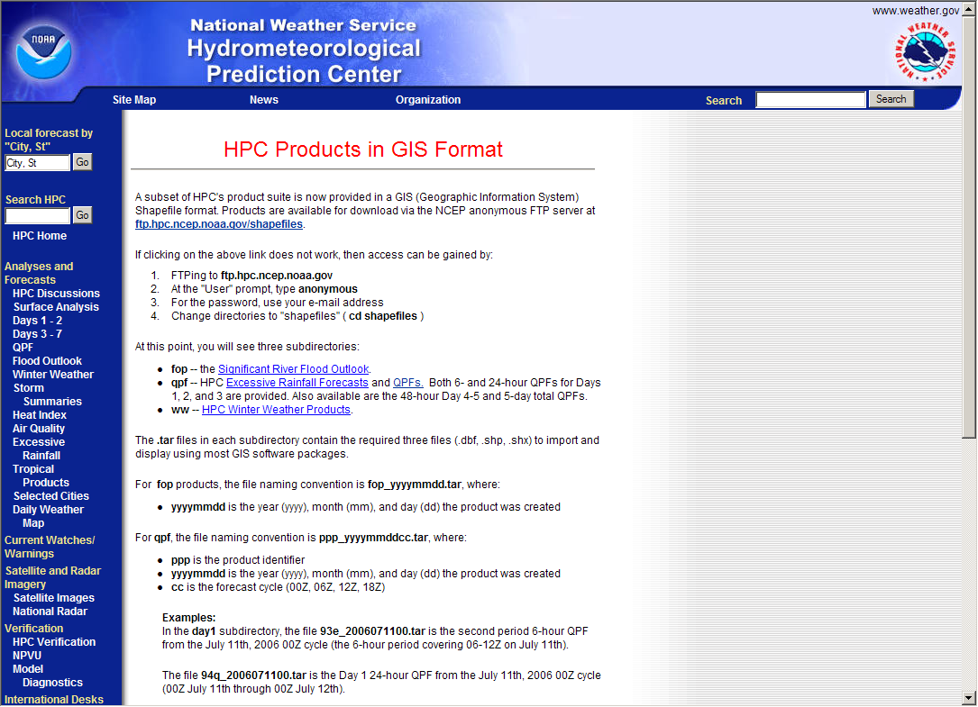
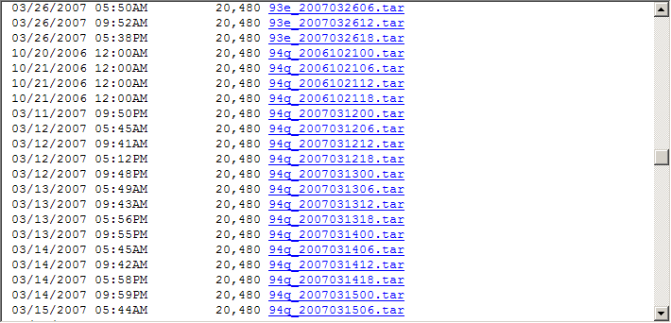
HPC QPF Availability

Slide 16
Digital Data Formats
Questions & Discussion

