Slide 1
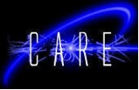




global crab-cavity simulation & theory effort
F.Z.
1. Beam-beam studies:
a. K. Ohmi (KEK) - white noise - SS & WS simulations , BBSS code,
scaling law with respect to noise correlation time,
effect of RF curvature, luminosity estimates
b. Y.-P. Sun, U. Dorda, R. Tomas (CERN); R. Calaga (BNL) –
single particle dynamics , Sixtrack/MADX/BBTRACK codes
WS simulations, footprints, luminosity, noise spectrum,…
c. J. Qiang (LBNL), SS simulations, BeamBeam3D code
2. Collimation & impedance:
a. Y.-P. Sun, R. Tomas, J. Barranco, F. Zimmermann (CERN);
R. Calaga (BNL) – Sixtrack/Colltrack tracking, cleaning efficiency
b. F. Zimmermann, E. Metral (CERN); R. Calaga (BNL),…:
impedance estimates and HOM damping requirements
3. Operational scenarios:
a. A. Morita (KEK); R. Calaga (BNL); R. Tomas, F. Zimmermann (CERN):
crab ramping/detuning studies
b. K. Oide et al (KEK): joined KEKB machine experiments & studies

Slide 2
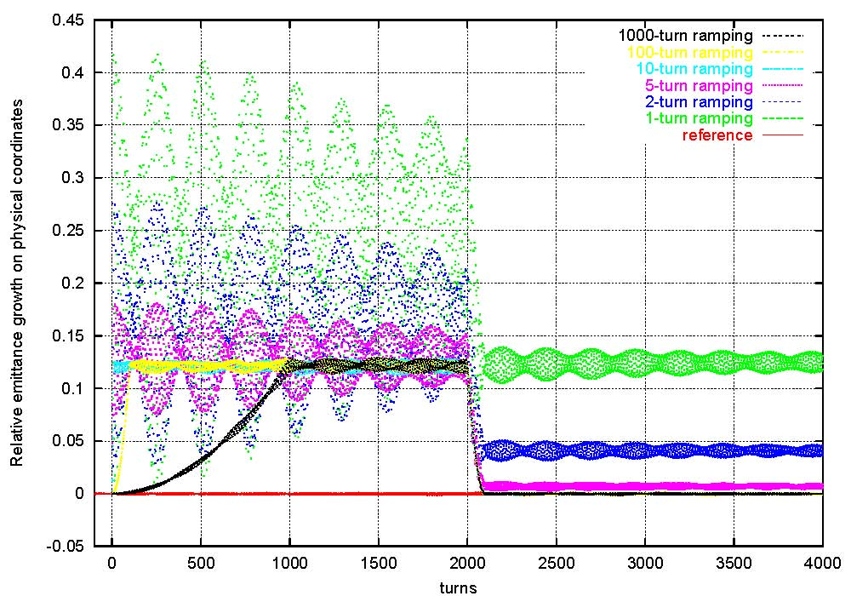
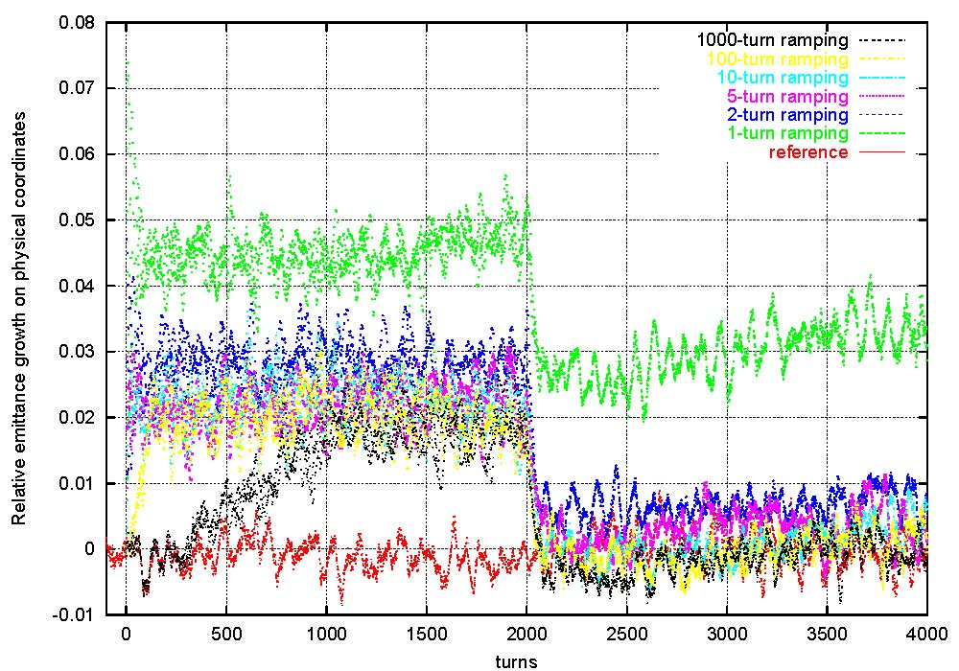
example:
emittance growth due to crab up/down ramping
F.Z.
Akio Morita
Akio Morita
w/o tune spread
with tune spread
→ no emittance dilution for ramp time > 10 turns
→ voltage ramping not a problem for Q_{loaded}>10⁶
Akio Morita

