Slide 1
High Level LHC Schottky Software Development
Jerry Cai
& The LAFS Team
28 January 2009
Presented by Elliott McCrory

Slide 2
High Level LHC Schottky Software
Initial version of High Level Software for LHC Schottky project has been completed.
Implements the requirements from:
“4.8 GHZ Schottky Software—High Level Requirements “
EDMS Document # 908986
by Andreas Jansson and Dave Mcginnis of Fermilab and Ralph Steinhagen (BE/BI)

Slide 3
Schottky Software
Integrates experience at Fermilab from the Tevatron Schottky system
It consists of two parts:
Monitor Application
Daemon
Control & Display Application
Operations GUI

Slide 4
Design Concept: Monitor and Control & Display
Beam Mode
Settings & Readings Configuration DB*
Monitor Daemon
Device Settings
ModeMap
Control & Display App
Schottky Front End/FESA
Setup Phase Only
Device Readings
Calculation Engine
Incl. Heartbeat
Publish/ Subscribe
Logging DB
SDDS

Slide 5
Monitor Application
Runs continuously in the background as a “Daemon Process”
Key Elements:
Configures Schottky per Beam Mode
See next slide
Reads raw FFT data from Schottky
Performs fits for:
Tune,
Momentum Spread,
Emittance,
Chromaticity, and
Averages of these
Publishes these results
Archives these results
Creates SDDS Files, post-mortem data sets and provides these data for the logging DB

Slide 6
Daemon: Interaction with Schottky
Reacts to the Beam Mode
The Monitor listen for changes in LHC Beam Mode
Configures Schottky hardware based on Beam Mode
Unique configuration table:
One “row” of settings per LHC Beam Mode
Each column is a settable attribute in the FESA class
Assumes the Schottky FESA class exists!
Control & Display GUI can change the configuration table
Is the only agent to receive raw Schottky data directly
Republishes raw data
Publishes calculated data
A true “daemon process”

Slide 7
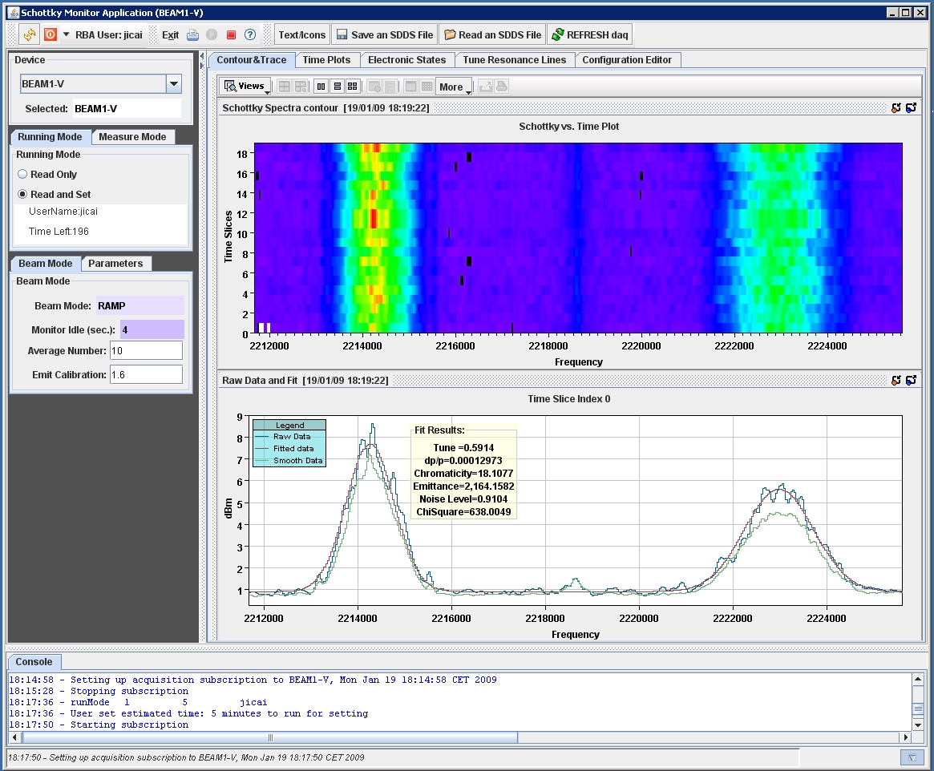
The Control and Display Application

Slide 8
Control & Display App (1/3)
Operations GUI
Subscribes to data from the Monitor
Displays these data
Can also display archived and post-mortem data
Two different run modes
READ ONLY
default
READ and SET
allow user to change things in the Monitor

Slide 9
Control & Display App (2/3)
Responsible for setting up configuration table for Monitor Daemon
Config Table:
One row per Beam Mode
One column per settable attribute in the hardware &/or the FESA class
Tables are saved in SDDS files
Would like to have a Config DB
Monitor reads “default.sdds”
Multiple Control & Display instances?
Each can read from the Monitor
Only one is allowed to have setting rights at a time
User requests setting rights from Monitor for N minutes
RBA Login Required

Slide 10

Control & Display App (3/3)
GUI has four sections:
Top Tool Bar
to exit program, read archived data ,etc.
Left Selection Panel
to select device and running mode
Central Tabbed Panel
to display data, create and load configuration tables, etc.
Bottom Console
to show messages while program is running

Slide 11
Screen Shots of GUI
Tabs
Contour and Trace
Live or Archived data/Post-Mortem
Time Plot
Live or Archived data/Post-Mortem
Electronics States/Live Schematic
Tune Resonance Lines
Configuration Editor
6. Selecting bunch/gates

Slide 12
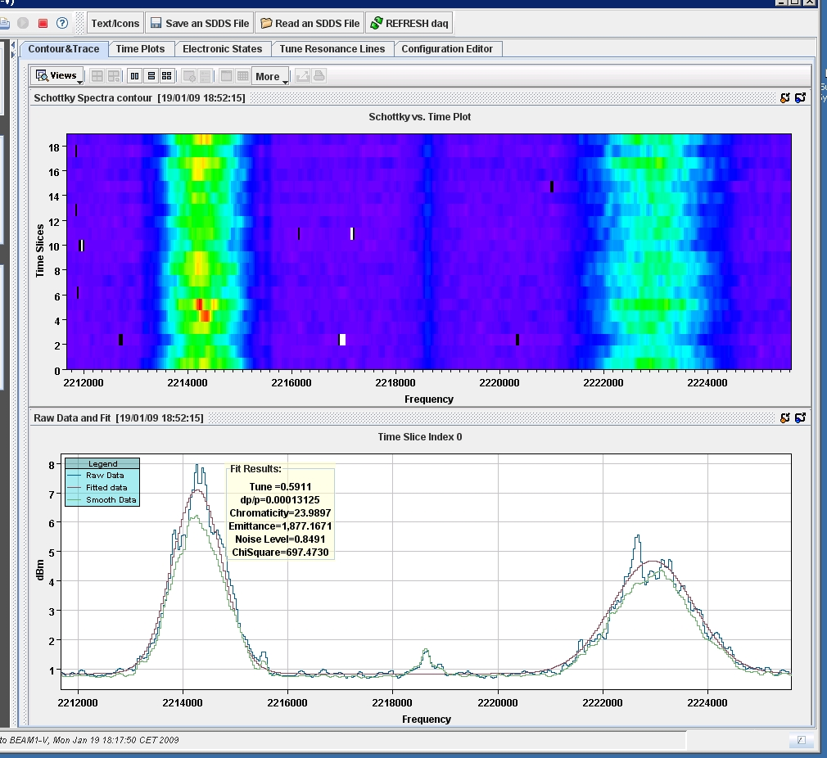
Tab for Contour and Trace (1/6)

Slide 13
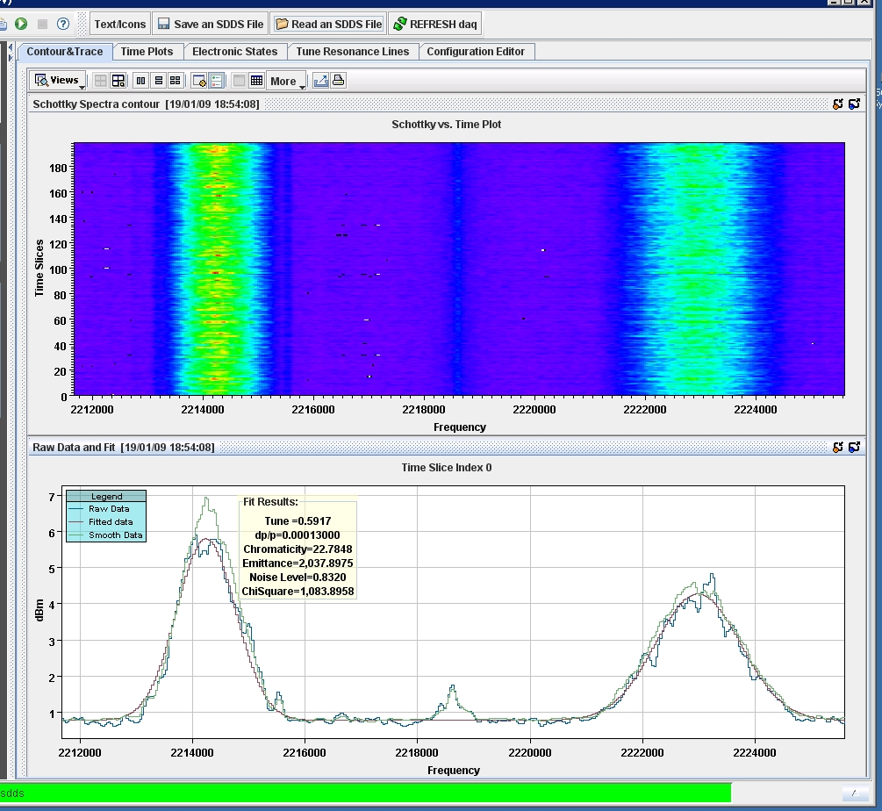
Post-Mortem data dump (200 spectra)

Slide 14
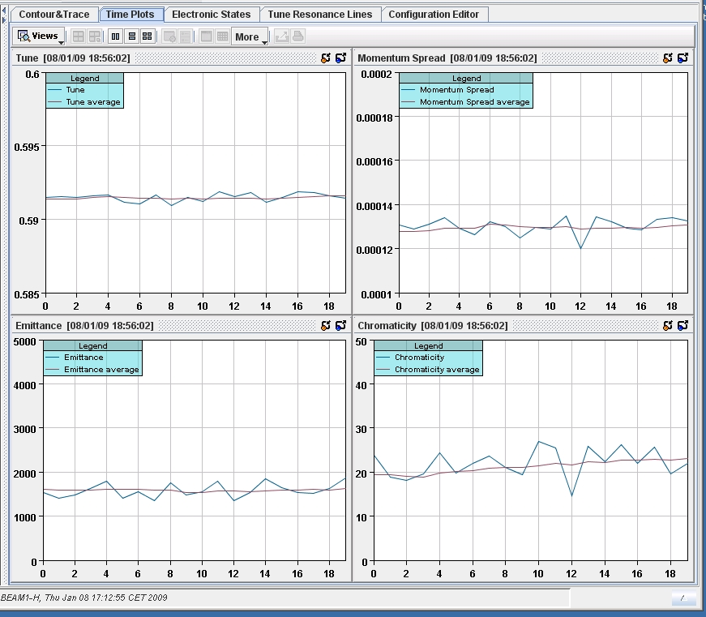
Tab for Time Plot (2/6)

Slide 15
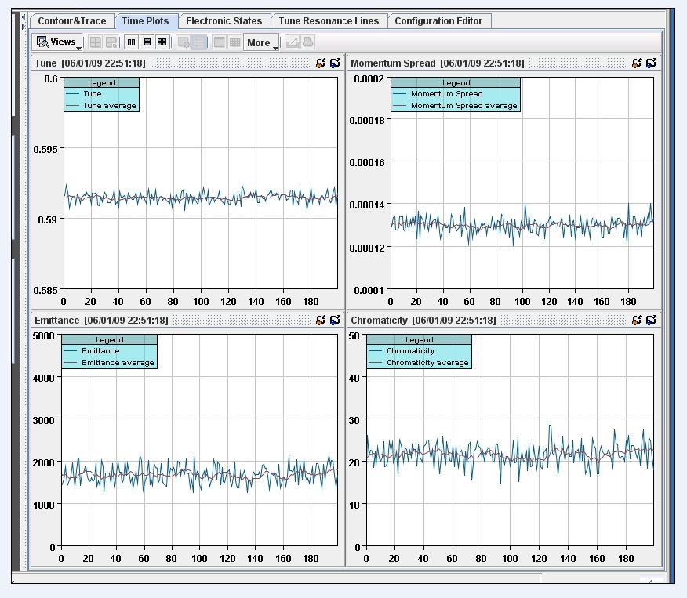
Time Plot for Post-Mortem Data

Slide 16
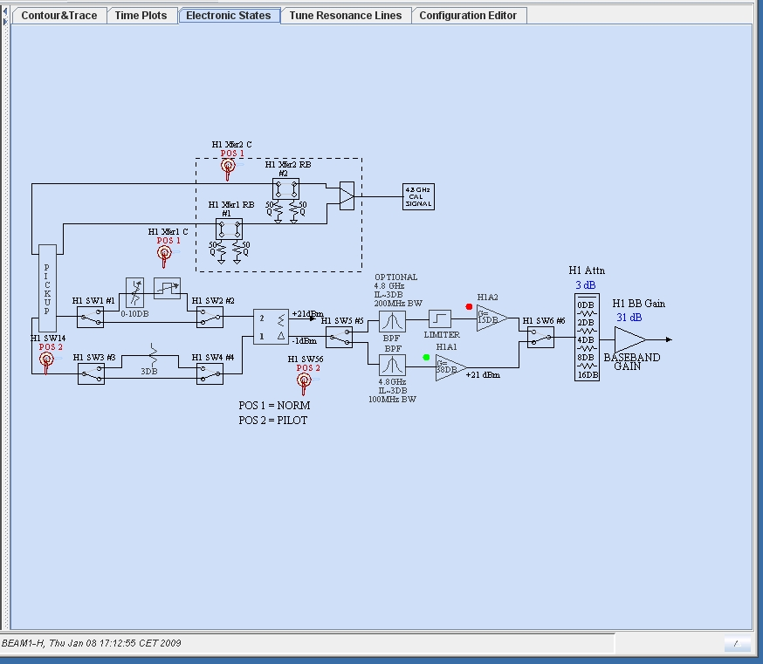
Tab for Electronic States (3/6)
Active elements are colored

Slide 17
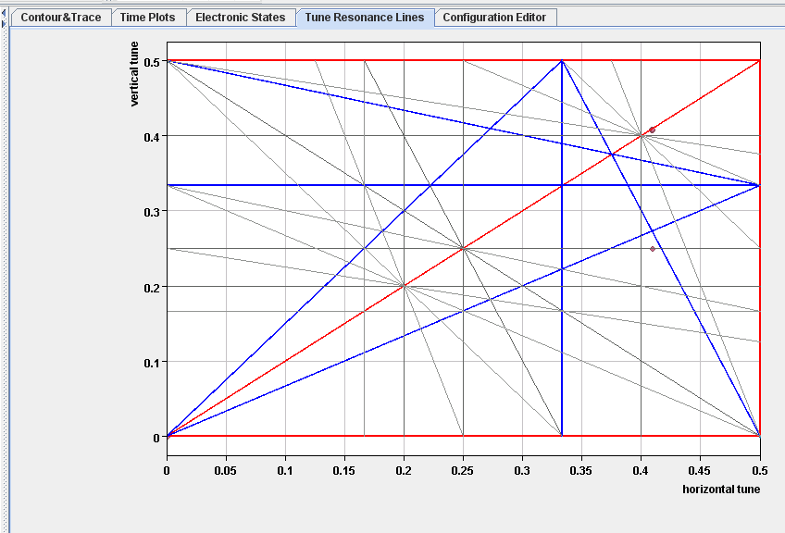
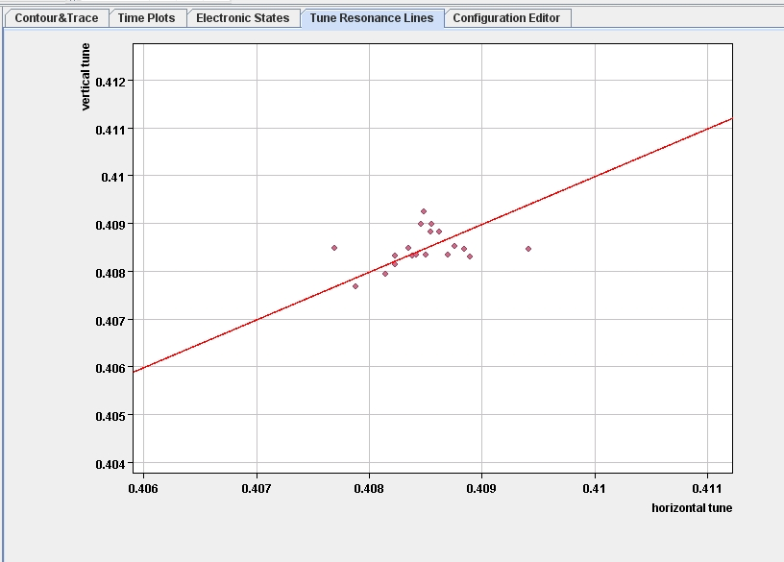
Tab for Tune Resonance Lines (4/6)
Zoom in, using JDataViewer zooming

Slide 18
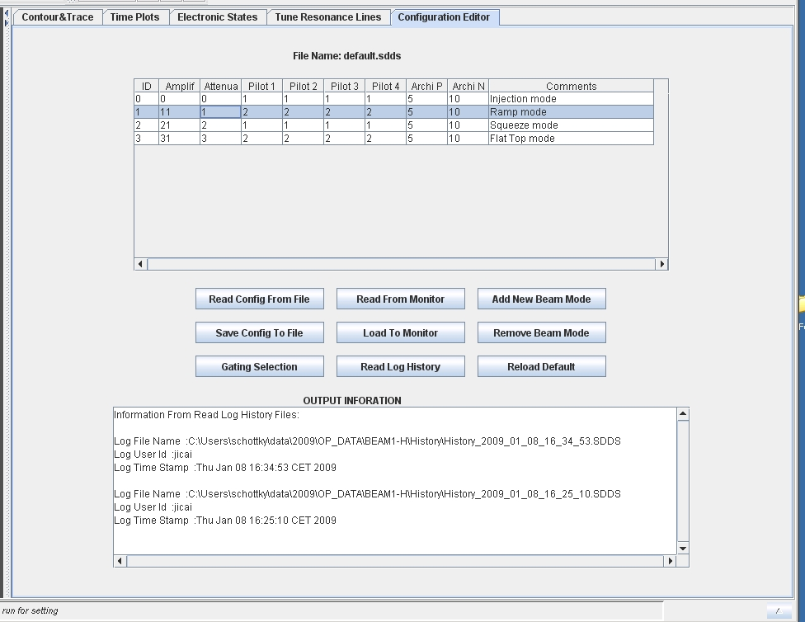
Tab for Configuration Editor (5/6)

Slide 19
Details of Configuration Editor
Row:
Beam Mode
Column:
A settable item in the Schottky front end
On the Electronics States diagram/schematic
Can read
Live configuration from Monitor
SDDS save files
History files
Can change any value in this table
Table can be extended easily in the Java
Disposition?
Send to Monitor
emporarily change live table, or
Create a new“default.sdds”
SDDS Save File/Config DB
Invisible control: Beam gating (next slide)

Slide 20
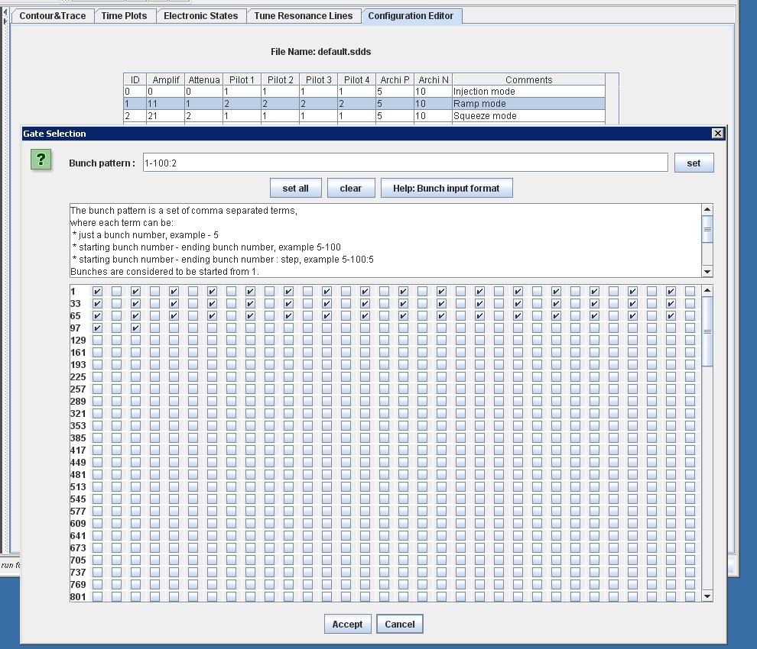
Bunch Gates: View and Set (Popup window, 6/6)

Slide 21
Running the Suite
CVS Package
lhc-daemons/lhc-daemon-schottky
Monitor Application
Must start this first
cern.lhc.daemon.schottky.monitor.MonitorMain.java
Control & Display Application
cern.lhc.daemon.schottky.controller.ControlMain.java

Slide 22
Comments
Users Guide & this talk available from Wiki
https://wikis.cern.ch/display/LAFS/Schottky
Known limitations of this demo
It does not connect with any LHC hardware
No FESA class
Daemon & GUI must be run on the same PC.
Using SDDS files instead of a Configuration DB
Awaiting proper “Command” communications example
From M. Misiowiec.
Do not run multiple Monitors at the same time, anywhere in the Control System—the subscriptions will not work properly.

Slide 23
Summary
This initial version of high level LHC Schottky Software has implemented the elements of the requirements document.
Monitor Process/Daemon
Control & Display Application/Operations GUI
Improvements?
“Configuration DB” is implemented as local SDDS files
need BE/CO/DM help
BE/OP feedback
Better use of JAPC-standard communications
Issue: FESA class not yet available.
This demo uses stored data from the Schottky monitors in the Tevatron.
Acknowledgements

