Slide 1
How to Create an Account on GForge
Ranjana Srivastava
Booz Allen Hamilton

Slide 2
GForge Site
Access at
https://gforge.nci.nih.gov

Slide 3
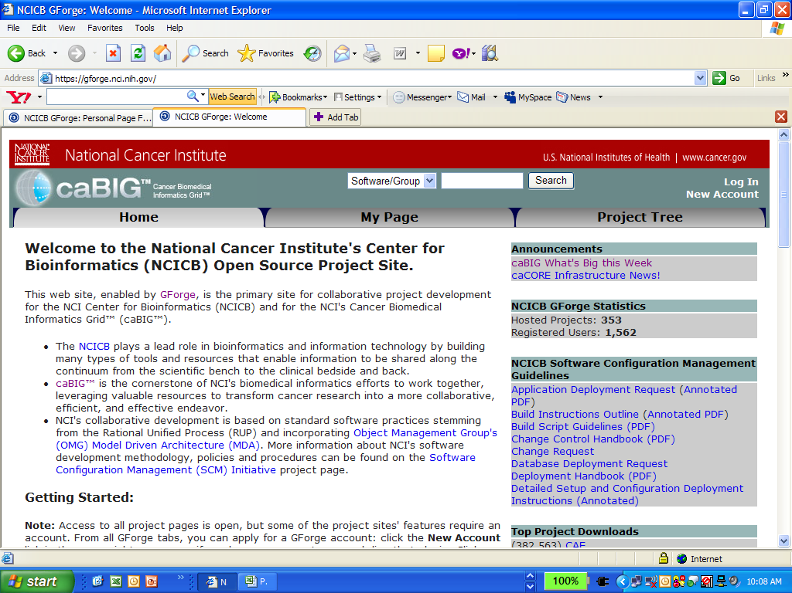
Click on “New Account” hyperlink

Slide 4
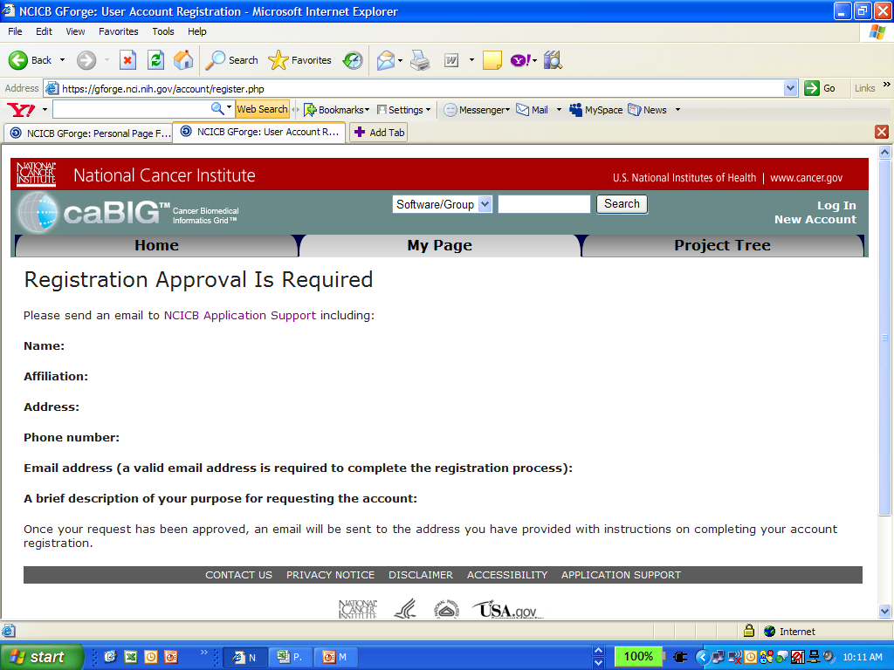
NCICB Application Support
Click on Hyperlink to send email
Send the requested information in your email

Slide 5
How to Request to join the CTCAE Project
Login to gForge website at
In the search field type “CTCAE”; press Search
Click on “CTCAE Terminology Set Development” hyperlink
Scroll to the bottom of the page
Click on ‘Request to join’
Enter into the text field something like “I am aWorking Group Member”, and click on “Submit”

Slide 6
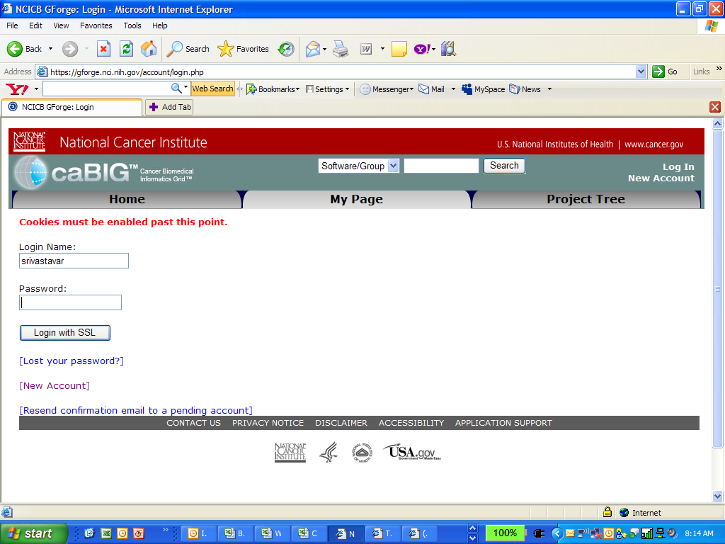
Login to gForge website at https://gforge.nci.nih.gov

Slide 7
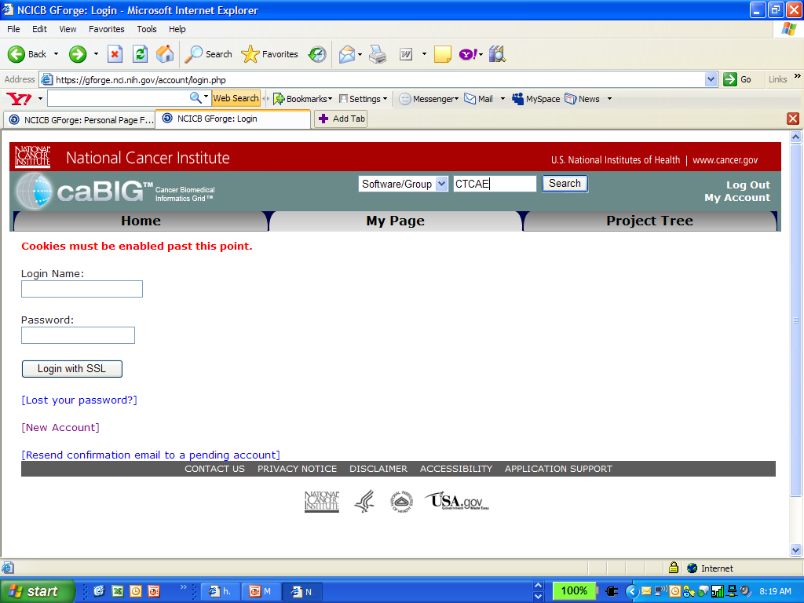
In the search field type “CTCAE”; press Search

Slide 8
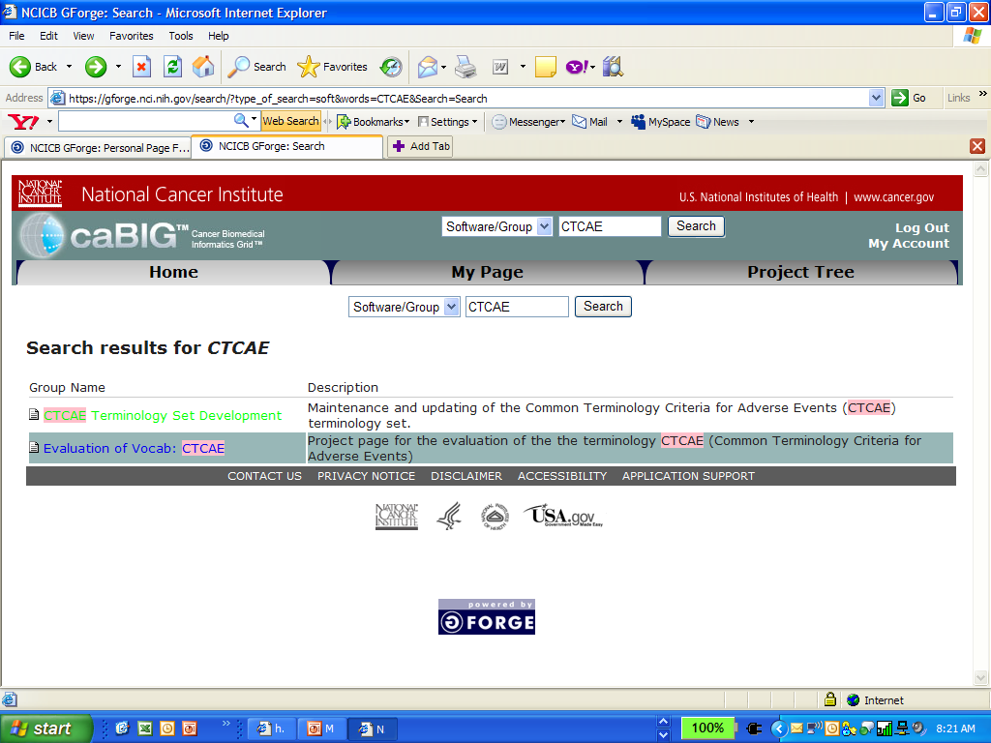
Click on “CTCAE Terminology Set Development” hyperlink

Slide 9
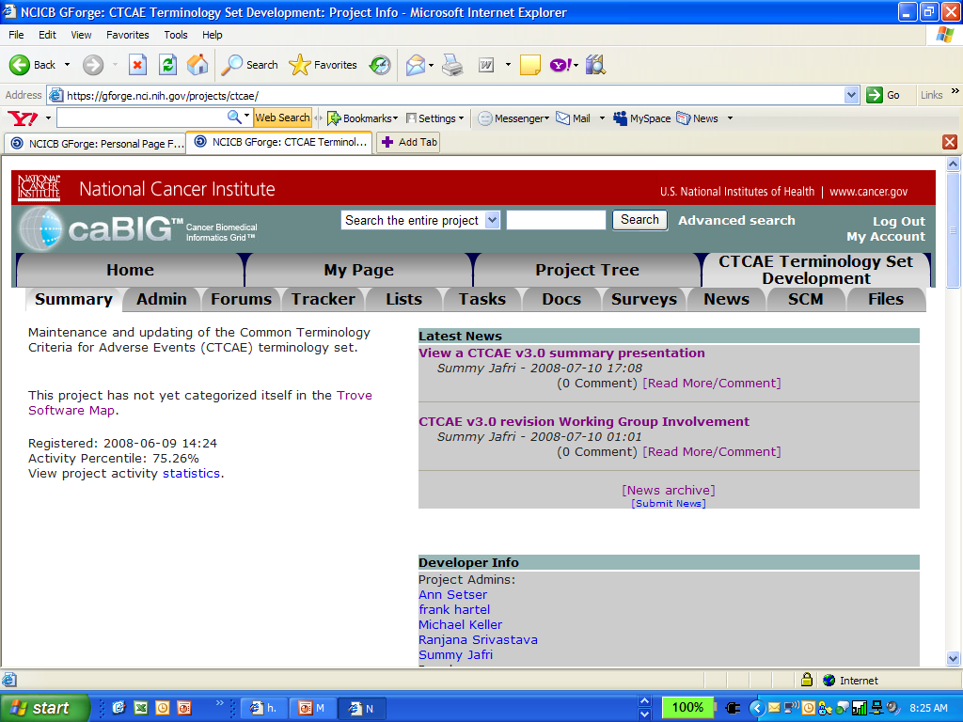
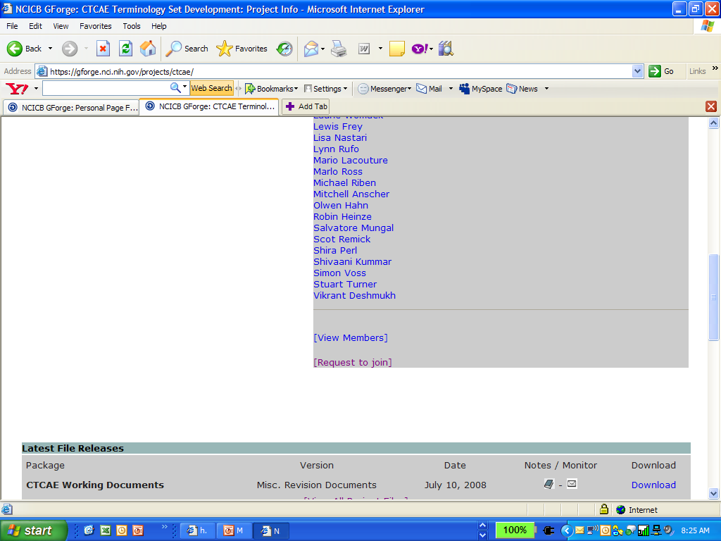
Scroll to the bottom of the page
Click on ‘Request to join’

Slide 10
Scroll to the bottom of the page
Click on ‘Request to join’

Slide 11
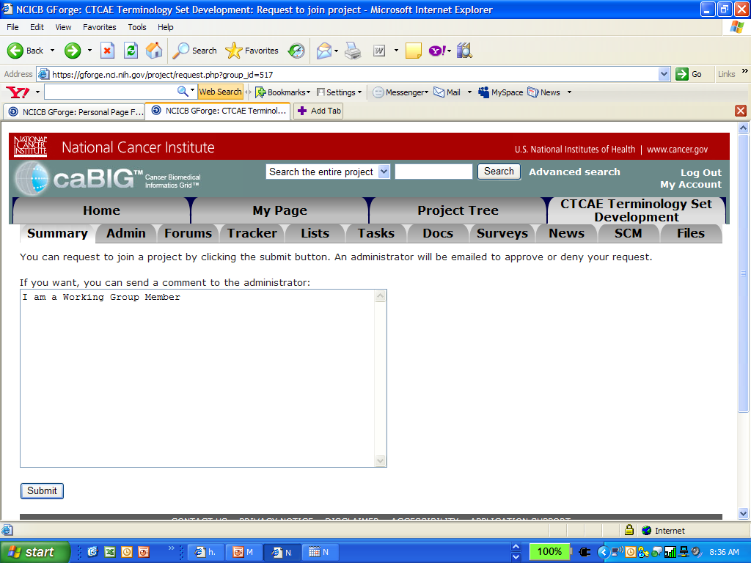
Enter into the text field something like “I am a Working Group Member”,
and click on “Submit”

Slide 12
You will have access to the project, once the project administrator assigns you the privileges.
Now you may access the project files and project documents.

Slide 13
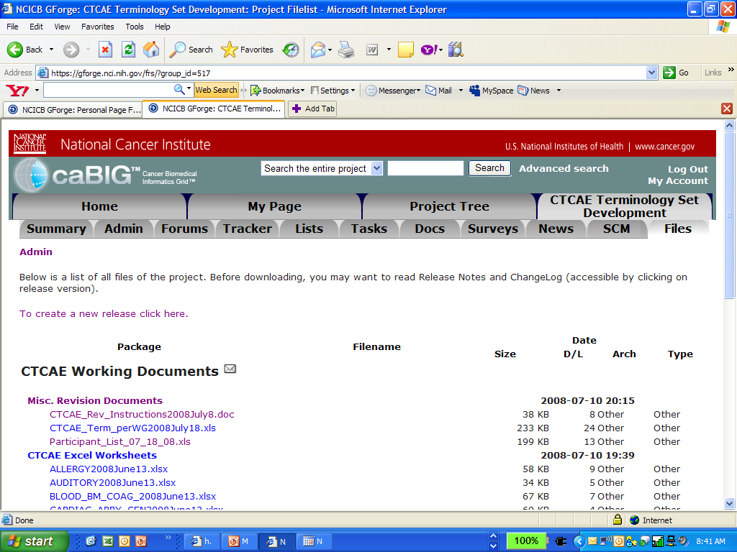
Now you may access the project files under the flies tab
You may access the project documents under the Docs tab

