Slide 1
Run-08 pC analysis summary
CNI meeting
Sep 4th, 2008
Vipuli Dharmawardane (NMSU)

Slide 2
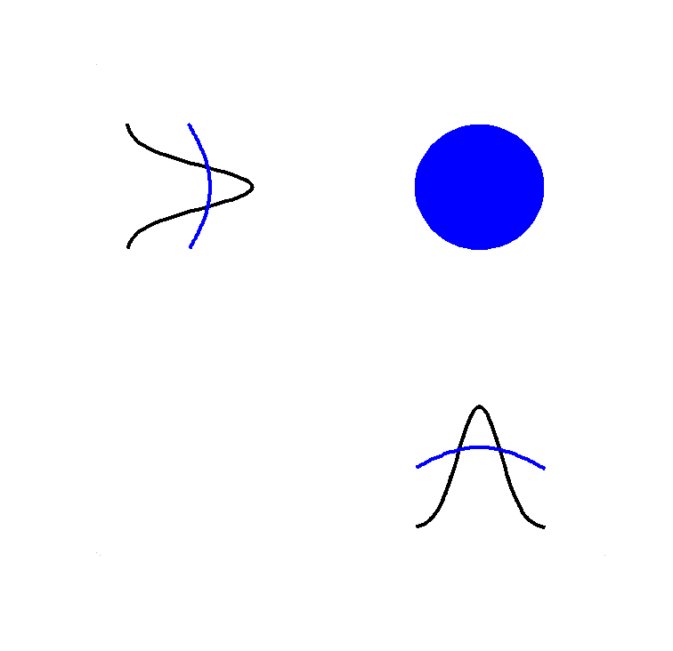
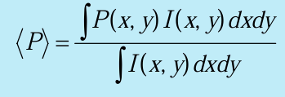
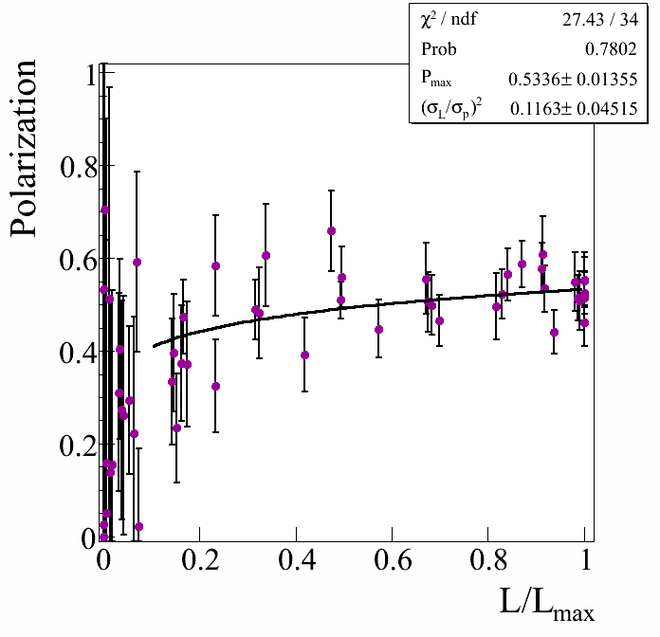
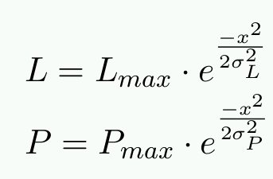
Polarization Profile
VERTICAL / HORIZONTAL
SCANS
A fit to P Vs L/L_{max} to determine P_{max} and σ_{L}/σ_{P}
Intensity/
Polarization
profile
Fixed target measurements
P_{max}

Slide 3
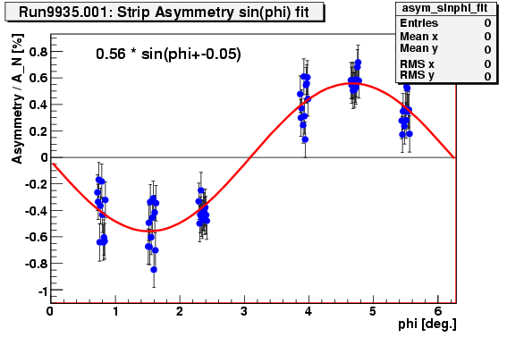
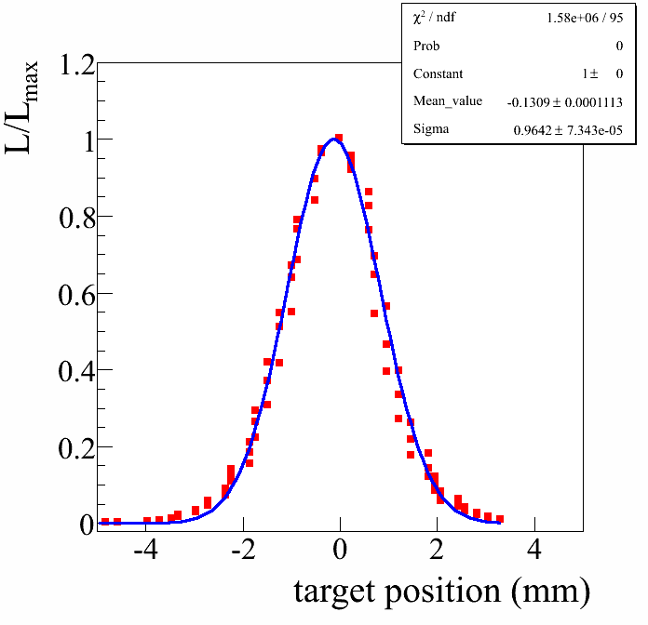
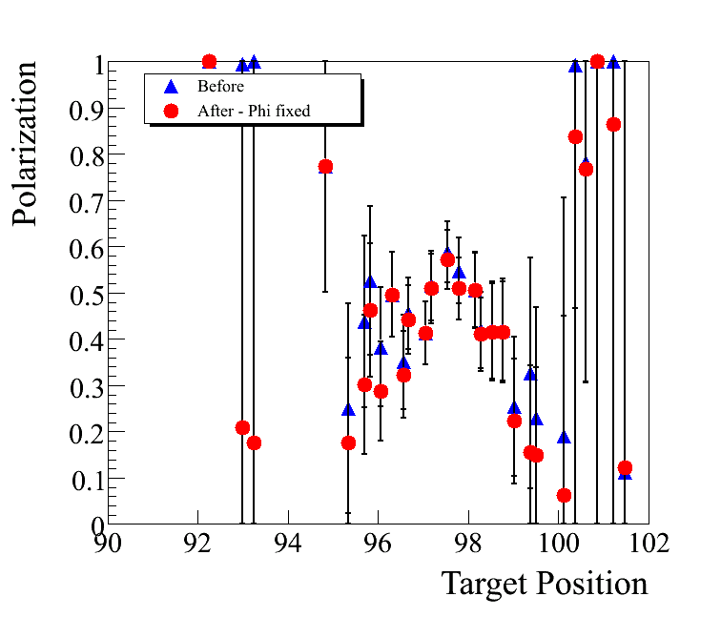
Polarization Profile
RUN08
Φ₀ was kept fixed at average Φ₀
Polarization for each target position is determined by doing a sin phi fit to asymmetry Vs phi measured at each target position

Slide 4
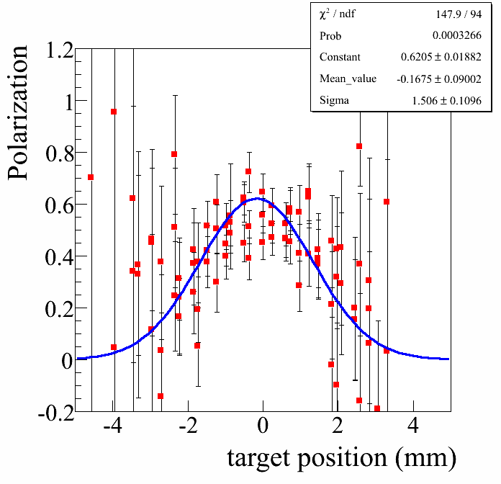
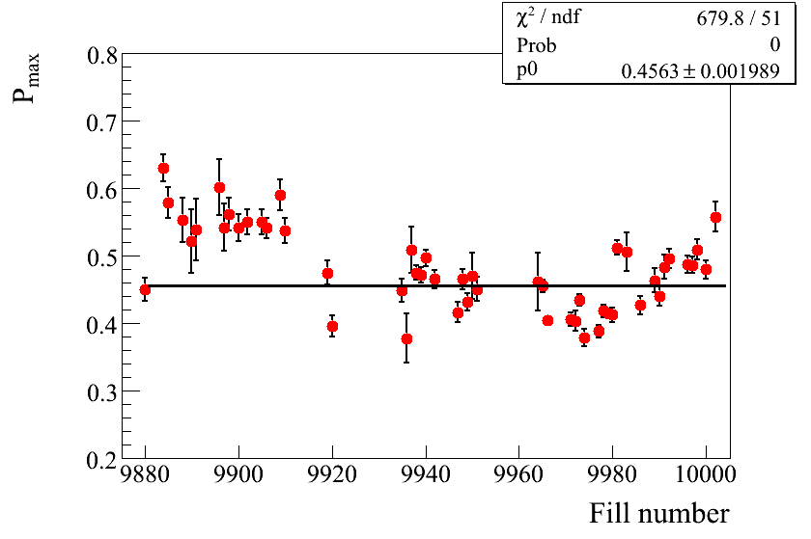
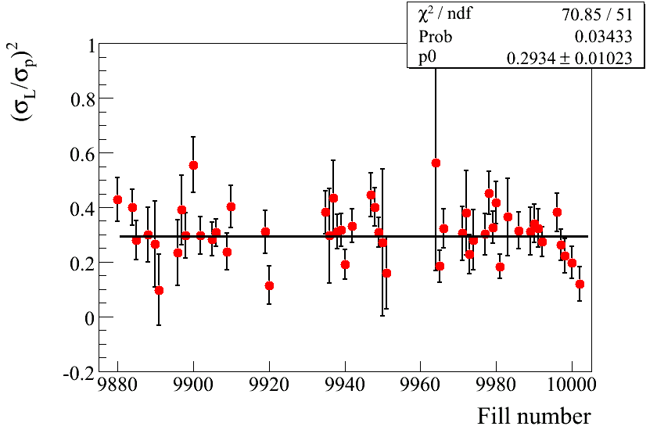
Polarization Profile : YELLOW
HORIZONTAL SCANS

Slide 5
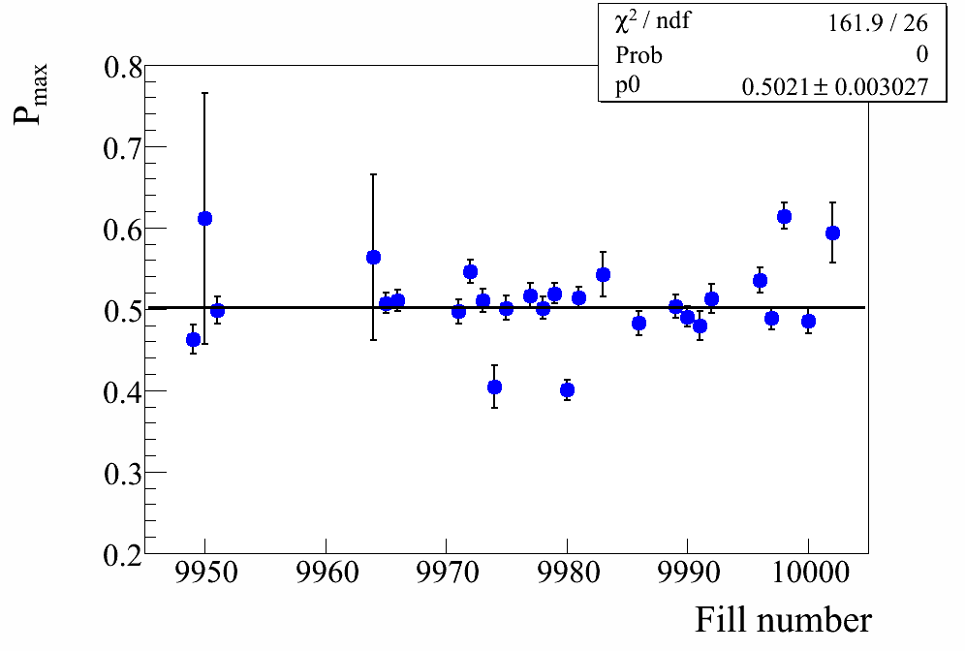
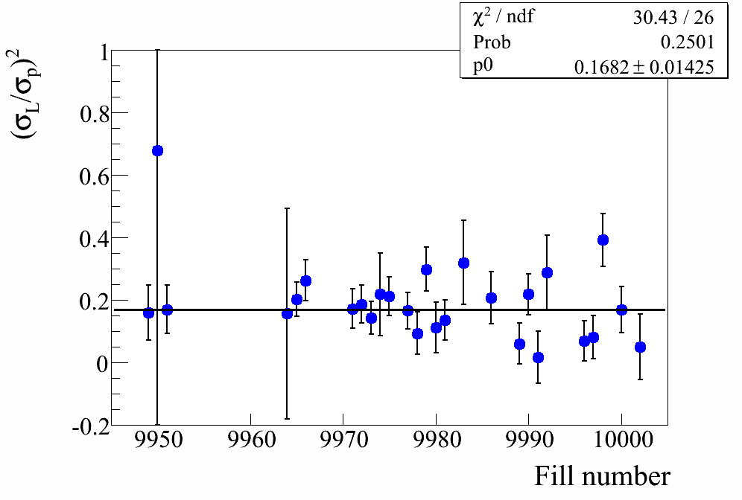
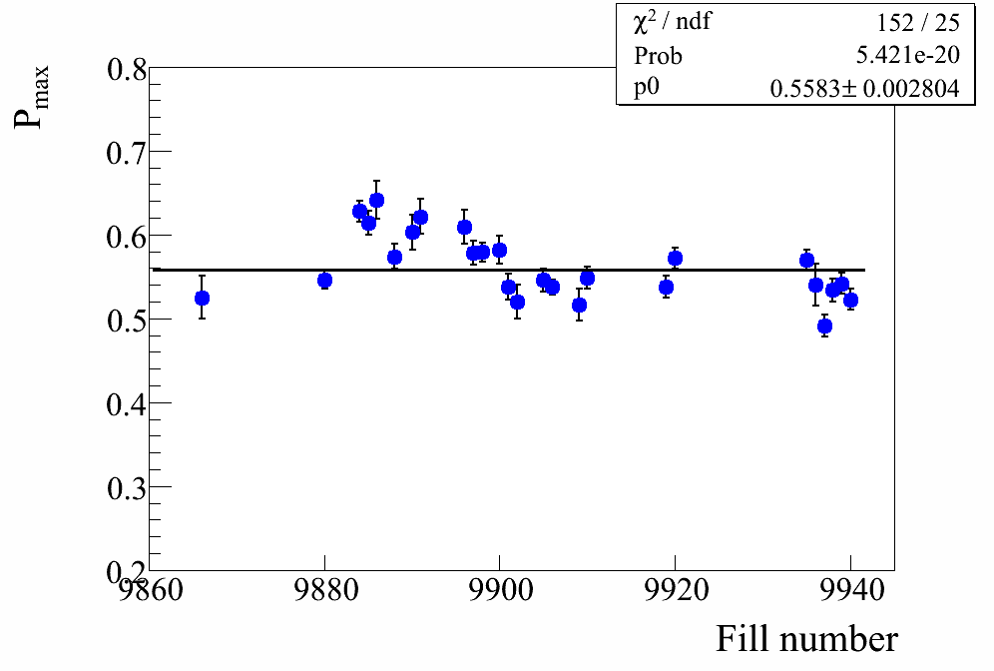
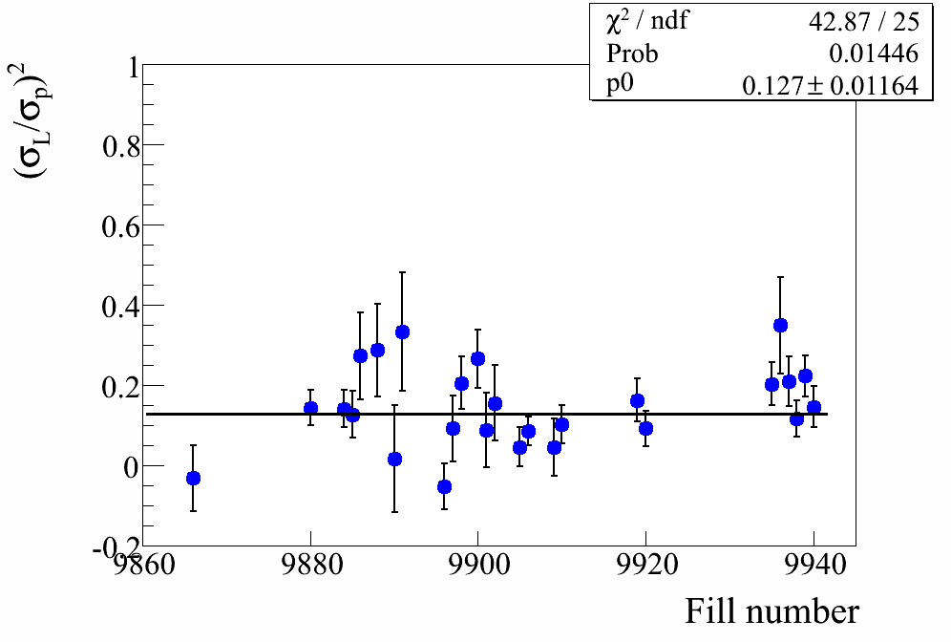
Polarization Profile : BLUE
VERTICAL SCANS
HORIZONTAL SCANS

Slide 6
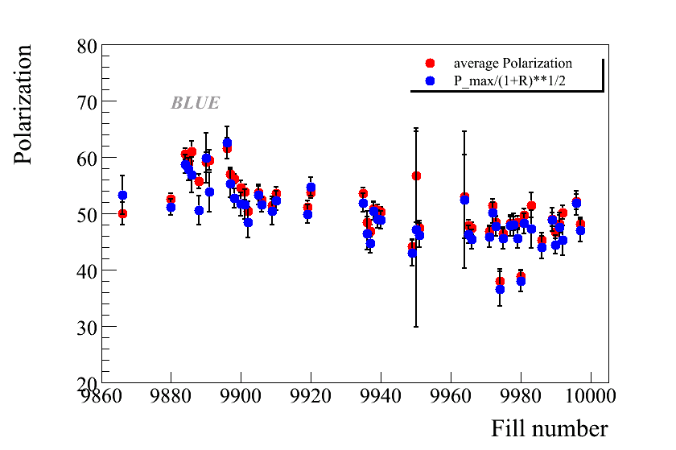
Polarization : BLUE

Slide 7
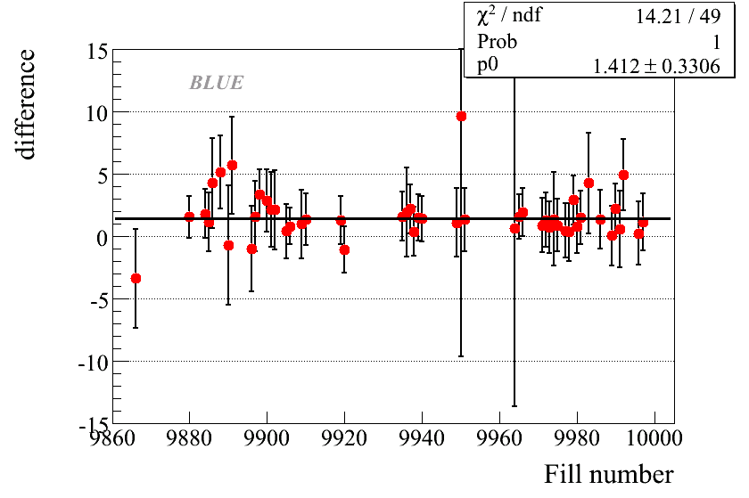
Polarization : BLUE

Slide 8
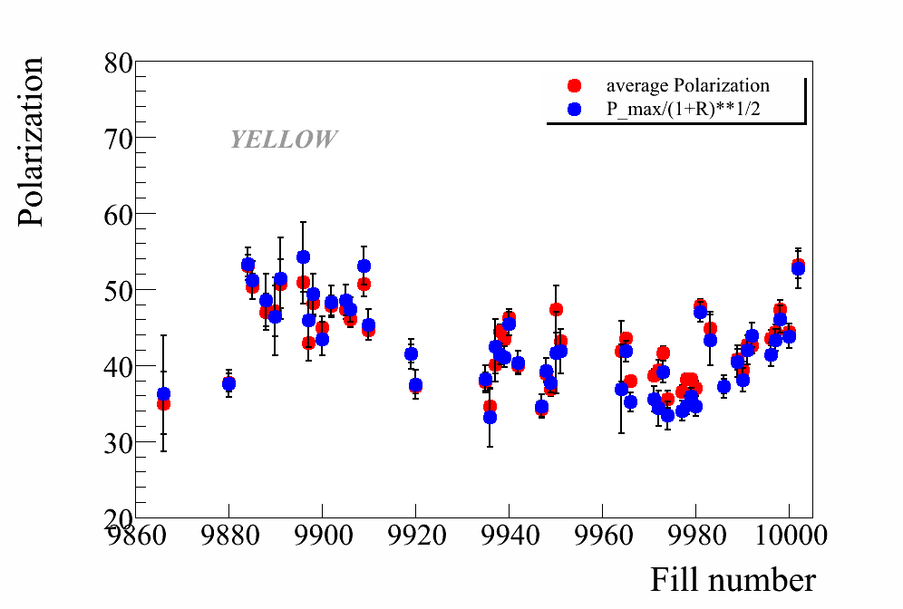
Polarization : YELLOW

Slide 9
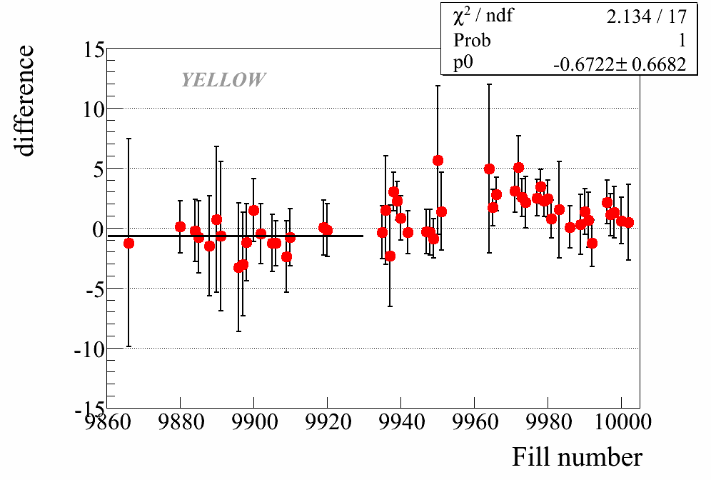
Polarization : YELLOW

Slide 10
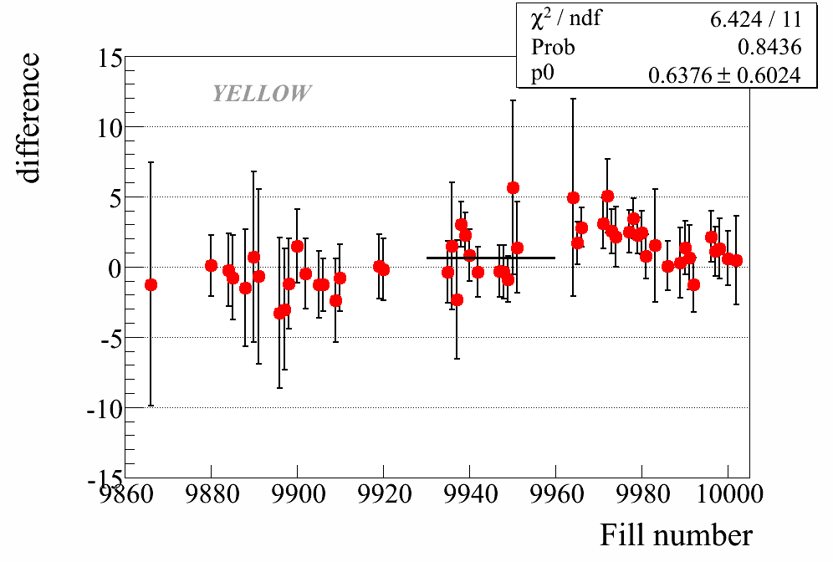
Polarization : YELLOW

Slide 11
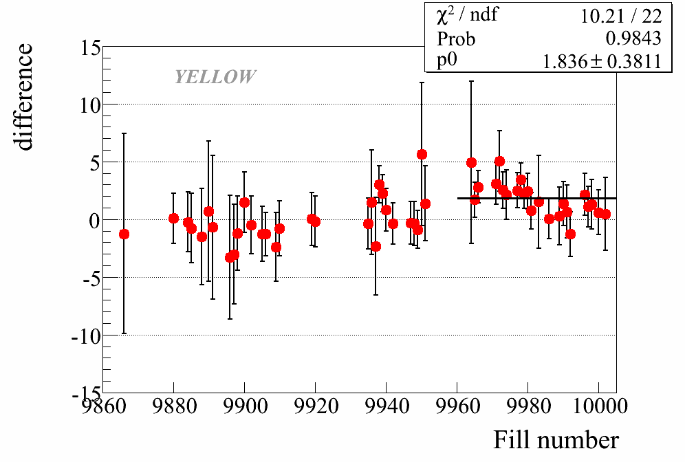
Polarization : YELLOW

Slide 12
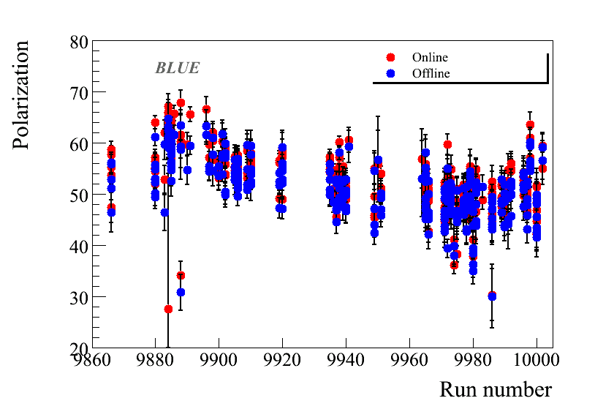
Online/Offline: BLUE

Slide 13
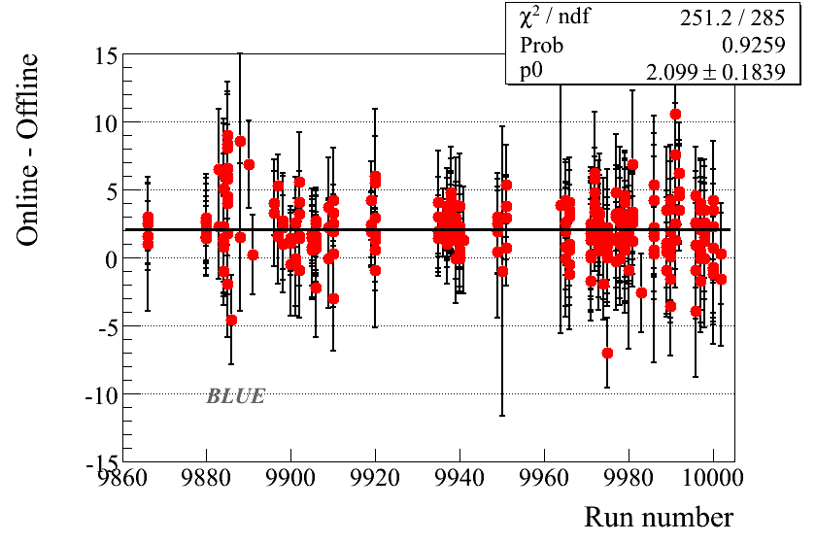
Online/Offline: BLUE

Slide 14
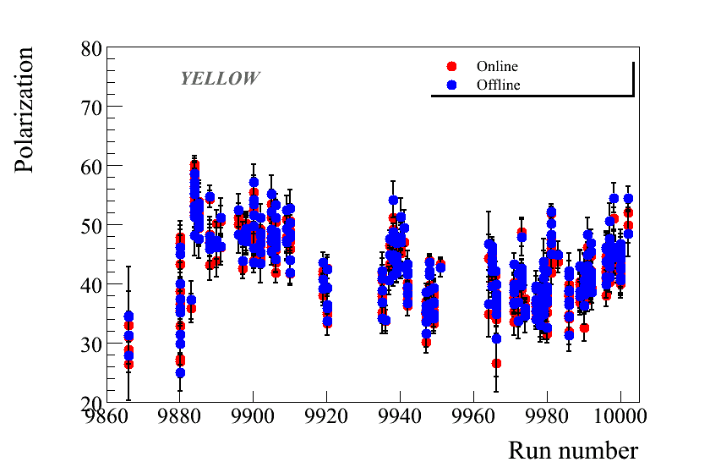
Online/Offline: YELLOW

Slide 15
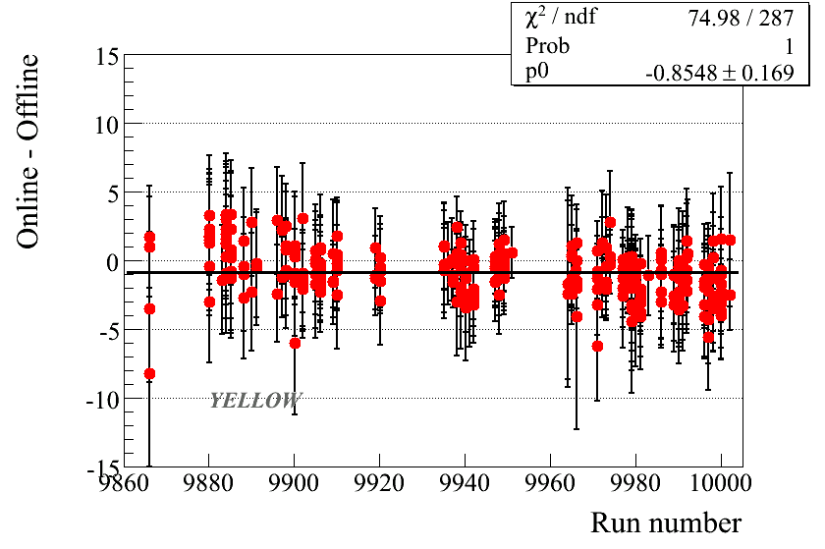
Online/Offline: YELLOW

Slide 16
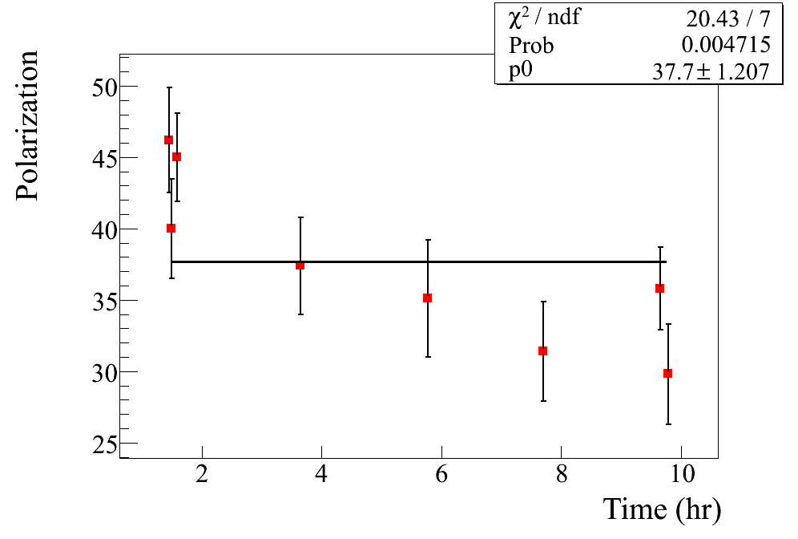
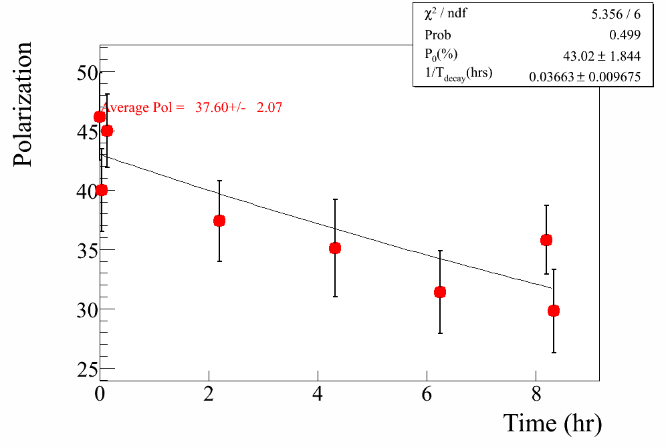
Polarization decay
Fill 9880
Both linear and exponential fits to Polarization for each fill
Assume the functional form
Average Polarization
Assumed α_{L} = 15 hrs

Slide 17
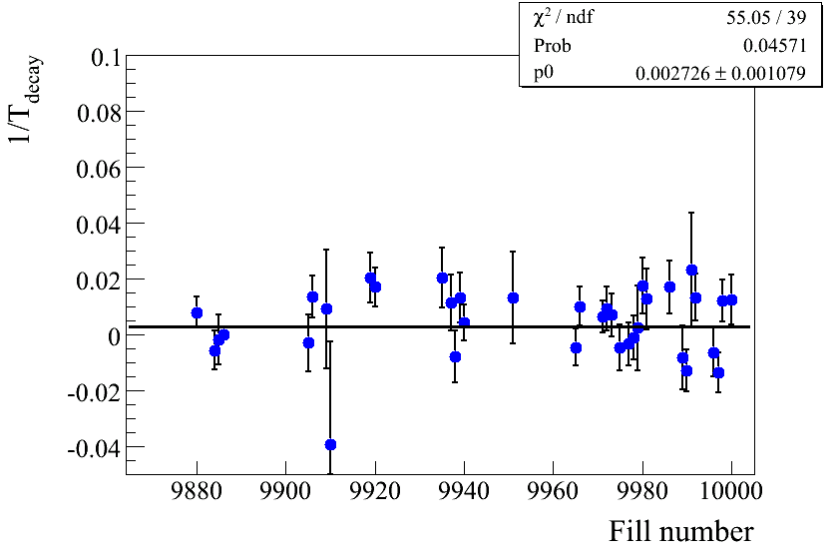
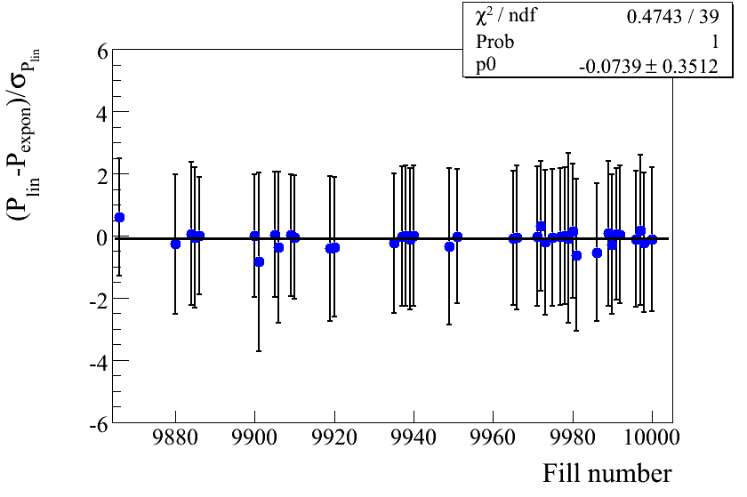
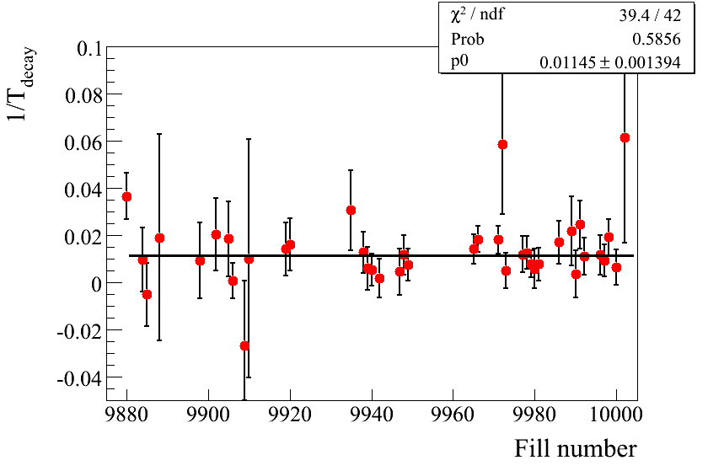
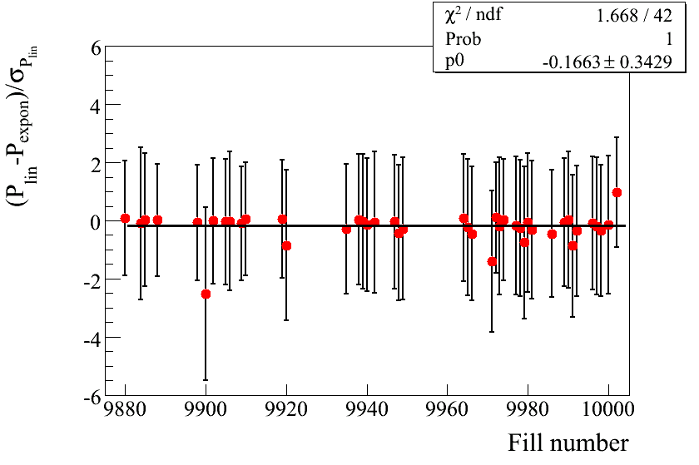
Polarization decay
T_{decay} ≈ 370 hrs
BLUE
T_{decay} ≈ 90 hrs
YELLOW

Slide 18
NORMALIZATION TO HJET
PERIOD | pC average | Hjet/pC
All | 39.62± 0.44 | 0.916± 0.030
1 | 40.96± 0.76 | 0.958± 0.051
2 | 38.29± 0.82 | 0.887± 0.055
3 | 39.55± 0.69 | 0.901± 0.051
PERIOD | pC average | Hjet/pC
ALL | 48.22 ±0.55 | 0.937± 0.025
1 | 51.82± 0.78 | 0.925± 0.049
3 | 47.51± 0.77 | 0.908± 0.037
4 | 48.17± 1.43 | 1.011± 0.059

Slide 19
BACKUP SLIDES

Slide 20
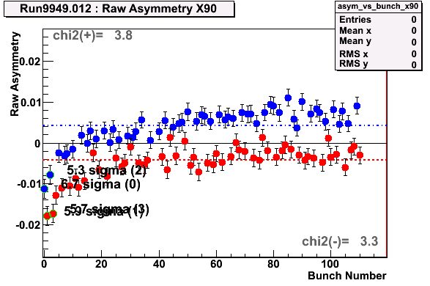
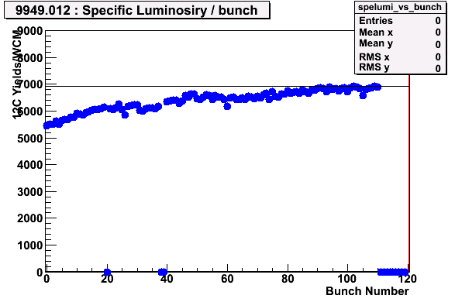
Run Selection
Same quality checks as run 05 and 06
Carbon mass position deviation : < 0.5 GeV from the Carbon mass
Carbon mass width : deviation below 1.9 sigmas
Number of events in banana : strips inside 20% from the average
Data taken with Blue vertical target 5
Fill #s :9942,9947,9948,9949

Slide 21
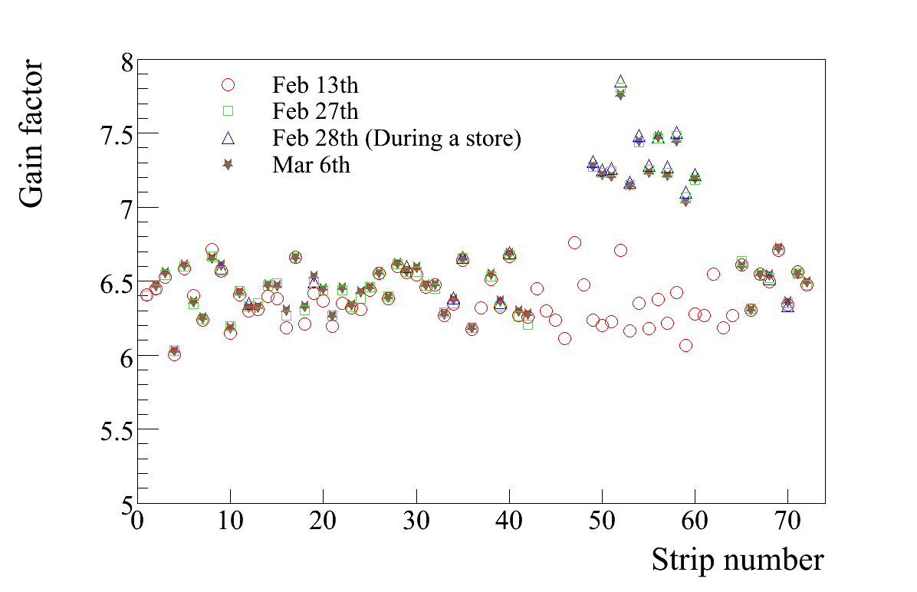
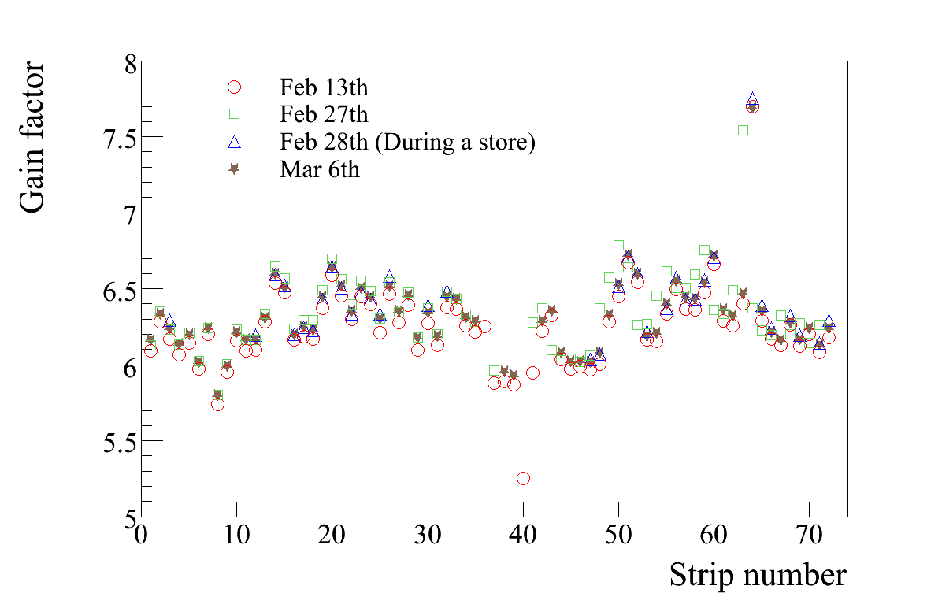
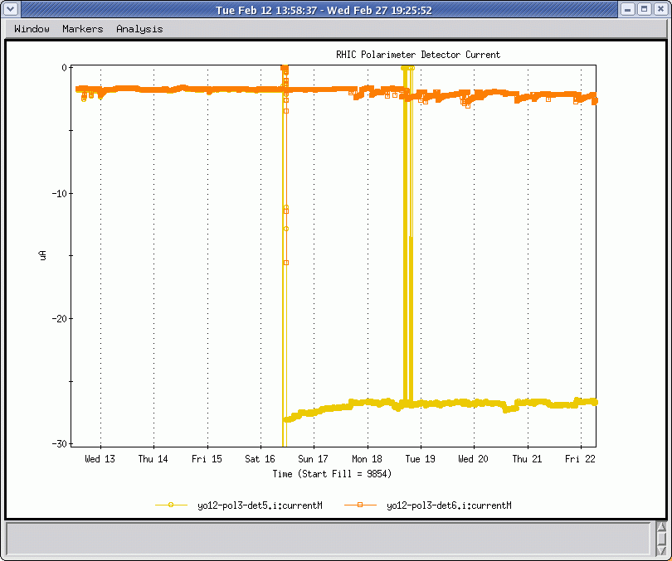
Calibrations
All runs
YELLOW
BLUE
Feb 16th 2008 (Fill 9886)
Feb 13th constants for det 1,2,3,4 and 6
Detector 5
Upto Fill 9886 Feb 13th constants
Feb 27th constants after Fill 9886
Jump in Detector 5 current

Slide 22
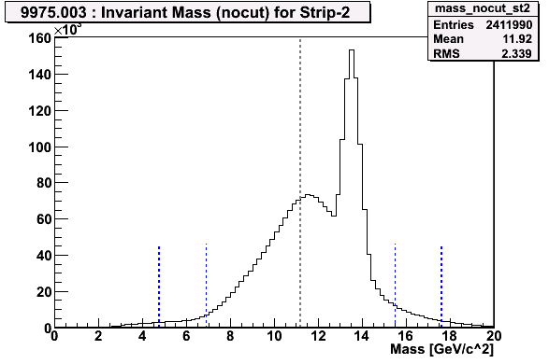
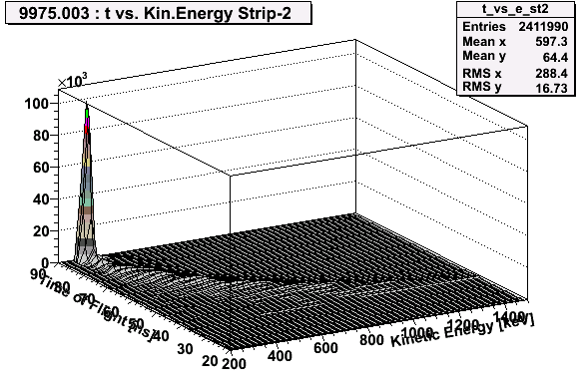
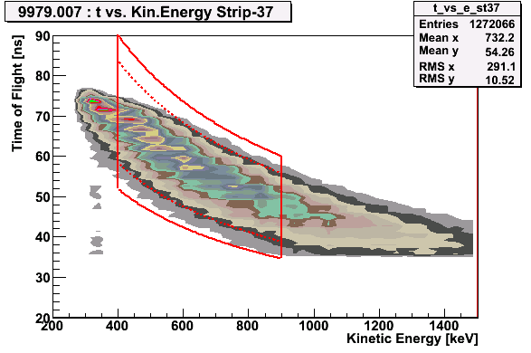
Dead Layer
Background due to beam induced pulses
Starting fill 9979 asymmetric shape in Time of Flight Vs Kinetic Energy
After fill 9978 500-900 keV cut
Up to fill 9978 450-900 keV cut to determine dead layer

Slide 23
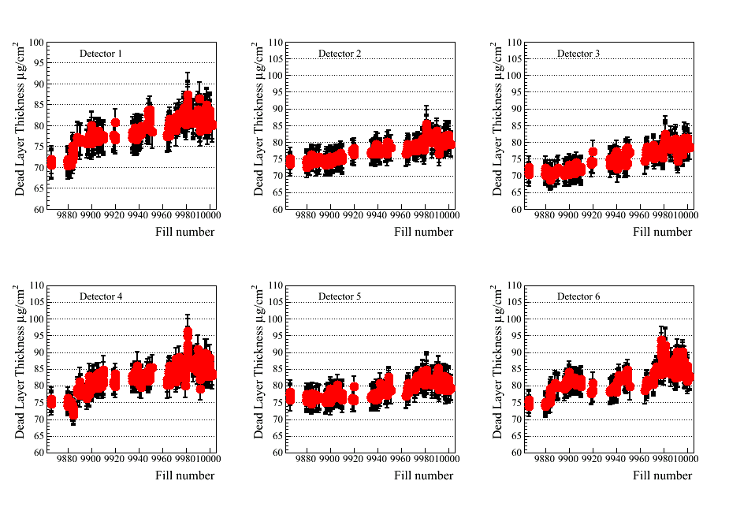
Dead layer : YELLOW

Slide 24
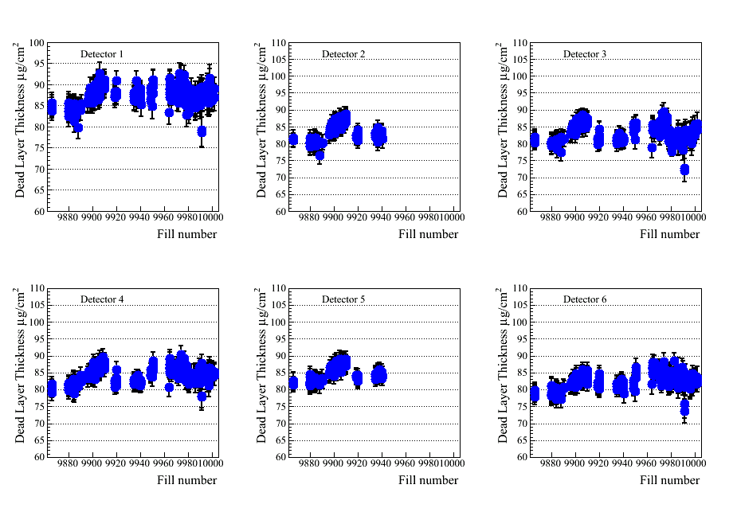
Dead layer : BLUE

Slide 25
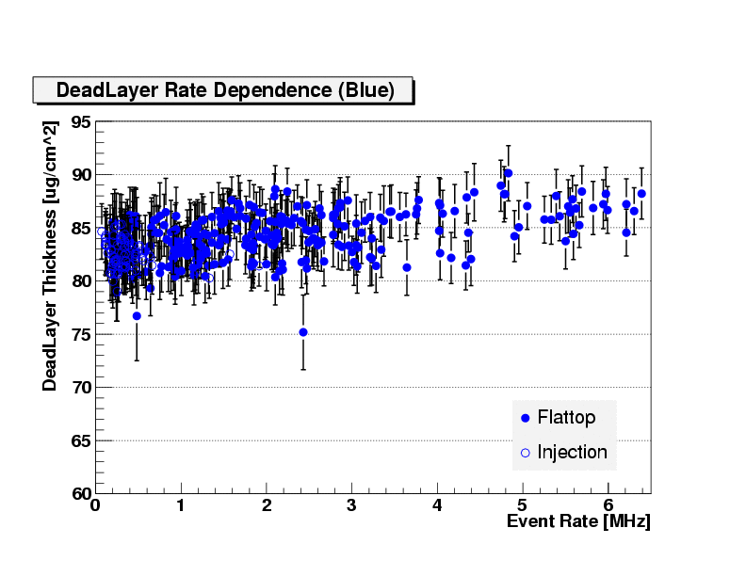
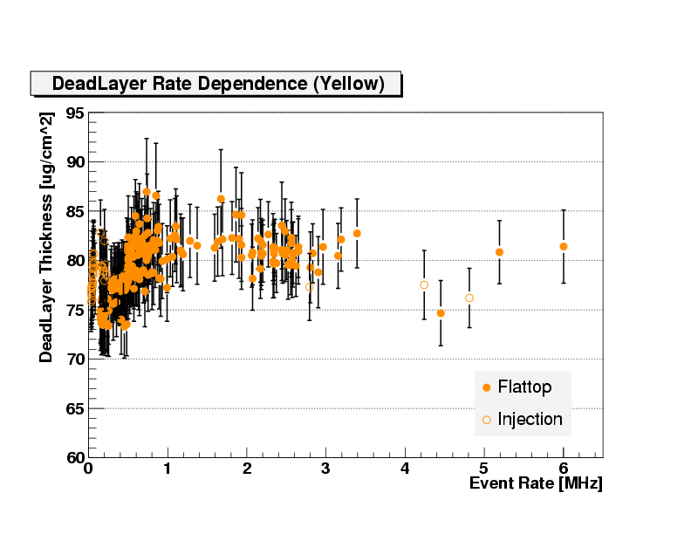
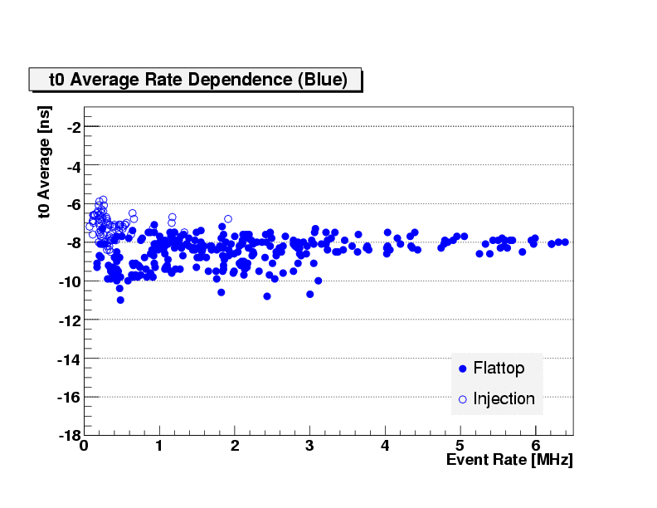
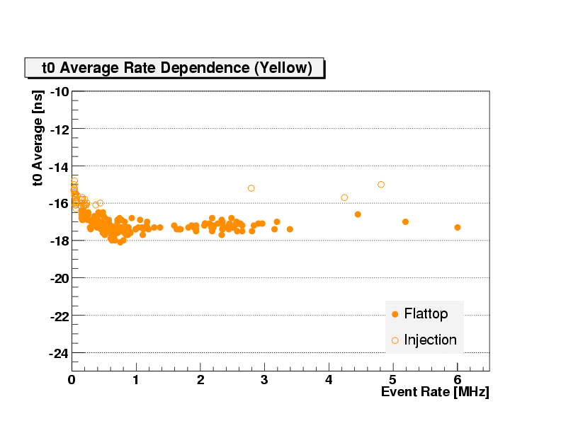
Rate dependence
Dead layer rate dependence
T0 rate dependence

