Slide 1
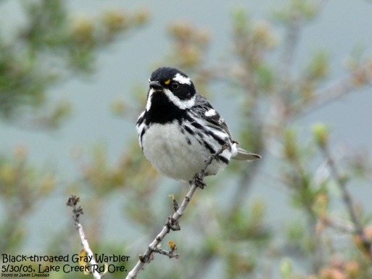
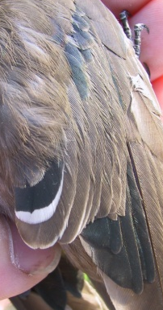
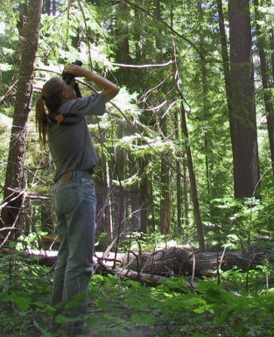
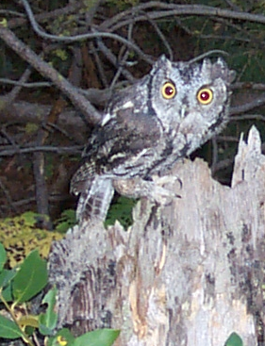
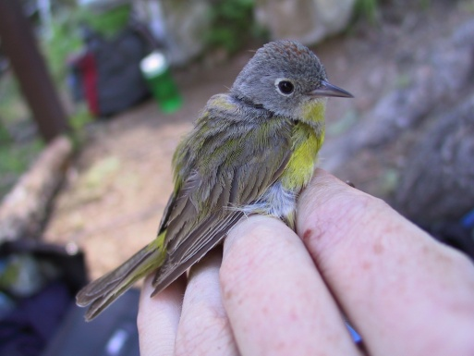
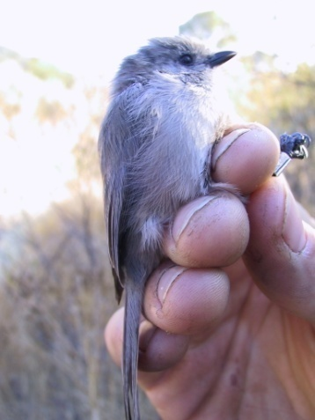
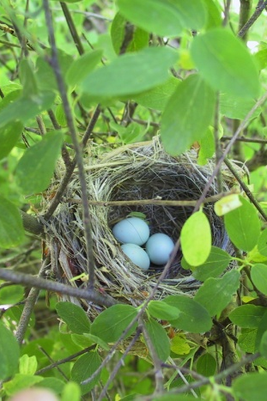
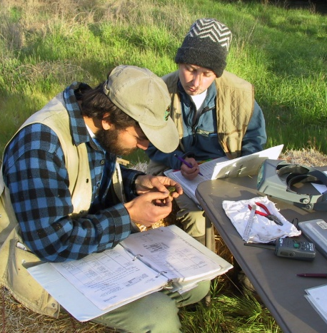
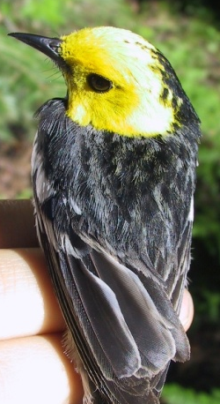
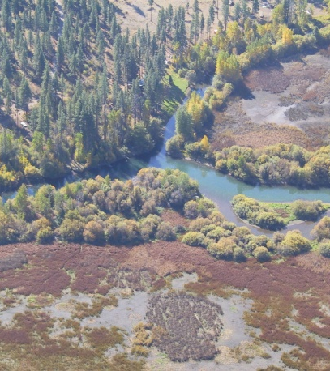
An Update on the Klamath Network
Landbird Monitoring Protocol

Slide 2
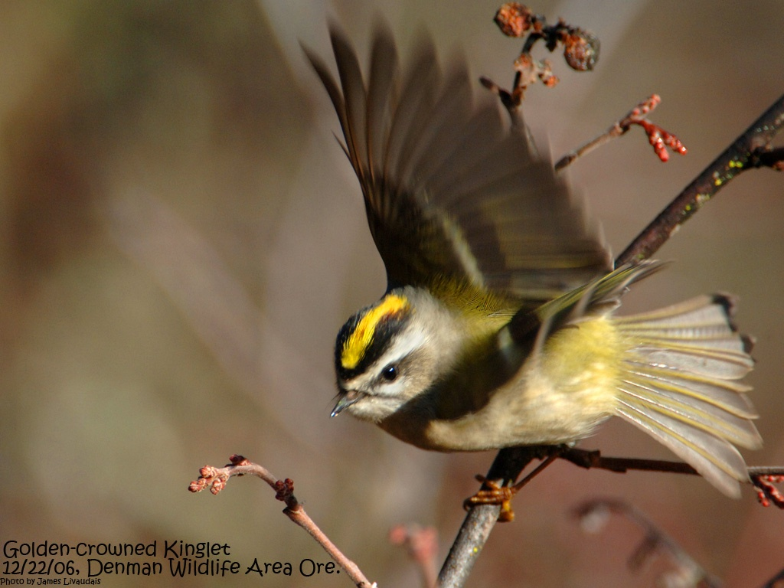
Objectives
Breeding bird status and trends (Species Richness and Density)
Bird communities and habitat
Demographic status and trends (productivity, adult survival, recruitment) for selected landbird species in mixed-conifer and riparian habitats at ORCA
Bird assemblages and ecological integrity

Slide 3
Current Protocol Development Schedule
Initial Scoping Meeting – May 2006
2nd Scoping Meeting – August 2007
Draft Protocol Submitted – February 2008
Peer Review Completed – October 2008
Final Protocol Developed – January 2009
Final Park Review – February 2009
Final Protocol Submission – February 2009
Implementation – Spring / Summer 2009

Slide 4
Concurrent Projects
Monumenting
Sites
Protocol Development / Implementation
Completed at LABE
Completed at RNSP
Permit Issues at WHIS
Permit Issues at LAVO
Not Completed at CRLA
Not Completed at ORCA
Implemented at LABE in 2008
Implemented at RNSP in 2008
Mist Nets Implemented at ORCA in 2008
Scheduled for Implementation at LAVO 2009
Scheduled for Implementation at WHIS 2009
Mist Nets Scheduled for Implementation at ORCA in 2009
Scheduled for Implementation at ORCA 2010 (point counts and mist net)
Scheduled for Implementation at CRLA 2010

Slide 5

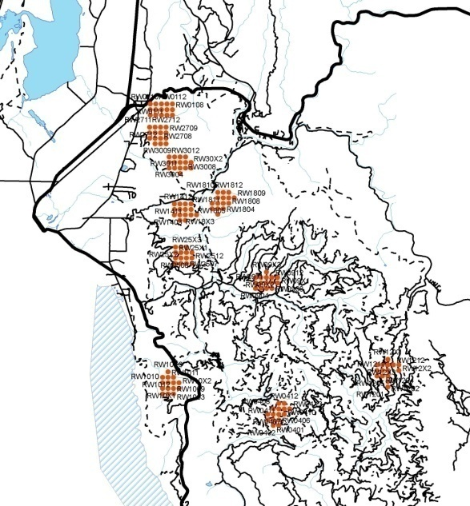
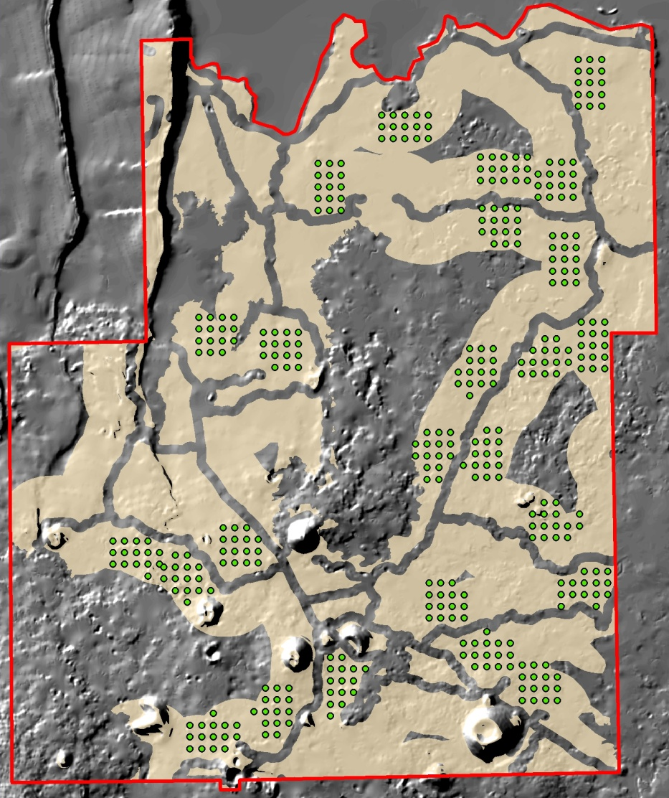
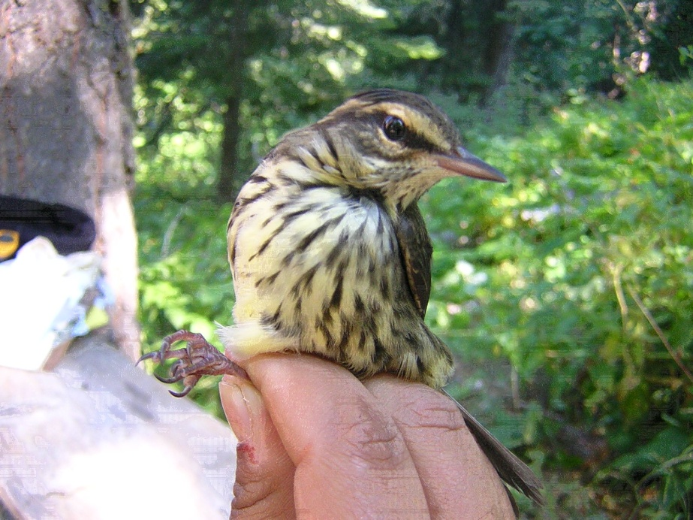
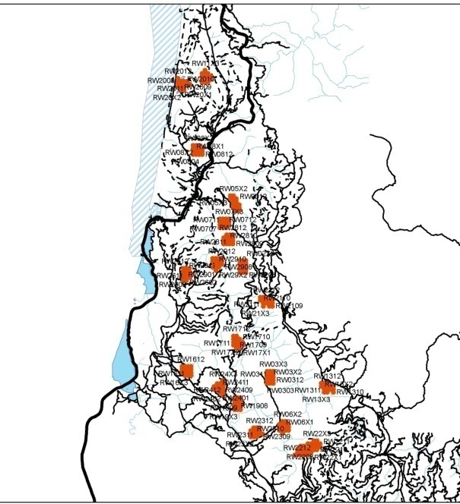
2008 Progress / Completions
Completed Monumenting Sites at LABE and RNSP
Surveyed 25 sites at LABE and 30 sites at RNSP
Reduced number of points / transect for RNSP
Completed mist netting at ORCA
Documented at new species at ORCA – Northern Waterthrush (Seiurus noveboracensis)
Notes:
Northern

Slide 6
2009 Workplan
Winter / Spring 2009
Complete monument of sites at WHIS
Finalize and Resubmit Protocol
Spring / Summer 2009
Implement Protocol at WHIS
Implement Protocol and Monument Sites at LAVO
Implement mist netting at ORCA
Summer / Fall 2009
Monument sites at CRLA and ORCA
Fall 2009
Finalize Protocol

Slide 7
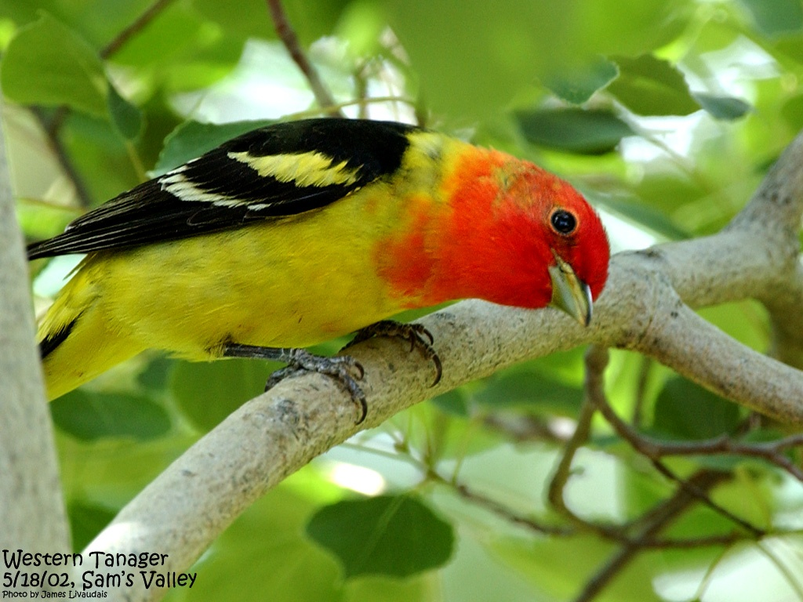
Questions?

