Slide 1
Polarized Source Development Run Results
Riad Suleiman
Injector Group
November 18, 2008

Slide 2
Outline
Injector Parity DAQ and Helicity Board
Pockels Cell Alignment
Fast Helicity Reversal Studies:
30 Hz, 250 Hz and 1 kHz
BPMs Electronics
Search for 60 Hz Noise
Halls A & C Beams Crosstalk
Summary and Future Parity Beam Studies
Thanks to: Roger Flood, Pete Francis, Paul King, Bob Michaels, Julie Roche

Slide 3
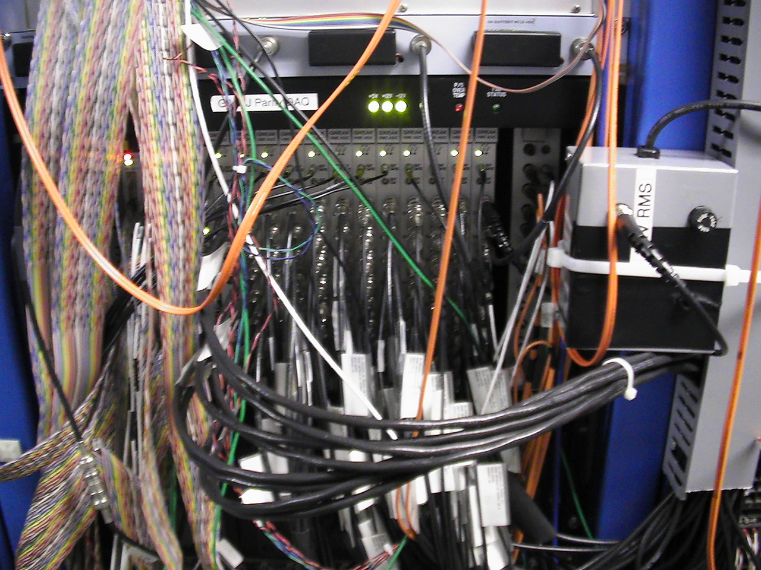

Slide 4
 | Chan 1 | Chan 2 | Chan 3 | Chan 4 | Chan 5 | Chan 6 | Chan 7 | Chan 8
ADC1 | QPD pm | QPD pp | QPD mm | QPD mp |  |  | Battery1 | Battery 2
ADC2 | 1I02 |  |  |  | 1I04
ADC3 | 1I06 |  |  |  | 0I02
ADC4 | 0I02A |  |  |  | 0I05
ADC5 | 0I07 |  |  |  | 0L01
ADC6 | 0L02 |  |  |  | 0L03
ADC7 | 0L04 |  |  |  | 0L05
ADC8 | 0L06 |  |  |  | 0L07
ADC9 | 0L08 |  |  |  | 0L09
ADC10 | 0L10 |  |  |  | 0R01
ADC11 | 0R02 |  |  |  | 0R05
ADC12 | 0R06 |  |  |  | BCM 0L02 | Battery 3 | Battery 4 | Phase Monitor
Notes:
For each BPM, the wires are: +X+, +X-, +Y+, +Y-.
BPM 0R06 is not connected yet.
There are only two injector BPMs we are not reading: 0R03 and 0R04.
Notes:
For 0R03 and 0R04, there is no space in the BPMs VME crate for another two S/H cards.
0R06 will be connected once Pete Francis has time.

Slide 5
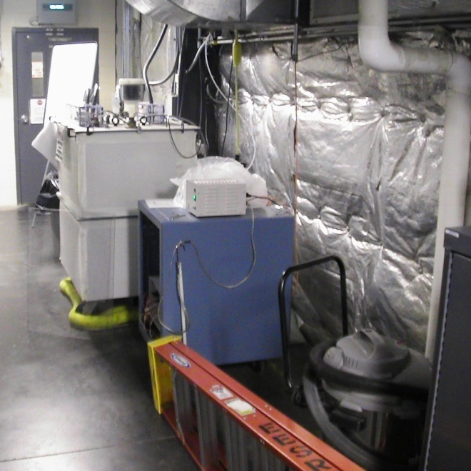
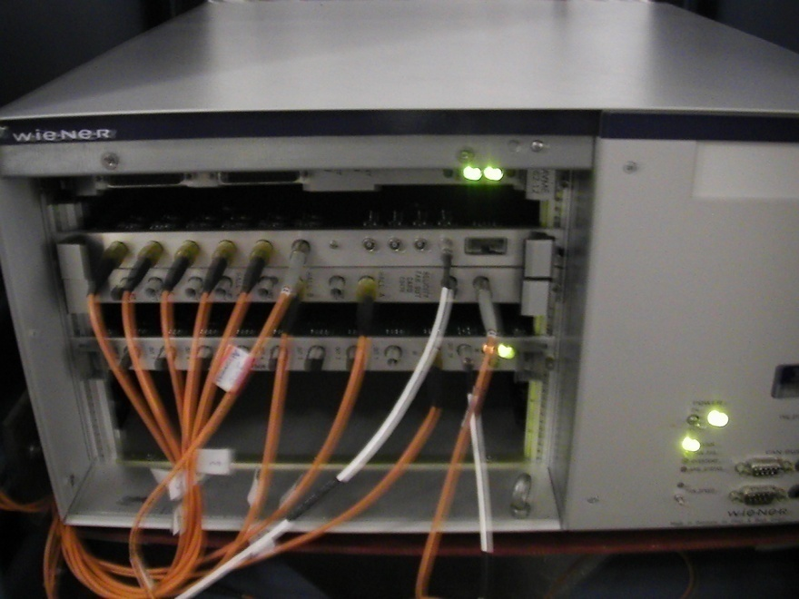
Helicity Board
Outputs (Fiber-optic Signals):
Real time helicity → Helicity Magnets, Pockels Cell and IA’s
QRT → Halls and Mott Polarimeters
MPS (T_Settle) → Halls and Mott Polarimeters
Reporting Helicity → Halls, Mott Polarimeters, iocse9 and iocse14
Pair Sync → Halls and Mott Polarimeters

Slide 6
Helicity Board Software
We only have two choices of helicity reversal rates at any given time:
30 Hz and 250 Hz or 30 Hz and 1 kHz.
To change the helicity reversal rate, a new code must be uploaded in the field to the helicity ioc
For both helicity reversal rates, a common choice of T-Settle (4 options):
500, 200, 100, and 60 µs or 500, 100, 60, and 10 µs
Reporting Delay: No Delay, 2, 4, or 8 Cycles
Helicity Pattern: Pair (+- or -+) or Quartet (-++- or +--+)
Helicity Generation: Toggle or Pseudorandom (24-Bit Shift Register that repeats every 13 days at 30 Hz)
Free running: for example at 30 Hz,
f = 29.xx Hz = 1/(T_Settle+ Integration Window)
We are re-designing the Helicity Board
Notes:
For 1 kHz, the cycle will repeat every 10 hours. Will change to 30-Bit shift register.

Slide 7
Cycle Rae (HZ) | MPS (µs) | MPS (Hz) | QRT (Hz) | Helicity (ms) | Helicity (Hz)
30 | 500 | 29.58 | 7.386 | 33.83 | 14.78
30 | 200 | 29.76 | 7.451 | 33.53 | 14.91
30 | 100 | 29.90 | 7.474 | 33.43 | 14.96
30 | 60 | 29.94 | 7.485 | 33.39 | 14.97
250 | 500 | 226.3 | 56.56 | 4.420 | 113.1
250 | 200 | 242.7 | 60.68 | 4.120 | 121.4
250 | 100 | 248.8 | 62.68 | 4.020 | 124.4
250 | 60 | 251.3 | 62.81 | 3.980 | 125.6
Notes:
These values as measured by a scope
Signals to Parity DAQ: MPS (T_Settle), QRT, Reporting Helicity, and Pair-Sync
The length and frequency of Pair-Sync are identical to Helicity
The length of QRT is identical to Helicity
The integration window is generated by MPS AND Pair-Sync
The integration window for 30 Hz is 33.33 ms and for 250 Hz it is 3.92 ms

Slide 8
Cycle Rae (HZ) | MPS (µs) | MPS (Hz) | QRT (Hz) | Helicity (ms) | Helicity (Hz)
30 | 500 | 29.58 | 7.386 | 33.83 | 14.78
30 | 100 | 29.90 | 7.474 | 33.43 | 14.96
30 | 60 | 29.94 | 7.485 | 33.39 | 14.97
30 | 10 | 29.99 | 7.496 | 33.34 | 14.99
1000 | 500 | 675.7 | 168.9 | 1.480 | 337.8
1000 | 100 | 925.9 | 231.5 | 1.080 | 463.0
1000 | 60 | 961.5 | 240.4 | 1.040 | 480.8
1000 | 10 | 1010 | 252.5 | 0.9900 | 505.1
Notes:
These values as measured by a scope
The integration window for 1 kHz is 0.980 ms

Slide 9
Parity ADC Internal Programming (for this study)
For 30 Hz helicity reversal:
Acquisition starts 40 µs after the gate begins
There are 4 blocks of 4161 samples/block for each gate.
The acquisition time is 33.328 ms
For 250 Hz helicity reversal:
Acquisition starts 40 µs after the gate begins
There are 4 blocks of 485 samples/block for each gate.
The acquisition time is 3.880 ms
For 1 kHz helicity reversal:
Acquisition starts 40 µs after the gate begins
There are 4 blocks of 117 samples/block for each gate.
The acquisition time is 936 µs
Notes:
This 40 us is what we have during this test. It will be lowered later.

Slide 10
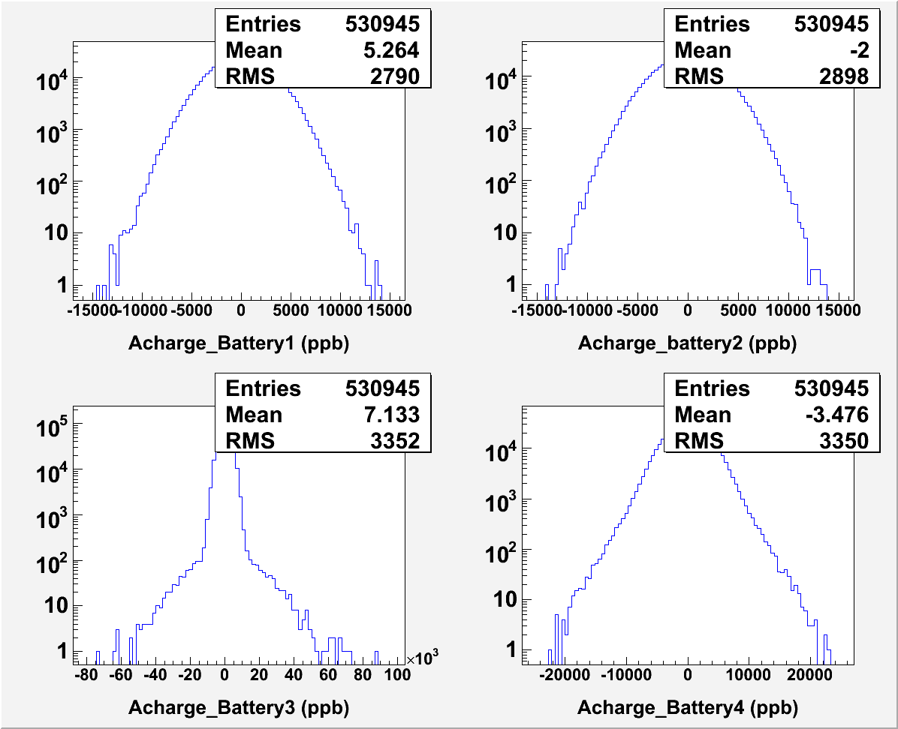
Battery Signals (3 V) Random, 8-Cycles Delay, Run 361
Bad ADC Channels
Notes:
Battery3 and Battery4 have wider tails because for these two ADC channels, the pedestals have outliers and even jumps. So the problem is with noisy ADC channels.

Slide 11
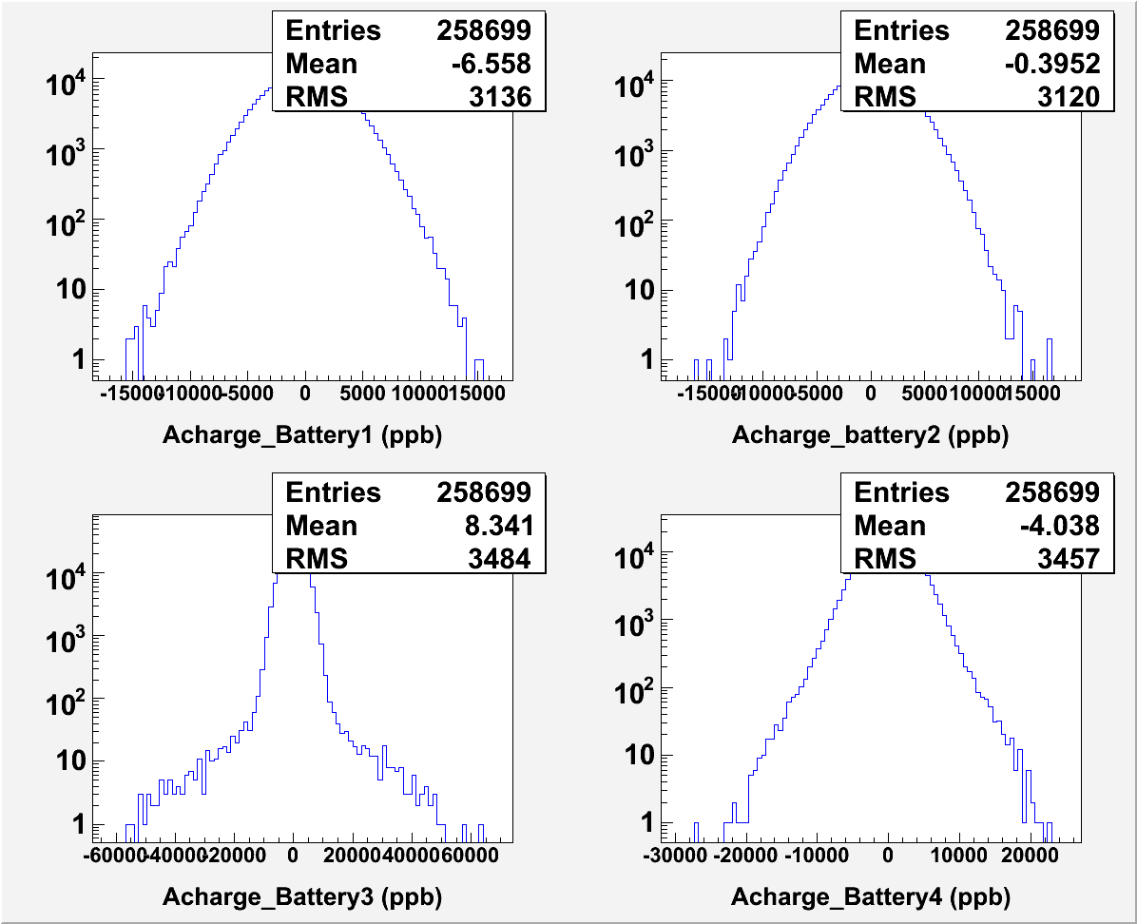
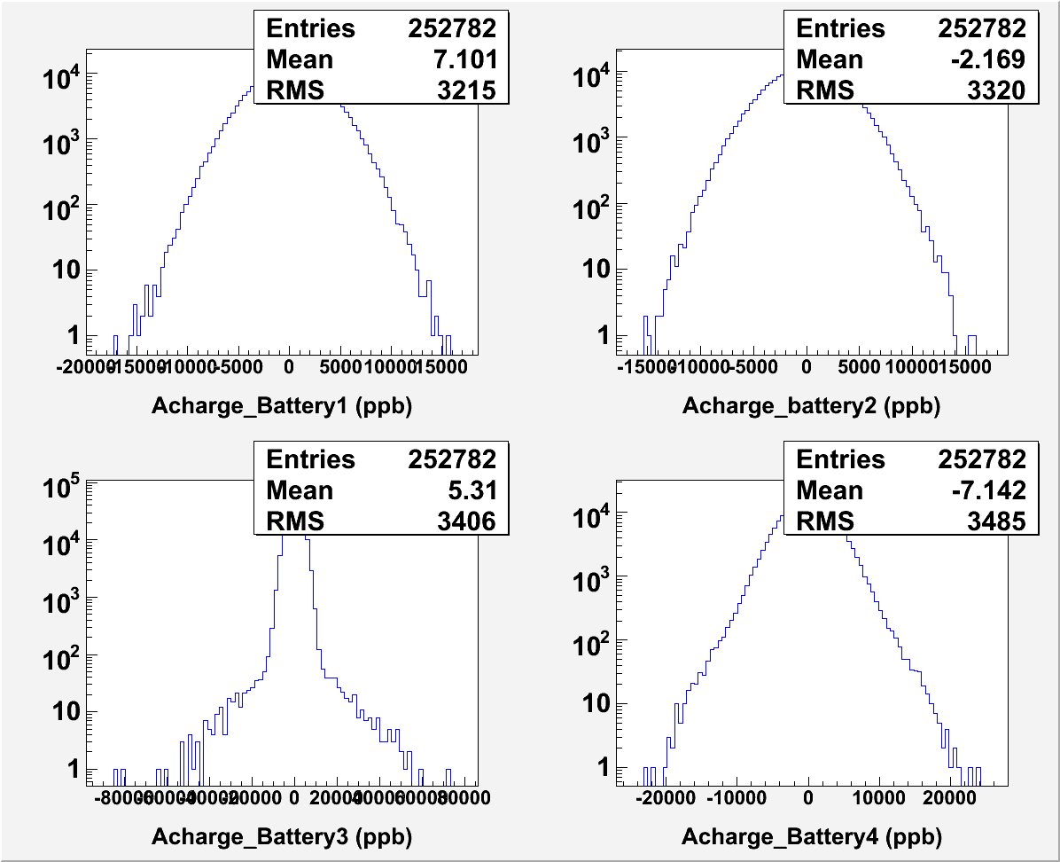
Battery Signals Battery1 and Battery2 Round Trip to Laser Table
Random, 8-Cycles Delay, Run 398
Random, No Delay, Run 406
Notes:
No pickup from the “Real Helicity” signal and from the “Reporting Helicity” signal. With no delay the “Reporting” is also “Real”.

Slide 12
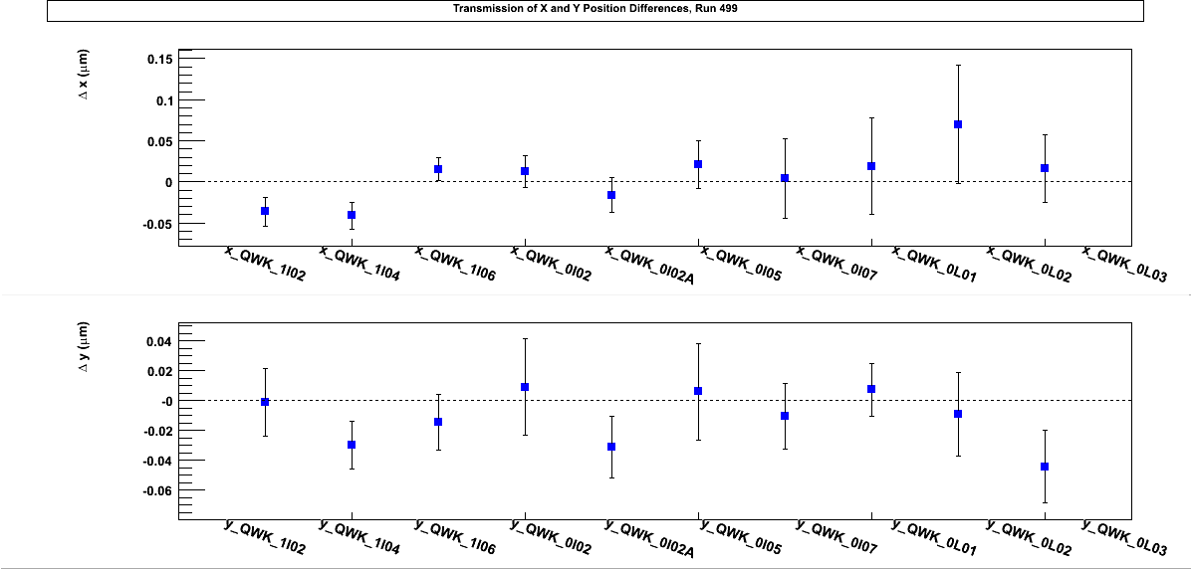
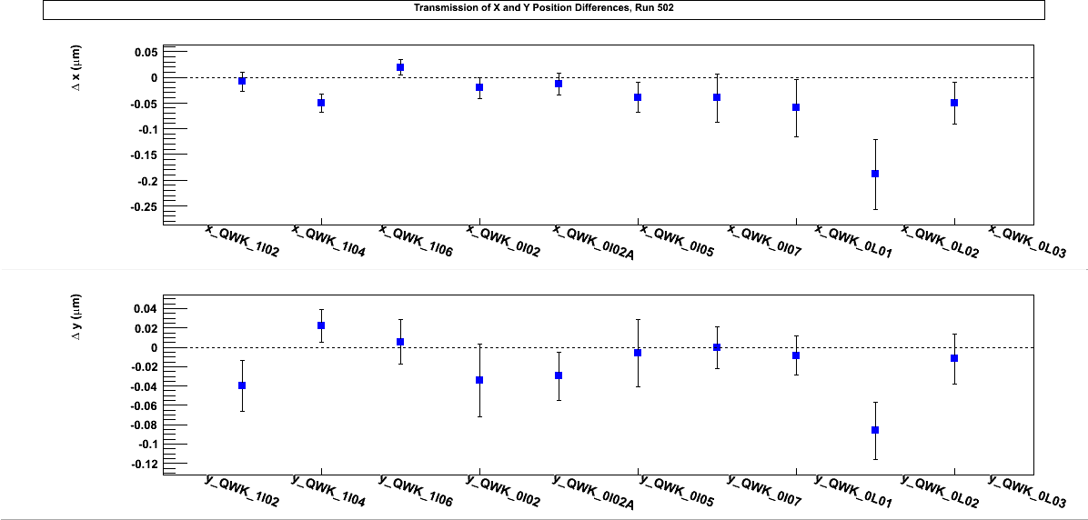
Pockels Cell OFF
Random, 8-Cycles
Delay, Run 499
No Helicity pickup
Random, No
Delay, Run 502

Slide 13
Pockels Cell Alignment
The Pockels Cell rise time was measured with a laser beam to be about 80 µs
With a Spinning Half Wave Plate or a Spinning Linear Polarizer and a Scope, the Circular polarization was maximized by checking:
Laser isogyro pattern
Pockels Cell Pitch, Yaw, Roll, X & Y
Pockels Cell Voltages
The above was checked for IHWP IN and OUT and for 30 Hz and 250 Hz helicity reversal
The Circular polarization = 99.97 %, and the Linear Polarization = 2.56 %
Notes:
This rise time will give a dead time of 8%. It was measured with laser passing thru the Pockels Cell before alignment then thru a Linear Polarizer to a Photodiode. On the scope you will see two levels of voltages for the two helicities. This is the rise time going from one level to the other.
For the old switch , it was 200 us.

Slide 14
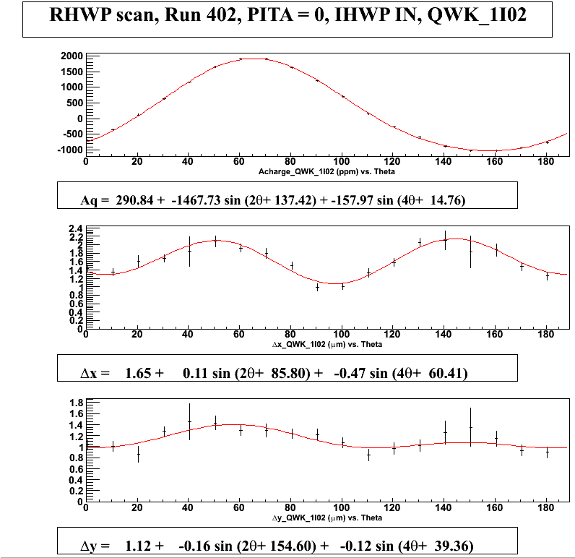
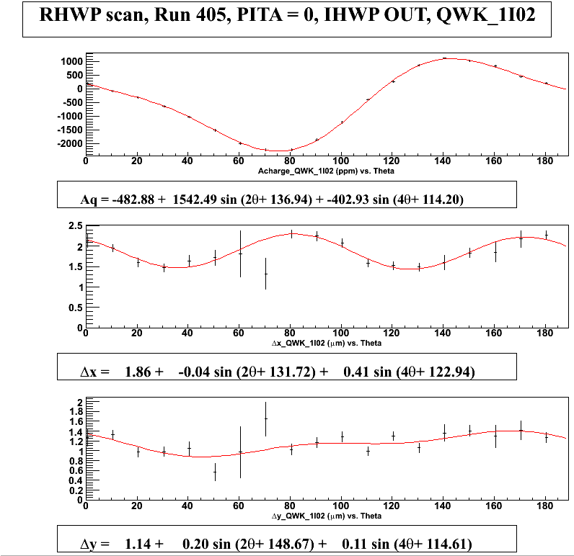
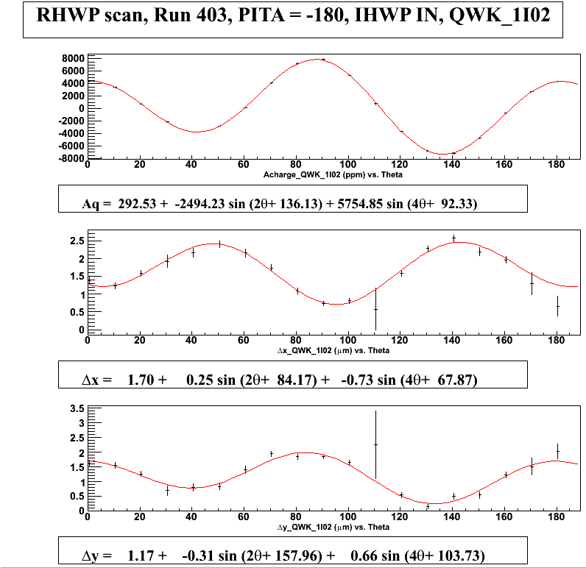
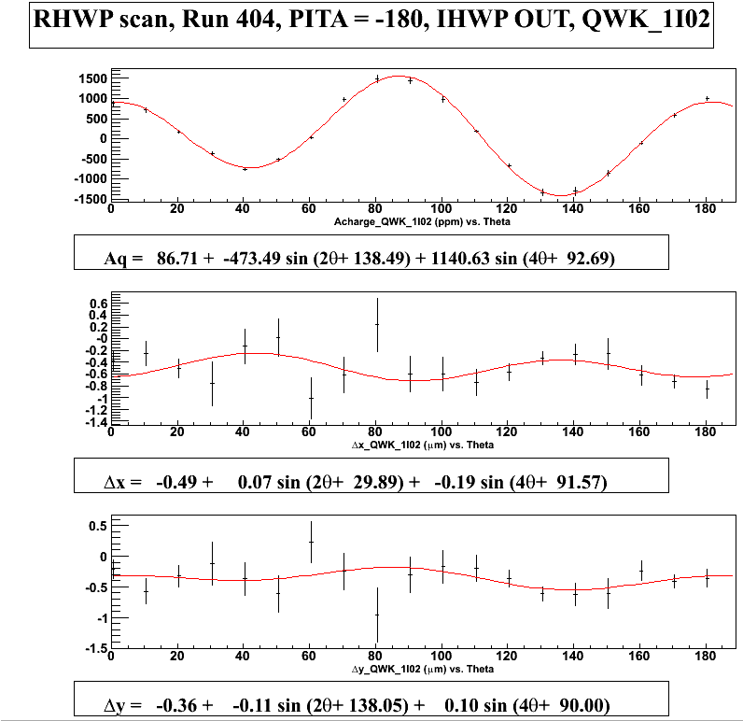

Slide 15
T-Settle Study (500, 200, 100, 60 µs)
30 Hz
Run 399: PC OFF, IHWP IN, 500 µs
Run 381: IHWP OUT, 500 µs
Run 382: IHWP IN, 500 µs
Run 383: IHWP IN, 200 µs
Run 384: IHWP IN, 100 µs
Run 385: IHWP IN, 60 µs

Slide 16
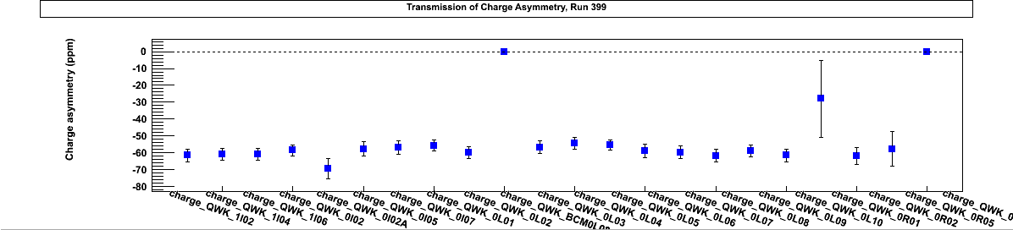
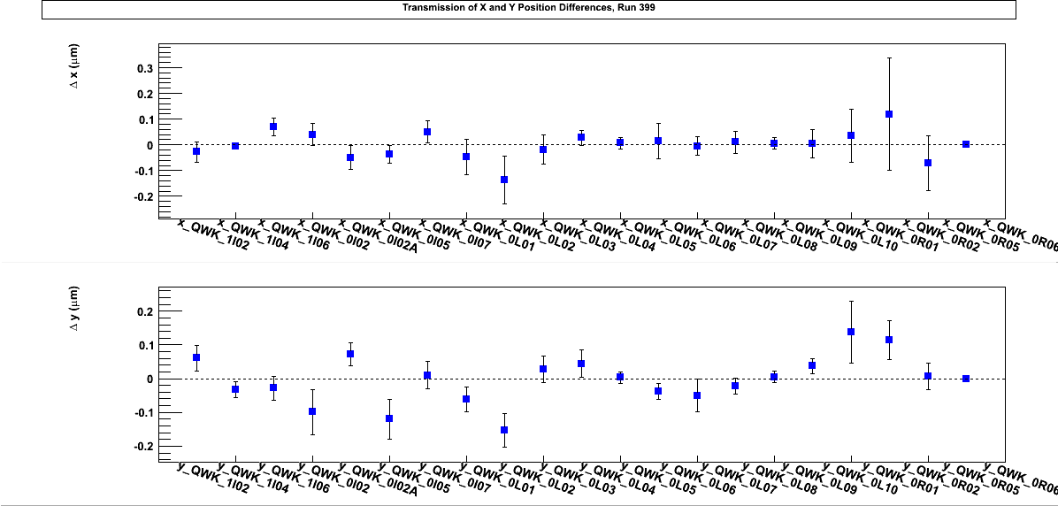
BCM0L02 is broken
IA is not OFF
Notes:
The charge asymmetry is not zero because of an offset on the IA Cell, well known effect since G0.
BCM0L02 was not working during 30 Hz and 250 Hz data period. Fixed at the start of 1 kHz beam studies.

Slide 17
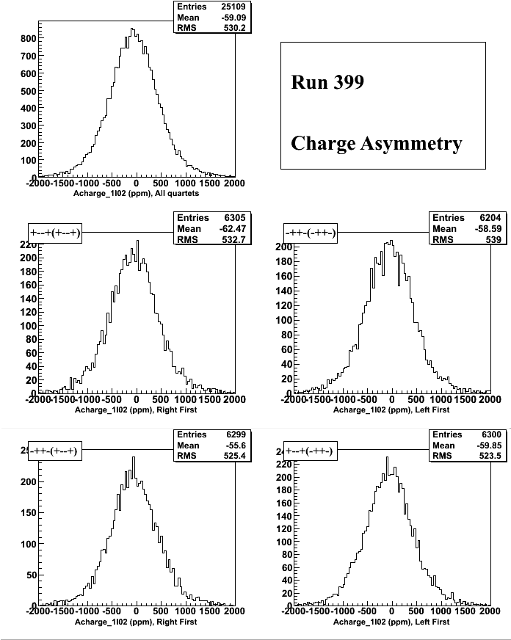
Watch the mean of the 4 distributions

Slide 18
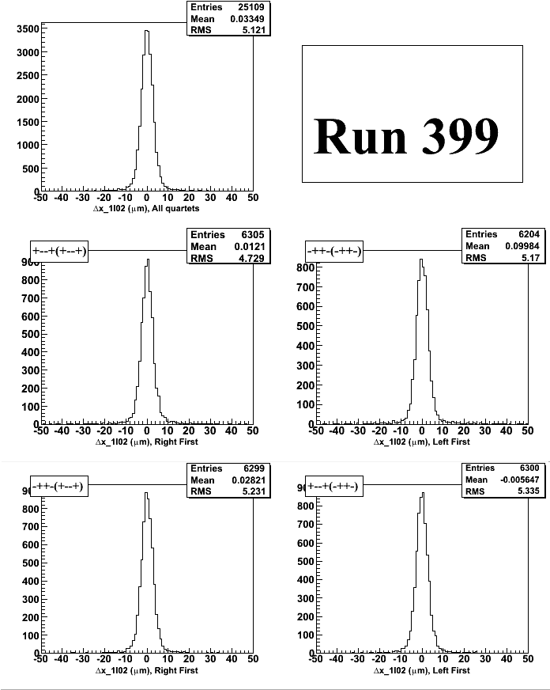


Slide 19
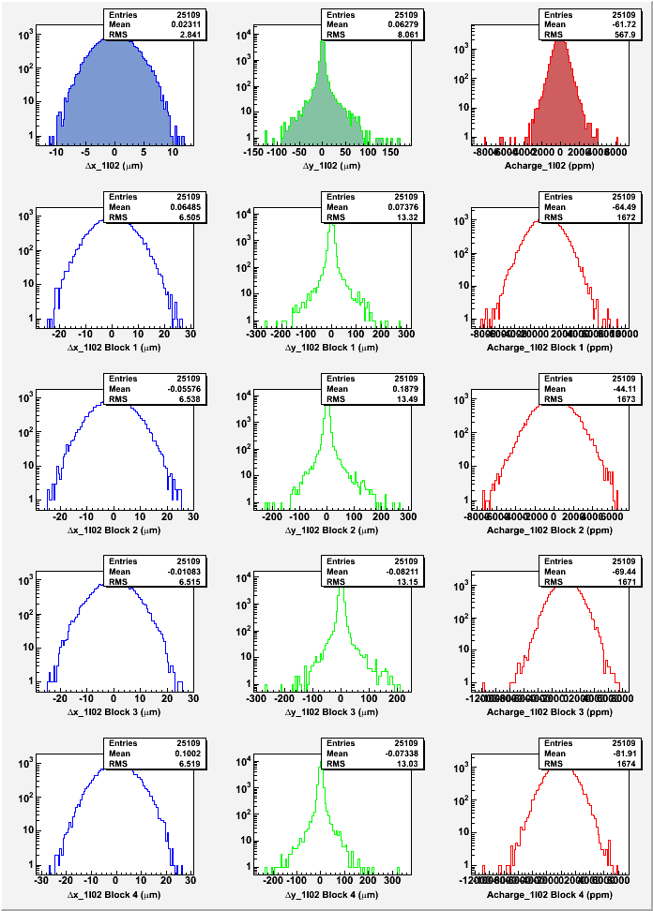
Total
?
Block 1
Block 2
Block 3
Block 4
Notes:
I do not know why the y-position differences look this way. This was during this part of the data at 30 Hz. The beam was unstable during part of the data. Frequent current trips but no easy way to cut the trips since the BCM0L02 was not working.

Slide 20
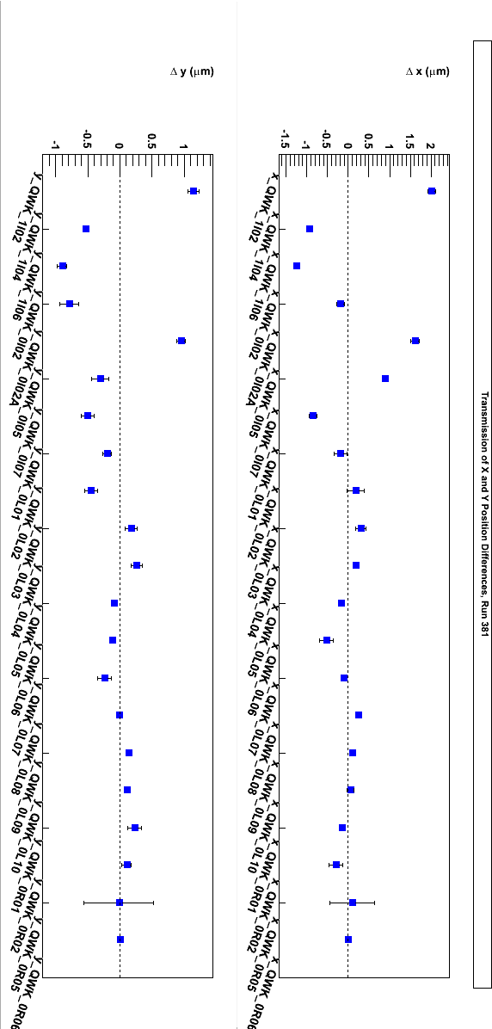
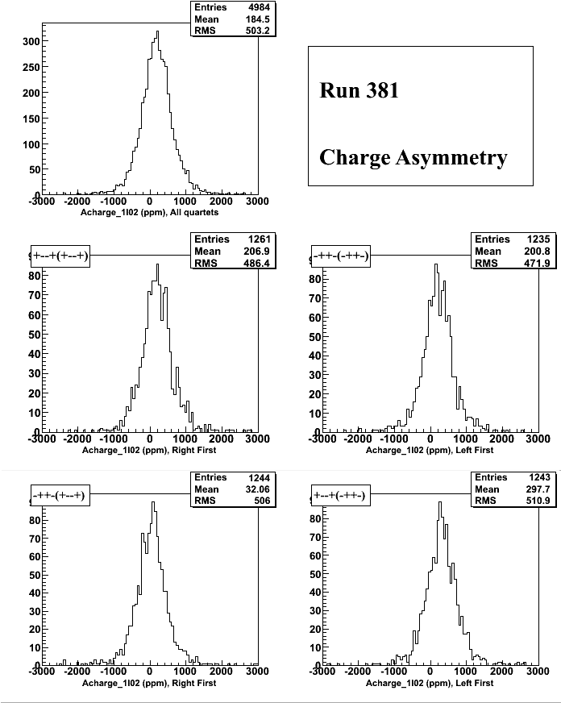

Slide 21
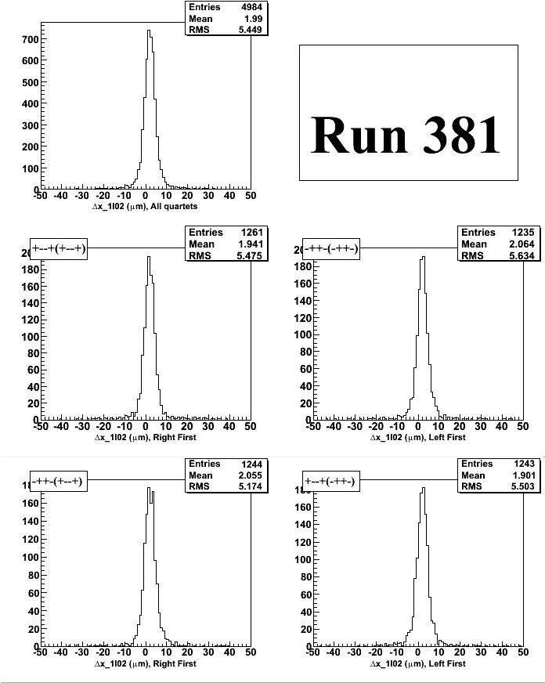
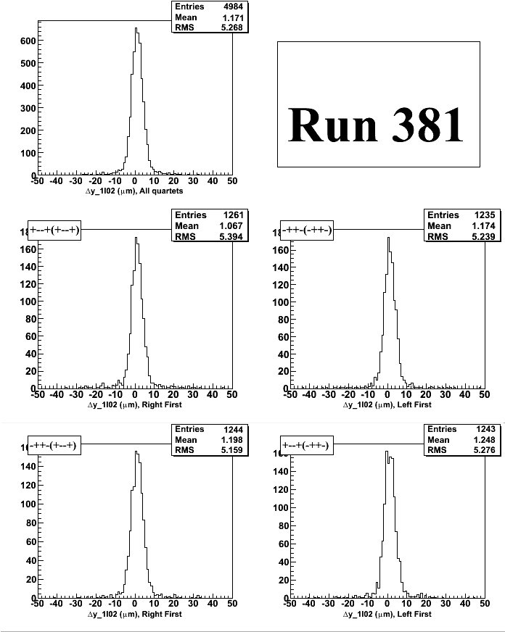

Slide 22
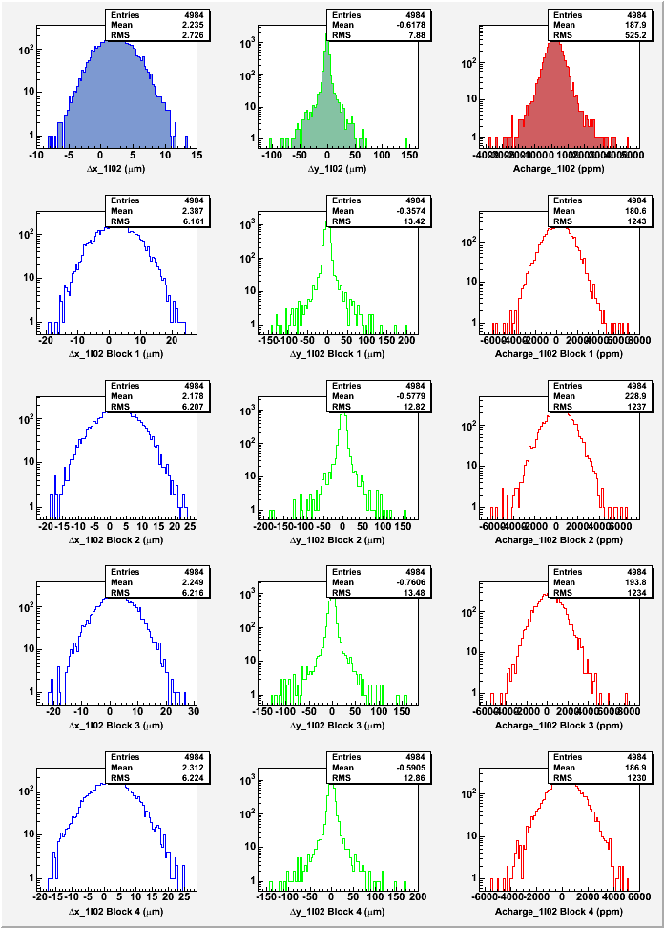

Slide 23
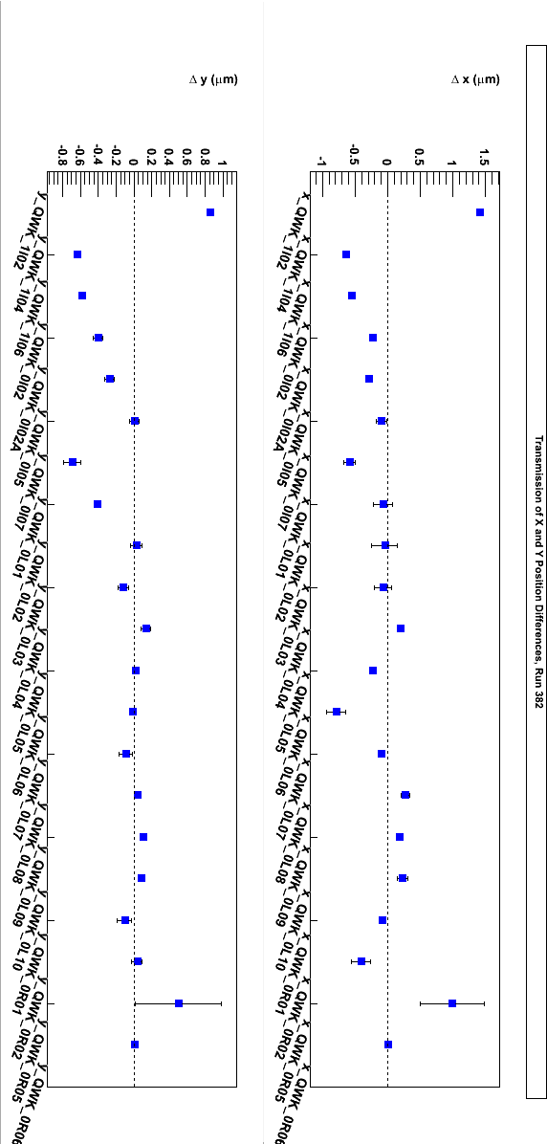
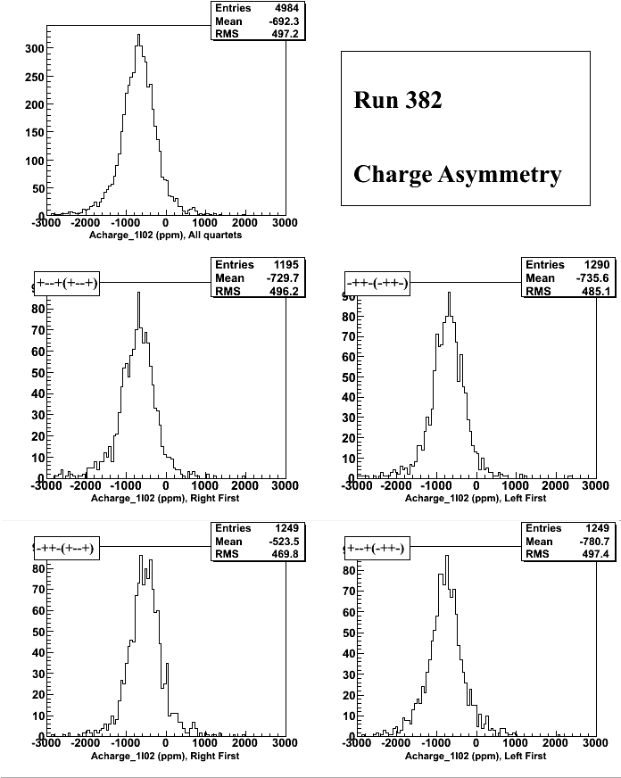

Slide 24

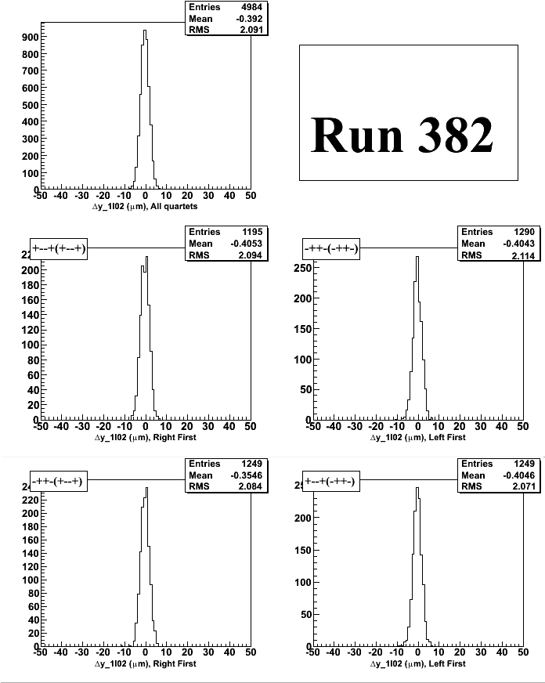

Slide 25
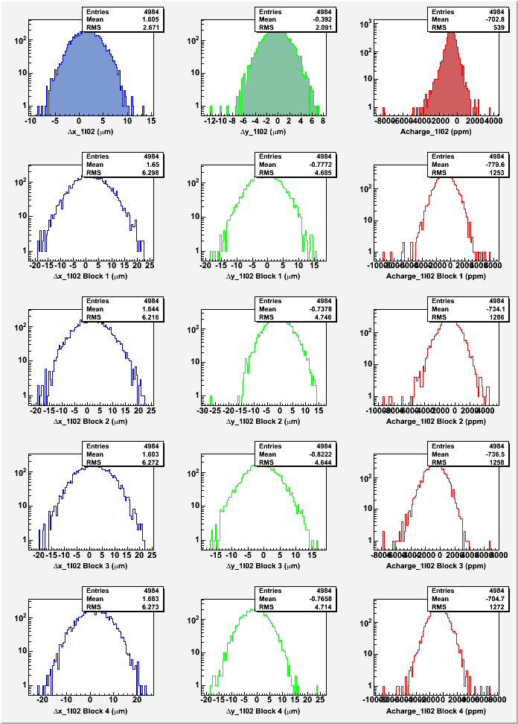

Slide 26
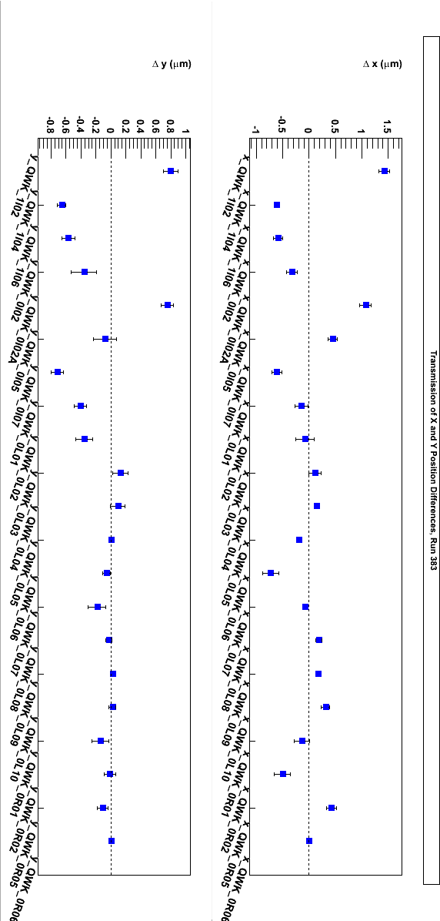
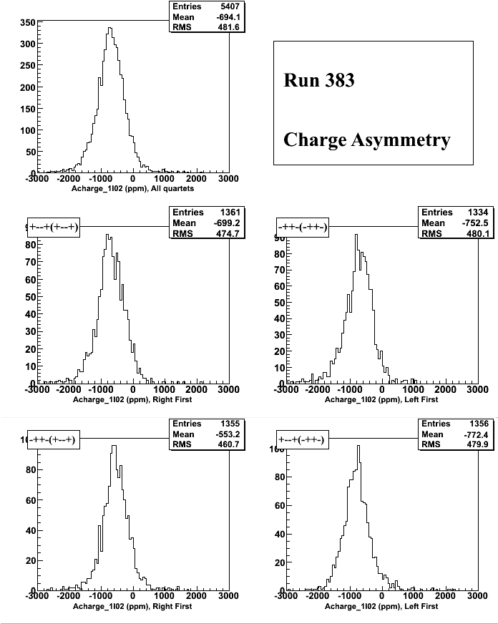

Slide 27
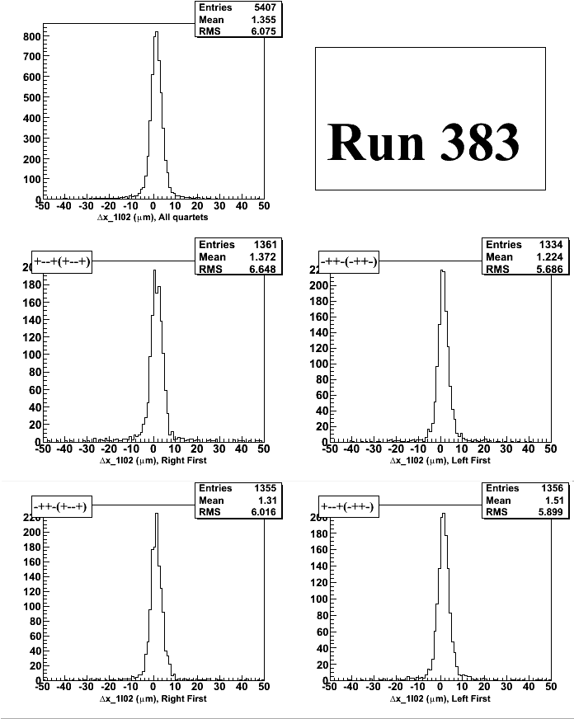


Slide 28
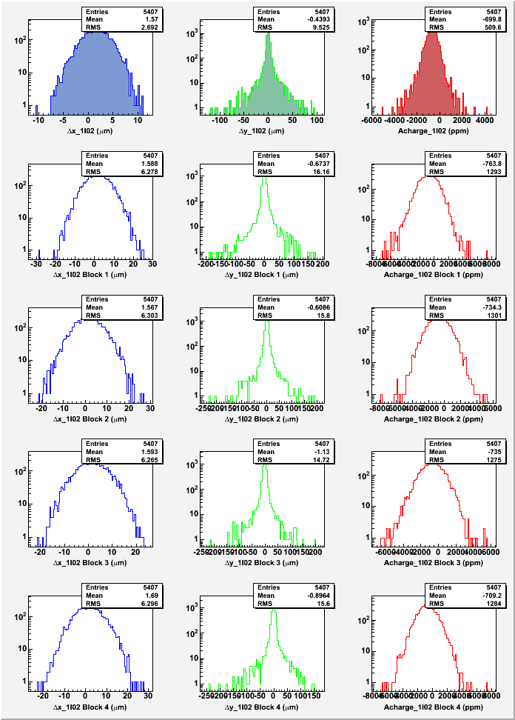

Slide 29
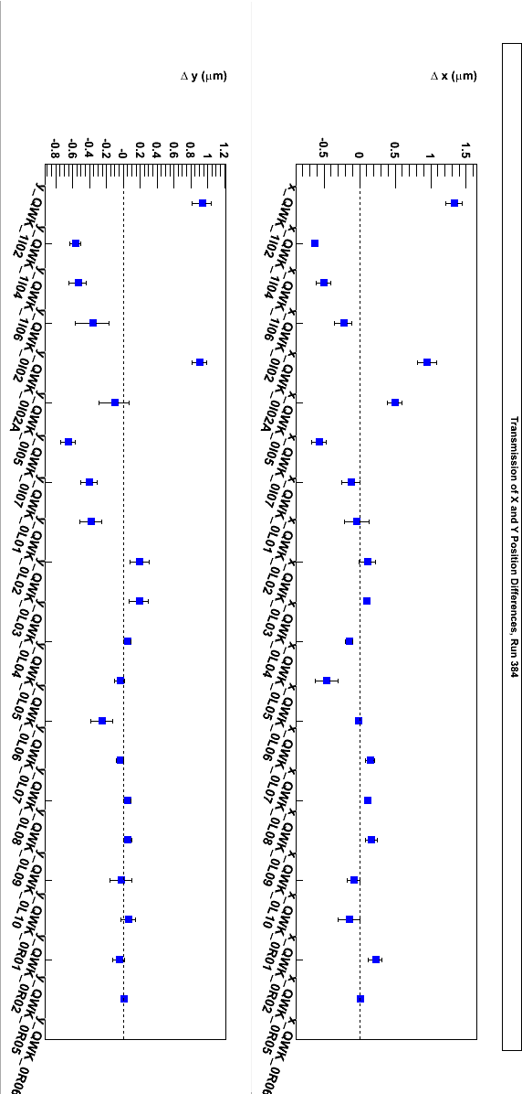
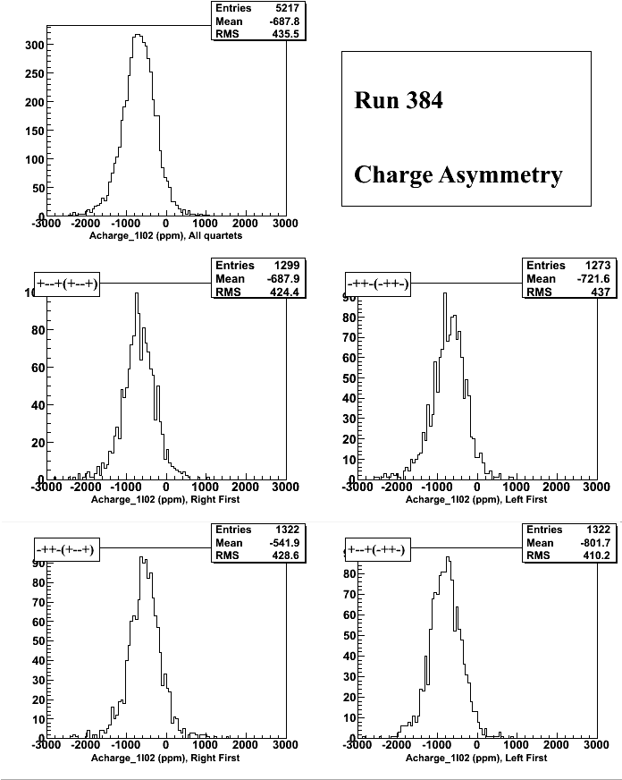

Slide 30

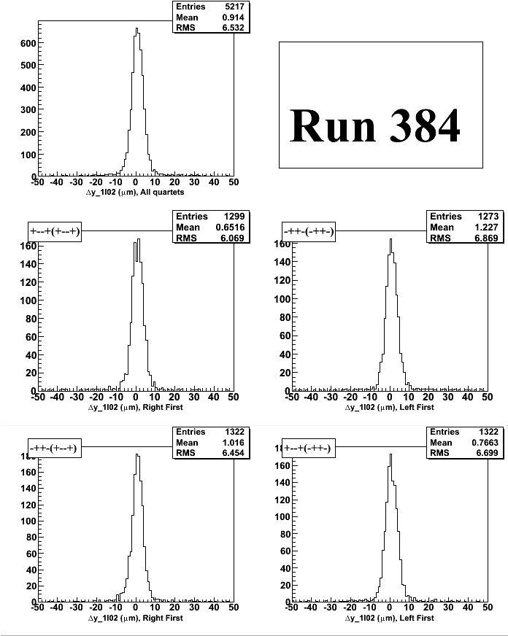

Slide 31
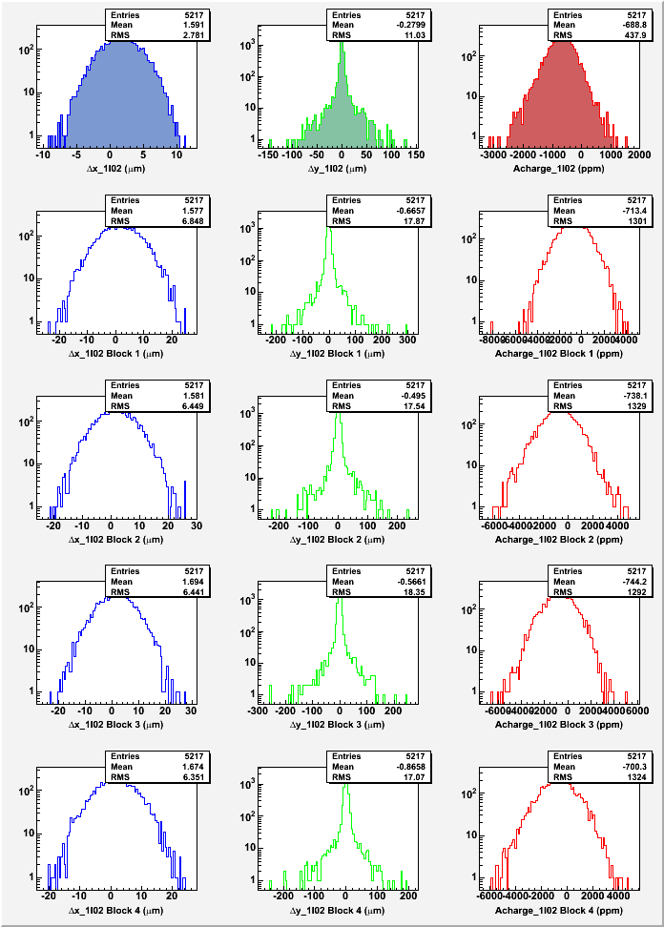

Slide 32
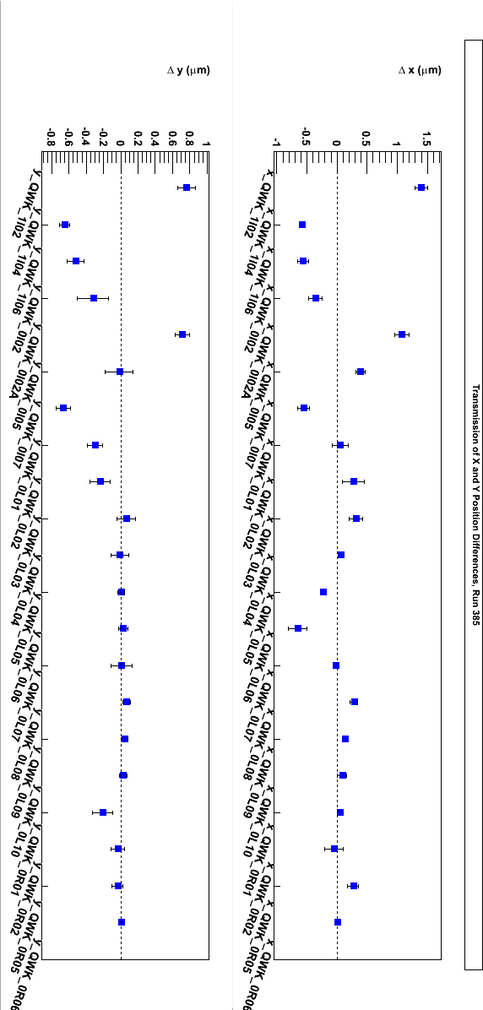
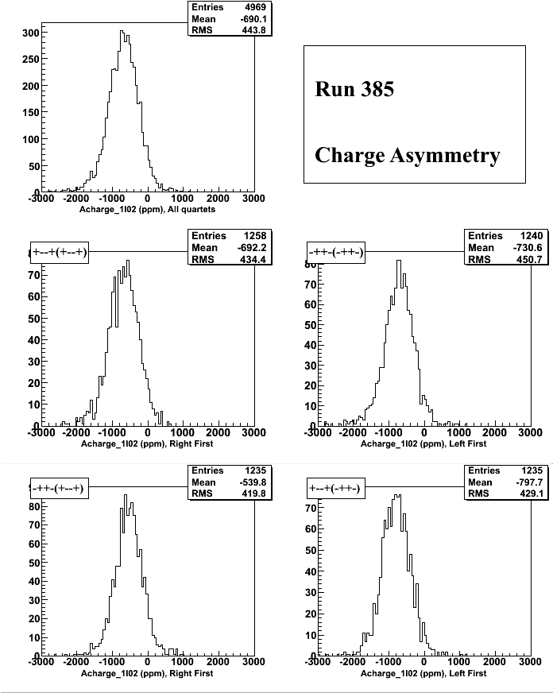

Slide 33
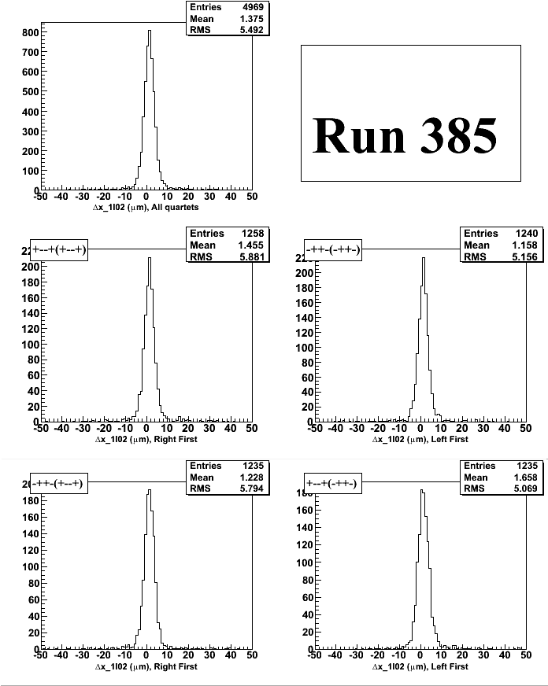
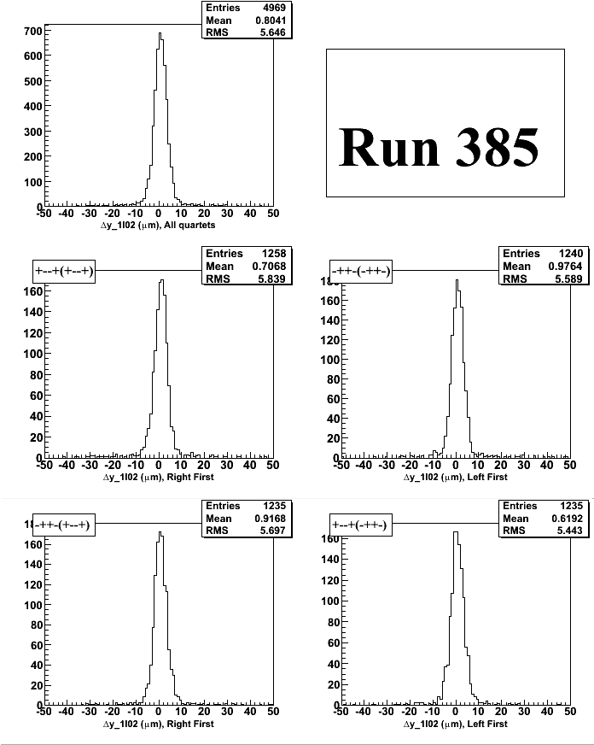

Slide 34
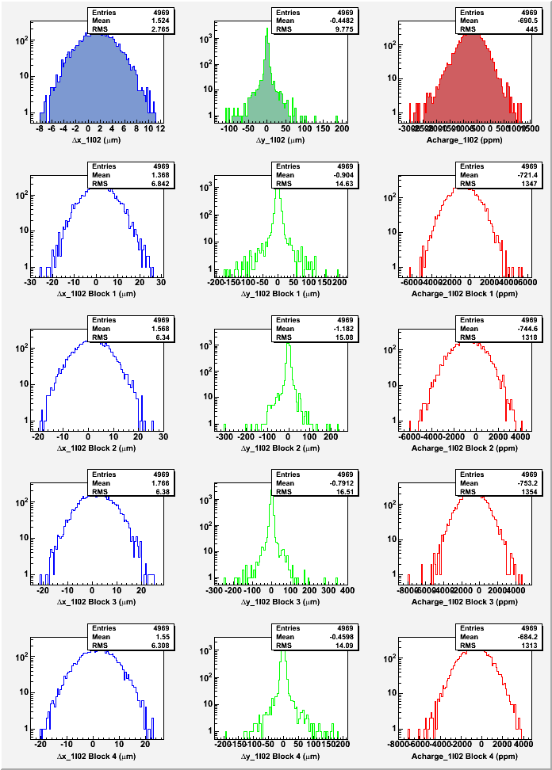

Slide 35
T-Settle Study (500, 200, 100, 60 µs)
250 Hz
Run 391: PC OFF, IHWP IN, 500 µs
Run 394: IHWP OUT, 500 µs
Run 392: IHWP IN, 500 µs
Run 395: IHWP IN, 200 µs
Run 396: IHWP IN, 100 µs
Run 397: IHWP IN, 60 µs

Slide 36
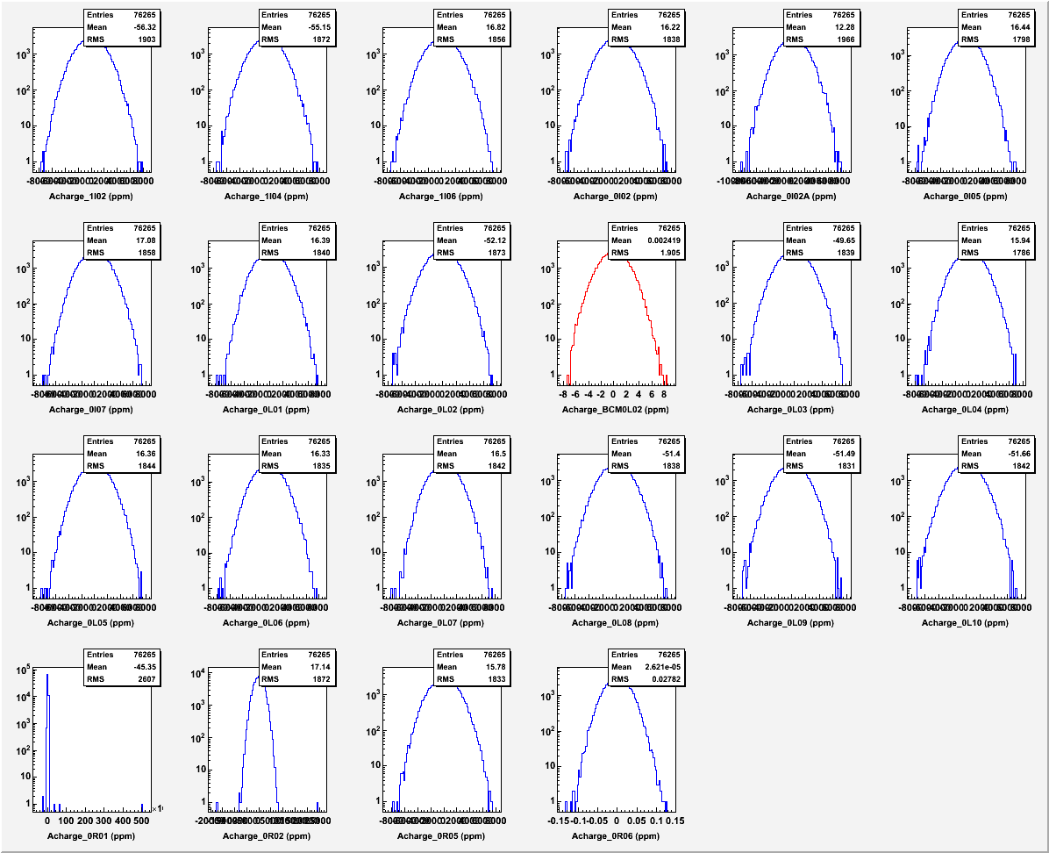

Slide 37
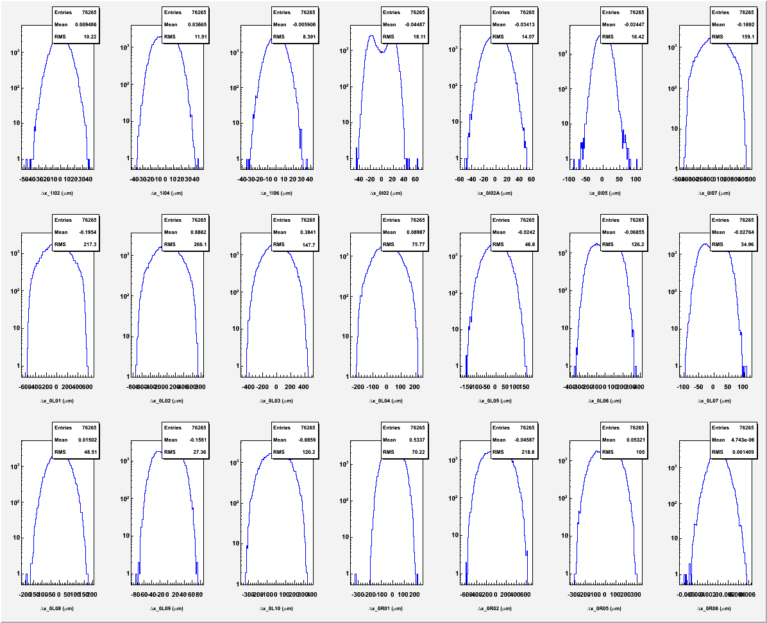
Huge increase in width due to 60 Hz noise

Slide 38
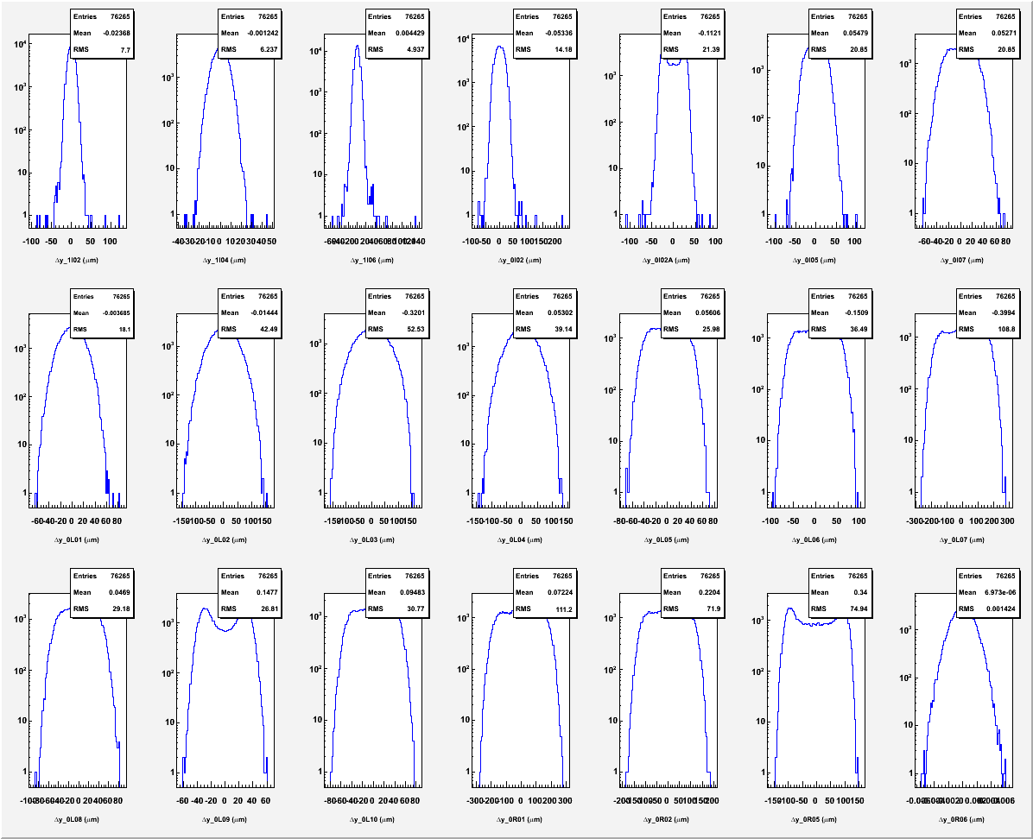

Slide 39
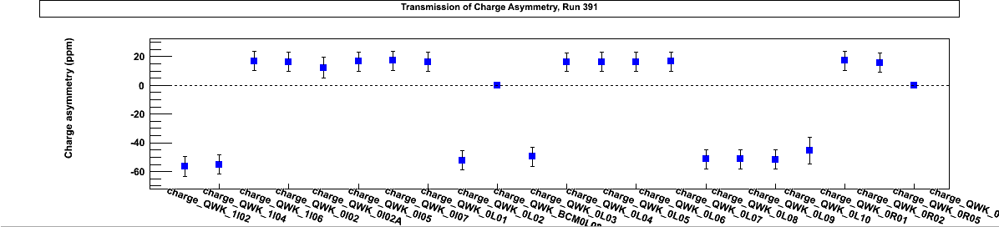
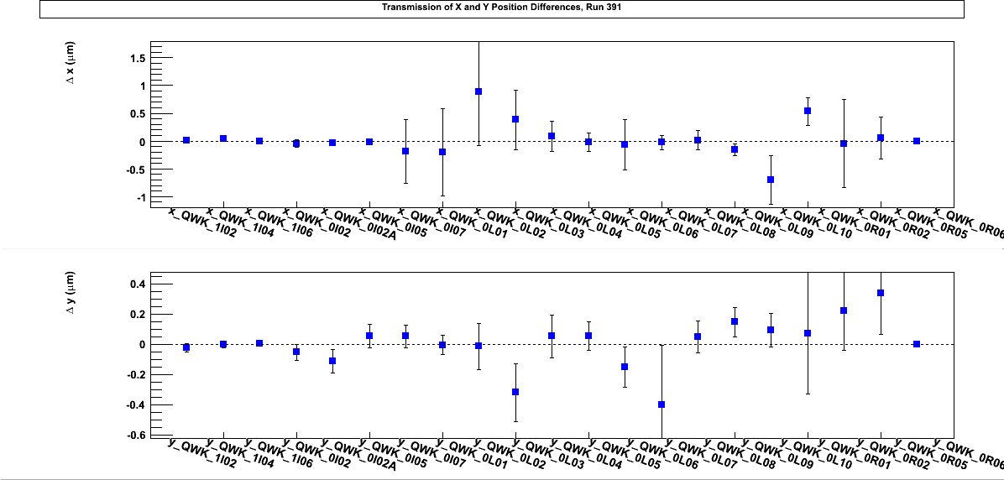
Huge increase in error due to 60 Hz noise

Slide 40
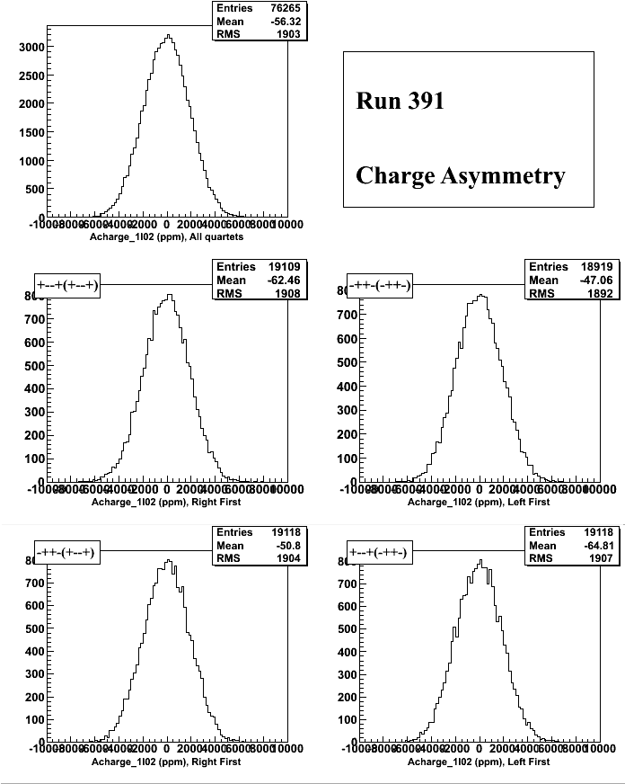

Slide 41
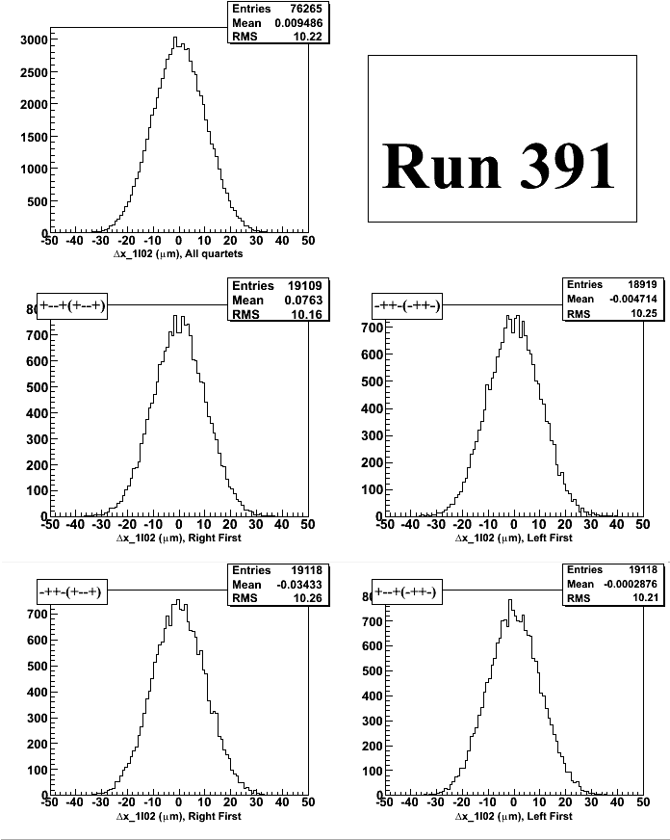
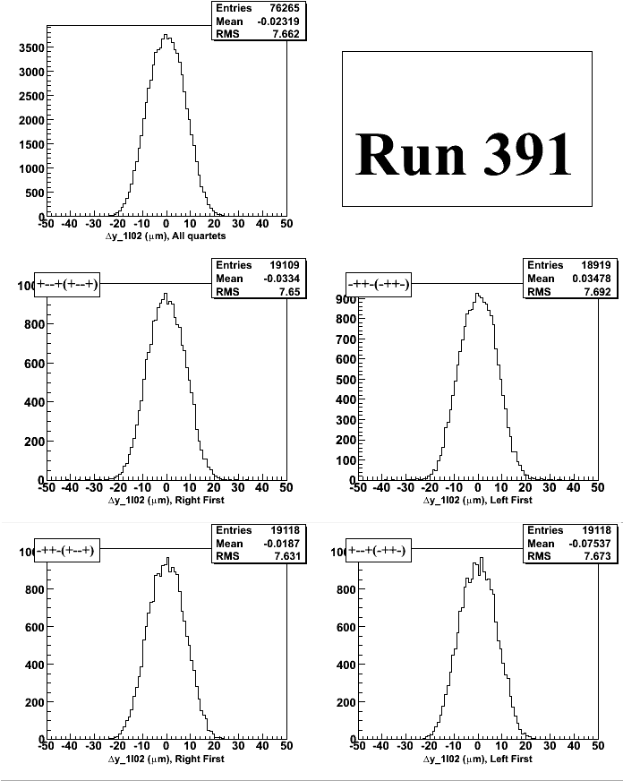

Slide 42
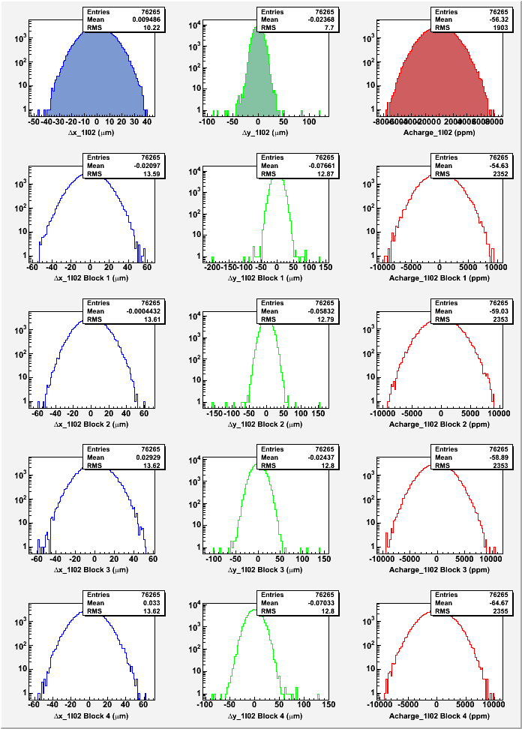

Slide 43
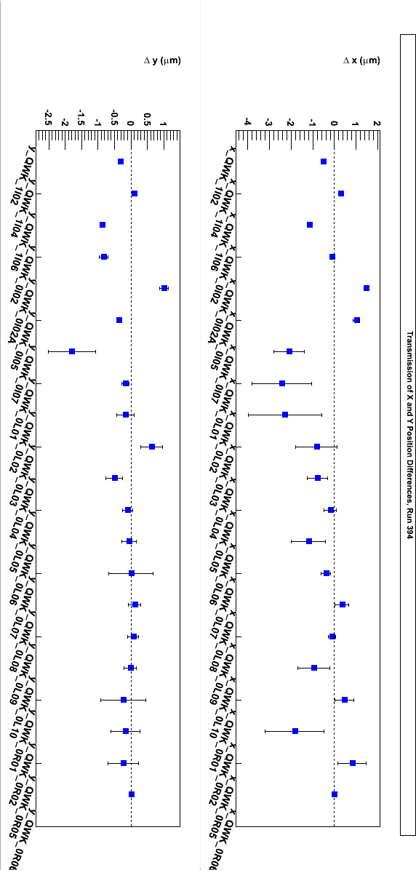
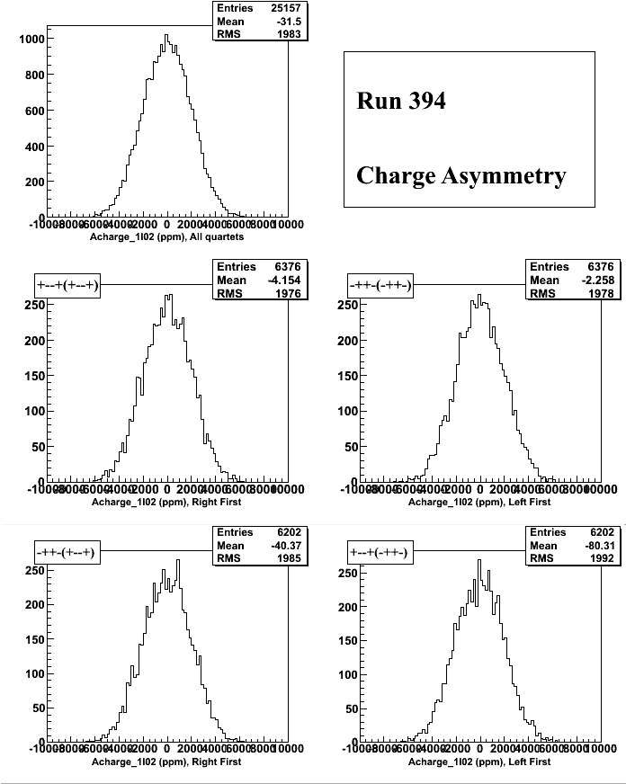

Slide 44



Slide 45


Slide 46



Slide 47



Slide 48


Slide 49



Slide 50



Slide 51


Slide 52



Slide 53



Slide 54


Slide 55



Slide 56



Slide 57


Slide 58
T-Settle Study (500, 100, 60, 10 µs)
1 kHz
Run 477: PC OFF, IHWP OUT, 100 µs
Run 470: IHWP IN, 100 µs
Run 471: IHWP OUT, 100 µs
Notes: CODA gave error messages with the other T_Settle choices. Problem fixed on November 15, 2008.
Notes:
BCM0L02 was fixed at the start of this data set.

Slide 59


Slide 60


Slide 61


Slide 62


Modest increase in error due to 60 Hz noise

Slide 63


Slide 64



Slide 65


Slide 66



Slide 67


Due to BPMs Electronics

Slide 68

Due to BPMs Electronics

Slide 69



Slide 70



Slide 71

Notes:
Note the big change in the first block due to BPMs electronics readout.

Slide 72




BPMs Electronics
Notes:
Chan 1: X+, Chan 2: X-, Chan 3: MPS (Trigger)
Pockels
Cell ON
Pockels
Cell OFF
Pockels
Cell ON
Pockels
Cell OFF

Slide 73

Notes:
Injector iocse11, iocse12, and iocse19 have “TRANSPORT” style IF cards
To study Pockels Cell Settling Time, should we: Change to LINAC? Use Hall BPMs? Use laser Quad Photodiode (QPD)?
 | TRANSPORT | LINAC
Sample Time | 140 µs | 8.6 µs
Fixed Delay | 70 µs | 4.3 µs
Dynamic Range | 70 nA – 200 µA | 700 nA – 2,000 µs
Notes:
Hall C iocse18 and iocse14 have “TRANSPORT” style IF cards
Hall C iocse17 has “LINAC” style IF cards
1I02, no
beam

Slide 74
Search for 60 Hz Noise
Did 60 Hz Noise Search with Extech 480824 EMF Adapter and a Fluke 87
High reading areas:
→ PSS 500 keV MBO0I06 Dipole current sensor

Slide 75

30 Hz
PSS Dipole Magnet
250 Hz
1 kHz
Notes:
The PSS dipole is between 0I05 and 0I07.

Slide 76

30 Hz data: 60 Hz noise averaged out
Notes:
30 Hz data

Slide 77

250 Hz data: 60 Hz noise maximum
Stripe!
Notes:
250 Hz data

Slide 78

1 kHz data: 60 Hz noise smaller
Correlated because of BPMs Electronics
Notes:
1kHz data
The correlation between Dx and Dy is coming from the first block of the data due to the BPMs electronics.

Slide 79

Sensor
ON
Sensor
OFF
Sensor
ON
Notes:
The PSS dipole is between 0I05 and 0I07.

Slide 80

Sensor
ON
Sensor
OFF
Sensor
ON

Slide 81



Hall A & G0 Cross-talk
Hall A IA Scan:
Hall A IA Scan (80 uA)
Hall C Charge asymmetry and position differences during the Hall A IA Scan (20 uA)

Slide 82


G0 Charge Asymmetry Width:
G0 @ 20 uA
Hall A @ 90 uA
G0 @ 20 uA
Hall A OFF

Slide 83
Halls A & C Beams Cross-talk
→ Could it be the Surface Charge Limit of the Photo-Cathode
Change current and phase of Hall C beam
Stop Hall C beam on the Chopper, measure the parity quality of Hall A beam after the Chopper
Run 410: Hall A 120 µA, Hall C 0 µA
Run 412: Hall A 0 µA, Hall C 110 µA
Run 413: Hall A 120 µA, Hall C 0 -110 µA, Hall C laser phase 55 degree
Run 414: Hall A 120 µA, Hall C 110 µA, changed Hall C laser phase

Slide 84



Slide 85



Slide 86

Hall C Current Scan
Notes:
No obvious dependence

Slide 87

Hall C Laser Phase Scan
Notes:
No obvious dependence. Try again once the photo cathode QE worsen.

Slide 88
Summary
The parity DAQ, BPMs, and Analysis are working fine
30 Hz: The standard PQB at 30 Hz was achieved
250 Hz: The PQB is very similar to 30 Hz otherwise for the 60 Hz noise
1 kHz: The PQB is very similar to 30 Hz, again issues with 60 Hz noise (less sensitive than at 250 Hz)
BPMs Electronics are affecting T_Settle studies
New charge feedback will be implemented: No slow controls (EPICS), zeroed the asymmetry for each of the 4 helicity sequences → New Helicity Board design
What’s next?
Finish analysis: 4 blocks, Phase Monitor, Batteries, …
Study 1 kHz for all T_Settle choices
More Beams cross-talk studies: with bad QE, IA scans, …
Eliminate the vacuum window birefringence by rotating the LLGun2 photocathode
Check Helicity Magnets, Mott Polarimeters at 1 kHz

