Slide 1
FastSim vs FullSim and PileUp Studies
Frank Chlebana
JetMET, Feb 14 2008

Slide 2
FastSim vs FullSim
Comparison of FullSim (CMSSW 1.5.2) and
FastSim (CMSSW 1.6.8)
FullSim: read data files and run analysis code
FastSim: generate events and run same analysis code
Looked at three QCD samples
pT = (80 – 120)
pT = (600 – 800)
pT = (3500 – inf)

Slide 3
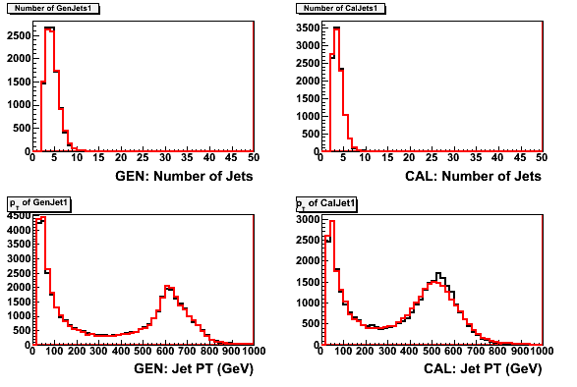
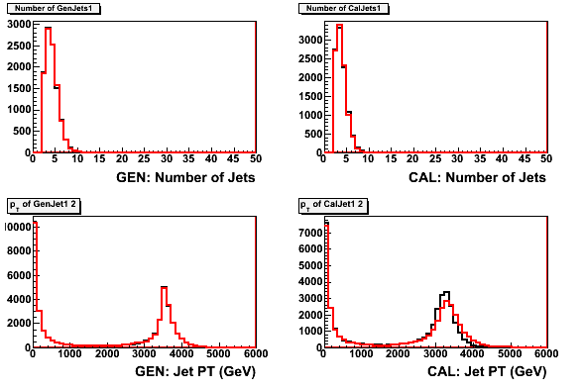
FastSim vs FullSim
Looked at many other distributions
http://ncdf76.fnal.gov/~chlebana/CMS/FastSim
Generated quantities agree…
Jet are constructed with
higher pT in the high pT
sample

Slide 4
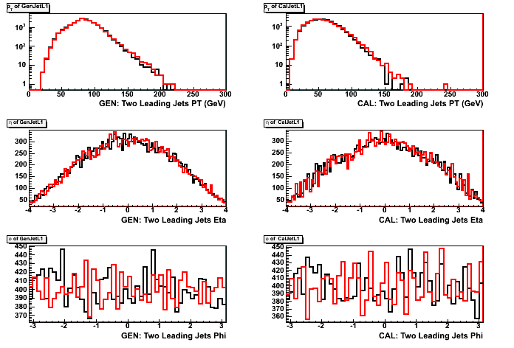
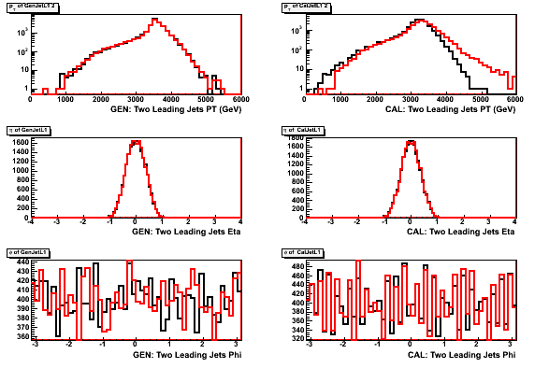
FastSim vs FullSim
pT = 80 – 120 GeV
Comparison of Gen and Cal quantities
Gen quantities agree in both samples
Black: fullsim
Red: fastsim
Gen
Cal
pT
η
pT = 3500 – inf GeV
φ
See better agreement for Cal
quantities in the low pT sample

Slide 5
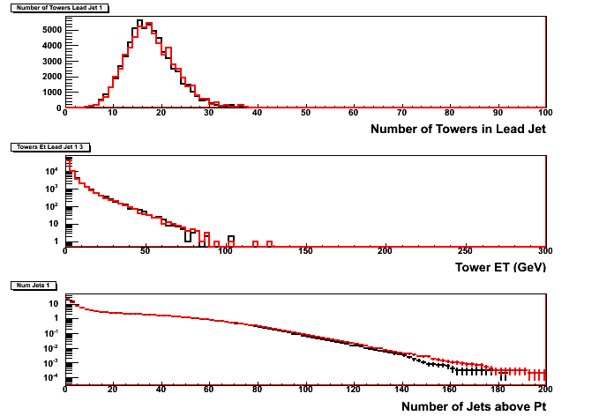
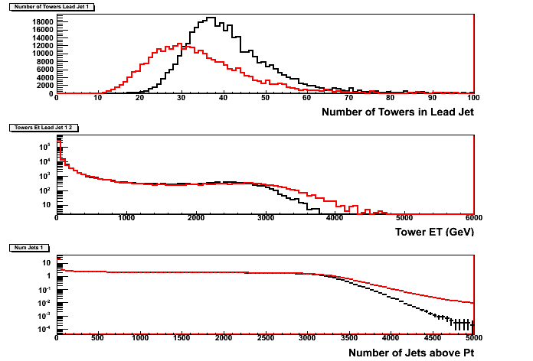
FastSim vs FullSim
pT = 80-120 GeV
At higher pT we see fewer
towers
pT = 3500-inf GeV
Towers have higher energy
See better agreement in the
low pT sample
Find more energetic jets

Slide 6
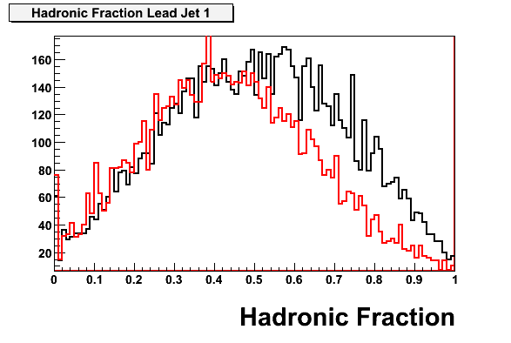
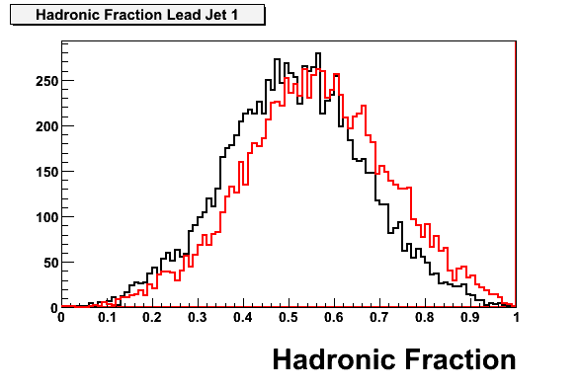
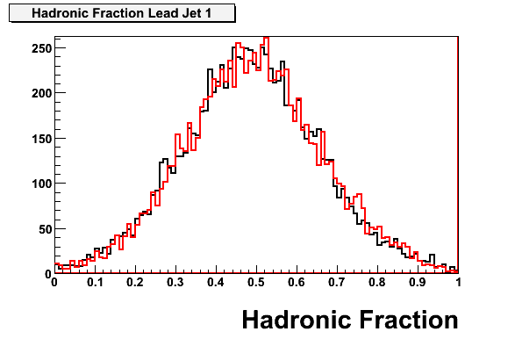
FastSim vs FullSim
Hadronic fraction of the Leading Jet is
smaller in the low pT sample and higher
in the high pT sample
pT = 80 - 120
pT = 600 - 800
pT = 3500 - inf

Slide 7
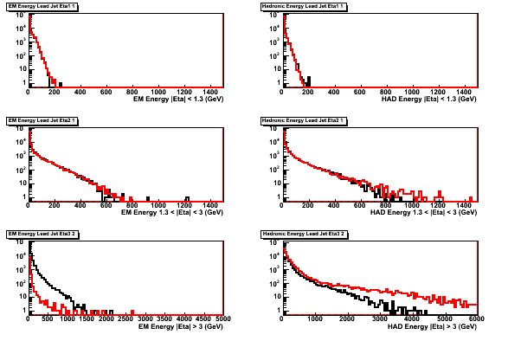
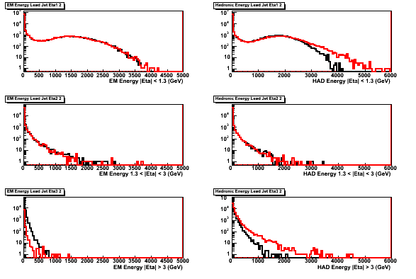
FastSim vs FullSim
EM and HAD energy in three η regions
pT = 80 – 120
EM
HAD
For |η| < 1.3: HAD high
pT = 3500 – inf
|η| < 1.3
1.3 < |η| < 3
For |η| > 3: EM low, HAD high
|η|>3

Slide 8
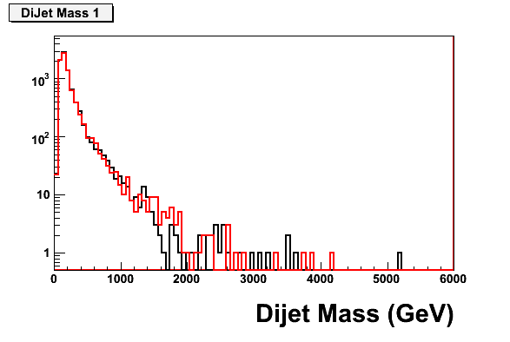
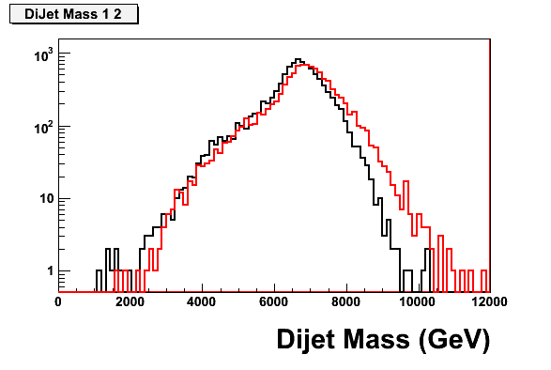
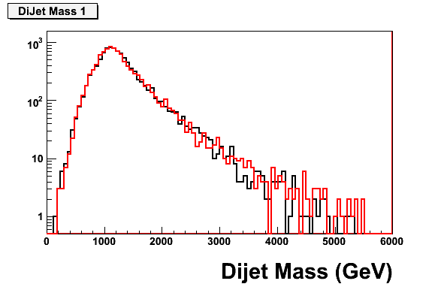
FastSim vs FullSim
Dijet Mass from the two leading jets

Slide 9
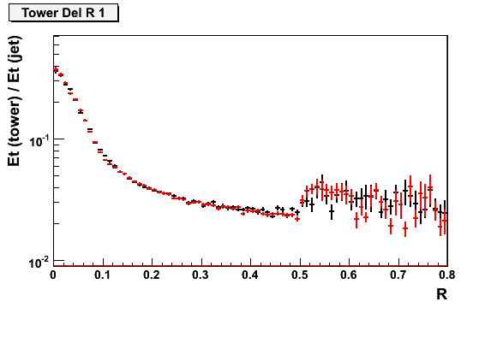
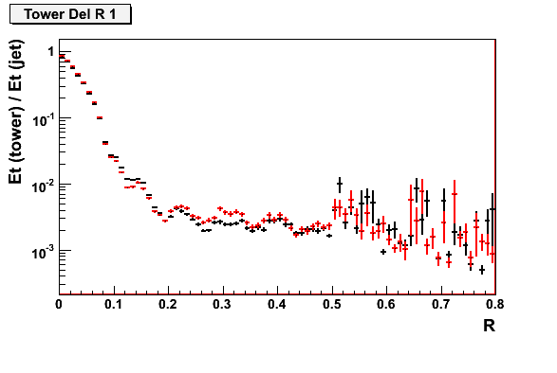
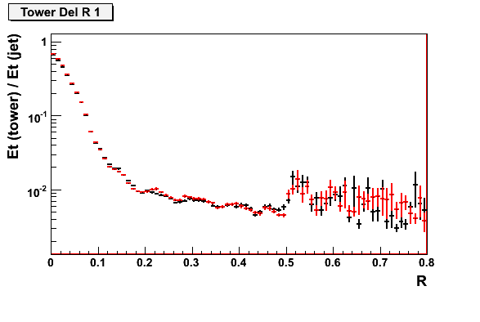
FastSim vs FullSim
Et(tower) / Et (Jet) vs R

Slide 10
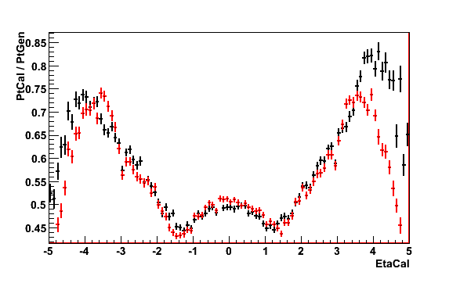
FastSim vs FullSim
Jet Response vs Eta
Known Problem

Slide 11
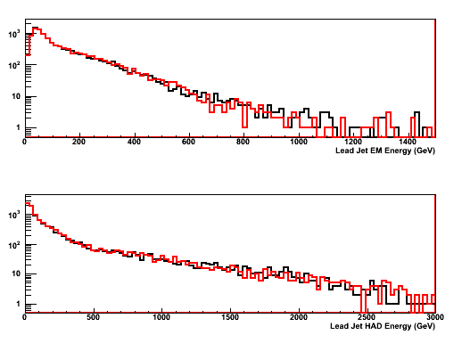
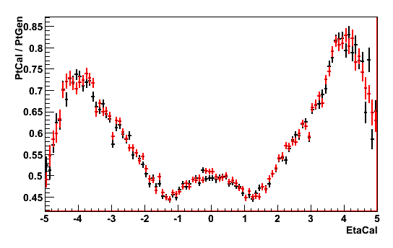
CMSSW152 vs CMSSW167
Working with the CMSSW152 samples because they are easier
to get at and cover a wider pT range
Compared CMSSW152 (black) with
CMSSW167 (red), pT = (80 – 120)
→ distributions look very similar
Lead Jet EM Energy
HCAL Gains too high
Fixed in CMSSW168
Lead Jet HAD Energy

Slide 12
FastSim vs FullSim
Results have been shown to experts… several email
exchanges
High pT sample (first time looking at high pT)
See fewer towers and towers have more energy
Lateral shower spread
FastSim jets are more energetic
Energy scale/linearity
FastSim jets have a larger hadronic component
Longitudinal shower
Forward Region (known issue)
FCAL short/long fibre geometry not properly simulated

Slide 13
PileUp Studies
Study pileup effects using FastSim
Saw differences in response for FastSim vs FullSim
but should be ok for pileup studies
FastSim pileup simulation only includes in-time pileup
Compared evts=0 with evts=20
Goal is to demonstrate that the performance of
SISCone is not compromised when PileUp is present
(If that is really the case….)

Slide 14
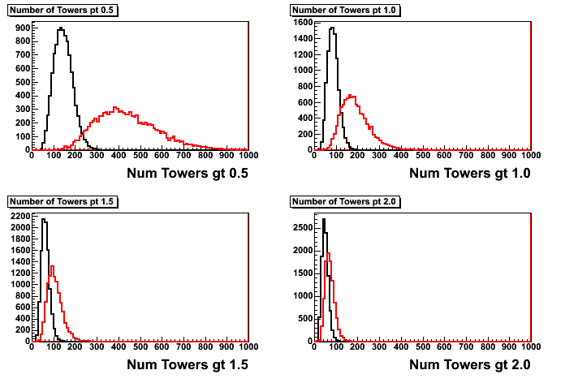
PileUp Studies
QCD: pT = 600-800 GeV
Red: with pileup
Black: no pileup

Slide 15
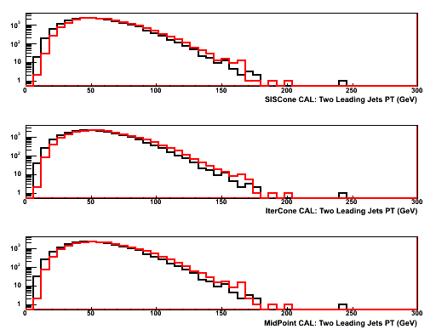
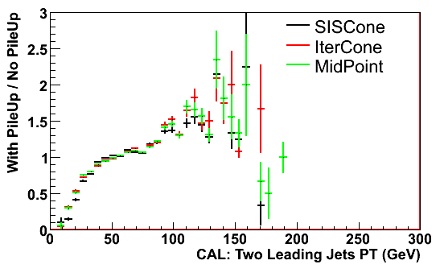
PileUp Studies
SISCone
pT distribution of two leading jets
no pileup: black
with pileup : red
IterCone
MidPoint
Change in the pT distribution
in the presence of pileup
looks similar for the different
jet algorithms

Slide 16
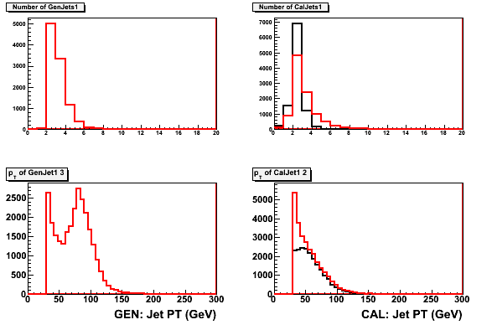
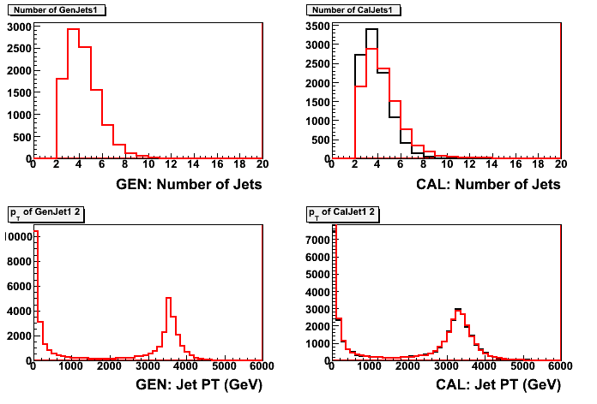
PileUp Studies
pT = 80 - 120
Distributions look
reasonable
pT = 3500 - inf
More lower pT jets
(as expected)

Slide 17
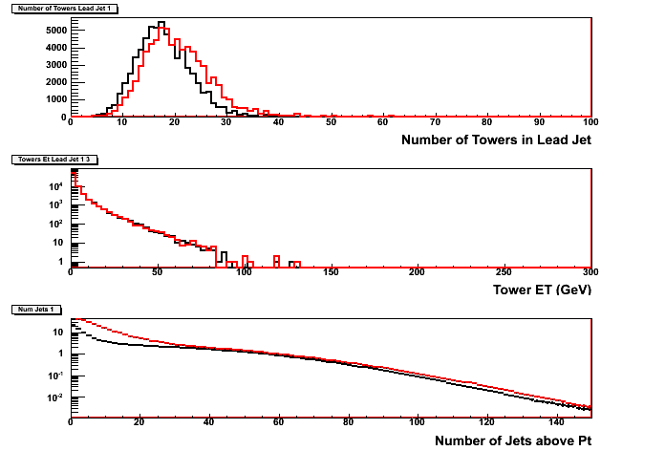
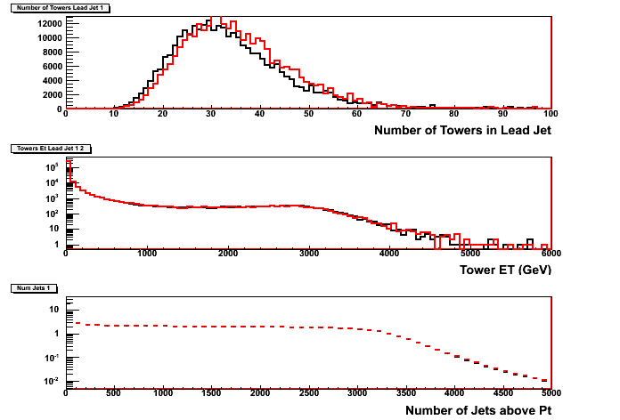
PileUp Studies
Jets have slightly more towers
(as expected)
Finding more jets with lower pT

Slide 18
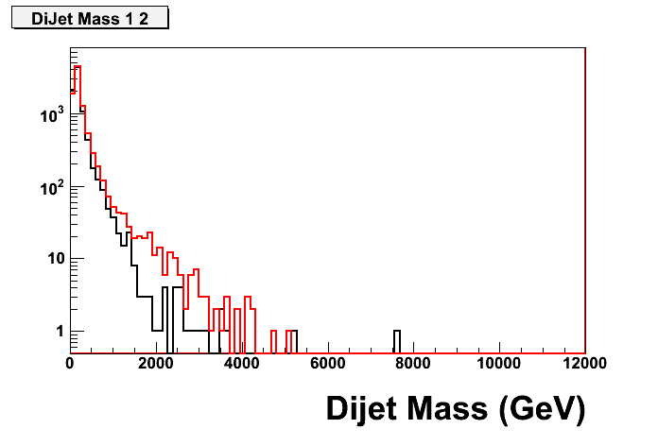
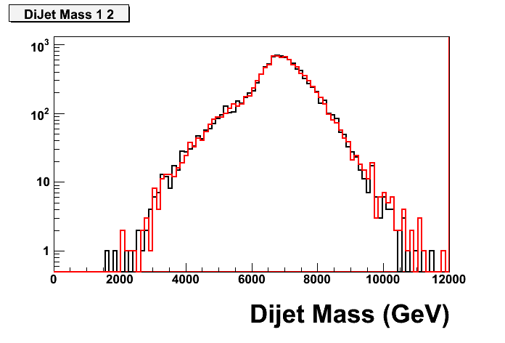
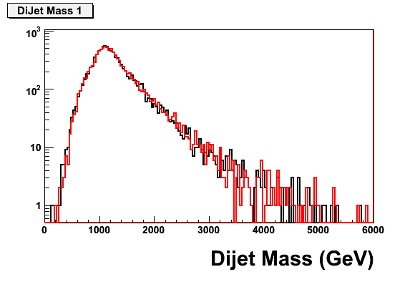
PileUp Studies
Dijet mass determined from the two
leading jets
pT = 80-120 GeV
Similar distributions with and
without pileup…
pT = 3500-inf GeV
pT = 600-800 GeV

Slide 19
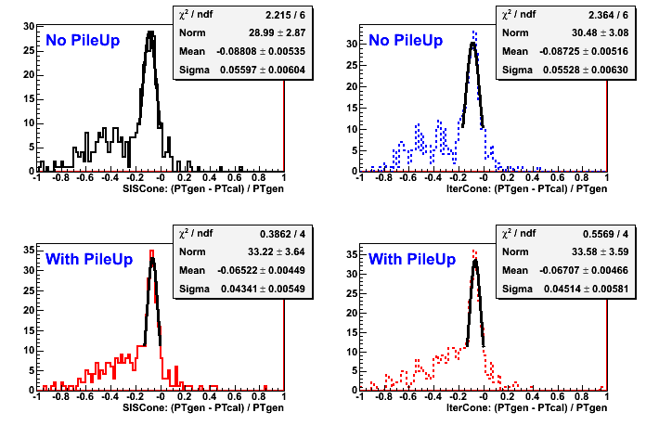
pT Resolution
SISCone
IterCone

Slide 20
PileUp Studies: Summary
Using FastSim to study the effects of PileUp on the
jet algorithms
So far see that results for SISCone, MidPoint, and
IterCone are very similar
More plots can be found at:
http://ncdf76.fnal.gov/~chlebana/CMS/PileUp

