Slide 1
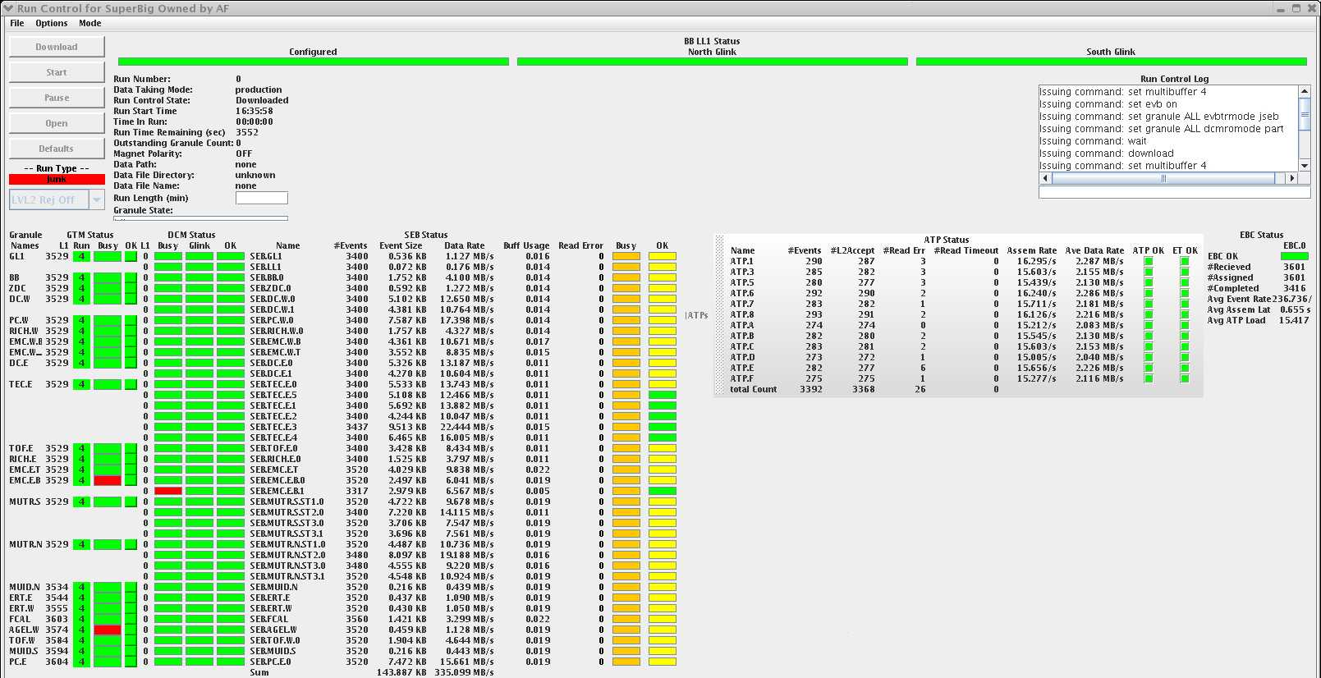
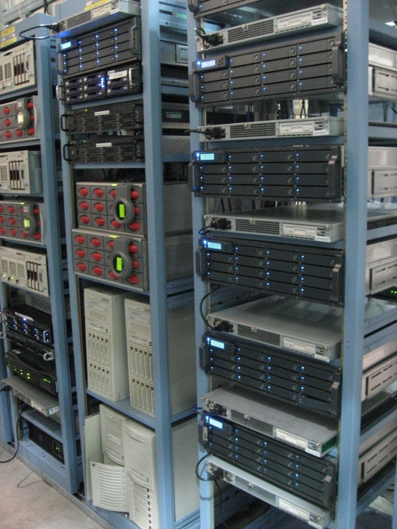
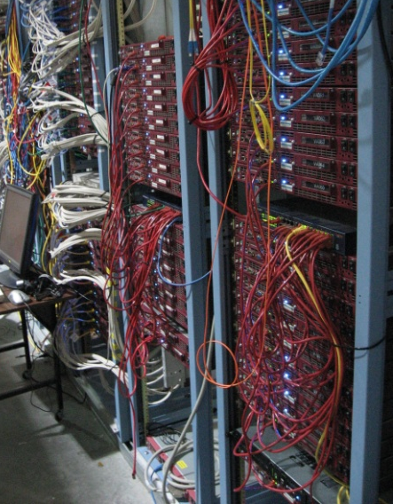
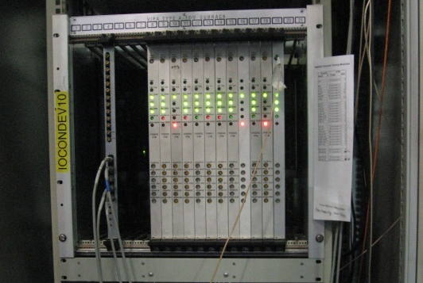
After OS upgrades, PHENIX DAQ now running with all subsystems

Slide 2
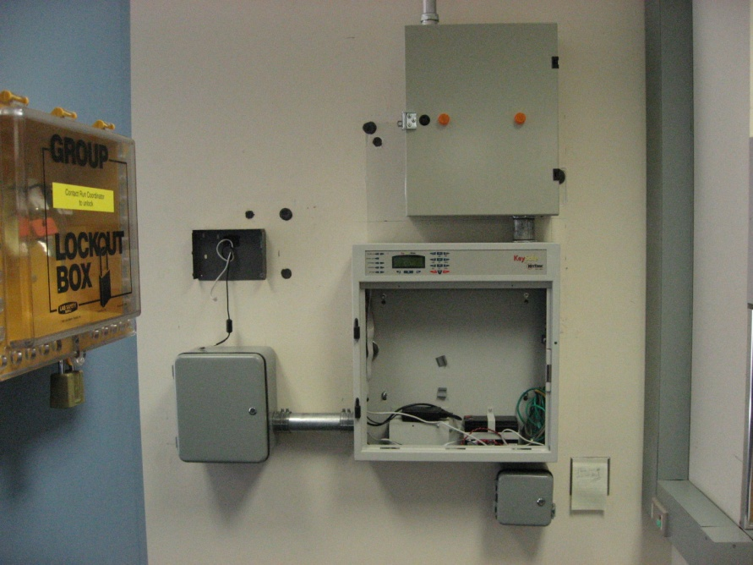
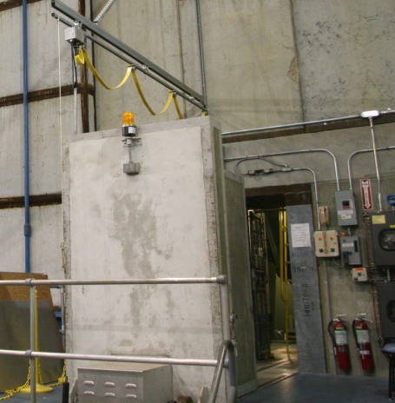
Old PHENIX IRIS Scanner removed
new one partially installed
expected to done this Friday
in meantime Controlled access only via key from MCR
PHENIX shift crews cannot get into IR quickly

