Slide 1
NOAA’s Information Technology Office of the Chief Information Officer (OCIO)

Slide 2
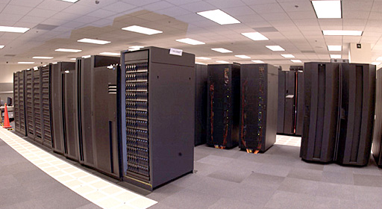
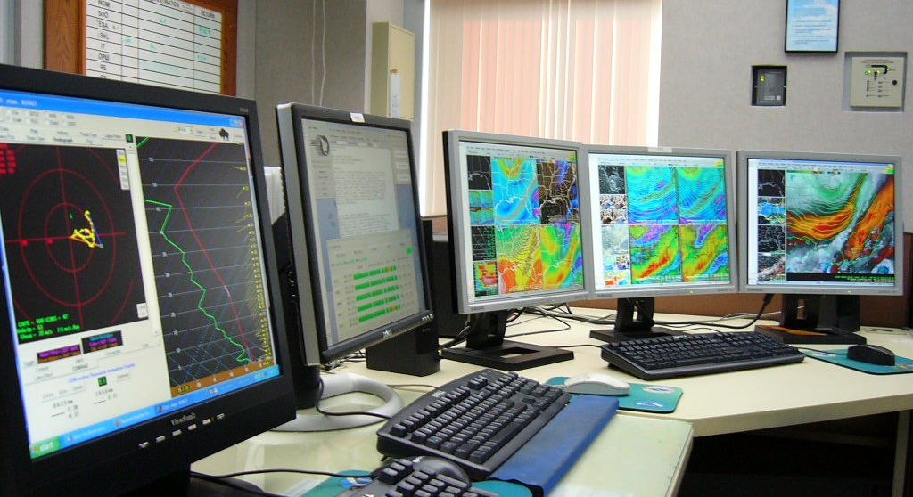
Office of the Chief Information Officer NOAA’s Information Technology
A secure and agile information enterprise with advanced computing capability that propels NOAA’s scientific and operational missions
To deliver information and technology services that enable NOAA’s mission

Slide 3
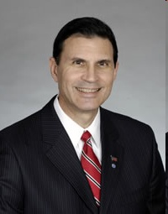
Leadership
Joseph F. Klimavicz
Chief Information Officer and
Director, High Performance Computing and Communications
Implements the Clinger-Cohen Act, Federal Information Security Management Act, and other statutory requirements pertaining to the acquisition, management, and use of NOAA’s information and information technology (IT) resources.
Chief Information Officer and
Director, High Performance Computing and Communications
Joseph F. Klimavicz
High
Performance
Computing and
Communications
Office
Mike Kane
(Acting)
Homeland
Security
Program Office
CAPT. Wade Blake
IT Security
Office
Larry Reed
Business
Management
Office
Kathy Stowe
Enterprise
Architecture
Office
David Layton
Policy,
Planning
and Analysis
Office
Robert Swisher
Program
Management
Office
John Unekis
(Acting)
Information
Systems
Management
Office
John Villemarette

Slide 4
Services
Efficient and Effective Enterprise IT for NOAA
Provide Enterprise Information Technology (IT)
Develop, Manage & Ensure Quality IT Investments ($700M FY09)
Manage NOAA’s High Performance Computing and Communications Infrastructure/Resources
Ensure NOAA’s Business Continuity
Protect NOAA’s Information and IT Resources
Attract and Develop Skilled IT Workforce

Slide 5
IT Legislation
Implement Legislation with Policies and Guidance
Clinger-Cohen Act
Government Performance and Results Act
E-Government Act
Federal Information Security and Management Act (FISMA)
Privacy Act
Information Quality Act
Federal Records Act
Rehabilitation Act – Section 508
Telecommunications Act
Paperwork Reduction Act
Government Paperwork Elimination Act
National Continuity Policy (NSPD-51/HSPD-20)
High Performance Computing and Communications Act

Slide 6
OCIO Budget

Slide 7


Facilities and Personnel
OCIO Personnel
FTEs 109
Contractors 128
Political 0
Vacant 10
OCIO Support
NOAA Administrative Support Centers
NOAA High Performance Computing

Slide 8
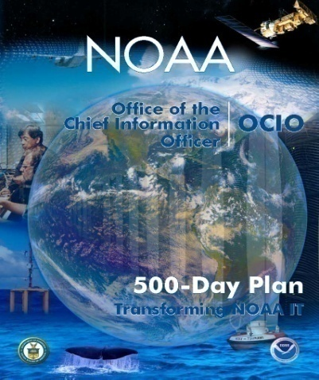
Progress
Past 500-days (April 2007-Sept 2008)
Standardized and Automated Certification and Accreditation
Created and Deployed Enterprise Standard for Mobile Computing
Aligned OCIO Organization to New IT Governance Model
Increased NOAA’s HPC Capacity by a Factor of Five at No Cost
Strengthened NOAA’s Support to Emergency Response Community
Maintained 99.9% Availability of Systems and Networks
Began Implementation of NOAA IT Workforce Investment Strategy

Slide 9
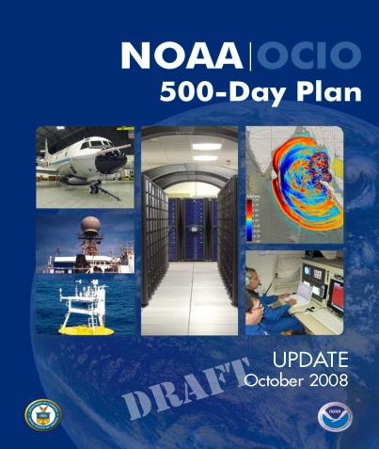
Looking Ahead
Next 500-days (Oct 2008-Feb 2010)
Secure Information and IT Infrastructure
Increase Efficiency and Effectiveness through Enterprise-wide Solutions
Build Robust High Performance Computing
Operate IT as Customer-focused Service Provider
Attract, Develop, and Retain a Skilled IT Workforce

