Slide 1
eDRN Catalog and Archive Service (eCAS)
Chris A. Mattmann

Slide 2
Roadmap
Purpose
What problem is eCAS addressing?
Relationship to EDRN efforts and standards
High Level Architecture
Curation Process
Current Status
Data sets loaded
Dev and Ops Instances
Role of DMCC and NCI
Next Steps

Slide 3
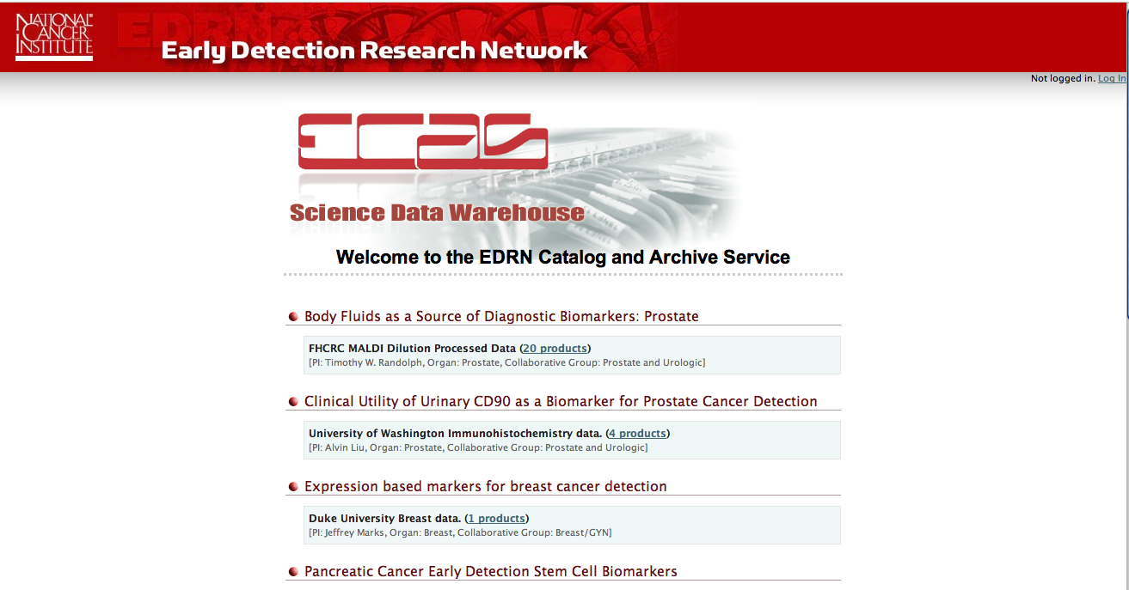
eCAS purpose
Data Warehousing Application
Store raw and processed data from local laboratories
NCI eCAS that holds curated “high quality” eCAS data published from local sites
Many potential applications
Specimen images, datasets, instrument generated products, etc.

Slide 4
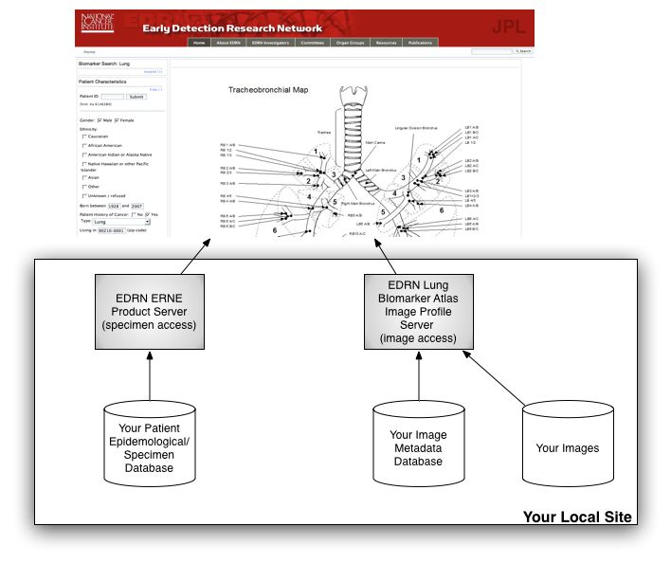
Relationship to EDRN efforts and Standards
Efforts
Used to capture SELDI datasets
Used in Lung Biomarker Atlas Application (UCHSC & Roswell Park)
CT Database
Standards
Lung Biomarker Atlas CDEs
Ontology
eCAS

Slide 5
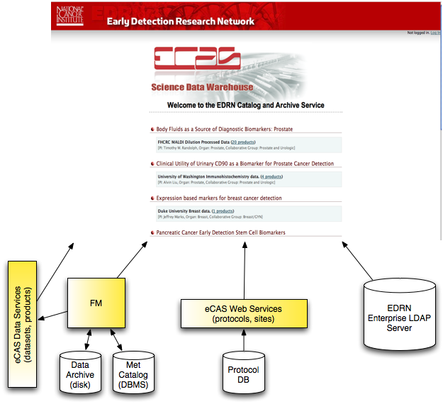
High Level Architecture

Slide 6
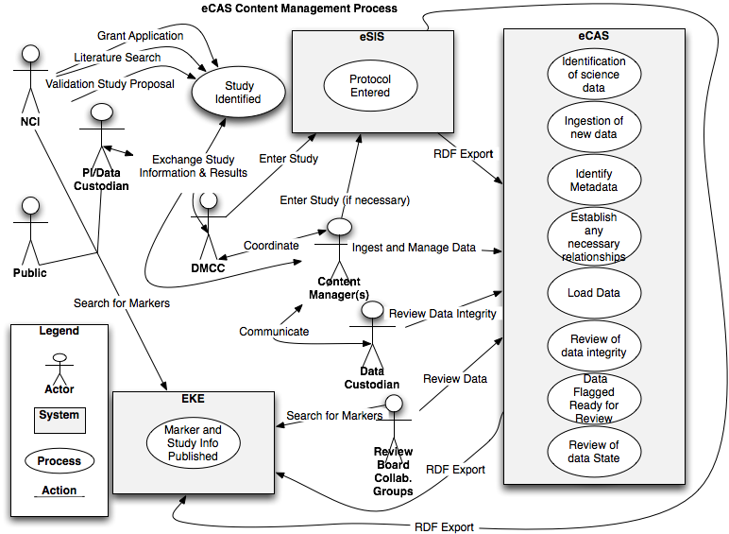
Curation Process
Source: H. Kincaid

Slide 7
Current Status
Data Loaded
SELDI Phase I/II, MALDI Dilution Data, Misc PI data (Immunohistochemistry, LabMAP Mass Spectrometry, FISH data)
Sites: NIST, FHCRC, EVMS, UAB, Duke, Univ Pitt, Univ Wash
Servers
Dev: http://tumor.jpl.nasa.gov/ecas/ (JPL internal)
Ops: http://cancer.jpl.nasa.gov/ecas/ (public)
Current Release: 0.1.0 beta
Pending: 0.2.0 beta: issues to be fixed in this release:
CA-152 Make eCAS RDF dataset link point to the eCAS dataset page

Slide 8
Role of DMCC and NCI
DMCC
Help to derive metadata standards for different dataset types
Annotation of datasets
Delivery of data (processed)
NCI
Encourage PIs to submit data to eCAS
Encourage PIs to run local laboratory eCAS
Capture Prostate 2000 data along with disclaimer

Slide 9
Next Steps
Get more data from PIs
Timeframe: ongoing
Data Quality
Vet with Ontology working group
Timeframe: next 2 months
Deploy Roswell Park eCAS instance for Lung Biomarker Atlas
Timeframe: next 6 months
Continue bi-weekly software release updates
CA-154 Determine security standards to be used between eCAS and EKE
CA-149 Pagination of results in eCAS UI
CA-104 Disclaimer field needs to be added to all eCAS Dataset Metadata

Slide 10
Questions?

