Slide 1
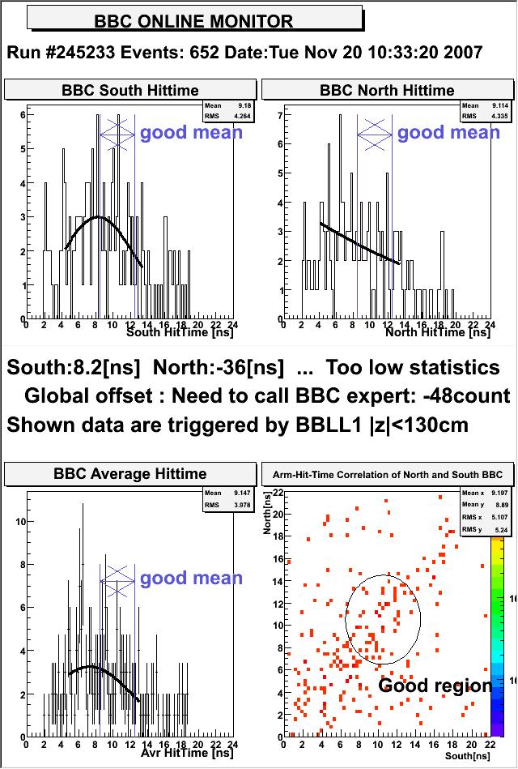
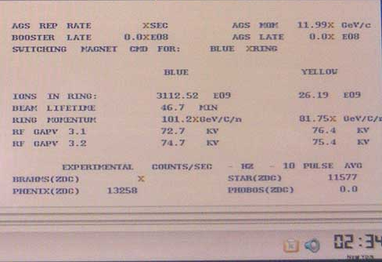
Collisions Sun night
13.3khz ZDC rate at PHENIX
And rough timing in of detector started this morning

Slide 2
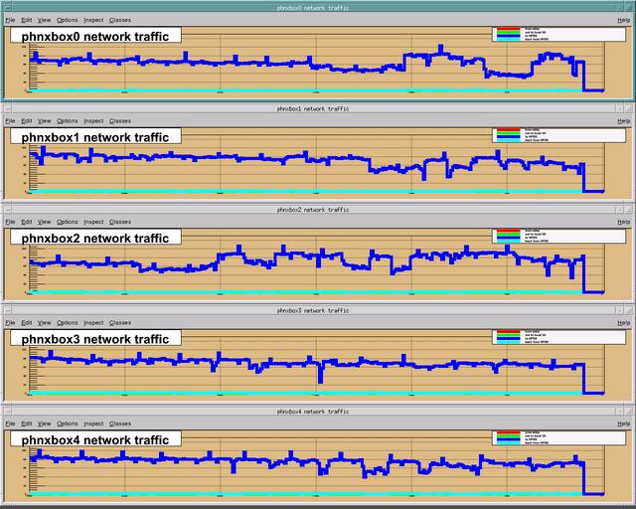
Mock Data Transfers to HPSS 450 MB/s – Sat 11am – 4pm

Slide 3
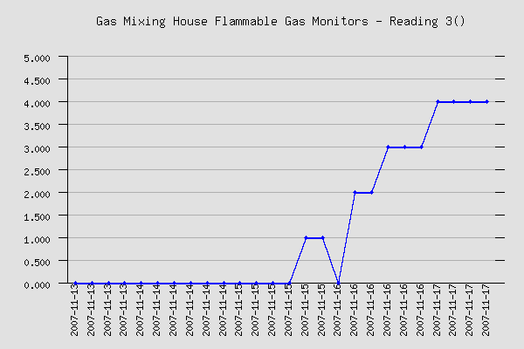
Drifting flammable gas detectors in mixing house

