Slide 1
PHENIX Almost Ready for Physics
Tuning (mainly south muon) triggers
DAQ routinely at ~6 khz event rate
can get to 7+ khz soon
Level-2 “physics” filtering will be turned on in next few days
Final Run8 BBC trigger constants soon
Various minor things to fix on Wed Maintenance day
FCal South LED pulser (7-oclock tunnel)
RICH FEE boards, PC-E LV supply, AeroGel LED, MuID LL1 fiber
Get HPSS transfers running

Slide 2
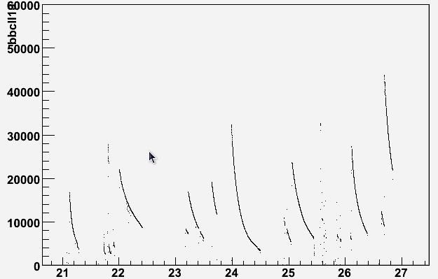
Luminosity?
Monday evening store had about 45 khz BBC rate in our vertex cut (±30cm) - just after rates stabilized
L = 45khz/(2.26b x 0.88) = 23 mb⁻¹/sec
PHENIX vertex efficiency about 50%
so about 46 mb⁻¹/sec delivered
compare to CA goal 46/300 = 1/6.5
BBCLL1 (±30cm)
day

Slide 3
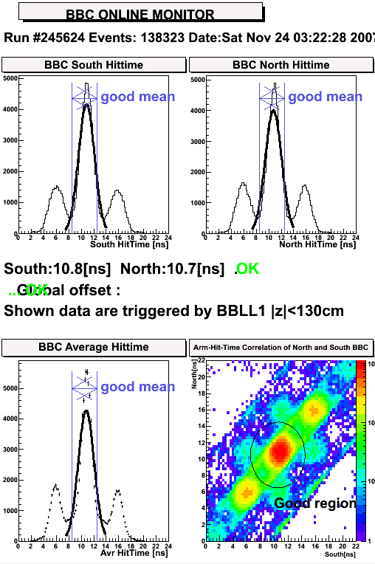
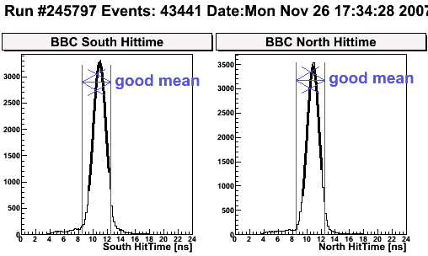
Timing
Saturday
Some of this probably due to change in PHENIX trigger mix
Monday

Slide 4
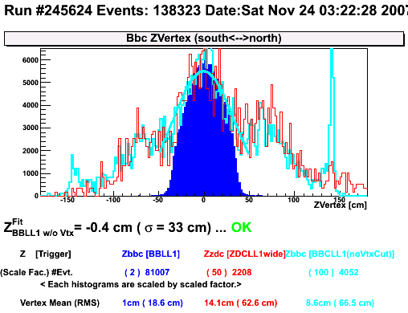
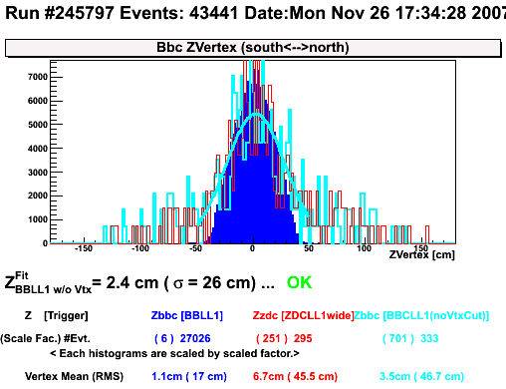
Vertex
Saturday
Monday

Slide 5
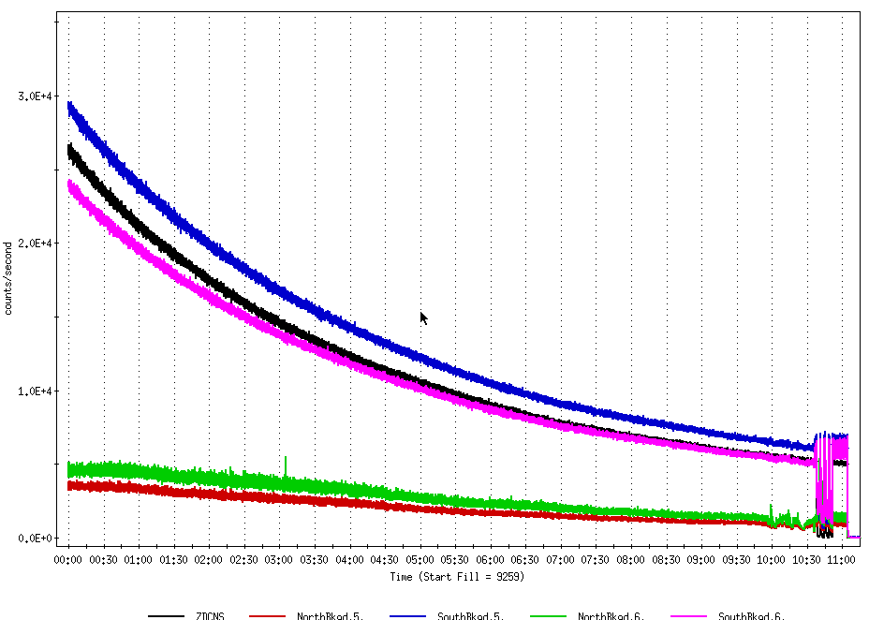
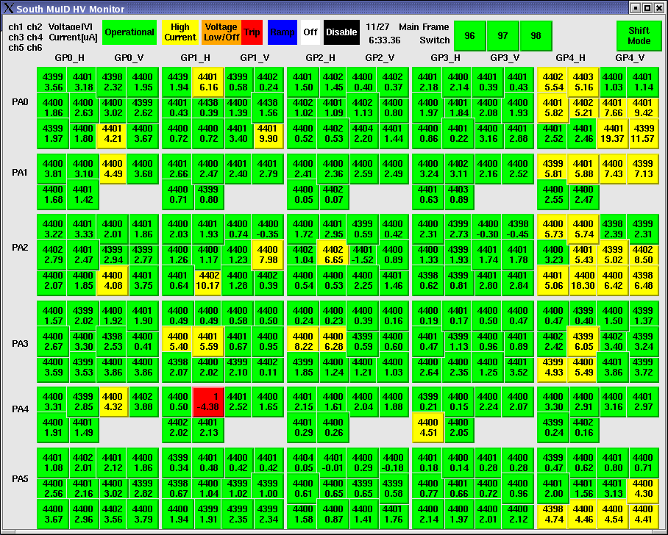
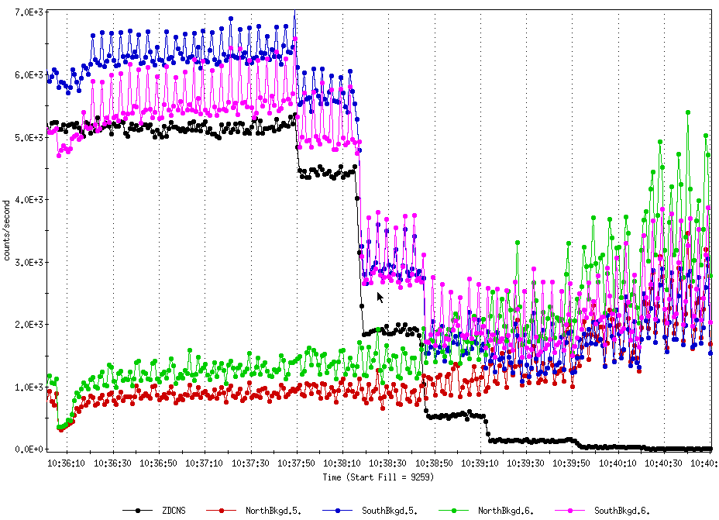
PHENIX background scintillator rates mostly scale with interactions (ZDC in black, red/green 9:00, blue/pink 7:00)
Vernier scan Sunday morning

