Slide 1
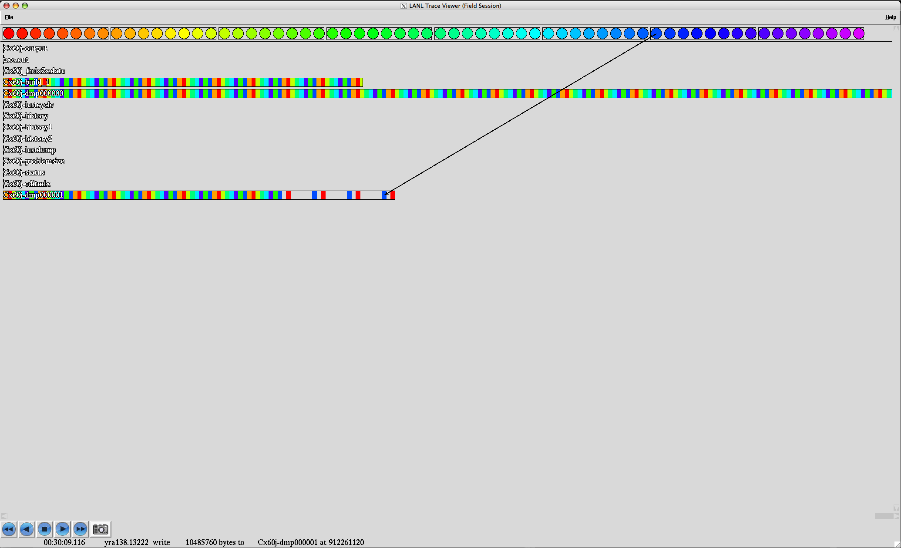
LANL Trace Visualizer
Circles are processes.
Enclosing rectangles are nodes.
Arrows depict IO btwn a process and a file
Wide rectangles are files. Internal rectangles represent each IO and are colored to match the issuing process. The colors reveal these are N-1 strided files.
The trace visualizer reads LANL trace files and creates an animation showing which processes did IO to what offsets within which files.
Text describes each IO
The visualization can be played, stopped, forwarded or reversed.

Slide 2
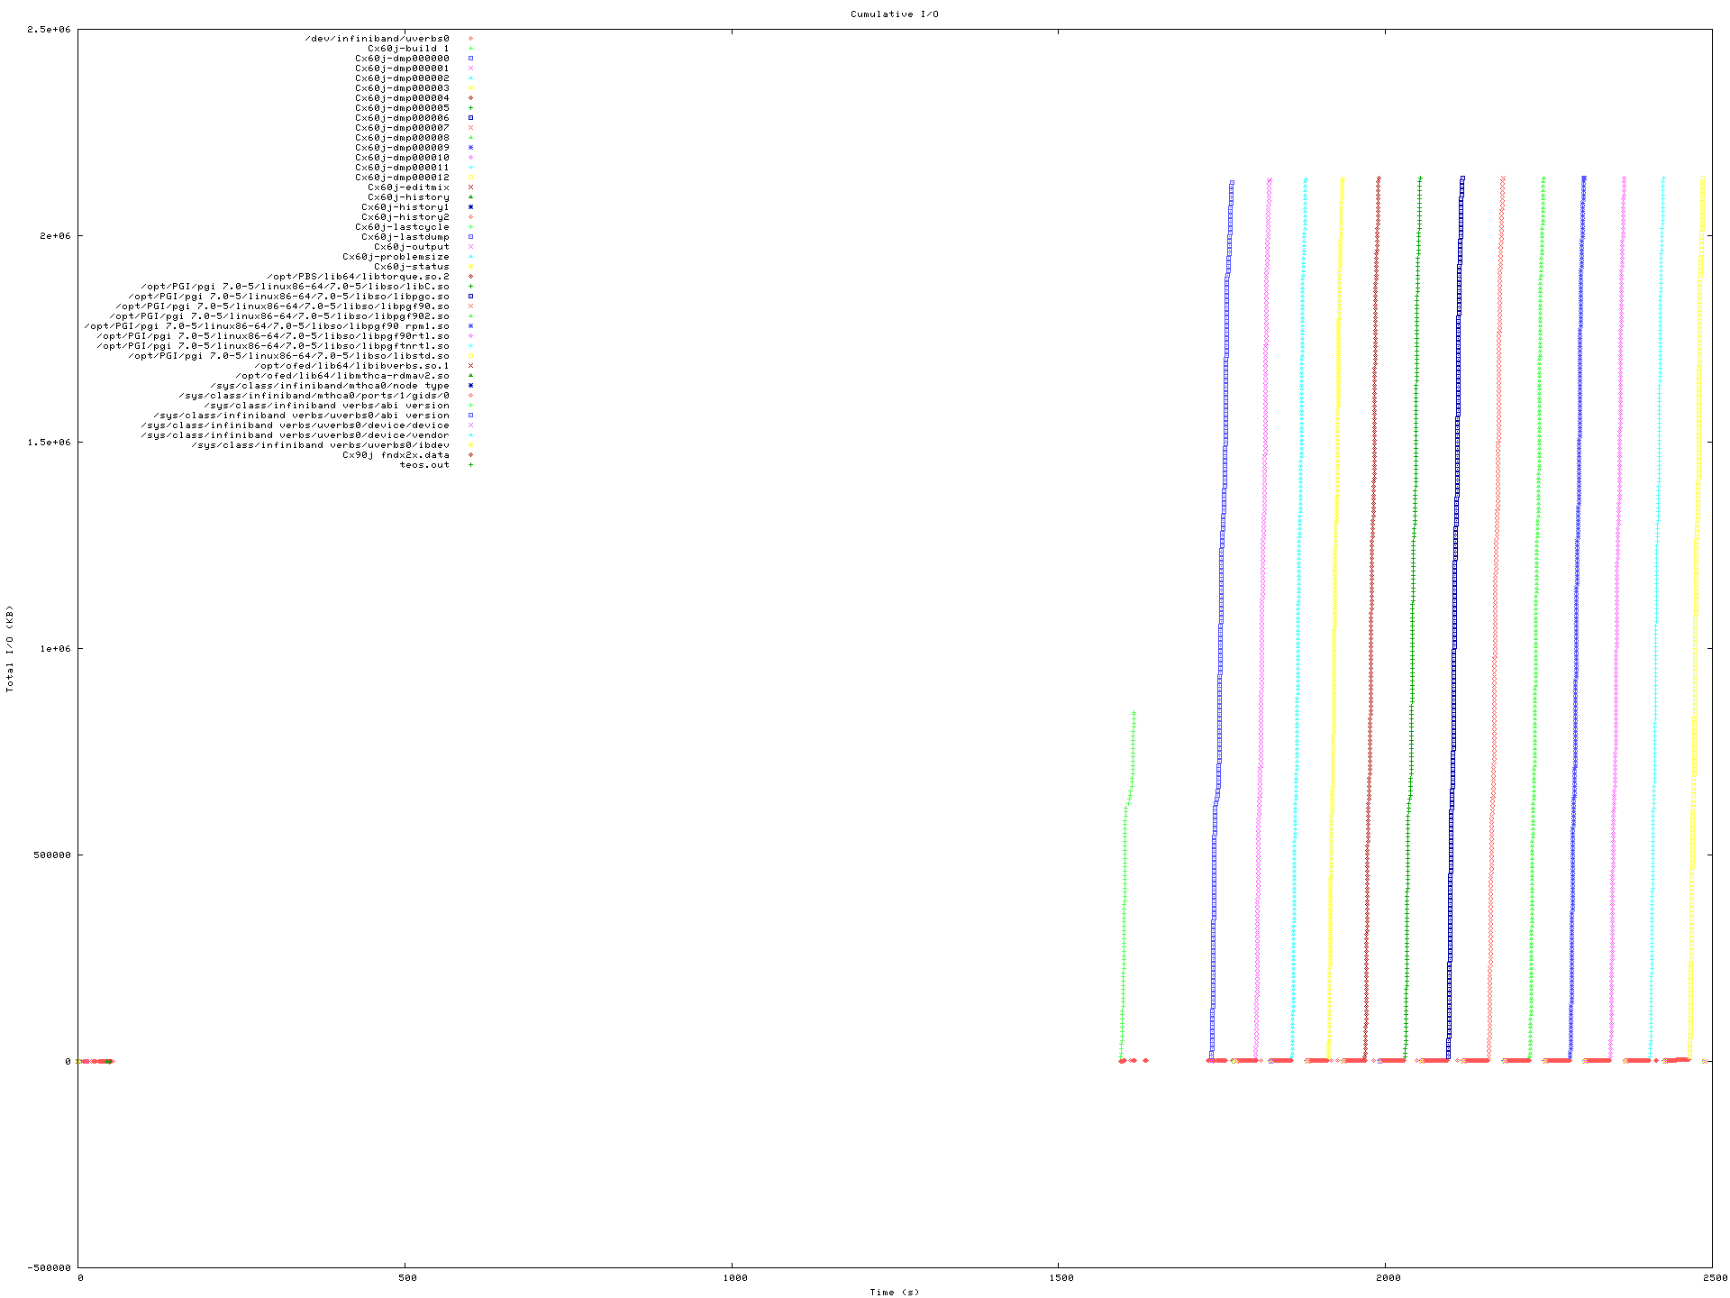
LANL Trace Static Visualizer
This is a trace of the checkpoint dump phase of an application which is why it is exclusively writes and no reads. Notice this shows IO as a function of time but does not show the pattern of IO (i.e. N-1 or N-N).
Reads LANL trace files.
Produces a single snapshot showing all cumulative IO as a function of time.
Each color represents a different file.
The y-axis is the cumulative amount of IO to that file.
Above 0 is data written to the file, below is data read
The x-axis is time.

