Slide 1
High Level LHC Schottky Software Development
Jerry Cai
&
The LAFS Team

Slide 2
High Level LHC Schottky Software
An initial version of High Level Software for LHC Schottky project has been created.
Implements the requirements from the document:
“4.8 GHZ Schottky Software --- High Level Requirements “
EDMS Document # 908986
by Andreas Jansson and Dave Mcginnis of Fermilab and Ralph Steinhagen (BE/BI),

Slide 3
Schottky Software
Integrates experience at Fermilab from the Tevatron Schottky system
It consists of two parts:
Monitor Application
Daemon
Control & Display Application
Operations GUI

Slide 4
Design Concept: Monitor and Control & Display
Beam Mode
Settings & Readings Configuration DB*
Monitor Daemon
Config Data
Control & Display App
Device Settings
Schottky Front End/FESA
Device Readings
Calculation Engine
Publish/ Subscribe
Logging DB
SDDS

Slide 5
Monitor Application
Runs continuously in the background as a “Daemon Process”
Key Elements:
Configures Schottky per Beam Mode
See next slide
Reads raw FFT data from Schottky
Performs fits for:
Tune,
Momentum Spread,
Emittance,
Chromaticity, and
Averages of these
Publishes these results
Archives these results
Creates SDDS Files, post-mortem data sets and provides these data for the logging DB

Slide 6
Daemon: Interaction with Schottky
Reacts to the Beam Mode
The Monitor listen for changes in LHC Beam Mode
It configures the Schottky Hardware based on the Beam Mode
Assumes a Schottky FESA class exists
Unique configuration for each Beam Mode
Control & Display GUI can change this configuration
Is the only agent to receive raw Schottky data directly
Republishes raw data
Publishes calculated data
Thus, this is a true “daemon process”

Slide 7
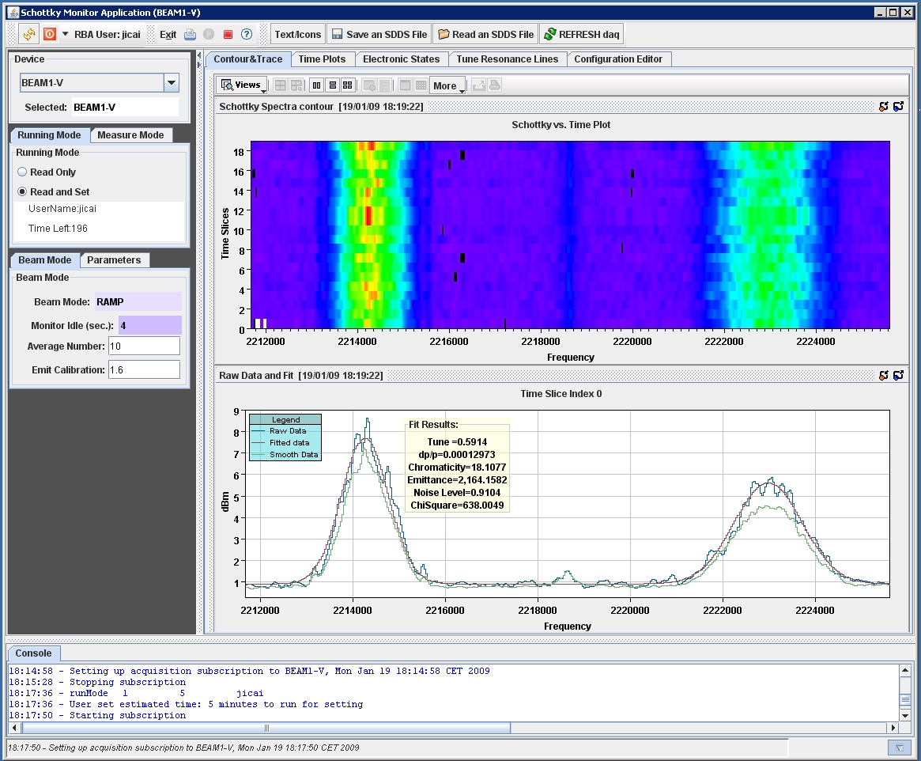
The Control and Display Application

Slide 8
Control & Display App (1/3)
An operations-level GUI
Subscribes to data from the Monitor to acquire and display all of the published data
Can also display archived and post-mortem data
Two different run modes
READ ONLY
default
READ and SET
allow user to change things in the Monitor

Slide 9
Control & Display App (2/3)
What can be set?
The values for each of the hardware components in the Schottky front ends
These can be set manually, or
They can be set in a configuration table
One “row” of settings per LHC Beam Mode
Multiple Control & Display instances?
Each can read from the Monitor
Only one is allowed to have setting rights at a time
User requests setting rights from Monitor for N minutes
RBA Login Required

Slide 10
Control & Display App (3/3)
GUI has four sections:
Top-Tool-Bar
to exit program, read archived data etc.
Left-Selection-Panel
to select different device and different running mode
Central-Tabbed-Panel
to display data, create and load configuration file etc.
Bottom-Console
to show message while program is running

Slide 11
Screen Shots of GUI
Tabs
Contour and Trace
Live or Archived data/Post-Mortem
Time Plot
Live or Archived data/Post-Mortem
Electronics States/Live Schematic
Tune Resonance Lines
Configuration Editor
Selecting bunch/gates

Slide 12
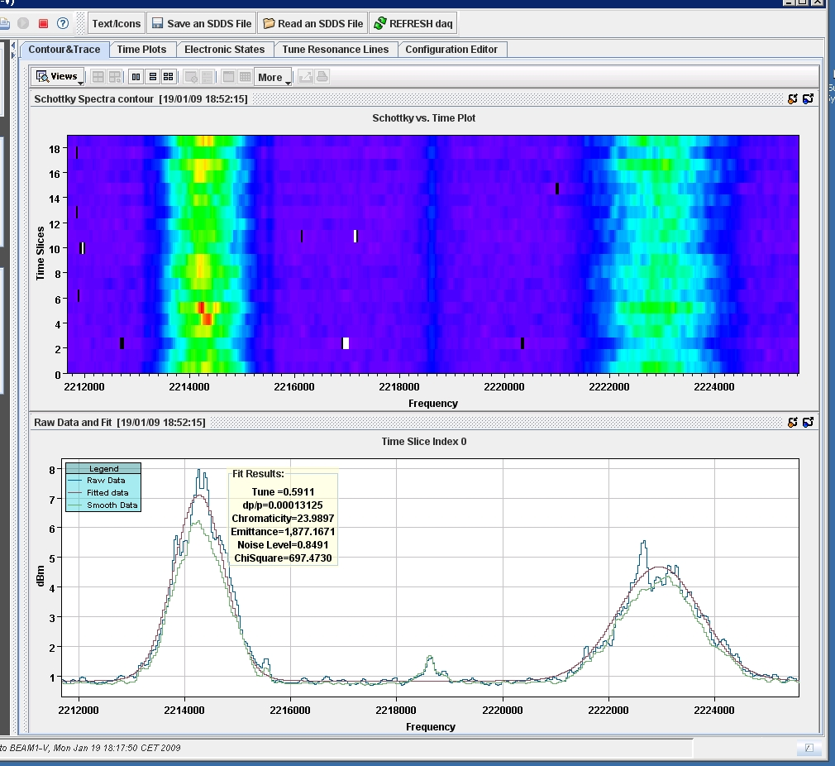
Tab for Contour and Trace (1/6)

Slide 13
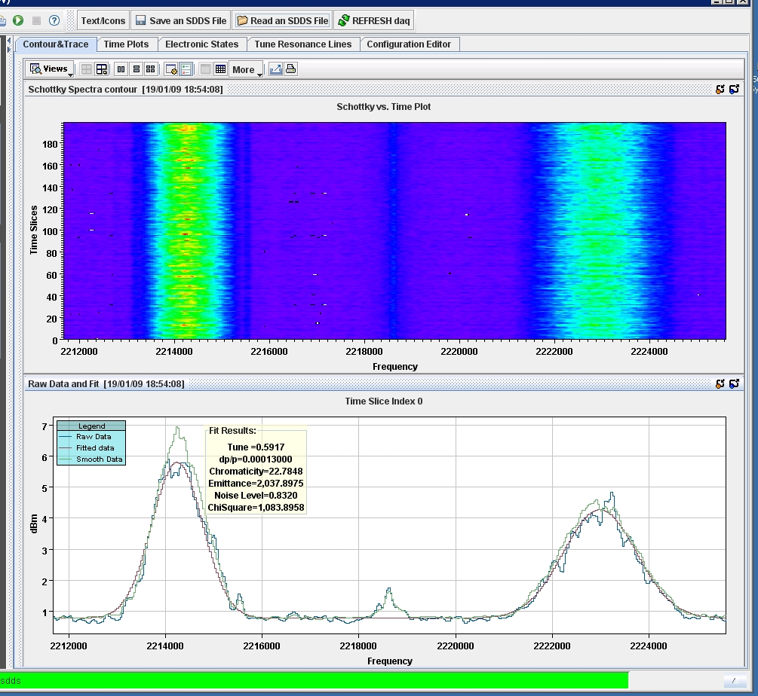
Post-Mortem data dump (200 spectra)

Slide 14
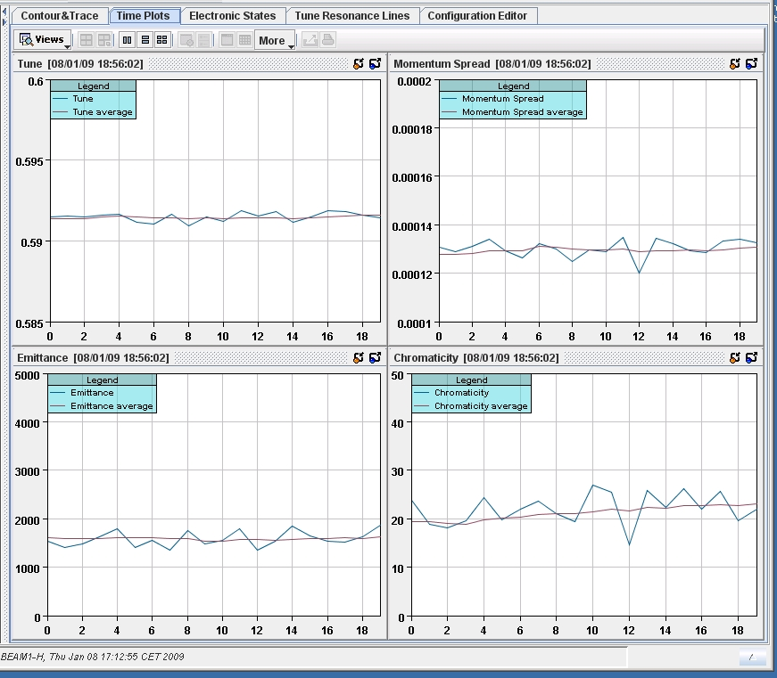
Tab for Time Plot (2/6)

Slide 15
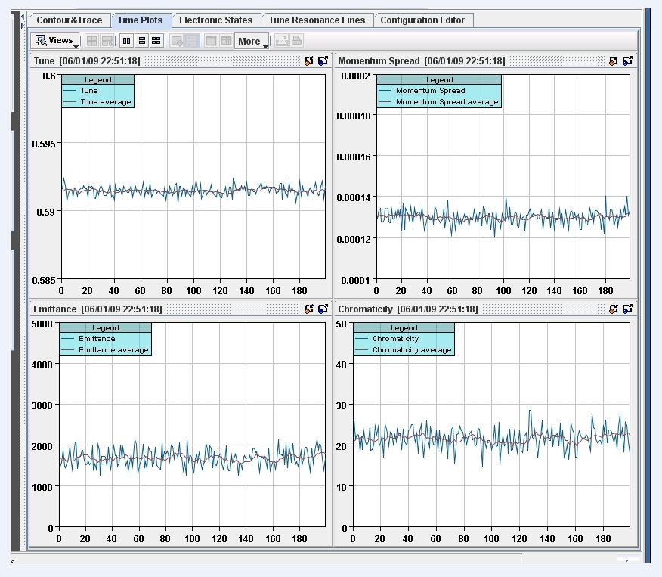
Time Plot for Post-Mortem Data

Slide 16
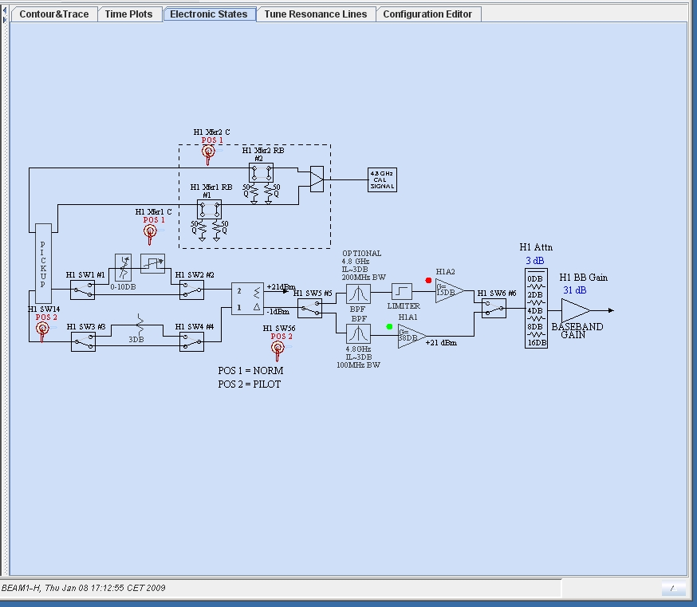
Tab for Electronic States (3/6)
Active elements are colored

Slide 17
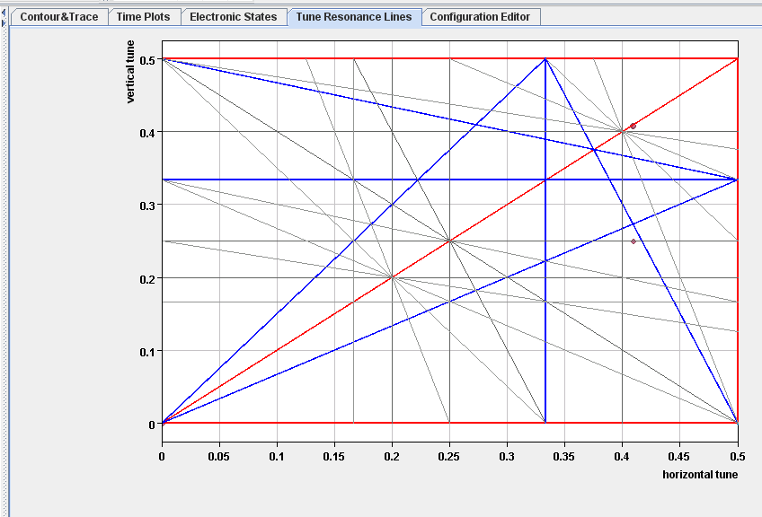
Tab for Tune Resonance Lines (4/6)

Slide 18
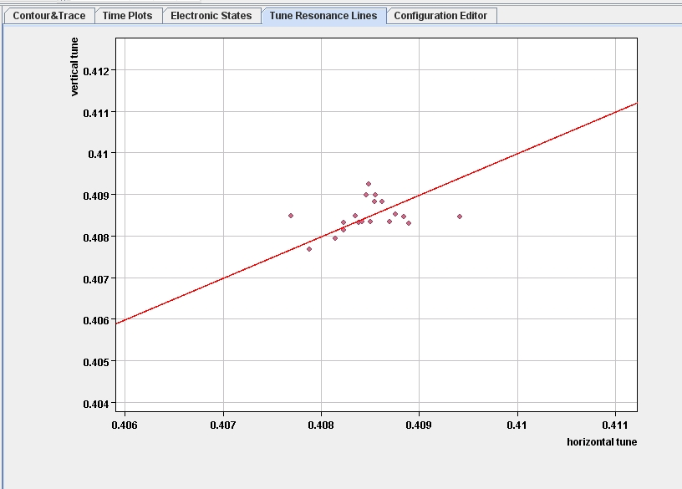
Tab for Tune Resonance Lines (4/6)

Slide 19
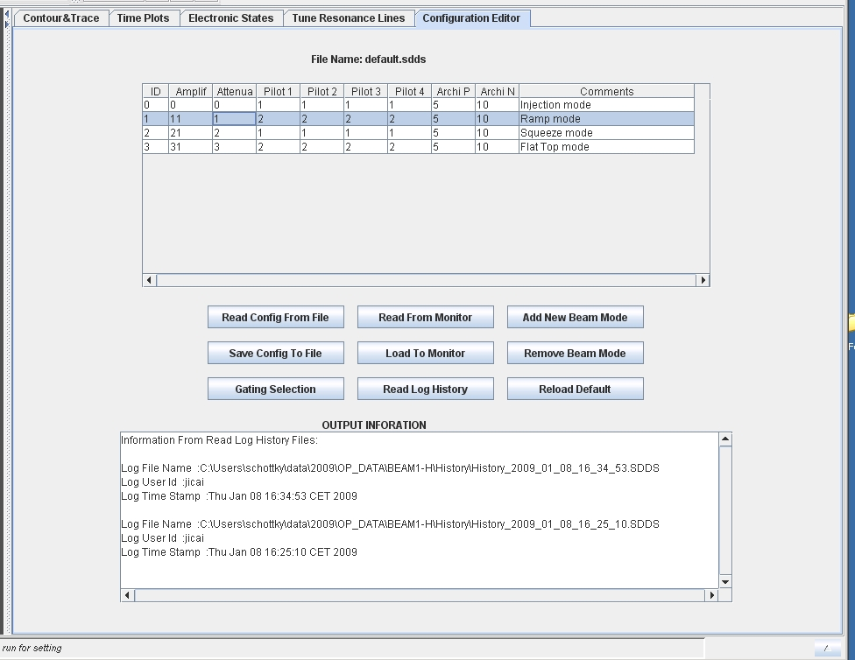
Tab for Configuration Editor (5/6)

Slide 20
Details of Configuration Editor
One row per beam mode
Each column represents one item that is set in the Schottky front end
On the Electronics States diagram/schematic
Can change any value in this table
Can either send to Monitor
Can read live configuration from Monitor
In this demo, “Pilot” columns are switches
Invisible control: Beam gating (next slide)

Slide 21
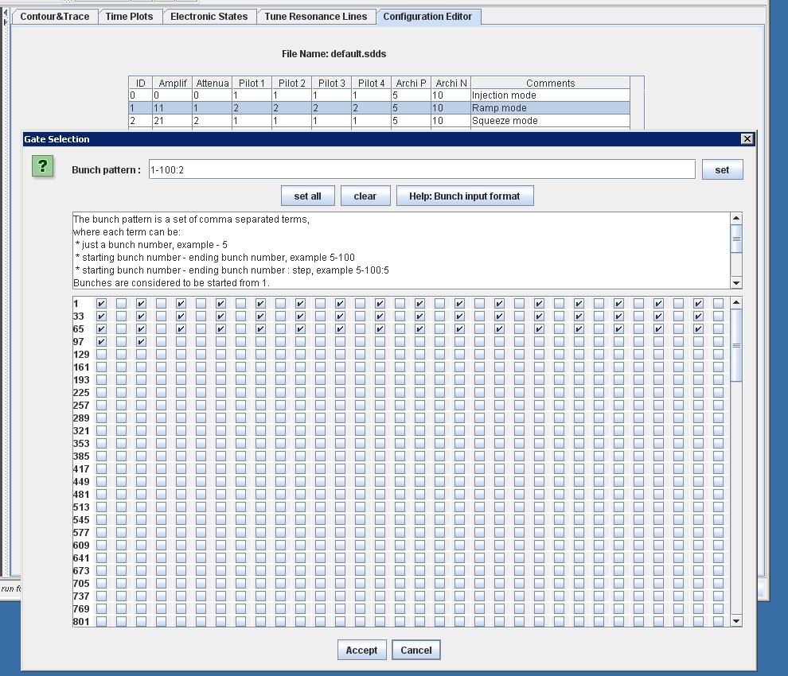
Bunch Gates: View and Set (Popup window, 6/6)

Slide 22
Running the Suite
CVS Package
lhc-daemons/lhc-daemon-schottky
Monitor class (must start this first):
cern.lhc.daemon.schottky.monitor.MonitorMain.java
Control & Display Application
cern.lhc.daemon.schottky.controller.ControlMain.java
Known limitations of this demo
Because this implementation uses SDDS files rather than a true “Configuration DB”, one must run Daemon & GUI on the same PC.
Do not run multiple Monitors at the same time, anywhere in the Control System—the subscriptions will not work properly.

Slide 23
Summary
This initial version of high level LHC Schottky Software has implemented the elements of the requirements document.
Monitor Process/Daemon
Control & Display Application/Operations GUI
Improvements?
“Configuration DB” is implemented as local SDDS files
need BE/CO/DM help
BE/OP feedback
A very important issue: FESA class not yet available.
This demo uses stored data from the Schottky monitors in the Tevatron.

